Slide 1
Positions from Sound​
Talk by Tillman Keller and Hauke Uhde​

Slide 2

The problem: localising sound sources
A sound is produced
It propagates through space
We want to know where it came from
Since we are in 3D we need at 4 microphones
Each microphone measures signal

Slide 3
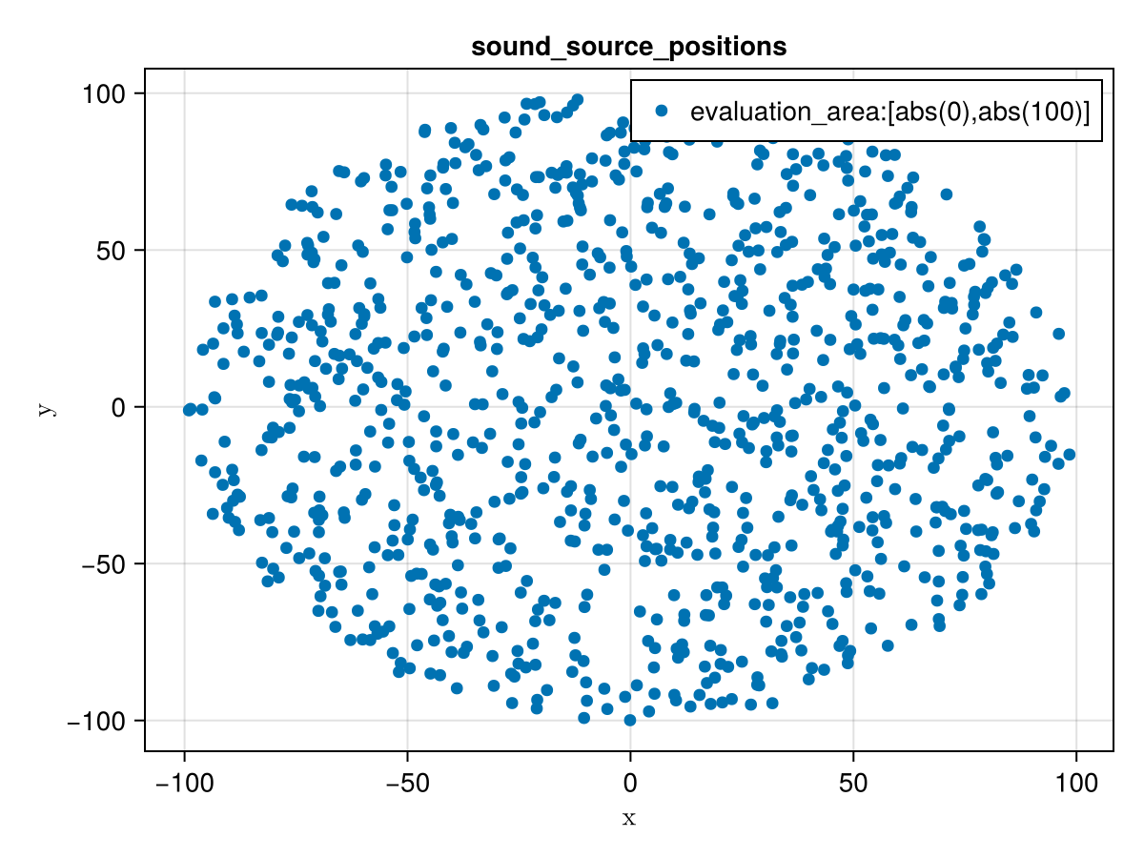
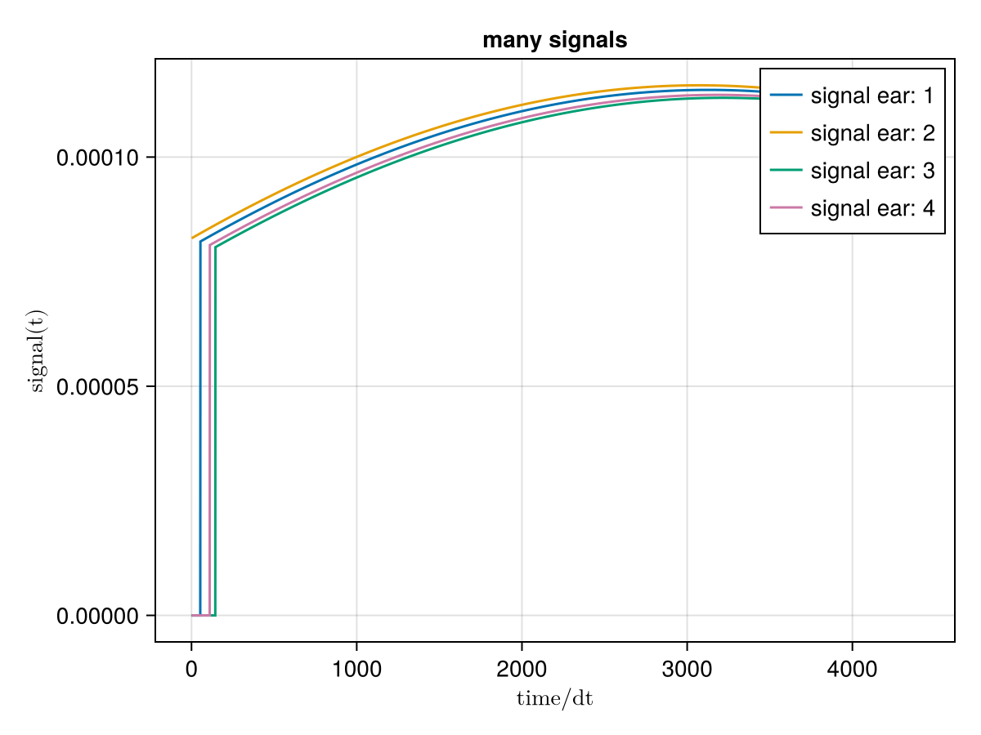

Generating data
First sample random points in 3d space
Then simulate sond from each
Calculate signal at each microphone
  Amplitude $\sim \frac{1}{r^{2}}$
  Time differences
Train model

Slide 4
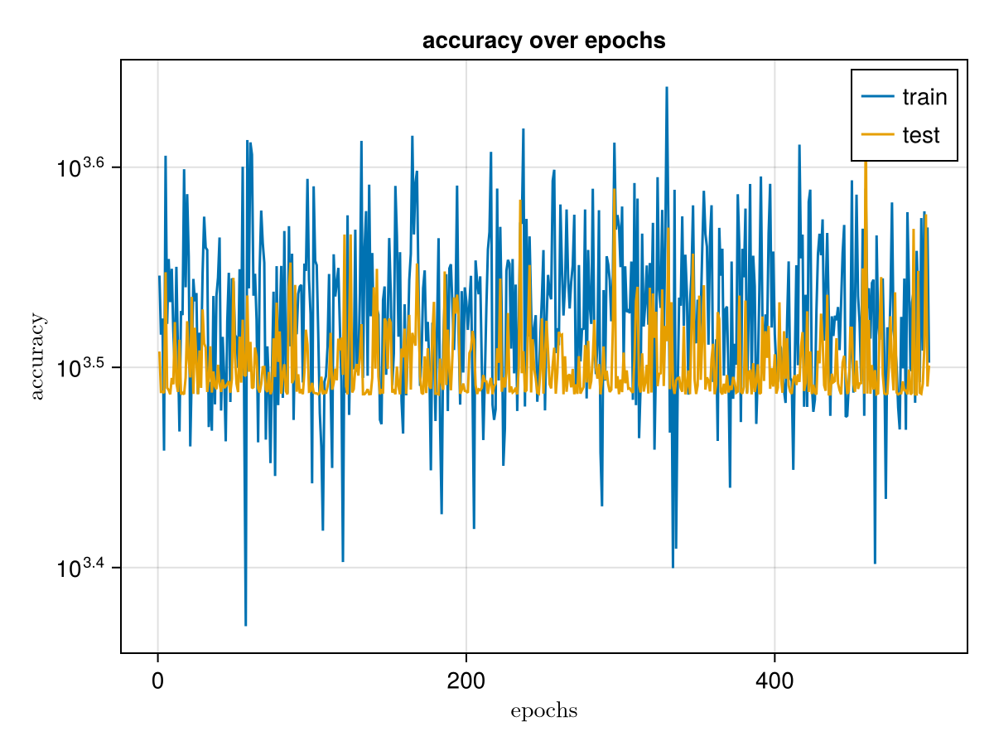
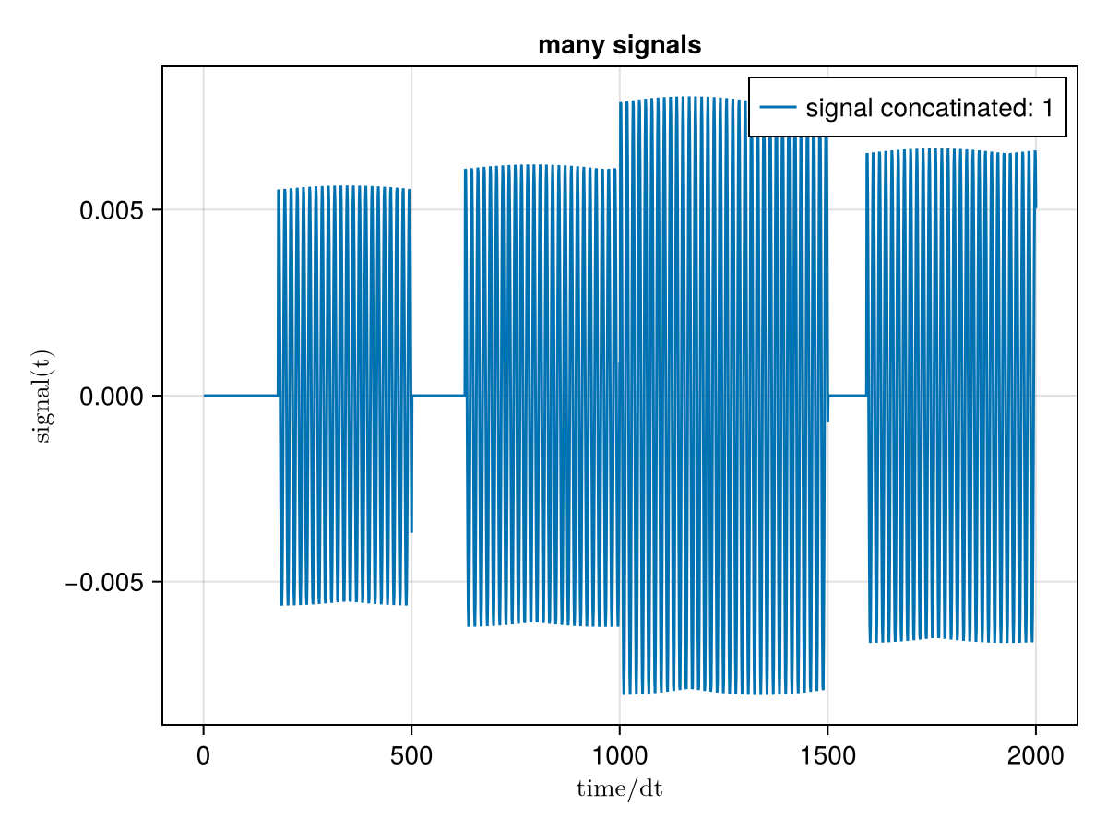

1st try: Big DNN
Input all signals concatenated
  ($≈12000$ neurons)
Then a deep network to 3 outputs
Bad performance caping mse at $≈3000$
Instable slow learning

Slide 5
2nd try: CNN
Now each signal parralel -> like an image
Goal still the three coordinates
Used maxpooling and one dense layer
Did not converge at all
**CNN Struckture**

Slide 6
Which sub network…

Slide 7
Here we go again: Combining CNN and DNN
1:Amp,time
CNN
1: signal
2:Amp,time
CNN
2: signal
position
DNN
3:Amp,time
CNN
3: signal
4:Amp,time
CNN
4: signal

Slide 8
Triangulation is hard

Slide 9
Specialised models + classifier

Slide 10
The full picture

Slide 11
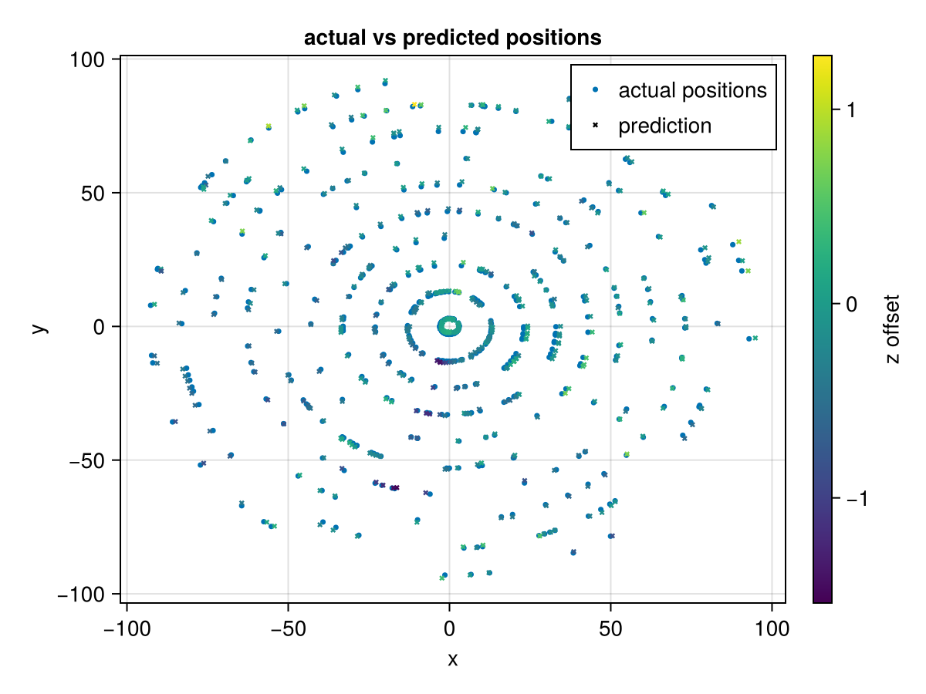
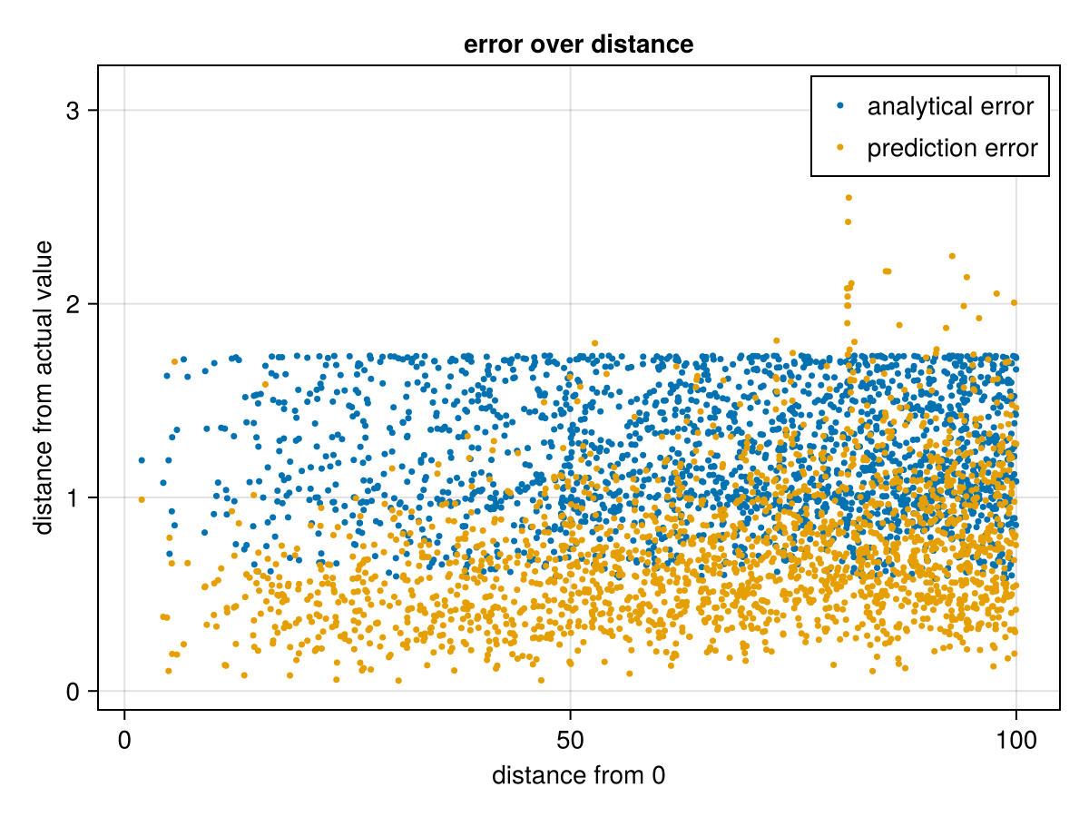
Results
CNN not yet converged
Amplitude and time extracted differently
Classifier is really accurate (99.8%)

Slide 12
Anamerics
?

Slide 13
Criticism
The problem is analytically solvable
The models are constrained to learned distance range
Computationally and storage wise really expensive
Generally: decomposition into sub task not always possible

Slide 14

Take Home Message
There might be better solutions for physical problems​
Specialized sub-networks for sub-tasks​
Play with archicture, optimizer, hyperparameters, data, …​
Thanks for your attention

Slide 15
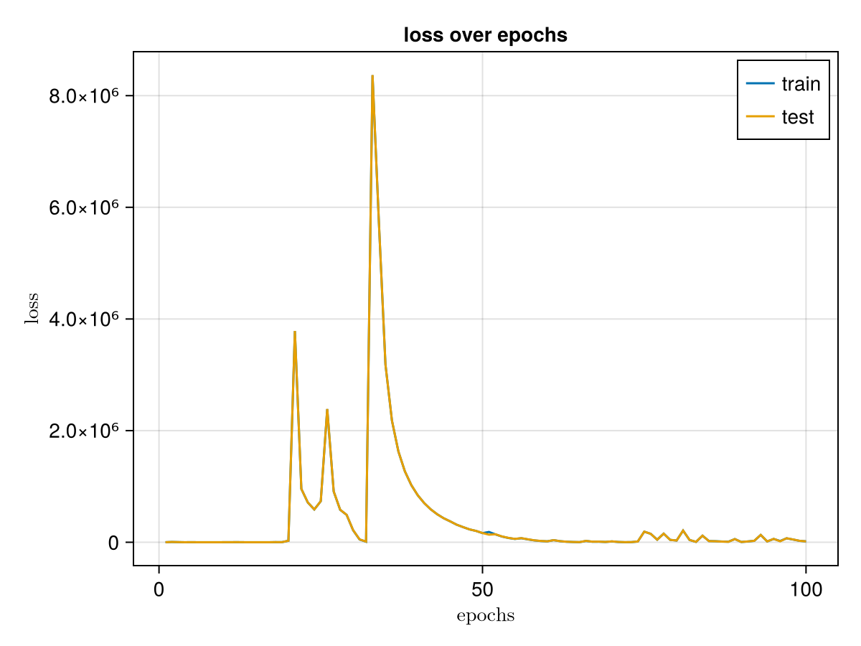
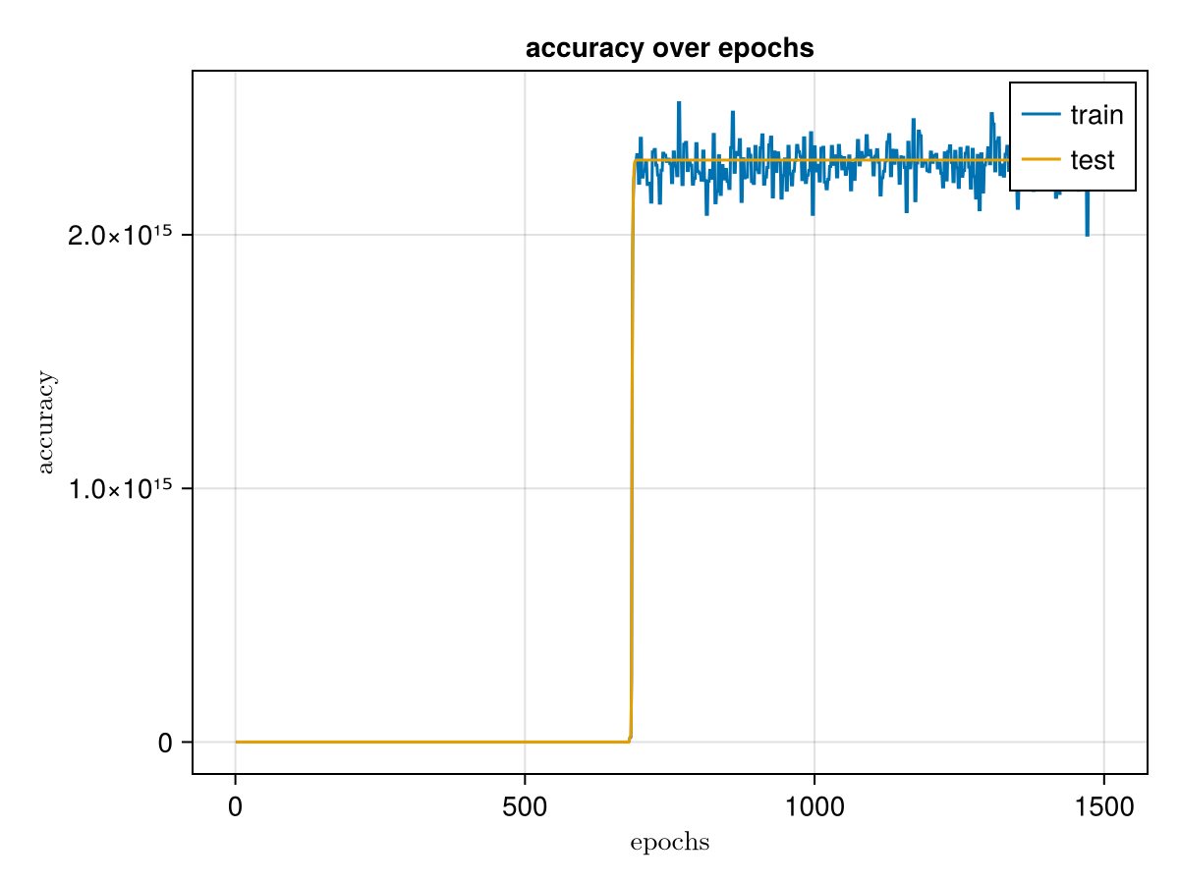
Bad Adam, Good NADAM ?

