Slide 1
Flyweight
Design pattern

Slide 2
Info
- Reduce number of objects created
- Decrease memory use
- Increase performance
- Primary used when you need to create a large number of similar objects
- Structural Design pattern
Intrinsic - state that naturally belongs to the 'FlyWeight' object and thus should be permanent or immutable (internal) or context free.
Extrinsic - state that belongs to the context of the object (external) or unique to that instance

Slide 3
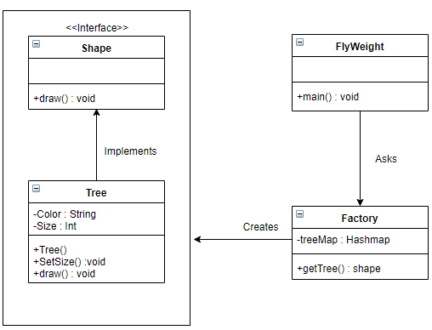
Code
Instrinsic State : Color
Extrinsic State : Size

