Slide 1
State
Design pattern

Slide 2
Info
Intent
Allows an object to alter its behavior when its internal state changes. The object wil appear to change its class. (Change its type at run-time)
What problems does it solve?
1. An object should change its behavior when its internal state changes
2. State-specific behavior shuld be defined independently. That is, adding new states should not affect the behavior of existing states.
Behavioral Design pattern:
- Define manners of communication between classes and object.

Slide 3
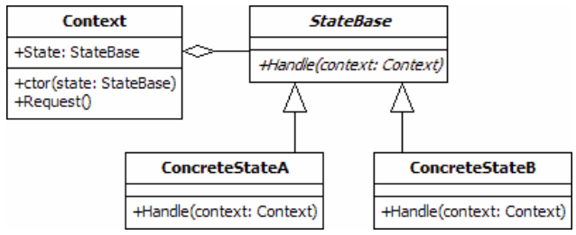
Code
Context
StateBase
ConcreteState A/B

