Slide 1
DESIGNED FOR NARRATION. RESPONSIVE. INTUITIVE AND ADAPTIVE.
Designed to not only to keep the end user engaged from beginning to end, but to also help adsorb key information. One simple homepage for both HCP and Health Plan forms. The Digital Privacy Notice you will actually want to read!

Slide 2
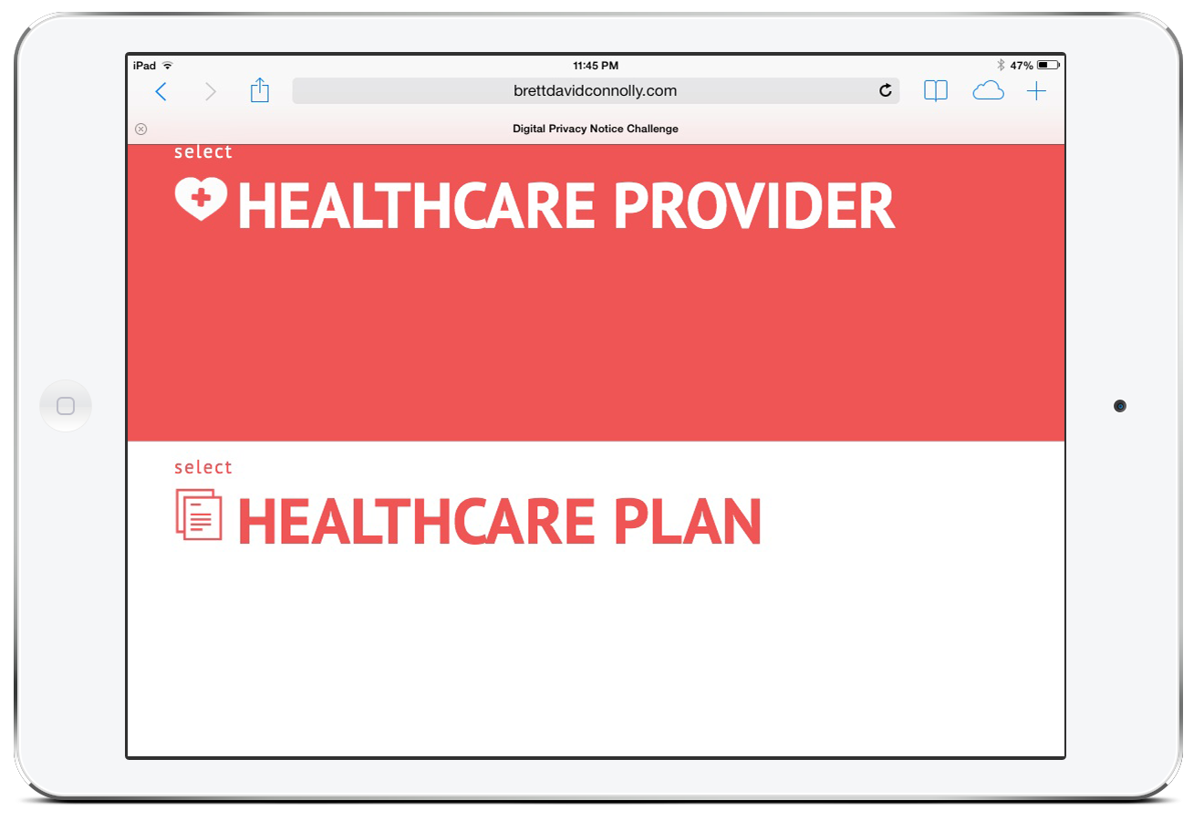
Designed to not only to keep the end user engaged from beginning to end, but to also help adsorb key information. One simple homepage for both HCP and Health Plan forms.
OUR APPROACH.
Created for more than the desktop computer; swipe through on iPads and mobile devices to reach the growing demographic of mobile users.

Slide 3
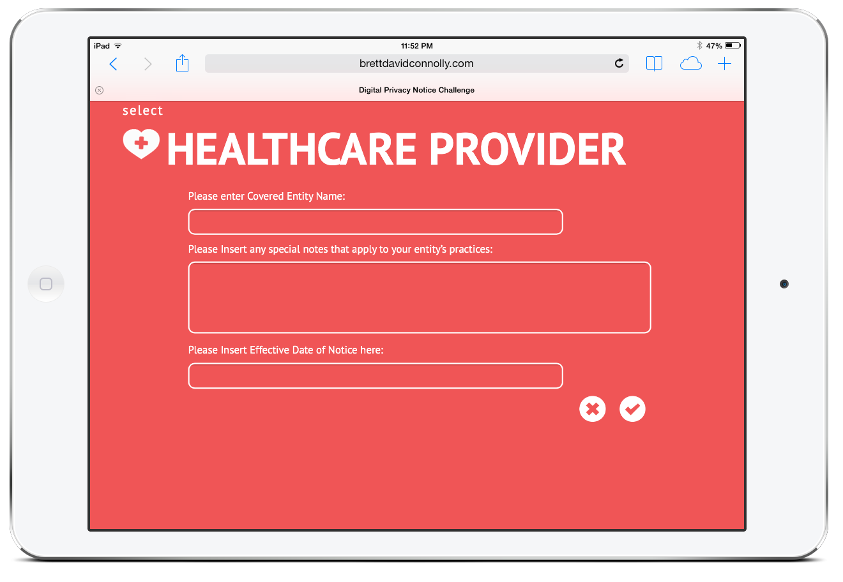
NEED DATA? WE GOT YOU COVERED.
Input fields are incorporated to allow “users to include information unique to their entity, such as organization name, contact information or the name and contact information of their privacy officer” and “to be able to insert an effective date of notice.”

Slide 4
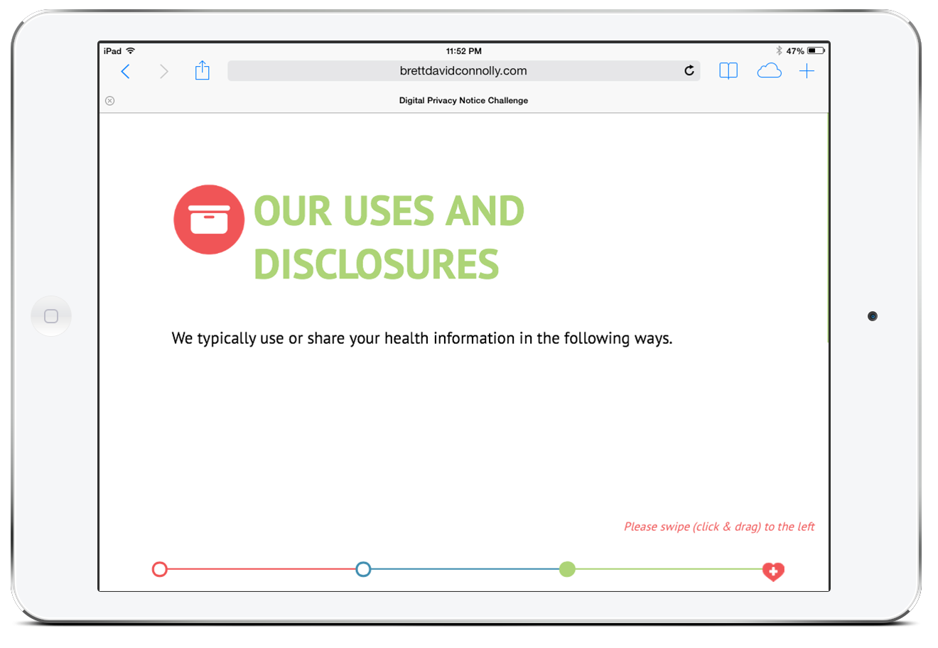
Making this website horizontal allows the end user to read through the information as a narrative, helping to keep them engaged and attentive. An horizontal site also helps for implementation on other website since this notice of privacy can be placed as a scrolling banner.
WHY HORIZONTAL?

Slide 5
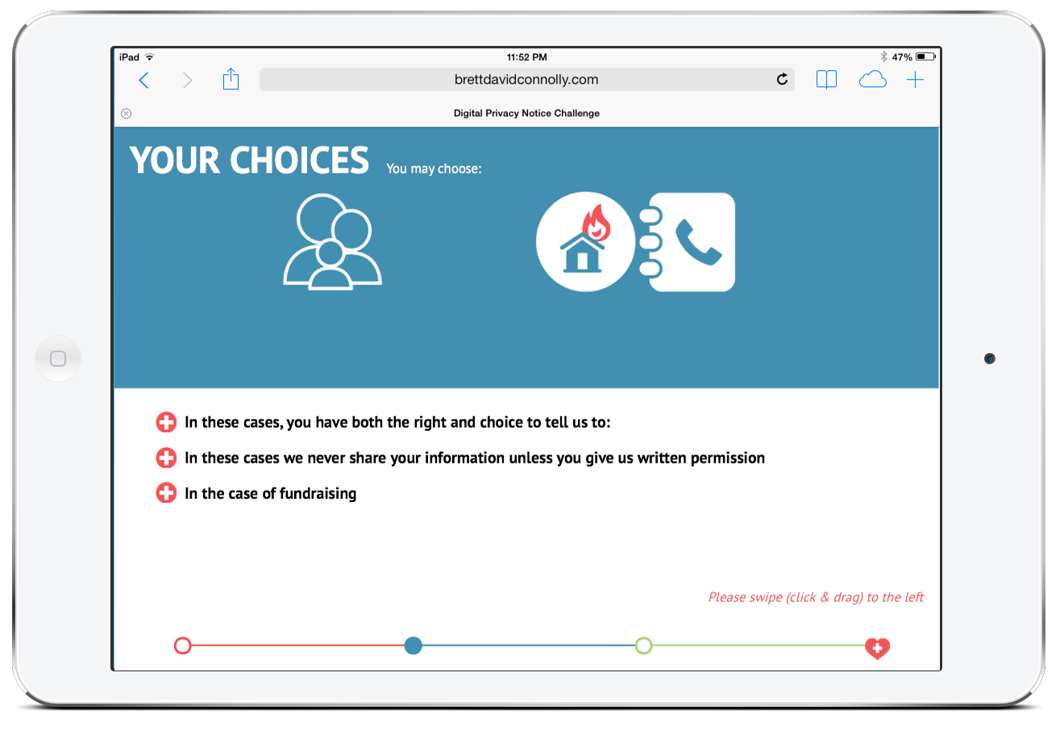
Animations keep you engaged and help convey certain key messages.
YOUR ATTENTION PLEASE.
Why not parallax? Animations are automatic upon certain key frames, not on a timeline to simply user actions for a demographic not familiar with parallax websites.

Slide 6
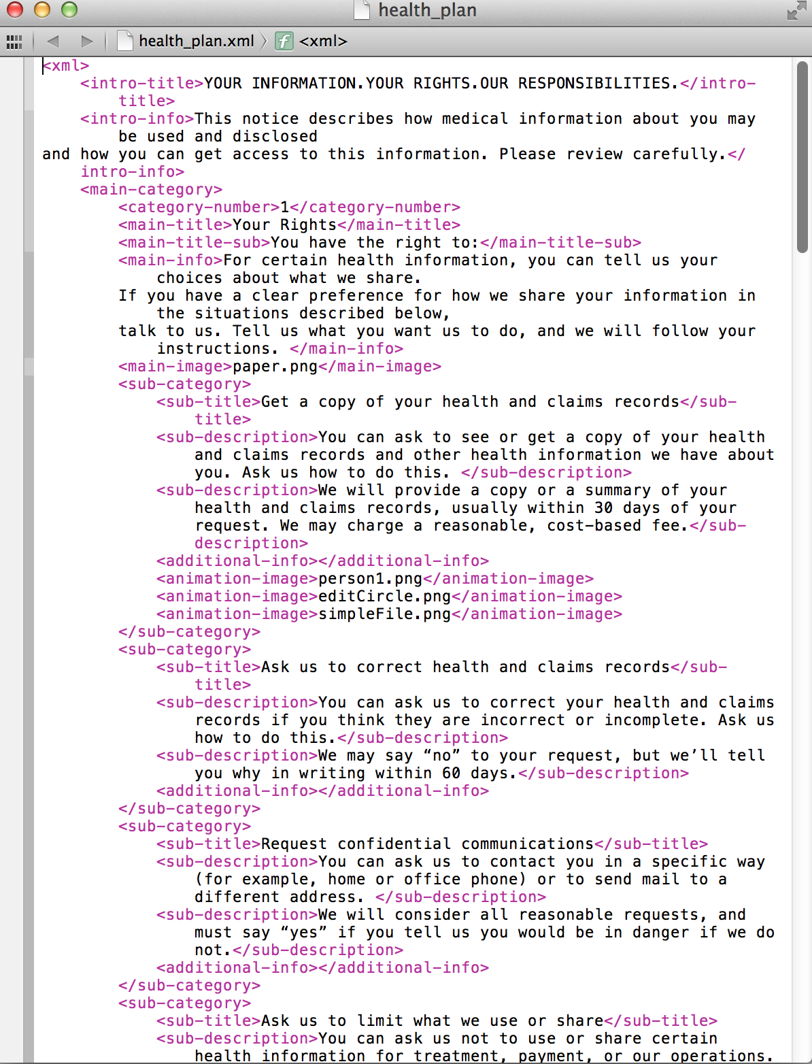
XML files are simple to use and help keep content relevant. The HTML and CSS pulls data straight from XML to make update easy.
FUTURE USE.
Although XML files are easily editable even without a developer to add additional content, animations will not be performed for the additional content. To keep the end user engaged, this is a trade off.

