Slide 1
Using entropy in dynamic deduplication – A file system approximation
Keith Woelfel
Igor Crk

Slide 2
Presentation topics
An Introduction to Deduplication
What is Deduplication?
Block vs. Dynamic Deduplication
Rabin Fingerprinting
Deduplication Today
Our Hypothesis – Entropy in Deduplication
What is Entropy (Information Theory)?
The Link Between Entropy and Compression Algorithms
The Link Between Entropy and Deduplication?

Slide 3
Presentation topics
The Deduplication File System Approximation
Basic Structure
Key Variables
The Data Set
The Link Between Fingerprints (Blocks) and Entropy
Finding “Ideal” Fingerprints Based on Entropy
Storage Savings and Performance Based on Entropy Control
Conclusion and Questions

Slide 4
What is Deduplication?
Deduplication is a method of data compression
Is not “compression”
Compression finds repeated substrings, small sets of data
Deduplication finds repeated sections, large volumes
Entire filesystem
Multiple volumes
Entire datacenter
More differences than scale
Compression “forgets” saved data (dictionary)
Often can and does have duplicated substrings
Deduplication NEVER does this
Not mutually exclusive, but order matters!

Slide 5
What is deduplication?
An example of Block Deduplication
Bit string: 101101011011, 4 bit blocks
Library Contains:
1011
0101
Final Result (“Recipe”):
Saved “Chunks” 1011 and 0101
Three pointers ( ->1011, ->0101, ->1011)
101101011011, Create Pointer
101101011011, Add to Library, Create Pointer
101101011011, Add to Library, Create Pointer

Slide 6
Block vs. dynamic deduplication
Important concern in deduplication -> how to choose data to examine
The first (naïve) method is by fixed-size blocks
Works, but suffers major drawbacks when data is modified
I.E, adding a single bit to the beginning of a file throws off every subsequent block in the file
Causes performance issues (how?)
Possible storage savings issues (how?)
10110101 00101101 10011001
| BLOCK | BLOCK | BLOCK |
10110101 00101101 10011001
01011010 10010110 11001100 1

Slide 7
Block vs. dynamic deduplication
A different method -> dynamic (variable) blocking
Why “dynamic”?
Data is split based on the content of the data itself – this concept is the basis of our research
Typically done at run-time, in the formal concept of “dynamic”
Data is split at naturally occurring data points, avoiding the problem of changes to data
Simple example – split data at every “001” pattern
101101010010110110011001
10110101001 011011001 1001

Slide 8
BLOCK VS. DYNAMIC DEDUPLICATION
Also referred to as “variable block” deduplication
From previous example:
10110101001 011011001 1001
Results in different sized chunks of data
But doesn’t different sized chunks cause problems?
Not often the case -> data often follows patterns in its creation, creating like sized chunks
File headers
File with language structures
Instructions
Large sets of any repeating data (repeating “0” bits are very common)
Thus, nearly every type of file imaginable has some semblance of order
Exception -> Compressed data (all order removed)
Avoids the problem of changing every subsequent chunk in file from block deduplication

Slide 9
Rabin Fingerprinting
Then how to split data intelligently and repeatedly?
Avoid arbitrary methods -> too many chunks
Like the previous example
Too many chunks = increased computation time to unacceptable levels
Why?
Solution was provided by Dr. Michael Rabin in “Fingerprinting By Random Polynomials” in 1981

Slide 10
Rabin fingerprinting
Using a random, irreducible, and prime polynomial, a “fingerprint” of a bit string can be created
This “fingerprint” is a very large integer value
Why random, irreducible, and prime?
Applying modulus division to this large prime results in a user defined set of possible values for any bit string
Creates a set of byte patterns acceptable as breakpoints
Any byte string can be associated with a value
Finding breakpoints does not necessarily mean matching data (data may proceed the breakpoint in the string analyzed)
A larger modulus division value = larger chunks

Slide 11
Rabin fingerprinting
Fingerprinting process:
Given our n-bit string m₀,…,m_{n-1}
Convert to a polynomial f(x) = m₀ + m₁x + … + m_{n-1}x^{n-1}
Pick a random, irreducible, prime polynomial of degree k: p(x)
Divide f(x) by p(x), results in remainder r(x)
r(x) is evaluated as a k-bit number
This produces our fingerprint value, which we then can then apply modulo division on

Slide 12
Rabin fingerprinting
An example: bit string 101101010010110110011001
2⁶⁴ – 1 possible integer values produced by fingerprint algorithm (we use 64th degree polynomials)
Output of 18446744073709505612
Use a modulus value to reduce (i.e. % 2048)
18446744073709505612 % 2048 = 1100
The result is compared to a constant value. If they are equal, this bit string is a breakpoint for a chunk.
Often, this value is set as “0”
So the above value would NOT be a breakpoint, as 1100 != 0

Slide 13
Rabin fingerprinting
When searching for a breakpoint in a bit stream, the fingerprinting algorithm slides a “window” over the stream to compute the fingerprint
Every iteration -> Move window one byte
Seems computationally expensive, but isn’t
Only one byte is new in the window, results in low computation overhead
Only requires bit shifts and an OR operation
Simple example: a four byte window
BYTE BYTE BYTE BYTE BYTE BYTE BYTE BYTE
|------------WINDOW------------|

Slide 14
Rabin fingerprinting
Every time the window moves -> new fingerprint
Apply modulus division to fingerprint
If this equals a constant (“0”), we have a breakpoint
Can now compare chunk to see if it is unique
If a match, discard data, create a pointer
If unique, store data, add a pointer
For performance, we often use a hash of the data for comparisons
Why? – The data must be maintained across runs
Further enhancements -> Specific data structures
I.e. Self-balancing trees, Bloom-Filter, etc.

Slide 15
Rabin fingerprinting
Main idea: fingerprinting allows us to find natural breakpoints, resolves problems of block dedup
Fingerprinting uses data tendencies itself to create breakpoints
The two variables of interest in any deduplication program process with fingerprinting are:
The size of the window used to create fingerprints
The value we use for modulus division of the fingerprint (referred to as “chunksize” variable, due to its tendency to produce chunks that average around the size of this variable)

Slide 16
Deduplication today
Deduplication -> most often implemented with variable blocks (fingerprinting)
Block based still exists for special instances
Setting minimum block sizes
Setting maximum block sizes
Blocking under certain pretexts (such as file structure)
Knowledge of most dedup systems fuzzy -> most usage is proprietary
Most usage occurs as “appliances” -> add on hardware
Input data, output dedup metadata, maintain file structure

Slide 17
Deduplication today
Typical usage -> secondary and archival storage
In such instances, typical data composition is not what is found on most systems
Extremely large files
Files that are already compressed (problematic)
Typical deduplication solutions are extremely sensitive to performance concerns
Evidenced by typical utilization of hardware implementations
Symantec, Dell, Western Digital, etc.
Some pure deduplication filesystems exist, but aren’t the norm
Venti, LBFS, etc.

Slide 18
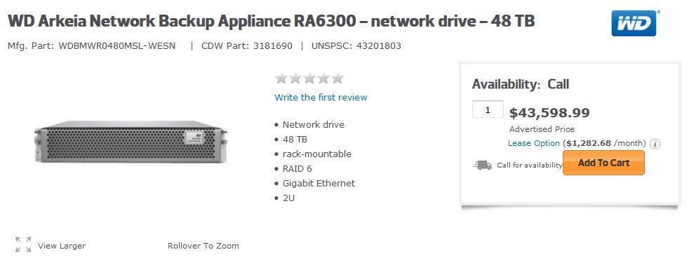
Deduplication today
The typical hardware implementation of deduplication is extremely costly

Slide 19
Deduplication today
Based on the previous, any performance increases would be highly valuable
May be instances where the deduplication process can be modified to achieve performance gains
Certain files may be poor candidates for deduplication
Do something different with these files!
We came to the conclusion that analyzing entropy of data would be a good starting point to achieve this

Slide 20
What is entropy?
Entropy is central in our study of the deduplication, so a basic understanding is necessary.
The measure of how unique data is.
Can also be thought of as how predictable data is
For example, we look at a stream of bits
We see eight “0” bits in a row
What will be the next bit we see?
What if we had four “0” bits, and four “1” bits, what will we see next in this case?
Can be determined with a knowledge of the distribution of data in a stream.

Slide 21
What is entropy?
For entropy, usually measure by bytes -> value between 0 and 8
For a byte stream, count each unique byte (256 types) to get distribution to determine entropy
Entropy values of 0 indicate streams of highly predictable data (all of a single byte type)
Entropy values of 8 indicate stream of highly unpredictable data (equal distribution of all byte types)

Slide 22
What is entropy?
Actual formula:
Entropy = -Σ(probability(x) * ln(probability(x))) for all possible values of x
Again, in a byte stream, this function is the summation of the entropy values for each individual byte type of 256 possible
It might be easier to understand entropy from a graphic representation of the distribution of bytes than to think of it mathematically

Slide 23
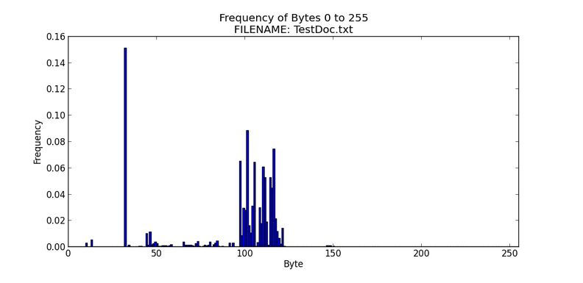
What is entropy?
High frequencies of specific byte types results in lower entropy (higher predictability)

Slide 24
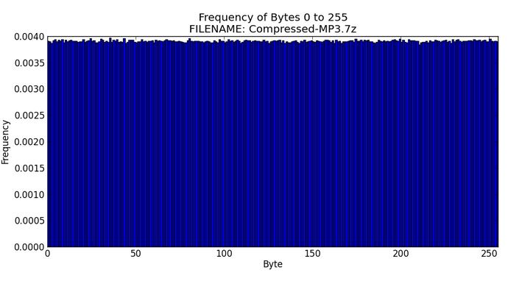
What is entropy?
Equally occurring frequencies of byte types results in high entropy (low predictability)

Slide 25
The link between entropy and compression algorithms
Entropy relates to compression
The more predictable (alike) data there is, the more effective compression is (low entropy = good compression ratios)
The less predictable (unalike) data there is, the less effective compression is (high entropy = bad compression ratios)
Compression results in a new dataset that is extremely homogenous, or high in entropy
This is why compressed data cannot be further compressed for much gain, especially when using the same compression algorithm

Slide 26
The Link between Entropy and deduplication?
Does the same link exist between the deduplication process and entropy?
Initially, seems like a silly question (both are compression!)
It should affect finding like segments of data just like in a compression algorithm
However, there is more going on in deduplication that we believe makes entropy even more important than in compression
Because we use Rabin fingerprints to select breakpoints in data, and fingerprint selection is made by nature of the data itself, entropy should have an effect on the ability of the deduplication process to find like data segments beyond the causal implications found in standard compression algorithms
Also the difference of the scale of data we are looking at
E.g. English text (character vs. phrase vs. sentence vs. book)

Slide 27
The Link between Entropy and deduplication?
Why do we care?
We might be able to alter the variables to best find fingerprints that find matching data chunks with entropy
Might result in more matching chunks of data -> reduced storage requirements
Knowledge of entropy in the deduplication process may lead to situations that enable performance gains
Little research exists on managing the data itself to improve deduplication, and none dealing with entropy

Slide 28
The Deduplication file system approximation
In order to test our assertions, we need the ability to perform deduplication
An actual, fully implemented deduplication file system is overkill, as we only need to study the effectiveness of deduplication
We designed a program that performs all of the steps of deduplication without the actual implementation of the file system
This also avoids issues of hardware skewing test results, such as with disc access timings, etc.

Slide 29
The Deduplication file system approximation
Very similar to the actual deduplication process
Files are streamed into a buffer
The buffer is chunked using the fingerprint process
Chunks are turned into hashes
Hashes are inserted into a mapping to determine if they are unique
If data is not unique, we save the details of the chunk, to include its size
Actual chunks are not saved, nor is the pointer tree (“recipe book”) maintained
Various other statistics are maintained for recordkeeping
Only difference between full implementation is lack of permanence between runs, and writing chunks to disc

Slide 30
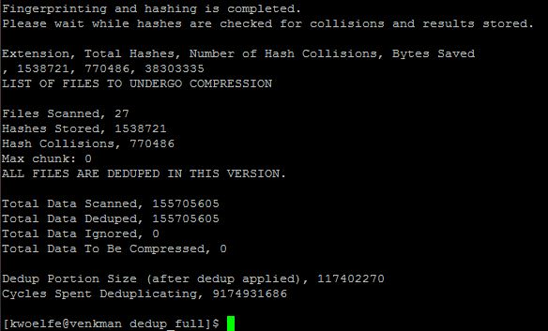
The deduplication file system approximation

Slide 31
The Deduplication file system approximation
The key variables in the deduplication emulation program are the same variables for fingerprinting
“chunksize” variable, for modulus division, and to average chunks around an specific size
“windowsize” variable, for determining the size of the fingerprint window

Slide 32
The Data Set
Find an acceptable set of test data was the hardest part of the process
Tried to randomly select data, yet find data that fit the necessary size, and within an entropy range
Data was pulled from personal filesystems as well as the public domain (Wikipedia data dumps, for example)
Other research publications note this problem prominently
A lack of a common test set is a problem, as deduplication is data dependent (choice of data can easily skew results)
We attempted to obtain such a data set from another research group who specifically wrote about this issue, but they were not forthcoming

Slide 33
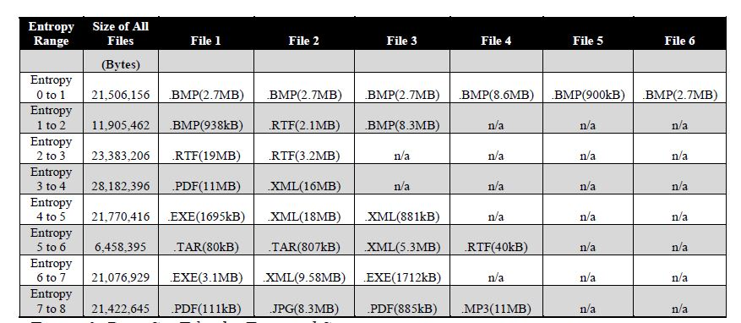
The Data Set

Slide 34
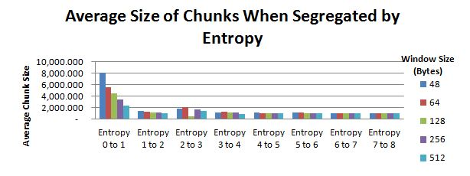
The Link between fingerprints (Blocks) and entropy
We first attempted to determine if entropy had an effect on the size of the chunks created by Rabin fingerprinting
Typically, the fingerprinting algorithm tends to force chunks to the size set by the “chunksize” variable
Here, we fixed this variable to 1024 (bytes)

Slide 35
The Link between fingerprints (Blocks) and entropy
As seen, at higher entropy levels, blocks adhered to their “typical” sizes
However, at lower entropy levels, files varied, and significantly so at very low levels
We believe that because data at low entropy levels is so homogenous, the algorithm has difficulties finding a breakpoint without highly diversified data
1024 ______________________________________________________________

Slide 36
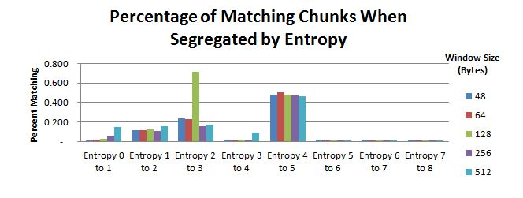
The Link between fingerprints (Blocks) and entropy
We also looked at how many of the chunks created were actually matching
In other words, how many of these chunks did not need to be written to disc (stored)?
Again, here we fixed the “chunksize” variable to 1024 (bytes)

Slide 37
The Link between fingerprints (Blocks) and entropy
Here, data was much more noisy
High entropy -> poor performance
Low entropy ->poor/chaotic performance
Mid-range entropy -> best performance?

Slide 38
The Link between fingerprints (Blocks) and entropy
Several things concluded:
High entropy files just perform poorly, as expected
Low entropy files:
We believe that due to their homogenous nature, fingerprinting sometimes has problems finding a breakpoint (as seen earlier). This sometimes leads to poor matching
Although not pictured, the larger low entropy chunks would match, offsetting the % matched with good space savings
Why did mid-range entropy do the best?
We believe that a combination of easy to find breakpoints, with an entropy that still allows repeated data makes the most stable and reliable point to perform well
Entropy + Deduplication = Inherent Link

Slide 39
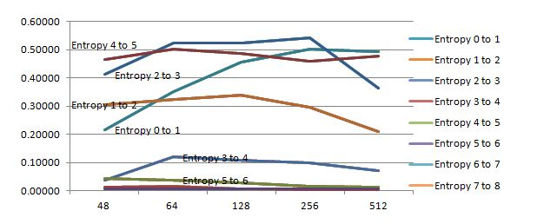
Finding “ideal” fingerprints based on entropy
Next, we moved to trying to find the ideal variable setting for deduplication based on entropy
Of the two variables, held one static for a set of trials (control), while varying the other
Two rounds (one for each variable) looking at percentage storage savings
We began with fixed window size (128 bytes shown here)

Slide 40
Finding “ideal” fingerprints based on entropy
Averaged out, window size typically performed best near 128 bytes
Variances by entropy dropped drastically beyond the scale of this chart
Slight differences in savings by entropy level did not warrant modification of the window dynamically (based on our set of data)

Slide 41
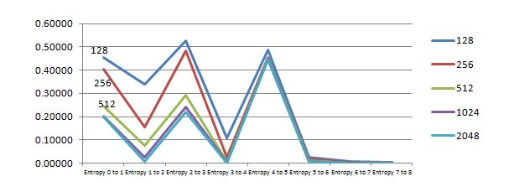
Finding “ideal” fingerprints based on entropy
Next, we analyzed differences in entropy in regards to the “chunksize” (modulus division) variable
A fixed window size of 128 bytes, with a varied “chunksize”

Slide 42
Finding “ideal” fingerprints based on entropy
High entropy -> No differences
Low to mid entropy -> Some large differences between different chunksize levels and entropy
Some noted trends in specific entropy levels

Slide 43
Finding “ideal” fingerprints based on entropy
“Chunksize” was best for all files at 128 bytes
High entropy files again perform uniformly (poor)
Certain low entropy files performed poorly regardless
Possibly due to our test data
Inherent format of files at these entropy levels
Possibly merit a further review of the composition of files, where strings of repeating bit/byte patterns could be extracted for space savings
Already done in some deduplication formats by removing “0” bits

Slide 44
Finding “ideal” fingerprints based on entropy
At this point, it appears that holding variables at specific levels across entropy levels performs the best space savings
We believe that a tradeoff occurs:
As entropy increases, number of blocks increase
However, the matching of these blocks decreases
Results in best averaged savings in the middle entropy levels
This does not necessitate a changing of variables dynamically if space savings is the only concern
However, performance is still a key issue

Slide 45
Storage savings / performance based on entropy level
Our final analysis is based on overall deduplication performance based on several different deduplication programs
Deduplication of all files
Deduplication only of files with entropy < 5
Deduplication only of files with entropy < 5, compression of files with entropy between 5 and 7
Deduplication only of files with entropy < 5, compression of all files with entropy > 5
In addition, each version listed has the option of compressing the resulting chunks after deduplication has completed
This is often used in typical settings where maximum space savings is required

Slide 46
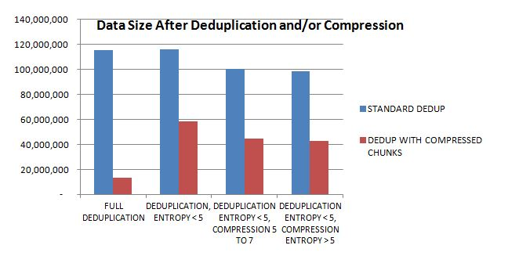
Storage savings / performance based on entropy level
First, we analyze space savings
Using previous results, variables are both set at 128 bytes, which we found to be optimal given our set of data

Slide 47
Storage savings / performance based on entropy level
For standard deduplication programs, space savings nearly the same when deduplicated files with entropy < 5 excluded
Same finding for compression as well, when extremely high (7 to 8) entropy files excluded

Slide 48
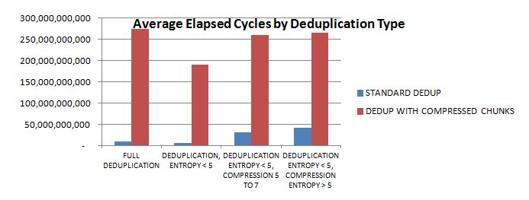
Storage savings / performance based on entropy level
Next, we concentrated on performance alone
Measured the cycles taken to perform each operation
Used a single core on an Intel I7-3770 @ 3.5 GHz
50,000,000,000 cycles ≈ 1.5s
Throughput ranged from 18.75MB/s to around 150MB/s

Slide 49
Storage savings / performance based on entropy level
When compression present, it dominated required CPU cycles
Reduction in cycles required when high entropy files excluded

Slide 50
Storage savings / performance based on entropy level
Deduplication with the exclusion of high entropy files results in performance increases with little lost in space savings

Slide 51
Conclusion and future
As we have seen, it is possible to reduce the overhead of deduplication yet achieve nearly the same space savings when filtering files by entropy level
Context is important – the test data we used was ensure fair results for files with varying entropy levels; this distribution of a typical system, or a archival system is much different
Most cases for deduplication usage today are archival storage, so large files with typically higher entropy levels are the norm in these situations
This scenario would further enhance the benefits of filtering which files to deduplicate based on entropy

Slide 52
Conclusion and future
Also, even typical user systems do not have an even representation of files by entropy level
File entropy below 2-3 is relatively rare, and becoming even more rare with applications and file types that inherently compress files
Deduplication is capable of making incredible space savings already (in the range of 20:1 as average, with peak at 100:1) as seen in other research
Performance is the area of highest concern, of which entropy based file filtering provides a credible method of partly addressing

Slide 53
Conclusions and future
Future studies of possible interest:
Different data sets (more common usage scenarios)
Larger data sets, as deduplication performs better with the more data provided to it
Removal of common bit/byte patterns
Possible adaptations (with enough performance savings) to user systems
Full-scale implementations
Altering the scale of entropy analysis for performance savings
I.E. Smaller than file, or greater than file

Slide 54
Conclusions and future
QUESTIONS?

