Slide 1
The Sentiment of Anime
Abhinav Havaldar
Pauline Okuda Ceraulo

Slide 2
The Sentiment Problememoetion
The Sentiment Problem:

Slide 3
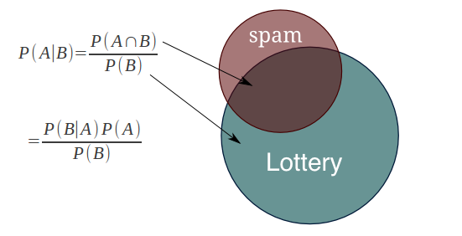
Our Approach: Naïve Bayes
Dd
D
D
D
D

Slide 4
Our Approach: Naïve Bayes
The Sentiment Problem:

