Slide 1
The Sentiment of Anime
Abhinav Havaldar
Pauline Okuda Ceraulo

Slide 2
The Sentiment Problem
Sentiment analysis: is usually used to determine whether a word is classified as positive or negative
We want to predict the popularity of a particular anime by classifying sentiment in reddit discussions about it.

Slide 3
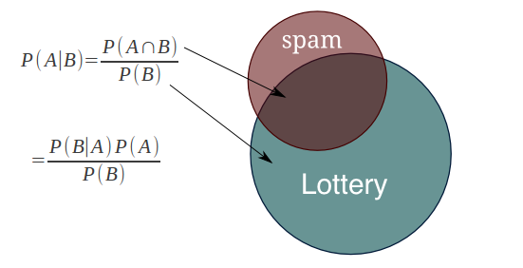
Our Approach: Naïve Bayes
The Naïve Bayes algorithm:
D
D
D
D

Slide 4
Analysis
Problems:
Kjdfkdkfj
T
D
D
D
D

Slide 5
Selected References
http://myanimelist.net/
https://www.reddit.com/
Jurafsky, Daniel and James H. Martin. Speech and Language Processing. Prentice Hall, New Jersey, 2000.

