Slide 1
HaveF/github-collaboration
{your github name}/github-collaboration

Slide 2
{your new branch}
HaveF/github-collaboration
{your github name}/github-collaboration

Slide 3
{your new branch}
HaveF/github-collaboration
{your github name}/github-collaboration

Slide 4
{your new branch}
HaveF/github-collaboration
{your github name}/github-collaboration

Slide 5
{your new branch}
{your new branch for PR}
HaveF/github-collaboration
{your github name}/github-collaboration

Slide 6
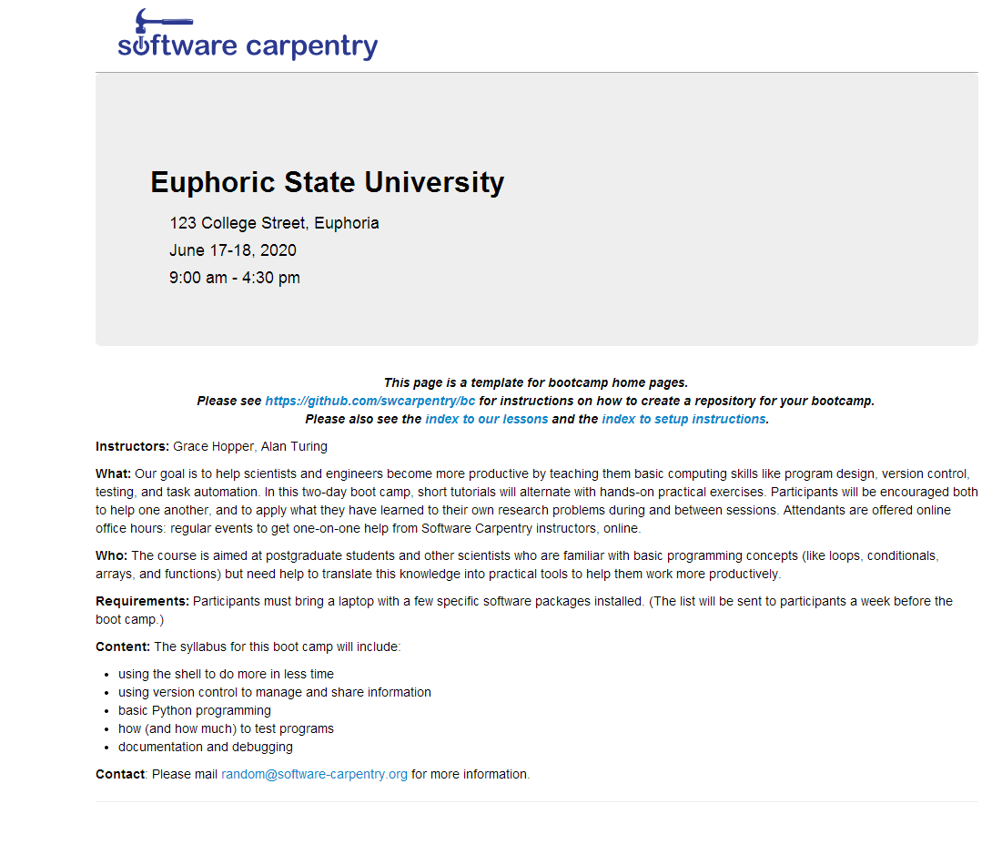
“gh-pages” branch
HaveF/github-collaboration
{your github name}/github-collaboration

Slide 7
“gh-pages” branch
HaveF/github-collaboration
{your github name}/YYYY-MM-DD-site

Slide 8
{your new branch}
{your new branch for PR}
Will push to
{your github name}/
YYYY-MM-DD-site/tree/gh-pages
Will push to
{your new branch for PR}/github-collaboration/tree/{PR tree name}
Then send PR on the web
Local machine

