Slide 1
CUSTOMER COHORT, RETENTION & PROFITABILITY REVIEW
Growth is real. Profit is not keeping up.
E-commerce retailer · 2020–2023 · 17,415 customers · 25,728 orders
Pham Hong Hieu (Haven) · github.com/Haven-Pham

Slide 2
FIVE THINGS MANAGEMENT SHOULD KNOW
Executive summary
1. 2023 sales +24%, but profit -12%: margin 18.0% → 12.8% in every category.
2. Repeat customers are 31% of customers but 56% of profit ($111 each vs $39).
3. Only ~2% of a cohort buys in any later month; the median gap to a 2nd purchase is 364 days.
4. Discounts above 20% lost $289K over four years.
5. Income does not separate profitable customers; behaviour does.

Slide 3
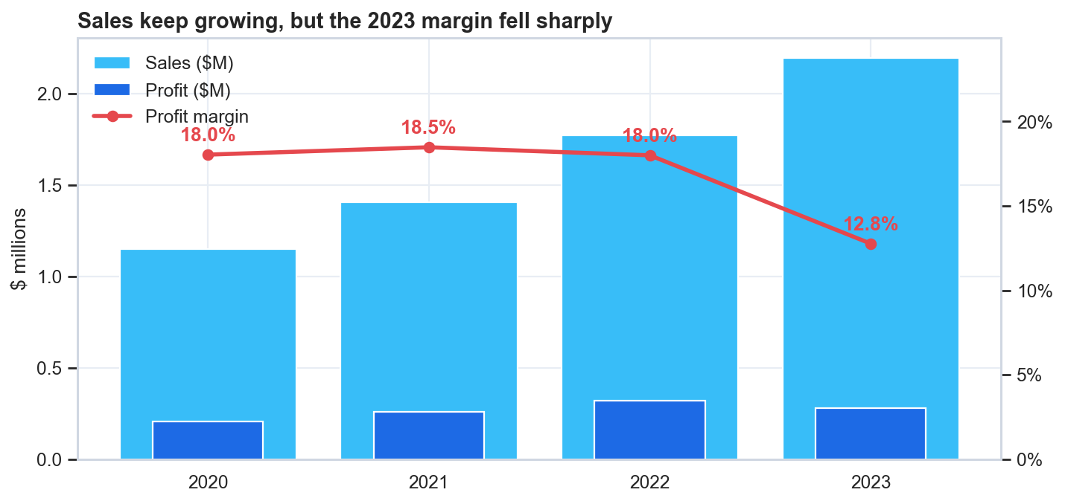
PROFITABILITY
2023: sales up, margin down
• Sales $1.77M → $2.19M
• Profit $319K → $280K
• Margin gap worth ≈ $115K at 2023 volume

Slide 4
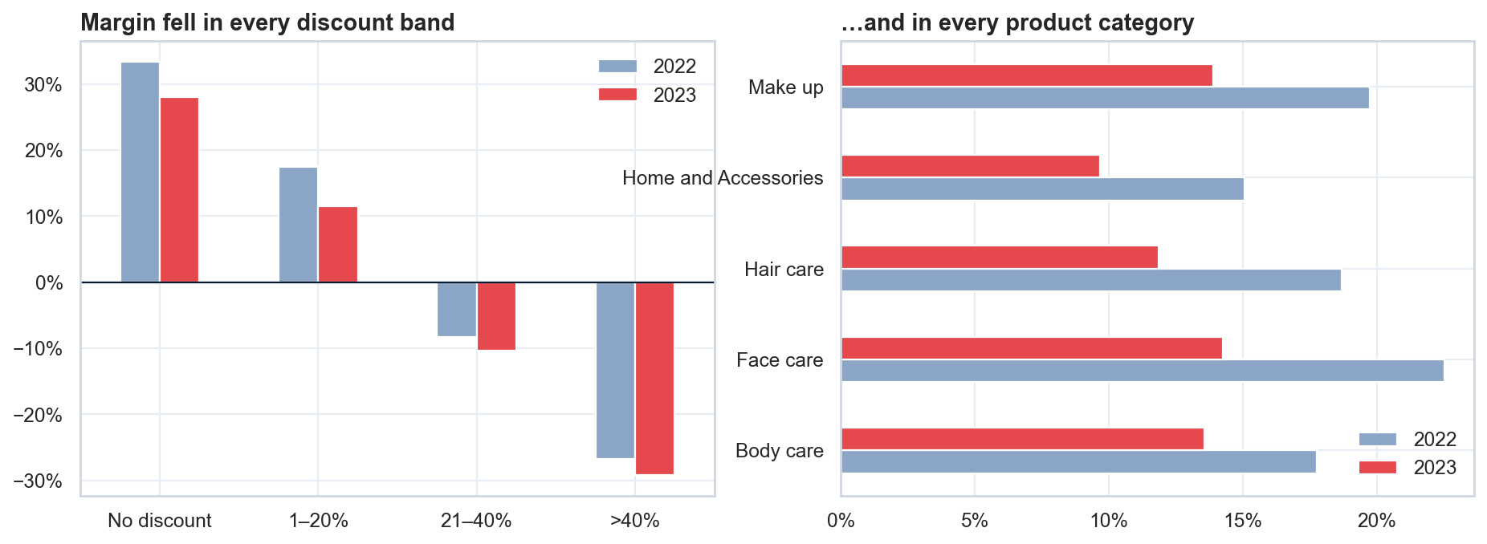
ROOT CAUSE
Not discounts, not mix: unit economics
• Undiscounted margin 33.4% → 28.1%
• Every category lost 4–8 pp
• Category mix moved < 1 pp
• Next step: cost and list-price data

Slide 5
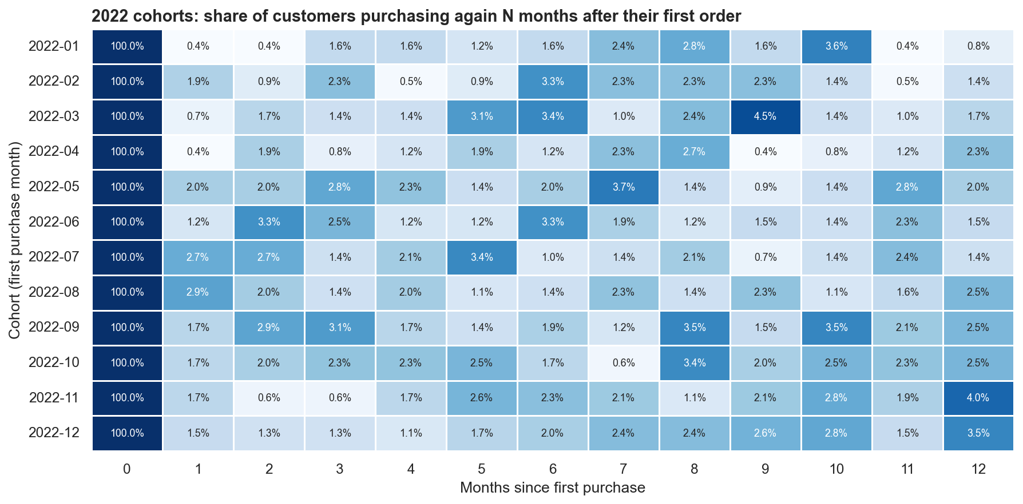
RETENTION
Most customers never come back
• 0.4–2.9% of a 2022 cohort active in any later month
• No decay curve: return is rare but steady
• Target the second purchase

Slide 6
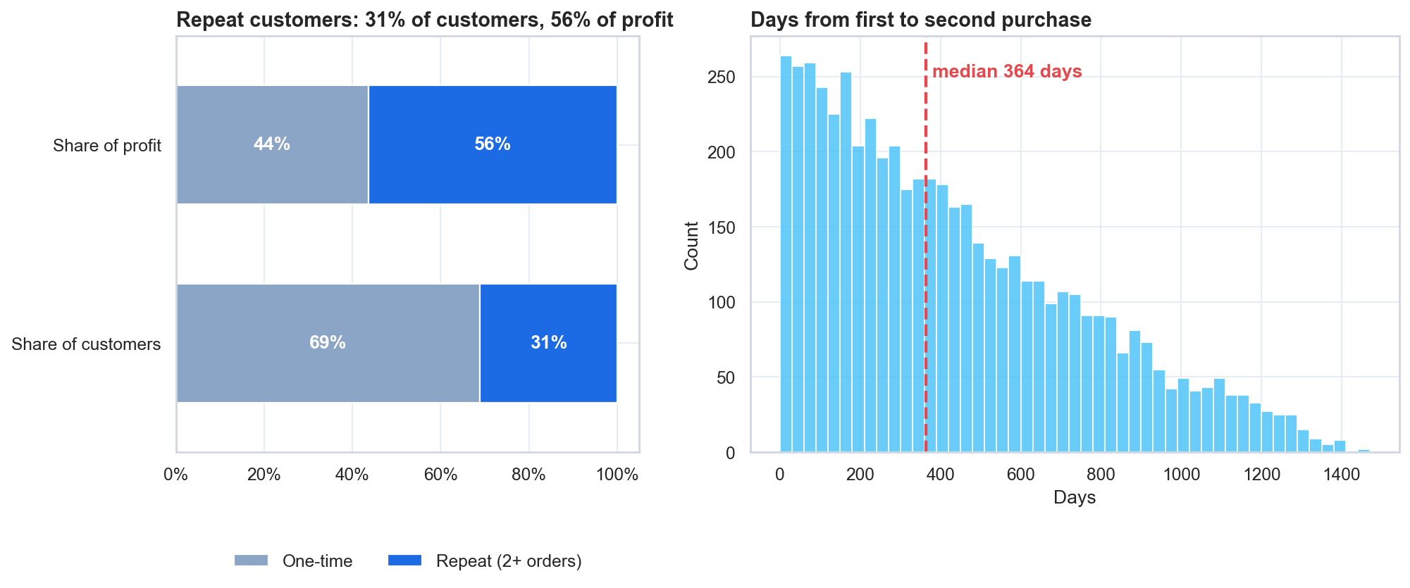
CUSTOMER VALUE
Repeat buyers carry the profit
• 31% of customers → 56% of profit
• Median 364 days to 2nd purchase
• +5% repeat conversion ≈ +$43K profit

Slide 7
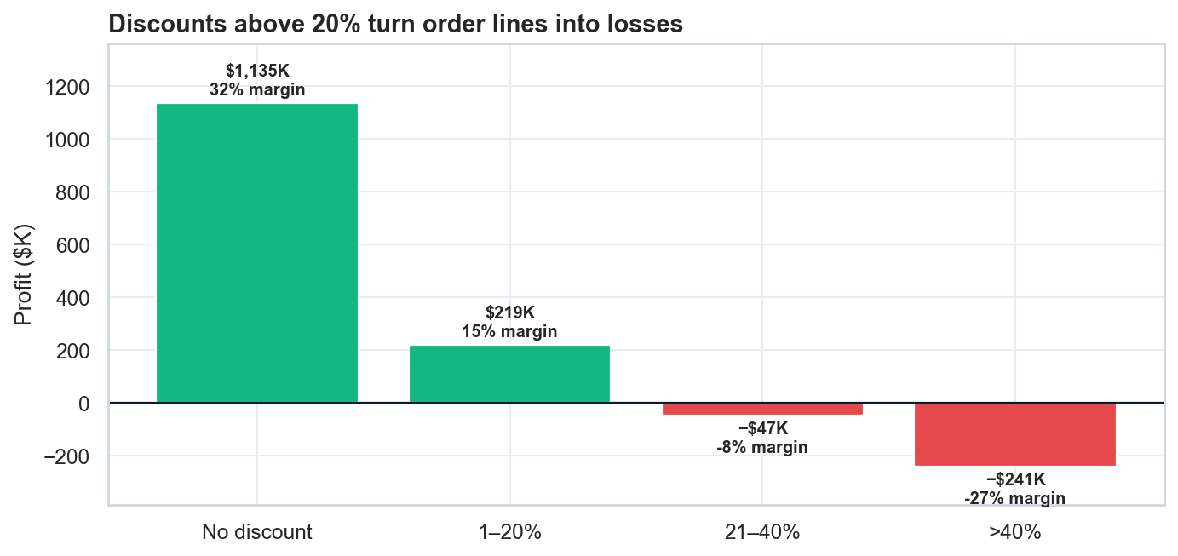
PRICING
Deep discounts lose money
• No discount: 31.7% margin
• 21–40%: −8.1% · >40%: −27.0%
• $289K lost on deep-discount lines

Slide 8
WHAT TO DO NEXT
Recommendations
1. Finance · Procurement: explain the 2023 margin drop with cost and list-price data (≈ $115K/yr).
2. Commercial: cap discounts at 20% with approval above it (up to ≈ $72K/yr).
3. CRM: second-purchase programme timed at months 10–12, plus a tested 60–90-day nudge (≈ +$43K).
4. Sales: account management for Corporate (30% of customers, 57% of profit).
5. Marketing: replace income targeting with RFM and discount-sensitivity segments.

