Slide 1
From 39% to 50%+: Fixing On-Time Delivery at BharatLink Freight
Transportation & logistics analytics: 3,582 GPS-tracked trips, 10 golden questions, and three moves to lift OTIF by ≥ 5 pp next quarter
Prepared by Pham Hong Hieu, Logistics Data Analyst · For the Board & Head of Operations · October 2026
Notes:
Purpose: diagnose why only 4 in 10 trips arrive on time, and agree three actions for next quarter.

Slide 2
Most late trips were late before the truck left: the promise is the problem
38.6%
0%
12
82%
network OTIF across 3,582 trips: 2,201 trips arrived late
of trips over 1,200 km get a feasible ETA: a flat ~100-hour promise ignores distance
carriers perform ≥ 15 pp below their lane benchmark, on 22% of volume
of late trips are caught at booking by a 4-rule early-warning score (72% precision)
Three moves for next quarter (target ≥ +5 pp OTIF)
Re-tender the 12 weakest carriers and move their ~800 trips to 9 proven performers: +6.8 pp.
Run the booking-time early-warning score in customer service and dispatch: +5.0 pp at a cautious 10% recovery rate.
Replace the flat 100-hour ETA with a distance-based SLA (250 km/day): an honest promise that re-baselines OTIF by +15.6 pp, plus a North hub study.
Notes:
Moves 1 and 2 alone deliver about +11.8 pp, more than double the target, without changing what we promise. Move 3 fixes the promise itself.

Slide 3
The brief: ten golden questions from the Board
1
OTIF health
6
GPS anomalies
Network OTIF and its monthly trend
Which routes don't match straight-line distance?
2
Route bottlenecks
7
Seasonality
Where is lead time abnormal, and why?
Weekday vs. weekend: why Wednesday?
3
Carrier performance
8
Cost efficiency
Best and worst carriers: should we exit any?
Freight cost per unit by region
4
Delay root cause
9
Breaking points
Is delay linked to material type?
High volume, low success: hub or carrier?
5
Load utilisation
10
Delay prediction
How many trips run empty or under-loaded?
Rule-based warning at booking time
Notes:
Every question is answered with a number, a root cause and an action. The deck is grouped into three acts.

Slide 4
Raw GPS export → clean trip-level star schema → dashboard
1. Ingest
2. Audit
3. Clean
4. Enrich
5. Visualise
1 sheet, 28 columns of GPS tracking data
Types, placeholders, gaps, duplicates, ranges
Dedupe, normalise text, parse states, drop PII
SLA feasibility, GPS ratio, material type, risk score
Star schema → Power BI (3 pages)
3,582
192
34
3.1M
525
9 mo.
trips (bookings)
carriers
customers (OEMs)
km travelled
km median trip
Dec 2019 – Aug 2020
Definitions: OTIF = on-time arrival (Actual ETA ≤ Planned ETA); there is no in-full quantity in the data. SLA feasible = planned transit time ≥ distance ÷ 250 km/day (the dataset's own minimum-km policy). Expected OTIF = network on-time rate for the same distance band and SLA feasibility.
Tools: Python (pandas, scipy, plotly) · Power BI (PBIP, TMDL, DAX) · PowerPoint

Slide 5
A messy operational export: eight issues fixed before any analysis
Issue | Scale | Treatment
Mixed types in date columns + Excel zero-date 1899-12-30 | 10 placeholder dates | Coerced to datetime; placeholders → blank
Duplicate Booking IDs (same truck, different material lines) | 3 rows | One row per booking (trip grain)
Inconsistent text: 152 origin / 353 destination spellings | case & spacing variants | Normalised; state, city & zone parsed
712 free-text material descriptions | 1 column | Keyword rules → 6 material categories
Missing vehicle type / distance / driver fields | 21% / 4% / PII | 'Unknown' class; distance imputed (×1.31 road factor); PII dropped
Lead time < 0 or > 30 days (stale GPS closures) | 79 trips | Flagged; excluded from lead-time stats
'Unknown' carrier, 'Xxxxxx' material | 217 / 14 trips | Kept as explicit categories
No in-full quantity, weight or freight cost in the data | KPI gap | OTIF = on-time; utilisation & cost via labelled proxies
Notes:
Be transparent about the two missing inputs: weight and cost. Utilisation and cost answers are proxies with stated assumptions.

Slide 6
How healthy is delivery, and where does it break?
01
Q1 OTIF trend · Q2 route bottlenecks and the SLA design flaw

Slide 7
Q1: OTIF is 38.6%, and the summer rise is mostly a change in mix
Dec–May: 0–1% on time. Almost only L&T site shuttles (70–110 km). 85–95% of plans were feasible, yet trucks took days: dwell, not driving.
Jun → Aug: 23% → 31% → 67%. The August jump comes from short Daimler / Ashok Leyland lanes in Tamil Nadu (73–91% on time).
Long-haul did not improve. The trend is real only for short-haul.
Trips per month: 179 · 358 · 68 · 44 · 55 · 496 · 942 · 1,429
Notes:
Don't celebrate August: it is a mix effect. The structural problem is untouched.

Slide 8
Q2: a flat ~100-hour ETA makes every long-haul trip late by design
55.6% vs 16.7%
on-time rate when the plan is feasible vs. infeasible (Cramér's V = 0.40, the strongest driver found)
100 h
median planned transit for every band from 100 km to 2,000+ km, while 2,000+ km needs ≈ 233 h at 250 km/day
43.7%
of all bookings are given an ETA that is physically unachievable
Notes:
This is the single most important slide. The plan, not the truck, causes most long-haul lateness.

Slide 9
Bottleneck lanes: infeasible long-haul plans plus short-haul dwell
Route | Trips | OTIF | Median lead (d) | Median km | Feasible | Root cause
Maharashtra → Assam | 26 | 0% | 12.5 | 2,750 | 0% | Infeasible SLA (long haul)
Tamil Nadu → Haryana | 195 | 4% | 7.2 | 2,300 | 0% | Infeasible SLA (long haul)
Tamil Nadu → Gujarat | 128 | 9% | 6.1 | 1,900 | 0% | Infeasible SLA (long haul)
Maharashtra → Rajasthan | 73 | 1% | 7.7 | 1,178 | 0% | Infeasible SLA (long haul)
Uttar Pradesh → Uttar Pradesh | 84 | 8% | 6.9 | 68.5 | 96% | Dwell / waiting at site
Odisha → Odisha | 102 | 14% | 6.3 | 30 | 94% | Dwell / waiting at site
By destination zone: North-East 9.4 d / 22% · North 6.9 d / 12% · West 4.8 d / 37% · East 4.8 d / 29% · South 2.9 d / 53%
North-East adds terrain and permit delays: 9.4 days median for only 307 km.

Slide 10
Who and what drives delay?
02
Q3 carriers · Q4 material · Q5 utilisation · Q6 GPS anomalies · Q7 weekday · Q8 cost · Q9 breaking points

Slide 11
Q3: judge carriers against their lane, and twelve fall far short
Exit / re-tender: 12 carriers ≥ 15 pp below their lane benchmark, about 800 trips (22%). K M R (0%), A P R Trailler (10%), K. Ramachandran (5%), Sunita Carriers (17% on 160 trips).
Don't fire the wrong ones: Ekta (21.8%) and Trans Cargo (13.1%) look bad, but perform as expected on 1,900–2,400 km lanes. Fix their SLA instead.
Grow: 9 preferred carriers (e.g. Sr Transports 100% on 113 trips, VJ Logistics +26 pp on 174).
Data gap: 217 trips have no carrier recorded.
Notes:
Distance-adjusted benchmarking is what makes the exit decision defensible in a supplier review.

Slide 12
Q4 & Q7: neither the cargo nor 'Wednesday' explains the delays
OTIF % by material type
Weekday OTIF vs. lane-expected
Significant (p < 0.001) but weak: Cramér's V = 0.12 vs 0.40 for SLA feasibility. After controlling for lane, categories sit within ±7 pp of expected.
Wednesday (37.4%) is exactly what its lane mix predicts (−0.3 pp). The weak days are the weekend: Saturday sends the longest loads (median 1,083 km), and Sunday is 17 pp below expected.
Notes:
Two popular hypotheses rejected by the data. That saves the Board from investing in the wrong fix.

Slide 13
Q5 & Q6: one in ten trips runs empty; one in four has a GPS anomaly
10.6%
GPS route vs. straight-line distance (median road factor 1.31×)
11.7% impossible (route shorter than straight line): wrong distance or pin. Only 16% on time, because bad inputs make bad ETAs.
5.7% detours (> 2.5× straight line): route-compliance checks.
6.6% round trips (origin = destination): milk runs, 98% on time. They need their own SLA logic.
76% normal
of trips carry only returnable empty packaging (trays, bins, foam): ≈ ₹13.4 M of modelled spend
55%
of 25–35 MT trailer trips are shuttles under 100 km, so capacity is very likely under-used
No weight field exists, so these are observable proxies. Start capturing loaded tonnes at dispatch.

Slide 14
Q8 & Q9: the North is the costliest and least reliable region
Modelled cost per tonne (INR) by destination zone
Breaking point | Trips | OTIF | Feasible | Prescription
Haryana | 372 | 13% | 21% | Distance-based SLA + North / West hub
Maharashtra | 277 | 29% | 23% | Distance-based SLA + North / West hub
West Bengal | 175 | 30% | 90% | Dual-source (top carrier 57%)
Rajasthan | 126 | 21% | 28% | Distance-based SLA + North / West hub
Odisha | 123 | 17% | 89% | Dual-source (top carrier 63%)
Rule of thumb: a feasible plan with poor results points to the carrier. An infeasible long-haul plan points to the SLA and the network (hub).
Assumed rate card (₹22–58/km by vehicle class) × distance ÷ capacity. The North takes 34% of modelled spend.

Slide 15
Predict it, then fix it
03
Q10 early-warning rules · dashboard · recommendations and 90-day plan

Slide 16
Q10: four booking-time rules flag 82% of late trips in advance
Rule (known at booking) | Points | Late if flagged | Late otherwise
Infeasible SLA (planned speed > 10.4 km/h) | +3 | 72% | 14%
Long haul (> 1,200 km) | +1 | 70% | 21%
Carrier with weak history (< 25% on-time) | +2 | 71% | 20%
Customer lane with weak history (< 25% on-time) | +1 | 59% | 13%
72% / 82%
precision / recall at score ≥ 3 on the Aug-2020 out-of-time test
84%
accuracy vs. 67% for 'always on time'
37%
of bookings get an alert: manageable for customer service
Notes:
Critical: call the customer at booking with a realistic ETA. High: dispatcher checks carrier and slot. Low: no action.

Slide 17
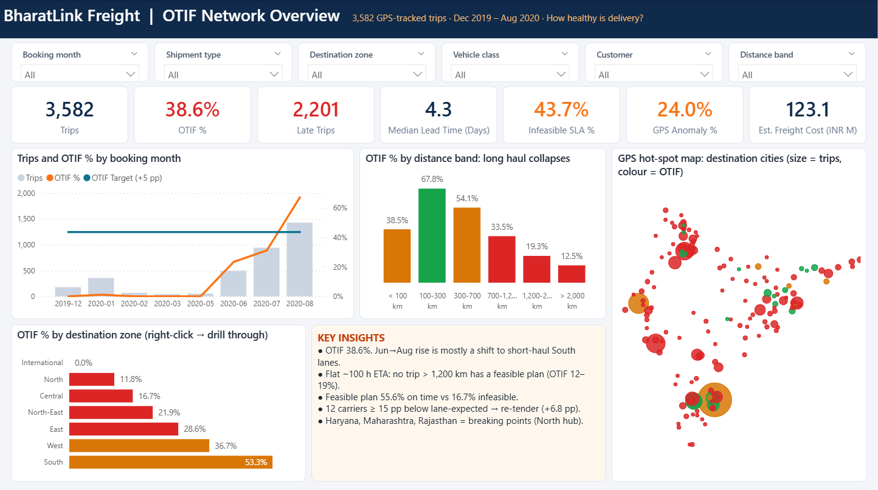
Power BI: Network Overview with a GPS hot-spot map

Slide 18
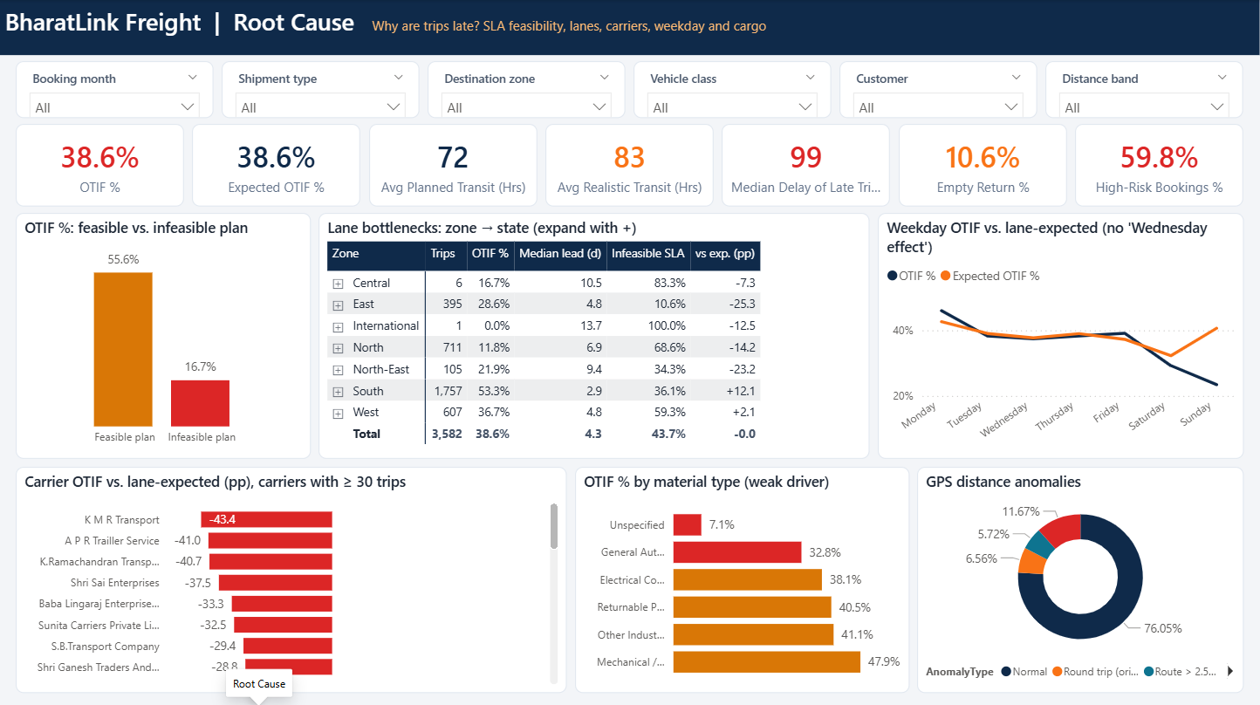
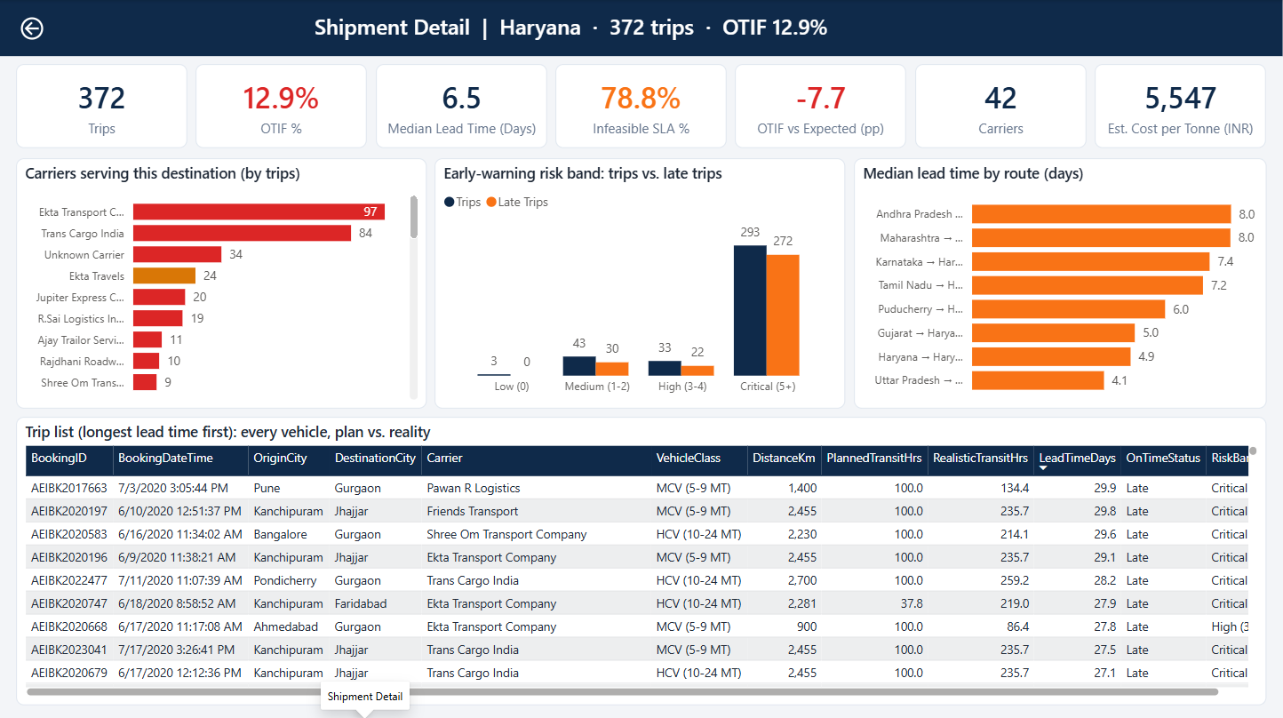
…plus a root-cause page and a region-to-shipment drill-through
Root Cause: feasible vs. infeasible plans, zone → state lane matrix, carrier vs. lane benchmark, weekday vs. expected, material, GPS anomalies.
Shipment Detail (drill-through): right-click a region to see its carriers, risk bands, routes and every truck (here Haryana: 372 trips, 12.9% OTIF).
1 Overview How healthy? KPIs, trend, map
2 Root cause Why late? SLA, lane, carrier
3 Drill-through Which trucks? Region → shipment

Slide 19
Three moves that beat the +5 pp target next quarter
1
Re-tender the 12 weakest carriers
+6.8 pp
Procurement · Weeks 1–6
Move about 800 trips to the 9 preferred carriers; lane-benchmark scorecard in every QBR.
2
Booking-time early-warning score
+5.0 pp
Customer service + dispatch · Weeks 2–4
Critical → call the customer with a realistic ETA; High → dispatcher checks carrier and slot.
3
Distance-based SLA + data fixes
+15.6 pp
Planning + IT · Weeks 4–12
Each lever is measured against today's 38.6% baseline; the levers are not simply additive. Moves 1 + 2 alone ≈ +11.8 pp.
Re-baselines the promise: ETA = distance ÷ 250 km/day + buffer; fix the 24% GPS anomalies; capture weight.
Notes:
Even without changing the SLA, moves 1 and 2 give about +11.8 pp. Network next step: a North cross-dock feasibility study for Haryana, Rajasthan, Delhi and HP.

Slide 20
90-day roadmap and the KPIs the dashboard will track
Days 0–30 Quick wins
Days 31–60 Re-plan
Days 61–90 Scale
Carrier scorecards shared; re-tender launched
Early-warning score live in CS
Weekend long-haul release rule
Distance-based SLA piloted on North lanes
GPS / distance master-data clean-up
Backhaul matching for empty returns
New carrier panel live
SLA rolled out network-wide
North hub business case to the Board
OTIF
Feasible ETAs
Exit carriers' share
GPS anomalies
Empty-return trips
Today 38.6%
Today 56%
Today 22%
Today 24%
Today 10.6%
Target ≥ 43.6%
Target 100%
Target < 5%
Target < 10%
Target < 7%

Slide 21
Thank you: questions & discussion
Decision needed: approve the carrier re-tender and the early-warning rollout now, and the distance-based SLA pilot on North lanes.
Appendix: notebook (03_Python) · Power BI project (04_PowerBI) · data quality log, carrier scorecard (03_Python/outputs)

