Slide 1
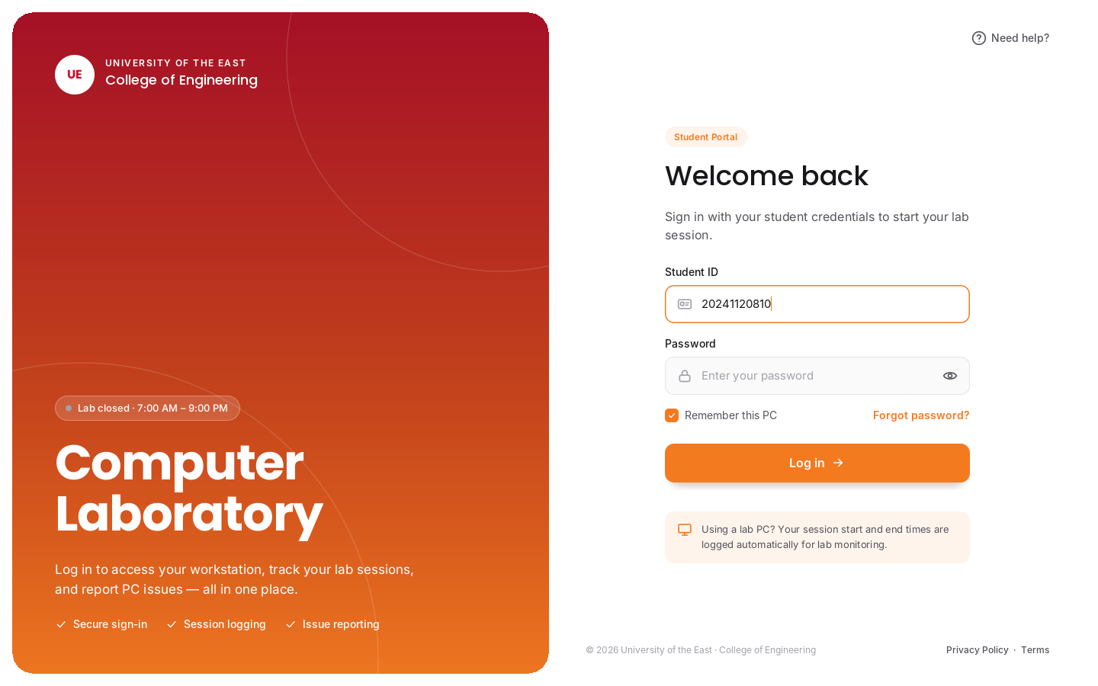
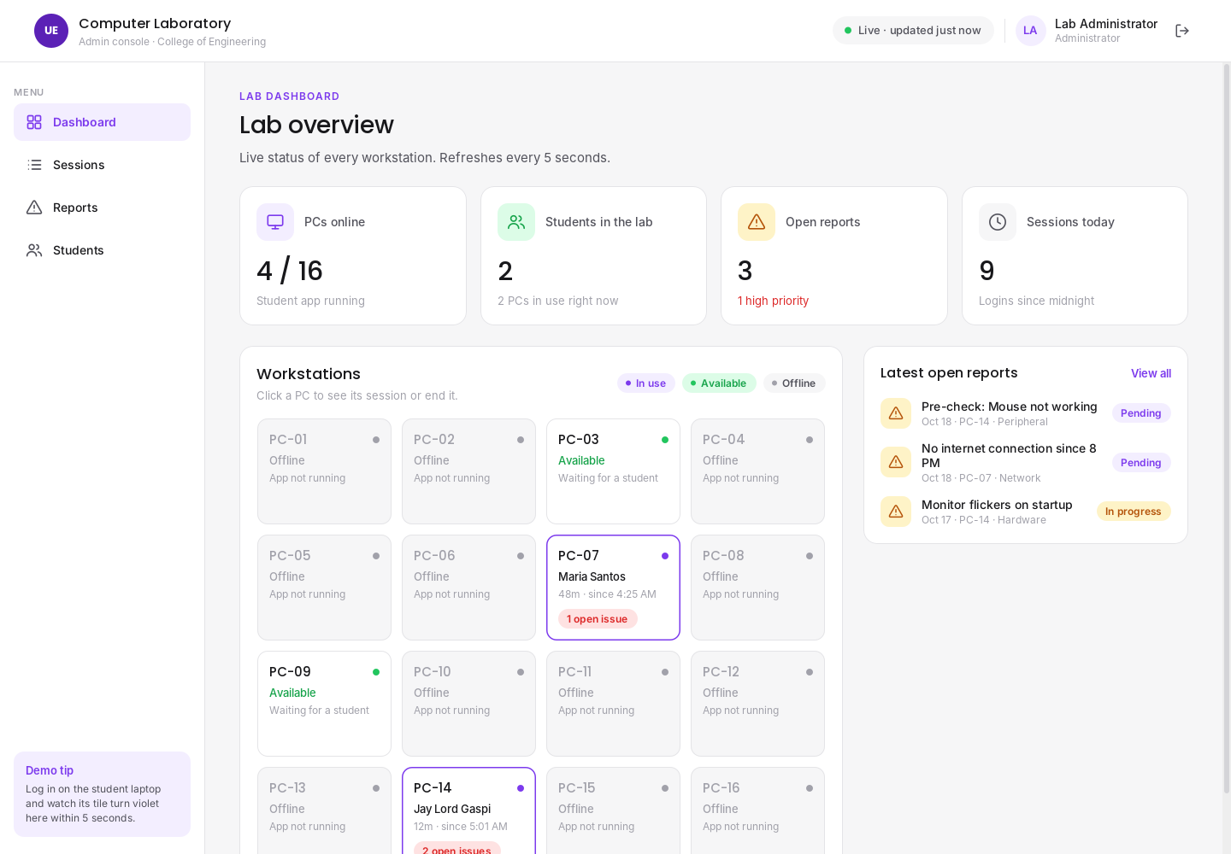
UE CompLab Monitoring System
JAVA FINAL PROJECT · COLLEGE OF ENGINEERING
A Java system that replaces the computer laboratory's paper logbook: students log in at each PC, report problems, and the lab admin sees everything live.
Dela Cruz, Justin
Gaspi, Jay Lord F.
Timbol, Alexandria T.
Notes:
Introduce the project: a Java system for monitoring our school's computer laboratory. Two apps: a locked student kiosk on each lab PC and an admin console for the lab assistant.

Slide 2
Who built it
PROJECT TEAM
JD
JG
AT
Dela Cruz, Justin
Gaspi, Jay Lord F.
Timbol, Alexandria T.
Project Manager
UI/UX Designer
UI/UX Designer
Developer
Developer
Documentation
Notes:
Justin — project manager and developer. Jay Lord — UI/UX designer and developer. Alexandria — UI/UX designer and documentation.

Slide 3



The lab still runs on a paper logbook
BACKGROUND
Manual, paper-based logging
OUR GOAL
Students write their name and time on paper. Entries are missed, unreadable, or written for someone else.
Make every lab session and every PC problem visible to the lab admin automatically, without paperwork.
Broken PCs go unreported
A dead mouse or missing keyboard is noticed by the next student, not by the lab assistant who can fix it.
No real-time view of the lab
The lab assistant can't see which PCs are in use, who is using them, or how long they've been there.
Notes:
Explain the current situation in our lab: a paper logbook, problems that are never reported, and no live overview. These three pain points are what the system solves.

Slide 4




Lock every PC, watch the whole lab live
CONCEPT DESCRIPTION
The UE CompLab Monitoring System is a Java desktop system with two apps that share one MySQL database. The Student Kiosk opens in fullscreen as soon as Windows starts, so the PC can't be used until a student logs in. Every login and logout is saved automatically, and students check their PC's equipment before they start. The Admin Console shows the whole lab live: which PCs are in use, by whom, and which problems need fixing.
1 Log in
2 Check the PC
3 Use the PC
4 Log out
Fullscreen login appears after Windows boots. Time in is saved.
Tick Monitor, Keyboard, Mouse. Anything not working becomes a report.
Screen unlocks. A small session bar shows the timer and Report issue.
Time out is saved and the PC locks again for the next student.
Notes:
This is the concept in one slide. Walk through the four steps a student goes through. Mention that all of it is saved to the database on the admin laptop.

Slide 5

Two laptops, one database
SYSTEM ARCHITECTURE
Student laptop
Admin laptop
Lab PC (e.g. PC-14)
Lab assistant's desk
Same Wi-Fi / phone hotspot
JDBC · TCP port 3306
Student Kiosk app (Java Swing)
Starts automatically with Windows
Locked fullscreen login
Workstation check + issue reports
Heartbeat every 10 seconds
Admin Console app (Java Swing)
MySQL database (XAMPP)
Live dashboard, refresh every 5 s
Session logs, reports, accounts
Can end a session remotely
Both apps are pure Java and come from one IntelliJ project. The kiosk reads and writes the database directly over the network, so the admin sees a new login or report within seconds.
Notes:
For the demo we use two laptops. The admin laptop runs MySQL and the admin console. The student laptop runs the kiosk and connects to the admin laptop's database through the same Wi-Fi or a phone hotspot.

Slide 6




What the system does
FEATURES
Kiosk lock screen
Automatic time in / out
Workstation check
Fullscreen login after Windows boots. Alt+F4 is ignored and Alt+Tab is pulled back.
Every session is saved with the student, PC, time in, time out and duration.
Students confirm Monitor, Keyboard and Mouse work before using the PC.
Issue reporting with photo
Live PC map
Report tracking
Category, priority, description and an optional photo, anytime during the session.
Admin sees every PC as In use, Available or Offline, updated every 5 seconds.
Admin marks reports In progress or Resolved; session logs export to CSV.
Notes:
Orange features are on the student kiosk, violet features are on the admin console.

Slide 7
Software requirements
REQUIREMENTS
Component | Software / version | Used on
Operating system | Windows 10 or 11 (64-bit) | Both laptops
Programming language | Java — JDK 17 or newer | Both apps
User interface | Java Swing (custom-styled components) | Kiosk + console
IDE | IntelliJ IDEA (Community or Ultimate) | Development
Database | MySQL / MariaDB via XAMPP | Admin laptop
Database driver | MySQL Connector/J (JDBC) | Both apps
Build tool | Apache Maven (one runnable .jar) | Development
Design & diagrams | Figma, draw.io, PlantUML, Canva | Documentation
Notes:
Everything is free software. Java and MySQL are the core; Maven packages the system into one .jar that runs on both laptops.

Slide 8

Hardware requirements
REQUIREMENTS
Student laptop / lab PC
Admin laptop (server)
Network
Dual-core CPU, 4 GB RAM
1366×768 display or higher
Keyboard and mouse
Wi-Fi or Ethernet
Windows 10/11
Quad-core CPU, 8 GB RAM recommended
Runs MySQL + Admin Console
10 GB free storage for data/photos
Wi-Fi or Ethernet
Windows 10/11
Phone hotspot or Wi-Fi router
Both laptops on the same network
Port 3306 open on the admin laptop
Optional: LAN cable between laptops
Notes:
For the demo: one laptop acts as the lab PC, the other as the admin's computer and database server, connected through a phone hotspot.

Slide 9


Who uses the system
ROLES
Student
Lab Admin / Lab Assistant
Uses a lab PC
Manages the lab
Logs in with Student ID and password
Checks Monitor, Keyboard and Mouse
Reports problems (with photo)
Sees recent reports on their PC
Logs out when done
Monitors all PCs live
Views and exports session logs
Marks reports In progress / Resolved
Ends a student's session remotely
Adds students, resets passwords
Notes:
There are two user roles. Students only see the kiosk. The lab admin uses the console. Team roles are on slide 2.

Slide 10
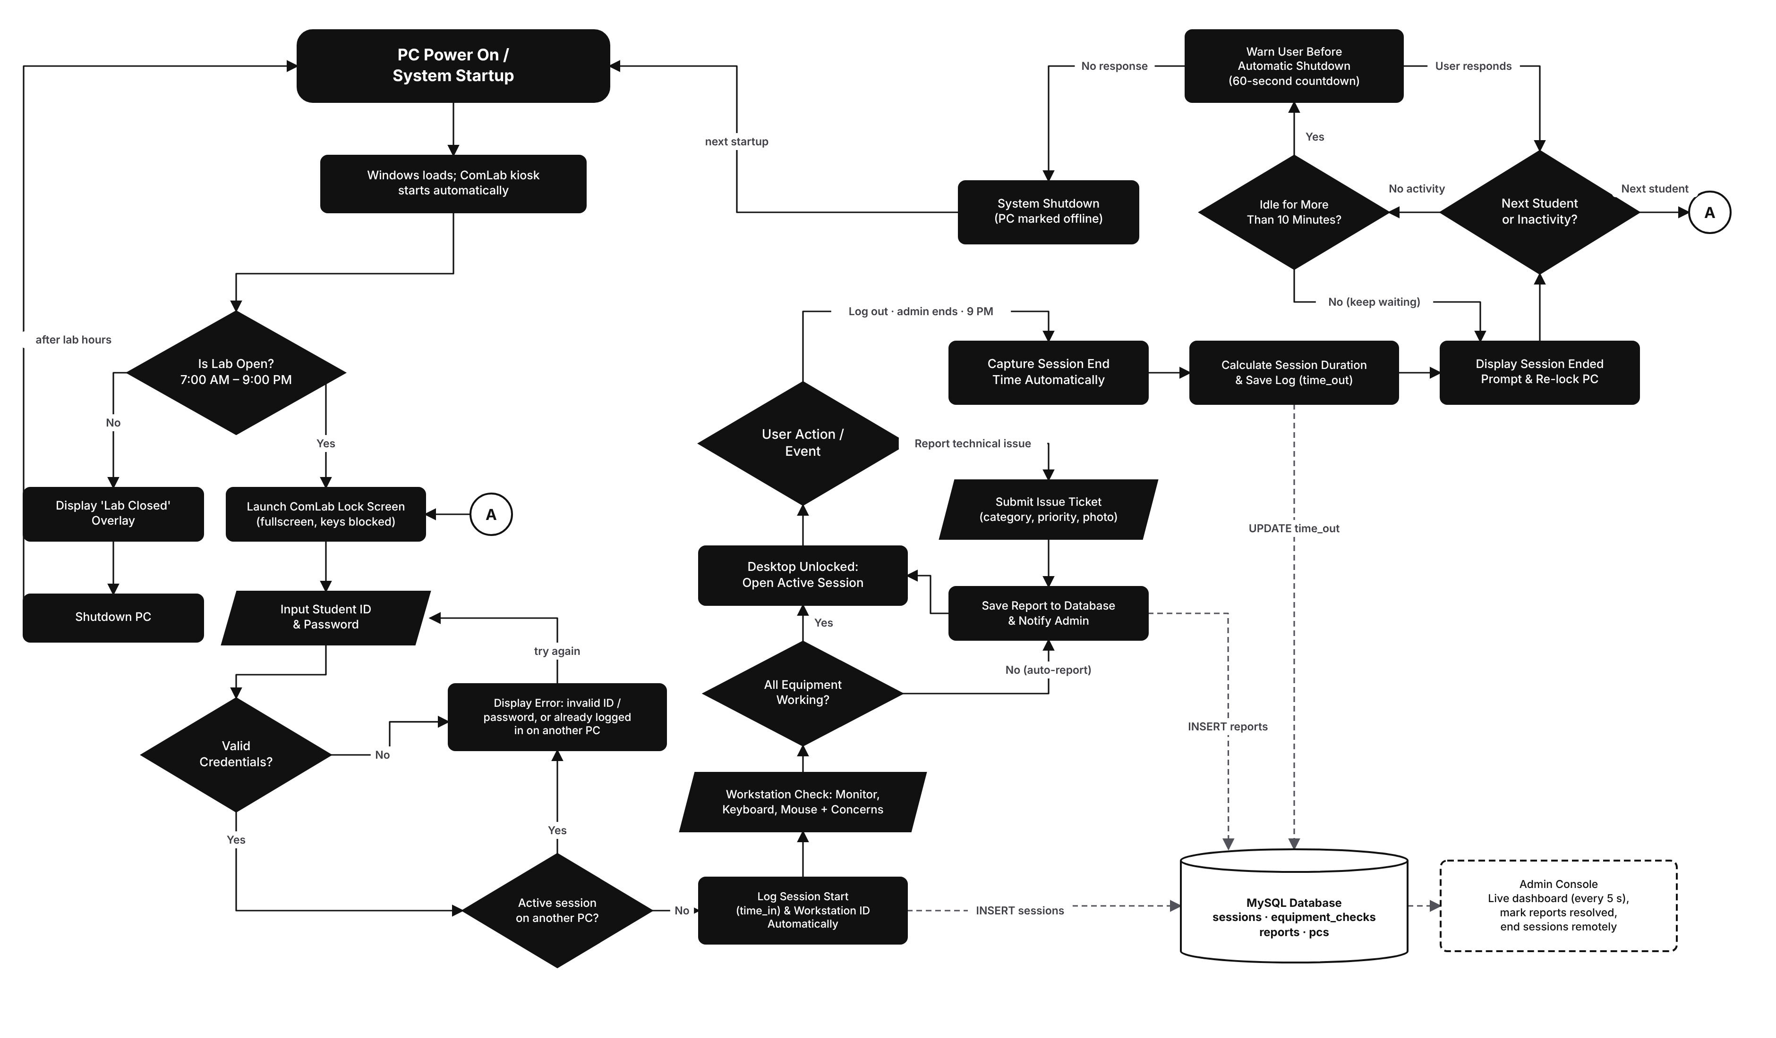
From power on to shutdown
SYSTEM FLOWCHART · DRAW.IO
1 Start-up
PC powers on and the kiosk starts. Outside 7 AM–9 PM a Lab Closed overlay shows and the PC shuts down.
2 Log in
ID and password are checked; a student can't be logged in on two PCs. Time in is saved.
3 Check & use
Workstation check, then the desktop unlocks. Issues can be reported anytime.
4 End
Log out, admin, or 9 PM ends the session and saves time out. Next student, or shut down after 10 idle minutes.
Notes:
Start top-left at PC Power On. Follow the arrows down to the login, along the bottom to the workstation check, up through the active session, and across the top for how the session ends. Dashed lines show what is saved to the MySQL database that the admin console reads. Circle A jumps back to the lock screen for the next student. Editable file: 1-system-flowchart-v2.drawio.

Slide 11
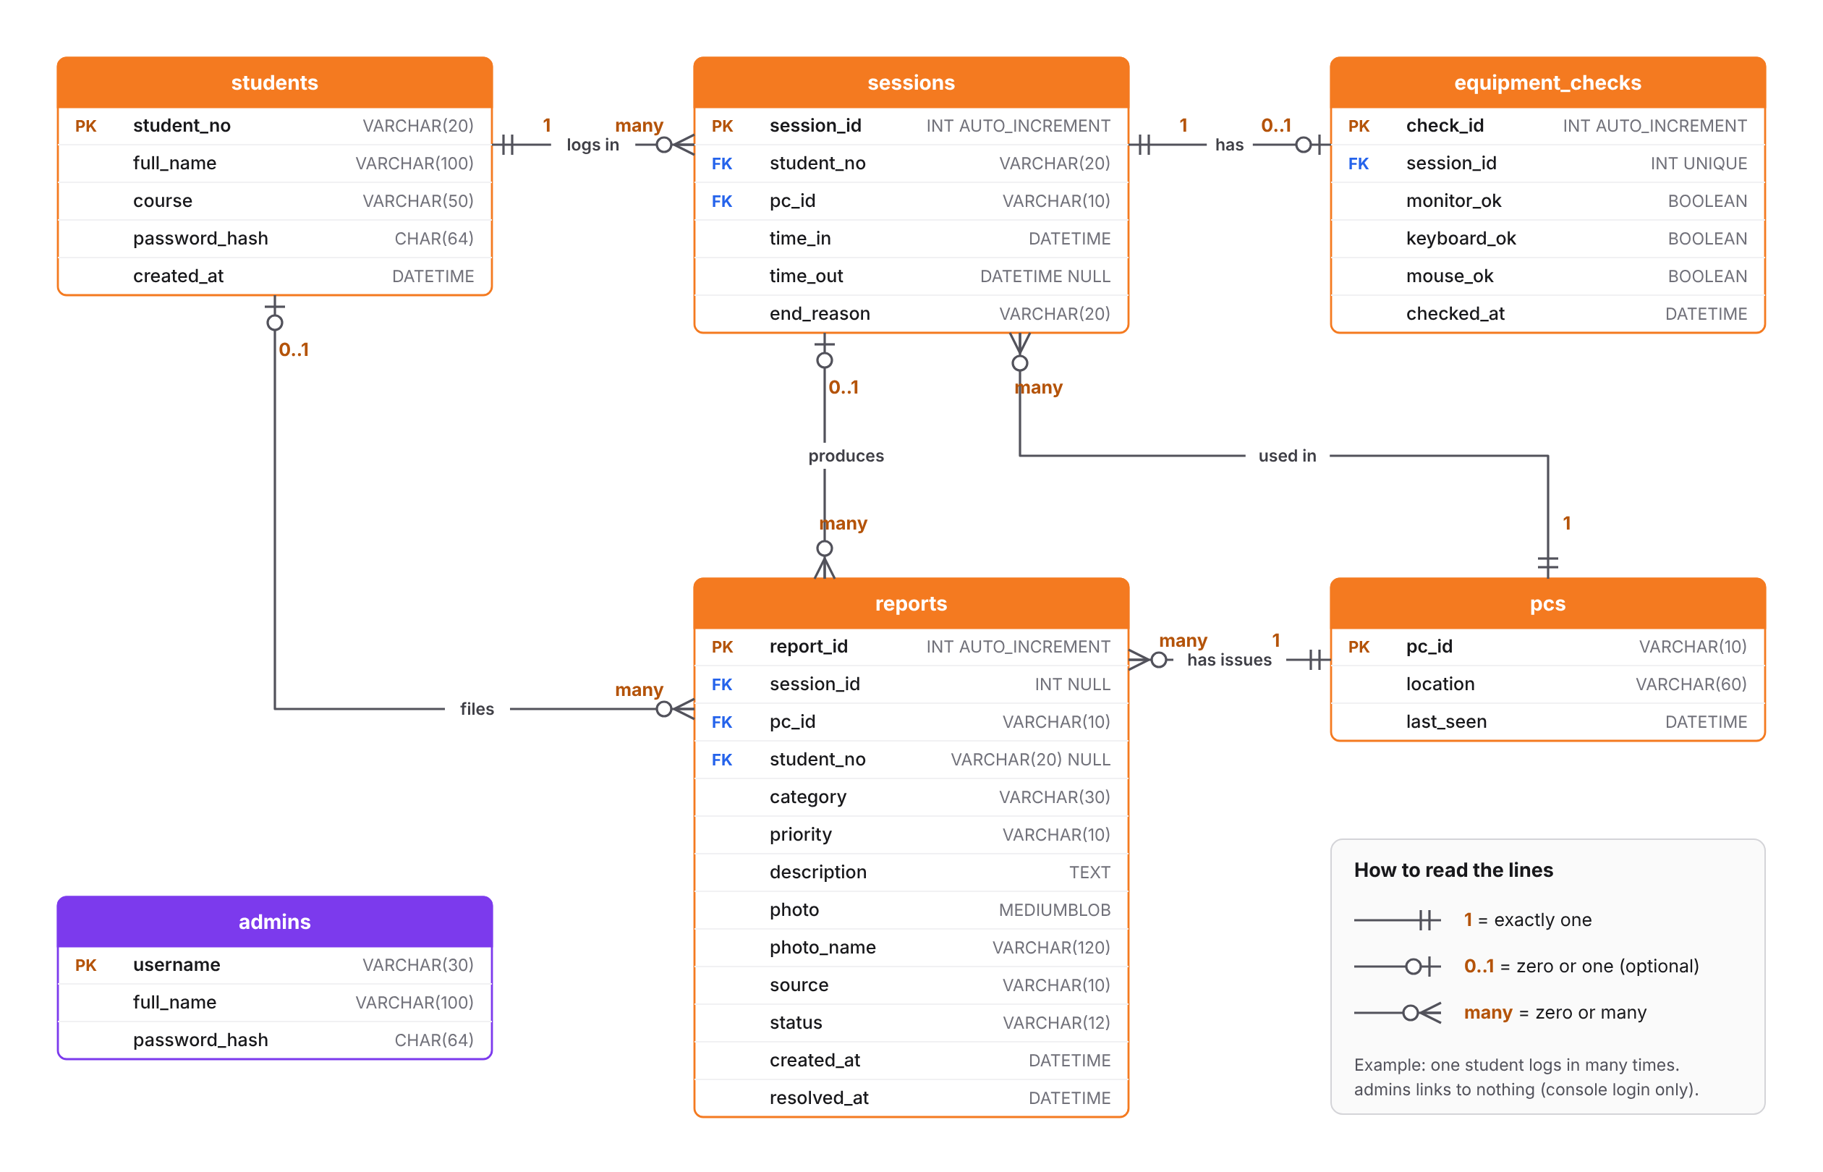
Six tables in MySQL
ENTITY RELATIONSHIP DIAGRAM · DRAW.IO
students → sessions
One student has many sessions
pcs → sessions
One PC is used in many sessions
sessions → equipment_checks
Each session has at most one check
sessions / pcs / students → reports
Reports point to the PC, and to the session and student when known
admins
Stand-alone; used only for the console login
Notes:
Primary keys are marked PK and foreign keys FK. Passwords are stored as SHA-256 hashes, never plain text. Editable file: 2-erd.drawio.

Slide 12
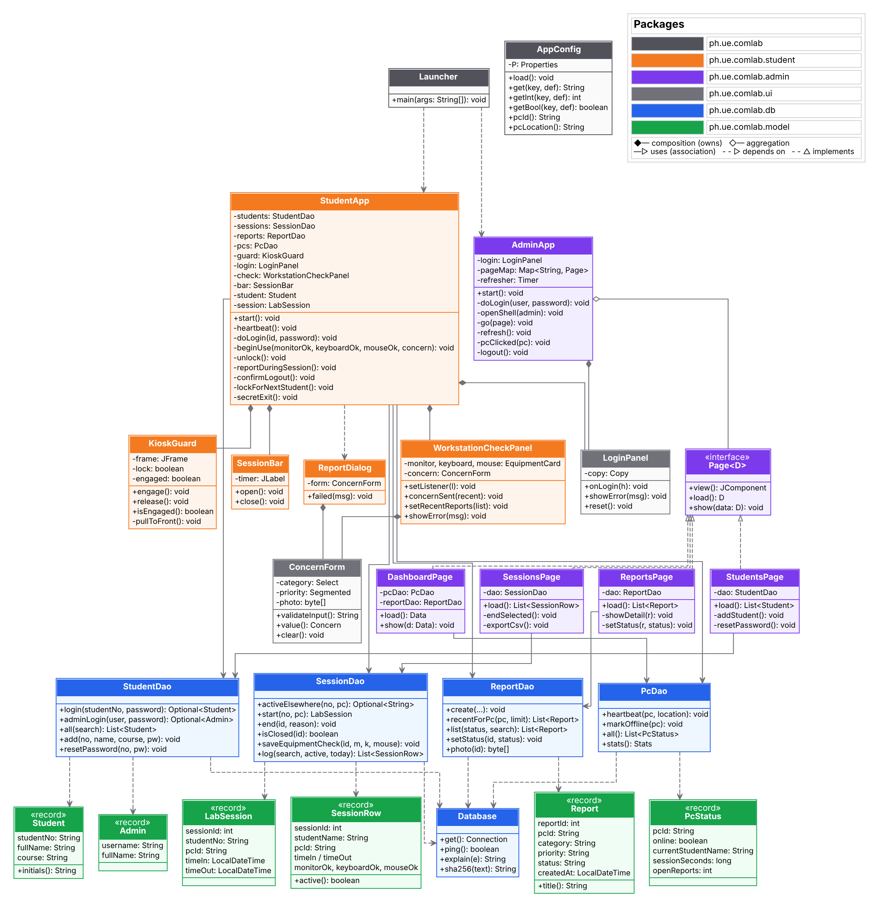
How the Java code is organized
CLASS DIAGRAM · PLANTUML
ph.ue.comlab.student
StudentApp, KioskGuard, WorkstationCheckPanel, SessionBar, ReportDialog
ph.ue.comlab.admin
AdminApp and the four pages that implement Page<D>
ph.ue.comlab.db
Database + one DAO per table group; all SQL lives here
ph.ue.comlab.model
Records returned by the DAOs: Student, LabSession, Report…
ph.ue.comlab.ui
Shared screens: LoginPanel, ConcernForm
Notes:
The code is layered: screens never write SQL; they call DAOs, which use the Database class. Source file: 3-class-diagram.puml.

Slide 13
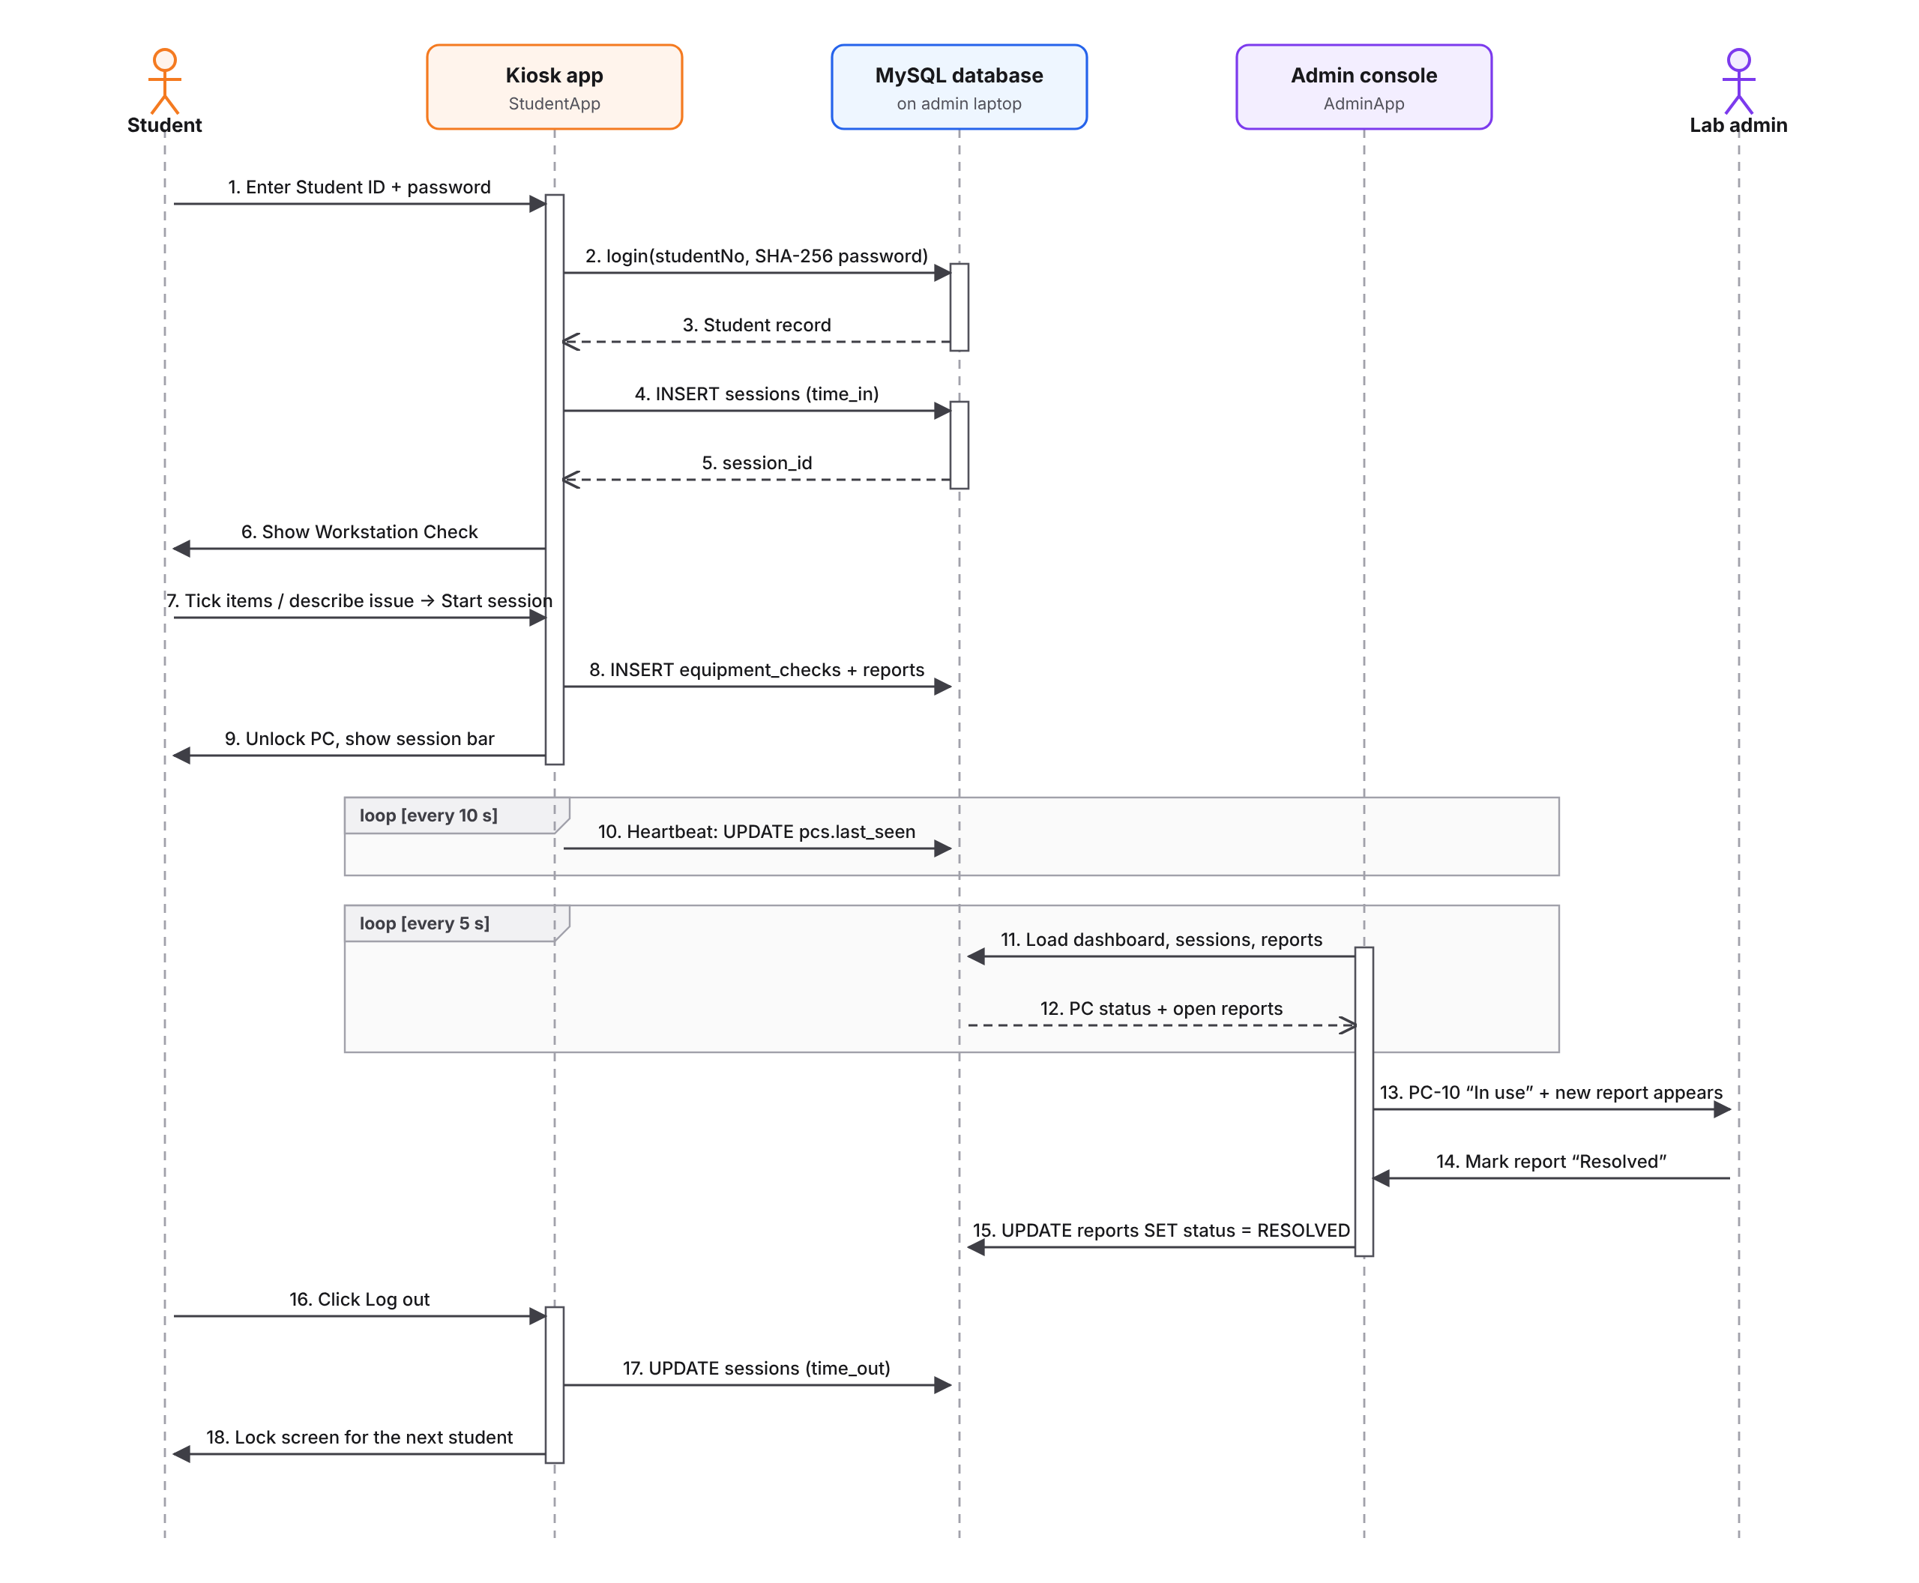
One lab session, message by message
SEQUENCE DIAGRAM · DRAW.IO
1–5
Login is checked against the database and a session row is created (time in).
6–9
The workstation check is saved and the PC unlocks.
10–12
Kiosk heartbeat every 10 s; the console reloads every 5 s.
13–15
The admin sees the PC in use and resolves the report.
16–18
Log out saves time out and locks the screen.
Notes:
Read the diagram top to bottom. Solid arrows are calls, dashed arrows are returns, and the boxes marked 'loop' repeat on a timer. Editable file: 4-sequence-diagram.drawio.

Slide 14
Student login (kiosk)
UI/UX · LOGIN
Fullscreen and locked
Appears right after Windows loads; the PC can't be used without logging in.
Student ID + password
Checked against the database; clear error messages.
Session note
Tells students their time in and time out are logged.
Lab status chip
Shows if the lab is open and its hours.
Notes:
This is the first screen a student sees. It covers the whole screen and ignores Alt+F4.

Slide 15
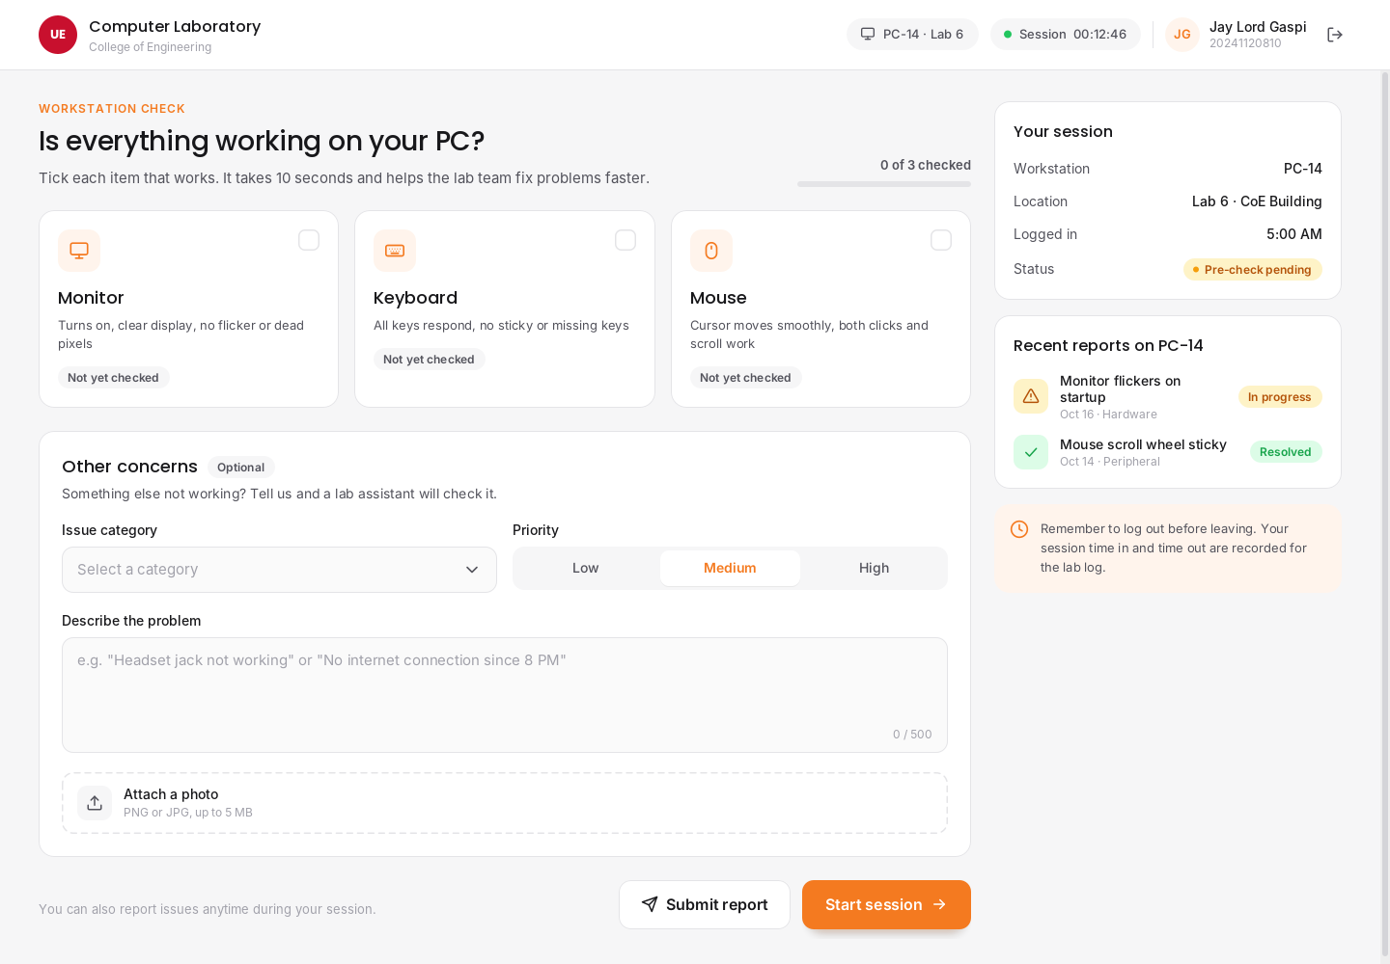
Workstation check
UI/UX · MAIN FEATURE
Tick what works
Monitor, Keyboard, Mouse. Unticked items are reported automatically.
Other concerns
Category, priority, description and an optional photo.
Your session
PC, location, time logged in and a live timer.
Recent reports
Shows known problems on this PC and their status.
Notes:
After logging in, students confirm their equipment works. This replaces asking students to report problems on paper.

Slide 16
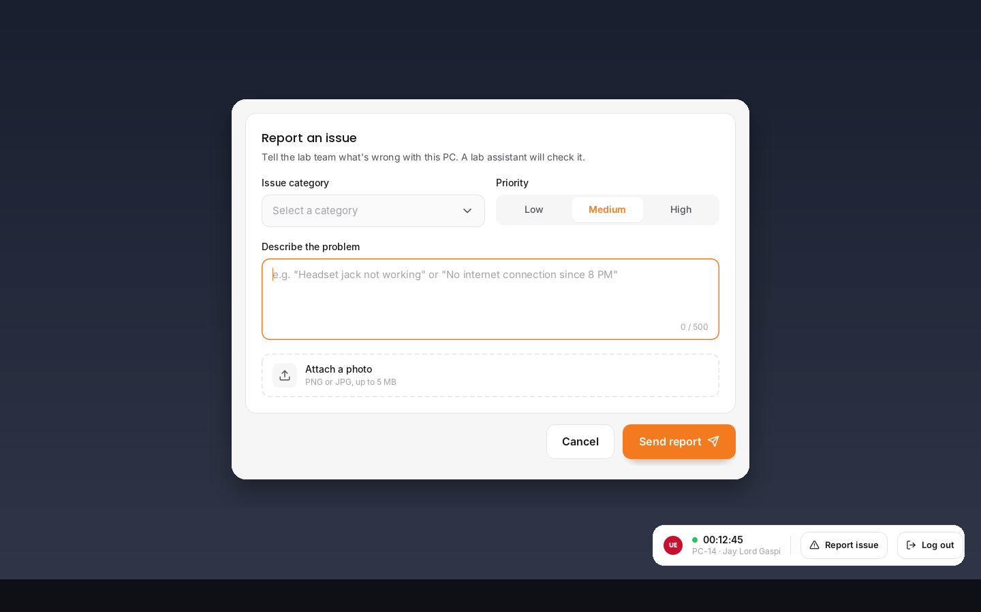
In session: session bar + report issue
UI/UX · MAIN FEATURE
Session bar
Small, always on top, shows the session timer.
Report issue
Opens the report form anytime during the session.
Log out
Saves time out and locks the PC for the next student.
Doesn't get in the way
The bar can be dragged and never takes keyboard focus.
Notes:
While the student is working, only this small bar is visible in the corner.

Slide 17
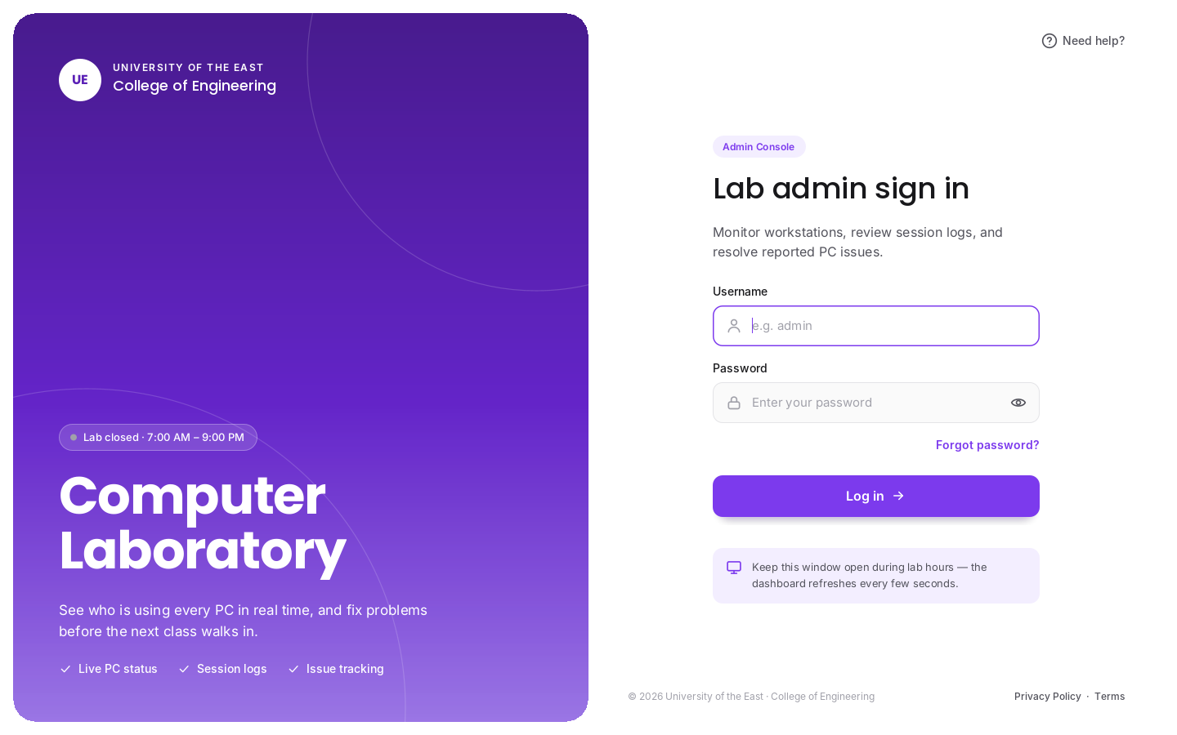
Admin console sign-in
UI/UX · ADMIN LOGIN
Same design, violet theme
The admin side uses violet so it's never confused with the student kiosk.
Separate admin accounts
Stored in the admins table with hashed passwords.
Server check
Warns if MySQL isn't running on this laptop.
Notes:
The admin console reuses the login design with the violet admin theme.

Slide 18
Admin dashboard
UI/UX · DASHBOARD
At-a-glance numbers
PCs online, students in the lab, open reports, sessions today.
Live PC map
Violet = in use, green = available, grey = offline. Click a PC to end a session.
Latest open reports
The newest problems that need attention.
Auto refresh
Updates every 5 seconds.
Notes:
Log in on the student laptop during the demo and the PC tile turns violet here within 5 seconds.

Slide 19
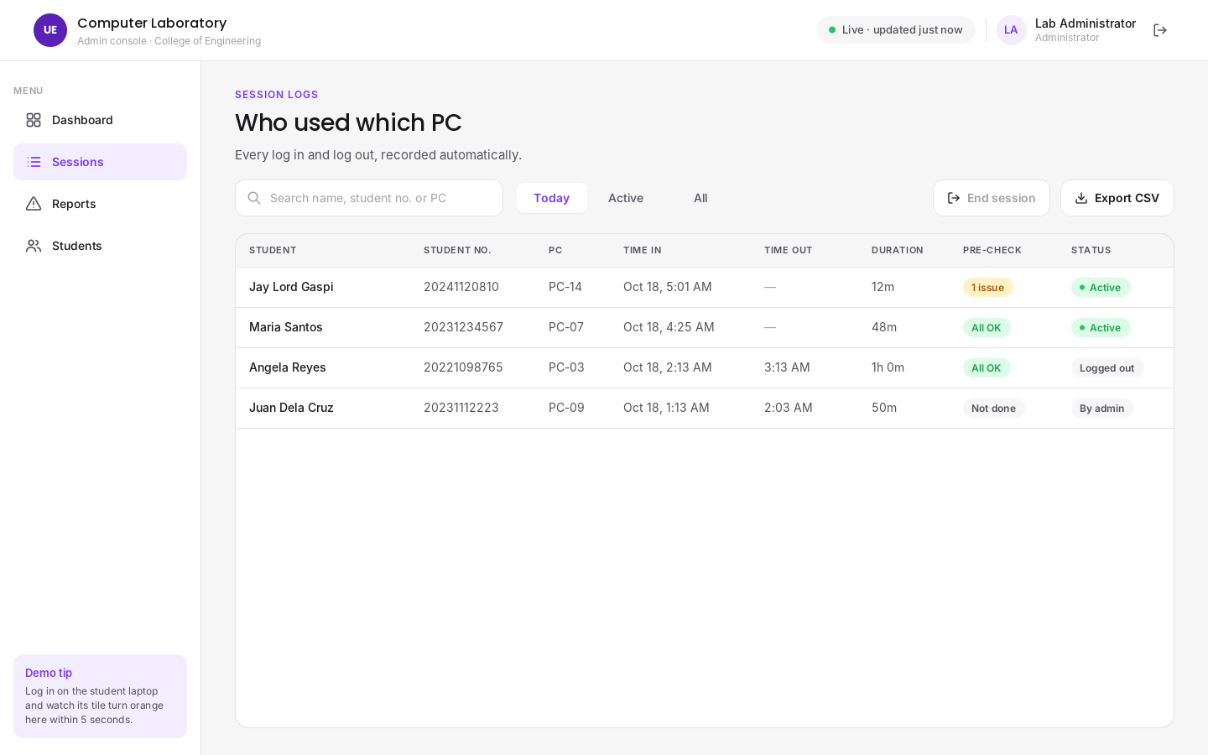
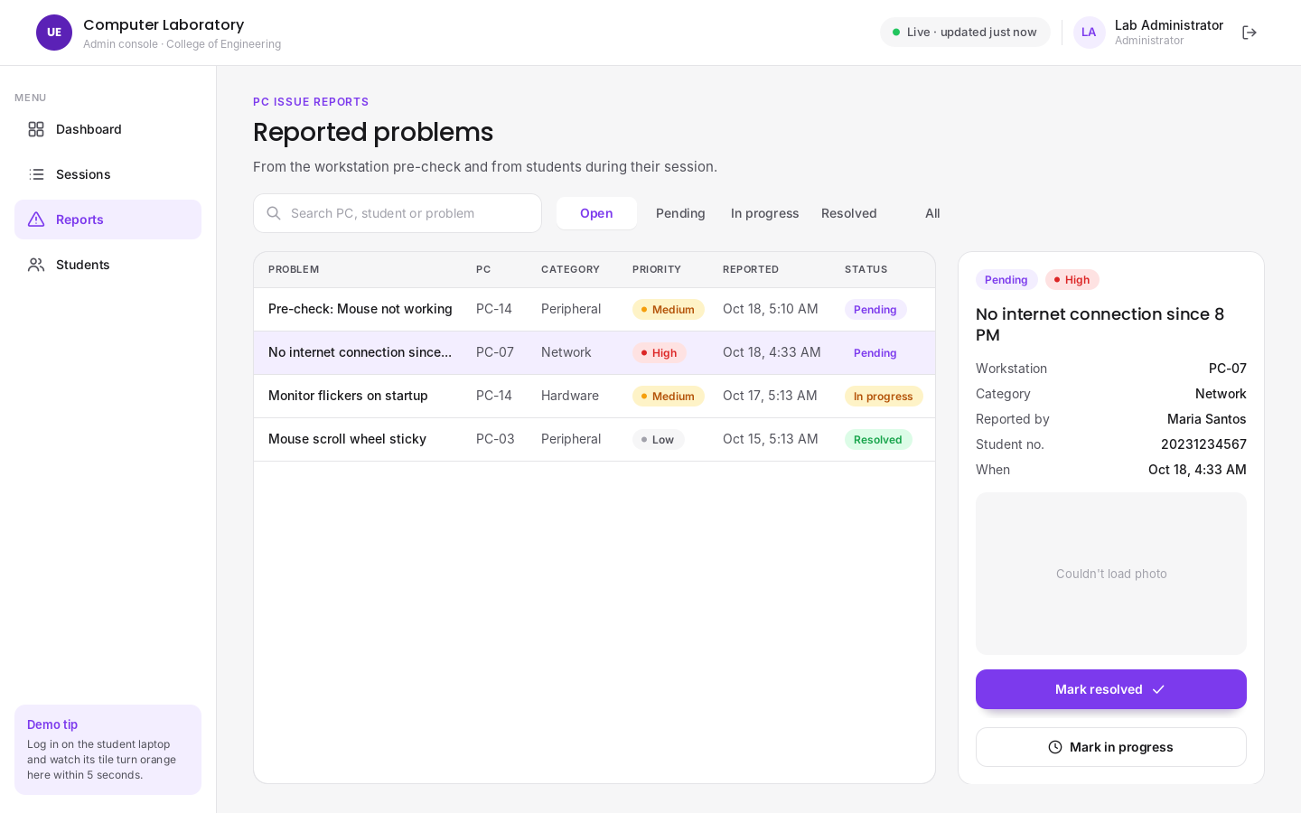
Session logs and reports
UI/UX · MAIN FEATURES
Session Logs
Reports
Who used which PC, time in, time out, duration and pre-check result. Filter, end a session, export to CSV.
Every reported problem with priority and status. Open one to see details and the photo, then mark it In progress or Resolved.
Notes:
These two pages replace the paper logbook and the verbal problem reports.

Slide 20


How the kiosk keeps the PC locked
SECURITY
Handled in Java
Handled by Windows settings
Fullscreen, no title bar, always on top
Alt+F4 and close requests ignored
Window pulls itself back on Alt+Tab
Restarts automatically if it is closed
Passwords stored as SHA-256 hashes
Secret admin exit (Ctrl+Shift+F12 + password)
Ctrl+Alt+Del can't be blocked by any app
kiosk-lockdown.reg removes Task Manager, Lock and Sign out from that screen
Kiosk is added to the Windows Startup folder
Auto sign-in so the kiosk appears right after boot
Notes:
This answers the professor's condition: students can't use the PC or close the login without logging in. Be honest that Ctrl+Alt+Del is reserved by Windows, and show how the registry settings cover it.

Slide 21






Future enhancements
NEXT STEPS
Idle auto-logout
Usage reports
Log out students who walk away without logging out.
Charts of busiest hours, most-used PCs and repair history.
Broadcast messages
Out-of-service PCs
“Lab closes in 10 minutes” on every student PC.
Block logins on a PC with a serious problem.
Lab reservations
ID card sign-in
Reserve the lab or specific PCs for a class schedule.
Scan the student ID (QR / barcode) instead of typing.
Notes:
Ideas we can add after the final project. Idle auto-logout and usage reports are the most useful for the lab.

Slide 22
Thank you
Questions? We'll now demo the system on two laptops: the student kiosk and the admin console.
Dela Cruz, Justin · Gaspi, Jay Lord F. · Timbol, Alexandria T.
Notes:
Open the floor for questions, then start the live demo.

