Slide 1
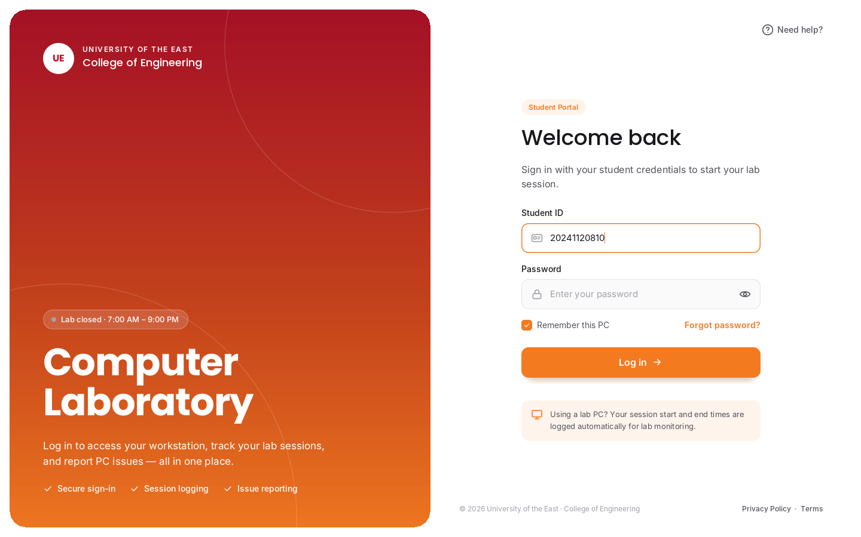
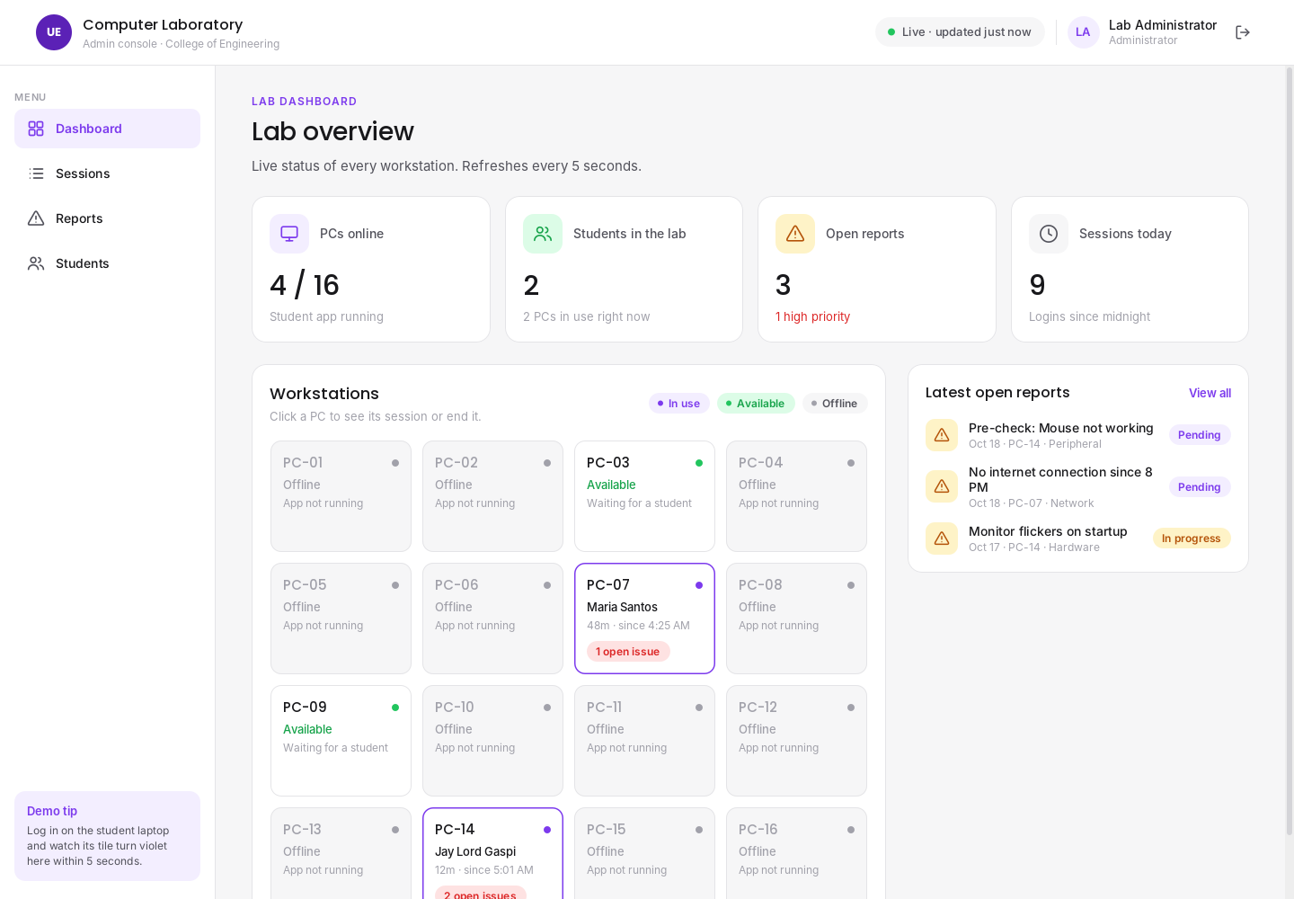
UE CompLab Monitoring System
PROJECT PROPOSAL · JAVA FINAL PROJECT
A proposed Java system that will replace the computer laboratory's paper logbook and let students report PC problems directly to the lab admin.
PROPONENTS
Dela Cruz, Justin
Gaspi, Jay Lord F.
Timbol, Alexandria T.
Notes:
Good day. We are proposing the UE CompLab Monitoring System, a Java system for monitoring our computer laboratory.

Slide 2
Project team and roles
PROPONENTS
JD
JG
AT
Dela Cruz, Justin
Gaspi, Jay Lord F.
Timbol, Alexandria T.
Project Manager
UI/UX Designer
UI/UX Designer
Developer
Developer
Documentation
Notes:
Justin will lead the project and develop the system. Jay Lord will design the UI/UX and develop. Alexandria will design the UI/UX and handle documentation.

Slide 3



The lab still runs on a paper logbook
BACKGROUND OF THE STUDY
Manual, paper-based logging
PROBLEM STATEMENT
Students write their name and time on paper. Entries are missed, unreadable, or written for someone else.
How can the lab record PC usage and equipment problems automatically, and give the lab admin a live view of every workstation?
Broken PCs go unreported
A dead mouse or missing keyboard is noticed by the next student, not by the lab assistant who can fix it.
No real-time view of the lab
The lab assistant can't see which PCs are in use, who is using them, or for how long.
Notes:
These are the problems we observed in our computer laboratory, and the question our project will answer.

Slide 4

What the project aims to achieve
OBJECTIVES
Specific objectives
1
Require every student to log in before using a lab PC through a locked, fullscreen login screen.
General objective
2
Automatically record each session's student, workstation, time in and time out in a database.
To develop a Java-based computer laboratory monitoring system that automatically records PC usage and lets students report equipment problems to the lab admin in real time.
3
Let students check their PC's equipment and report problems with category, priority and a photo.
4
Give the lab admin a live dashboard of PC status, active sessions and open reports.
5
Produce searchable, exportable session logs that replace the paper logbook.
Notes:
The general objective is the overall goal. The specific objectives are what the finished system must be able to do; we will use them to check if the project is successful.

Slide 5




Lock every PC, watch the whole lab live
CONCEPT DESCRIPTION
The proposed UE CompLab Monitoring System is a Java desktop system with two applications that share one MySQL database. The Student Kiosk will open in fullscreen as soon as Windows starts, so a PC cannot be used until a student logs in. Every login and logout will be saved automatically, and students will check their PC's equipment before starting. The Admin Console will show the whole lab live: which PCs are in use, by whom, and which problems need fixing.
1 Log in
2 Check the PC
3 Use the PC
4 Log out
A fullscreen login appears after Windows boots. Time in is saved.
Students tick Monitor, Keyboard, Mouse. Problems become reports.
The screen unlocks. A small session bar shows the timer and Report issue.
Time out is saved and the PC locks again for the next student.
Notes:
This is how a student will use the system, in four steps.

Slide 6

Two laptops, one database
PROPOSED ARCHITECTURE
Student laptop
Admin laptop
Represents a lab PC
Lab assistant's computer
Same Wi-Fi / phone hotspot
JDBC · TCP port 3306
Student Kiosk app (Java Swing)
Starts automatically with Windows
Locked fullscreen login
Workstation check + issue reports
Sends a heartbeat every 10 s
Admin Console app (Java Swing)
MySQL database (XAMPP)
Live dashboard, refresh every 5 s
Session logs, reports, accounts
Can end a session remotely
For the proposal and demo we will use two laptops: one acts as a lab PC, the other as the lab admin's computer and database server. In a real lab, every PC would run the Student Kiosk and connect to the same server.
Notes:
Explain that the database lives on the admin laptop and the kiosk connects to it over the same network.

Slide 7






What the system will do
PROPOSED FEATURES
Kiosk lock screen
Automatic time in / out
Workstation check
Issue reporting
Fullscreen login right after Windows boots; the PC can't be used without logging in.
Every session saved with the student, PC, time in, time out and duration.
Students confirm the Monitor, Keyboard and Mouse work before using the PC.
Category, priority, description and a photo, anytime during the session.
Lab hours & idle
Live PC map
Report tracking
Logs & accounts
'Lab Closed' screen outside 7 AM–9 PM; idle PCs shut down after 10 minutes.
The admin sees every PC as In use, Available or Offline, updated every 5 seconds.
The admin marks reports In progress or Resolved.
Searchable session logs exported to CSV; add students and reset passwords.
Notes:
Orange features are on the student side, violet features are on the admin side.

Slide 8


What the project covers and doesn't
SCOPE AND LIMITATIONS
Scope
Limitations
One computer laboratory of the College of Engineering
Student login, automatic time in / time out
Workstation check and issue reporting with photo
Live admin dashboard, session logs, report tracking
Student account management by the admin
Runs on Windows PCs on the same local network
Windows only; no web or mobile version
PCs must be on the same network as the database
Ctrl+Alt+Del can't be blocked by any app; covered by Windows settings
Does not track websites or apps students use on the PC
No integration with the university's student portal
Demo uses two laptops instead of a full lab
Notes:
Being clear about scope prevents scope creep. Note that the system will not spy on students' activity; it only records sessions and reported problems.

Slide 9




Who will benefit
SIGNIFICANCE OF THE STUDY
Students
Lab assistants & admins
Working PCs, faster help when something breaks, and no more paper logbook.
A live view of the lab, problems reported right away, and logs without paperwork.
College of Engineering
Future researchers
Accurate usage records for planning, accountability and equipment budgets.
A base system that can be extended with reservations, analytics or ID-card login.
Notes:
These are the groups who will benefit if the system is approved and built.

Slide 10
Software requirements
REQUIREMENTS
Component | Software / version | Used on
Operating system | Windows 10 or 11 (64-bit) | Both laptops
Programming language | Java — JDK 17 or newer | Both apps
User interface | Java Swing | Kiosk + console
IDE | IntelliJ IDEA | Development
Database | MySQL / MariaDB via XAMPP | Admin laptop
Database driver | MySQL Connector/J (JDBC) | Both apps
Build tool | Apache Maven | Development
Design & diagrams | Figma, draw.io, PlantUML, Canva | Documentation
Notes:
All the software we will use is free.

Slide 11

Hardware requirements
REQUIREMENTS
Student laptop / lab PC
Admin laptop (server)
Network
Dual-core CPU, 4 GB RAM
1366×768 display or higher
Keyboard and mouse
Wi-Fi or Ethernet
Windows 10/11
Quad-core CPU, 8 GB RAM recommended
Runs MySQL + Admin Console
10 GB free storage for data/photos
Wi-Fi or Ethernet
Windows 10/11
Phone hotspot or Wi-Fi router
Both laptops on the same network
Port 3306 open on the admin laptop
Optional: LAN cable between laptops
Notes:
Two laptops are enough to show the system working.

Slide 12

Who will use the system
USER ROLES
Student
Lab Admin / Lab Assistant
Uses a lab PC
Manages the lab
Logs in with Student ID and password
Checks Monitor, Keyboard and Mouse
Reports problems (with photo)
Sees recent reports on their PC
Logs out when done
Monitors all PCs live
Views and exports session logs
Marks reports In progress / Resolved
Ends a student's session remotely
Adds students, resets passwords
Notes:
There will be two user roles. Our team roles are on slide 2.

Slide 13
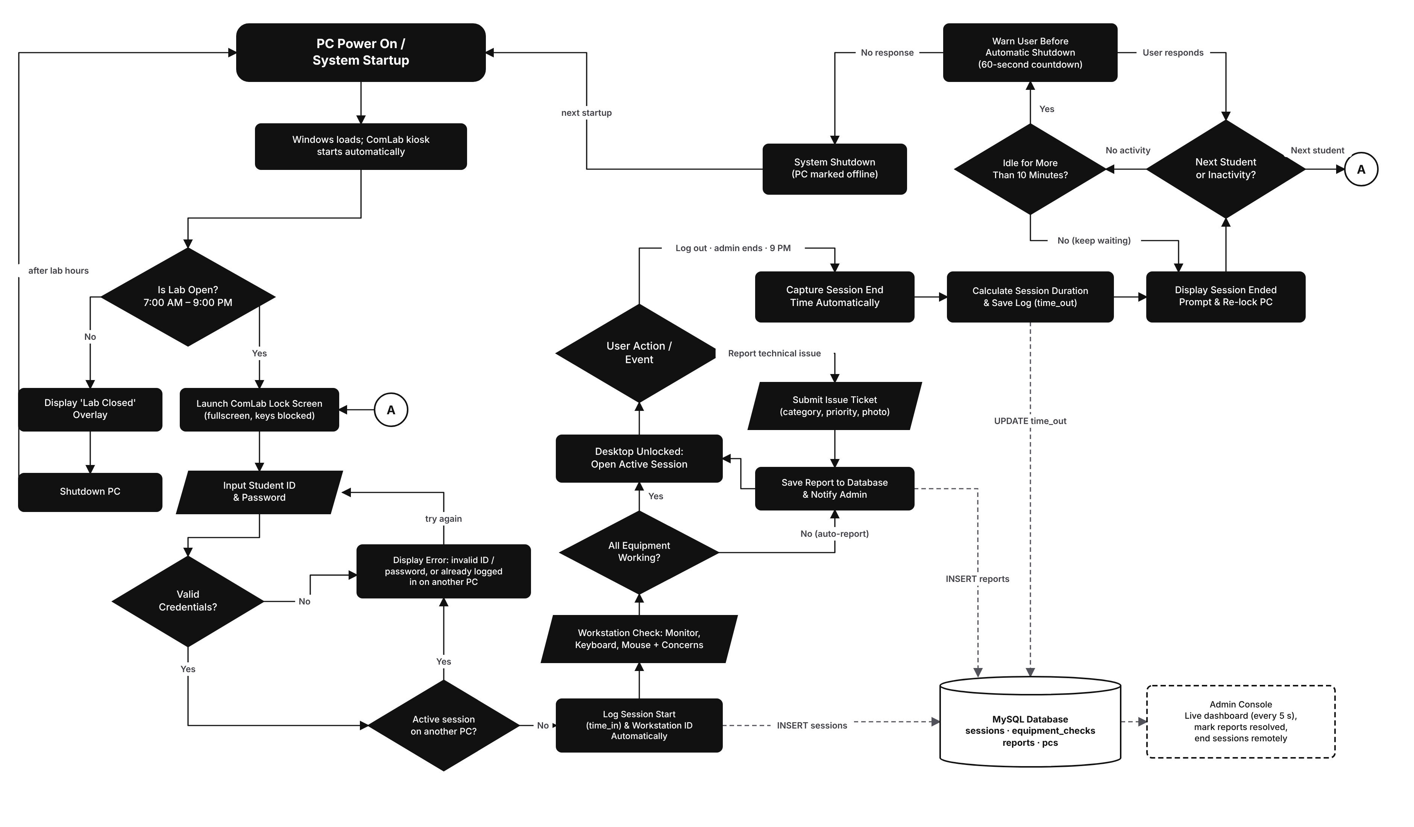
From power on to shutdown
SYSTEM FLOWCHART · DRAW.IO
1 Start-up
PC powers on and the kiosk starts. Outside 7 AM–9 PM a Lab Closed overlay shows and the PC shuts down.
2 Log in
ID and password are checked; a student can't be logged in on two PCs. Time in is saved.
3 Check & use
Workstation check, then the desktop unlocks. Issues can be reported anytime.
4 End
Log out, admin, or 9 PM ends the session and saves time out. Next student, or shut down after 10 idle minutes.
Notes:
Start top-left at PC Power On and follow the arrows. Dashed lines show what will be saved to the database that the admin console reads.

Slide 14
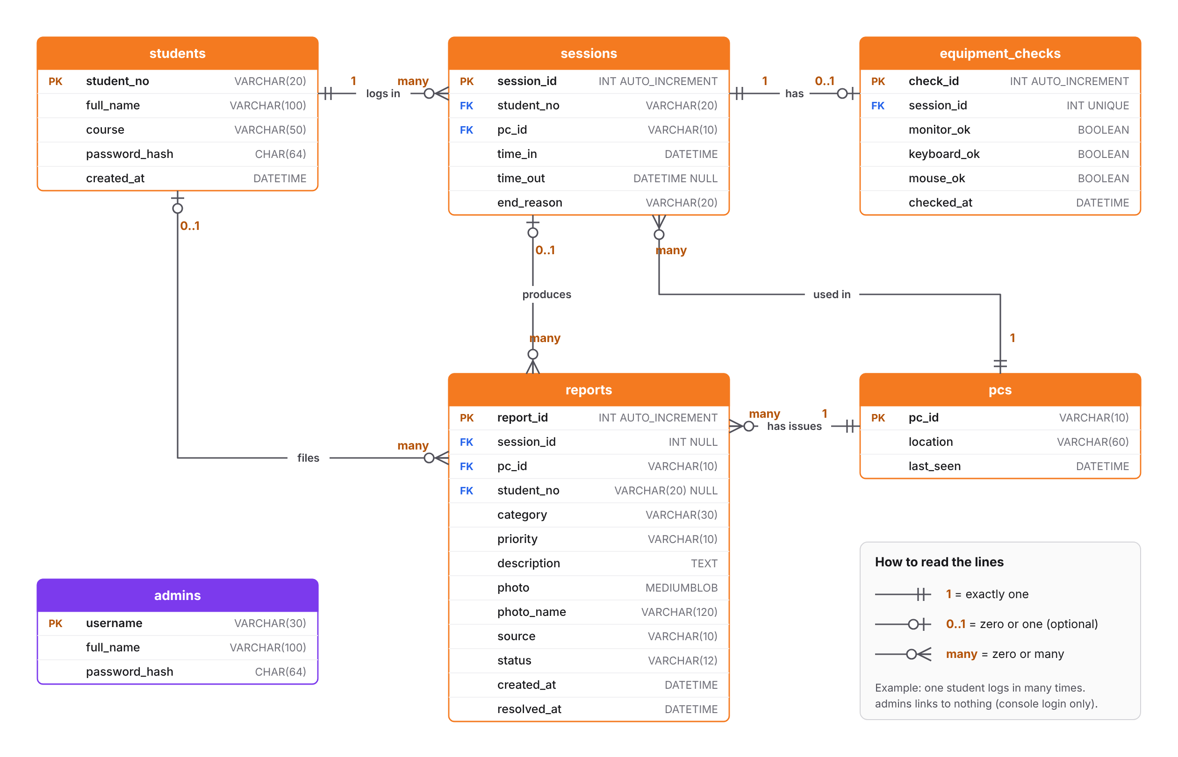
Proposed database: six tables
ENTITY RELATIONSHIP DIAGRAM · DRAW.IO
students → sessions
One student has many sessions
pcs → sessions
One PC is used in many sessions
sessions → equipment_checks
Each session has at most one check
sessions / pcs / students → reports
Reports point to the PC, and to the session and student when known
admins
Stand-alone; used only for the console login
Notes:
Primary keys are marked PK and foreign keys FK. Passwords will be stored as SHA-256 hashes, never as plain text.

Slide 15
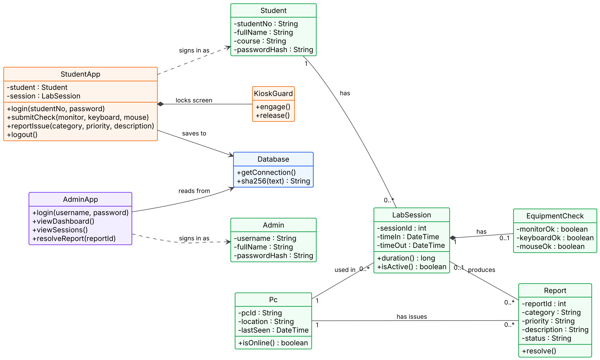
The building blocks of the code
CLASS DIAGRAM · PLANTUML
Box = one class
Top: class name. Middle: data it keeps (–). Bottom: what it can do (+).
Orange · violet
The two apps: Student kiosk and Admin console.
Blue
Database: the only class that talks to MySQL.
Green
Data classes. They match the tables in the ERD.
Lines
◆ = owns (part of) → = uses - - → = depends on 1 / 0..* = how many
Notes:
A class diagram shows the parts of the program, not the steps. Each box is a Java class: its name, the data it keeps, and what it can do. StudentApp runs on the lab PCs and owns KioskGuard, which locks the screen. AdminApp runs on the admin laptop. Both use Database to reach MySQL. The green classes hold data and mirror the ERD tables: one Student has many LabSessions, one Pc is used in many LabSessions, each LabSession has at most one EquipmentCheck, and Reports belong to a Pc.

Slide 16
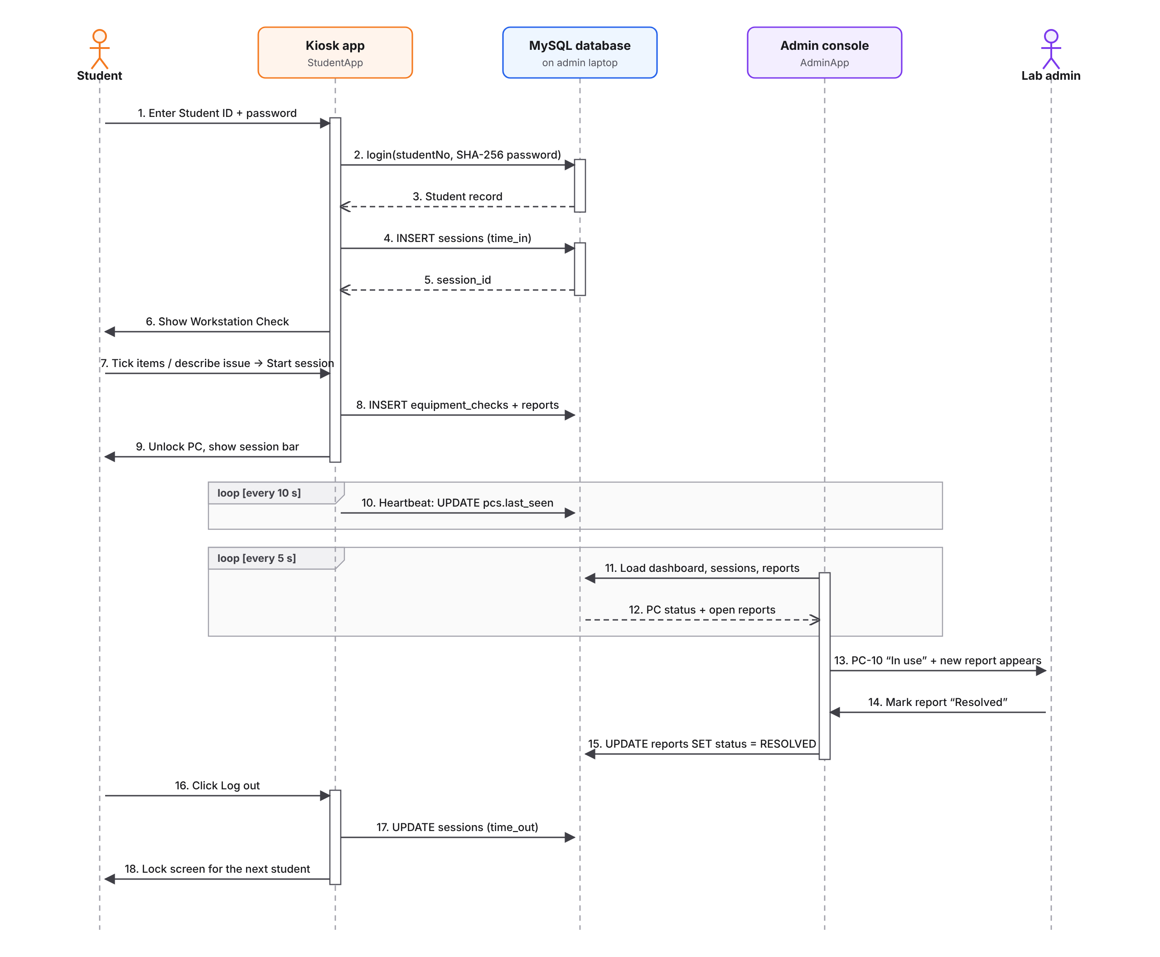
One lab session, message by message
SEQUENCE DIAGRAM · DRAW.IO
1–5
Login is checked against the database and a session row is created (time in).
6–9
The workstation check is saved and the PC unlocks.
10–12
Kiosk heartbeat every 10 s; the console reloads every 5 s.
13–15
The admin sees the PC in use and resolves the report.
16–18
Log out saves time out and locks the screen.
Notes:
Solid arrows are requests, dashed arrows are replies, and the 'loop' boxes repeat on a timer.

Slide 17
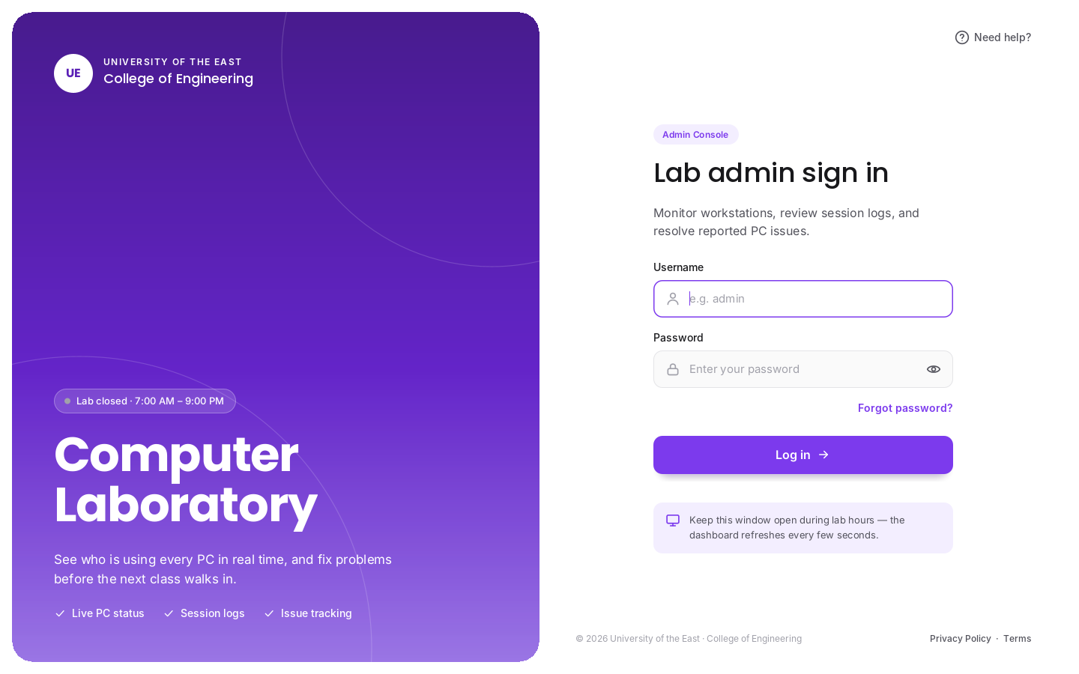
Login screens
UI/UX DESIGN · FIGMA · LOGIN
Student kiosk login
Admin console login
Fullscreen and locked; appears right after Windows loads. Student ID and password, with the lab hours shown.
Same layout in a violet theme so the admin side is never confused with the student kiosk.
Notes:
Both apps share one design language: orange for students, violet for the admin.

Slide 18
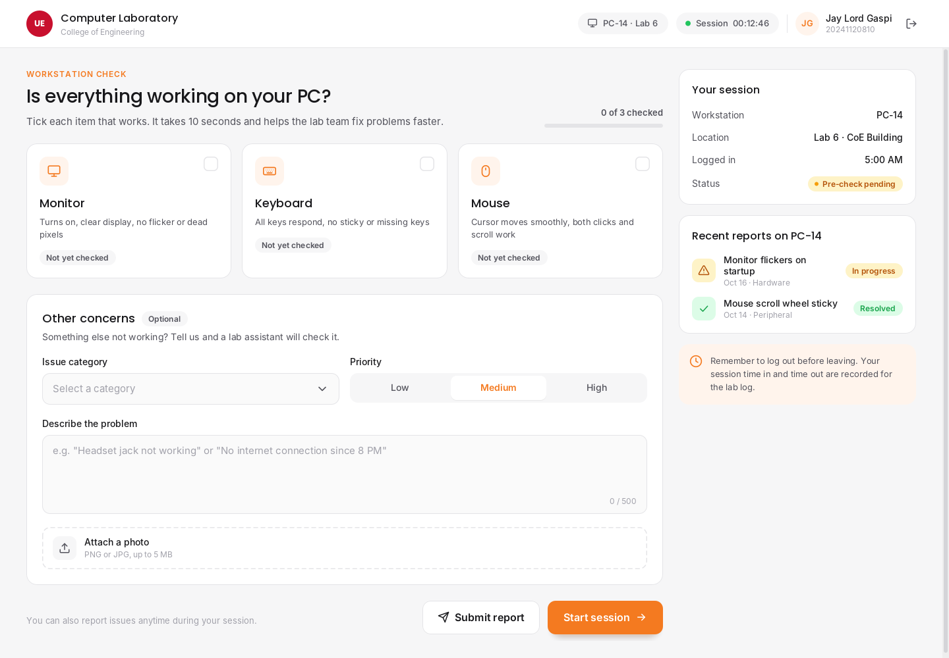
Workstation check
UI/UX DESIGN · FIGMA · MAIN FEATURE
Tick what works
Monitor, Keyboard, Mouse. Unticked items will be reported automatically.
Other concerns
Category, priority, description and an optional photo.
Your session
PC, location, time logged in and a live timer.
Recent reports
Known problems on this PC and their status.
Notes:
After logging in, students will confirm their equipment works before using the PC.

Slide 19
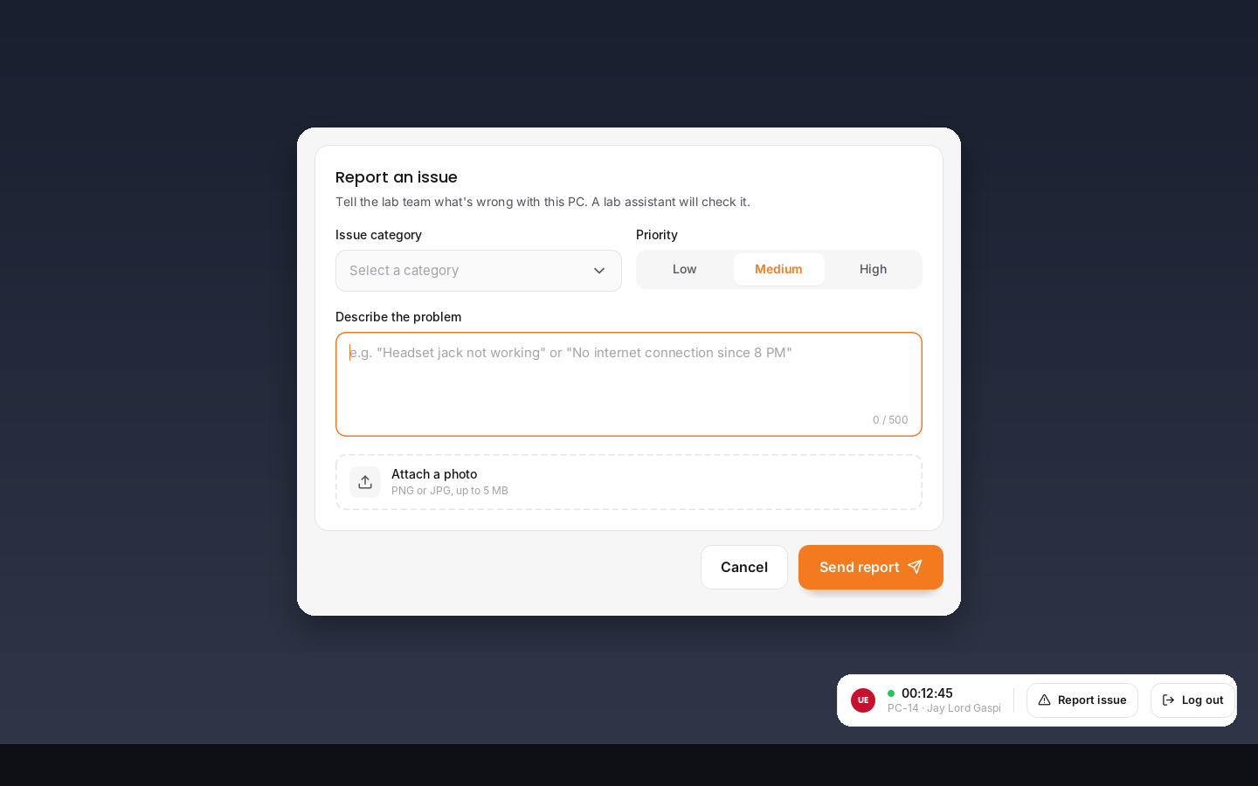
In session: session bar + report issue
UI/UX DESIGN · FIGMA · MAIN FEATURE
Session bar
Small, always on top, shows the session timer.
Report issue
Opens the report form anytime during the session.
Log out
Saves time out and locks the PC for the next student.
Stays out of the way
Can be dragged and never takes keyboard focus.
Notes:
While the student works, only this small bar will be visible.

Slide 20
Admin dashboard
UI/UX DESIGN · FIGMA · DASHBOARD
At-a-glance numbers
PCs online, students in the lab, open reports, sessions today.
Live PC map
Violet = in use, green = available, grey = offline.
Latest open reports
The newest problems that need attention.
Auto refresh
Updates every 5 seconds.
Notes:
The dashboard is the admin's main screen.

Slide 21
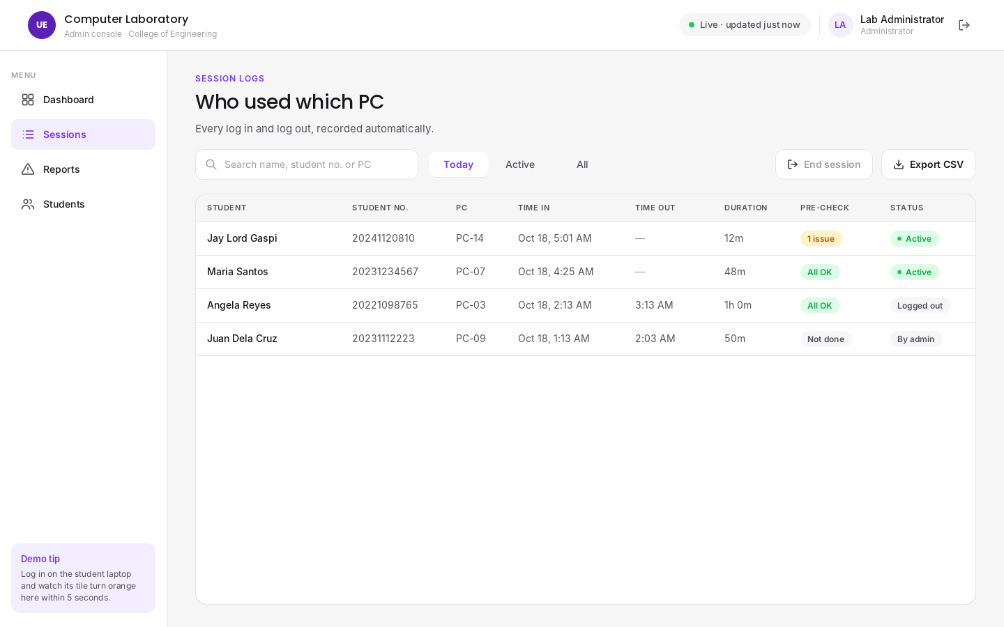
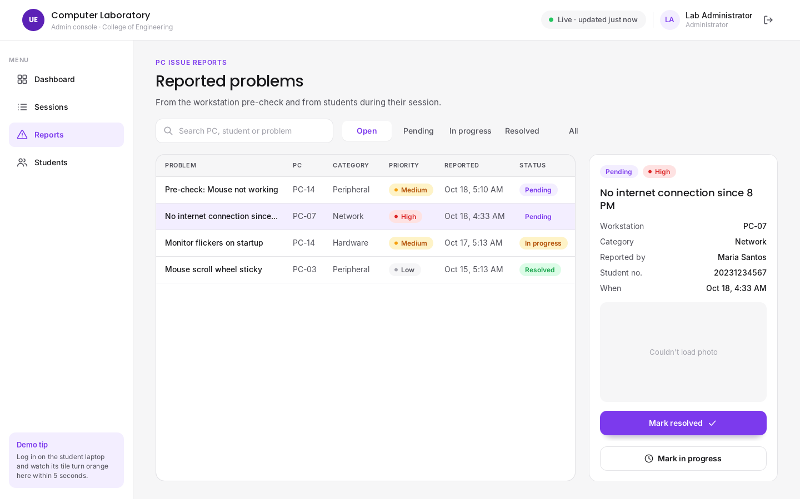
Session logs and reports
UI/UX DESIGN · FIGMA · MAIN FEATURES
Session Logs
Reports
Who used which PC, time in, time out, duration and pre-check result. Filter, end a session, export to CSV.
Every reported problem with priority and status. Open one to see details and the photo, then mark it In progress or Resolved.
Notes:
These two screens will replace the paper logbook and verbal problem reports.

Slide 22





Agile, built in short iterations
METHODOLOGY
Plan
Design
Develop
Test
Deploy
Gather requirements from the lab and define scope.
Flowchart, ERD, class and sequence diagrams; Figma UI.
Database, Student Kiosk, then Admin Console, feature by feature.
Test on two laptops over Wi-Fi; fix issues each iteration.
Install on the demo laptops and present.
After each iteration we test with the two laptops and show progress, so problems are found early instead of at the final presentation.
Notes:
We chose Agile because we can build and test the system in small parts and adjust after feedback.

Slide 23
Ten-week schedule
PROJECT TIMELINE
W1
W2
W3
W4
W5
W6
W7
W8
W9
W10
Planning & requirements
Justin
System design (diagrams)
All
UI/UX design in Figma
Jay Lord, Alexandria
Database setup (MySQL)
Justin
Student Kiosk development
Justin, Jay Lord
Admin Console development
Justin, Jay Lord
Testing on two laptops
All
Documentation & manual
Alexandria
Final presentation & demo
All
Week numbers count from proposal approval. Adjust them to your class calendar.
Notes:
This is our planned schedule. Testing and documentation overlap with the last week of development.

Slide 24
Thank you
We welcome your questions and suggestions for the proposed system.
Dela Cruz, Justin · Gaspi, Jay Lord F. · Timbol, Alexandria T.
Notes:
Thank the panel and open the floor for questions and suggestions.

