Slide 1
Simulation

Slide 2



Chapman
CNN core execute
Load input data

Slide 3

FSM / Pool

Slide 4
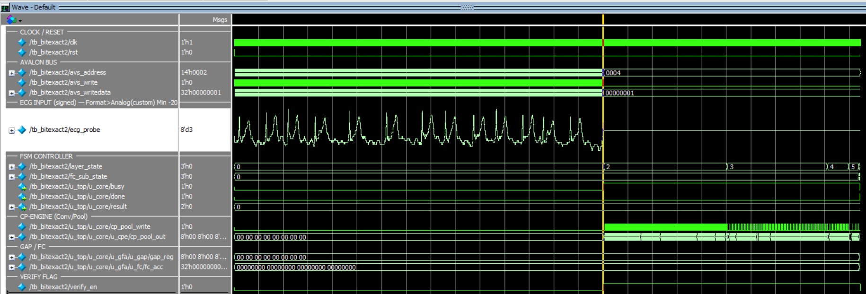

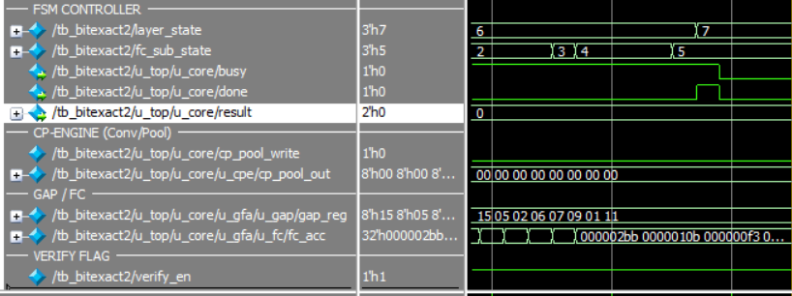
Georgia
CNN core execute
Load input data

Slide 5
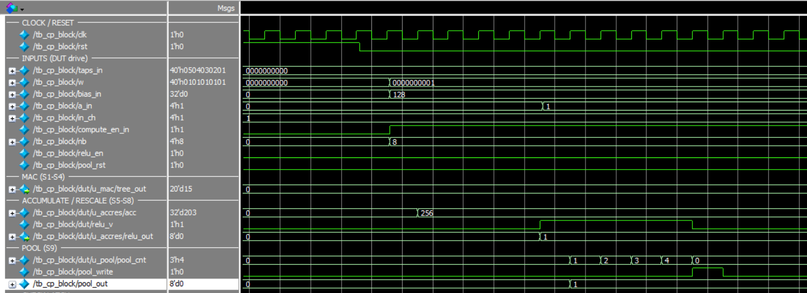
Cp_block

Slide 6
Cp_block

Slide 7
