Slide 1
Python Model CNN

Slide 2
Conv1
Input
2500 x 1
2500 x 4
K=5, P=2
2500 x 4
K=5, P=2

Slide 3

Input
Conv1
x4
MaxPool1
Raw
x1
x4
Lead II – 500Hz ~ 10s
Downsample
500 x 4
Stride=5
2500 x 4
K=5, P=2
2500 x 1

Slide 4
Input
Conv2
x4
MaxPool2
x1
x4
100 x 4
Stride=5
500 x 4
K=5, P=2
2500 x 1

Slide 5
Input
Conv3
x8
MaxPool3
x1
x8
20 x 8
Stride=5
100 x 8
K=5, P=2
2500 x 1

Slide 6
Conv4 + ReLU
GAP
x16
x1
Fully-Connected
Fully-Connected
x1
x1
MaxPool4
Output
x16
Output
4 x 16
Stride=5
20 x 16
K=5, P=2
16 x 1

Slide 7
Conv4 + ReLU
x8
Fully-Connected
Fully-Connected
GAP
x1
x1
MaxPool4
x1
Output
x8
Output
4 x 8
Stride=5
8 x 1
20 x 8
K=5, P=2

Slide 8
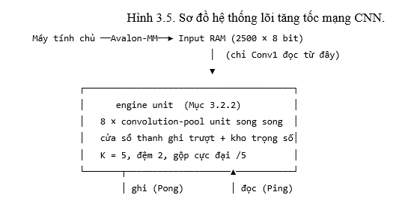
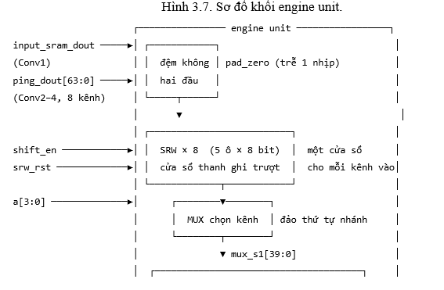
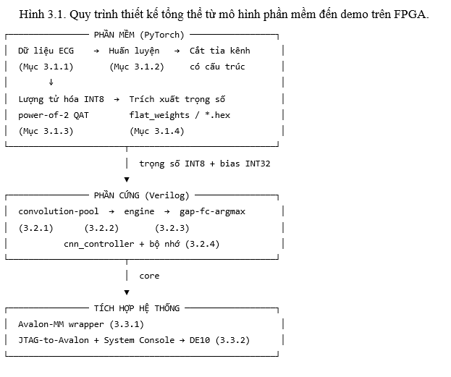
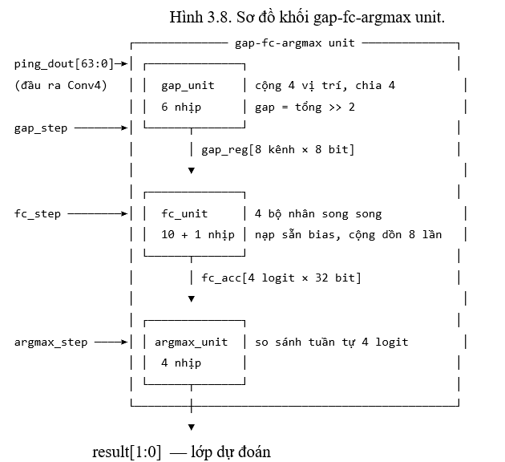
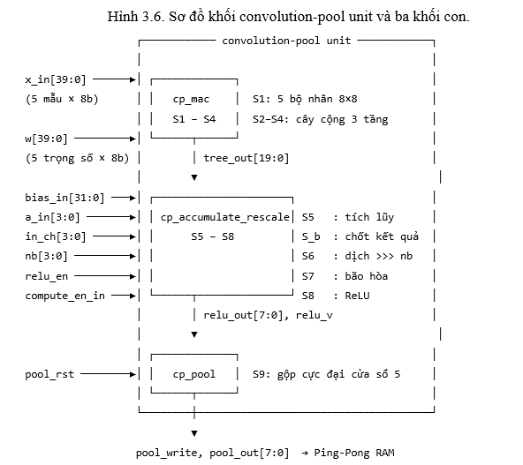
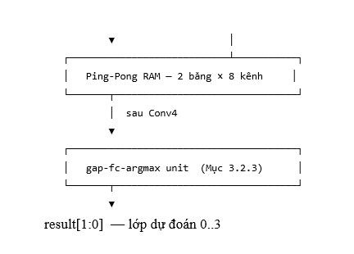
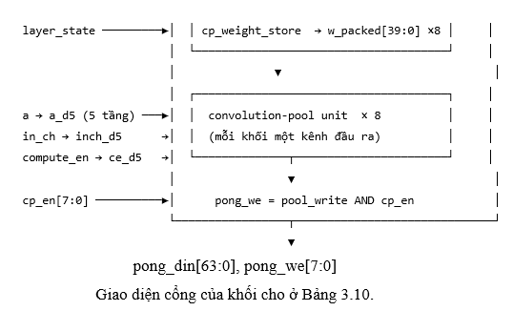

Slide 9
Conv4 + ReLU
Flatten
GAP
x16
x1
x1
MaxPool4
x16
4 x 16
Stride=5
20 x 16
K=5, P=2
64 x 1
16 x 1

Slide 10
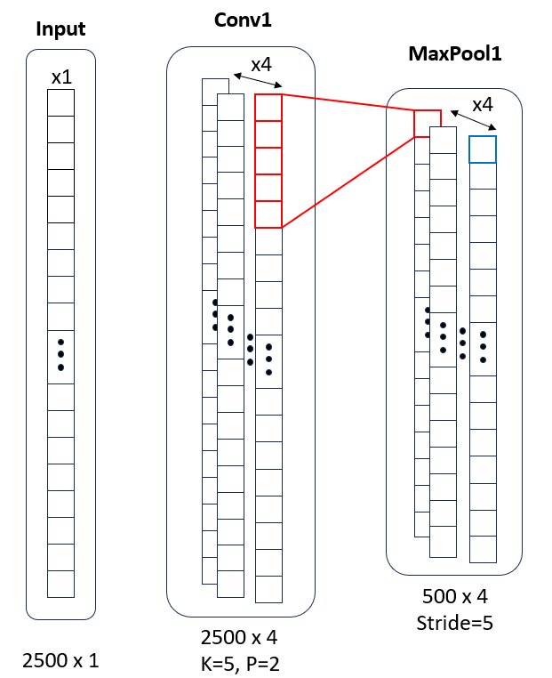
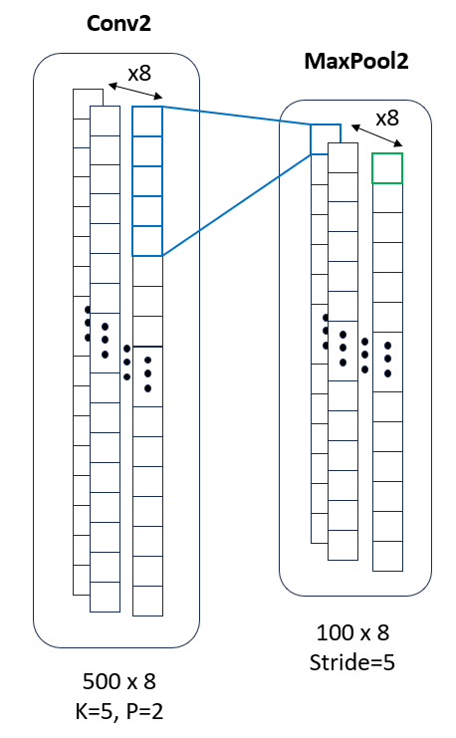
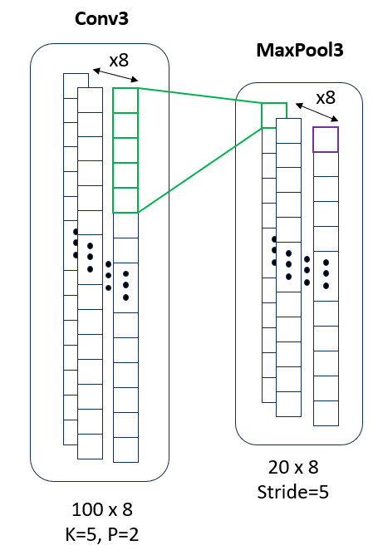
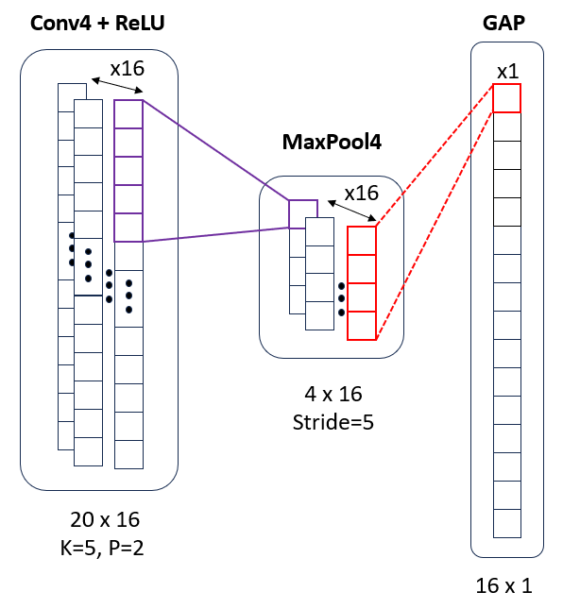

Slide 11
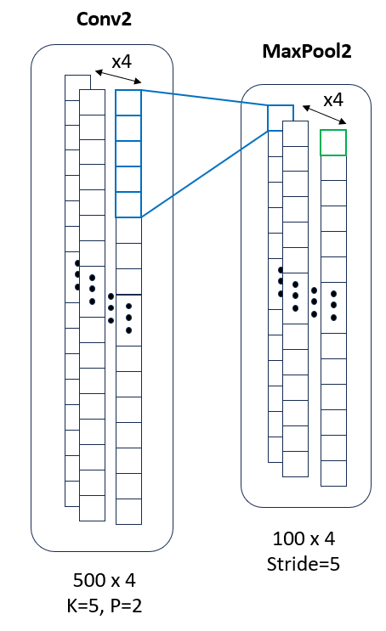
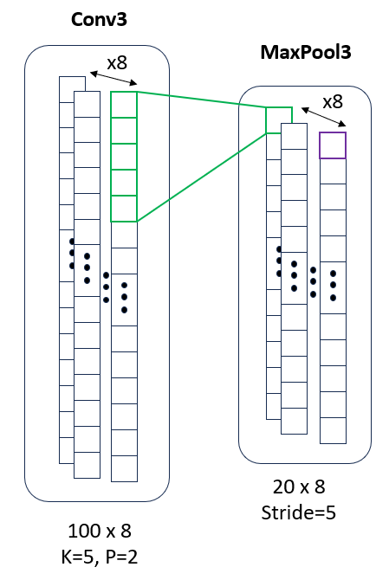
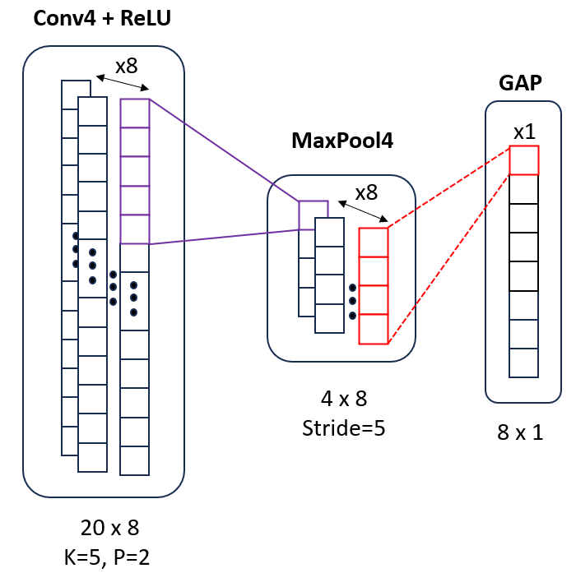

Slide 12
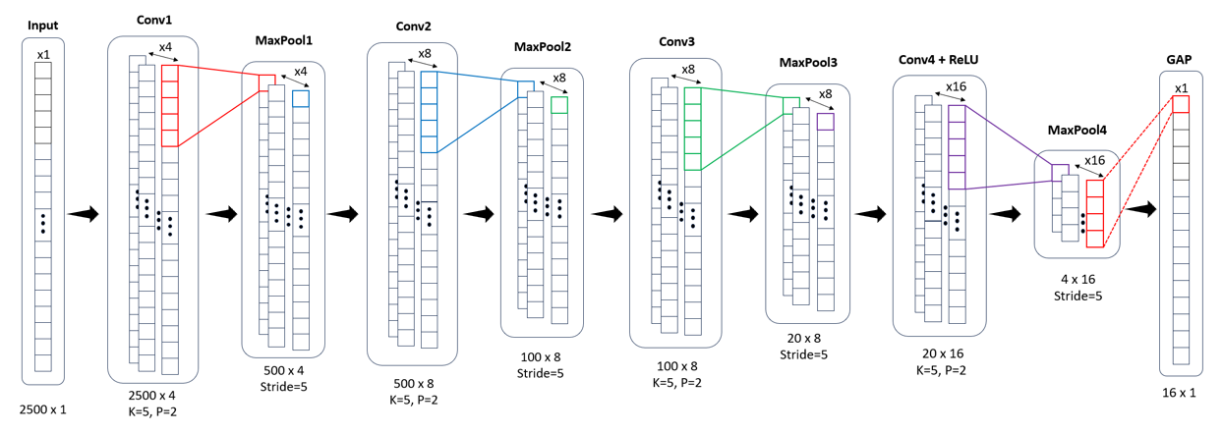
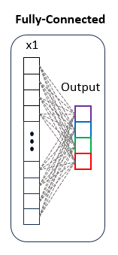

Slide 13
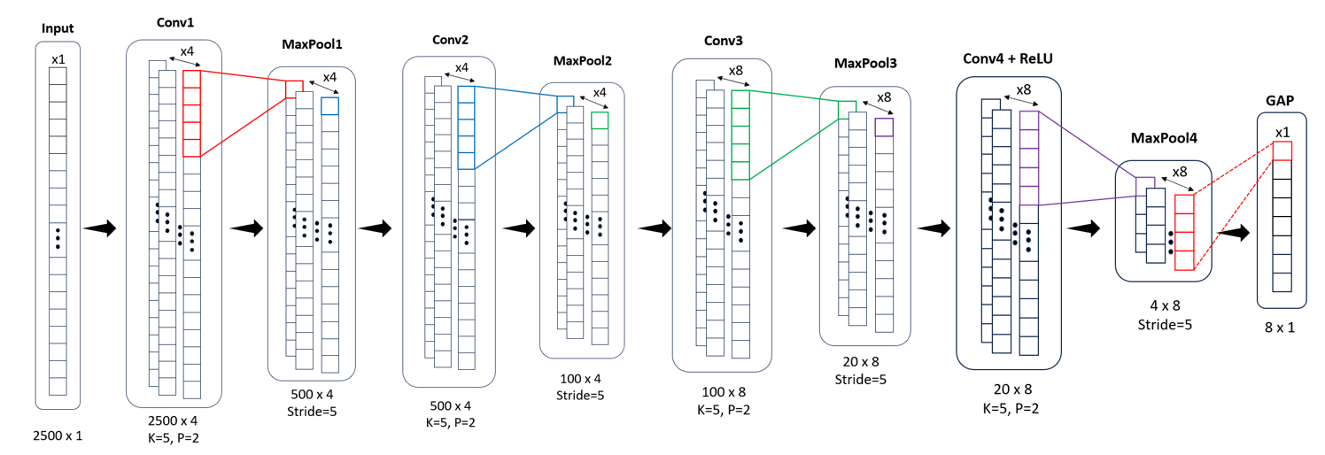
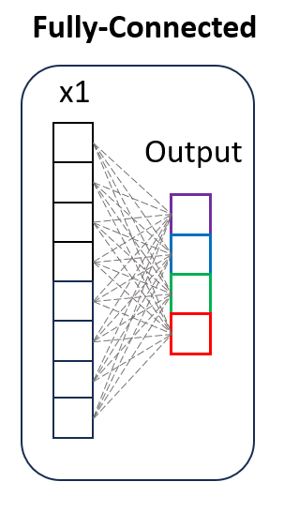

Slide 14
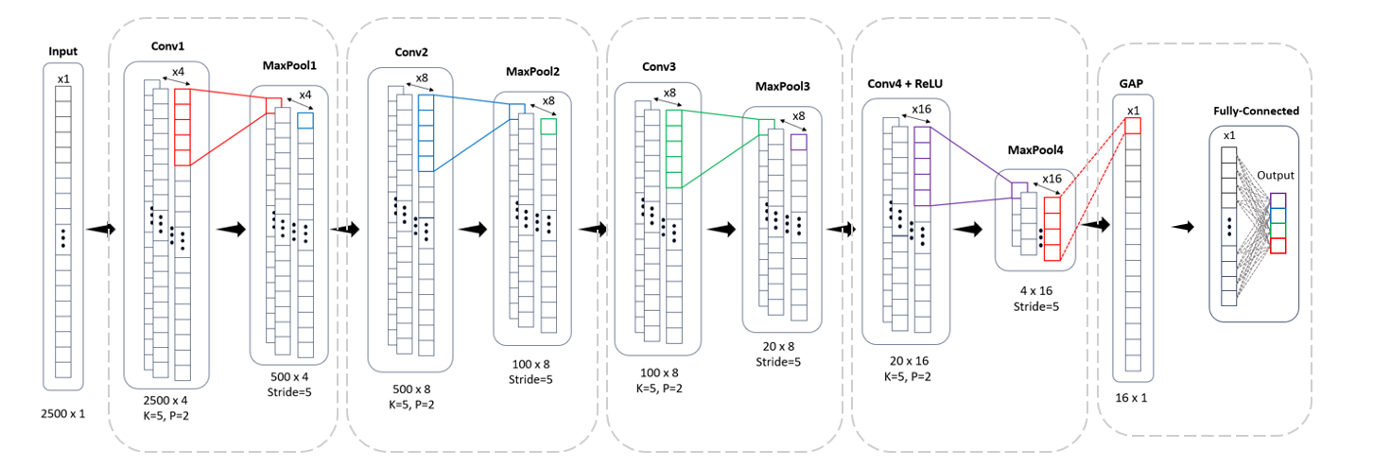
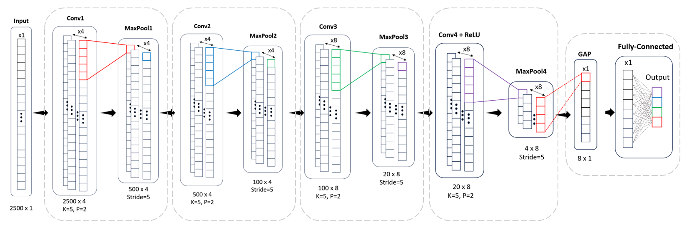

Slide 15
Hardware Architecture CNN

Slide 16
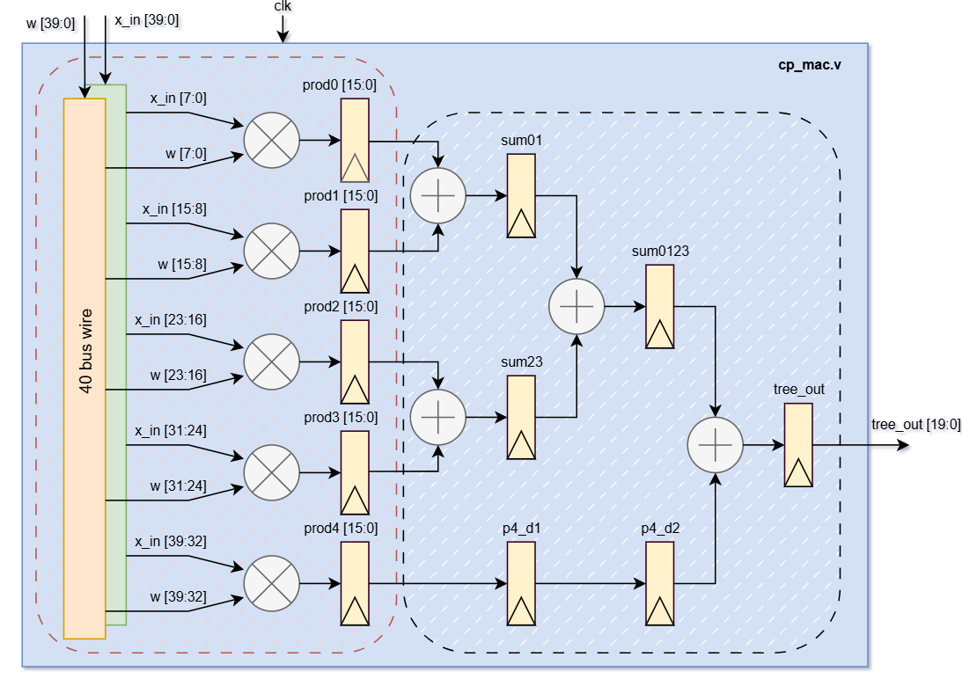
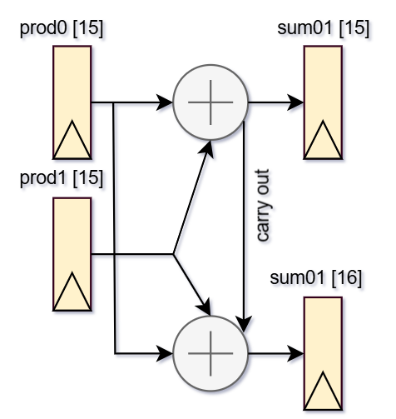

Slide 17
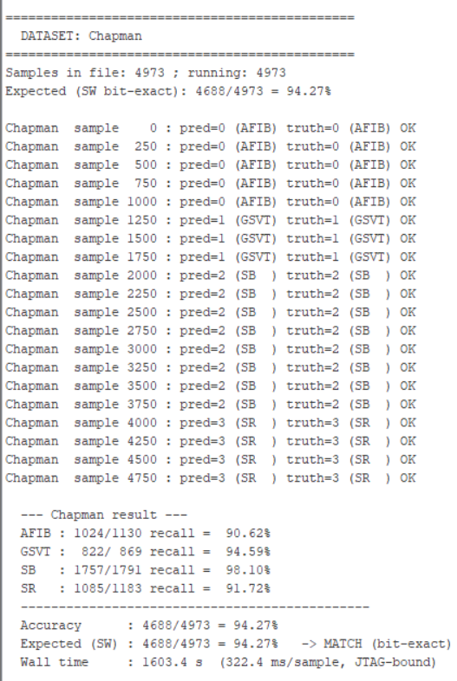
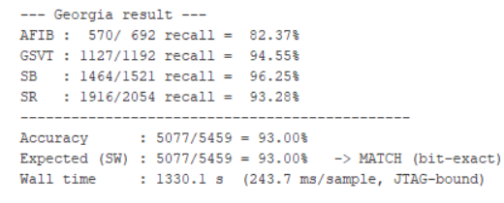
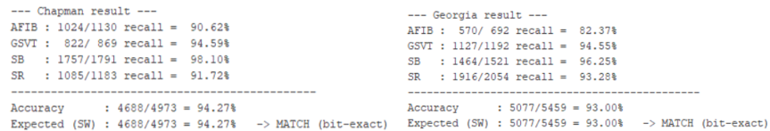

Slide 18
Tầng | Kênh vào | Kênh ra | Nhân chập | Đệm | Gộp | ReLU | Kích thước vào | Kích thước | Tham số
Conv1 | 1 | 4 | 5 | 2 | /5 | Không | 1 × 2500 | 4 × 500 | 24
Conv2 | 4 | 4 | 5 | 2 | /5 | Không | 4 × 500 | 4 × 100 | 84
Conv3 | 4 | 8 | 5 | 2 | /5 | Không | 4 × 100 | 8 × 20 | 168
Conv4 | 8 | 8 | 5 | 2 | /5 | Có | 8 × 20 | 8 × 4 | 328
GAP | 8 | 8 | — | — | /4 | — | 8 × 4 | 8 × 1 | 0
FC | 8 | 4 | — | — | — | — | 8 | 4 | 36
Tổng |  |  |  |  |  |  |  |  | 640

Slide 19
ECG data 12 lead, 500Hz
Preprocessing
Training
Down sample 500Hz -> 250Hz
Z-score normalization
1244 parameters
Export weight
Quantization
Structure Pruning
Conv weight. hex
Bias. hex
Power-of-2 QAT
Round-half-up
640 parameters
ROM

