Slide 1
DSU Connect
Austin Krieger, matthew dobbs, ryan butzke, carter flanery

Slide 2
Planning
Development Methodology: SCRUM
Proposed System: DSU Connect
Business Need: DSU lacks a way for its less social students to interact with others and make new friends around campus.
Functionality: Custom Profiles, Schedule Events, Instant Messaging, Making Friends
Intangible Value: We aim to make the campus more connected and social.
Notes:
We Chose the SCRUM development methodology, because it allows its members to self-manage.
Our proposed system is primarily a dating site for DSU called DSU Connect, but it has many uses. The shy and asocial students of DSU can connect with others and make new friends easier than they could in person, and students that are Resident Advisors can easily schedule an event on campus, such as a movie night or pizza party, without having to spread the word through posters and bulletin boards. In the future we would also like to remove the need to have multiple Facebook groups per dorm, by adding a mass notification system for R.A.s around campus for notifying their residents of current events.

Slide 3
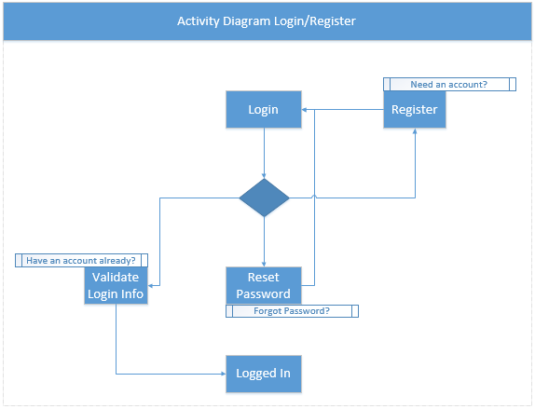
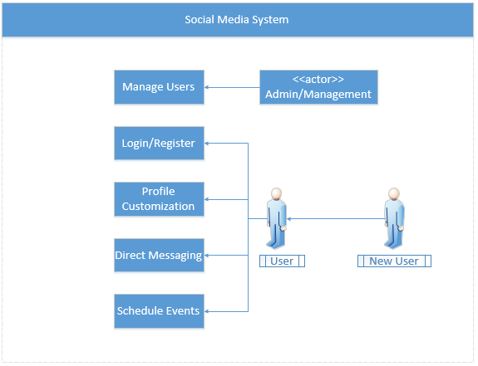
Analysis - diagrams

Slide 4
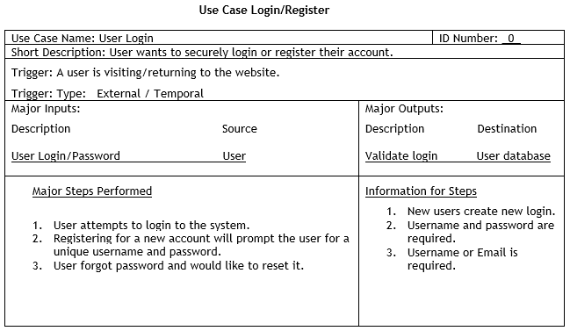
Analysis – use case description

Slide 5
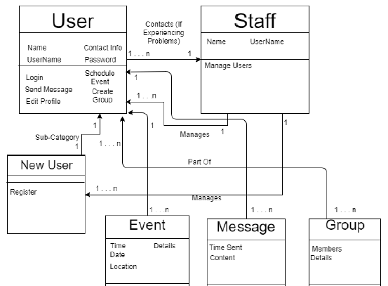
Analysis – class diagram

Slide 6
Analysis - functional
Functional requirements:
Match users
Like/Dislike photos
Notify a match has been made
Appealing user interface
Target age group: 18-28
Provide a means for students to be more social in their community

Slide 7
Analysis – non-functional
Non-Functional requirements
Operational
Mobile (IOS/Android) operating systems
Performance
Plenty of server space
Max logon time of 8 seconds
Security
No physical copy of matches list can be made
Photo approval system to filter explicit content

Slide 8
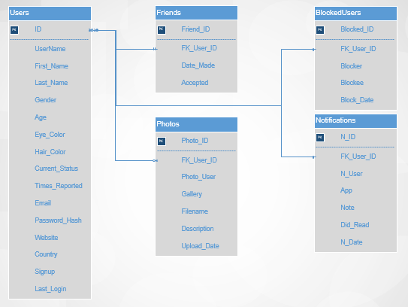
Design - Database

Slide 9
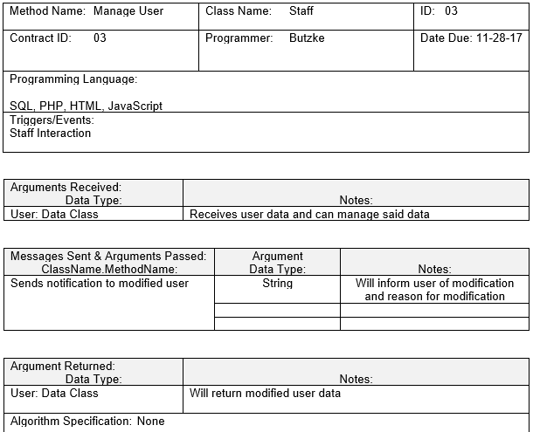
Design – method specification

Slide 10
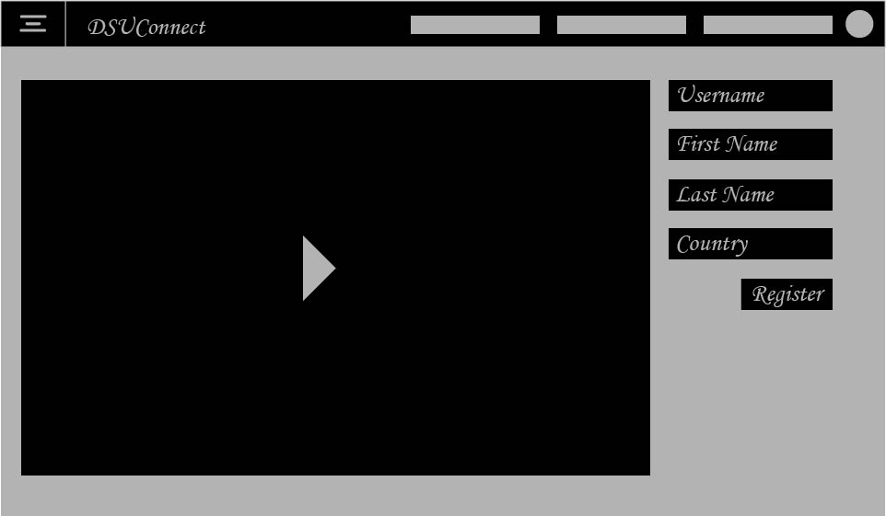
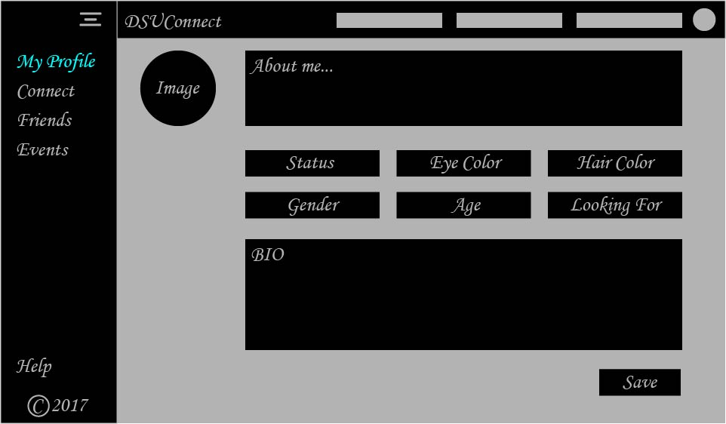
Design - UI
Notes:
We made 7 webpages in Illustrator, and here is the login page and personal profile page.

Slide 11
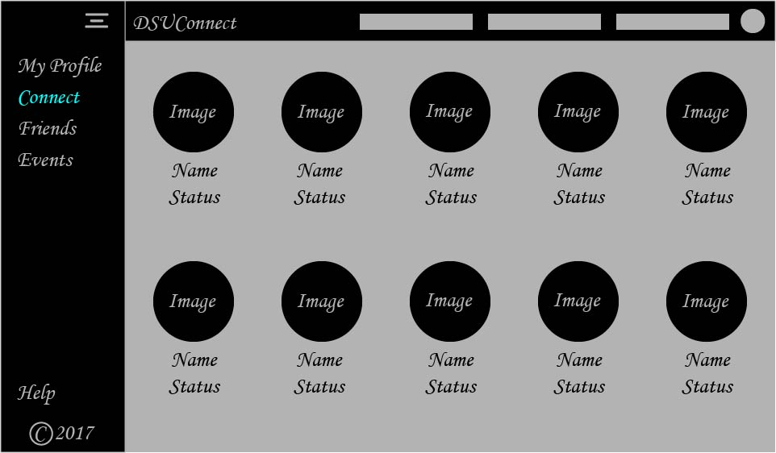
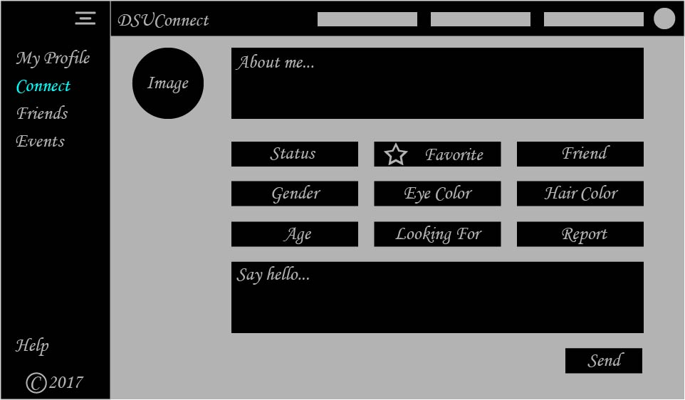
Design - UI
Notes:
Here is a page for display users near you and on the right is a profile page for one of those users.

Slide 12
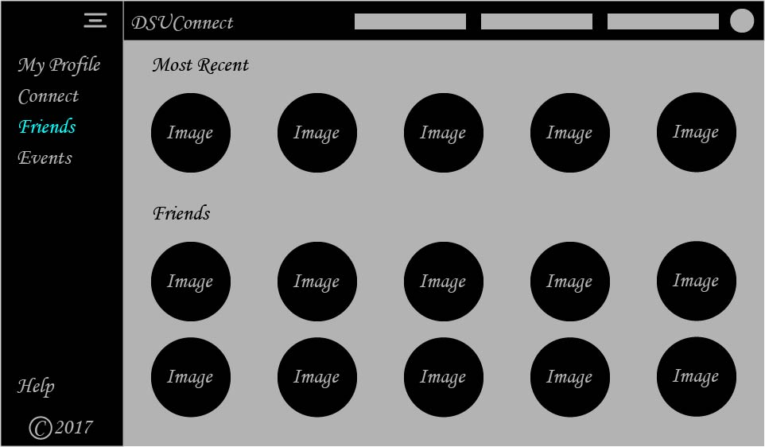
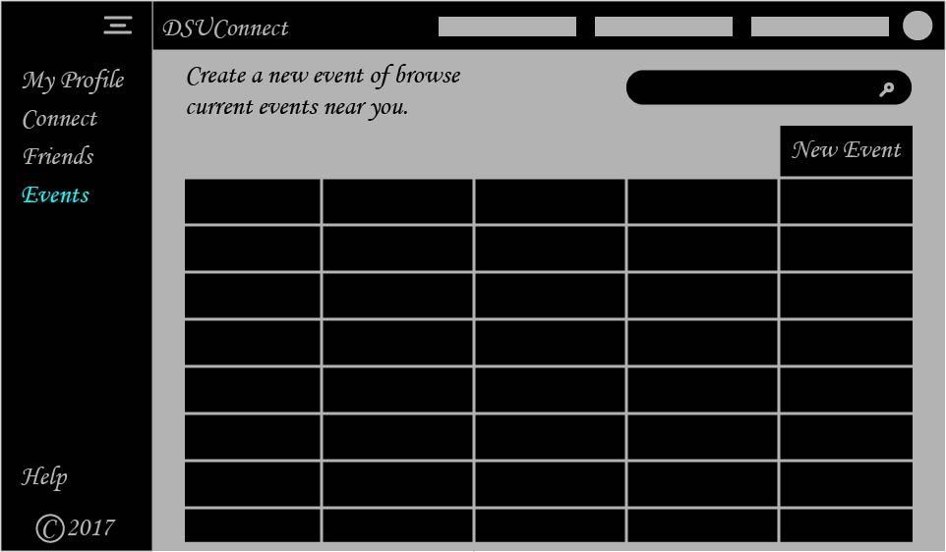
Design - UI
Notes:
Here is a page that will display the list of your friends/connections and a page for viewing and creating events.

Slide 13
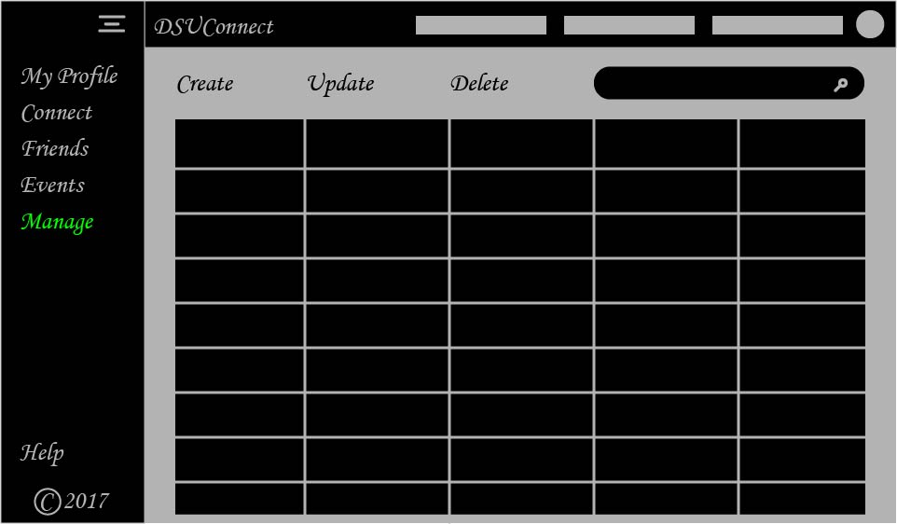
Design - UI
Notes:
Lastly we have a page for admins to manage users. Only admins can see this page.

Slide 14
Design – physical architecture
2 identical servers for uninterrupted upgrades and preventing downtime
4-8 CPUs with preferably 32 GB of memory
16-32 gigabytes of ram available
100+ GB of SSD space to keep up with binary and related file types
High usage will require a minimum of 25 Mbps, preferred speed around 100 Mbps for growth and a high-speed experience for all users.

Slide 15
Design - strategy
We determined that package software would be the most beneficial option for our system.
Risks:
Miscommunications with those designing the system.
Price of the package software.

Slide 16
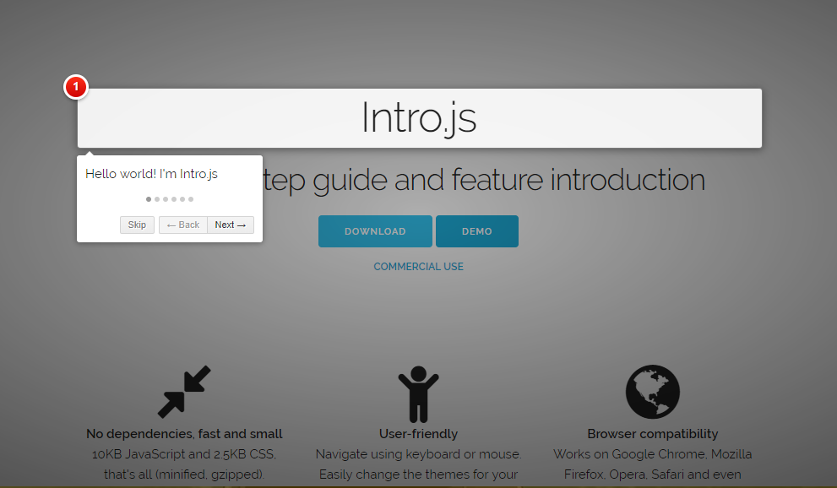
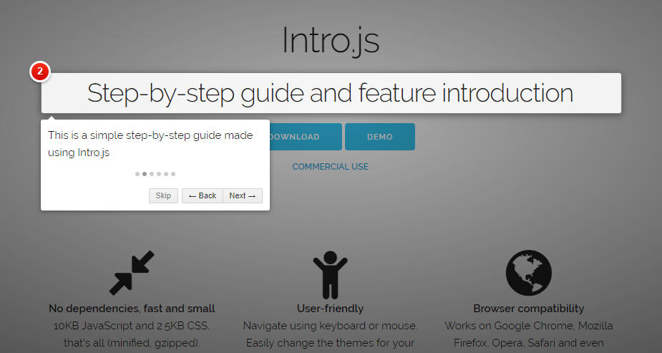
Implementation – Training
Notes:
For our users that are less technologically inclined or have not used social media before, implementing a tool such as Intro.js would walk them through what functionality is available in the site.

Slide 17
Implementation – Maintaining the system
Back up data
Clean dust form equipment
Practice good cable management
Keep systems up to date

Slide 18
Project assessment
What worked?
Assigning specific tasks to group members
What did not work?
Meeting regularly
Notes:
We assigned everyone to a specific task and after the first deliverable we assigned members to tasks that were fairly similar to their previous work.
We tried to meet at least once per week, however time constraints, other projects, and family issues prevented us from achieving that goal. Realistically we met only once per deliverable, possibly less.

Slide 19
Questions, Comments, Concerns?

