Slide 1
The Constriction Connoisseurs
22nd of April 2022
Frédèrick Franck
Havva Ebrahimi Pour
Mahboubeh Faghih Mohammadi

Slide 2
Overview
Introduction
Assignment
Approach
Solution
Recommendations

Slide 3

OUR COMPANY
We are all junior data scientists
@Be</code>
This is our third project
2nd UseCase

Slide 4



OUR TEAM
HAVVA EBRAHiMi POUR
FRÉDÈRiCK FRANCK
MAHBOUBEH
FAGHiH MOHAMMADi

Slide 5
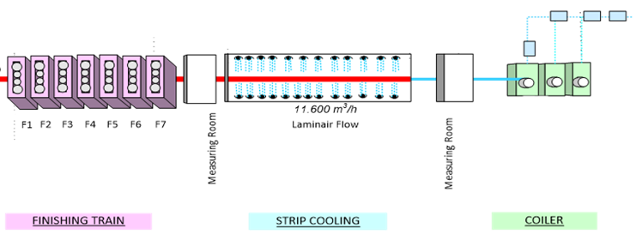
Predicting width contrictions during hot rolling
When the strip is picked up by the downcoiler, it is still in the finishing mill
This means tension is put on the strip, potentially lowering its cross section
Possibility of width constriction

Slide 6
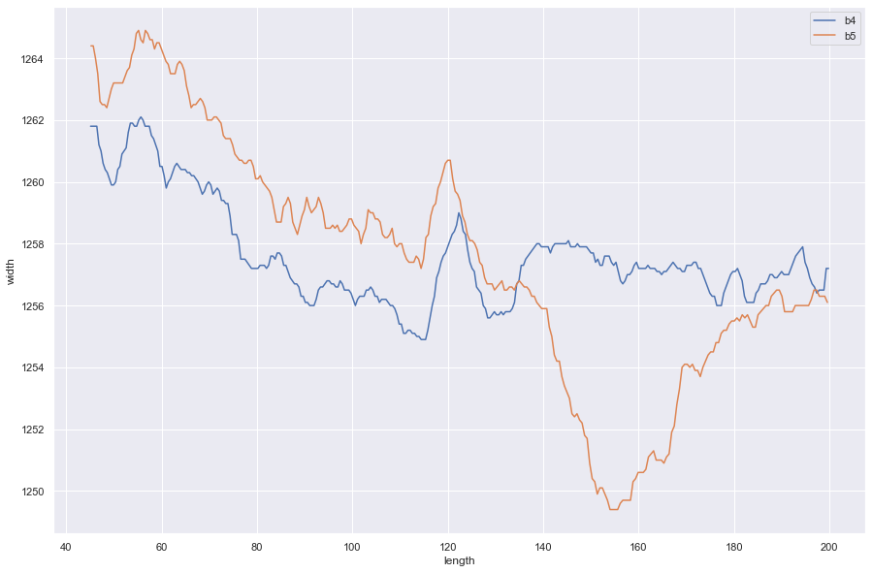
Mission
Build ML Model to predict this width constriction

Slide 7
—Nelson Mandela
“It always seems impossible until it is done.”

Slide 8
MACHINE LEARNING
PIPELINE
Training & Testing
Model Selection
Model
Validation
Defining Labels
Cleaning data
Model
Training
Classification Report
Confusion Matrix
Cross Validation
Data Preparation
Feature Selection
Downsampling
Data Ingestion

Slide 9

Data Ingestion
Defining Labels
Calculate constrictions
Measuring points dont line up 1-on-1
Method 1 : Comparing averages
Method 2 : Comparing closest points
Cleaning Data
Removing coils without measurments
Removing coils with empty measurments

Slide 10
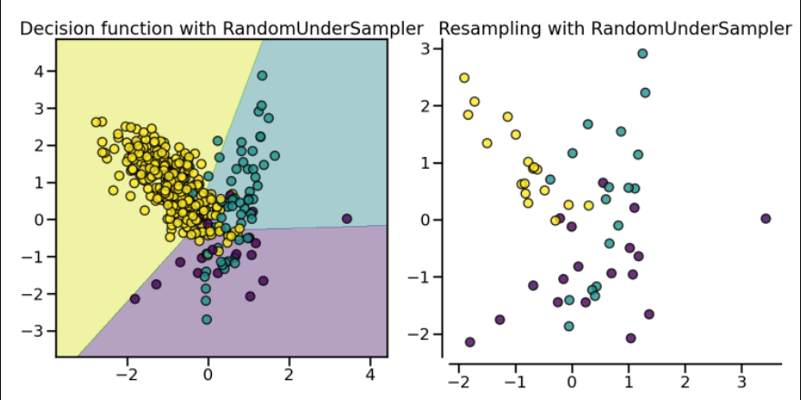
Data Preparation
Data is imbalanced
Downsampling
Reduce datapoints from unconstricted coils
Feature Selection
Selecting most impactful features
Graphing features
Calculating feature importance

Slide 11
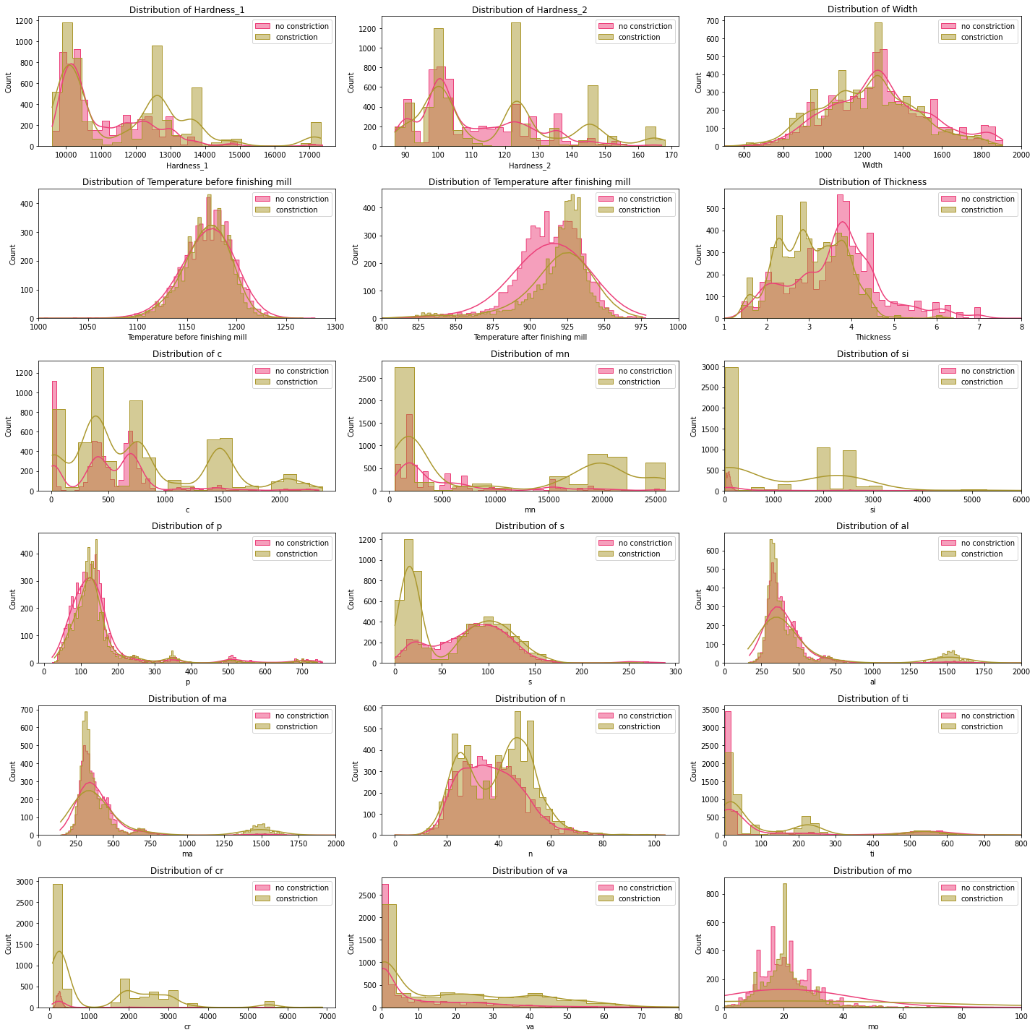
Feature Selection
Graphing different features in relation to the amount of constrictions

Slide 12
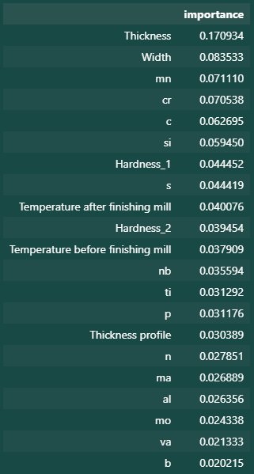
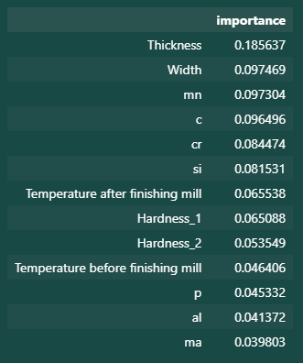
Feature Selection

Slide 13
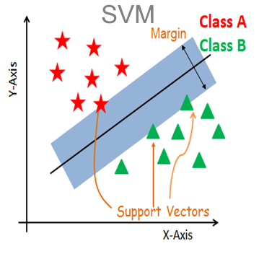
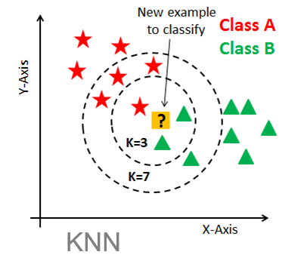
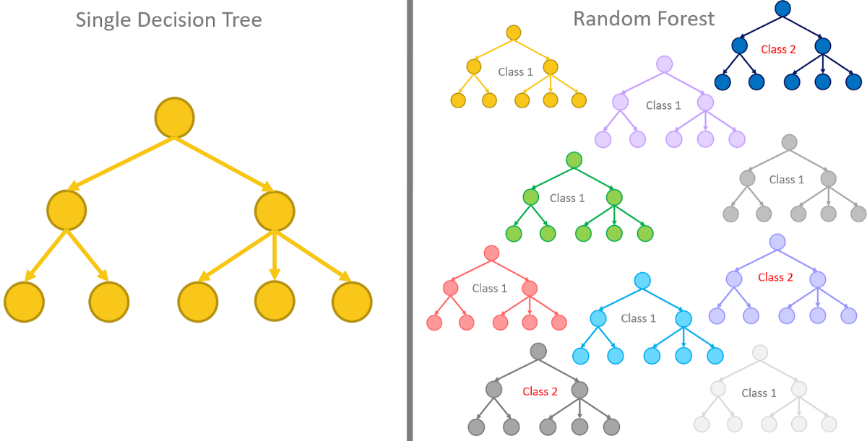
Models
Model selection:
SVM
KNN
Decision Tree
Random Forest -> best results

Slide 14
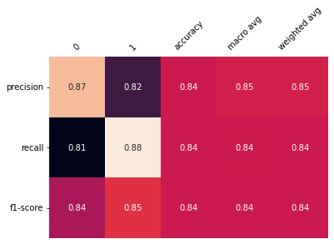
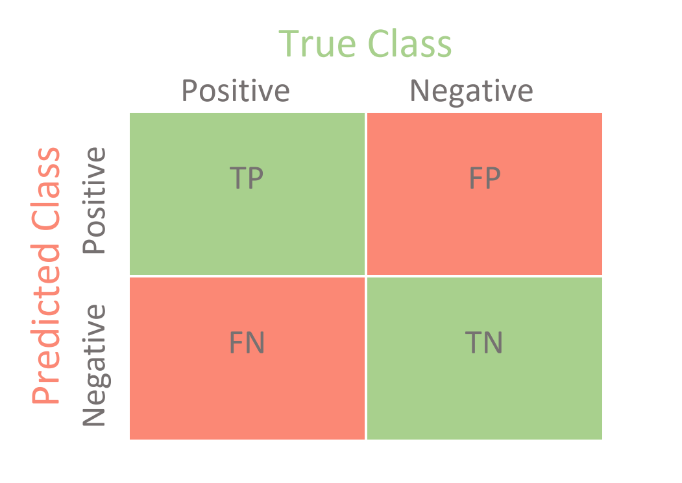
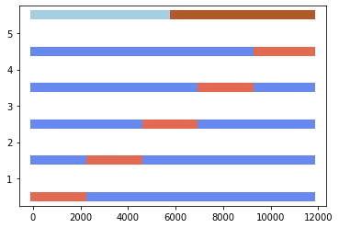
Validation
Classification Report
Confusion Matrix
Cross Validation

Slide 15
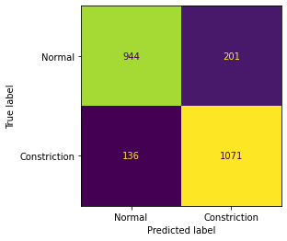
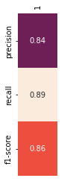
Result : Random Forest Method 1
Class Report
Confusion Matrix

Slide 16
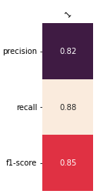
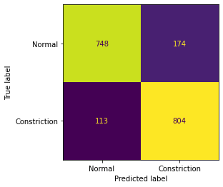
Result : Random Forest Method 2
Class Report
Confusion Matrix

Slide 17
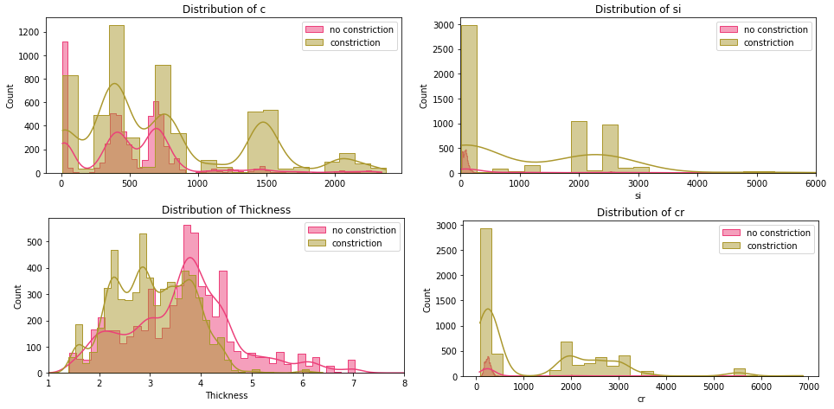
Recommendations
Some features seem to have a higher impact
Consider this when making new coils

Slide 18
Recommendations
Imbalanced dataset (~3600 constrictions out of ~54 000 coils )
We used down sampling
Better results if we work with a balanced dataset
Providing more features could also improve the results

Slide 19
THANKS
Are there any questions?
Connect with us
Frédèrick Franck
Havva Ebrahimi Pour
Mahboubeh Faghih Mohammadi

