Slide 1
VUE JS
Presented By:
Vennela Cheekoti
Venkata Sai Krishna Dasari
Zachary Haider
Suresh Chandra Peddinti
Havya Ravipati
Notes:
VUE is a progressive framework for building user interfaces.
The primary creator of vue was Evan You, but there is an entire international team of 25 people from: us china rusia, france, polan ect

Slide 2
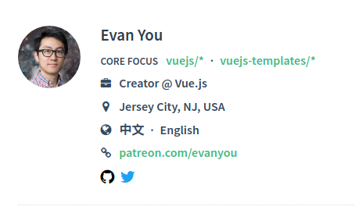
What is VUE?
Notes:
VUE is a progressive framework for building user interfaces and is based on angular.
The primary creator of vue was Evan You, but there is an entire international team of 25 people from: us china rusia, france, polan ect
Evan was a former member of googles development team.
One of the big things VUE does is take a standard object in the DOM and make it a Javascript object. This makes it very fast and reactive to user inputs. The downside is, your entire webpage is illegible without the javascript running and there is little separation between elements in your page. This will make it hard to migrate too or away from VUE.
VUE is becoming more popular with devs but is not seeing lasting users. Its user base is on the rise but it is not on top, yet.

Slide 3
Differences and Similarities of React, Angular & Vue
React | Angular | Vue
Very popular among large scale and small scale buisness | Very popular among large scale and small scale buisness | Extremely popular among small scale buisness.
Library for building and rendering components | Framework for building reactive, component driven apps. | Framework for building reactive, component driven apps.
Everything is javaScript | Uses Web APIs, HTML, CSS | Uses Web APIs, HTML, CSS
Routing and state management are not in-built | Routing and State Management are included | Routing And State Management provided
Developed by facebook Netflix and facebook are built using React | Developed by google | Developed by Evan You and other core team members (not from a reputed background)
Primarily to build Web Apps And mobile apps can be built using React Native or Ionic4 | Primarily used to build web apps mobile apps can be build using NativeScript or Ionic | Primarily for Web apps and mobile apps can be build using NativeScript or Ionic
Notes:
by – Havya Ravipati

Slide 4
Advantages and DisAdvantages
React | Angular | Vue
No complex build workflow is required as everything is in JavaScript | Uses HTML and CSS (which is known) | Uses HTML and CSS (which is known)
Existing Web Apps can use React | A complex project set is required to get started. | Existing Web Apps can use Vue
Uses only JS (sometimes JSX). | Need to know TypeScript and Dependency Injection | Intutive Syntax
Need to add a lot of features | Features are included for SPAs | Some features are not included
Notes:
Which one is better?
Its debatable and also depends on the Application.
By – Havya Ravipati

Slide 5
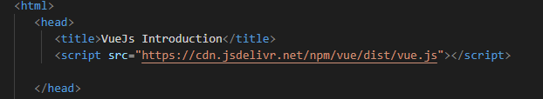
Packages Needed To Be Included
<!-- development version, includes helpful console warnings -->
<script src="https://cdn.jsdelivr.net/npm/vue/dist/vue.js"></script>
Notes:
Alternatively you could include <script src="https://cdn.jsdelivr.net/npm/vue"></script>
But you won’t Get console warnings

Slide 6
WHAT DOES VUE DO BEST
The primary feature of VUEJS is that it enables us to crate and edit data in the DOM using simple commands.
HTML
<div id="element">
{{ variable }}
</div>
JAVASCRIPT
let app = new Vue({
el: '#element',
data: {
variable: 'Hello World'
}
});

Slide 7
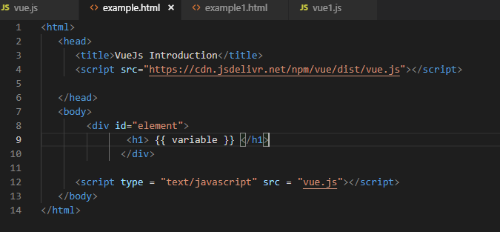
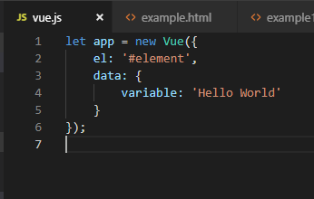
WHAT DOES VUE DO BEST

Slide 8
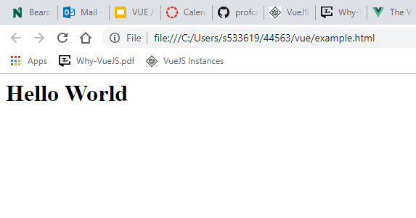
output

Slide 9
Directives
V-bind
V-if
V-for
V-model
V-on

Slide 10
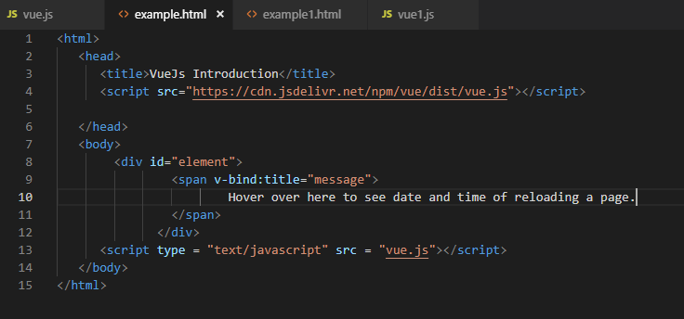
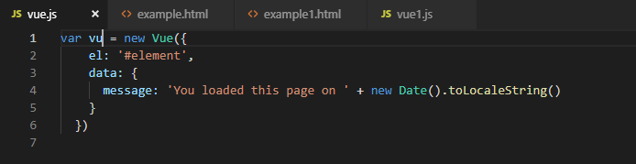
v-bind Directive Example:

Slide 11
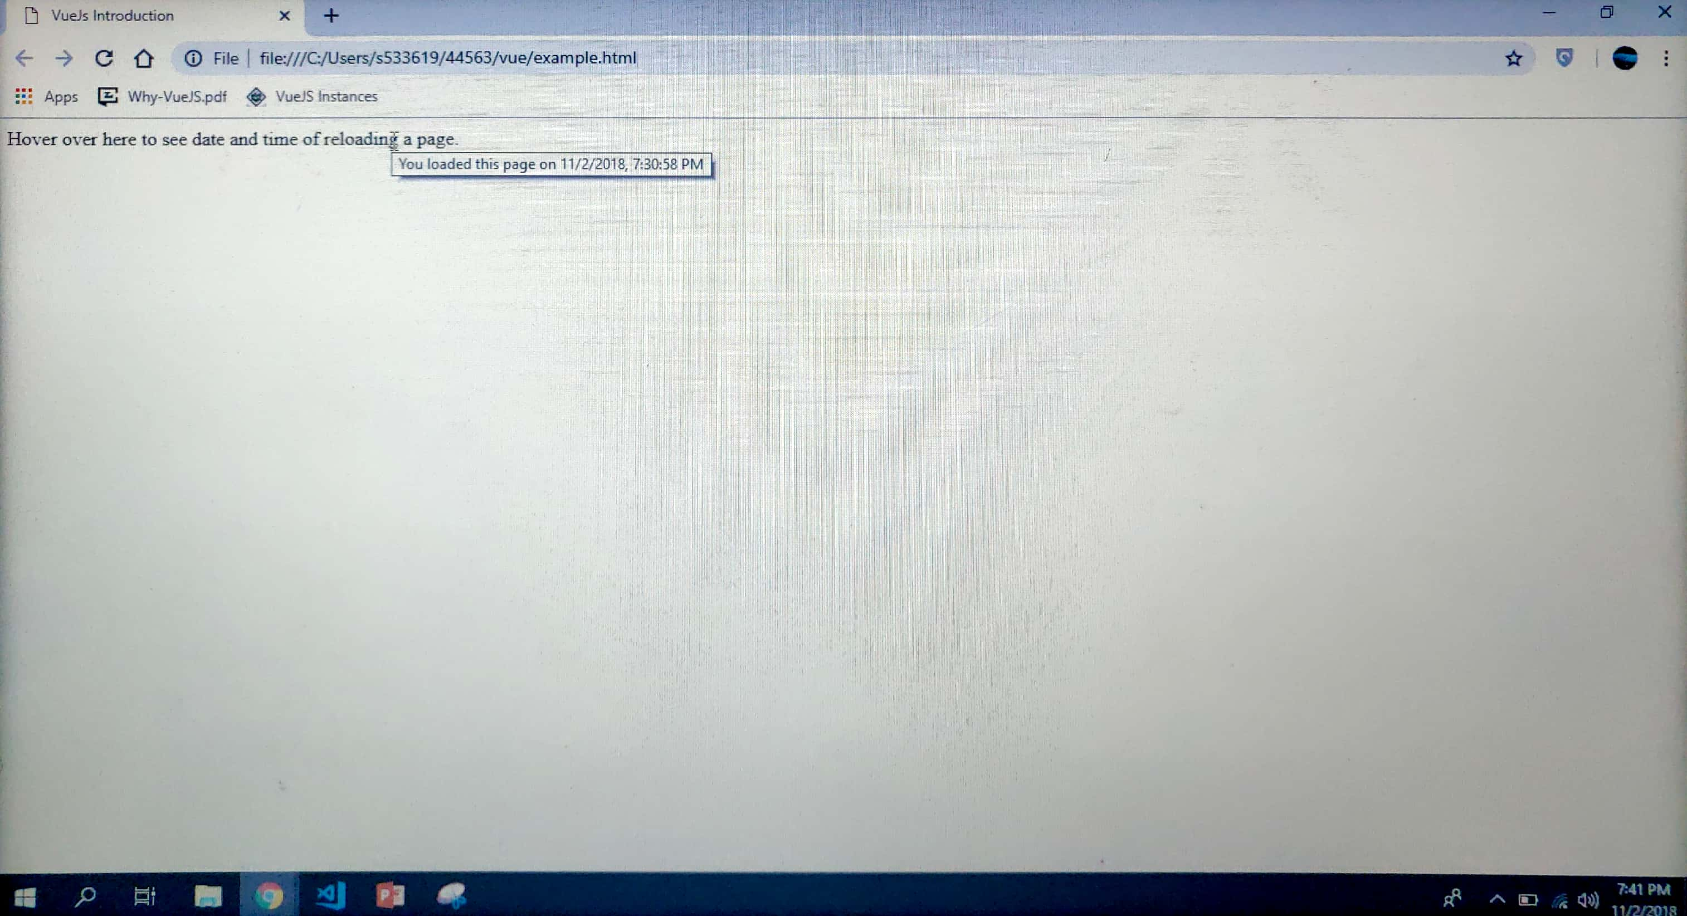
v-bind Directive output

Slide 12
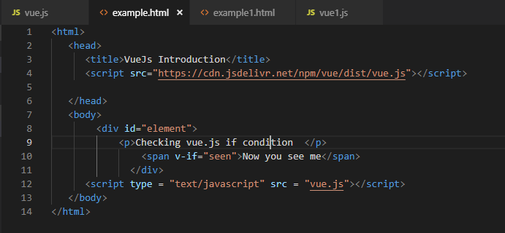
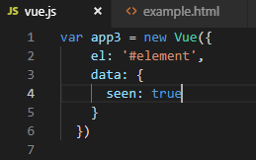
v-if directive

Slide 13
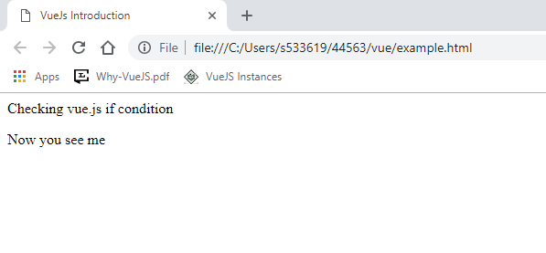
v-if directive output

Slide 14
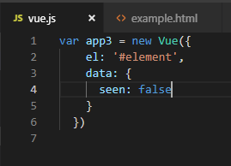
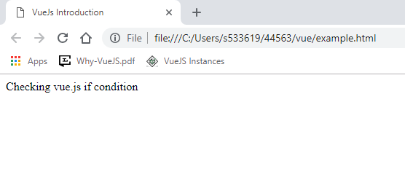
v-if directive

Slide 15
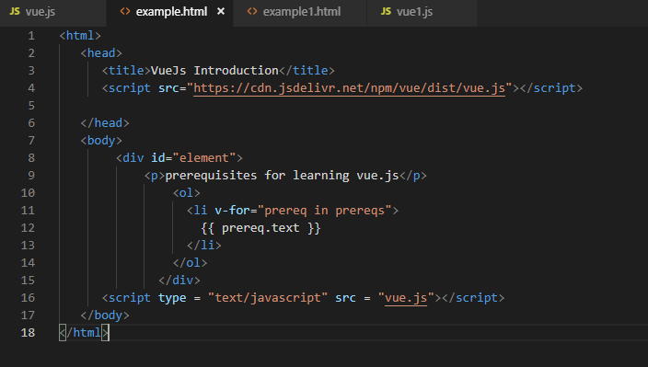
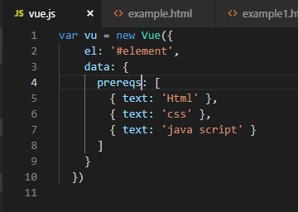
v-for directive

Slide 16
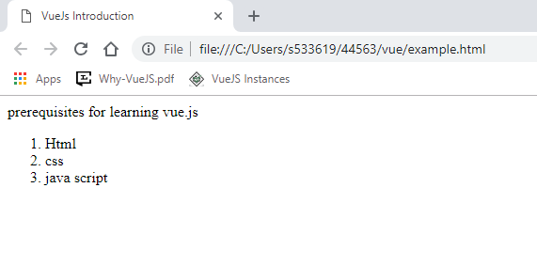
v-for directive output

Slide 17
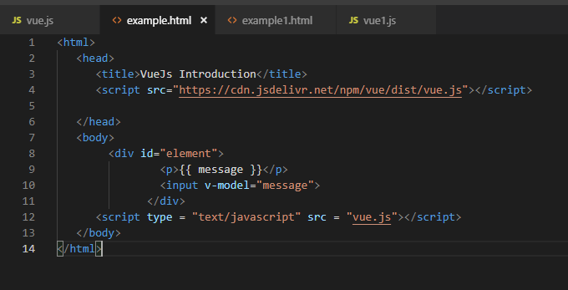
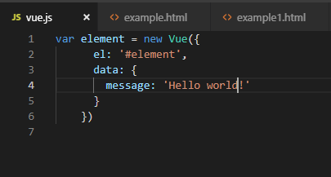
V-model directive example

Slide 18
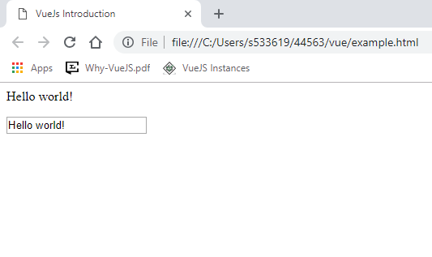
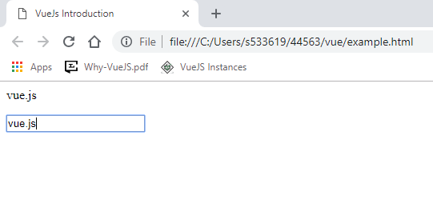
V-model directive output:

Slide 19
Event handling
VUE has its own event handler v-on. The v-on command is only applicable to instantiated vue elements.
HTML
<div id="element">
<button v-on:click="clickelement">STUFF!</button>
</div>
JAVASCRIPT
var handled = new Vue({
el: '#element',
data: {
name: ‘Welcome to Vue.Js Workshop’
},
methods: {
clickelement : function () {
alert('Hello ' + this.name + '!')
}}})

Slide 20
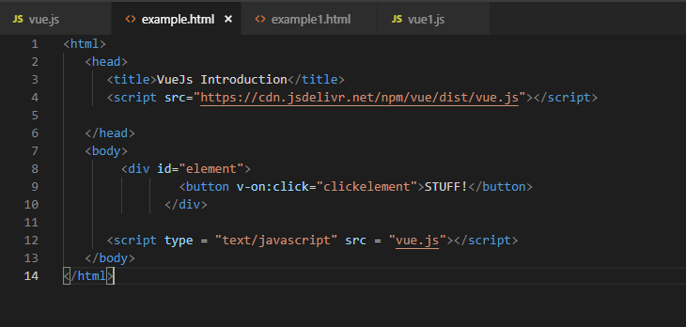
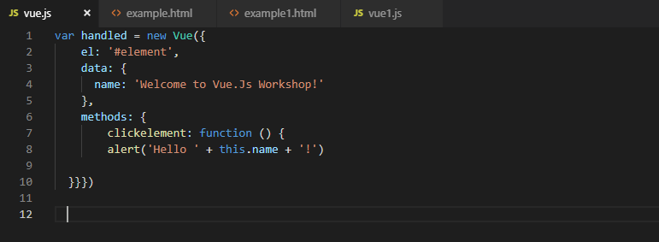
Event handling

Slide 21
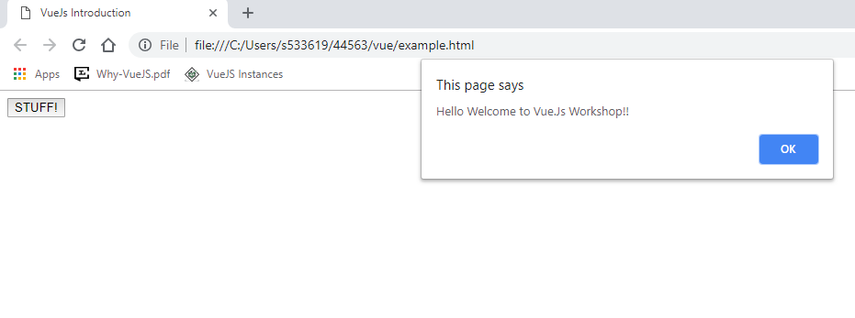
Event handling Output

Slide 22
Resources
https://vuejs.org/v2/guide/
https://en.wikipedia.org/wiki/Vue.js
https://clockwise.software/blog/angular-vs-react-vs-vue/

