Slide 1
BEYOND BOUNDARIES: MACHINE LEARNING FOR IPL OUTCOME FORECASTING
HAWIYA S
BE CSE
THIAGARAJAR COLLEGE OF ENGINNERING

Slide 2
INTRODUCTION
This project focuses on predicting the winners of IPL matches using machine learning techniques. It analyzes historical match data, including team details, toss decisions, and outcomes, to uncover patterns that influence results. Preprocessing steps like data cleaning and label encoding are applied before training models using algorithms such as XGBoost. The goal is to build an intelligent system that brings data-driven insights to cricket match forecasting.

Slide 3
DATASET OVERVIEW
Source: Kaggle – IPL Matches & Deliveries Dataset
Seasons: 2008–2024
Matches: 816
Files
matches.csv – Match-level data,Teams, toss, winner, venue, result, umpires, etc.
deliveries.csv – Ball-by-ball data,Runs, batsman, bowler, overs, dismissals, etc.
Purpose
Season Analysis: Toss trends, team performance, venues
Match Analysis: Player stats, over-by-over progress, dismissals

Slide 4
DATA CLEANING
Missing Values
Filled player_of_match with 'Unknown'
Filled winner, result_margin, target_runs, target_overs with defaults
Checked using isna().sum()
Dropped Columns
Removed id, method, umpire1, umpire2 using drop()
Fixed Inconsistent Values
Normalized season years (e.g., 2007/08 → 2008)
Standardized city names based on venue (e.g., Sharjah)
Renamed Teams
Used replace() for old IPL team names (e.g., Delhi Daredevils → Delhi Capitals)

Slide 5
DATA PREPROCESSING
Standardization & Consistency
Renamed Bangalore → Bengaluru, formatted venues (e.g., removed commas)
Unified team names and city values using replace() and str.strip()
Feature Engineering
Calculated matches_played, matches_won, and win_percentage per team
Added rank using rank() on win percentages
Data Merging
Cleaned and aligned columns in IPL_2025_SEASON_SCHEDULE.csv to match matches.csv
Split upcoming season data into:
s18_completed: With known match results
s18_new: Without results (for prediction)

Slide 6
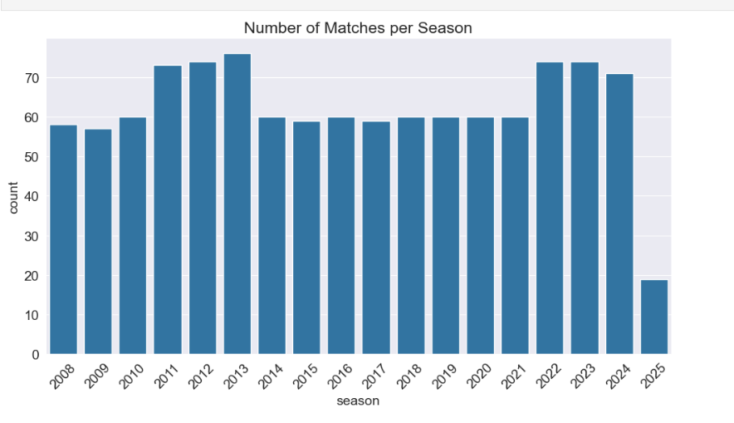
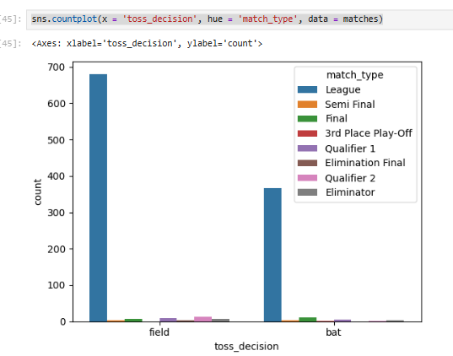
EXPLORATORY DATA ANALYSIS
No of Matches Per Season
Toss Decision Plot
This bar chart shows the number of IPL matches played in each season from 2008 to 2025.
This bar graph displays the distribution of toss decisions (field or bat) across different match types in IPL.

Slide 7
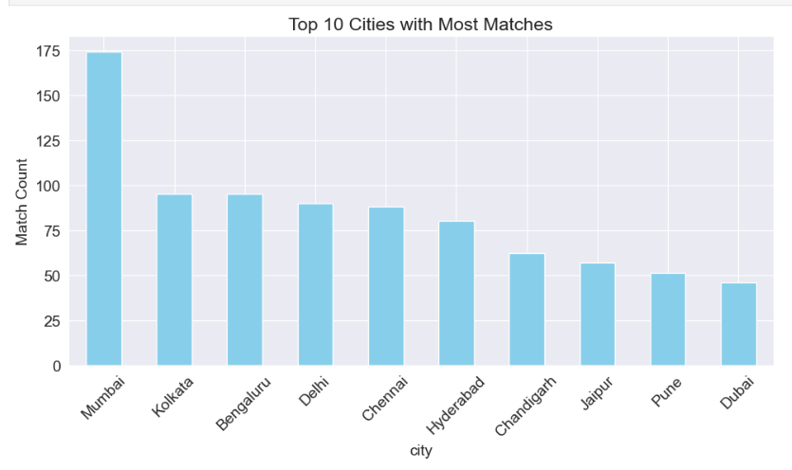
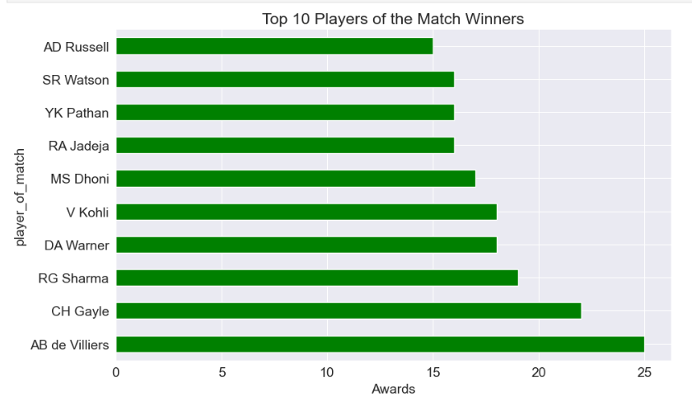
EXPLORATORY DATA ANALYSIS
Top 10 Players
Top 10 cities with most matches
Bar chart showing Mumbai hosted the highest number of IPL matches, followed by Kolkata and Bengaluru.
Horizontal bar chart highlighting AB de Villiers as the player with the most "Player of the Match" awards, followed by CH Gayle and RG Sharma.

Slide 8
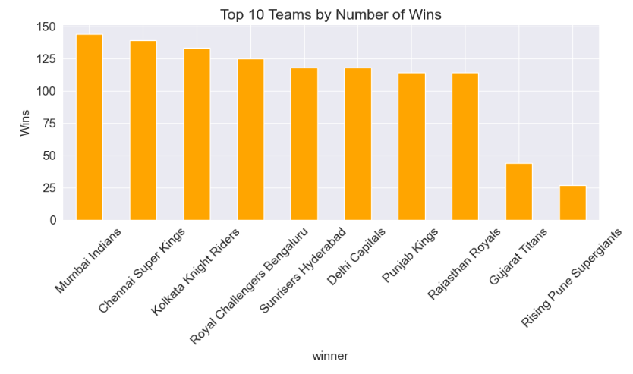
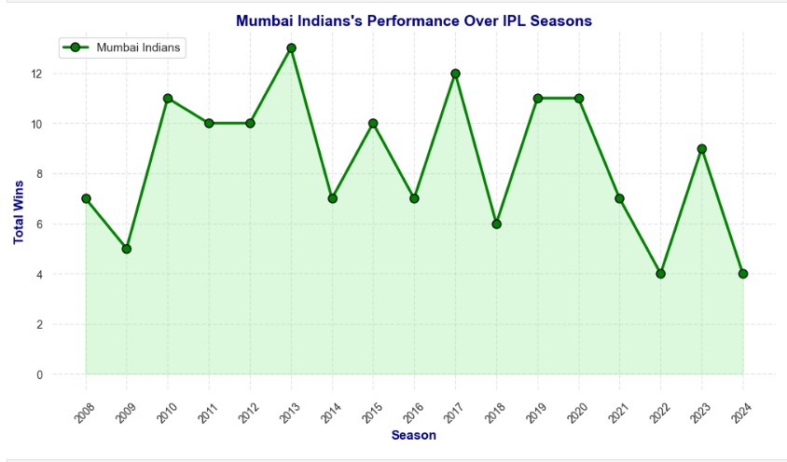
EXPLORATORY DATA ANALYSIS
Team Performance
Top 10 Teams
Bar chart ranking IPL teams by total wins, with Mumbai Indians leading, followed by Chennai Super Kings and Kolkata Knight Riders.
Line chart depicting Mumbai Indians’ win trend across IPL seasons, showing fluctuating performance over the years.

Slide 9
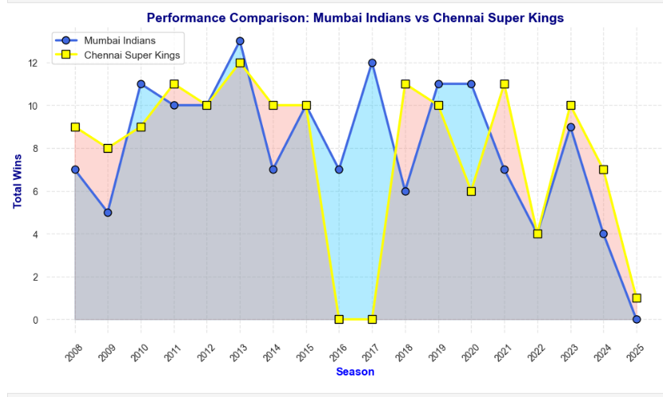
EXPLORATORY DATA ANALYSIS
Comparison between 2 teams
Line chart comparing the seasonal win trends of Mumbai Indians and Chennai Super Kings in the IPL from 2008 to 2025.

Slide 10
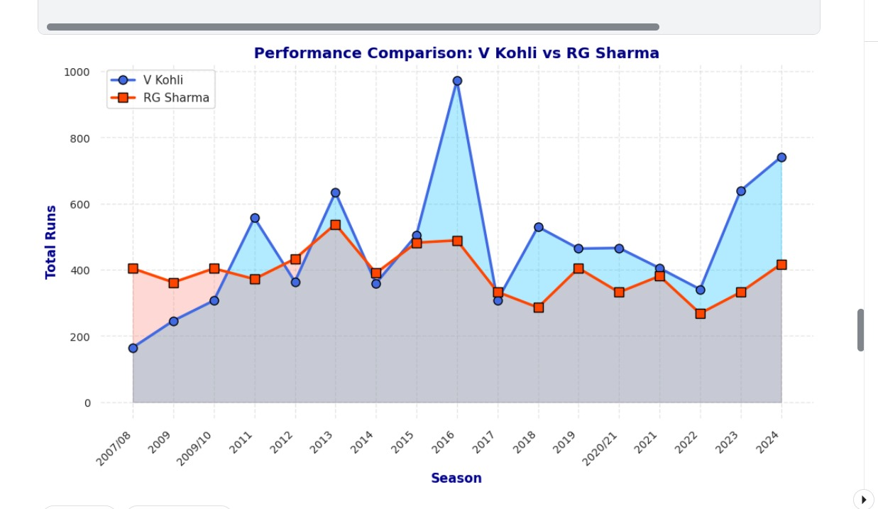
EXPLORATORY DATA ANALYSIS
Comparison between 2 Batsman
Line chart showing the IPL seasonal run comparison between batsmen V Kohli and RG Sharma from 2008 to 2024.

Slide 11
MODEL OVERVIEW
Objective: To predict how many runs a batsman will score in an IPL match using key contextual and player-based features.
Input Features (X):
Batsman Name
Bowler Name
Venue
Match Format / Type
Inning Number
Batting Position
Powerplay? (Yes/No)
Recent Form (e.g., average runs in last 5 matches)
Output (Y):
Predicted Runs scored by the batsman (Continuous value: e.g., 32.6 runs)

Slide 12
MODEL OVERVIEW
Model Definition: 1)The model is a supervised regression model using XGBoost to predict the number of runs a batsman will score in an IPL match. 2)t learns from historical match data and player context to estimate runs based on input features.
Why this algorithm has been used
1)XGBoost was used because it offers high accuracy, handles non-linear relationships, and is efficient for large datasets. 2)Its built-in regularization helps prevent overfitting, making it ideal for predicting batsman performance.

Slide 13
PREDICTED RUNS FOR A BATSMAN
Input Features:
Batsman: Rohit Sharma
Bowler: Part-time Spinner
Venue: Eden Gardens
Match Format: T20 IPL
Inning Number: 2nd
Batting Position: Opener
Powerplay?: Yes
Recent Form: Avg 70.4 runs (last 5 matches)
Model Output
Predicted Runs: 101.3 runs
Interpretation: Rohit Sharma is in top form and opening in a chase-friendly ground like Eden Gardens. With weak bowling opposition and powerplay advantage, the model projects a century. Historical data suggests Eden favors experienced openers chasing, especially when confidence is high.

Slide 14
THANK YOU

