Slide 1
Project: Battle of the Neighbourhoods
By: Arpit Verma

Slide 2
Introduction
Background: Building a good chain of outlets for any business is a necessity in the current world to survive as a brand. Correct time of expansion depends upon the brand, which usually depends on the quality or products and services as good quality of products and services gain them the necessary funding to expand. Correct placement of the outlet/branch in a given neighbourhood is a very important step which must be done with all the necessary background studies done as one wrong placement can result into huge loss, and thus we decided to deal with this particular problem. Our area of concern for this project will be the state of New York.
Problem Statement: Keeping in mind the problem stated in the background study, and for a sample client in our scenario, i.e., a Pizza Place owner. Thus the problem statement can be stated as: "To find the best locations in New York State for the expansion of a Pizza Place based in Carnegie Hill, Manhattan, NY."
Interest: Our current client is very much interested in the project as he will get a narrowed down list of all the places where he can possibly expand, based on location.
Any other business who wish to expand their business might also be interested in this project based on the success/satisfaction of our current client.

Slide 3
Data Acquisition and Cleaning
Data Sources:
The neighbourhoods in New York State along with their Latitude and Longitude values in this JSON file.
All the nearby venues in the form of JSON data from Foursquare API.
Data Cleaning and Feature Selection:
New York State JSON file consists of co-ordinates and Neighbourhood name along with Borough name for each neighbourhood which we retrieve for our purpose.
Foursquare API call JSON response consists of co-ordinates, venue name and venue category that we retrieve for our purpose

Slide 4
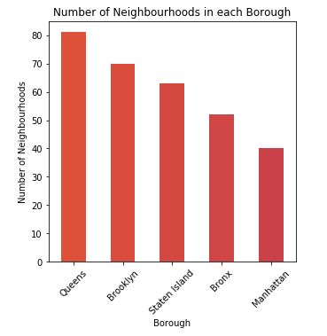
Exploratory Data Analysis
Following graph and table suggest number of neighbourhoods in each Borough of New York State:
Queens: 81
Brooklyn: 70
Staten Island: 63
Bronx: 52
Manhattan:40

Slide 5
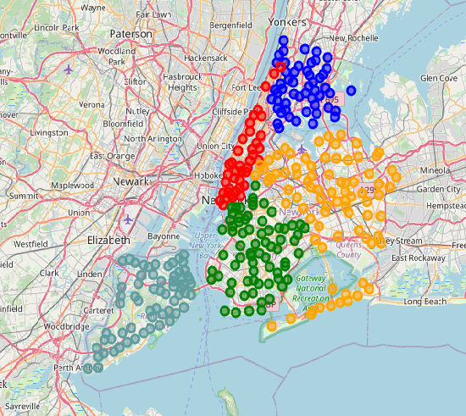
Exploratory Data Analysis(contd.)
Below map picturizes each neighbourhood in New York State in each Borough:

Slide 6
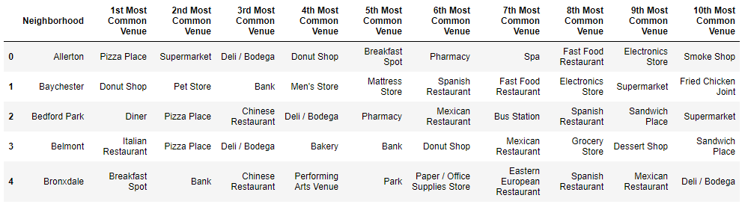
Most Common Venues in Neighbourhoods of Bronx (only 5 Neighbourhoods)

Slide 7
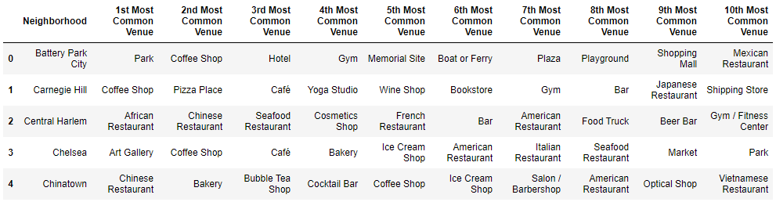
Most Common Venues in Neighbourhoods of Manhattan (only 5 Neighbourhoods)

Slide 8
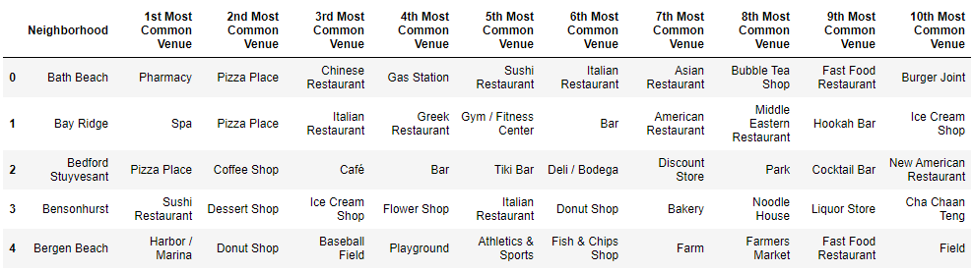
Most Common Venues in Neighbourhoods of Brooklyn (only 5 Neighbourhoods)

Slide 9
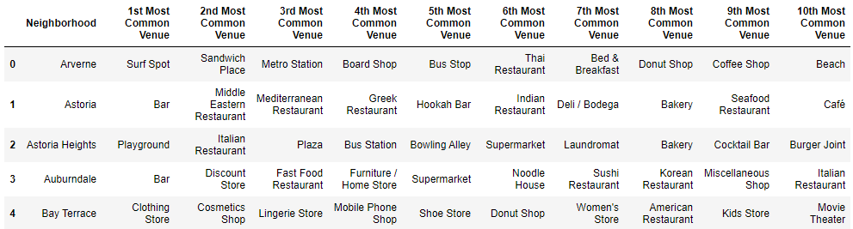
Most Common Venues in Neighbourhoods of Queens (only 5 Neighbourhoods)

Slide 10
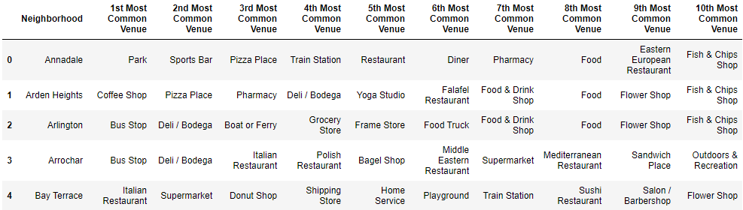
Most Common Venues in Neighbourhoods of Staten Island (only 5 Neighbourhoods)

Slide 11
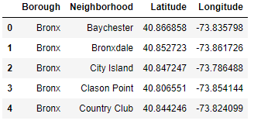
Predictive Procedure
First we collect all the neighbourhoods where our venue of concern, i.e., “Pizza Place” doesn’t come under top 10 most common place so as to make sure our client doesn’t place their new outlet in a region where their product is already very common. Below table suggests the same:

Slide 12
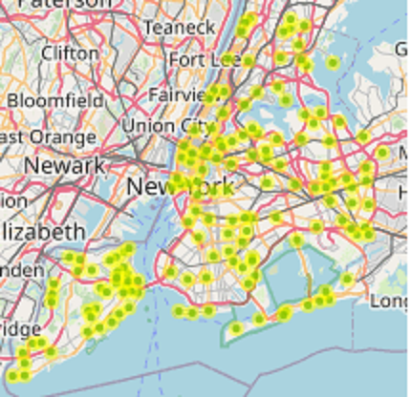
Predictive Procedure (contd.)
Map of all suggested Neighbourhoods

Slide 13
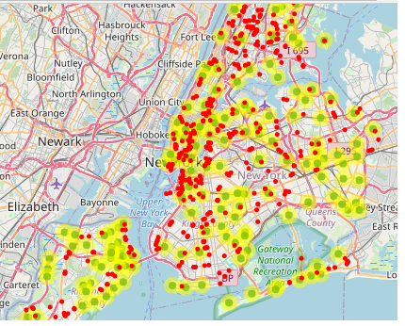
Predictive Procedure (contd.)
Map of all suggested Neighbourhoods with all Pizza Places

Slide 14
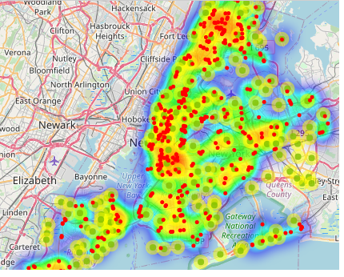
Predictive Procedure (contd.)
HeatMap of all suggested Neighbourhoods with all Pizza Places

Slide 15
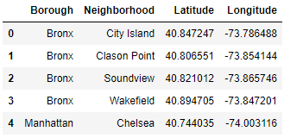
Predictive Procedure (contd.)
Now we will narrow down the list of suggested places further by finding all the competitors of our client within 1Km radius using Foursqaure API again.
Best suggested neighbourhoods

Slide 16
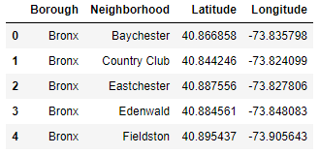
Predictive Procedure (contd.)
Moderate suggested neighbourhoods

Slide 17
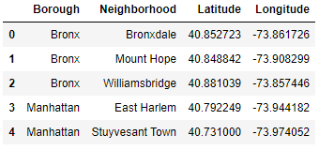
Predictive Procedure (contd.)
Worst suggested neighbourhoods

Slide 18
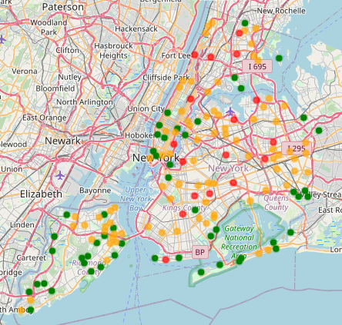
Predictive Procedure (contd.)
Best (in green), Moderate (in orange) and Worst (in red) suggested neighbourhoods

Slide 19
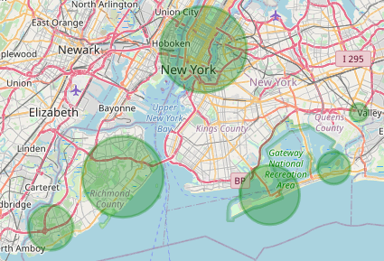
Predictive Procedure (contd.)
Now we use DBSCAN clustering algorithm to cluster the Best Suggested Neighbourhoods with at least 3 neighbourhoods per cluster with epsilon value of 0.005. Upon using the algorithm, we find the centres and radii of each cluster and plot them on the map as given below:
Clusters of best suggested neighbourhoods

Slide 20
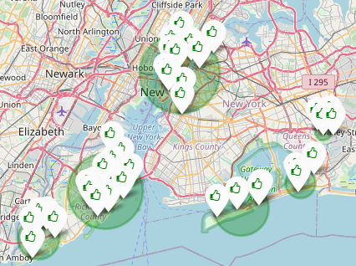
Predictive Procedure (contd.)
Clusters of best suggested neighbourhoods along with their locations

Slide 21
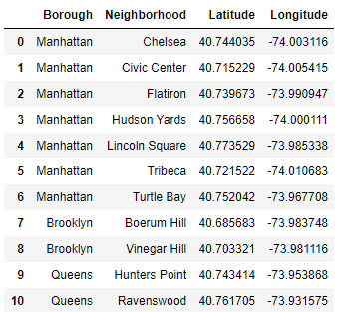
Predictive Procedure (contd.)
The biggest cluster among all these clusters suggests that there are a large number of neighbourhoods in close proximity where there are very few “Pizza Places” compared to other neighbourhoods and thus will be best suitable for our client to open a new branch/outlet, thus increasing their chances of success by a great factor.
Neighbourhoods which come under the biggest cluster of “Best” suggested Neighbourhoods

Slide 22
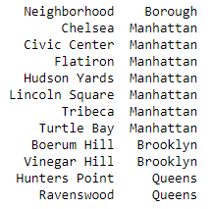
Conclusions
From all the above data processing and analysis, we can come to a final conclusion that following neighbourhoods are the best for our client to carry out further research on the likings and average money spent on eating out, by the residents, to further narrow down their new outlet location:

Slide 23
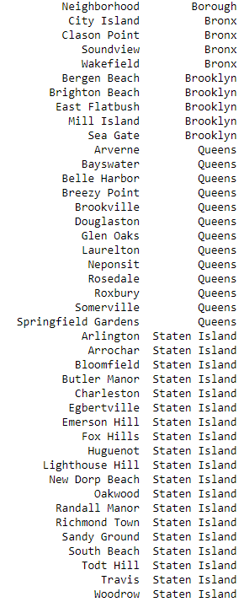
Conclusions (contd.)
Client may also want to look into following neighbourhoods, although they do not make a huge cluster and thus may not be as beneficial for our client to invest their resources on:

Slide 24
Future Directions
Based on our current research and methodology, we were only able to suggest our client a possible neighbourhood based on location.
Later on for further improvements, we may also want to look into the average salaries and average spending of people living in our target neighbourhoods so as to better analyse and further narrow down the list of suggested neighbourhoods.
We may also consider the general likes and dislikes of people as they also play an important factor in deciding whether any business will be successful in the region or not.

