Slide 1
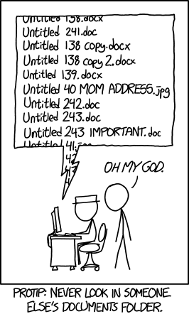
Data Management & R
Why is data managment important?
Overview of some helpful tools and tips
Example
Use your new tools: make a project folder for this class

Slide 2
Importance of data management
Fosters reproducible science
You MUST make sure that you and others can reproduce your work. That’s science.
Saves you from losing and/or duplicating things
Make it easy to share
Because you need to comply with funding agencies

Slide 3
Sketch your workflow
Excel
collect and enter data
check data for typos and outliers
R, RStudio,
RMarkdown
summary statistics, exploratory visualization
statistical analyses
production-quality figures
Powerpoint

Slide 4
Ideal workflow
Have a meta-data file for each data file
Import raw data and never edit raw data files. In general, keep a tidy file structure
Script as much as possible and annotate the crap out of your code
Make a tidy data frame to do all your downstream analyses
Follow best practices for scripting

Slide 5
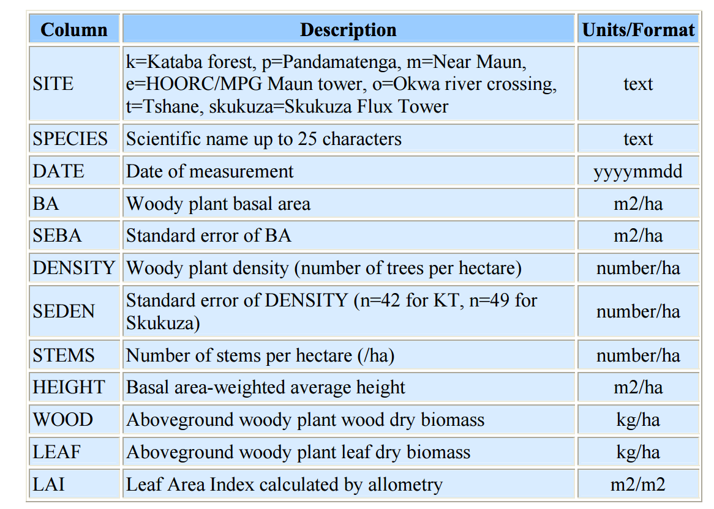
1. More on meta-data
Descriptive : variable names, data formats, data ranges, missing data codes
Structural : how different pieces of data relate to one another, such as in a database
Administrative : who made it and who can use it
Meta-data
Example from DataONE's best practicies :
https://www.dataone.org/best-practices

Slide 6
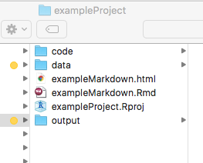
2. Keep a tidy file structure
File buckets
RMarkdown
more about this later
RStudio “projects”
file-monitoring
portable
version control
File structure

Slide 7
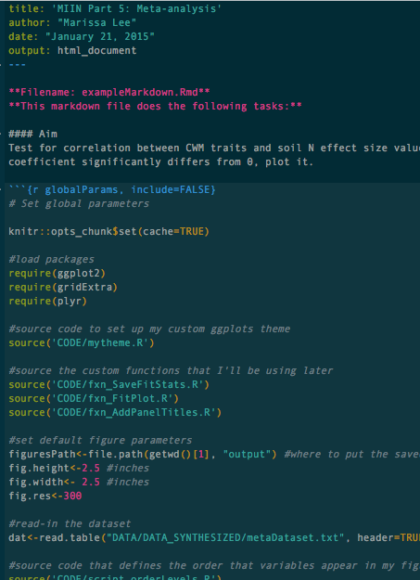
3. Annotate the crap out of your code
RMarkdown text
Within-code comments
Annotate

Slide 8
4. Tidy your data
What makes data “dirty”?
multiple varibles in one column
variables are stored in both rows and columns
multiple types of observational units are stored in the same table
single observational unit is stored in multiple tables
R packages that can help!
dplyr, tidyr
data.table
reshape, reshape2
Tidying

Slide 9
4. Scripting tips
Always start with pseudo code so you have a road map
Break hard problems up into small discrete pieces
Minimize redundancy by using functions and loops
Set up your workspace at the top of the file
Load package libraries
Source R script with my custom ggplot theme
Set default figure dimensions
Shortcut name for the output folder filepath
Set up knitr caching (RMarkdown only)
Scripting

Slide 10
Example from my research
Some things I’d like to show off with this example...
Tidy file structure
Annotation with markdown and comments
Scripting tips
Set up workspace
Source-in code to simplify the main script
Use functions and loops to avoid redundancy
I’m also looking for constructive criticism. What things are unclear? Would you use this dataset?
Example

Slide 11
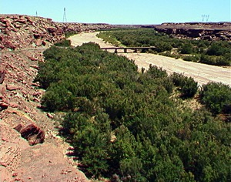
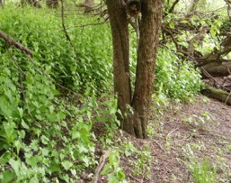
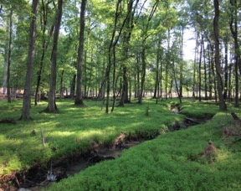

Biological Questions
Do invasive species with higher tissue %N cause more soil eutrophican when they invade?
Is the difference in plant trait values between reference and invaded plant communities a better indicator?
Example

Slide 12
Hypotheses
Invasive species
Reference community
Trait dissimilarity
Soil N pool & flux
Effect Size
Leaf, Litter
%N
Leaf, Litter
%N
Δ CWM %N (Inv. – Ref.)
Example
Notes:
I expected that invaded communities with higher leaf and litter %N than reference communities would cause larger increases in N pools and fluxes.
Say in words that I also looked at plant tissue C:N (and soil C:N) because N RELATIVE TO CARBON is important. Hypotheses are exactly the opposite.

Slide 13
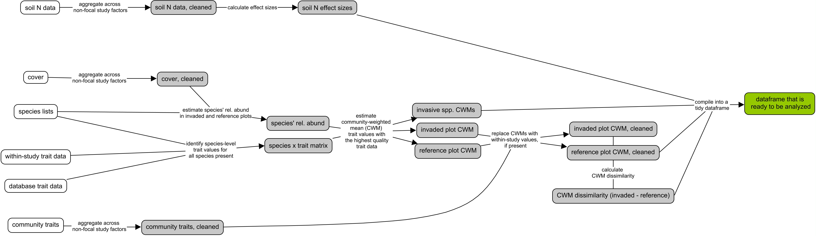
Work flow
don’t worry, this is just background
Example
Excel
R, RStudio, RMarkdown

Slide 14
Work flow
don’t worry, this is just background
Example
R, RStudio, RMarkdown

Slide 15
Work flow
I’ve provided the materials to do this
in the folder “exampleProject”
save fit statistics
fit a bunch of univariate meta-regression models
determine which relationships are significant
visualize relationships
produce set of panels with the key correlations for publication
Example
If you want to see the raw data and
previous scripts, follow this link...
https://github.com/marissalee/MetaInvN

Slide 16
Table to hold the results
Response variable | Trait type | Invasive species |  |  |  |  | Reference CWM |  |  |  |  | CWM Dissimilarity
 |  | Hyp. | Leaf |  | Litter |  | Hyp. | Leaf |  | Litter |  | Hyp. | Leaf |  | Litter
 |  |  | est | k | est | k |  | est | k | est | k |  | est | k | est | k
NH₄⁺ | %N | + | 0.01 | 122 | 0.56 | 19 | - | -0.14 | 117 | -0.11 | 26 | + | 0.19 | 115 | 0.61 | 26
NO₃⁻ |  | + | 0.07 | 128 | -0.01 | 20 | - | -0.04 | 124 | 0.01 | 30 | + | 0.11 | 122 | 0.18 | 30
NH₄⁺+NO₃⁻ |  | + | 0.09 | 173 | 0.51 | 21 | - | -0.06 | 146 | 0.17 | 24 | + | 0.15 | 144 | 1.55 | 24
Δ NH₄⁺ |  | + | 0.12 | 38 | 0.86 | 13 | - | 0.05 | 38 | -0.53 | 15 | + | -0.06 | 38 | 0.32 | 15
Δ NO₃⁻ |  | + | 0.14 | 67 | 0.81 | 16 | - | 0.13 | 65 | -1.23 | 18 | + | 0.19 | 65 | 0.58 | 18
Δ NH₄⁺+NO₃⁻ |  | + | 0.01 | 84 | 0.04 | 15 | - | -0.01 | 77 | -0.04 | 18 | + | 0.21 | 77 | -0.10 | 18
Soil N |  | + | 0.34 | 170 | 0.51 | 27 | - | 0.16 | 154 | -0.04 | 28 | + | -0.03 | 152 | 0.34 | 28
Soil C:N |  | - | -0.20 | 89 | -0.46 | 10 | + | -0.05 | 81 | 0.27 | 12 | - | 0.01 | 81 | -0.38 | 12
SOM |  | + | 0.27 | 88 | 0.11 | 19 | - | 0.15 | 81 | -0.36 | 18 | + | -0.03 | 81 | 0.51 | 18
NH₄⁺ | C:N | - | -0.02 | 64 | -0.02 | 11 | + | 0.01 | 48 | 0.01 | 17 | - | -0.01 | 48 | -0.02 | 17
NO₃⁻ |  | - | 0.00 | 75 | -0.03 | 12 | + | 0.01 | 61 | 0.00 | 18 | - | 0.00 | 61 | -0.02 | 18
NH₄⁺+NO₃⁻ |  | - | -0.01 | 97 | -0.01 | 14 | + | 0.01 | 70 | 0.01 | 23 | - | -0.02 | 70 | -0.02 | 23
Δ NH₄⁺ |  | - | 0.01 | 19 | -0.01 | 7 | + | 0.01 | 16 | 0.00 | 10 | - | -0.01 | 16 | 0.00 | 10
Δ NO₃⁻ |  | - | 0.00 | 38 | -0.01 | 14 | + | 0.00 | 28 | 0.01 | 18 | - | 0.00 | 28 | -0.01 | 18
Δ NH₄⁺+NO₃⁻ |  | - | 0.00 | 59 | -0.01 | 16 | + | 0.02 | 46 | 0.00 | 22 | - | -0.03 | 46 | -0.01 | 22
Soil N |  | - | -0.01 | 101 | -0.02 | 20 | + | 0.00 | 89 | 0.01 | 23 | - | -0.01 | 89 | -0.01 | 23
Soil C:N |  | + | 0.00 | 70 | NA | 12 | - | -0.02 | 66 | 0.00 | 13 | + | 0.03 | 66 | 0.01 | 13
SOM |  | - | 0.03 | 28 | -0.03 | 13 | + | 0.02 | 22 | 0.00 | 13 | - | -0.01 | 22 | 0.00 | 13
Meta-analysis
Notes:
Let me orient you with this table before I start showing any data...

Slide 17
Data management hurdles...
With 4 trait types, 3 plant communities, and 9 effect size measurments, there is a ton of potential for redundancy
There is a lot of information to store and save, but we don’t want to look at all of it at once
We want to be able to index and look at a subset of the results quickly
Example

Slide 18
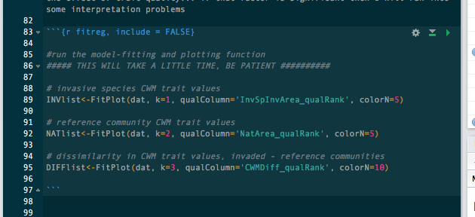
Download, run, explore
Go to this link
and download everything in ‘exampleProject’ and put it in one folder
https://github.com/marissalee/AnalysesR_example.git
Identify the r code “chunks”
Use the green arrow in the upper right to run each chunk in succession (warning, some take a while)
Example

Slide 19
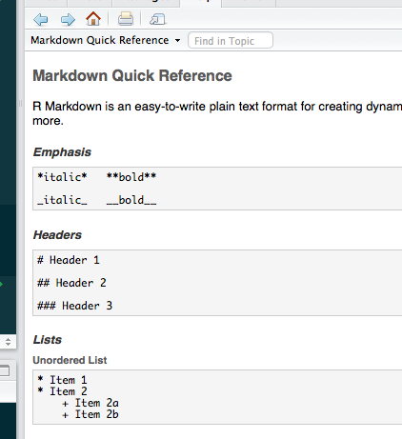
R Markdown
Note – I’ll give you more time to play with this using a smaller .md file
What is RMarkdown syntax like?
Check out the cheatsheets under Help > Cheatsheets or Help > Markdown reference
Example

Slide 20
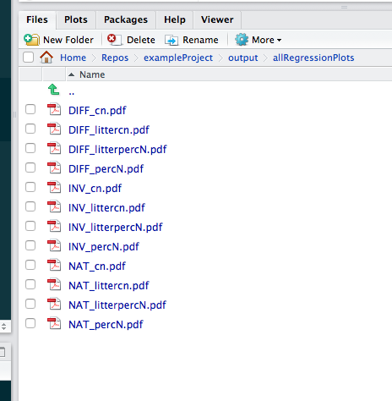
Tidy file structure
Find where you read in the “raw” data. How did this code navigate your tidy file structure?
Find where you write the results tables to new files. What’s the point of “paste” in there?
Find where you save the figures to files.
Example

Slide 21
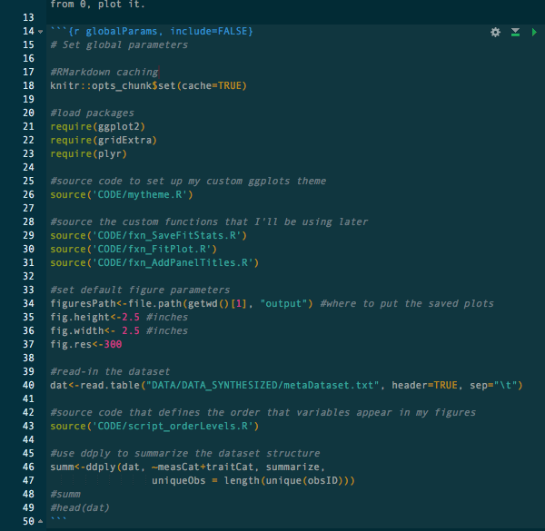
Set up workspace
Which global setting do you already routinuely set up in your scripts?
Which parts of this 1st chunk are new to you?
ddply/summarize – this is a nice tool for making certain you know the structure of your dataframe
Example

Slide 22
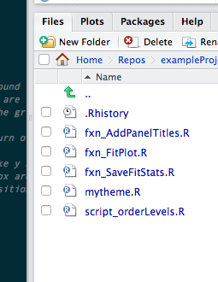
Source-in the ugly stuff if you know it works already
Check out the code files that are sourced-in ... they are ugly, right?
Did you notice my hyper-logical filenaming scheme?
How might this strategy be useful in your workflow?
Example

Slide 23
Lists are great
Whatever you do, don’t do str(INVlist) ... or just see what happens
Try these other approaches to see what I packed into that list
names(INVlist)
names(INVlist[[‘results’]])
names(INVlist[[‘results’]][[‘percN’]])
str(INVlist[['results']][['percN']])
INVlist[['figures']][['percN']][[‘soilN’]]
Try pulling up this plot using a line of code: Trait dissimilarity in litter %N (litterpercN) versus invasion effects sizes on total soil inorganic N (toti)
Example

Slide 24
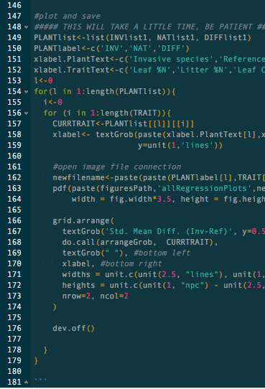
Reduce redundancy with functions and loops
Investigate the plot-saving loop (line 147 - 179)
What is the gooey core doing?The function grid.arrange() is the ggplot equivalent of par(mfrow())
What are objects that the loop is stepping through?
Example

Slide 25
Results
Response variable | Trait type | Invasive species |  |  |  |  | Reference CWM |  |  |  |  | CWM Dissimilarity
 |  | Hyp. | Leaf |  | Litter |  | Hyp. | Leaf |  | Litter |  | Hyp. | Leaf |  | Litter
 |  |  | est | k | est | k |  | est | k | est | k |  | est | k | est | k
NH₄⁺ | %N | + | 0.01 | 122 | 0.56 | 19 | - | -0.14 | 117 | -0.11 | 26 | + | 0.19 | 115 | 0.61 | 26
NO₃⁻ |  | + | 0.07 | 128 | -0.01 | 20 | - | -0.04 | 124 | 0.01 | 30 | + | 0.11 | 122 | 0.18 | 30
NH₄⁺+NO₃⁻ |  | + | 0.09 | 173 | 0.51 | 21 | - | -0.06 | 146 | 0.17 | 24 | + | 0.15 | 144 | 1.55 | 24
Δ NH₄⁺ |  | + | 0.12 | 38 | 0.86 | 13 | - | 0.05 | 38 | -0.53 | 15 | + | -0.06 | 38 | 0.32 | 15
Δ NO₃⁻ |  | + | 0.14 | 67 | 0.81 | 16 | - | 0.13 | 65 | -1.23 | 18 | + | 0.19 | 65 | 0.58 | 18
Δ NH₄⁺+NO₃⁻ |  | + | 0.01 | 84 | 0.04 | 15 | - | -0.01 | 77 | -0.04 | 18 | + | 0.21 | 77 | -0.10 | 18
Soil N |  | + | 0.34 | 170 | 0.51 | 27 | - | 0.16 | 154 | -0.04 | 28 | + | -0.03 | 152 | 0.34 | 28
Soil C:N |  | - | -0.20 | 89 | -0.46 | 10 | + | -0.05 | 81 | 0.27 | 12 | - | 0.01 | 81 | -0.38 | 12
SOM |  | + | 0.27 | 88 | 0.11 | 19 | - | 0.15 | 81 | -0.36 | 18 | + | -0.03 | 81 | 0.51 | 18
NH₄⁺ | C:N | - | -0.02 | 64 | -0.02 | 11 | + | 0.01 | 48 | 0.01 | 17 | - | -0.01 | 48 | -0.02 | 17
NO₃⁻ |  | - | 0.00 | 75 | -0.03 | 12 | + | 0.01 | 61 | 0.00 | 18 | - | 0.00 | 61 | -0.02 | 18
NH₄⁺+NO₃⁻ |  | - | -0.01 | 97 | -0.01 | 14 | + | 0.01 | 70 | 0.01 | 23 | - | -0.02 | 70 | -0.02 | 23
Δ NH₄⁺ |  | - | 0.01 | 19 | -0.01 | 7 | + | 0.01 | 16 | 0.00 | 10 | - | -0.01 | 16 | 0.00 | 10
Δ NO₃⁻ |  | - | 0.00 | 38 | -0.01 | 14 | + | 0.00 | 28 | 0.01 | 18 | - | 0.00 | 28 | -0.01 | 18
Δ NH₄⁺+NO₃⁻ |  | - | 0.00 | 59 | -0.01 | 16 | + | 0.02 | 46 | 0.00 | 22 | - | -0.03 | 46 | -0.01 | 22
Soil N |  | - | -0.01 | 101 | -0.02 | 20 | + | 0.00 | 89 | 0.01 | 23 | - | -0.01 | 89 | -0.01 | 23
Soil C:N |  | + | 0.00 | 70 | NA | 12 | - | -0.02 | 66 | 0.00 | 13 | + | 0.03 | 66 | 0.01 | 13
SOM |  | - | 0.03 | 28 | -0.03 | 13 | + | 0.02 | 22 | 0.00 | 13 | - | -0.01 | 22 | 0.00 | 13
Example
Notes:
So, taking a step back, you can see that trait dissimilarity really had the most information.
Another thing to note is that there are a lot of no-relationship findings, but none of our hypotheses have been challenged.
Dissimilarity explains inorganic N pools, mineralization rates, soil C:N

Slide 26
Now, start making your own tidy project folder for scripts from this class
Here’s a template to get you started
https://github.com/marissalee/AnalysesR_template.git
Make your own

