Slide 1
An Integrative Theory of Transportation and Location Decision-Making
Jason Hawkins, University of Nebraska Lincoln

Slide 2
What is a city?
A large town
A region of high population density
Civitas: a community of citizens governed by a common set of laws
Polis: the administrative center of a city-state

Slide 3
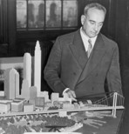

What is a city?

Slide 4
Our Interactions with the Built Environment

Slide 5
Transportation Demand Models = Models of Time Use

Slide 6
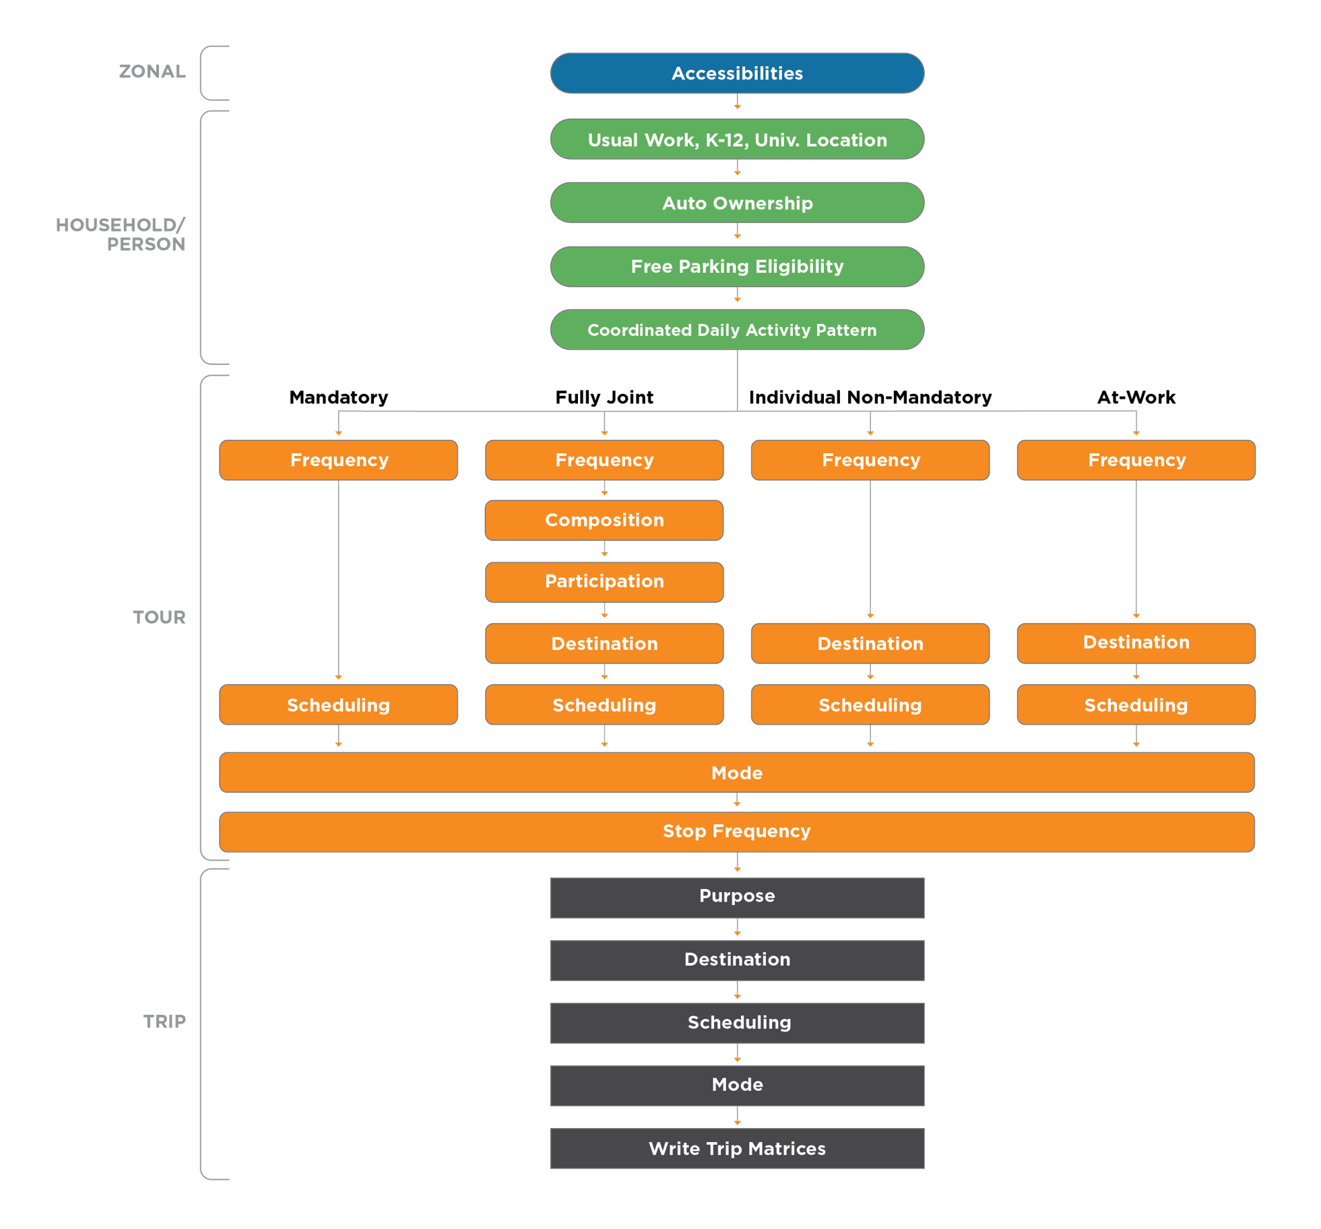
Activity-Based Travel Model Integration
What is the underling theory of integration?

Slide 7
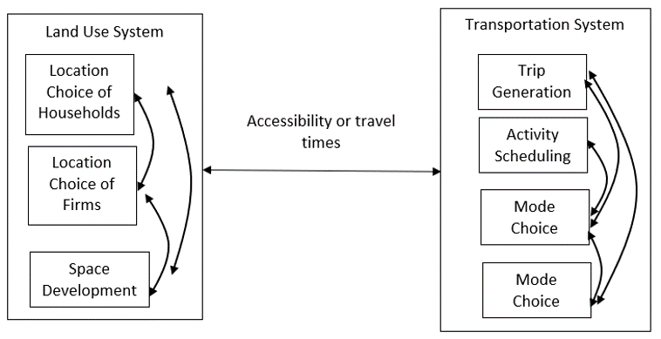
Transportation-Land Use Model Integration
What is the underling theory of integration?

Slide 8
Conceptual Systems Integration

Slide 10
A Note on Theory of Integration
Individual decision models (comprising holons) as complex emergent systems vs. joint decision models (structural, copula multivariate distributions, etc.) as microeconomic systems
No absolute answers: Analogous to the frequentist vs. Bayesian debates in statistics

Slide 11
Home Production and Location Choice
“Eco-nomics” from Greek: Oikos (“household”) and Nemein (“management”)
Begin from model of Becker: households make tradeoffs between home production (time allocation) & market consumption (money allocation)
Forms a consistent theoretical basis for integrating transportation, land use, & macroeconomic models
Activity-based travel models have similar theoretical lineage (through value of travel time literature of DeSepera, Evans, & Jara-Diaz)
How much time do I spend on activities in the home vs. out of the home?
Do I want a large home with plenty of space for cooking or a small apartment close to a variety of restaurants?

Slide 12
Research Gaps in Home Production
Data Gaps
Household travel surveys do not consider in-home activities
Expensive & challenging to collect survey data with both time use & expenditure responses (we tried it)
Data fusion methods used in home production literature are ad hoc & poorly developed
Model Gaps
Only considers single-person households
Does not model non-working household members
Arbitrary definition of consumption technology: minimum time required to consume a good or service

Slide 13
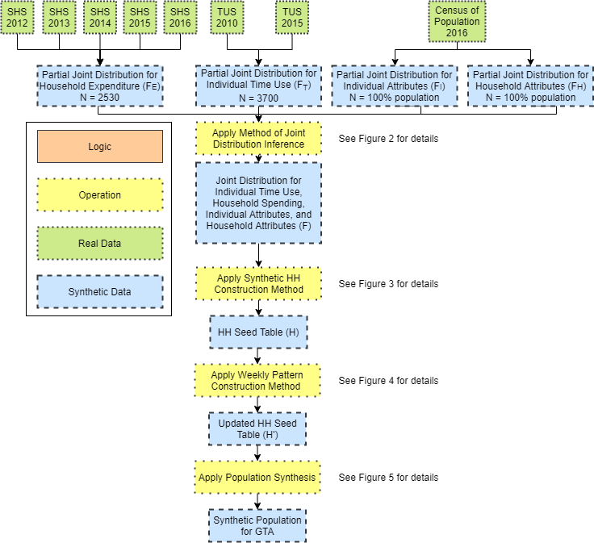
Data Synthesis

Slide 14
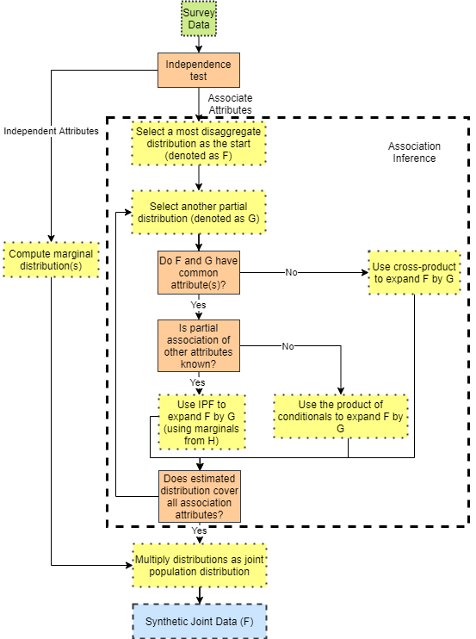
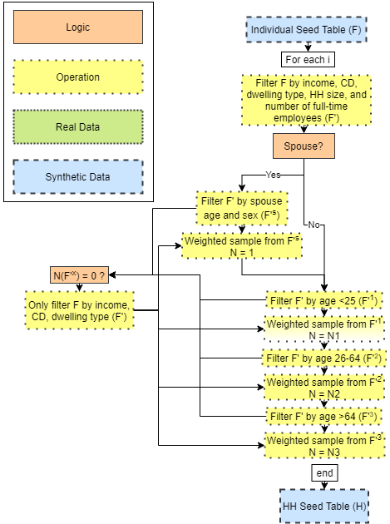
Data Synthesis

Slide 15
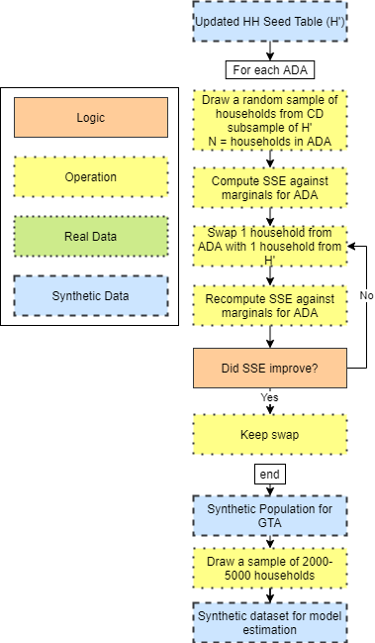
Data Synthesis

Slide 16
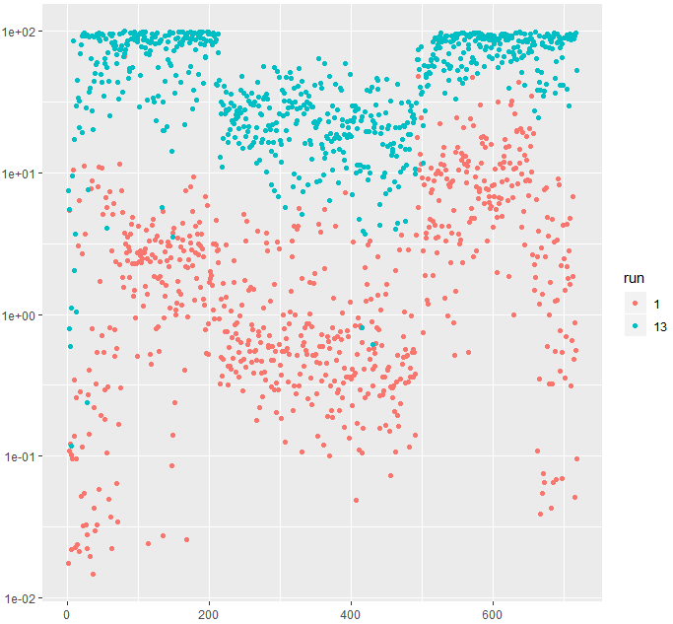
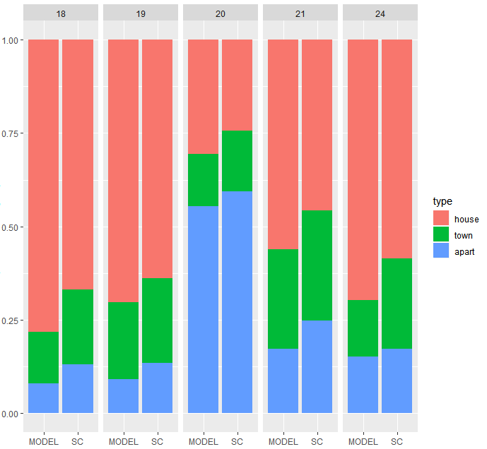
Data Synthesis Validation

Slide 17
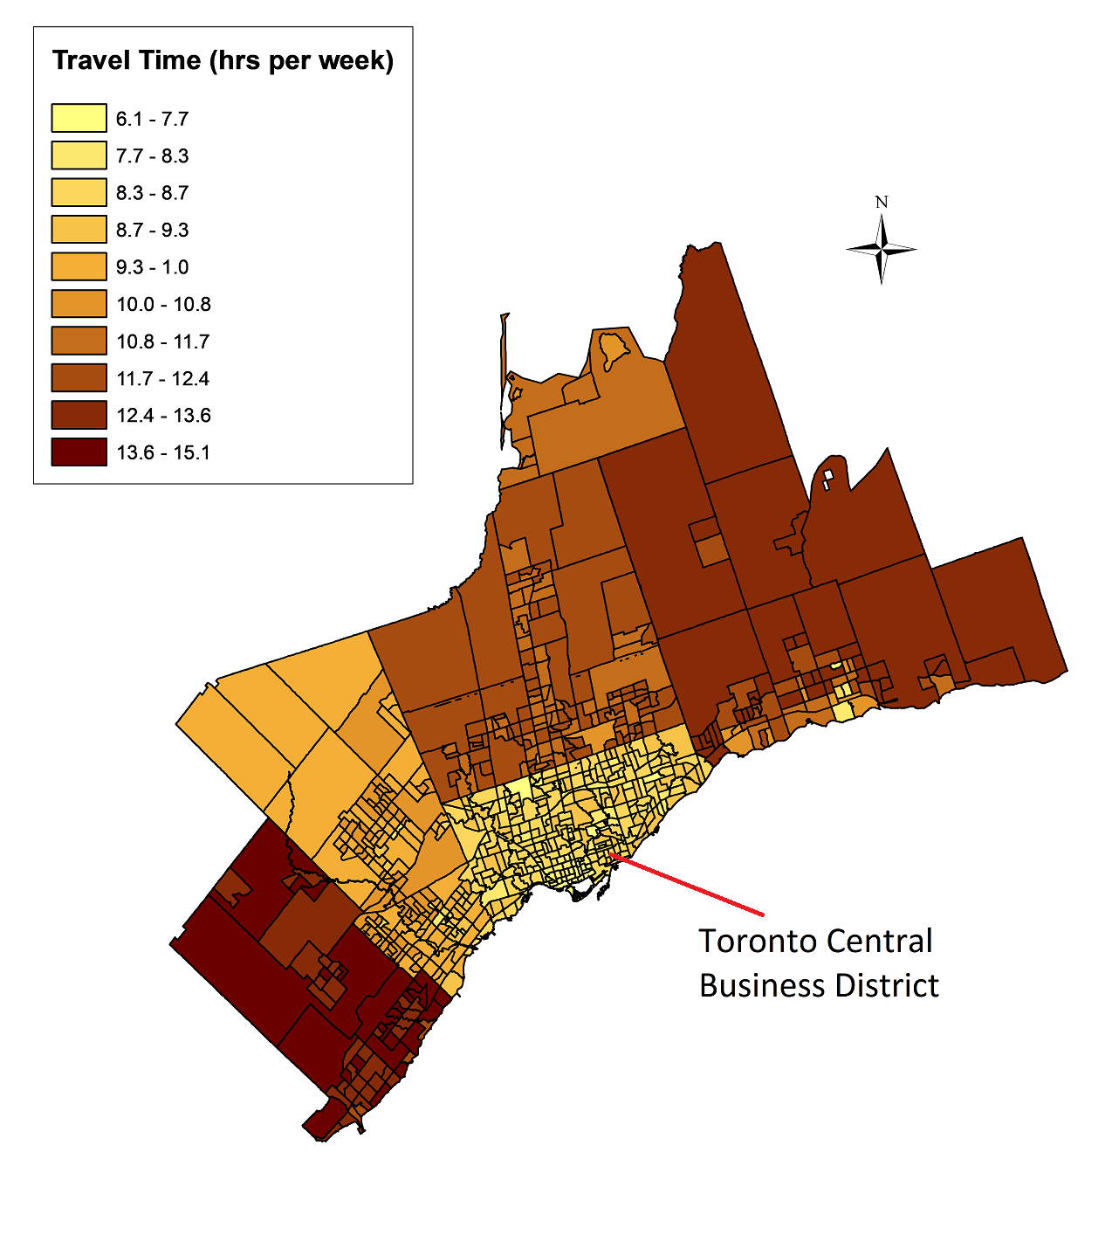
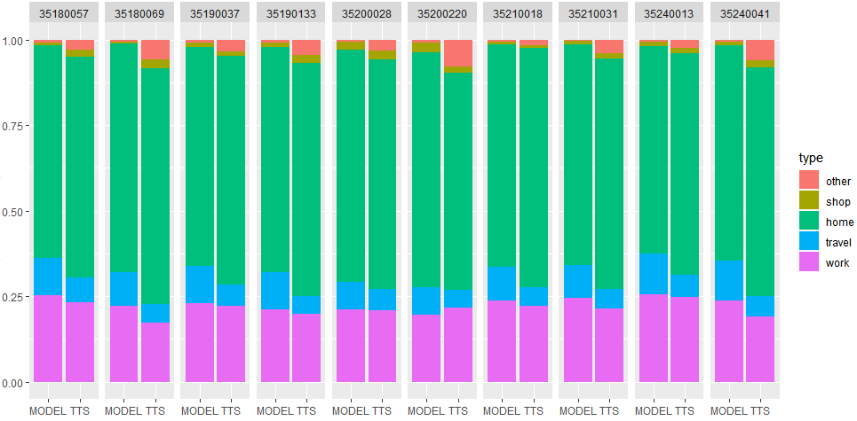
Data Synthesis Validation

Slide 18
Conceptual Model Framework
Assume a multiple discrete-continuous extreme value (MDCEV) model with a generalized nested logit error structure
Conceptual model developed for joint location-time use-consumption decisions
$$ F\left(\epsilon_1^*,\left(\epsilon_{12},…\epsilon_{1k} \right),\left(\epsilon_{l2},…\epsilon_{lK} \right),…\left(\epsilon_{L1},…\epsilon_{LK} \right)\right)= \\ \exp \left(-\exp \left(\frac{-\epsilon_1^*}{\sigma}\right)\right)\prod_{l=1}^L\left[\exp -\left(\sum_{k=1}^K \exp \left(\frac{-\epsilon_{lk}}{\sigma\theta}\right)\right)^\theta \right]$$

Slide 19
Conceptual Model Framework
Maximize the objective function
$$max\left(U_{q}\left(x_{ql},t_{ql},t_{qlw}\right)\right)=\sum_{l=1}^{L}{\sum_{k=1}^{K}{u_{k}}}\left(x_{qlk}\right)+\sum_{l=1}^{L}{\sum_{n=1}^{N}{{\tilde{u}}_{n}}}\left(t_{qln}\right)+\sum_{l=1}^{L}{{\tilde{u}}_{w}}\left(t_{qlw}\right)$$
With the following baseline utility function
$$ψ_{qkl}=exp\left(β_{q}^{′}z_{qlk}+δ_{q}^{′}x_{ql}+ϵ_{qlk}\right)$$
$$ψ_{qnl}=exp\left({\tilde{β}}_{q}^{′}{\tilde{z}}_{qln}+{\tilde{δ}}_{q}^{′}{\tilde{x}}_{ql}+{\tilde{ϵ}}_{qln}\right)$$
$$ψ_{qwl}=exp\left({\tilde{β}}_{q}^{′}{\tilde{z}}_{qlw}+{\tilde{δ}}_{q}^{′}{\tilde{x}}_{ql}+{\tilde{ϵ}}_{qlw}\right)$$

Slide 20
Location Choice Models
I do plenty of these models!
Residential location choice - bid-auction setup with multi-person utility
Firm location choice - considering firm structure and choiceset generation
Semi-Compensatory Indepedent Availability Logit (SCIAL) with Aggregation of Alternatives

Slide 21
Empirical Model Framework
Simplify from general model structure by removing location choice $L$
Assume a multiple discrete-continuous extreme value (MDCEV) utility with a translated CES function (assuming $α_{k}−>0$ gives a variant of the LES function)
$$U\left(x\right)=\sum_{n=1}^{N}{\frac{γ_{n}}{α_{n}}}ψ_{n}\left[{\left(\frac{x_{n}}{γ_{n}}+1\right)}^{α_{n}}−1\right]$$

Slide 22
Empirical Model Framework
Maximize the objective function
$$max\left(U_{q}\left(x_{q},t_{q},t_{qw}\right)\right)=\sum_{k=1}^{K}{u_{k}}\left(x_{qk}\right)+\sum_{n=1}^{N}{{\tilde{u}}_{n}}\left(t_{nq}\right)+{\tilde{u}}_{w}\left(t_{wq}\right)$$
Subject to the constraints
$$\sum_{k=1}^{K}{p_{qk}}x_{qk}=E_{q}+ω_{q}t_{qw}$$
$$\sum_{n=1}^{N}{t_{qn}}+t_{qw}=T_{q}$$

Slide 23
Empirical Model Framework
Assume all members of a household are subject to a common monetary budget constraint & independent temporal budget constraints
Introduce a parallel constraint (model called PC-MDCEV) through a change in the specification of the GEV error structure to
$$G\left(Y_{11},Y_{12},…Y_{1k}…Y_{H1}…Y_{Hk}\right)=\prod_{h}^{H}{{\left(\sum_{k}^{K}{Y_{hk}}\right)}^{θ_{h}^{q}}}$$
$θ_{h}^{q}$ represents the contribution of individual q (household member h) to consumption by household H
$θ_{h}^{q}$ can be parameterized based on member characteristics and is identified off inter-household variations

Slide 24
Empirical Model Framework
With some simplication, the joint likelihood function for individual $q$ is given by
$$\begin{matrix}P_{q}=\left[c_{qw}\prod_{k=2}^{K}{c_{qk}}\sum_{k=1}^{M}{\frac{1}{c_{qk}}}\prod_{n=2}^{\tilde{M}}{c_{qn}}\sum_{n=1}^{\tilde{M}}{\frac{1}{c_{qn}}}\right]\left[\frac{{\tilde{V}}_{qw}}{a−b}exp\left({\tilde{β}′}_{qw}{\tilde{z}}_{qw}\right)exp\left(−\frac{{\tilde{V}}_{qw}}{a−b}exp\left({\tilde{β}′}_{qw}{\tilde{z}}_{qw}\right)\right)\right] \\ \prod_{k=1}^{M}{\frac{exp\left({θ_{h}^{q}W}_{qk}\right)}{\left(\sum_{k=1}^{K}{e}xp\left({θ_{h}^{q}W}_{qk}\right)\right)}}\left(M−1\right)!\left[\frac{\prod_{\tilde{M}=1}^{\tilde{M}}{exp}\left(W_{qn}\right)}{\sum_{n=1}^{N}{exp}\left(W_{qn}\right)}\left(\tilde{M}−1\right)!\right]\end{matrix}$$
where
$$a=\frac{ω_{q}}{x_{q1}^{*}}$$
$$b=\frac{1}{t_{q1}^{*}}$$

Slide 25
Standard Definition of Minimum Time
Conceptually: minimum time to consume a given good or service
Leisure activities defined as those to which a person devotes > minimum time (constraint is non-binding)
Challenging to determine the minimum time and define leisure vs. maintenance activities: based on if the time constraint is binding?
Jara-Diaz pioneered applications in transportation field
Applied work uses an assumption about leisure activities or minimum reported time in dataset

Slide 26
Standard Definition of Minimum Time
Problems:
How do we define a uniform set of leisure activities? Walking? Watching TV? What about if I think about a research project while riding my bike?
Travel time has a negative marginal utility & does not fit with positive marginal utility assumption of MDCEV

Slide 27
Proposed Definition of Minimum Time
My approach:
Travel time removed from total travel budget
Time budget then becomes endogenous as a function of the travel time necessary to move between activity locations (transportation model connection)
Similarly, monetary budget could be considered conditional upon the home purchase (a daily vs. long-term expenditure connection)

Slide 28
Some Empirical Results

Slide 29
Some Empirical Results

Slide 30
Some Empirical Results
Members of larger households tend to spend less time on home production
Represents an opportunity to apply the economics of the firm to an interpretation of household behavior!
Larger households, like larger firms, benefit from economies of scale
Type & mix of dwellings (detached, townhouse, apartment, etc.) have significant influences on both time use and expenditure
Both in-home and out-of-home food consumption time tends to increase with age – younger individuals are in a rush to finish their meals?

Slide 31
Next Steps
Difficult to jointly model long-term location & medium-term transportation choice for variety of reasons
Conceptually, model structure is feasible….
However, how to determine counterfactual activity patterns given a different home location?

Slide 32
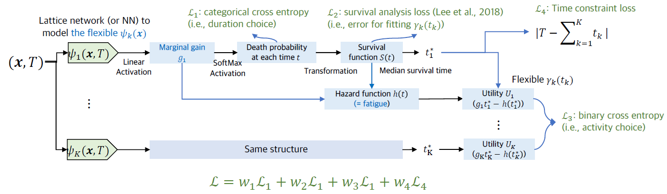
Next Steps
Machine Learning (Flexibility) + Econometrics (Interpretation)

Slide 33
Thank you!

