Slide 1
Diagnostics

Slide 2

Agenda
01
DTCs
02
OBD
03
UDS

Slide 3

01 – DTCs

Slide 4
DTCs
DTC Classification (OBD II)
Overview
P – Powertrain
C – Chassis
B – Body
U – Network (wiring bus)
Definition: Diagnostic Trouble Codes (DTCs) are alphanumeric codes generated by ECUs to indicate faults or malfunctions
Importance: DTCs are essential in identifying faults in cars
Standardization
Identification
Classification
Notes:
DTCs provide a standardized way of identifying and diagnosing issues as they come up.
Standardization – DTCs follow standardization forms created by the SAE and ISO. Though different manufacturers may have DTCs that are specific to them, the standardization ensures that general trends are followed
Identification – DTCs can easily be looked up to identify the exact problem
Classification – DTCs can be classified by severity or the system affected. DTCs with higher severity should be addressed first
On the left, we see an example of classification as designated by the OBD-II

Slide 5
02 – OBD

Slide 6
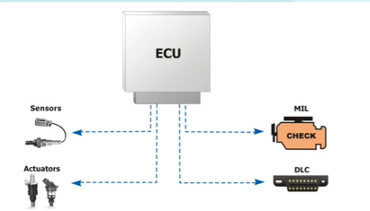
OBD
OBD Diagram
Overview
Definition: The On-Board Diagnostic (OBD) System refers to the vehicle’s ability to diagnose and report faults
Importance: OBDs handle faults by either fixing them or alerting the driver, so the vehicle can continue operating
ECU
Actuators
MIL – Malfunction Indicator Light
DLC – Diagnostic Link Connector
Scan Tool
OBD II
Notes:
ECU (Electronic Control Unit), which uses input from various sensors (e.g., oxygen sensors) to control the actuators
Actuators (e.g., fuel injectors) are regulated according to the sensor input to get the desired performance.
"MIL: When the ECU collects a DTC code, it sends a signal to the vehicle dashboard to turn on the appropriate indicator lights. These lights, known formally as Malfunction Indicator Lights or MILs, provide an early warning system for vehicle malfunctions. Generally speaking, if the light turns on and stays on, the problem is minor. If the light flashes, the problem is urgent.
A modern vehicle can support hundreds of parameters, which can be accessed via the DLC (Diagnostic Link Connector)
Scan Tool – used to scan and interpret parameters via the DLC
This on-board computer system collects information from the network of sensors inside the vehicle, which the system can then use to regulate car systems or alert the user to problems.
OBD-II
OBD II is the latest version of on-board diagnostics. It monitors and tracks the vehicle's performance by collecting various parameters from a network of sensors. These parameters are processed by the OBD system and are stored as diagnostics trouble code (DTC) when found beyond acceptable range. Let's understand by taking the example of an emission control system.
Example: If the vehicle is emitting CO at a higher rate than permissible, the sensor will send a signal to the OBD system. It will store this piece of information in the form of a DTC, specified in the OBD II protocol. Additionally, the OBD system will also switch on the malfunction indication light (MIL) to inform the vehicle user.

Slide 7
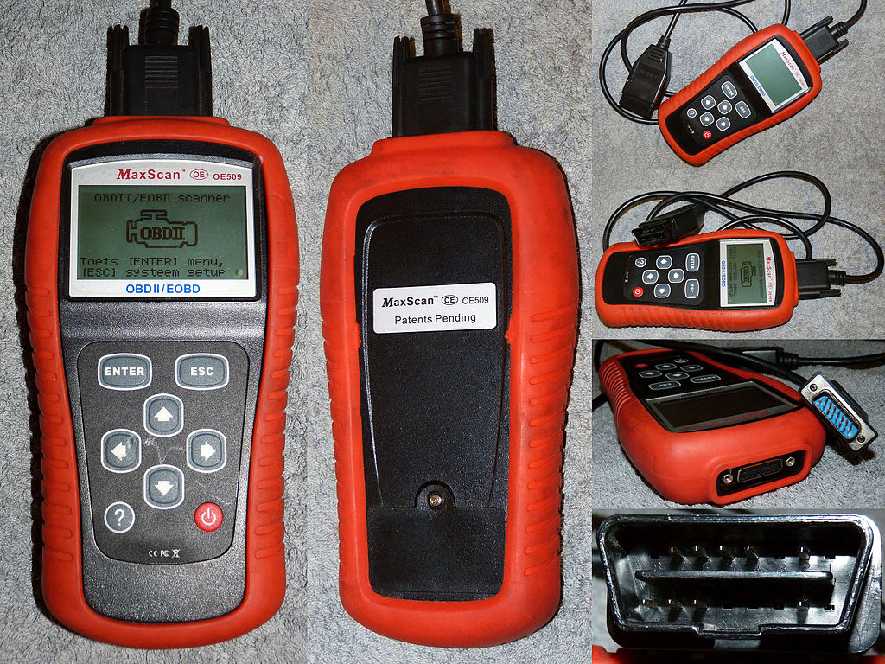
Interpreting DTCs
OBD Device
Overview
Importance: Being able to interpret DTCs is essential to diagnosing faults
Five Characters (OBD II)
Control System Identification
Standardization
Subsystem Identification
Exact Issue
Notes:
For OBD II, DTCs are 5 characters long. The first character indicates the control system that has an issue (P powertrain, C chassis, B body, U network)
The second character indicates if the code is standardized (0 for generic, according to SAE, 1 for manufacturer specific)
The third character indicates which subsystem is at fault (1 for fuel/air metering, 3 for ignition, etc.)
The last 2 characters represent a number from 0 to 99 that reveal the exact issue of the vehicle
In practice, these codes can be looked up in a manual.

Slide 8
DTC Code | Description | Troubleshooting Guide
P0001 | Fuel Volume Regulator Control Circuit/Open | - Check the fuel volume regulator wiring and connectors.<br>- Inspect the fuel pressure regulator.
P0100 | Mass or Volume Air Flow Circuit | - Check the MAF sensor's wiring and connectors.<br>- Clean or replace the MAF sensor if it's dirty or faulty.
P0171 | System Too Lean (Bank 1) | - Inspect for vacuum leaks.<br>- Check the fuel injector operation.<br>- Examine the oxygen sensors.
P0300 | Random/Multiple Cylinder Misfire Detected | - Check spark plugs and spark plug wires.<br>- Inspect the ignition coils.<br>- Look for any vacuum leaks.
P0420 | Catalyst System Efficiency Below Threshold (Bank 1) | - Inspect the catalytic converter.<br>- Check the rear and front O2 sensors.<br>- Look for exhaust leaks.
P0455 | Evaporative Emission System Leak Detected (large leak) | - Check the fuel cap (often a loose cap is the culprit).<br>- Inspect the EVAP system for leaks.
P0456 | Evaporative Emission System Leak Detected (small leak) | - As with P0455, check the fuel cap.<br>- Use a smoke machine to find tiny leaks in the EVAP system.
P0500 | Vehicle Speed Sensor A | - Check the speed sensor's wiring and connectors.<br>- Inspect the speedometer and instrument cluster.
P0700 | Transmission Control System Malfunction | - Inspect the transmission control module.<br>- Check for other transmission-related DTCs that might provide more specifics.
C0035 | Left Front Wheel Speed Circuit Malfunction | - Inspect the ABS sensor on the left front wheel.<br>- Check the sensor's wiring and connectors.
B0100 | Electronic Front End Sensor Fault | - Inspect the front end sensors and their wiring.<br>- Check for damage to the front bumper or collision-related issues.
U0001 | High-Speed CAN Communication Bus | - Check the CAN bus wiring for shorts or opens.<br>- Inspect the CAN bus terminators at both ends of the bus.
Notes:
Here, we some examples of DTCs, their description, and how to troubleshoot

Slide 9
Service | PID | Description
01 | 00 | List of supported PIDs (01-20)
01 | 01 | Monitor status since DTCs cleared (includes MIL status and number of DTCs)
01 | 02 | Freeze DTC
01 | 03 | Fuel system status
01 | 04 | Calculated engine load
01 | 05 | Engine coolant temperature
01 | 0C | Engine RPM
01 | 0D | Vehicle speed
01 | 0F | Intake air temperature
01 | 11 | Throttle position
01 | (Same as Service 01 PIDs) | Show freeze frame data (data captured when a fault is detected)
01 | N/A | Show stored Diagnostic Trouble Codes (DTCs) (No PIDs, just request the service)
01 | N/A | Clear/reset stored emissions-related diagnostic information (No PIDs, just request the service)
01 | 00 | List of supported PIDs for Service 09
01 | 01 | VIN (Vehicle Identification Number) Message Count
01 | 02 | VIN (Vehicle Identification Number)
Notes:
This slide details some sample parameters we can take when interacting with an OBD tool.

Slide 10
03 – UDS

Slide 11

UDS
UDS
Overview
Definition: Unified Diagnostic Services (UDS) is a diagnostic communication protocol used in ECUs
Importance: UDS provides a standardized protocol which enables diagnostics, updates, and testing of vehicles
Standardization
Client-Server
Multiple Use Cases
DTC Analysis
Parameter Extraction
Testing
Modification
Notes:
Unified Diagnostic Services (UDS) is a diagnostic communication protocol used in ECUs within automotive electronics, which is specified in the ISO 14229-1.
Diagnostic tools are able to contact all ECUs installed in a vehicle, which has UDS services enabled.
It lets the diagnostic systems communicate with the ECUs to diagnose faults and reprogram the ECUs according required).
Standardization – Standardized across both manufacturers and standards
We can think of UDS as a client-server architecture, where the client is the tester tool and the server is the vehicle. Thus, we can send requests to the vehicle to retrieve certain information
DTC Analysis – UDS lets us read and analyze DTCs so we know what is wrong with the vehicle
We can extract parameters such as temperature, state of charge, even VIN
Because we are diagnosing the vehicle, can test safety-critical features to ensure there aren’t any critical faults
We can even directly modify ECU behavior through resets, firmware flashing, and modifying settings

Slide 12
UDS Deep Dive
UDS
Overview
Importance: Analyzing the specific standards employed and functionalities of UDS can provide further clarity on its importance
Request Format
Response Format
Diagnostic Session Control
ECU Reset
Communication Control
Notes:
- SID - Service Identifier
- Request Formats - Request Formats contain a SID, an optional subfunction, and request data
- Example with sub-function: 0x31 0x01 0xAA 0x00
- Example w/o subfunction: 0x22 0xF1 0x86
- Response Formats -
- For positive responses: Comprised of the SID + 0x40, an optional subfunction, and response data
- For negative responses: Comprised of 0x7F, the SID, and the negative response code (NRC)
- Special case: 0x78 is the NRC for response pending
- Diagnostic Session Control (0x10)
- UDS uses different operating sessions, which can be changed using the different sub functions of session control.
- Default Session (0x01): On start, the control unit is by default in the "Default Session".
- Programming Session (0x02): used to upload software
- Extended Diagnostic Session (0x03): used to unlock additional diagnostic functions, such as the adjustment of sensors. Safety system diagnostic session, used to test all safety-critical diagnostic functions, such as airbag tests. In addition, there are reserved session identifiers that can be defined for vehicle manufacturers and vehicle suppliers specific use.
- ECU Reset (0x11)
- The service "ECU reset" is used to restart the control unit (ECU). Depending on the control unit hardware and implementation, different forms of reset can be used,
- Hard Reset (0x01): Simulates the power-on / start-up sequence typically performed after a server has been previously disconnected from its power supply (i.e. battery).
- key off on Rese (0x02): Simulates condition similar to the driver turning the ignition key off
and back on. This reset condition should simulate a key-off-on sequence.
- Soft Reset (0x03): Simulates condition which causes the server to immediately restart the application program
- Communication Control (0x28) - The purpose of this service is to switch on/off the transmission and/or the reception of certain messages of server(s) (e.g. application communication messages).
- enableRxAndTx (0x00): This value indicates that the reception and transmission of messages shall be enabled for the specified communication Type.
- enableRxAndDisableTx (0x01): This value indicates that the reception of messages shall be enabled and the transmission shall be disabled for the specified communication Type.
- disableRxAndEnableTx (0x02): This value indicates that the reception of messages shall be disabled and the transmission shall be enabled for the specified communication Type.
- disableRxAndTx (0x03): This value indicates that the reception and transmission of messages shall be disabled for the specified communication Type.

Slide 13
Appendix I: Negative Response Codes

Slide 14
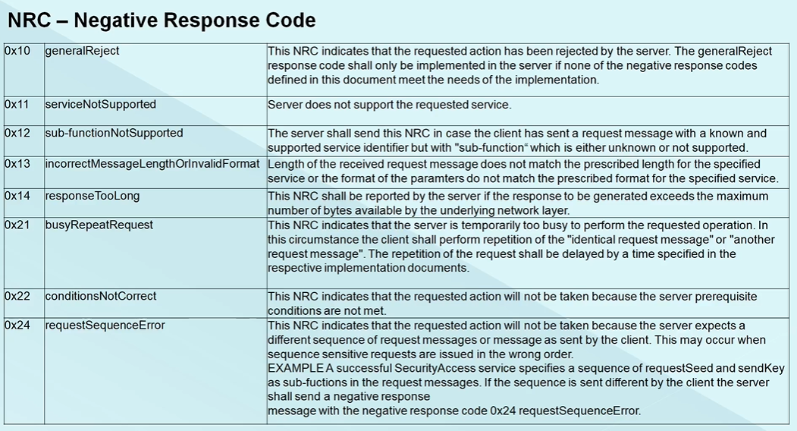
Notes:
Here, we see some examples of Negative Response Codes and their descriptions

Slide 15
