Slide 1
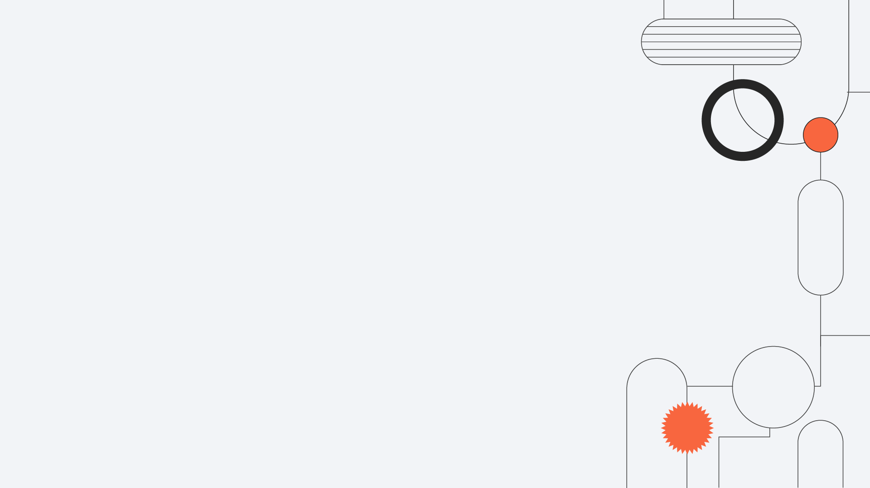
Pump Impeller Quality Control Using CNN
Hamed Aarab | 9925003
Fateme Khodabande | 9825011
Rosha Moshtaghian | 9825080

Slide 2

The Importance of Quality Control
1
Image processing in casting manufacturing product
Chosen Product
2
Submersible pump impeller
The CNN Model
3
Dataset, prerequisites, data visualization, data preprocessing, model definition, training, and testing

Slide 3
Economic Loss
1
1
Rotating machines are widely used in manufacturing industry, operating usually for long time under harsh conditions.
Unexpected Breakdown of Machines
Environmental Pollution
2
3
Human Casualties

Slide 4
Economic Loss
Early and accurate detection of defects and failures of such components of rotating machinery is critical to ensure operational reliability and avoid catastrophic accidents in industrial applications.
1
1
Unexpected Breakdown of Machines
Environmental Pollution
2
3
Human Casualties

Slide 5
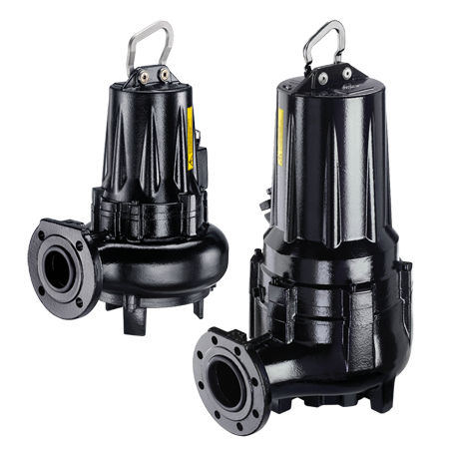
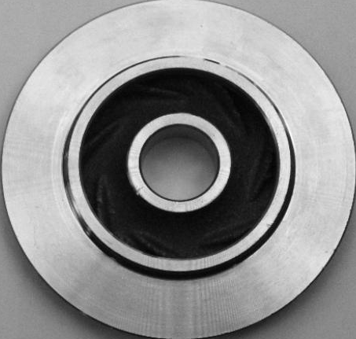
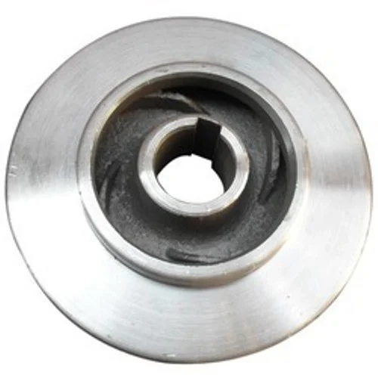
1
1
2
3

Slide 6
Dataset
The data we used are available on Kaggle (https://www.kaggle.com/ravirajsinh45/real-life-industrial-dataset-of-casting-product).
The dataset contains 7348 300x300 grey-scaled images in total. Augmentation is already applied to the images.
1
1
Data
Train
Test
Defective (3758)
Non-defective (2875)
Defective (453)
Non-defective (262)
2
3

Slide 7
About CNN
In deep learning, a convolutional neural network (CNN, or ConvNet) is a class of deep neural networks, most commonly applied to analyzing visual imagery. They are also known as shift invariant or space invariant artificial neural networks (SIANN), based on their shared-weights architecture and translation invariance characteristics. They have applications in image and video recognition, recommender systems, image classification, medical image analysis, natural language processing, brain-computer interfaces, and financial time series.
Project Description
This project is basically a classification problem. Since we are dealing with images, we have decided to solve it with a convolutional neural network due to its abilities in image processing.
1
1
2
3

Slide 8
Prerequisites
The libraries we need are:
Tensorflow for defining the CNN model.
Numpy for transforming arrays.
Matplotlib for visualizing images.
VisualKeras for visualizing our model.
1
1
2
import tensorflow as tf
import numpy as np
import matplotlib.pyplot as plt
import visualkeras as vk
3

Slide 9
Data Visualization
First, we define a function for loading images in the gray-scale mode.
Then, we define another function to get an image and visualize it using Matplotlib. This function transforms the image into an array and rescales its values to [0, 1].
1
1
2
def get_image(path):
return tf.keras.preprocessing.image.load_img(path, color_mode = 'grayscale')
def visualize_image(image):
plt.figure()
plt.imshow(
tf.keras.preprocessing.image.img_to_array(image) / 255,
cmap = 'gray',
)
plt.show()
3

Slide 10
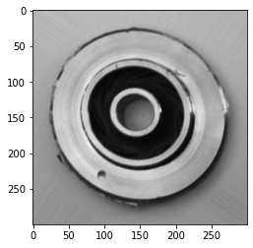
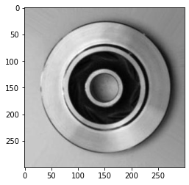
Defective Image Example
Non-Defective Image Example
1
1
2
3

Slide 11
Data Preprocessing
Now, we need to pre-process our data by loading and rescaling the train data and the test data separately. To improve our model's processing abilities, we randomly zoom and shear the train data in order to simulate seeing objects from different angles and distances.
1
1
2
train_data = tf.keras.preprocessing.image.ImageDataGenerator(
rescale = 1 / 255,
zoom_range = 0.2,
shear_range = 0.2,
).flow_from_directory(
'./data/train',
class_mode = 'binary',
batch_size = 8,
target_size = (64, 64),
color_mode = 'grayscale',
)
test_data = tf.keras.preprocessing.image.ImageDataGenerator(
rescale = 1 / 255,
).flow_from_directory(
'./data/test',
#...
)
3

Slide 12
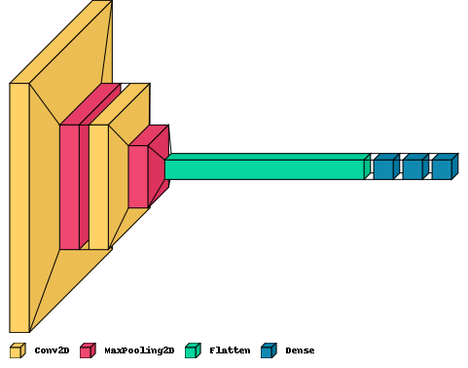
Defining the CNN Model
Our CNN model is going to have two series of convolution and max-pooling layers. Then, we flatten the output and pass it to an MLP with two hidden layers.
Finally, we compile our model with the adam optimizer and binary cross entropy loss function.
1
1
2
3

Slide 13
model = tf.keras.models.Sequential()
model.add(
tf.keras.layers.Conv2D(
filters = 8,
kernel_size = 3,
activation = 'relu',
padding = 'same',
input_shape = (64, 64, 1),
)
)
model.add(tf.keras.layers.MaxPooling2D(pool_size = 2))
model.add(
tf.keras.layers.Conv2D(
filters = 8,
kernel_size = 3,
activation = 'relu',
padding = 'same',
)
)
model.add(tf.keras.layers.MaxPooling2D(pool_size = 2))
model.add(tf.keras.layers.Flatten())
model.add(tf.keras.layers.Dense(units = 16, activation = 'tanh'))
model.add(tf.keras.layers.Dense(units = 16, activation = 'relu'))
model.add(tf.keras.layers.Dense(units = 1, activation = 'sigmoid'))
model.compile(
optimizer = 'adam',
loss = 'binary_crossentropy',
metrics = ['binary_accuracy'],
)
vk.layered_view(model, legend = True)
1
1
2
3

Slide 14
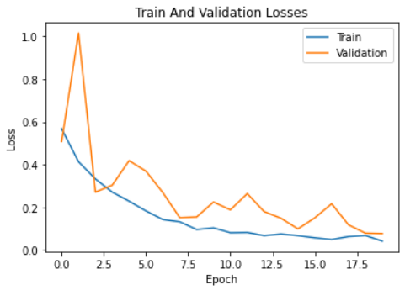
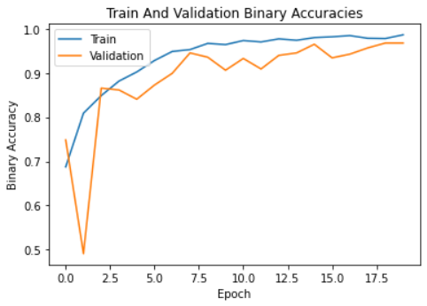
Training and Testing the CNN Model
We train our model with 20 epochs and save the one with the highest validation accuracy.
Here, we plot our model's accuracy over all of the epochs.
1
1
history = model.fit(train_data, validation_data = test_data, epochs = 20)
model.save('classifier_model.h5')
2
3
Our CNN model can classify images of pump impeller with an accuracy of ~98%.

Slide 15

Thank You!
Any Questions?

