Slide 1
An Overview on Deep Neural Networks (DNNs)
Hamed Araab

Slide 2
Common Tasks in Deep Learning

Slide 3
Binary Classification
The primary objective is to assign each item to either Class 1 or Class 0.
Consider the task of classifying images as either "cat" (Class 1) or "not cat" (Class 0):

Slide 4
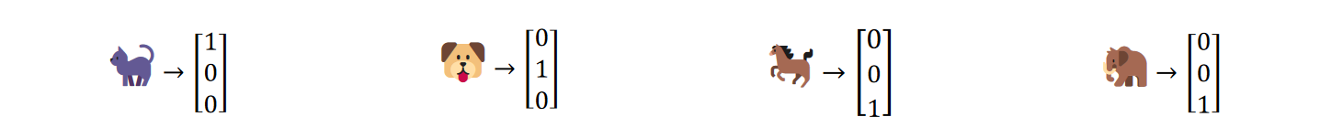
Multi-Class Classification
The primary objective is to categorize items across multiple classes rather than just two.
Consider a scenario where we aim to classify images into distinct categories such as "cat," "dog," and "neither"

Slide 5
Multi-Label Classification
In this scenario, the goal is to identify and assign multiple labels to each input.
For instance, we may seek to find out whether each image contains a "cat," "dog," or "elephant":

Slide 6
Regression
In this task, the goal is to predict a continuous numerical value rather than a class label.
It involves learning a mapping function from input features to a continuous output variable.
For example, we can predict house prices based on features such as square footage, number of bedrooms, and location.

Slide 7
DNNs

Slide 8
What is a DNN?
An artificial neural network (ANN) with multiple layers.
Can model complex relationships due to its multi-layer structure.
In each layer, there are neurons connected to each other.
These connections have weights and each neuron has a bias.

Slide 10
Notes
The input is not usually considered to be a “layer”.
Commonly, total layers = hidden layers + output layer

Slide 11
Forward Propagation

Slide 12
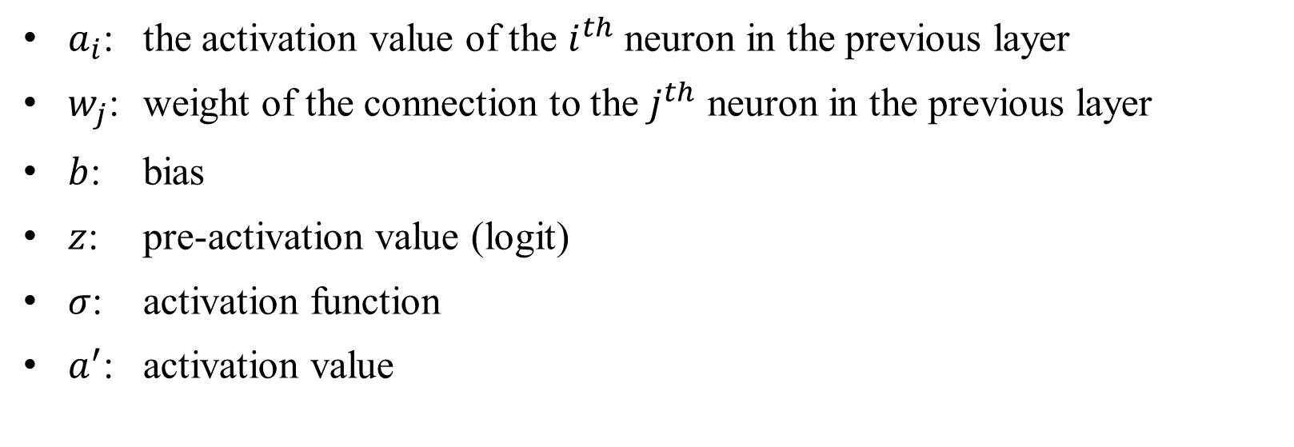
Forward Propagation: A Neuron
$a_{i}$: the activation value of the $i^{th}$ neuron in the previous layer
$w_{j}$: weight of the connection to the $j^{th}$ neuron in the previous layer
$b$: bias
$z$: pre-activation value (logit)
$σ$: activation function
$a^{′}$: activation value

Slide 13
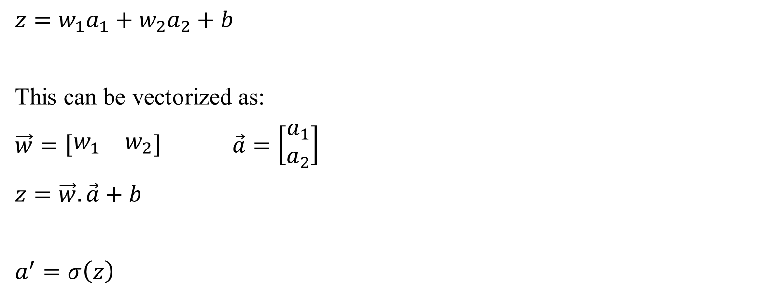
Forward Propagation: A Neuron
$z=w_{1}a_{1}+w_{2}a_{2}+b$
This can be vectorized as:
$\vec{w}=\left[\begin{matrix}w_{1} & w_{2}\end{matrix}\right]$ $\vec{a}=\left[\begin{matrix}a_{1} \\ a_{2}\end{matrix}\right]$
$z=\vec{w}.\vec{a}+b$
$a^{′}=σ\left(z\right)$

Slide 14
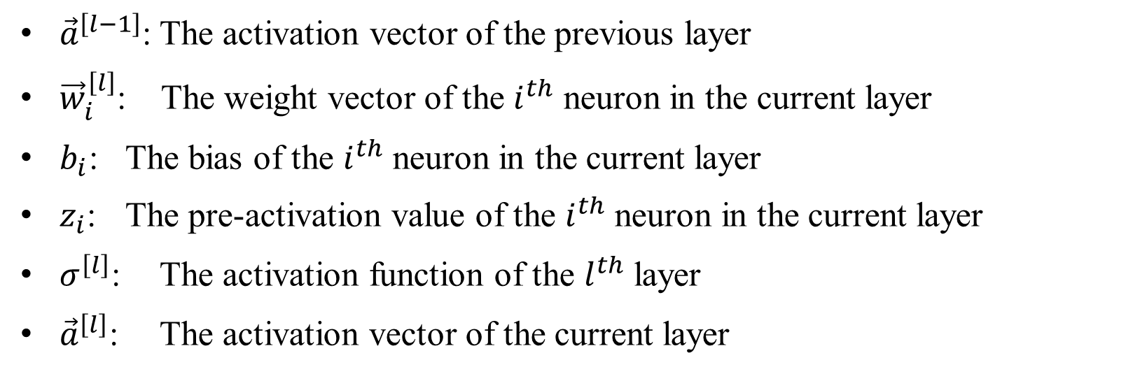
Forward Propagation: A Layer
${\vec{a}}^{\left[l−1\right]}$: The activation vector of the previous layer
${\vec{w}}_{i}^{\left[l\right]}$: The weight vector of the $i^{th}$ neuron in the current layer
$b_{i}$: The bias of the $i^{th}$ neuron in the current layer
$z_{i}$: The pre-activation value of the $i^{th}$ neuron in the current layer
$σ^{\left[l\right]}$: The activation function of the $l^{th}$ layer
${\vec{a}}^{\left[l\right]}$: The activation vector of the current layer

Slide 15
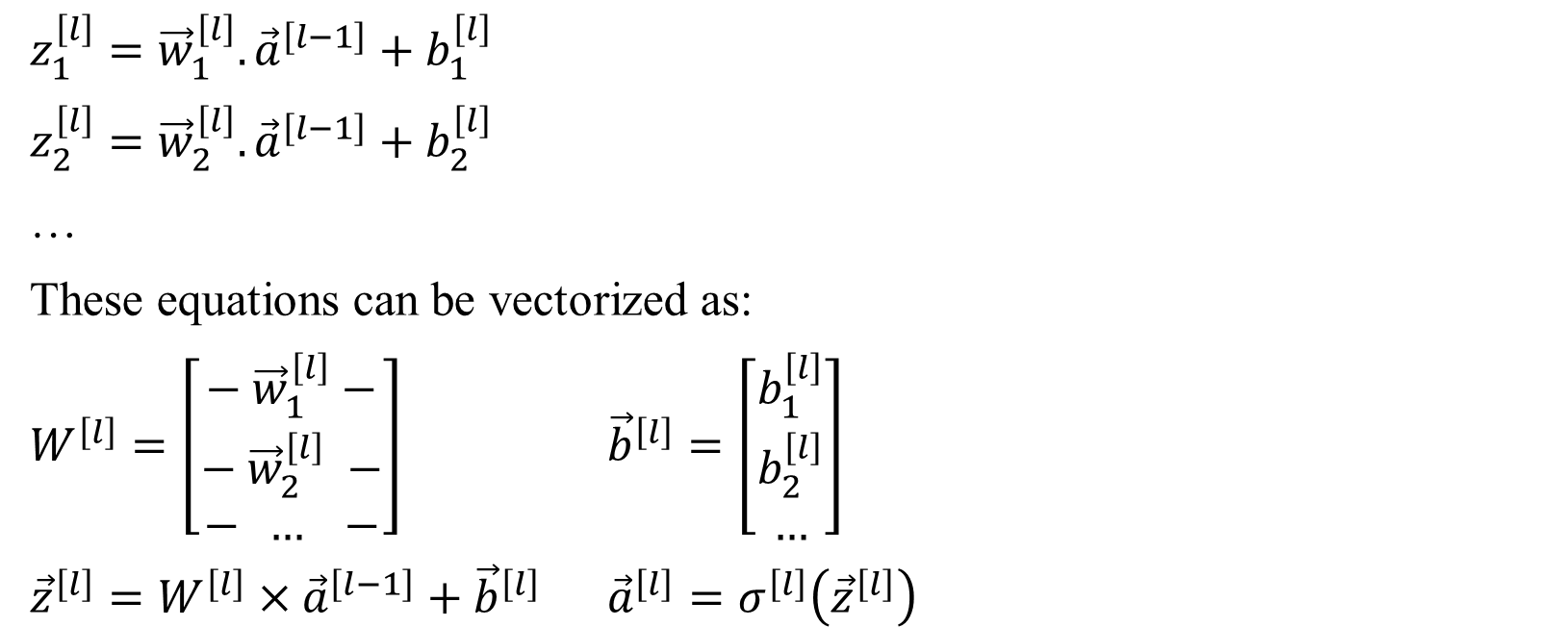
Forward Propagation: A Layer
$z_{1}^{\left[l\right]}={\vec{w}}_{1}^{\left[l\right]}.{\vec{a}}^{\left[l−1\right]}+b_{1}^{\left[l\right]}$
$z_{2}^{\left[l\right]}={\vec{w}}_{2}^{\left[l\right]}.{\vec{a}}^{\left[l−1\right]}+b_{2}^{\left[l\right]}$
…
These equations can be vectorized as:
$W^{\left[l\right]}=\left[\begin{matrix}− {\vec{w}}_{1}^{\left[l\right]}− \\ − {\vec{w}}_{2}^{\left[l\right]} − \\ − … −\end{matrix}\right]$ ${\vec{b}}^{\left[l\right]}=\left[\begin{matrix}b_{1}^{\left[l\right]} \\ b_{2}^{\left[l\right]} \\ …\end{matrix}\right]$
${\vec{z}}^{\left[l\right]}=W^{\left[l\right]}×{\vec{a}}^{\left[l−1\right]}+{\vec{b}}^{\left[l\right]}$ ${\vec{a}}^{\left[l\right]}=σ^{\left[l\right]}\left({\vec{z}}^{\left[l\right]}\right)$

Slide 16

Input and Output in Forward Propagation
${\vec{x}}_{j}$: The input vector of the $j^{th}$ item in the dataset
${\vec{y}}_{j}$: The actual output vector of the $j^{th}$ item in the dataset
${\vec{\hat{y}}}_{j}$: The predicted output vector for the $j^{th}$ item in the dataset

Slide 17

Input and Output in Forward Propagation
${\vec{a}}_{j}^{\left[0\right]}={\vec{x}}_{j}$ $∀j=1,2,…,m$
${\vec{z}}_{j}^{\left[l\right]}=W^{\left[l\right]}×{\vec{a}}_{j}^{\left[l−1\right]}+{\vec{b}}^{\left[l\right]}$ $∀l=1,2,…,L$ $∀j=1,2,…,m$
${\vec{a}}_{j}^{\left[l\right]}=σ^{\left[l\right]}\left({\vec{z}}_{j}^{\left[l\right]}\right)$ $∀l=1,2,…,L$ $∀j=1,2,…,m$
${\vec{y}}_{j}={\vec{a}}_{j}^{\left[L\right]}$ $∀j=1,2,…,m$

Slide 18
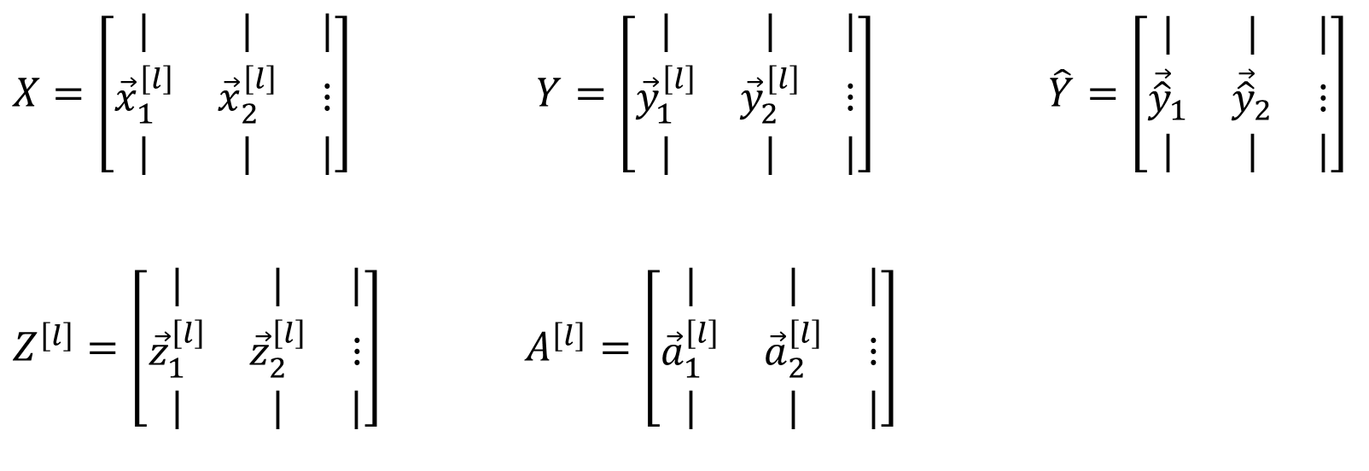
Final Form of Forward Propagation
$X=\left[\begin{matrix}| & | & | \\ {\vec{x}}_{1}^{\left[l\right]} & {\vec{x}}_{2}^{\left[l\right]} & ⋮ \\ | & | & |\end{matrix}\right]$ $Y=\left[\begin{matrix}| & | & | \\ {\vec{y}}_{1}^{\left[l\right]} & {\vec{y}}_{2}^{\left[l\right]} & ⋮ \\ | & | & |\end{matrix}\right]$ $\hat{Y}=\left[\begin{matrix}| & | & | \\ {\vec{\hat{y}}}_{1} & {\vec{\hat{y}}}_{2} & ⋮ \\ | & | & |\end{matrix}\right]$
$Z^{\left[l\right]}=\left[\begin{matrix}| & | & | \\ {\vec{z}}_{1}^{\left[l\right]} & {\vec{z}}_{2}^{\left[l\right]} & ⋮ \\ | & | & |\end{matrix}\right]$ $A^{\left[l\right]}=\left[\begin{matrix}| & | & | \\ {\vec{a}}_{1}^{\left[l\right]} & {\vec{a}}_{2}^{\left[l\right]} & ⋮ \\ | & | & |\end{matrix}\right]$

Slide 19

Final Form of Forward Propagation
$A^{\left[0\right]}=X$
$Z^{\left[l\right]}=W^{\left[l\right]}A^{\left[l−1\right]}+b^{\left[l\right]}$ $∀l=1,2,…,L$
$A^{\left[l\right]}=σ^{\left[l\right]}\left(Z^{\left[l\right]}\right)$ $∀l=1,2,…,L$
$\hat{Y}=A^{\left[L\right]}$

