Slide 1
An Overview on Deep Neural Networks: Part 2

Slide 2
Backward Propagation

Slide 3

Calculating the Loss and Cost
$A^{\left[0\right]}=X$
$Z^{\left[l\right]}=A^{\left[l−1\right]}W^{\left[l\right]}+b^{\left[l\right]}$ $∀l=1,2,…,L$
$A^{[l]}=σ^{\left[l\right]}\left(Z^{\left[l\right]}\right)$ $∀l=1,2,…,L$
$\hat{Y}=A^{\left[L\right]}$
$C=\frac{1}{n}J\left(Y,\hat{Y}\right)$

Slide 4

Gradient Descent and Chain Rule
$A^{[l]}=σ^{\left[l\right]}\left(Z^{\left[l\right]}\right)$ $∀l=1,2,…,L$
$\hat{Y}=A^{\left[L\right]}$
$C=\frac{1}{n}J\left(Y,\hat{Y}\right)$
$\frac{∂C}{∂\hat{Y}}=\frac{1}{n}\frac{∂J}{∂\hat{Y}}$
$\frac{∂C}{∂A^{\left[L\right]}}=\frac{∂C}{∂\hat{Y}}$
$\frac{∂A^{\left[l\right]}}{∂Z^{\left[l\right]}}={σ^{′}}^{\left[l\right]}\left(Z^{\left[l\right]}\right)$ $∀l=L,L−1,…,1$

Slide 5

Gradient Descent and Chain Rule
$Z^{\left[l\right]}=A^{\left[l−1\right]}W^{\left[l\right]}+b^{\left[l\right]}$ $∀l=1,2,…,L$
$\frac{∂Z^{\left[l\right]}}{∂W^{\left[l\right]}}=A^{\left[l−1\right],T}$ $∀l=L,L−1,…,1$
$\frac{∂Z^{\left[l\right]}}{∂b^{\left[l\right]}}=1_{1×n}$ $∀l=L,L−1,…,1$
$\frac{∂Z^{\left[l\right]}}{∂A^{\left[l−1\right]}}=W^{\left[l\right],T}$ $∀l=L,L−1,…,2$

Slide 6
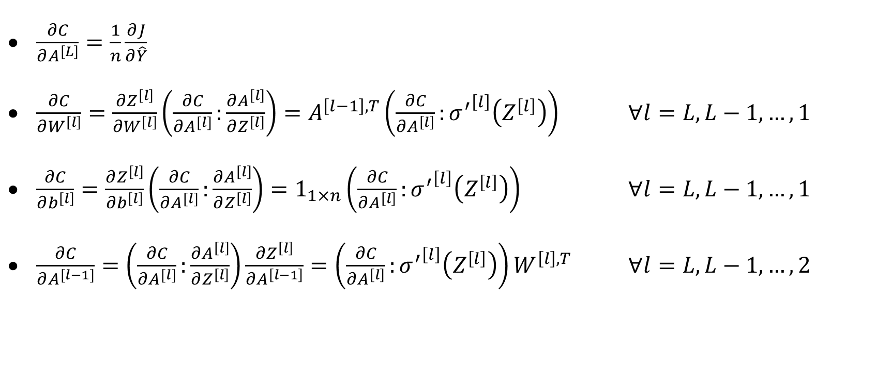
Putting It All Together
$\frac{∂C}{∂A^{\left[L\right]}}=\frac{1}{n}\frac{∂J}{∂\hat{Y}}$
$\frac{∂C}{∂W^{\left[l\right]}}=\frac{∂Z^{\left[l\right]}}{∂W^{\left[l\right]}}\left(\frac{∂C}{∂A^{[l]}}:\frac{∂A^{\left[l\right]}}{∂Z^{\left[l\right]}}\right)=A^{\left[l−1\right],T}\left(\frac{∂C}{∂A^{\left[l\right]}}:{σ^{′}}^{\left[l\right]}\left(Z^{\left[l\right]}\right)\right)$ $∀l=L,L−1,…,1$
$\frac{∂C}{∂b^{\left[l\right]}}=\frac{∂Z^{\left[l\right]}}{∂b^{\left[l\right]}}\left(\frac{∂C}{∂A^{[l]}}:\frac{∂A^{\left[l\right]}}{∂Z^{\left[l\right]}}\right)=1_{1×n}\left(\frac{∂C}{∂A^{\left[l\right]}}:{σ^{′}}^{\left[l\right]}\left(Z^{\left[l\right]}\right)\right)$ $∀l=L,L−1,…,1$
$\frac{∂C}{∂A^{[l−1]}}=\left(\frac{∂C}{∂A^{[l]}}:\frac{∂A^{\left[l\right]}}{∂Z^{\left[l\right]}}\right)\frac{∂Z^{\left[l\right]}}{∂A^{\left[l−1\right]}}=\left(\frac{∂C}{∂A^{\left[l\right]}}:{σ^{′}}^{\left[l\right]}\left(Z^{\left[l\right]}\right)\right)W^{\left[l\right],T}$ $∀l=L,L−1,…,2$

Slide 7

Updating the Weights and the Biases
$∆W^{\left[l\right]}=−α\frac{∂C}{∂W^{\left[l\right]}}$ $∀l=L,L−1,…,1$
$∆b^{\left[l\right]}=−α\frac{∂C}{∂b^{\left[l\right]}}$ $∀l=L,L−1,…,1$

Slide 8
Loss Function Examples

Slide 9
Loss Function Examples
Sum of Squared Errors (SSE)
Binary Cross Entropy (BCE)
Categorical Cross Entropy (CCE)

Slide 10

SSE
Commonly used in regression.
The sum is divided by two for easier derivative calculation.
$$J\left(Y,\hat{Y}\right)=\frac{1}{2}\sum_{i=1}^{n}{\sum_{j=1}^{m_{y}}{{\left({\hat{Y}}_{i,j}−Y_{i,j}\right)}^{2}}}$$

Slide 11

BCE
Commonly used in binary or multi-label classification.
$$J\left(Y,\hat{Y}\right)=−\sum_{i=1}^{n}{\sum_{j=1}^{m_{y}}{\left(Y_{i,j}\log\left({\hat{Y}}_{i,j}\right)+\left(1−Y_{i,j}\right)\log\left(1−{\hat{Y}}_{i,j}\right)\right)}}$$

Slide 12

CCE
Commonly used in multi-class classification.
$$J\left(Y,\hat{Y}\right)=−\sum_{i=1}^{n}{\sum_{j=1}^{m_{y}}{\left(Y_{i,j}\log\left({\hat{Y}}_{i,j}\right)\right)}}$$

Slide 13
Summary of Activation and Loss Functions

Slide 14
Summary of Activation and Loss Functions
Task | Output Layer Activation Function | Loss Function
Regression | ReLU | SSE
Binary of Multi-Label Classification | Sigmoid | BCE
Multi-Class Classification | Softmax | CCE

