Slide 1
An Overview on Deep Neural Networks: Part 1

Slide 2
Introduction

Slide 3
Common Tasks in Deep Learning
Classification
Binary
Multi-Class
Multi-Label
Regression

Slide 4
Binary Classification
Class 1: “cat”
Class 0: “not cat”

Slide 5
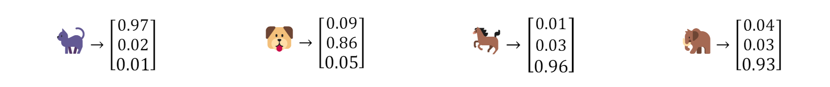
Multi-Class Classification
“cat”, “dog”, “neither”

Slide 6
Multi-Label Classification
“cat”, “dog”, “elephant”

Slide 7
Regression
Housing:
(area, number of bedrooms, location, etc.) -> price

Slide 8
DNN Structure

Slide 10
Forward Propagation

Slide 11









Forward Propagation: A Neuron
$z=x_{1}w_{1}+x_{2}w_{2}+x_{3}w_{3}+…+b$
$y=σ\left(z\right)$
Vectorized form:
$\vec{w}=\left[\begin{aligned}w_{1} \\ w_{2} \\ ⋮\end{aligned}\right]$ $\vec{x}=\left[\begin{matrix}x_{1} & x_{2} & …\end{matrix}\right]$
$z=\vec{x}\vec{w}+b$ $y=σ\left(z\right)$
$$x_{1}$$
$$w_{1}$$
$$w_{2}$$
$$x_{2}$$
$$y$$
$$w_{3}$$
$$x_{3}$$
$$⋮$$

Slide 12









Forward Propagation: A Layer of Neurons
$$a_{1}^{\left[l−1\right]}$$
$$a_{1}^{\left[l\right]}$$
$z_{1}^{\left[l\right]}={\vec{a}}^{\left[l−1\right]}{\vec{w}}_{1}^{\left[l\right]}+b_{1}^{\left[l\right]}$
$z_{2}^{\left[l\right]}={\vec{a}}^{\left[l−1\right]}{\vec{w}}_{2}^{\left[l\right]}+b_{2}^{\left[l\right]}$
$…$
Vectorized form:
$W^{\left[l\right]}=\left[\begin{matrix}| & | & | \\ {\vec{w}}_{1}^{\left[l\right]} & {\vec{w}}_{2}^{\left[l\right]} & … \\ | & | & |\end{matrix}\right]$ ${\vec{b}}^{\left[l\right]}=\left[\begin{matrix}b_{1}^{\left[l\right]} & b_{2}^{\left[l\right]} & …\end{matrix}\right]$
${\vec{z}}^{\left[l\right]} ={\vec{a}}^{\left[l−1\right]}W^{\left[l\right]}+{\vec{b}}^{\left[l\right]}$ ${\vec{a}}^{\left[l\right]} =σ\left({\vec{z}}^{\left[l\right]}\right)$
$$a_{2}^{\left[l−1\right]}$$
$$a_{2}^{\left[l\right]}$$
$$a_{3}^{\left[l−1\right]}$$
$$a_{3}^{\left[l\right]}$$
$$⋮$$
$$⋮$$

Slide 13


Forward Propagation: A Dataset with $n$ items
${\vec{a}}_{i}^{\left[0\right]}={\vec{x}}_{i}$ $∀i=1,2,…,m$
${\vec{z}}_{i}^{\left[l\right]}={\vec{a}}_{i}^{\left[l−1\right]}W^{\left[l\right]}+{\vec{b}}^{\left[l\right]}$ $∀l=1,2,…,L$ $∀i=1,2,…,m$
${\vec{a}}_{i}^{\left[l\right]}=σ^{\left[l\right]}\left({\vec{z}}_{i}^{\left[l\right]}\right)$ $∀l=1,2,…,L$ $∀i=1,2,…,m$
${\vec{\hat{y}}}_{i}={\vec{a}}_{i}^{\left[L\right]}$ $∀i=1,2,…,m$

Slide 14


Forward Propagation: A Dataset with $m$ items
$$X=\left[\begin{matrix}− & {\vec{x}}_{1} & − \\ − & {\vec{x}}_{2} & − \\ − & ⋮ & −\end{matrix}\right]$$
$A^{\left[0\right]}=X$
$Z^{\left[l\right]}=A^{\left[l−1\right]}W^{\left[l\right]}+b^{\left[l\right]}$ $∀l=1,2,…,L$
$A^{[l]}=σ^{\left[l\right]}\left(Z^{\left[l\right]}\right)$ $∀l=1,2,…,L$
$\hat{Y}=A^{\left[L\right]}$

Slide 15
Activation Function Examples
Rectified Linear Unit (ReLU)
Sigmoid
Softmax

Slide 16
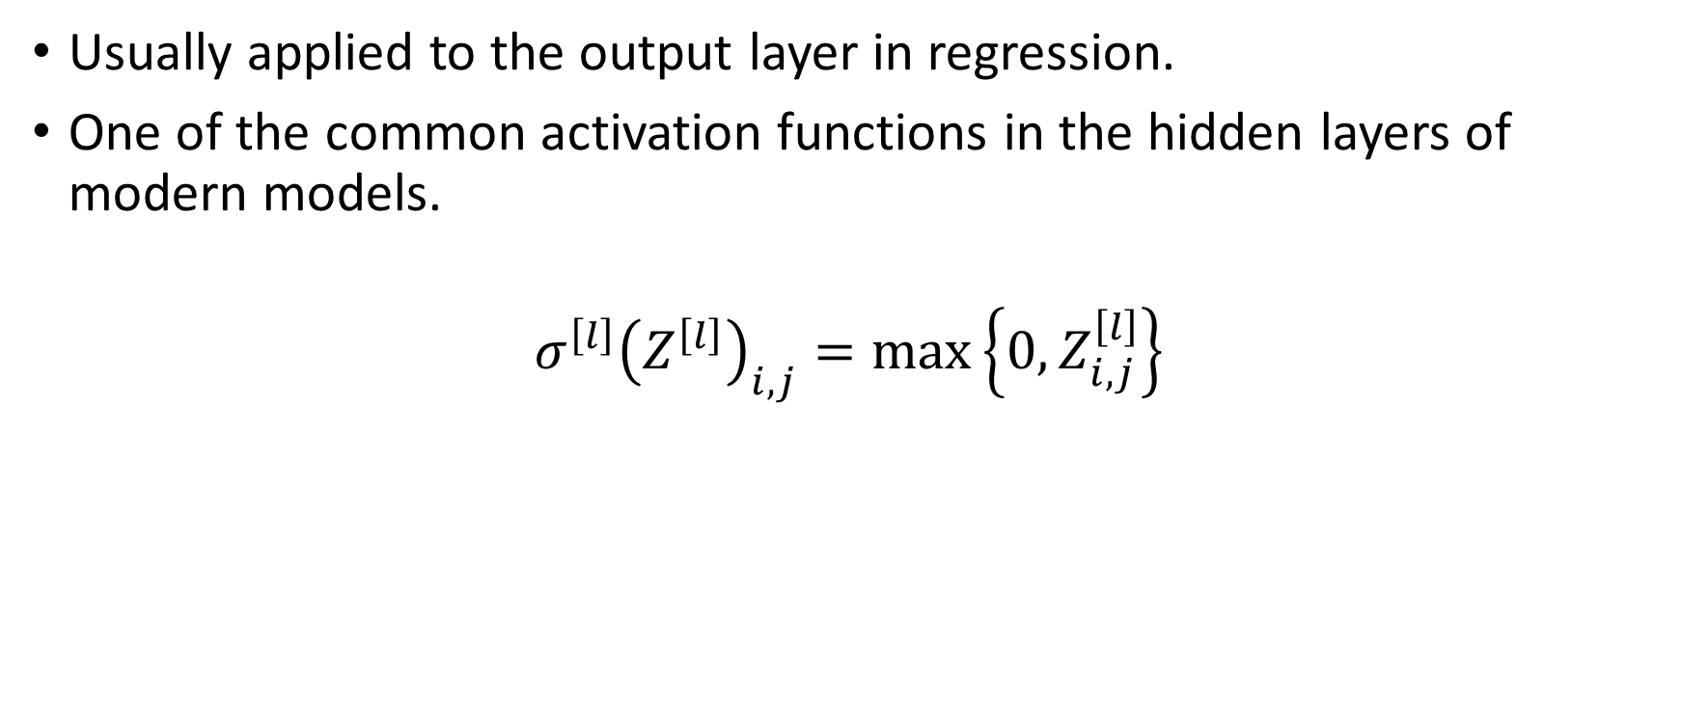
ReLU
Usually applied to the output layer in regression.
One of the common activation functions in the hidden layers of modern models.
$$σ^{\left[l\right]}{\left(Z^{\left[l\right]}\right)}_{i,j}=\max\left\{0,Z_{i,j}^{\left[l\right]}\right\}$$

Slide 17

Sigmoid
Usually applied to the output layer in binary or multi-label classification.
$$σ^{\left[l\right]}{\left(Z^{\left[l\right]}\right)}_{i,j}=\frac{1}{1+\exp\left(−Z_{i,j}^{\left[l\right]}\right)}$$

Slide 18

Softmax
Usually applied to the output layer in multi-class classification.
$$σ^{\left[l\right]}{\left(Z^{\left[l\right]}\right)}_{i,j}=\frac{\exp\left(Z_{i,j}^{\left[l\right]}\right)}{\sum_{k=1}^{m_{h}^{\left[l\right]}}{\exp\left(Z_{i,k}^{\left[l\right]}\right)}}$$

