Slide 1
An Overview on Deep Neural Networks: Part 3

Slide 2
Activation Functions’ Derivatives

Slide 3

Activation Functions’ Derivatives
$${σ^{′}}^{\left[l\right]}{\left(Z^{\left[l\right]}\right)}_{i,j,u,v}=\frac{∂}{∂Z_{u,v}^{\left[l\right]}}σ^{\left[l\right]}{\left(Z^{\left[l\right]}\right)}_{i,j}$$

Slide 4

ReLU
$$σ^{\left[l\right]}{\left(Z^{\left[l\right]}\right)}_{i,j}=\max\left\{0,Z_{i,j}^{\left[l\right]}\right\}$$
$${σ^{′}}^{\left[l\right]}{\left(Z^{\left[l\right]}\right)}_{i,j,u,v}=\left\{\begin{matrix}1 & i=u and j=v and Z_{u,v}^{\left[l\right]}>0 \\ 0 & otherwise\end{matrix}\right.$$

Slide 5

Sigmoid
$$σ^{\left[l\right]}{\left(Z^{\left[l\right]}\right)}_{i,j}=\frac{1}{1+\exp\left(−Z_{i,j}^{\left[l\right]}\right)}$$
$${σ^{′}}^{\left[l\right]}{\left(Z^{\left[l\right]}\right)}_{i,j,u,v}=\left\{\begin{matrix}A_{i,j}^{\left[l\right]}\left(1−A_{i,j}^{\left[l\right]}\right) & i=u and j=v \\ 0 & otherwise\end{matrix}\right.$$

Slide 6

Softmax
$$σ^{\left[l\right]}{\left(Z^{\left[l\right]}\right)}_{i,j}=\frac{\exp\left(Z_{i,j}^{\left[l\right]}\right)}{\sum_{k=1}^{m_{h}^{\left[l\right]}}{\exp\left(Z_{i,k}^{\left[l\right]}\right)}}$$
$${σ^{′}}^{\left[l\right]}{\left(Z^{\left[l\right]}\right)}_{i,j,u,v}=\left\{\begin{matrix}A_{i,j}^{\left[l\right]}\left(1−A_{i,j}^{\left[l\right]}\right) & i=u and j=v \\ −A_{i,j}^{\left[l\right]}A_{i,v}^{\left[l\right]} & i=u and j≠v \\ 0 & i≠u\end{matrix}\right.$$

Slide 7
Loss Functions’ Derivatives

Slide 8

SSE
$$J\left(Y,\hat{Y}\right)=\frac{1}{2}\sum_{i=1}^{n_{y}}{\sum_{j=1}^{m}{{\left({\hat{Y}}_{i,j}−Y_{i,j}\right)}^{2}}}$$
$$\frac{∂ℒ}{∂{\hat{Y}}_{i,j}}={\hat{Y}}_{i,j}−Y_{i,j}$$
$$\frac{∂ℒ}{∂\hat{Y}}=\hat{Y}−Y$$

Slide 9
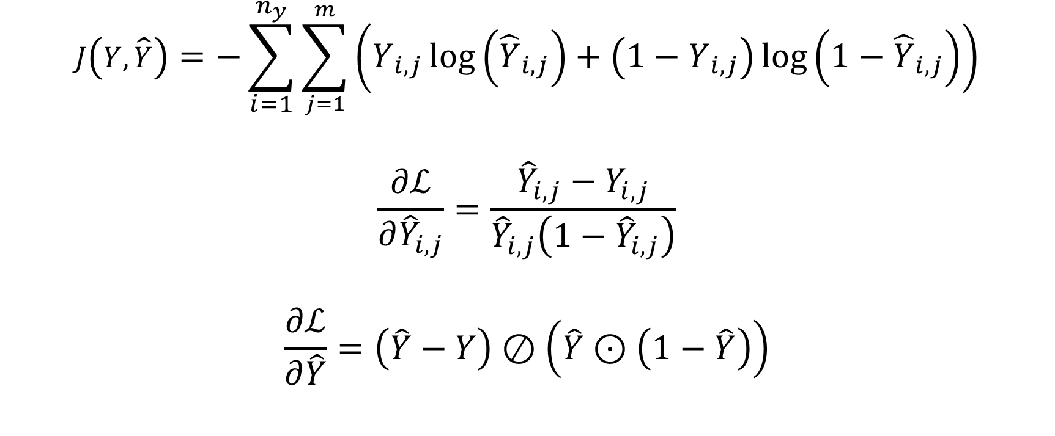
BCE
$$J\left(Y,\hat{Y}\right)=−\sum_{i=1}^{n_{y}}{\sum_{j=1}^{m}{\left(Y_{i,j}\log\left({\hat{Y}}_{i,j}\right)+\left(1−Y_{i,j}\right)\log\left(1−{\hat{Y}}_{i,j}\right)\right)}}$$
$$\frac{∂ℒ}{∂{\hat{Y}}_{i,j}}=\frac{{\hat{Y}}_{i,j}−Y_{i,j}}{{\hat{Y}}_{i,j}\left(1−{\hat{Y}}_{i,j}\right)}$$
$$\frac{∂ℒ}{∂\hat{Y}}=\left(\hat{Y}−Y\right)⊘\left(\hat{Y}⊙\left(1−\hat{Y}\right)\right)$$

Slide 10

CCE
$$J\left(Y,\hat{Y}\right)=−\sum_{i=1}^{n_{y}}{\sum_{j=1}^{m}{\left(Y_{i,j}\log\left({\hat{Y}}_{i,j}\right)\right)}}$$
$$\frac{∂ℒ}{∂{\hat{Y}}_{i,j}}=−\frac{Y_{i,j}}{{\hat{Y}}_{i,j}}$$
$$\frac{∂ℒ}{∂\hat{Y}}=−Y⊘\hat{Y}$$

Slide 11
Different Types of Gradient Descent

Slide 12
Different Types of Gradient Descent
Batch
Stochastic
Mini-Batch

Slide 13
Some Mathematical Notations and Their NumPy Equivalents

Slide 14

Some Mathematical Notations and Their NumPy Equivalents
$AB$ $≡$ A @ B
$A:B$ $≡$ np.tensordot(A, B)
$A⊙B$ $≡$ A * B
$A⊘B$ $≡$ A / B

