Slide 1
An Introduction to Convolutional Neural Networks

Slide 2
Problems with Fully Connected Networks

Slide 3
Fully Connected Network Structure

Slide 4
Problems with Fully Connected Networks
As the networks grows in size, the number of parameters, especially weights, increases significantly.
More parameters need stronger hardware for computation and storage.
Can we reduce the number of the weights or even share them?

Slide 5
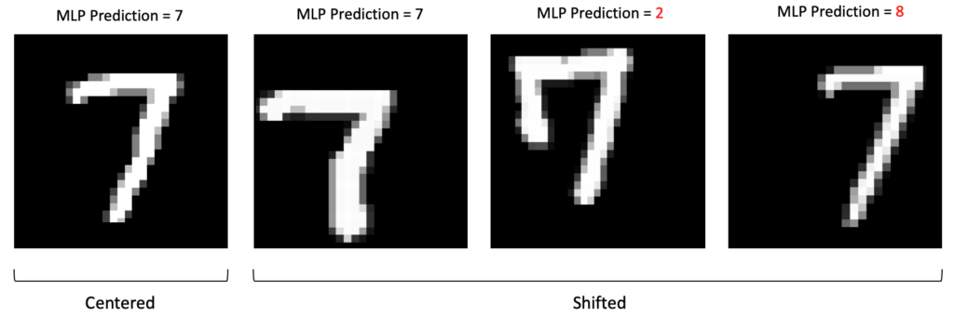
Problems with Fully Connected Networks
Fully Connected Networks are not translation invariant.

Slide 6
Intuitive Explanation

Slide 7
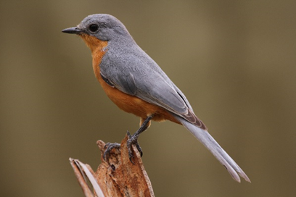
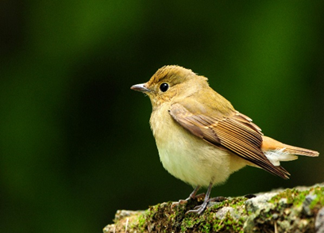
Case: Image Classification
Consider a network that has to classify images as “bird” or “not bird”.
A fully connected network is undesirable due to its limitations.
Some patterns, e.g. the wings or the tail, are much smaller than the whole image.
These patterns can appear in different parts of the images.

Slide 8
CNN Structure

Slide 9
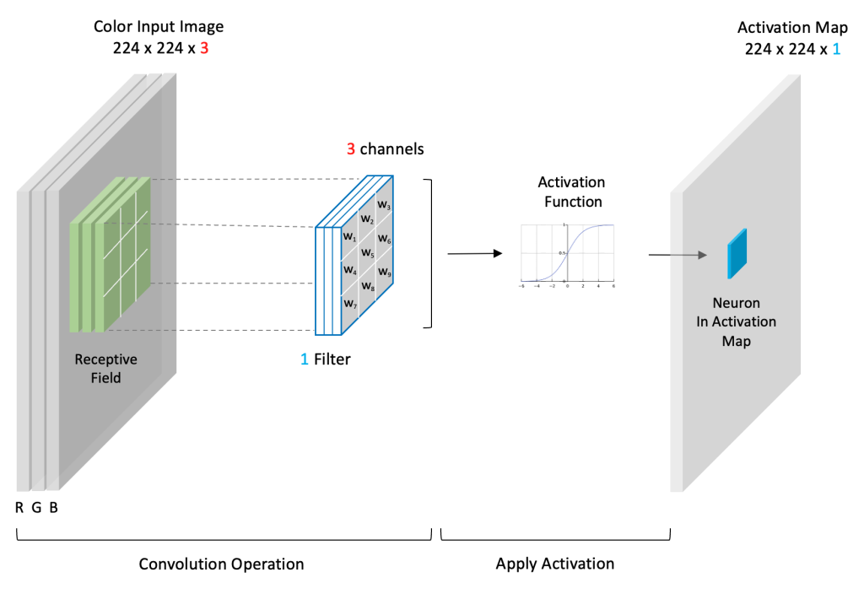
Convolutional Layer

Slide 10
Convolution Operation

Slide 11
Filters
Each filter gradually learns to detect a specific pattern.
The number of channels in the output of a convolutional layer is equal to the number of its filters.

Slide 12
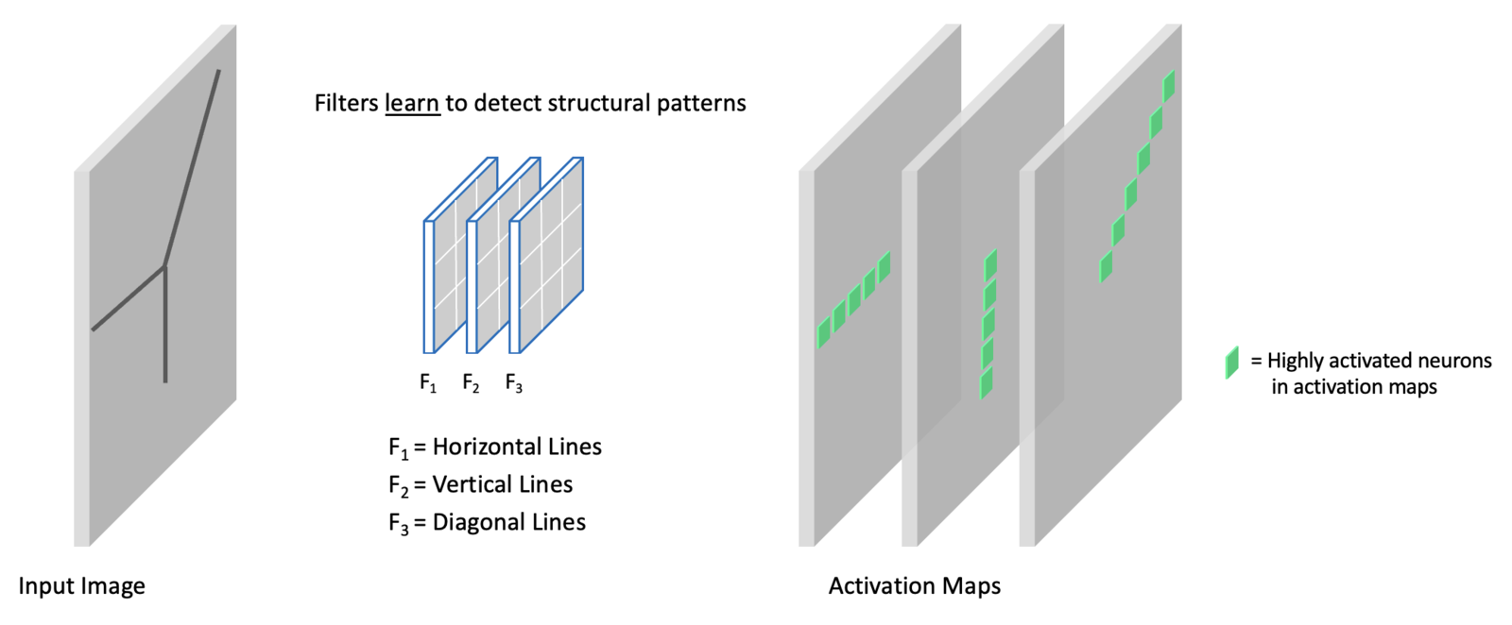
Filters

Slide 13
Padding and Stride
Padding in convolution refers to adding extra border pixels around the input image to preserve spatial dimensions after convolution.
Stride refers to the number of pixels the filter kernel moves at each step during the convolution operation.

Slide 14
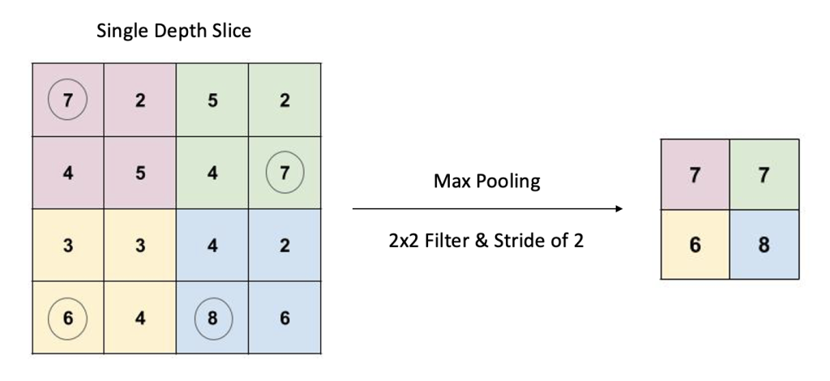
Max Pooling Layer

Slide 15
Pooling Layers
There are other types of pooling layers such as average pooling.
However, max pooling is the most commonly used pooling layer in modern CNNs.

Slide 16
Convolutional Block
A convolutional block typically contains one or more convolutional layers followed by a pooling layer.
Other layers are also sometimes incorporated, but we will focus on these two layer types to keep things simple.

Slide 17
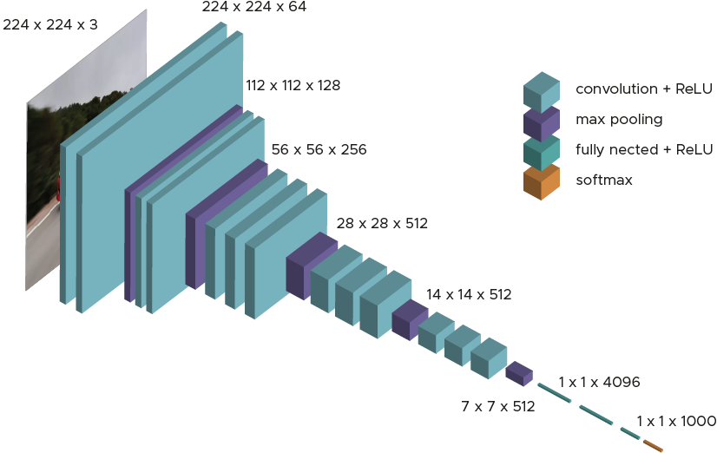
CNN Example: VGG-16

