Slide 1
Data Cleaning Challenge
Interview Task Report
Presenter: Hamed Araab

Slide 2
Introduction
Objective: Showcase expertise in data cleaning, analysis, visualization, and reporting for restaurant data in Ahvaz.
Dataset: Restaurant data with columns: Name, Address, Rate, Review, Phone, Super Type, Marketing Area.
Task Overview:
Clean the provided dataset.
Add "Subtype" and "Type ID" columns.
Assign grades (A to C) based on a scoring system using Rate and Review.
Create and visualize a comprehensive report.

Slide 3
Data Cleaning
Objective: Ensure data integrity by removing incomplete or incorrect entries.

Slide 4
Data Cleaning
Stripping Strings: Removed leading/trailing whitespace from all string columns to ensure consistency.
Duplicate Check: Verified no duplicate restaurant names in the dataset.
Normalization:
Rate: Converted Persian digits and decimal separators to English (e.g., “۳،۸” to 3.8).
Review: Removed “نفر” and parentheses, converting to numeric values (e.g., “(۲۲ نفر)” to 22).
Phone: Used phonenumbers library to format valid phone numbers in national format (e.g., "tel://06132226611" to "061 3222 6611") and marked invalid entries as "Unknown“.
Dropping Missing Values: Removed rows with null values in any column, reducing dataset from 49 to 46 entries.

Slide 5
Adding Subtype and Type ID
Objective: Derive "Subtype" and "Type ID" columns based on Super Type.

Slide 6
Adding Subtype and Type ID
Subtype:
If the record’s Name contains its Super Type (e.g. “رستوران”‍) and it is preceded or succeeded by a word with a “و” in between, that word is assumed to be Subtype.
Otherwise, a map is created to find a set of keywords corresponding to each predefined Subtype. If the record’s Name contains any keyword, the corresponding Subtype is assigned to it.
The type pairings included an unreasonable pair: “فست‌فود” and “سنتی”. In such cases, “فست‌فود” is replaced with “رستوران”.
Type ID: Things are kept simple. Thus, the Type ID feature is created by joining the Super Type and Subtype values with an underscore (e.g., “سنتی_رستوران”).

Slide 7
Grading System
Objective: Assign grades (A to C) to restaurants based on Rate and Review.

Slide 8
Grading System
Input Data: A copy of the dataset containing only the Rate and Review features with no outliers.
Clustering:
Train a 3-means clustering model with the input data.
Sort the cluster centers according to the sum of standardized Rate and Review.
Label the sorted cluster centers as A, B, and C.
Grading: For each record,
If Rate = 0, then grade = Unrated
Otherwise, grade = the closest cluster center

Slide 9
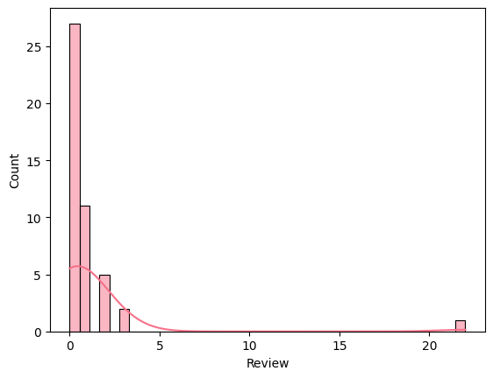
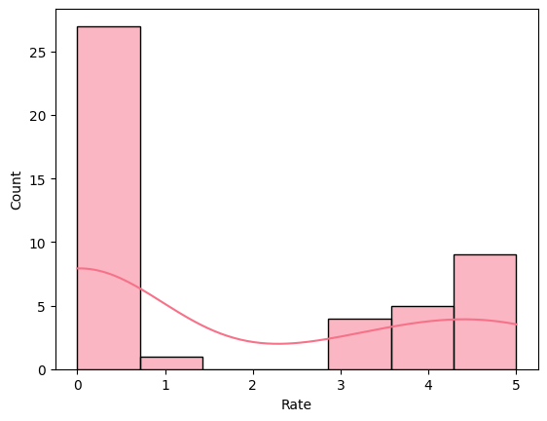

Slide 10
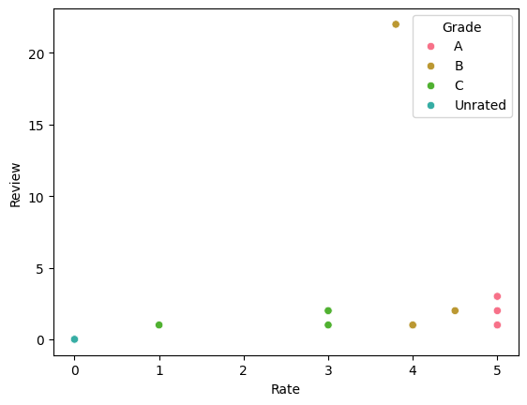

Slide 11
Data Visualization
Objective: Present data insights visually for clarity.

Slide 12
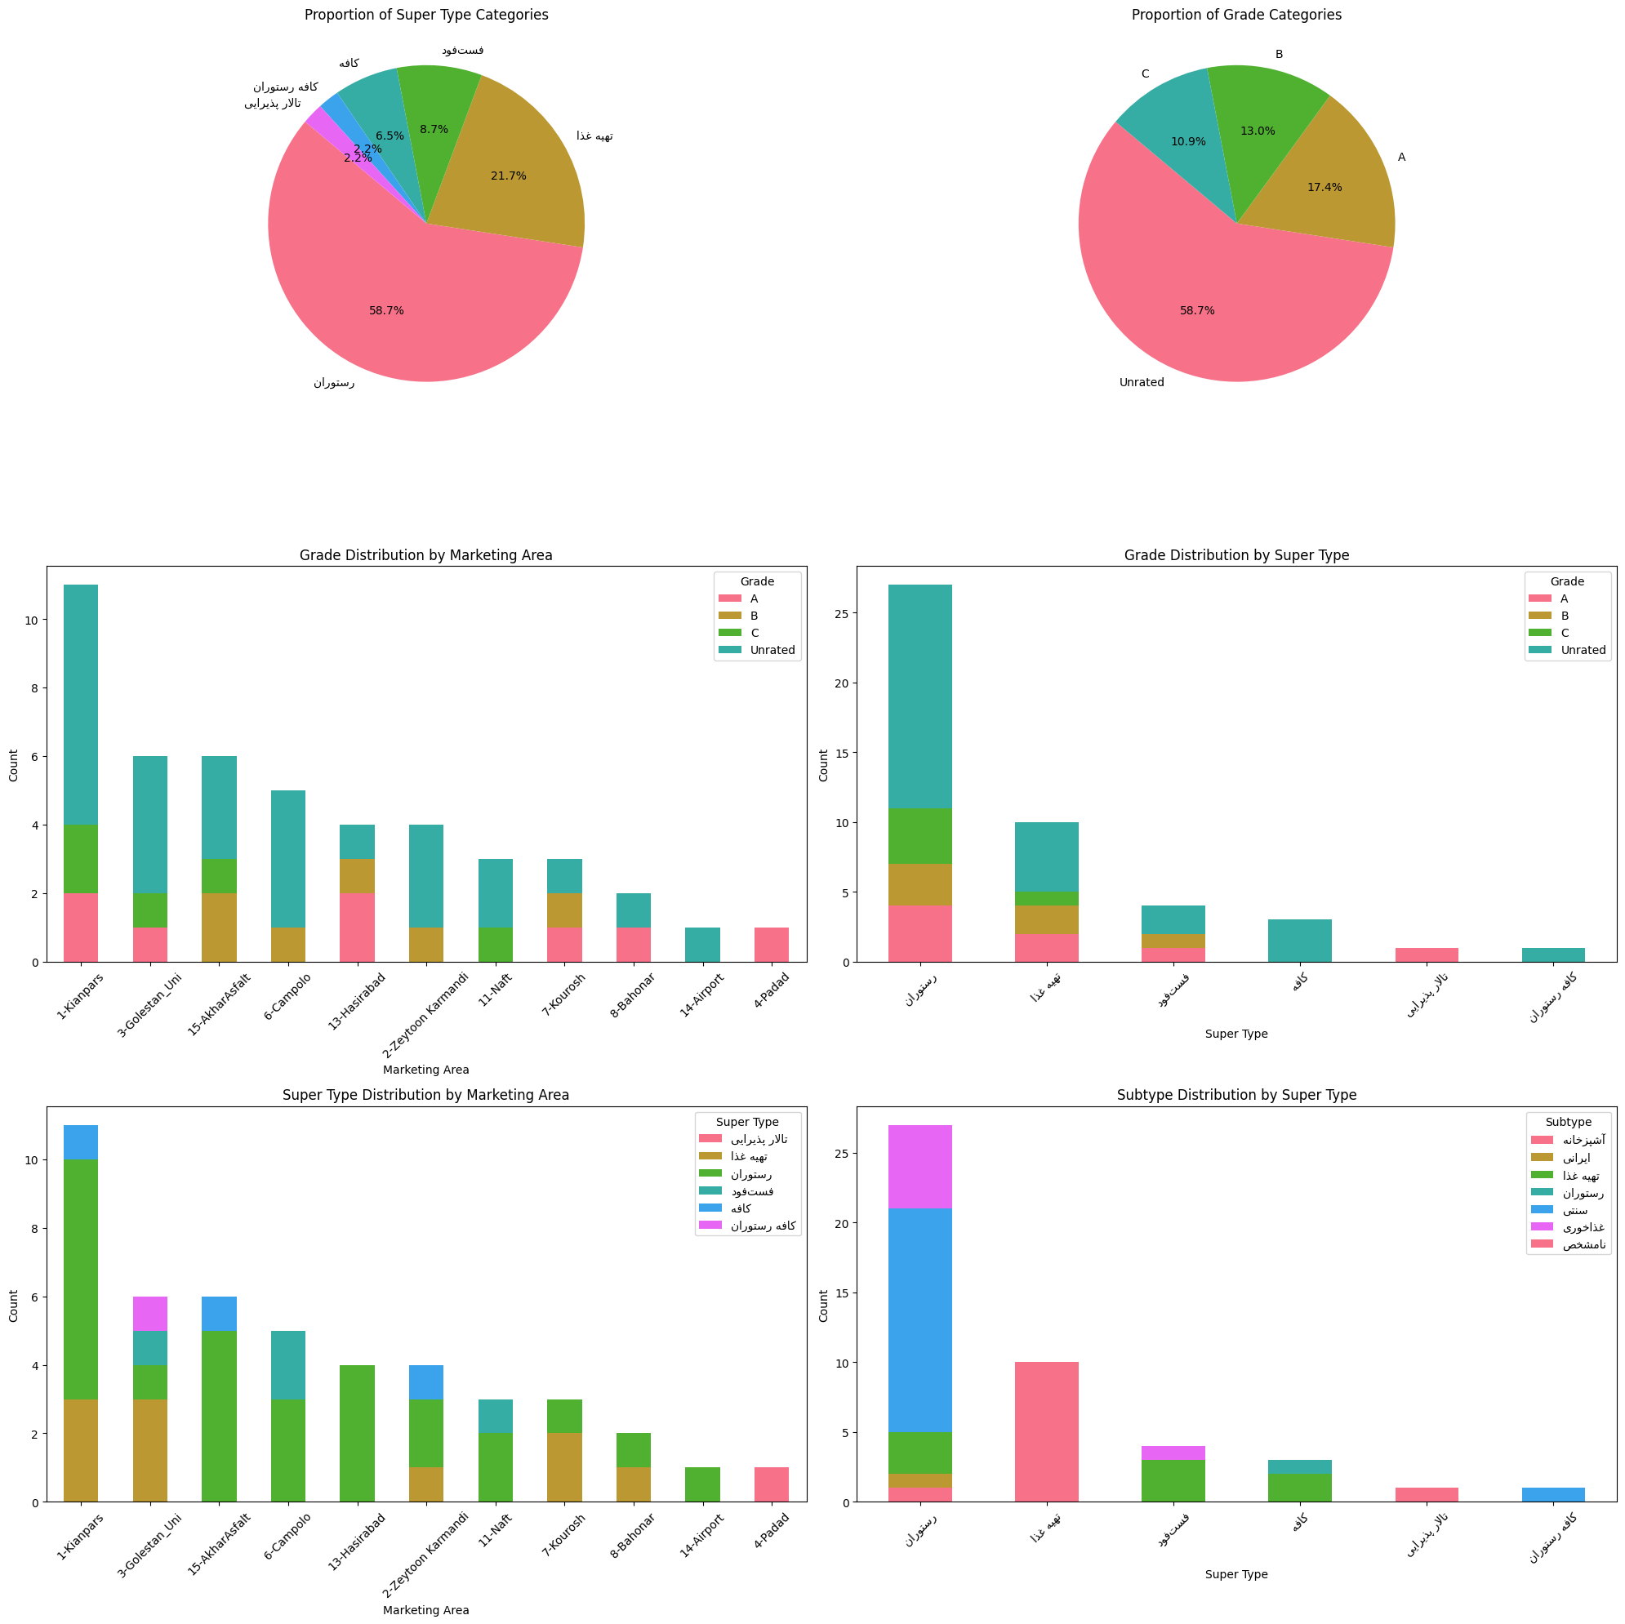

Slide 14
Data Analysis Insights

Slide 15
Data Analysis Insights
Marketing Area Concentration: Over 23% of entries are concentrated in Kianpars, followed by Golestan_Uni and AkharAsfalt (each ~13%), indicating geographic focus in a few key regions.
Grade Distribution: A majority (58.7%) of businesses are unrated, with only 17.4% receiving an A grade, suggesting a need for more evaluations.
Super Type Breakdown: Restaurants dominate the market at 58.7%, followed by Catering Services at 21.7%, showing a strong preference for dining establishments.
Subtype Insights: The most common subtype is Traditional (37%), while Unspecified entries remain high at 23.9%, pointing to potential improvements in the subtype assignment approach.
Diversity of Offerings: Less common categories like Cafes and Reception Halls represent small shares, possibly indicating niche opportunities or underrepresentation.

Slide 16
Thank You

