Slide 1
HTML II

Slide 2
Objectives
Learn how to make links to other web pages and add multimedia to an HTML document.
HTML tables and HTML forms are also explained in this task. The span and div tags are discussed.

Slide 3
Links
You can add links to your web page as follows:
<a href="url" target="_blank">link text</a>
The <a> element is used to add all links on a web page. Using this element you can link to other pages in your website, external web pages and enable users to send an email

Slide 4
Links
Linking to other places on your webpage:
An ID can be assigned to any of your elements:
To reference it we use the <a> tag and a #
Notes:
Often on your web page, you will want your users to be able to click on a link which will then take them to another part of the same page. Think about the “back to the top” button - you click on this and you are suddenly viewing the top of the page again!
In order to do this, we need to use ID attributes. An ID is used to uniquely identify one of your HTML elements, such as a paragraph, heading or table. Then we can use the link tag to make the text or image a link that the user clicks on to take them to whichever address we choose!

Slide 5

Links
/Linking to other webpages:
To open a new tab:
Notes:
The “http://” in front of the address lets the browser know that you are linking to an external website rather than a file on your system.
That’s not to say, however, that you can only link through text! All the content that is between the <a> tags is what is to be clicked on in order to get to the destination address.
With the link specified above, if you click on the link it will change the window you’re currently on. What if you wanted to open the destination address of a link in a new tab? You can add an attribute to the link tag called target which specifies how the link should be opened, e.g. in the same window, new browser instance or new tab.

Slide 6
Images
Adding images:
<img> does not have a closing tag
<img> attributes that can describe it:
src=
alt=
height and width attributes
src can point to a URL or a file location
Notes:
There are a few things to note about the <img> element.
Unlike most of the other elements we have explored so far, the <img> element doesn’t have a closing tag.
The <img> element has a number of attributes that can describe it. These include:
src= The src attribute gives the path to where the image can be found or the source of the image.
alt= The alt attribute defines the alternate text that will be displayed if the image won't display.
Intuitively, the height and width attributes define the height and width of the image.
The src attribute can point to a URL or a file location. In the example above, the first image uses a URL as the source of an image. The second image shows how the src attribute is defined to display an image named image1.jpg that is stored in a folder named images that resides in the same folder as your web page.

Slide 7
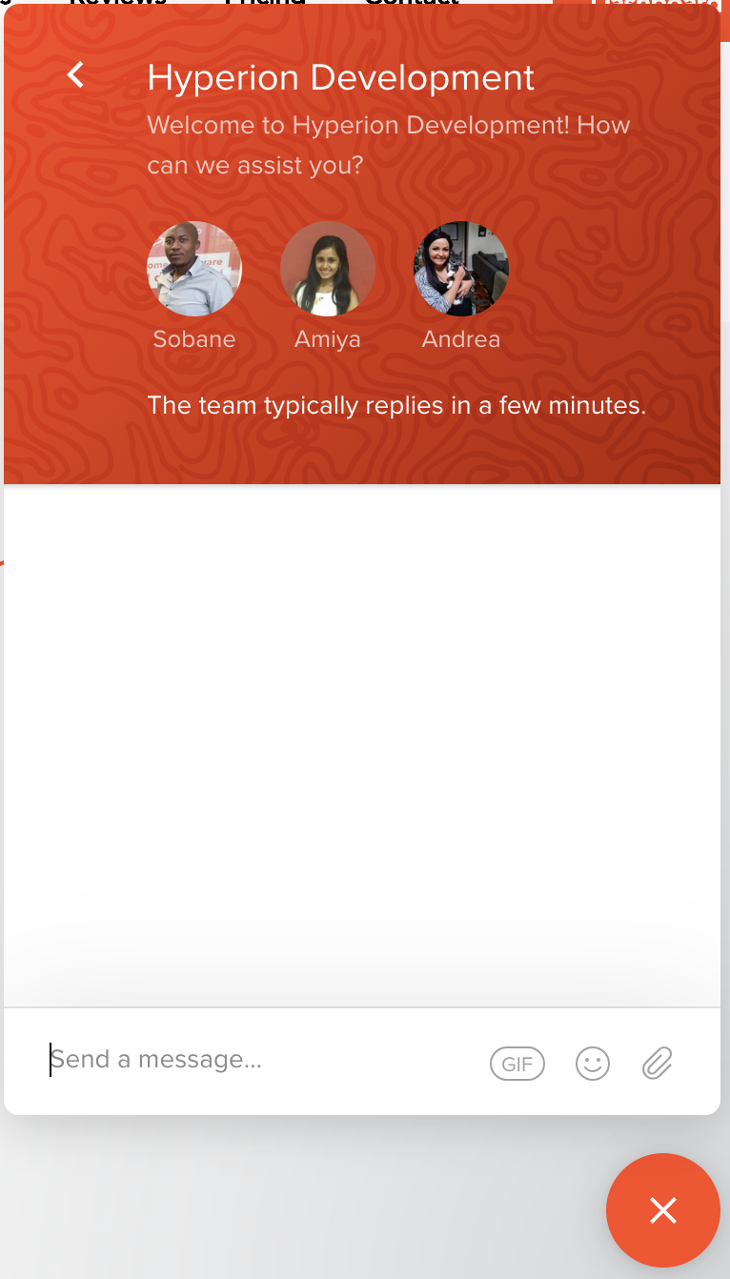
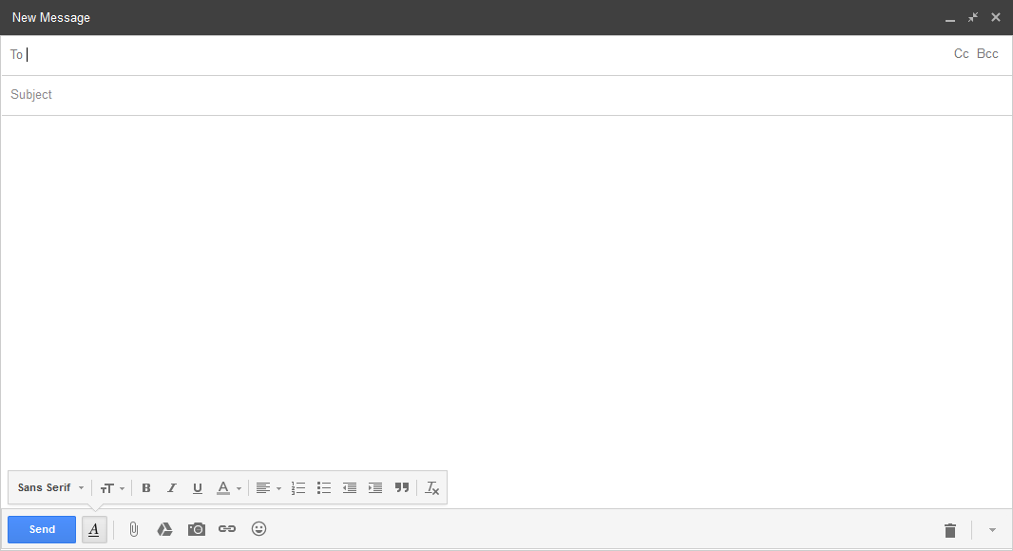
HTML Forms
Instruments that we use to allow users to enter data in HTML
Different kinds of forms:

Slide 8
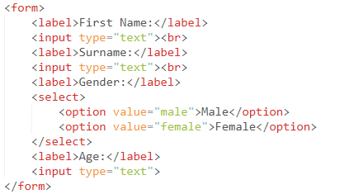
Creating a Form
At this stage, our forms won’t be functional. You will create forms that function correctly later when you learn JavaScript.
Notes:
In the example above we create a form to capture our user’s biographical information. It captures the following information:
First Name
Surname
Gender
Age
We expect the user to enter text for their name and surname. We, therefore, use the input element. This element has a type attribute with the text property assigned to it. This displays text boxes in the browser into which users can type input. We add labels to tell our visitors what information we want them to enter into the boxes.
The select element is used to create a drop-down menu that users can select from instead of typing out their gender.

Slide 9
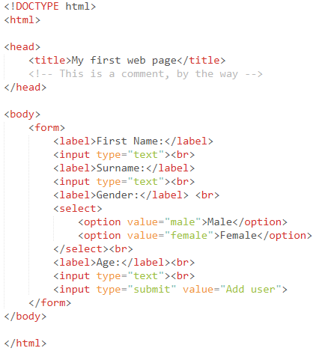
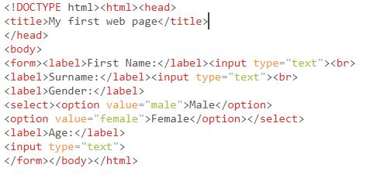
Readability
An important principle in software development
Indenting is important for readability
Notes:
As you can see above, indentation should be used to show which HTML elements are nested within other HTML elements. As shown above, all the other elements are nested within the <html> element. There are several tools that can help you improve the readability of your HTML. Since you will soon be working with CSS and JavaScript too, we highly recommend that you use HTML-CSS-JS Prettify.
You can add this package to Sublime Text by doing the following:
Make sure that you install package control for Sublime Text. Open Sublime Text and follow the simple instructions here to do this.
Open the Command Palette (Tools > Command Palette…).
Search for and choose “Package Control: Install Package” (give it a few seconds to return a list of available packages).
Type “prettify”.
Select HTML-CSS-JS Prettify.
To use this tool, right click on the markup you would like to edit and select “HTML/CSS/JS Prettify” > “Prettify code”.

