Slide 1
CSS Bootstrap

Slide 2
Objectives
Learn how to style like Twitter does.

Slide 3
What is Bootstrap?
A front-end framework used to build pages faster using HTML and CSS
Provides a lot of useful CSS and HTML templates that you can use and modify
It helps you to create websites that automatically adjust based on the device which they are being used on (aka a responsive website)
It’s free!
Notes:
The templates provide well-designed pages with attractive layouts, fonts, colours, objects etc that have already been designed and which you can reuse and modify to save yourself a lot of time and effort.

Slide 4
Advantages of Bootstrap
Easy to use
Responsive features
Mobile-first approach
Browser compatibility
Notes:
Easy to use: Anybody with just basic knowledge of HTML and CSS can start using Bootstrap.
Responsive features: Bootstrap's responsive CSS adjusts to phones, tablets, and desktops.
Mobile-first approach: In Bootstrap, mobile-first styles are part of the core framework.
Browser compatibility: Bootstrap is compatible with all modern browsers (Chrome, Firefox, Internet Explorer, Edge, Safari, and Opera).

Slide 5
How do you use it?
Link to Bootstrap from your HTML files
CDN (Content delivery network): a network of servers that work together to provide fast delivery of Internet content including stylesheets
Notes:
To use Bootstrap in a web page, you need to link to it from your html files. It’s similar to what you’re accustomed to when you use external CSS but you won’t have the stylesheet file in your folder. Instead, it will load from an online source.
Notice that in the example above, there are links to 2 stylesheets. The order of the CSS files matter:
The browser sees that the Bootstrap CSS should be included from a CDN and applies those styles to the page. A CDN is a content delivery network, i.e. a network of servers that work together to provide fast delivery of Internet content including stylesheets. You will notice that the link to the Bootstrap CSS file points to a CDN:
Then the browser then sees main.css and applies those custom styles to the page. The custom styles override the Bootstrap styles.
The order of the CSS files tells the browser that your styles in main.css are more important than the styles in bootstrap.css, so the final page that loads is the customised web page.

Slide 6
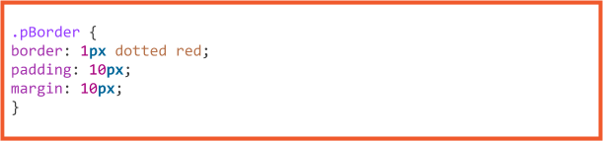

How Does Bootstrap Work?
Bootstrap has predefined contexts which automatically format a selection
It makes using CSS more efficient
Style a border around a paragraph:
CSS:
Bootstrap:
Notes:
This wrapped CSS code is stored "online" in the Bootstrap repository, hence the need to reference Bootstrap from either an online source or saving the CSS file to your website folder. To illustrate the difference between using Bootstrap and writing your own CSS, let's consider an arbitrary example.
Libraries such as Bootstrap already include style rules for adding borders to elements. Instead of writing your own style rules each time you want to add a border therefore, you would rather add an appropriate Bootstrap class (called .pBorder in this example) to your HTML code and the above properties would be looked for in the Bootstrap library and applied. For example, inside your HTML you would have without any additional CSS:
Linking the Bootstrap library allows you to use some predefined CSS rules that you don't need to duplicate inside your own CSS file. Thus, in your own custom CSS file, you would only add non-Bootstrap styles.

Slide 7
Examples of How to use Bootstrap
The Bootstrap Grid System: Allows you to create rows and columns and then place content in the “intersected” areas
You can create up to 12 columns and unlimited rows
Made up of:
Container
Rows
Columns
Class Prefix | Device Size
.col-xs- | <768px
.col-sm- | 768px to 991px
.col-md- | 992px to 1199px
.col-lg- | >= 1200px
Notes:
Bootstrap’s Grid System is made up of 3 things:
A container
Bootstrap’s grid system needs a container to hold rows and columns. A container is a simple <div> element with a class named .container. The container is used to provide a proper width for the layout, acting as a wrapper for the content. It also has different fixed widths in different sized devices. You can choose a fluid container instead of a fixed layout. To do this, you use the class .container-fluid. A fluid container has no fixed width; its width will always be the width of the device.
Rows
A row spans from the left edge to the right edge of the container element. It is created by adding the class .row to a block level element inside the container.
Columns
Bootstrap uses different column class prefixes for different sized devices.

Slide 8
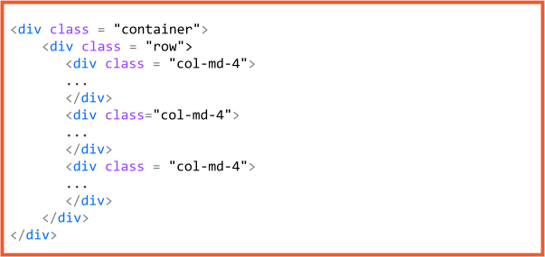
Examples of How to use Bootstrap
The Bootstrap Grid System:
Notes:
Remember that Bootstrap's grid is 12 columns. If you do not want to use all 12 columns individually, you can group the columns together to create wider columns. Therefore, to create three equal-sized columns, they each need to span 4 grid columns.

Slide 9
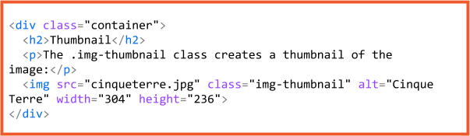
Examples of How to use Bootstrap
Bootstrap Thumbnails:
Notes:
Bootstrap provides the .img-thumbnail class to easily display an image with a rounded 1px border appearance.
An img element is wrapped in a div container with the class .img-thumbnail. Bootstrap also defines other images classes such as .rounded and .circle to create images with rounded corners and to be shaped as a circle respectively.

