Slide 1

CSS Grid

Slide 2
Some review
What direction does a Flexbox natively go - horizontal or vertical?
Bonus: What CSS property adjusts that?

Slide 3
More review
How do you reorder Flexbox children?
Bonus: What CSS property adjusts that?

Slide 4
enough already
Can you nest a flexbox inside of a flexbox? How?

Slide 5
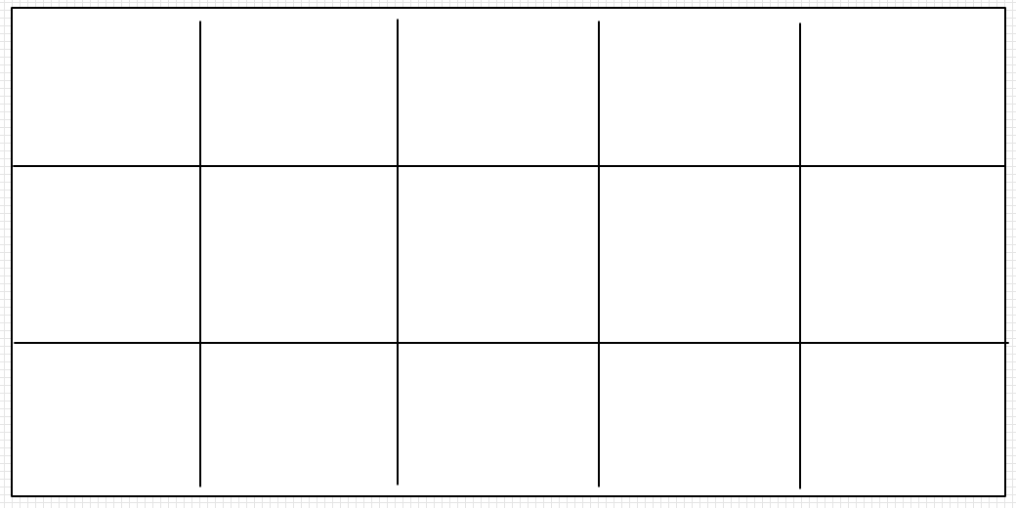
What is a grid?
Think of spreadsheets - columns and rows - that you can lay content into.

Slide 6
Why do I want this?
Flexbox only works in ONE dimension at a time (either a row or a column).
Floats don’t work in any dimension ;)
Grid works in TWO dimensions all the time (row and column).

Slide 7

Flexbox can be a row
1
2
3
4
5

Slide 8
Or a column
1
2
3
4

Slide 9

But not both

Slide 10
How does
Grid
work?

Slide 11
Cousin of flexbox
Built with modern web in mind
Natively responsive
Parent —> Child Relationship

Slide 12

grid tracks
(thats what the rows and columns are called)

Slide 13
1 - Use Display
.container {
display: grid;
}

Slide 14

2 - Think !

Slide 15
What kind of layout
do you want?

Slide 16

columns
Make some

Slide 17

row
Row
And maybe a

Slide 18
example
/* 2 column, 1 row grid */
.container {
display: grid;
grid-template-column: 100px 100px;
grid-template-row: 100px;
}
.item {
background-color: orange;
}

Slide 19
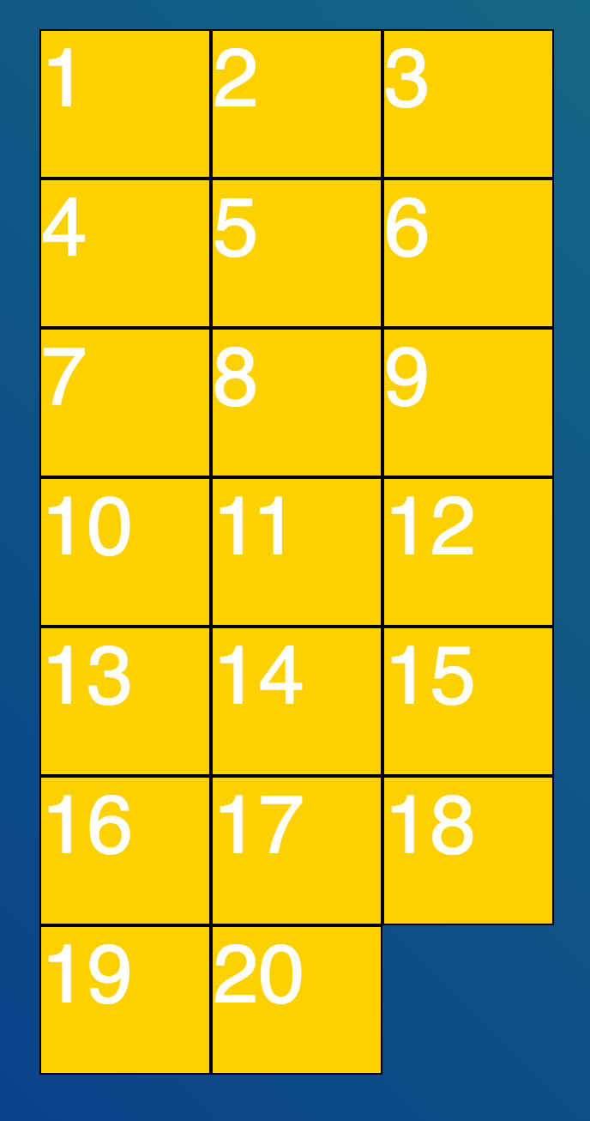

Slide 20
implicit tracks
You can leave off grid-template-row and CSS grid will automatically make the rows, conceptually called the implicit grid.

Slide 21
so this also works
/* 2 column, 1 row grid */
.container {
display: grid;
grid-template-column: 100px 100px;
}
.item {
background-color: orange;
}

Slide 23
grid-gap
grid-gap is the margin/padding of CSS grid. If you want space between your grid items, you apply grid-gap to the container. So easy!

Slide 24
grid-gap
One Value
.container {
display: grid;
grid-template-column: 100px 100px;
grid-gap: 20px;
}
.item {
background-color: orange;
}

Slide 25
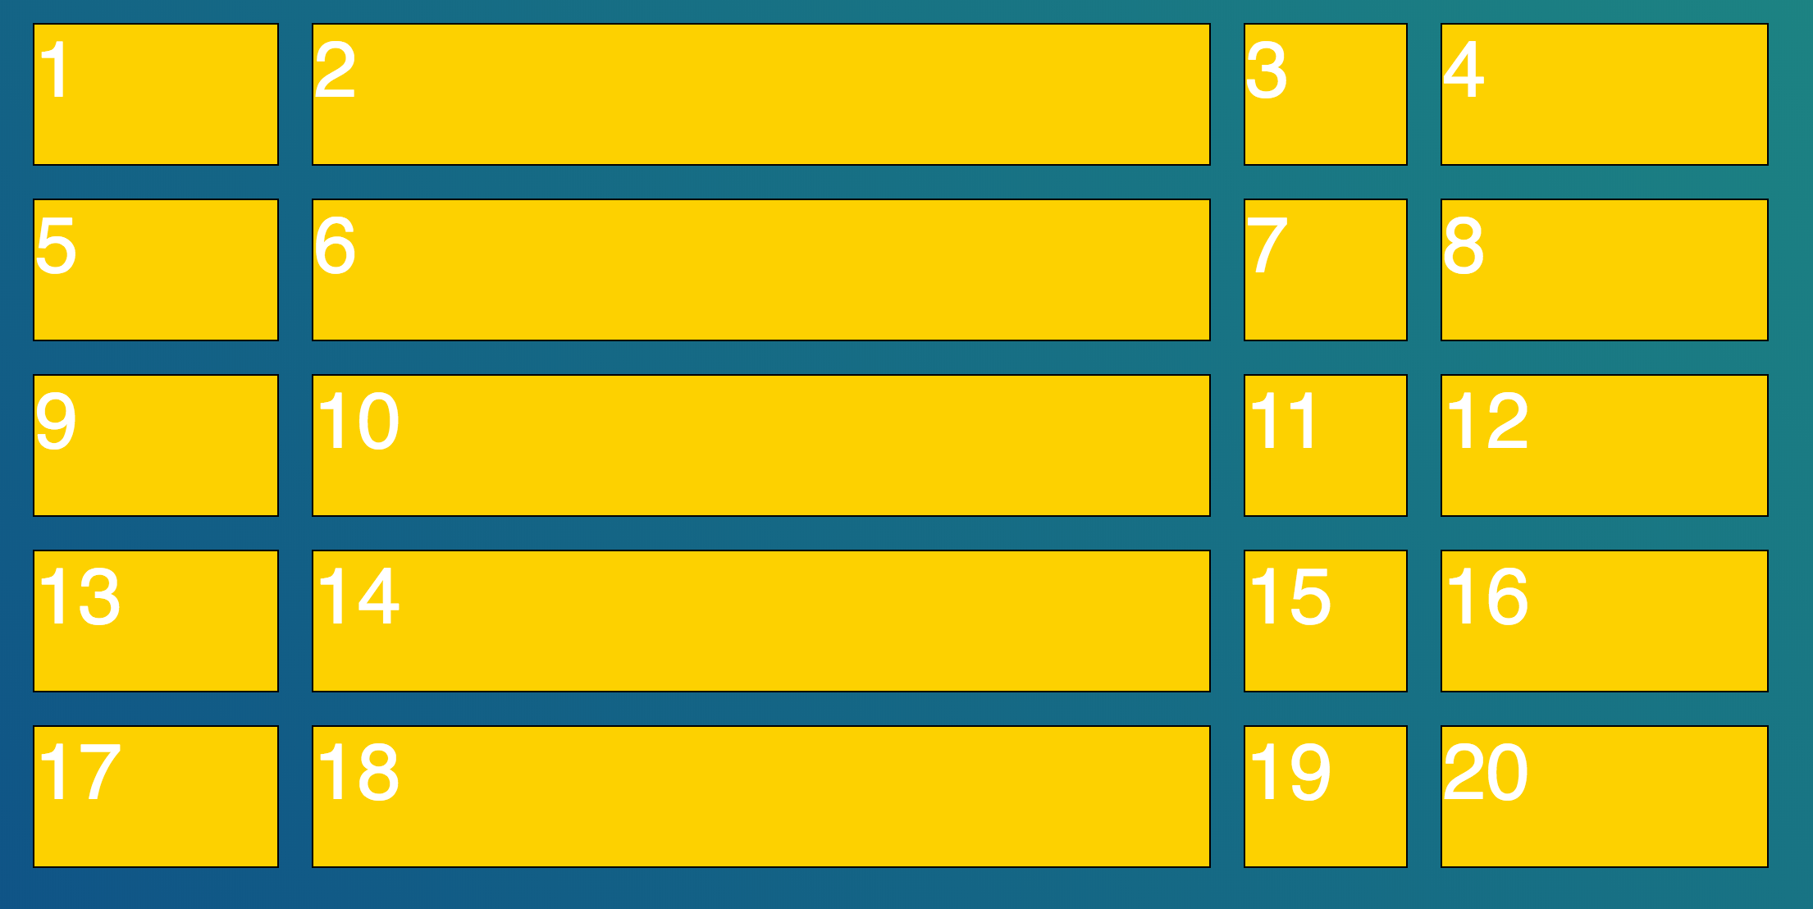
grid-gap
One Value

Slide 26
grid-gap
grid-gap can take two values, which set column and row padding respectively

Slide 27
grid-gap
Two Value
.container {
display: grid;
grid-template-column: 100px 100px;
grid-gap: 20px 80px;
}
.item {
background-color: orange;
}

Slide 28
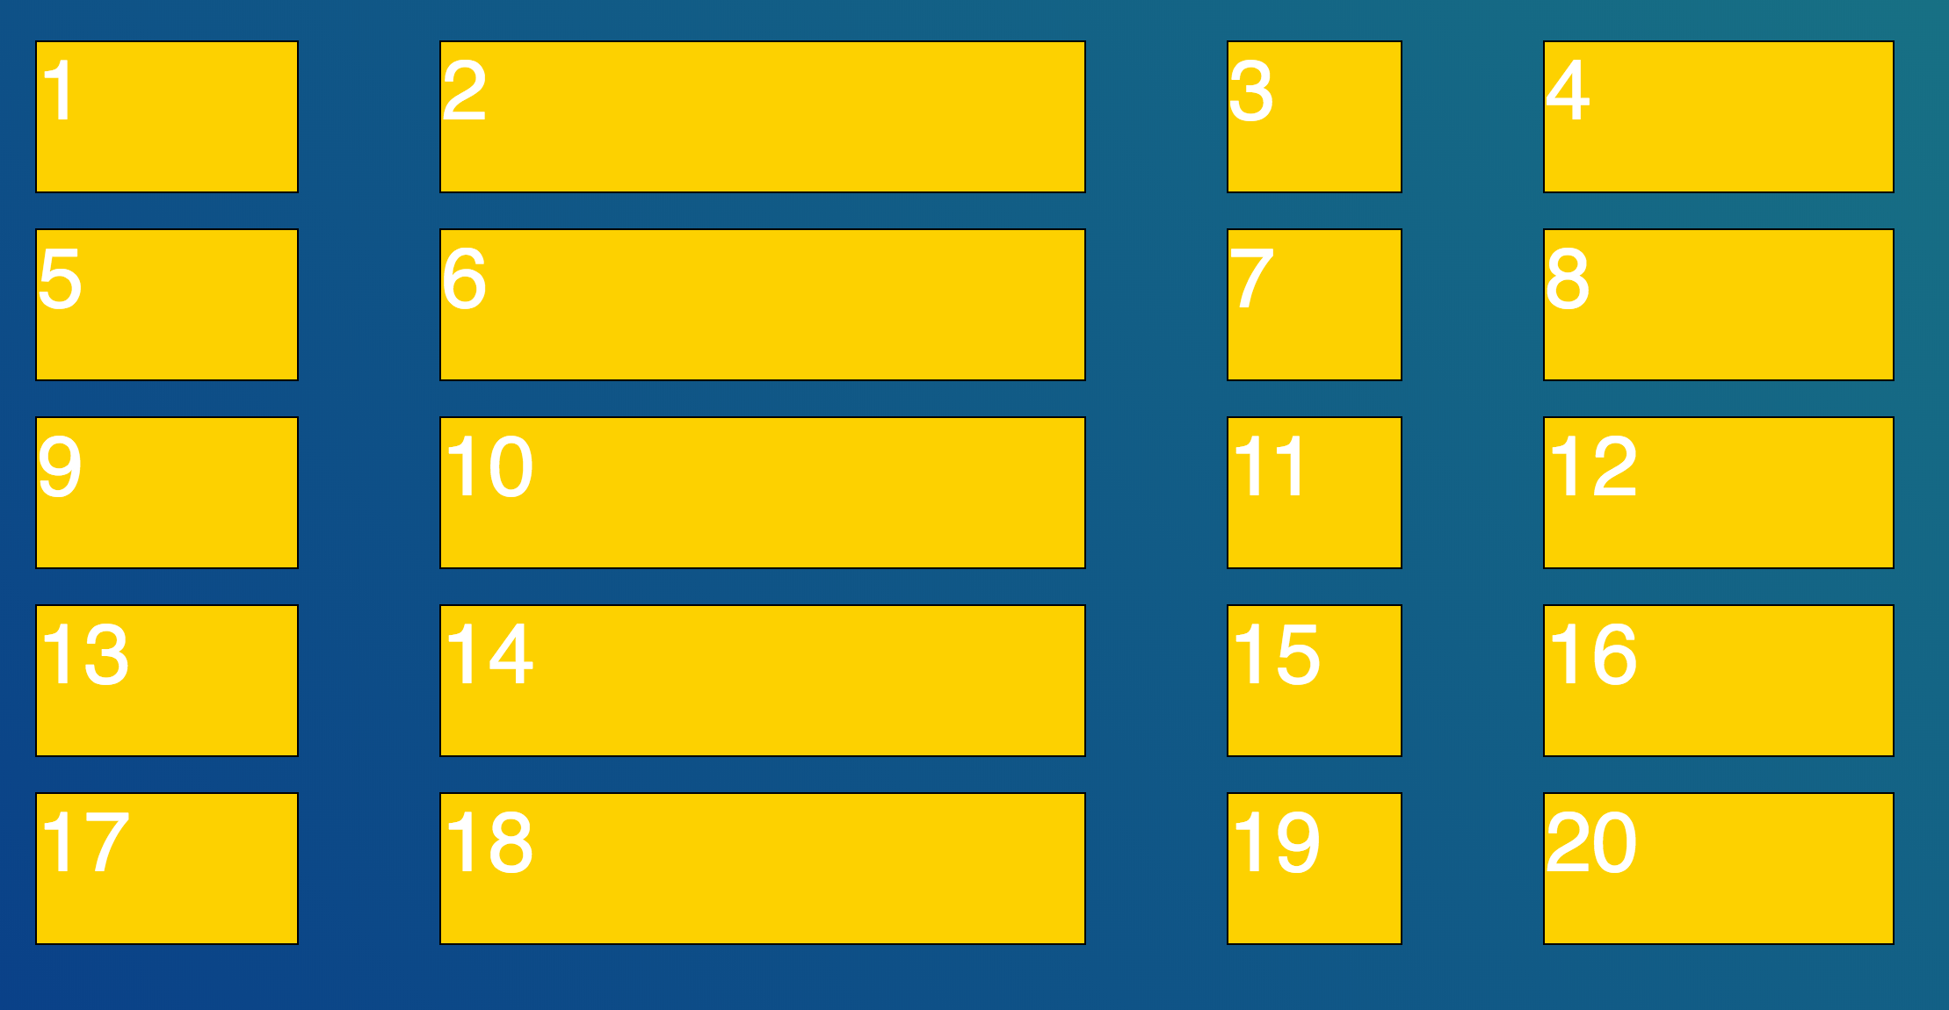
grid-gap
Two Value (note column/row padding difference)

Slide 29
fr unit
The ‘fractional unit’ - fr - is a new unit to be used with CSS grid (similar to percentages).
It stands for fractions of a grid container, and it intelligently takes grid-gap into account.

Slide 30
FR Unit
/* 4 column grid, with fr */
.container {
display: grid;
grid-template-columns: 1fr 1fr 1fr 1fr;
grid-gap: 20px;
}
.item {
background-color: orange;
}

Slide 31
mix fr & pixel / % ?
Yeah - we feel free to mix fixed width and variable width units like pixels, fr and percentages.
They can be used together - fr is like saying ‘use the remainder of the space left AFTER you take out the fixed width elements’.

Slide 32
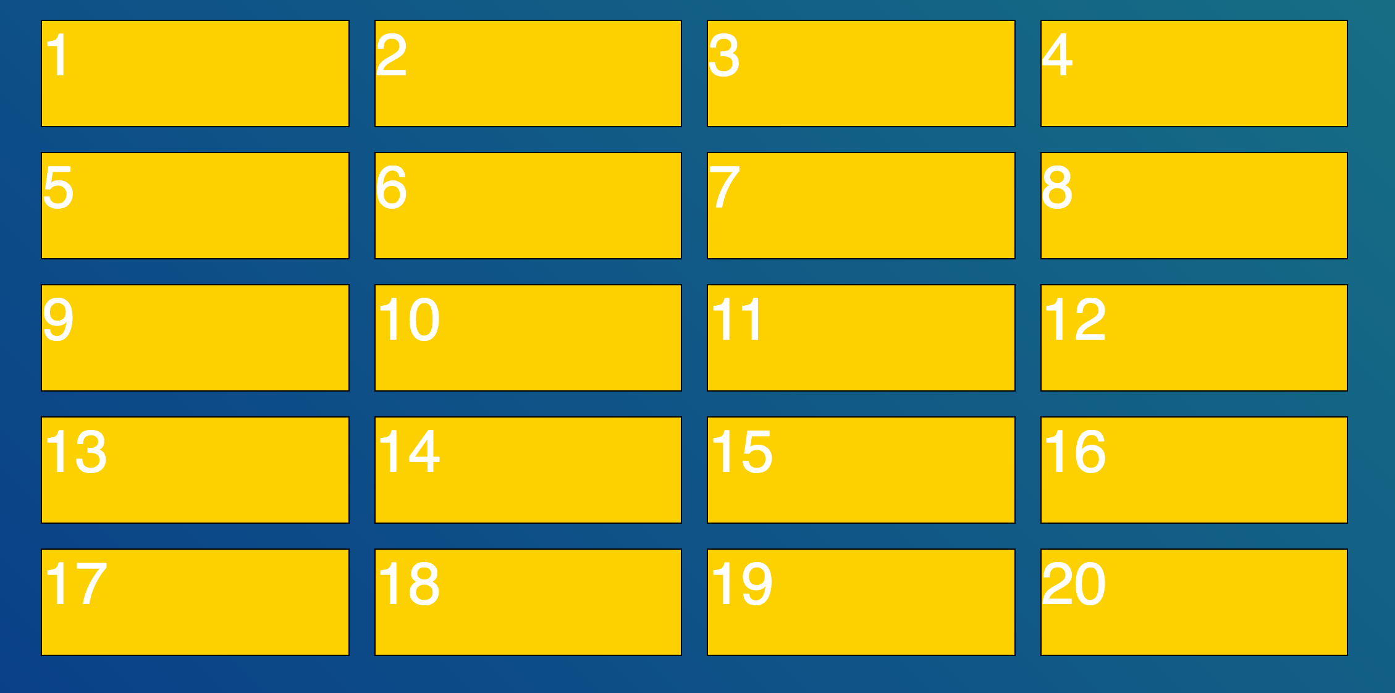
FR unit
Can’t really tell what’s going on unless you open a browser up

