Slide 1
Bridge and Flashlight problem
CSC361

Slide 2
Contents
1
Code Overview
2
Visualizations
3
Performance

Slide 3
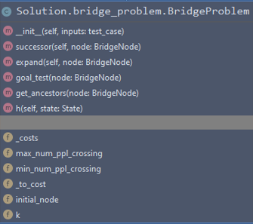
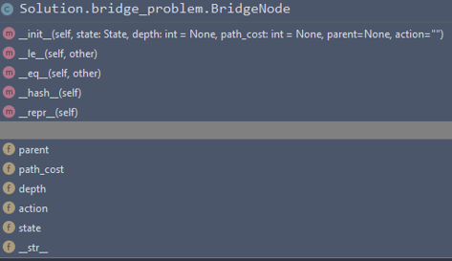
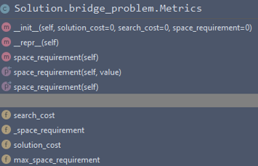
Code Overview

Slide 4
Heuristic
We obtain A*’s heuristic by relaxing the Flashlight rule
9 8 7 6 5 1
21

Slide 5
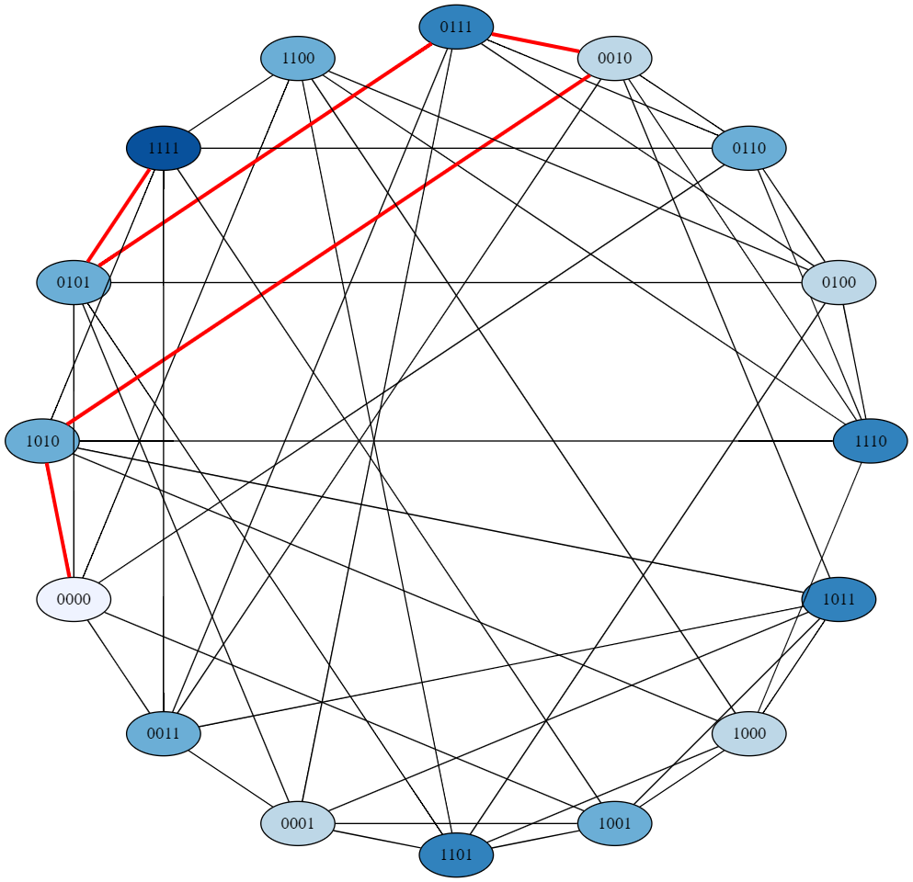
State Space of a k=4 problem represented by booleans

Slide 6
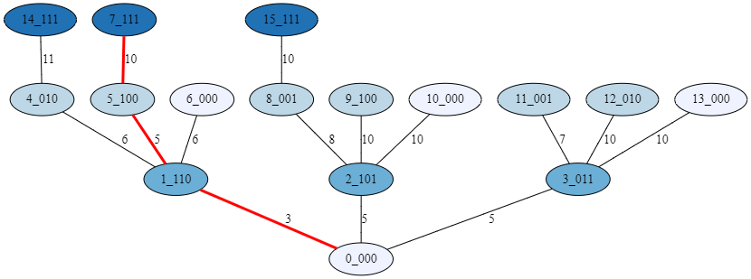
Visualization of UCS Search

Slide 7
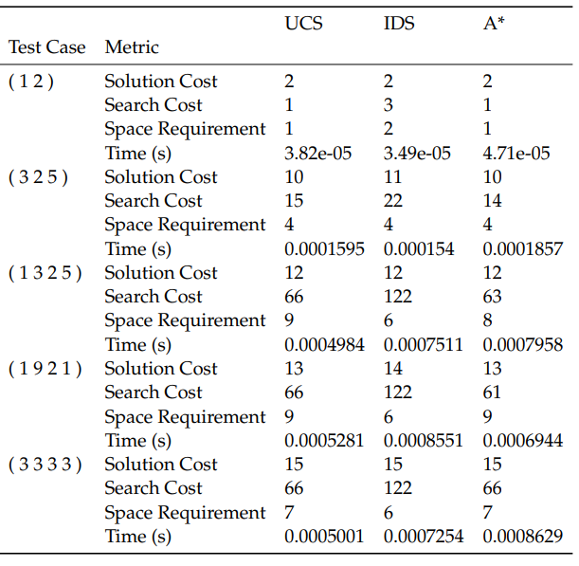
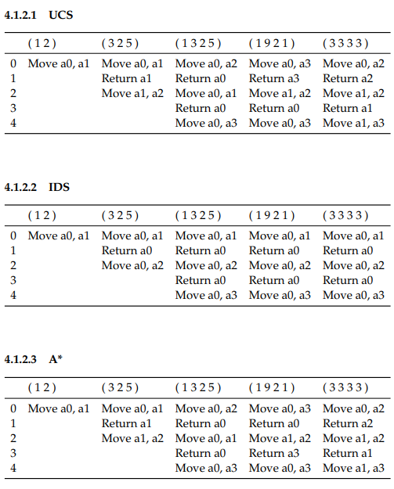
Performance

Slide 8
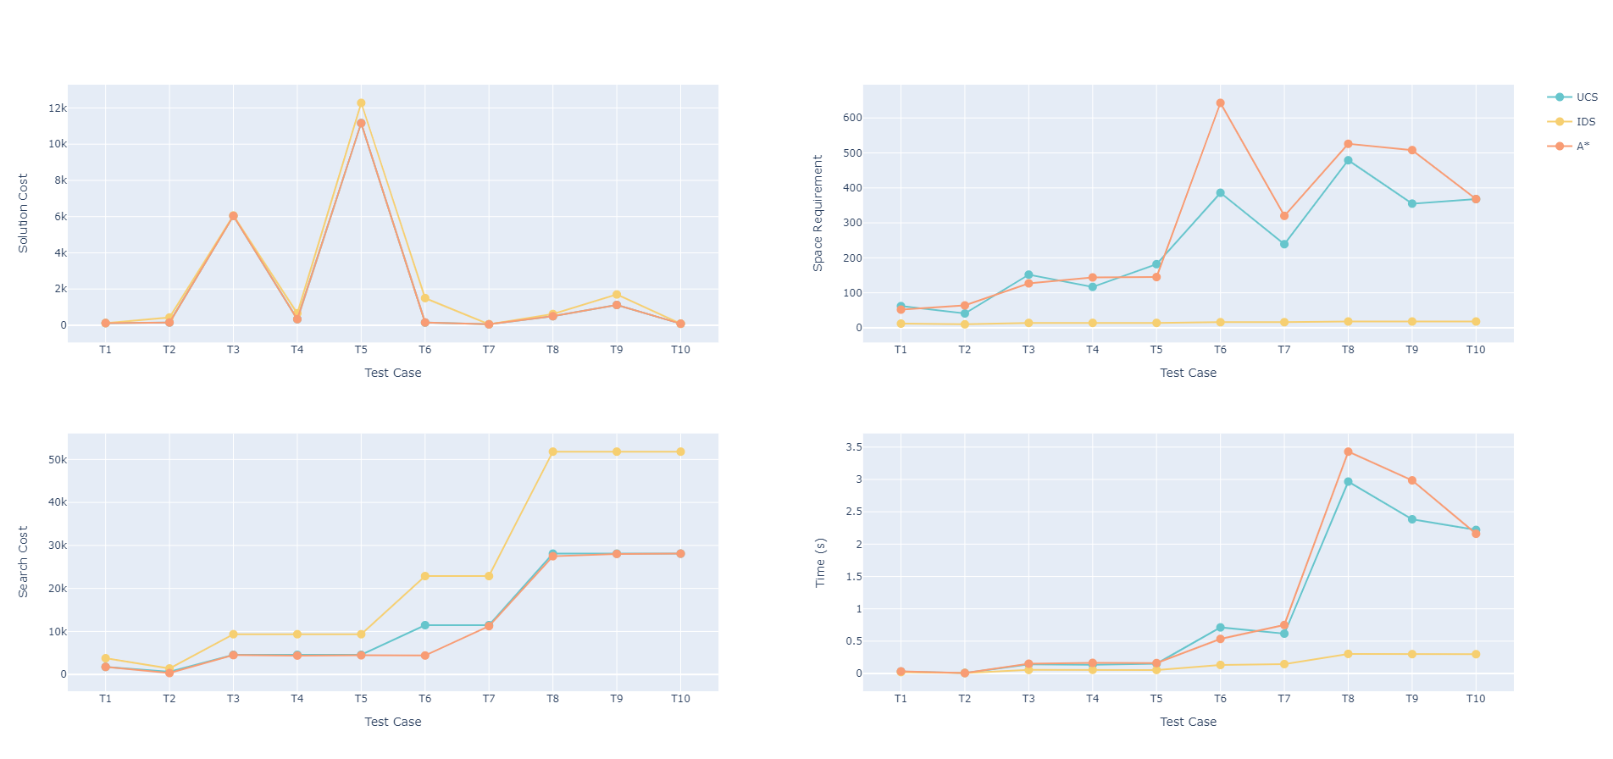
Performance

Slide 9
Thank you
Mohand Al-Rasheed
Abdulaziz Al-Jamhour, Abdulmalik Al-Argani

