Slide 1
Chapter 5: Classes and Objects in Depth
Information Hiding

Slide 2
Objectives
Information hiding principle
Modifiers and the visibility
UML representation of a class
Methods
Message passing principle
Passing parameters
Getters and setters
Constructors
Overloading
Page <number>
Dr. S. GANNOUNI & Dr. A. TOUIR
Introduction to OOP

Slide 3
Object Oriented Basic Principles
Abstraction
Encapsulation
Information Hiding
Message Passing
Overloading
Inheritance
Overriding
Polymorphism
Dynamic Binding
Information hiding and Message passing are discussed in this chapter.
Overloading is discussed in chapter 6.
Inheritance, Polymorphism, Overriding and Dynamic binding are discussed in CSC 113.
Page <number>
Dr. S. GANNOUNI & Dr. A. TOUIR
Introduction to OOP

Slide 4
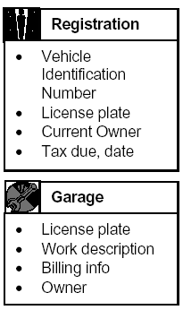
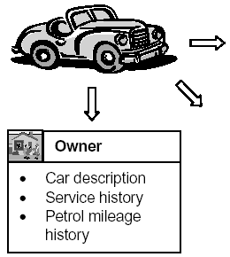
Abstraction Principle
Data Abstraction
  In order to process something from the real world we have to extract the essential characteristics of that object.
  Data abstraction is the process of:
    Refining away the unimportant details of an object,
    Keeping only the useful characteristics that define the object.
  For example, depending on how a car is viewed (e.g. in terms of something to be registered, or alternatively something to be repaired, etc.) different sets of characteristics will emerge as being important.
Functionality Abstraction
  Modeling functionality suffers from
    unnecessary functionality may be extracted,
    or alternatively, an important piece of functionality may be omitted.
  Functionality abstraction is the process of determining which functionality is important.
view
view
view
Page <number>
Dr. S. GANNOUNI & Dr. A. TOUIR
Introduction to OOP

Slide 5
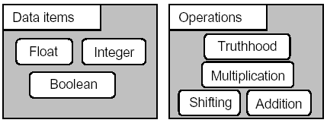
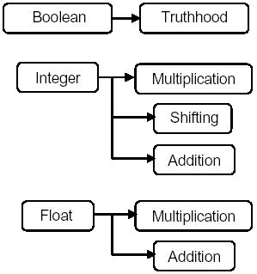
Encapsulation Principle
Abstraction involves reducing a real world entity to its abstraction essential defining characteristics.
Encapsulation extends this idea by also modeling and linking each data of an entity to the appropriate functionality of that entity.
Page <number>
Dr. S. GANNOUNI & Dr. A. TOUIR
Introduction to OOP

Slide 6
Encapsulation Gives Classes
OOP makes use of encapsulation to ensure that data is used in an appropriate manner.
  by preventing from accessing data in a non-intended manner (e.g. asking if an Integer is true or false, etc.).
Through encapsulation, only a predetermined appropriate group of operations may be applied (have access) to the data.
Place data and the operations that act on that data in the same class.
Encapsulation is the OO principle that allows objects containing the appropriate operations that could be applied on the data they store.
  My Nokia-N71 cell-phone stores:
    My contacts,
    Missed calls
    … etc.
  My Nokia-N71 may perform the following operations on the data it contains:
    Edit/Update/Delete an existing contact
    Add a new contact
    Display my missed calls.
    …etc.
Page <number>
Dr. S. GANNOUNI & Dr. A. TOUIR
Introduction to OOP

Slide 7
Information Hiding Principle
Limit access to data only to internal operations that need it.
OO classes hide the data as private data members and use public accessor operations to get at it.
    The scope of the data is limited to the class.
Page <number>
Dr. S. GANNOUNI & Dr. A. TOUIR
Introduction to OOP

Slide 8
Information Hiding Objectives
Information hiding protects from exposing:
    data items (attributes).
    the difference between stored data and derived data.
    the internal structure of a class.
    implementation details of a class.
Page <number>
Dr. S. GANNOUNI & Dr. A. TOUIR
Introduction to OOP

Slide 9
Encapsulation and
Information Hiding
Encapsulation (is a language construct that ) facilitates the bundling of data with the operations acting on that data.
    Place data and the operations that perform on that data in the same class
Information hiding is a design principle that strives to shield client classes from the internal workings of a class.
Encapsulation facilitates, but does not guarantee, information hiding.
Smearing the two into one concept prevents a clear understanding of either.
Page <number>
Dr. S. GANNOUNI & Dr. A. TOUIR
Introduction to OOP

Slide 10
public and private modifiers
Let’s consider a class X.
Let’s consider Y a client class of X.
    Y is a class that uses X.
Attributes (and methods) of X declared with the public modifier are accessible from instances of Y.
    The public modifier does not guarantee the information hiding.
Attributes (and methods) of X declared with the private modifier are not accessible from instances of Y.
    The private modifier guarantee the information hiding.
Page <number>
Dr. S. GANNOUNI & Dr. A. TOUIR
Introduction to OOP

Slide 11
Accessibility from Inside
(the Instance itself)
object:X
Accessible
Inaccessible
public
private
All members of an instance
are accessible from the
instance itself.
Page <number>
Dr. S. GANNOUNI & Dr. A. TOUIR
Introduction to OOP

Slide 12
Accessibility from
an Instance of another Class
object:X
Accessibility from
The Client class.
Accessible
Inaccessible
public
:Y(client)
private
Only public members
Are visible from outside.
All else is hidden from
Outside.
Page <number>
Dr. S. GANNOUNI & Dr. A. TOUIR
Introduction to OOP

Slide 13
Accessibility from
an Instance of the same Class
one:X
Accessibility from
The Client class.
Accessible
Inaccessible
public
two:X
private
If a member is accessible
from an instance, it is also
accessible from other
instances of the same
class.
Page <number>
Dr. S. GANNOUNI & Dr. A. TOUIR
Introduction to OOP

Slide 14
UML Representation of a Class
(UML Class Diagram)
UML uses three symbols to represent the visibility of the class’ members.
    + : mentions that the member is public.
    - : mentions that the member is private.
    # : introduced in the CSC 113.
ClassName
att₁: dataType₁
…
att_{i}: dataType_{i}
Attributes
+ m₁(…): dataType₁
+ ...
+ m_{j}(…): dataType_{j}
Methods (Services)
Page <number>
Dr. S. GANNOUNI & Dr. A. TOUIR
Introduction to OOP

Slide 15
Declaring Private Attributes
  <modifiers> <data type> <attribute name> ;
Modifiers
Data Type
Name
  private String studentName ;
Page <number>
Dr. S. GANNOUNI & Dr. A. TOUIR
Introduction to OOP

Slide 16
Example of a Class with
Private attributes
ClassName
studentName: String
courseCode: String
public class Course {
// Attributes
private String studentName;
private String courseCode ;
// No method Members
}
Page <number>
Dr. S. GANNOUNI & Dr. A. TOUIR
Introduction to OOP

Slide 17
class Course {
// Data Member
private String studentName;
private String courseCode ;
}
public class CourseRegistration {
public static void main(String[] args) {
Course course1, course2;
//Create and assign values to course1
course1 = new Course( );
course1.courseCode= “CSC112“;
course1.studentName= “Majed AlKebir“;
//Create and assign values to course2
course2 = new Course( );
course2.courseCode= “CSC107“;
course2.studentName= “Fahd AlAmri“;
System.out.println(course1.studentName + " has the course “+
course1.courseCode);
System.out.println(course2.studentName + " has the course “+
course2.courseCode);
}
}
Page <number>
Dr. S. GANNOUNI & Dr. A. TOUIR
Introduction to OOP

Slide 18
Accessibility Example
  …
  Service obj = new Service();
  obj.memberOne = 10;
  obj.memberTwo = 20;
  obj.doOne();
  obj.doTwo();
  …
  class Service {
  public int memberOne;
  private int memberTwo;
  public void doOne() {
  …
  }
  private void doTwo() {
  …
  }
  }
Client
Service
Page <number>
Dr. S. GANNOUNI & Dr. A. TOUIR
Introduction to OOP
Notes:
This is a simple example of public and private modifiers. See how the client can access the public data member and method.

