Slide 1
Chapter 5: Classes and Objects in Depth
Introduction to methods

Slide 2
What are Methods
Objects are entities of the real-world that interact with their environments by performing services on demand.
Objects of the same class have:
    the same characteristics: store the same type of data.
    And the same behavior: provide the same services to their environment.
Services that objects provide are called methods.
Page <number>
Dr. S. GANNOUNI & Dr. A. TOUIR
Introduction to OOP

Slide 3
Why Methods
Information hiding prevent the data an object stores from being directly accessed by outsiders.
Encapsulation allows objects containing the appropriate operations that could be applied on the data they store.
So, the data that an object stores would be accessed only through appropriate operations.
Page <number>
Dr. S. GANNOUNI & Dr. A. TOUIR
Introduction to OOP

Slide 4
Method Declaration
Method declaration is composed of:
    Method header.
    Method body
  <method header> {
  <method body>
  }
Page <number>
Dr. S. GANNOUNI & Dr. A. TOUIR
Introduction to OOP

Slide 5
Method Declaration (cont.)
  <modifiers> <return type> <method name> ( <parameters> ){
  <method body>
  }
Modifier
Return Type
Method Name
Parameters
  public void setOwnerName ( String name ) {
  ownerName = name;
  }
Method body
Page <number>
Dr. S. GANNOUNI & Dr. A. TOUIR
Introduction to OOP

Slide 6
Method Header
  <modifiers> <return type> <method name> ( <parameters> ){
  <method body>
  }
The modifiers represent the way the method is accessed.
The return type indicates the type of value (if any) the method returns.
    If the method returns a value, the type of the value must be declared.
    Returned values can be used by the calling method.
    Any method can return at most one value.
    If the method returns nothing, the keyword void must be used as the return type.
The parameters represent a list of variables whose values will be passed to the method for use by the method.
    They are optional.
    A method that does not accept parameters is declared with an empty set of parameters inside the parentheses.
Page <number>
Dr. S. GANNOUNI & Dr. A. TOUIR
Introduction to OOP

Slide 7
Types of methods
There 3 different criteria defining types of methods:
    Modifiers: this criteria is also composed of 3 sub-criteria:
        Visibility: public or private (or protected in csc 113)
        Shared between all instances or not: class member (static) or instance method.
        Override able or not (final): to be discussed in CSC 113.
    Return type: method with or without (void) return value.
    Parameters: with or without parameters.
Page <number>
Dr. S. GANNOUNI & Dr. A. TOUIR
Introduction to OOP

Slide 8
Example of Methods with
No-Parameters and No-Return value
import java.util.Scanner;
public class Course {
// Attributes
private String studentName;
private String courseCode ;
private static Scanner input = new Scanner(System.in); //Class att.
// Methods
public void enterDataFromKeyBoard() {
System.out.print (“Enter the student name: ”);
studentName = input.next();
System.out.print (“Enter the course code: ”);
courseCode = input.next();
}
public void displayData() {
System.out.println (“The student name is: ” + studentName);
System.out.println (“The the course code is: ”+ courseCode);
}
}
Page <number>
Dr. S. GANNOUNI & Dr. A. TOUIR
Introduction to OOP

Slide 9
Message Passing Principle or Method Invocation
Message passing is the principle that allows objects to communicate by exchanging messages.
Passing a message to an object means ordering this latter to execute a specific method.
Passing messages to objects is also known as method invocation.
Page <number>
Dr. S. GANNOUNI & Dr. A. TOUIR
Introduction to OOP

Slide 10
Method Invocation
Invoking a method of a given object requires using:
    the instance variable that refers to this object.
    the dot (.) operator as following:
        instanceVariable.methodName(arguments)
public class CourseRegistration {
public static void main(String[] args) {
Course course1, course2;
//Create and assign values to course1
course1 = new Course( );
course1.enterDataFromKeyBoard(); course1.display();
//Create and assign values to course2
course2 = new Course( );
course2.enterDataFromKeyBoard(); course2.display();
}
}
Page <number>
Dr. S. GANNOUNI & Dr. A. TOUIR
Introduction to OOP

Slide 11
Method Invocation Execution Schema
class Client {
public static void
main(String[] arg) {
X obj = new X();
// Block statement 1
obj.method();
// Block statement 2
}
. . .
}
class X {
. . .
public void method() {
// Method body
}
. . .
}
The client
Block statement 1 executes
The method Invocation
Passing Parameters
if exist
The method body starts
Return result if any
The method body finishes
Block statement 2 starts
The client
Page <number>
Dr. S. GANNOUNI & Dr. A. TOUIR
Introduction to OOP

Slide 12
Returning a Value from a Method
A method returns to the code that invoked it when it:
    completes all the statements in the method,
    reaches a return statement, or
    throws an exception (covered in CSC 113),
If the method returns a value:
    The caller must declare a variable of the same type of the return value.
    The caller assigns the return value to the variable:
      variableName = instanceVariable.methodName(args);
Page <number>
Dr. S. GANNOUNI & Dr. A. TOUIR
Introduction to OOP

Slide 13
The return keyword
The method's return type is declared in its method declaration.
The return statement is used within the body of the method to return the value.
Any method declared void doesn't return a value.
    It does not need to contain a return statement.
    It may use a return statement to branch out of a control flow block and exit the method. The return statement is simply used like this:
      return;
    Return a value from a such method, will cause a compiler error.
Any method that is not declared void:
    must contain a return statement with a corresponding return value, like this:
      return returnValue;
    The data type of the return value must match the method's declared return type.
    you can't return an integer value from a method declared to return a boolean.
Page <number>
Dr. S. GANNOUNI & Dr. A. TOUIR
Introduction to OOP

Slide 14
Example of a Method with Return value
public class Student {
// Attributes
private String studentName;
private int midTerm1, midTerm2, lab, final ;
// Methods
public int computeTotalMarks() {
int value = mid1 + mid2 + lab + final;
return value;
}
}
public class TestStudent {
public static void main (String [] args) {
Student st = new Student();
int total;
…
total = st.computeTotalMarks();
System.out.println(total);
}
}
Page <number>
Dr. S. GANNOUNI & Dr. A. TOUIR
Introduction to OOP

Slide 15
Template for Methods with Return value
public class ClassName {
// Attributes
...
// Methods
...
public returnType methodName(…) {
returnType variableName;
// 1 - calculate the value to return
// 2 - assign the value to variableName
return variableName;
}
}
public class ClientClass {
public static void main (String [] args) {
ClassName instanceVariable = new ClassName();
returnType receivingVaraiable;
...
receivingVaraiable = instanceVariable.methodName(…);
...
}
}
Page <number>
Dr. S. GANNOUNI & Dr. A. TOUIR
Introduction to OOP

Slide 16
Passing Information to a Method
The declaration for a method declares the number and the type of the data-items to be passed for that method.
Parameters refers to the list of variables in a method declaration.
Arguments are the actual values that are passed in when the method is invoked.
When you invoke a method, the arguments used must match the declaration's parameters in type and order
Page <number>
Dr. S. GANNOUNI & Dr. A. TOUIR
Introduction to OOP

Slide 17
Arguments and Parameters
An argument is a value we pass to a method.
A parameter is a placeholder in the called method to hold the value of the passed argument.
class Sample {
public static void
main(String[] arg) {
Account acct = new Account();
. . .
acct.add(400);
. . .
}
. . .
}
parameter
class Account {
. . .
public void add(double amt) {
balance = balance + amt;
}
. . .
}
argument
Page <number>
Dr. S. GANNOUNI & Dr. A. TOUIR
Introduction to OOP

Slide 18
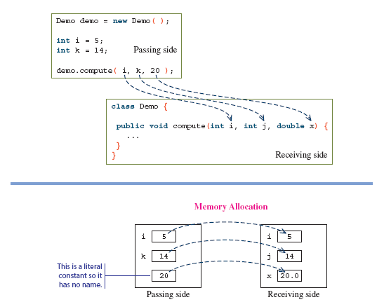
Matching Arguments and Parameters
The number or arguments and the parameters must be the same
Arguments and parameters are paired left to right
The matched pair must be assignment-compatible (e.g. you cannot pass a double argument to a int parameter)
Page <number>
Dr. S. GANNOUNI & Dr. A. TOUIR
Introduction to OOP
Notes:
The following calls are valid
int i, k, m;
i = 12; k = 10; m = 14;
demo.compute(3, 4, 5.5);
demo.compute(i, k, m);
demo.compute(m, 20, 40);
The following calls are not valid
demo.compute(2, 4);
demo.compute(14.0, 2, 3.0);

Slide 19
Parameter Passing
When a method is called:
    The parameters are created.
    The values of arguments are copied into the parameters’ variables.
    The variables declared in the method body (called local variables) are created.
    The method body is executed using the parameters and local variables.
When the method finishes:
    Parameters and local variables are destroyed.
Page <number>
Dr. S. GANNOUNI & Dr. A. TOUIR
Introduction to OOP

Slide 20
Passing Objects to a Method
As we can pass primitive data type values, we can also pass object references to a method using instance variables.
Pass an instance variable to a method means passing a reference of an object.
    It means that the corresponding parameter will be a copy of the reference of this objects.
        Because the passing parameter mechanism copies the value of the argument (which is an object reference) into the parameter.
    The argument and its corresponding parameter refer to the same object.
        The object is not duplicated.
        There are two instance variables (the argument and the parameter) referring to the same object.
Page <number>
Dr. S. GANNOUNI & Dr. A. TOUIR
Introduction to OOP

Slide 21
How Private Attributes could be Accessed
Private attributes are not accessible from outside.
    Except from objects of the same class.
They are accessible:
    From inside: from the object containing the data itself.
    From objects of the same class.
They are accessible from outside using accessor operations.
    Getters
    Setters
Page <number>
Dr. S. GANNOUNI & Dr. A. TOUIR
Introduction to OOP

Slide 22
class Course {
// Data Member
private String studentName;
private String courseCode ;
}
public class CourseRegistration {
public static void main(String[] args) {
Course course1, course2;
//Create and assign values to course1
course1 = new Course( );
course1.courseCode= “CSC112“;
course1.studentName= “Majed AlKebir“;
//Create and assign values to course2
course2 = new Course( );
course2.courseCode= “CSC107“;
course2.studentName= “Fahd AlAmri“;
System.out.println(course1.studentName + " has the course “+
course1.courseCode);
System.out.println(course2.studentName + " has the course “+
course2.courseCode);
}
}
Page <number>
Dr. S. GANNOUNI & Dr. A. TOUIR
Introduction to OOP

Slide 23
Getters
The object point of view
The user point of view
Are operations performed by the object returning to outsiders data retrieved from the object state.
Are services called from outside allowing to retrieve data from the object state.
:Y (Client)
object:X
Getters are:
  Public
  With no parameters
  With return value
public
private
Data
Data
Getters
Page <number>
Dr. S. GANNOUNI & Dr. A. TOUIR
Introduction to OOP

Slide 24
Template for Getters
public class ClassName {
private dataType1 attribute1;
. . .
private dataTypen attributen;
. . .
public dataType1 getAttribute1() {
return attribute1;
}
. . .
public dataTypen getAttributen() {
return attributen;
}
. . .
}
Page <number>
Dr. S. GANNOUNI & Dr. A. TOUIR
Introduction to OOP

Slide 25
Setters
The object point of view
The user point of view
Are operations performed by the object allowing to receive and store in the object state the data provided by outsiders.
Are services used by outsiders allowing to provide to the object the data that should be stored in the object state.
:Y (Client)
object:X
Setters are:
  Public
  With 1 parameter
  With no return value
public
private
Data
Data
Setters
Page <number>
Dr. S. GANNOUNI & Dr. A. TOUIR
Introduction to OOP

Slide 26
Template for Setters
public class ClassName {
private dataType1 attribute1;
. . .
private dataTypen attributen;
. . .
public void setAttribute1(dataType1 param){
attribute1 = param;
}
. . .
public void setAttributen(dataTypen param) {
attributen = param;
}
. . .
}
Page <number>
Dr. S. GANNOUNI & Dr. A. TOUIR
Introduction to OOP

Slide 27
public class Course {
// Attributes
private String studentName;
private String courseCode ;
...
public String getStudentName() {
return studentName;
}
public String getCourseCode() {
return courseCode;
}
...
public void setStudentName(String val) {
studentName = val;
}
public void setCourseCode(String val) {
courseCode = val;
}
}
Page <number>
Dr. S. GANNOUNI & Dr. A. TOUIR
Introduction to OOP

Slide 28
public class CourseRegistration {
public static void main(String[] args) {
Course course1, course2;
//Create and assign values to course1
course1 = new Course( );
course1.setCourseCode(“CSC112“);
course1.setStudentName(“Majed AlKebir“);
//Create and assign values to course2
course2 = new Course( );
course2.setCourseCode(“CSC107“);
course2.setStudentName(“Fahd AlAmri“);
System.out.println(course1.getStudentName() +
" has the course “ + course1.getCourseCode());
System.out.println(course2.getStudentName() +
" has the course “ + course2.getCourseCode());
}
}
Page <number>
Dr. S. GANNOUNI & Dr. A. TOUIR
Introduction to OOP

Slide 29
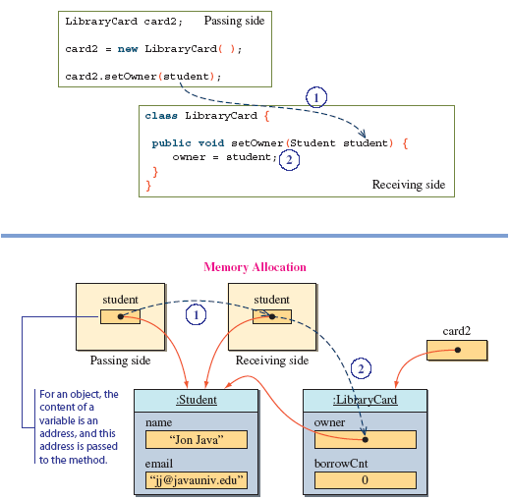
Passing an Object to a Setter
Page <number>
Dr. S. GANNOUNI & Dr. A. TOUIR
Introduction to OOP

Slide 30
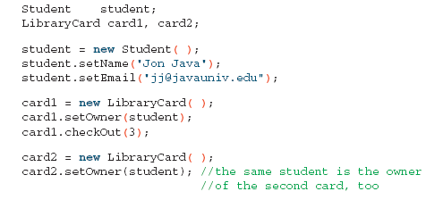
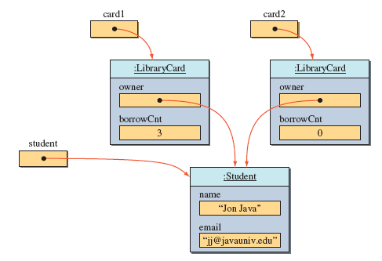
Using Setters and sharing the same Object
The same Student object reference is passed to card1 and card2 using setters
Since we are actually passing the same object reference, it results in the owner of two LibraryCard objects referring to the same Student object
Page <number>
Dr. S. GANNOUNI & Dr. A. TOUIR
Introduction to OOP

Slide 31
Class Constructors
A class is a blueprint or prototype from which objects of the same type are created.
Constructors define the initial states of objects when they are created.
    ClassName x = new ClassName();
A class contains at least one constructor.
A class may contain more than one constructor.
Page <number>
Dr. S. GANNOUNI & Dr. A. TOUIR
Introduction to OOP

Slide 32
The Default Class Constructor
If no constructors are defined in the class, the default constructor is added by the compiler at compile time.
The default constructor does not accept parameters and creates objects with empty states.
    ClassName x = new ClassName();
Page <number>
Dr. S. GANNOUNI & Dr. A. TOUIR
Introduction to OOP

Slide 33
Class Constructors Declaration
  public <constructor name> ( <parameters> ){
  <constructor body>
  }
The constructor name: a constructor has the name of the class .
The parameters represent values that will be passed to the constructor for initialize the object state.
Constructor declarations look like method declarations—except that they use the name of the class and have no return type.
Page <number>
Dr. S. GANNOUNI & Dr. A. TOUIR
Introduction to OOP

Slide 34
Example of a Constructor with No-Parameter
public class Kasree {
private int bast;
private int maquam;
public Kasree() {
bast = 0; maquam =1;
}
. . .
}
A. The instance variable is allocated in memory.
x
B. The object is created with initial state
Object: Kasree
bast
0
1
maquam
C. The reference of the object created in B is assigned to the variable.
x
A
Kasree x;
B
x = ;
Object: Kasree
new Kasree ( )
bast
0
1
maquam
C
State of Memory
Code
Page <number>
Dr. S. GANNOUNI & Dr. A. TOUIR
Introduction to OOP

Slide 35
Class with Multiple Constructors
public class Kasree {
private int bast;
private int maquam;
public Kasree() {
bast = 0; maquam =1;
}
public Kasree(int a, int b) {
bast = a;
if (b != 0) maquam = b;
else maquam = 1;
}
. . .
}
A. The constructor declared with no-parameter is used to create the object
x
Object: Kasree
bast
0
1
maquam
B. The constructor declared with parameters is used to create the object
y
Kasree x , y;
A
Object: Kasree
x = new Kasree()
y = new Kasree(4, 3);
bast
4
B
3
maquam
State of Memory
Code
Page <number>
Dr. S. GANNOUNI & Dr. A. TOUIR
Introduction to OOP

Slide 36
Overloading
Two of the components of a method declaration comprise the method signature:
    the method's name
    and the parameter types.
    The signature of the constructors declared above are:
      Kasree()
      Kasree(int, int)
overloading methods allows implementing different versions of the same method with different method signatures.
    This means that methods within a class can have the same name if they have different parameter lists.
Page <number>
Dr. S. GANNOUNI & Dr. A. TOUIR
Introduction to OOP

Slide 37
Overloading (cont.)
Overloaded methods are differentiated by:
    the number,
    and the type of the arguments passed into the method.
You cannot declare more than one method with:
    the same name,
    and the same number and type of parameters.
The compiler does not consider return type when differentiating methods.
    No declaration of two methods having the same signature even if they have a different return type.
Page <number>
Dr. S. GANNOUNI & Dr. A. TOUIR
Introduction to OOP

