Slide 1
Fitness AI Exercise Classification System
A Deep Learning Approach for Automated Workout Recognition
Author: Hay Lahav

Slide 2

Problem Statement & Motivation
Project objectives:
Build a robust classifier for 22 exercise types achieving high accuracy while handling real-world video conditions and enabling practical deployment

Slide 3
Agenda
Solution Overview
Dataset Dataset analysis
Challenges and solutions
Data preprocessing
Model Architecture (overview and main components)
Training Results
Future Improvements

Slide 4
Solution Overview
High-Level Approach
Use MediaPipe for real-time pose estimation (33 body landmarks)
Extract biomechanical features from pose sequences
Train attention-based neural network for classification
Why MediaPipe?
Optimized for Google Colab environment
Real-time performance on CPU
Robust landmark detection with confidence scores
No GPU requirements for pose estimation
Pipeline Flow
Video → MediaPipe pose detection
Landmarks → Biomechanical feature extraction (83 features)
Sequences of 20 frames each (20,83) → Bidirectional LSTM (20,64)+ Attention
Output → Exercise classification + confidence

Slide 5





Overall Project Flow
Video Input Processing
Frame extraction
MediaPipe Pose Estimation
33 landmarks
Min detection confidence: 0.5
Confidence filtering: 0.6
Feature Engineering
Biomechanical features
Temporal Processing
Sliding windows with 70% overlap
Neural Network
Attention-based classification
Ensemble voting

Slide 6
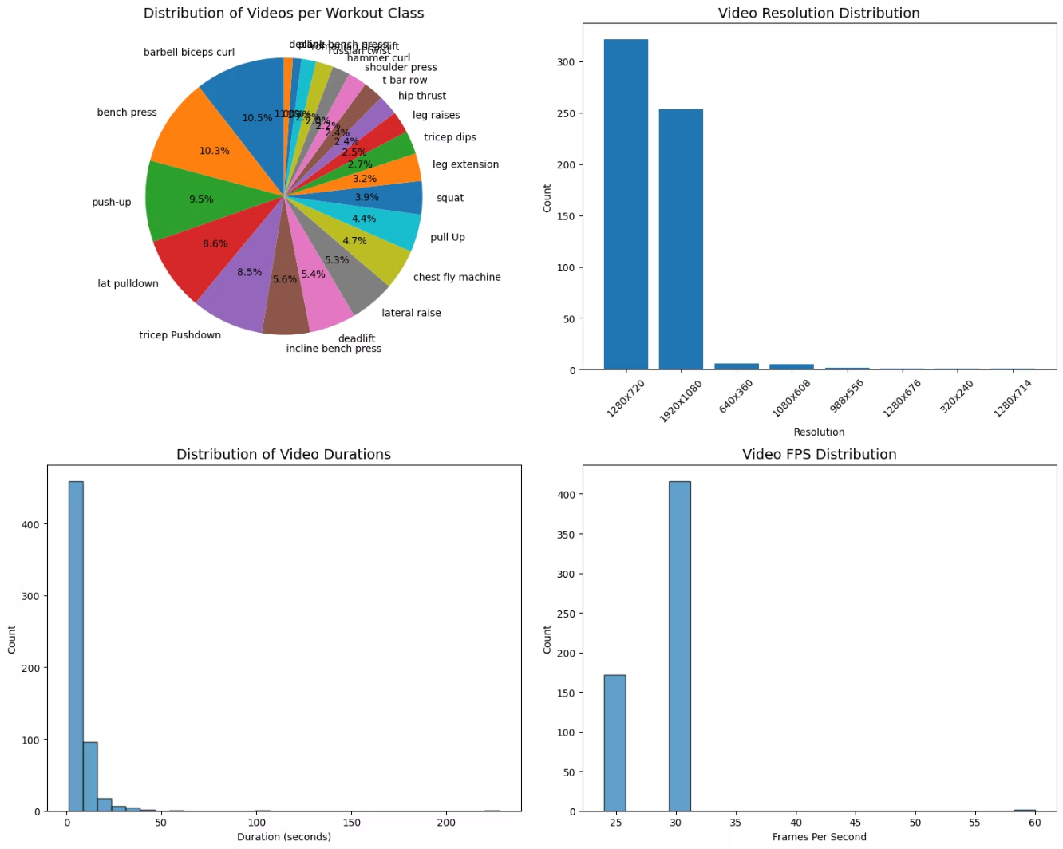
Dataset Overview
Exercise Types
Video Characteristics
Resolutions from 320×240 to 1920×1080
Durations from 5 seconds to 200+ seconds
Varying lighting conditions
Partial body coverage
Multiple people in frame
Class Distribution
Significant class imbalance exists with popular exercises like bench press (10.3%) dominating while others like plank represent less than 3% of the dataset

Slide 7



Challenges & Solutions
Pose Detection Quality (MediaPipe)
Exercise Motion Similarity
Class Imbalance
Challenge: 10%+ vs <3% distribution
Challenge: Variability from lighting, angles, and occlusion
Challenge: Similar movements like bench press vs chest fly
Solution: Focal loss implementation, class weight balancing, and targeted data augmentation for underrepresented exercises
Solution: Confidence-based filtering (0.6 threshold), quality metrics tracking, and robust error handling ensuring only high-quality training data
Solution: Exercise-specific feature engineering with targeted angle calculations, attention mechanisms, and temporal pattern analysis

Slide 8
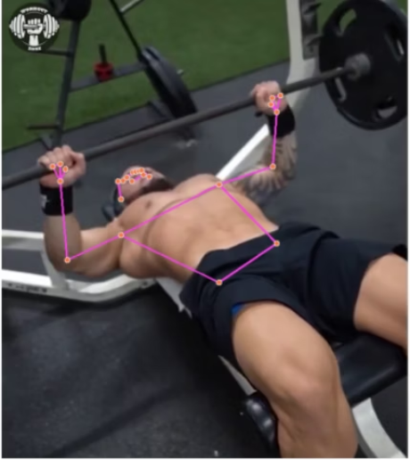
Challenge 1 - Exercise Motion Similarity
The Biomechanical Similarity Problem
Bench Press vs Chest Fly Machine
Similar horizontal arm movement
Both target chest muscles
Difference: pressing vs fly motion pattern
Barbell Biceps Curl vs Hammer Curl
Same elbow flexion movement
Similar arm positioning
Difference: wrist rotation and grip
Incline vs Regular vs Decline Bench Press
Similar pressing mechanics
Same muscle groups targeted
Difference: torso angle and movement plane
In this example, this decline bench press frame was captured from an angle that could easily confuse the model, leading it to misinterpret it as a standard or even incline bench press.

Slide 9
Solution 1 - Exercise-Specific Feature Engineering
Targeted Discrimination Features
Arm Convergence Angle
Torso Incline Ratio
Hip Dominance Ratio
Measures how arms come together during movement
Calculates angle between torso and horizontal plane
Measures hip movement relative to knee movement
Bench press: Arms move in parallel pressing motion
Incline bench: 30-45° positive angle
Romanian deadlift: High hip dominance (0.8-0.9)
Chest fly: Arms converge in arc-like motion
Decline bench: 15-30° negative angle
Regular deadlift: Moderate hip dominance (0.6-0.7)
Knee Bend Analysis
Wrist Alignment Feature
Hand Separation Distance
Tracks knee flexion throughout movement
Measures wrist orientation relative to forearm
Calculates distance between hands during movement
Romanian: Minimal knee bend (<20°)
Barbell curl: Supinated grip, consistent alignment
Barbell curl: Fixed separation distance
Regular: Significant knee bend (>45°)
Hammer curl: Neutral grip, different wrist angle
Hammer curl: Independent hand movement
Biomechanical Intelligence Integration
✅ Domain Knowledge: Exercise science principles guide feature selection✅ Temporal Awareness: Features consider movement phases✅ Context Sensitivity: Features adapt based on detected exercise type
Note: Specific features for specific exercises.

Slide 10
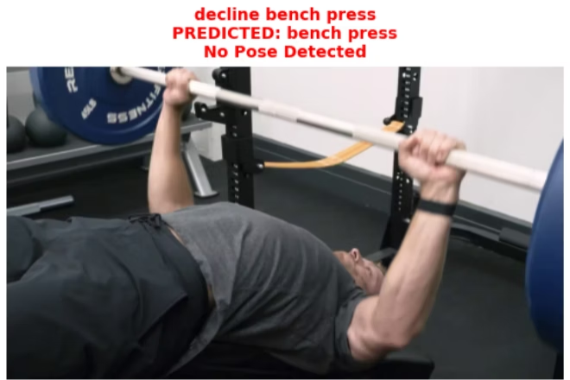
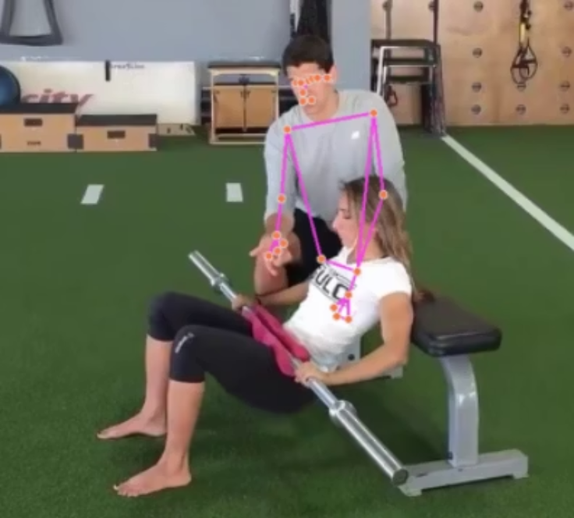
Challenge 2 - Pose Detection Variability
MediaPipe Limitations in Real-World Scenarios
Lighting Sensitivity
Poor Performance in Low Light
Multi-Person Detection
Confidence drops below 0.3 in dim lighting
MediaPipe detects multiple pose skeletons
Shadows cause landmark instability
Uncertainty about which person is exercising
Background people interfere with primary subject
Camera Angle Issues
📐 Optimal vs Suboptimal Angles
🎥 Scale and Distance Problems
Side view: Best for sagittal plane exercises
Close-up shots: Missing full body context
Front view: Optimal for frontal plane movements
Inconsistent subject-to-camera distances
Oblique angles: Compromise detection quality
Impact on Training Quality
⚠️ Noisy Training Data: Poor detections create incorrect feature vectors⚠️ Inconsistent Features: Same exercise produces different feature patterns⚠️ Model Confusion: Network learns from unreliable ground truth data

Slide 11
Solution 2 - Robust Quality Control System
Multi-Tier Filtering Architecture
Tier 1: MediaPipe Confidence Filtering
🎯 Detection Confidence Threshold: 0.5
🔍 Per-Landmark Visibility Check
Rejects frames with low overall pose confidence
Individual landmark confidence assessment
Ensures basic pose skeleton is reliable
Critical joints must meet minimum visibility
Filters out frames with poor lighting/occlusion
Graceful degradation for non-critical landmarks
Tier 2: Average Visibility Assessment
Overall Quality Metric: 0.6 Threshold
Critical Joint Priority
Calculates mean visibility across all 33 landmarks
Hip center: Most important for normalization
Ensures sufficient body coverage for feature extraction
Shoulders/elbows: Essential for upper body exercises
Accounts for partial occlusion scenarios
Knees/ankles: Critical for lower body movements
Tier 3: Sequence-Level Quality Control
Pose Detection Rate
Temporal Consistency Check
Minimum 30% valid poses per video sequence
Validates smooth landmark transitions between frames
Ensures sufficient data for temporal modeling
Detects and filters sudden position jumps
Automatically rejects low-quality videos
Maintains temporal coherence in sequences
Error Handling Strategy
✅ Graceful Degradation: System continues with reduced features when possible✅ Quality Metrics Tracking: Continuous monitoring of detection performance✅ Automatic Rejection: Bad sequences removed without manual intervention✅ Robust Interpolation: Smart filling of missing landmarks using temporal context
Note: We lose information, which can be critical for a rare classes.

Slide 12
Challenge 3 - Class Imbalance Problem
The Imbalance Statistics
📊 Severe Class Distribution Skew
Most Popular: Bench press (10.3%), Barbell biceps curl (10.5%)
Least Popular: Plank (<3%), Romanian deadlift (<3%)
Ratio: 3.5:1 between most and least represented classes
Why Class Imbalance is Critical
Biased Model Predictions
Gradient Dominance
Standard Cross-Entropy Loss
Network learns to predict popular classes
Popular classes dominate loss calculation
Treats all misclassifications equally
Doesn't emphasize learning difficult examples
Poor performance on underrepresented exercises
Rare classes contribute minimally to learning
Popular classes overwhelm gradient updates
High overall accuracy but terrible per-class metrics
Model ignores minority class patterns

Slide 13
Solution 3 Focal Loss Implementation for Class Imbalance
Focal Loss Mathematical Foundation
📐 Standard Cross-Entropy Problem
CE(pt) = -log(pt)
Treats all examples equally
Easy examples dominate loss calculation
Hard examples (rare classes) get insufficient attention
📐 Focal Loss Solution
FL(pt) = -α(1-pt)^γ log(pt)
Where:
pt = model's predicted probability for ground truth class
α = 1.0 = class balancing parameter
γ = 2.0 = focusing parameter for hard examples
How Focal Loss Works
Hard Example Emphasis
Class Balancing Effect
When pt is low (wrong prediction): (1-pt)^γ is high → large loss
α parameter provides additional weighting for rare classes
When pt is high (correct prediction): (1-pt)^γ is low → small loss
Combined with (1-pt)^γ term for maximum effect
Prevents easy examples from overwhelming gradients

Slide 14
Solution 3 Class Weight Computation Strategy
Balanced Class Weights
Automatically computed weights inversely proportional to class frequency to counteract dataset imbalance. Each training sample is weighted by its class rarity, ensuring underrepresented exercises (like plank) contribute more to gradient updates than overrepresented ones (like bench press).
📊 Weight Calculation Results
High-frequency classes (bench press): weight = 0.48
Medium-frequency classes (push-up): weight = 0.72
Low-frequency classes (plank): weight = 1.89
Combined Strategy: Focal Loss + Class Weights
✅ Dual Protection: Both hard examples AND rare classes get emphasis✅ Gradient Balance: Prevents popular classes from dominating learning✅ Training Stability: Maintains convergence while improving rare class performance

Slide 15
Data Preprocessing Pipeline
Stage 1: MediaPipe Filtering
Detection confidence > 0.5
Stage 2: Landmark Quality Assessment
Average visibility > 0.6 across all 33 landmarks
Critical joints (hips, shoulders, elbows, knees) must be visible
Frame-by-frame confidence tracking
Stage 3: Sequence Generation
Sliding window: 20 frames per sequence
70% overlap for maximum data extraction
Frame skip = 2 for computational efficiency

Slide 16
Data Augmentation Strategy
Temporal Augmentation
Time stretching: 0.8-1.2x speed simulation
Temporal shifts: ±2 frame offsets
Sequence subsampling for variation
Noise Injection
Gaussian noise (σ=0.01) for landmark coordinates
Simulates sensor noise and detection variability
Applied to 30% of training sequences
Class-Specific Augmentation
2x augmentation for classes <30 samples
Targeted augmentation for underrepresented exercises
Maintains temporal coherence

Slide 17
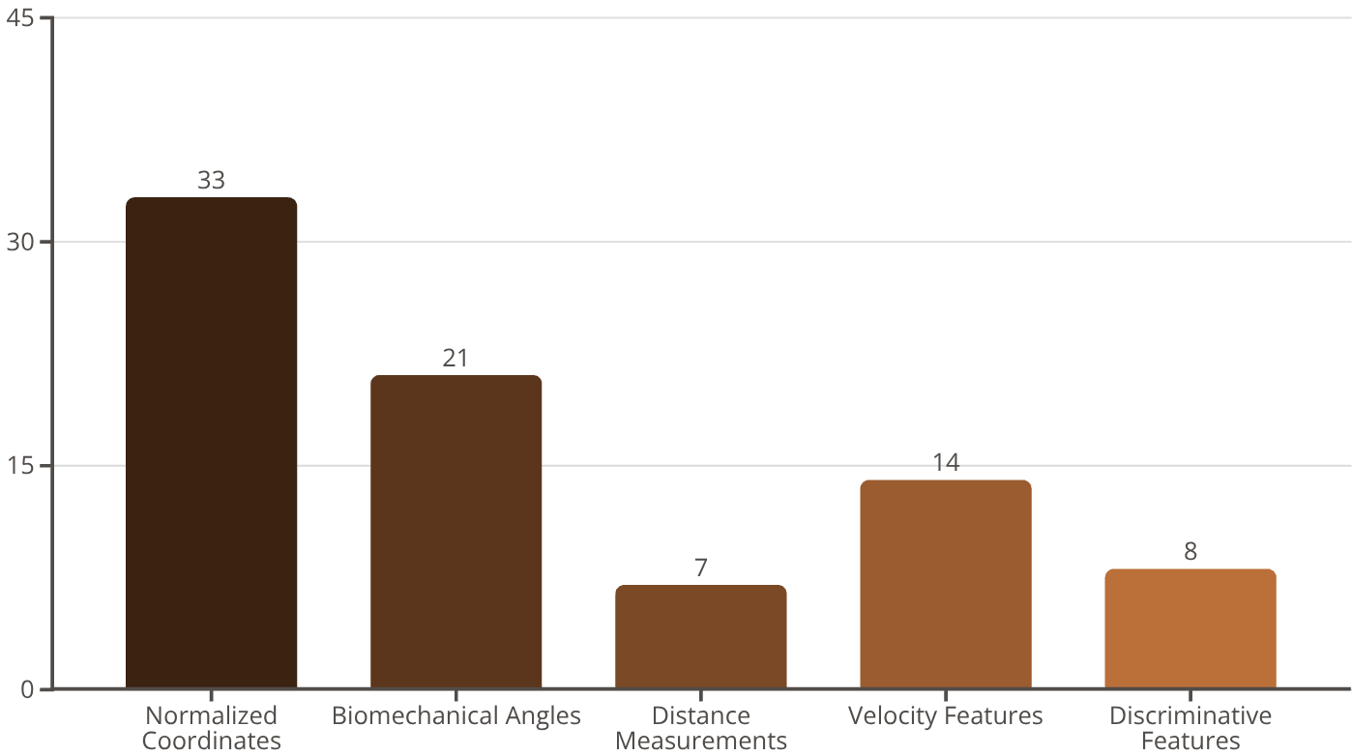
Feature Engineering Deep Dive
83-Dimensional Feature Vector
Distance Measurements (7): Body segment relationships (hand-to-hand, shoulder width, arm reach)
Velocity Features (14): Frame-to-frame movement dynamics for upper body landmarks
Discriminative Features (8): Exercise-specific patterns (arm convergence, hip dominance ratios)
Key Intelligence
Exercise-specific angle calculations adapt based on detected movement type
Temporal velocity tracking captures movement quality and rhythm
Scale-invariant normalization handles varying video conditions
Normalized Coordinates (33): Body landmarks relative to hip center for scale/position invariance
Biomechanical Angles (21): Joint angles (elbow, knee, hip, shoulder) + exercise-specific discrimination angles

Slide 18
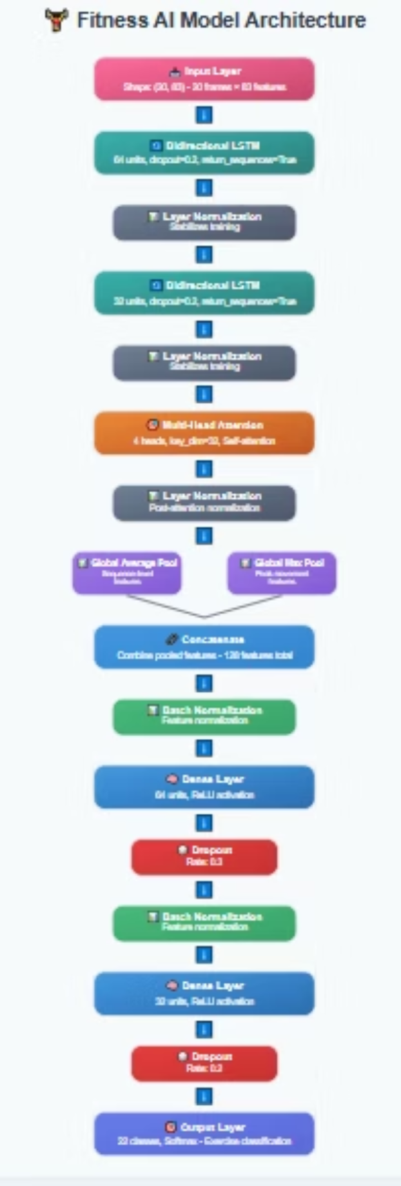
Model Architecture

Slide 19
Multi-Head Attention Mechanism
Self-Attention for Exercise Focus
Attention is a mechanism that allows the model to dynamically focus on the most relevant parts of the input sequence, automatically learning which frames contain the most discriminative information for exercise classification.
The Attention Problem in Exercise Classification
🎯 Not All Frames Are Equal
Peak contraction moments most discriminative
Transition phases less informative
Rest positions between reps should be ignored
🎯 Exercise-Specific Critical Moments
Deadlift: Peak hip extension moment
Bench Press: Bottom position and lockout phase
Squat: Depth achievement and drive initiation
Multi-Head Attention Architecture
Technical Specifications
Number of Heads: 4 parallel attention mechanisms (Peak Movement, Movement Transition, Exercise Initiation , Temporal Rhythm)
Key Dimension: 32 features per attention head
Input: (batch_size, 20, 64) from bidirectional LSTM
Output: (batch_size, 20, 64) attention-weighted features

Slide 20
Self-Attention Computation
Query = Input × WQ (64 → 32 per head)Key = Input × WK (64 → 32 per head) Value = Input × WV (64 → 32 per head)Attention(Q,K,V) = softmax(QK^T/√dk)V
Query (Q): What information am I looking for? (represents the current frame asking "what should I pay attention to?")Key (K): What information do I contain? (represents each frame's content that can be matched against queries)Value (V): What information do I actually provide? (represents the actual features/content each frame contributes to the output)

Slide 21
What Each Attention Head Learns
Head 1: Peak Movement Detection
🔍 Focus: Maximum contraction or extension moments🔍 Learning: Critical exercise phases with highest discriminative power🔍 Examples: Peak bicep contraction, squat depth, deadlift lockout
Head 2: Movement Transition Analysis
🔍 Focus: Phase transitions and movement quality🔍 Learning: Smooth vs jerky movements, tempo variations🔍 Examples: Eccentric-to-concentric transitions, pause patterns
Head 3: Exercise Initiation Patterns
🔍 Focus: Starting positions and setup phases🔍 Learning: Exercise-specific preparation patterns🔍 Examples: Deadlift setup, squat unracking, curl starting position
Head 4: Temporal Rhythm Recognition
🔍 Focus: Overall movement timing and rhythm🔍 Learning: Exercise-specific tempo patterns🔍 Examples: Controlled vs explosive movements, pause lengths
Attention Benefits for Exercise Classification
Automatic Feature Selection
✅ Dynamic Importance: Each frame receives appropriate attention weight✅ Exercise-Adaptive: Different exercises focus on different critical moments✅ Noise Reduction: Less important frames receive minimal attention
Improved Discrimination
✅ Similar Exercise Separation: Attention highlights subtle differences✅ Quality Assessment: Attention patterns indicate movement quality✅ Robust Classification: Less sensitive to irrelevant frame variations

Slide 22
Bidirectional LSTM Deep Dive
Why Bidirectional LSTM for Exercise Classification?
Bidirectional LSTM processes sequences in both forward and backward directions simultaneously, allowing the model to access both past and future context when making predictions about any given time step. Unlike standard LSTM that only sees previous frames, BiLSTM understands the complete temporal context of each movement phase.
LSTM Gates & Activation Functions
Forget Gate (σ): Decides what information to discard (0-1 range)
Input Gate (σ) + Candidate (tanh): Controls what new info to store (-1 to +1 values)
Output Gate (σ): Controls what memory to output (0-1 range)
Key Functions:
Sigmoid (σ): 0-1 range → Perfect for gates (0=closed, 1=open)
Tanh: -1 to +1 range → Stores actual information (positive/negative)
Temporal Dependencies in Exercise Movements
Forward Temporal Patterns
Backward Temporal Context
Exercise initiation and preparation phase
End-of-movement informs beginning analysis
Peak contraction or movement phase
Complete motion understanding
Return to starting position
Better discrimination of similar exercises
🎯 Exercise-Specific Benefits
Deadlift: Lift phase → peak → lowering phase analysis
Bicep Curl: Flexion → peak contraction → extension pattern
Squat: Descent → bottom position → ascent recognition
Exercise Example-Specific Gate Learning
Bicep Curl Gates:├── Forget Gate: Discard setup details at peak (0.2)├── Input Gate: Store peak contraction strongly (0.9) ├── Output Gate: Reveal contraction pattern (0.85)└── Result: Focus on discriminative peak moment

Slide 23
Bidirectional Architecture Specifications
Layer 1: Primary Temporal Processing
Units: 64 LSTM cells × 2 directions = 128 total outputs
Input: (batch_size, 20, 83) feature sequences
Output: (batch_size, 20, 128) bidirectional features
Dropout: 0.2 for regularization
Return Sequences: True (feeds into next LSTM layer)
Layer 2: High-Level Pattern Recognition
Units: 32 LSTM cells × 2 directions = 64 total outputs
Input: (batch_size, 20, 128) from previous layer
Output: (batch_size, 20, 64) refined temporal features
Dropout: 0.2 for regularization
Return Sequences: True (feeds into attention layer)
What Bidirectional LSTM Learns
🧠 Complete Movement Context: Understanding both where movement is going and where it came from🧠 Improved Disambiguation: Better discrimination between similar exercises using full temporal context🧠 Robust Pattern Recognition: More stable features that capture complete exercise biomechanics

Slide 24
BiLSTM + Attention Integration
Two-Stage Temporal Processing
Stage 1: BiLSTM Pattern Recognition
Input (20, 83) → BiLSTM → Temporal Features (20, 64)
What BiLSTM Does: Learns movement sequences with selective memory
Gate Function: Manages what to remember/forget internally
Output: Rich temporal features for ALL 20 frames
Stage 2: Attention Selective Focus
BiLSTM Features (20, 64) → Attention → Weighted Features (20, 64)
What Attention Does: Decides which BiLSTM outputs matter most
Key Point: Receives features from ALL frames (despite internal forgetting)
Result: Exercise-specific temporal focus patterns
Critical Distinction
LSTM "Forgetting": Internal memory management only
Attention Input: Complete access to all 20 processed frames
Synergy: Temporal understanding + Selective focus = 93.8% accuracy

Slide 25
Dual Pooling
Fundamental Purpose
Pooling converts sequences to vectors - transforms (20, 64) attention output into (128,) fixed-size representation for classification.
Why Dual Pooling?
Average: Captures overall exercise characteristics and patterns Max: Preserves peak moments and discriminative features Combined: Comprehensive representation (128 features total)
Real-World Example:
Bicep Curl Analysis:Average Pool: "Moderate elbow flexion throughout movement"Max Pool: "Peak contraction reaches 90° flexion" Combined: "This is a bicep curl with typical range and peak"
The pooling stage is critical - it's what transforms the temporal understanding into a classification decision by creating a comprehensive exercise "fingerprint" that captures both the journey (average) and the destination (max) of each movement!

Slide 26
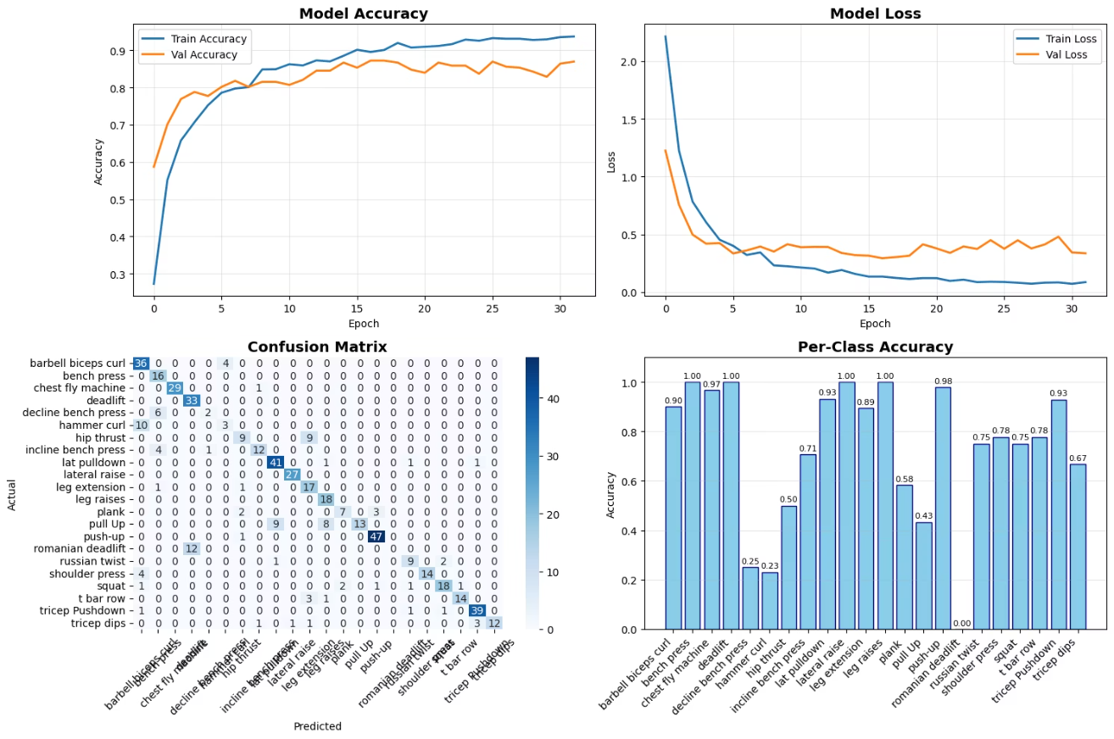
Training Model
Training Strategy
Focal loss implementation (α=1.0, γ=2.0)
Class weighting for dataset imbalance
Adam optimizer
Batch size 32
Regularization:
Dropout
Layer normalization
Early stopping
Training Results
Excellent convergence in 32 epochs with 85.87% training and validation accuracy. The training was stopped by early stopping with patience=15 epochs on validation accuracy

Slide 27
Results & Performance
Validation Performance
Challenging Exercises
85.87%
76%
Exercise
Accuracy
Barbell Biceps Curl
69%
Accuracy
Precision
Hammer Curl
43%
73%
72%
Test Performance
Held-out videos achieved 77.8% (7/9)accuracy with 0.724 average confidence
Recall
F1-Score
Ensemble voting effectiveness and proper confidence calibration preventing overconfident wrong predictions

Slide 28




Future Improvements
Vision-Language Model Integration
Exercise Form Assessment
Combining LLaVA, ViLT for multimodal understanding
Combining pose features with semantic context
Equipment recognition and environmental awareness
Range of Motion
Resolving current confusion cases
Analyzing movement completeness
Real-time Optimization
Model quantization by using TensorFlow Lite (4-8x speedup by converting 32-bit floats to 8-bit integers). TensorFlow Lite is optimized for minimal latency and enables real-time processing
Pipeline parallelization
Movement Symmetry
Mobile deployment targeting sub-100ms latency
Detecting imbalances
Immediate feedback applications
Better Hardware
Using better GPU for training Instead of the limited Google Collab GPU
Real-time Coaching
GAN-based data augmentation
Providing feedback
Generates synthetic pose sequences for underrepresented exercise classes.
It can significantly increase training set diversity , help the model learn more complex movement patterns.
Personalization
This could directly address my barbell curl vs hammer curl confusion by generating more diverse training examples
Federated learning & wearable integration:
Skill Level Recognition: Adapts feedback complexity based on user proficiency
Injury-Aware Modifications: Suggests exercise variations based on limitations
Body Type Adaptation: Adjusts biomechanical expectations based on individual anthropometrics

