Slide 1

Smart ETT
Why treat what we can prevent?
Bedside intelligence for every intubated patient — cuff pressure, secretions and infection risk in one screen, before the culture comes back.
Riyadh, Saudi Arabia · Working prototype, 2026
Notes:
Smart ETT — نظام مراقبة الأنبوب الحنجري. Our line: why treat what we can prevent? A respiratory-therapy and biomedical-engineering team from Riyadh, with a working prototype.

Slide 2
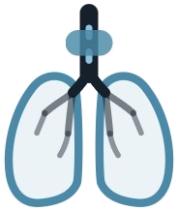
THE PROBLEM
The tube is checked. The risk is not.
A ventilated patient is watched minute by minute — yet the tube itself is judged by feel, and infection is confirmed only after the lab replies.
10–25%
$40,144
48–72 h
of ventilated patients
develop VAP
attributable cost of
one VAP episode
before culture results
come back
And the one number nurses do record is usually wrong
Independent re-measurement of 2,120 cuff readings in one ICU:
Only 4 in 10 readings sit where the protocol says they should — the tube is being managed blind.
Sources: VAP incidence, Int. J. Critical Care Medicine · cost per episode, J. Thoracic Disease · culture turnaround 48–72 h · cuff audit of 2,120 readings, Critical Care (2015).
Notes:
Three numbers: one in four ventilated patients gets VAP, each episode costs about forty thousand dollars, and the culture takes two to three days. Meanwhile the cuff — the one thing we do measure — is in range less than half the time.

Slide 3
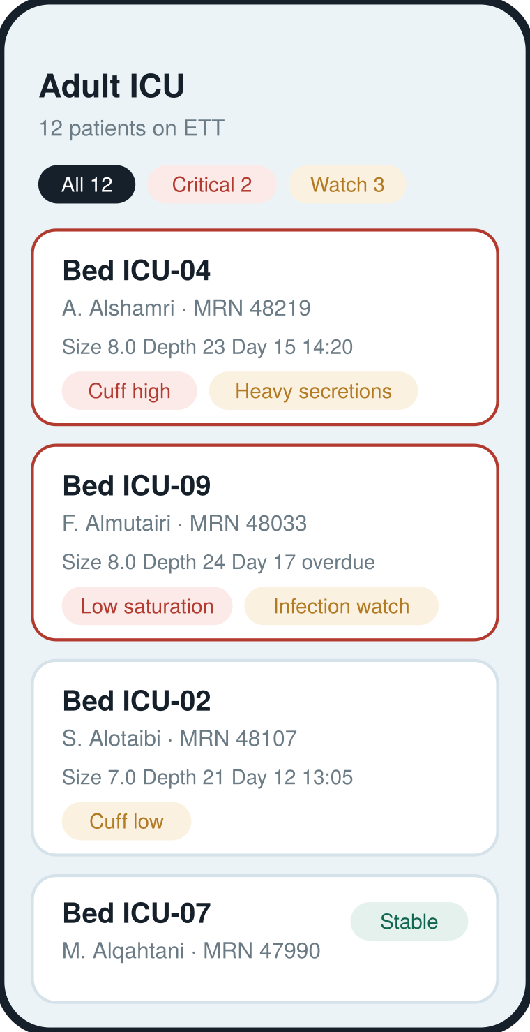
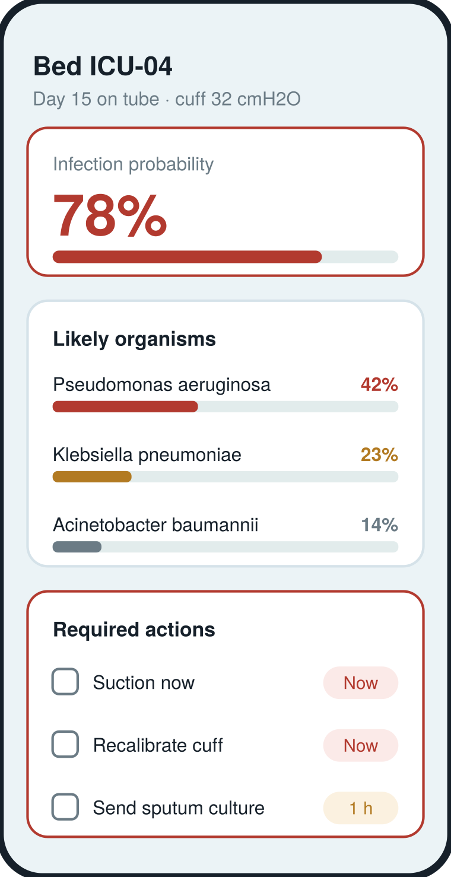
THE SOLUTION
Read the tube now.
Do not wait for the lab.
1
Assess in 30 seconds
Cuff pressure, secretion amount, colour and texture, temperature and saturation — entered at the bedside during routine suctioning.
2
Predict before the culture
Those inputs become an infection probability and a ranked list of the organisms most likely behind it, weighted by the unit’s own resistance pattern.
3
Act, and record it
Every score ends in a short task list — suction, recalibrate, send a culture, notify. One tap records it and the whole unit view updates.
Unit view — who needs you first
Live prototype · works on any phone or browser · no new hardware
Patient view — risk, organisms, actions
Notes:
Demo path: open the unit, the critical patients sort to the top, open a patient, tick suction and recalibrate, record — the risk drops from 78 to 42 percent and the unit counter falls by one.

Slide 4
CUSTOMER
Who we serve, and how we reach them.
Adult and paediatric ICUs
How we get in
A
Respiratory therapy and ICU nursing — the daily users. 12–30 ventilated beds per hospital.
1
60-day pilot
One adult ICU. Free, no integration, phones only.
Infection control committees
2
Show the numbers
B
Cuff compliance and VAP rate before vs after, to infection control.
They own the VAP rate, sign the pilot, and hold the budget line for prevention.
3
Hospital licence
Per ventilated bed, per year, once the committee has the report.
Hospital groups and health clusters
4
Cluster rollout
C
Private groups and MoH clusters buy once and deploy across every ICU they run.
Same evidence pack carried into group and MoH tenders.
Entry points: respiratory therapy departments, ICU nursing directors, infection control committees, and national health-innovation programmes.
Notes:
We sell to the people who already own the VAP rate. The pilot is free and needs no integration, so the decision is small; the report from that pilot is what unlocks the hospital and then the cluster.

Slide 5
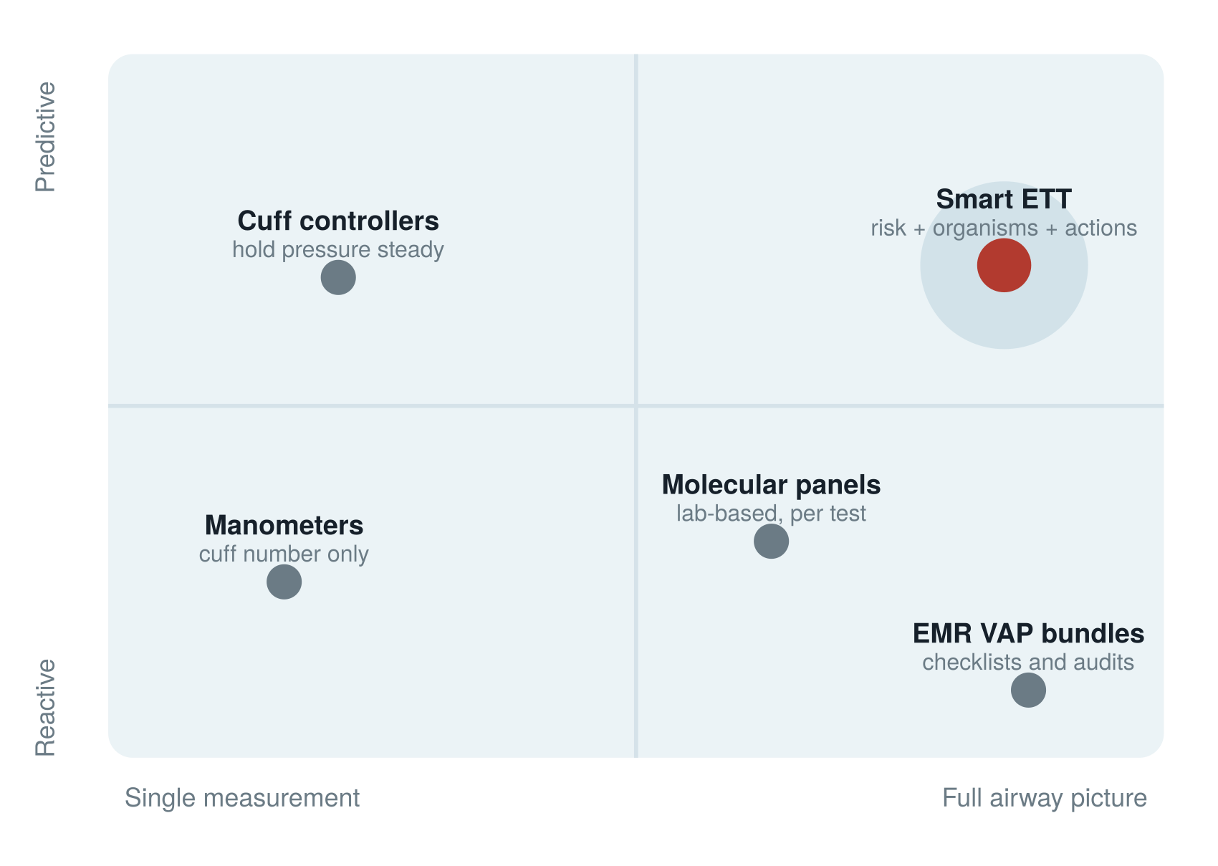
LANDSCAPE
Everyone measures a piece. We connect them.
Our edge
•
One picture
Cuff, secretions and patient factors read together — the combination is what predicts infection, not any single reading.
•
It shows its work
Every score lists the factors behind it, so a nurse can agree or overrule it.
•
It ends in an action
Ranked tasks with a time limit, recorded in one tap — not another alarm.
•
Nothing new to buy
Runs on the phones and manometers the unit already owns.
Manometers, cuff controllers, EMR bundles and molecular panels each solve one part well. Smart ETT sits on top of them and turns their data into a decision at the bedside.
Notes:
We are complementary, not a replacement. Manometers give a number, controllers hold it, bundles audit compliance, panels identify organisms in the lab. None of them tell the nurse at the bedside what this patient needs in the next hour.

Slide 6
THE TEAM
Clinicians and an engineer, building for the bedside they work at.
SA
RA
HA
Sarah Alharthi
Reem Almuhimed
Haya Alsufiyan
Respiratory Therapy
Respiratory Therapy
Biomedical Engineering
Smart ETT · Why treat what we can prevent?
Notes:
Two respiratory therapists who do this assessment every shift, and a biomedical engineer who builds the device side. The clinical judgement and the build capability are both inside the team.

