Slide 1





Quora Insincere Questions Classification
Haya Almadhi
Amwaj Hantol

Slide 2



Outlines
Introduction
Data Cleaning
Data visualization
Modeling

Slide 3
Introduction
Quora is a question answer website, anyone can ask question from any domain, which are then answered by others.
In this project we propose to classify these "insincere" questions, then appropriate actions can be taken against them.

Slide 4
Dataset
Contains approximately 1.3 million rows and 4 columns: Unnamed: 0 , target , qid and question_text.
From
Kaggle

Slide 5
Data Cleaning
Check missing
Check
null value
Check formats
Check duplicates
Clean text
Drop un-necessary columns
Remove white spaces
Reindex tha dataset

Slide 6
Data Cleaning
Before cleaning:
target | question_text | qid | Unnamed: 0
0 | how did quebec nationalists see their province... | 00002165364db923c7e6 | 0
After cleaning:
question_text | clean_qtext
sincere | quebec nationalist see provinc nation

Slide 7
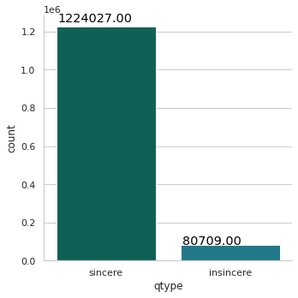

Data visualization
Which the most questions sincere or insincere

Slide 8
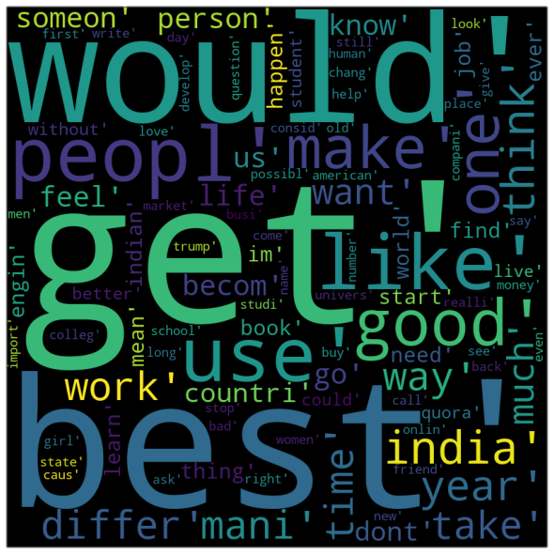
Data visualization
What is the most frequent words

Slide 9
Modeling
Logistic Regression
Naive Bayes
TF-IDF

Slide 10
Conclusion
 | LogReg1 | LogReg2 | NB1 | NB2 | LR1-TFIDF | LR2-TFIDF | NB1-TFIDF | NB2-TFIDF
Accuracy | 0.942 | 0.942 | 0.939 | 0.934 | 0.941 | 0.941 | 0.940 | 0.934
Precision | 0.948 | 0.948 | 0.954 | 0.955 | 0.947 | 0.947 | 0.941 | 0.955
Recall | 0.993 | 0.992 | 0.983 | 0.976 | 0.993 | 0.993 | 0.998 | 0.976
F1 Score | 0.970 | 0.970 | 0.968 | 0.965 | 0.969 | 0.969 | 0.969 | 0.965
According to various models, it can be stated that Logistic regression perform the best Other models also perform considerably well and there is no marginal difference between the different models.

Slide 11
Tools
numpy
pandas
seaborn
sklearnl
matplotlib
nltk
Wordcloud
collections

Slide 12
Future Work
For future implementation, this project can be implemented using various deep learning models, LSTM, …etc.
The problem of data imbalance can be solved by first training the data with equal number of sincere and insincere questions.
We will include more words for modeling.

Slide 13


Thank you

