Slide 1
Electron
Stability &
Valence
Electrons
2.4
Count valence electrons, explain why noble gases are stable, write ion configurations, and predict main-group ion charges.
U02 • S02.4
Notes:
Section title. PROVISIONAL/OPEN: verbatim DECISIONS title now in the panel. Scope boundary (Matt, 2026-10-04): S2.4 owns what an ion's configuration IS and valence-electron-based charge prediction at the end of the section (main group only). U3.7 and U3.4 own the energetics. PROVISIONAL: group 14 and transition metals are not predicted by the rule here. Not taught here: Lewis dot preview (PROVISIONAL, omitted; belongs to a later unit). Transition-metal valence counting (PROVISIONAL, brief slide 6) also omitted. Image slot empty. Prompt subject: a glass tube of neon gas glowing orange on a dark bench.

Slide 2
Who Reacts, Who Doesn't
UNIT 02 • CHEMISTRY
Helium, neon, and argon barely react with anything. Sodium and chlorine react easily.
What is different about the electrons in He, Ne, and Ar?
U02 • S02.4
Notes:
Hook. Ask first, answer later. Do not say 'want' or 'need' of atoms; describe outcomes. Image slot empty. Prompt subject: a row of glowing noble gas discharge tubes against a dark background.

Slide 3
Three Words You Need First
UNIT 02 • CHEMISTRY
Write these before we go further. Everything after this slide uses them.
VALENCE ELECTRON
CORE ELECTRON
NOBLE GAS CONFIGURATION
An electron in the outermost energy level.
An electron in an inner, filled energy level.
Outer s and p sublevels full: 2 or 8 electrons.
Valence electrons are the electrons in the outermost energy level, the one with the highest n.
U02 • S02.4
Notes:
Students write the three terms. Noble gas configuration = outer s and p sublevels full (2 for He, 8 for the rest); say 'full' means s and p, not the whole shell. Image slot empty. Prompt subject: a worn chemistry notebook open to a hand-ruled page.

Slide 4
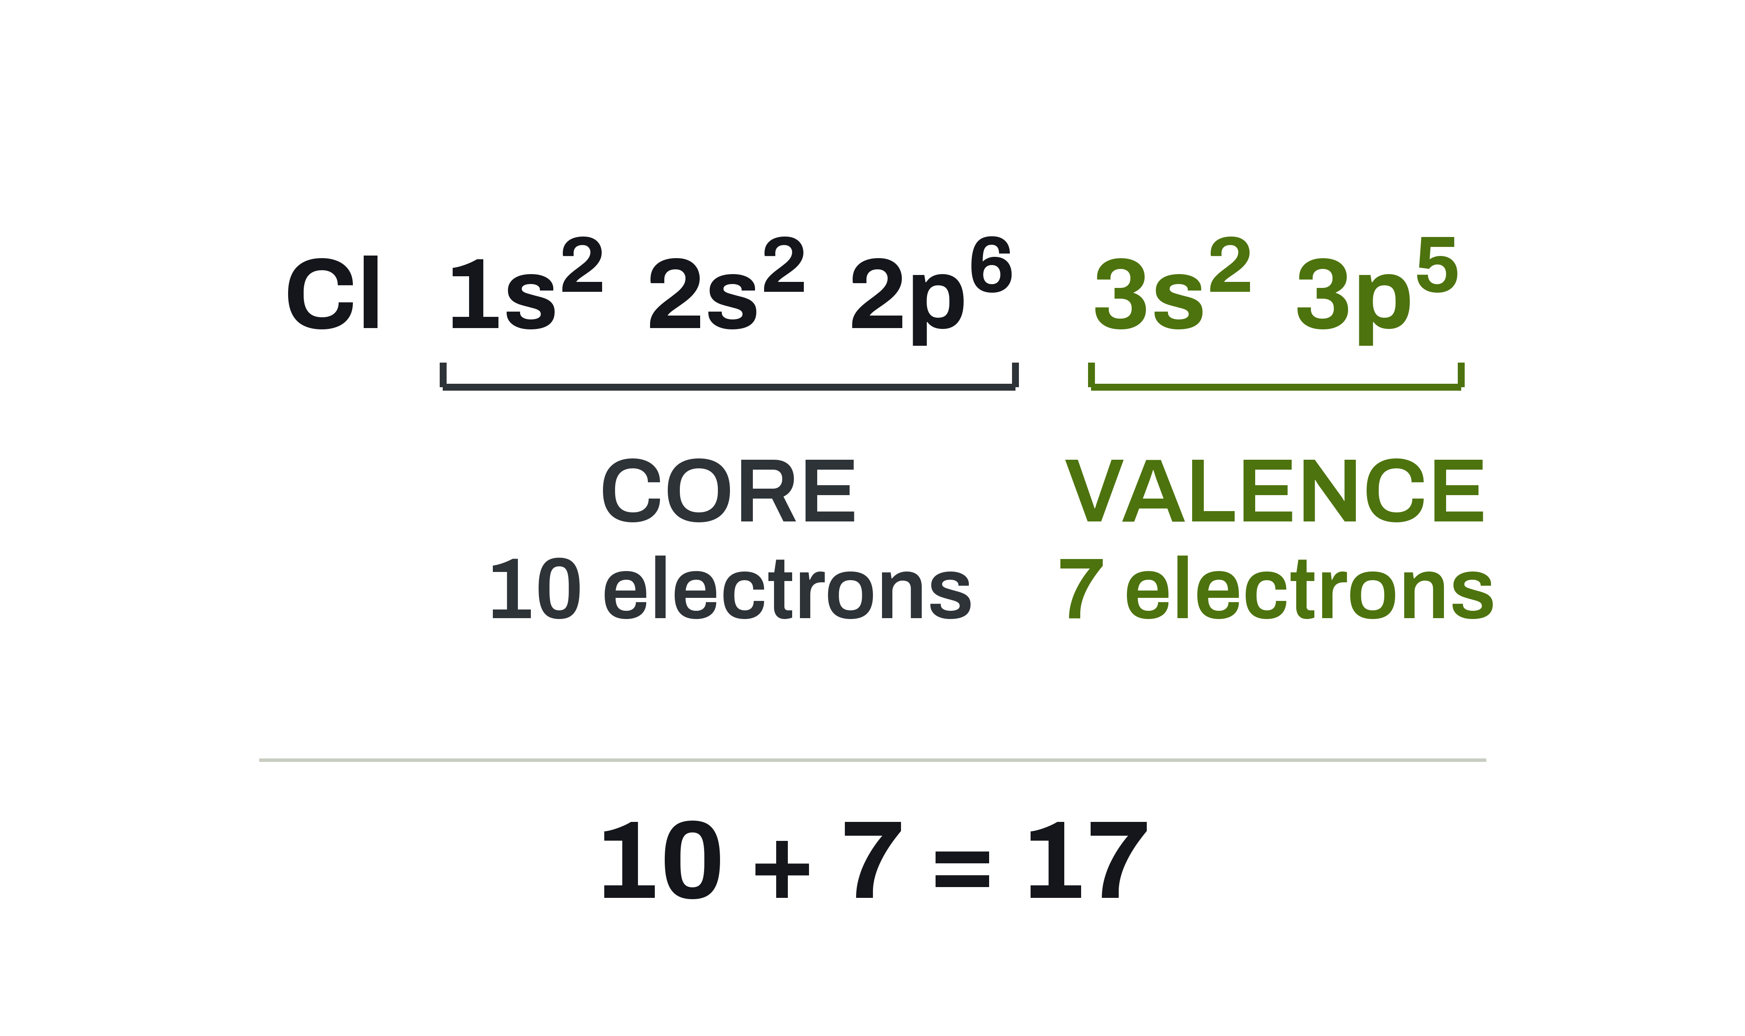
Core or Valence? Find the Highest n
UNIT 02 • CHEMISTRY
Chlorine has 17 electrons. Only the ones in n = 3 are valence.
CORE
1s² 2s² 2p⁶ fill n = 1 and n = 2. That is 10 electrons.
VALENCE
3s² 3p⁵ is the highest level, n = 3. That is 7 electrons.
THE CHECK
10 + 7 = 17, the atomic number of chlorine.
U02 • S02.4
Notes:
Cl: 10 core + 7 valence = 17. Valence = highest n only. Figure shows the split.

Slide 5
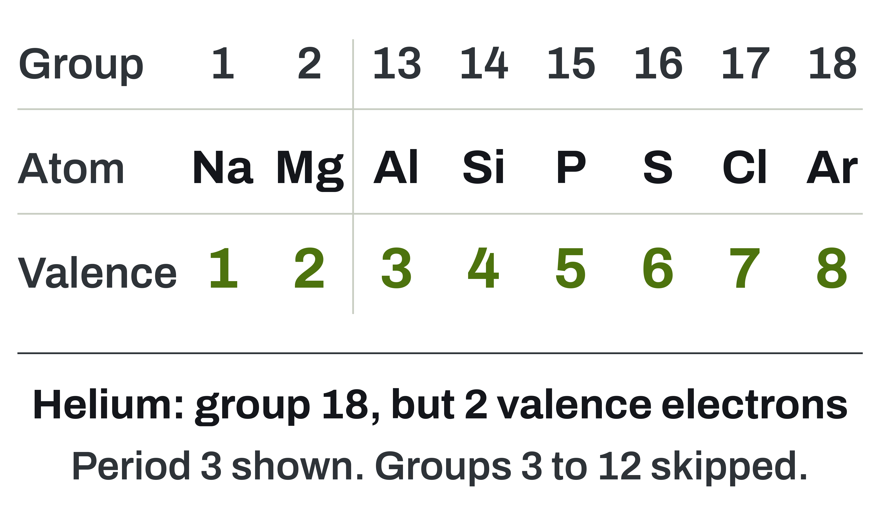
Valence Electrons From the Table
UNIT 02 • CHEMISTRY
For main-group elements, the group number gives you the count.
THE PATTERN
Groups 1 and 2: the group number.
Groups 13 to 18: the units digit.
THE EXCEPTION
Helium is in group 18 and has 2 valence electrons, not 8.
WHAT THIS SKIPS
Groups 3 to 12, the transition metals. Their ions follow the rule on slide 13.
U02 • S02.4
Notes:
Main-group only. PROVISIONAL: transition-metal valence counting is deliberately left out (brief slide 6; Matt to decide whether d electrons count). Say only that their ions lose the outer s electrons first (slide 13). Lewis dot preview omitted: belongs to a later unit (S5.1), PROVISIONAL.

Slide 6
Example: Valence Electrons of P and Ca
UNIT 02 • CHEMISTRY
We do this one together. Copy the setup, not just the answer.
Use each configuration to find the number of valence electrons in phosphorus and calcium.
GIVEN
NEED
P: [Ne] 3s² 3p³
Ca: [Ar] 4s²
Highest n for each
Valence electron count
Check against the group
Valence electrons are the s and p electrons in the highest n only.
U02 • S02.4
Notes:
Worked example, do together. Answers on next slide. Image slot empty. Prompt subject: a block of red phosphorus beside a piece of calcium metal.

Slide 7
Phosphorus and Calcium, Worked
UNIT 02 • CHEMISTRY
Check the group number last. It should agree with your count.
SETUP
Find the highest n.
Count every electron in it.
P: n = 3, so 3s² 3p³
2 + 3 = 5 valence
Ca: n = 4, so 4s²
2 valence
P has 5 valence electrons (group 15). Ca has 2 (group 2).
U02 • S02.4
Notes:
P: n = 3, 3s2 3p3 = 5. Ca: n = 4, 4s2 = 2. Both agree with group number. Image slot empty. Prompt subject: a pencil resting on a page of handwritten configurations.

Slide 8
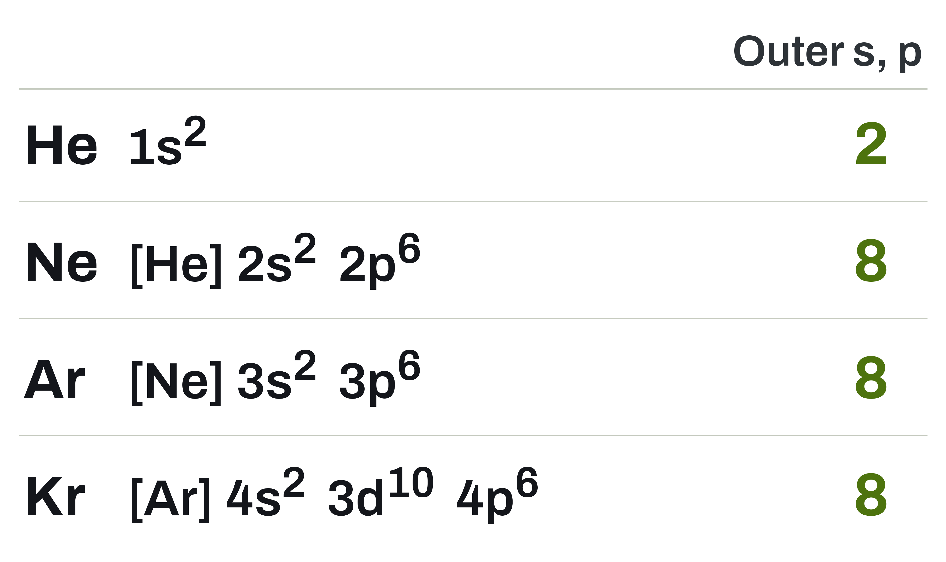
Why Noble Gases Barely React
UNIT 02 • CHEMISTRY
Look at the outer s and p sublevels of each one.
OCTET AND DUET
Ne, Ar, and Kr have 8 electrons in their outer s and p sublevels. Helium has 2.
WHAT FULL MEANS
Full means s and p. Argon's 3d sublevel is empty, so n = 3 is not completely full.
HOW WE USE IT
Later in this section we compare ions to these four configurations.
U02 • S02.4
Notes:
Full means outer s and p. Argon's 3d is empty, so n = 3 is not completely full; this fixes the 'full shell = 8' misconception. Avoid personifying atoms.

Slide 9
What Makes an Ion
UNIT 02 • CHEMISTRY
Atoms become ions by gaining or losing electrons. The nucleus does not change.
CATION
ANION
Loses electrons.
Positive charge.
Na → Na⁺: 11 electrons become 10.
Charge: 1+
Gains electrons.
Negative charge.
Cl → Cl⁻: 17 electrons become 18.
Charge: 1−
Electrons = atomic number − charge. Protons never change.
U02 • S02.4
Notes:
Electrons = atomic number minus charge. Protons never change. Here we only describe what an ion is; the charge-prediction rule comes at the end of the section (slide 18). Anion charge is also written plain (1−) because the superscript minus is faint. Image slot empty. Prompt subject: a bowl of table salt crystals on dark slate.

Slide 10
Na Loses One, Cl Gains One
UNIT 02 • CHEMISTRY
Electrons leave from the highest n first. A gained electron fills the open 3p spot.
SODIUM
Na⁺
3s¹ leaves: 11 → 10 electrons.
Na⁺: charge 1+. Matches [Ne].
1s²
2s²
2p⁶
3s⁰
Na⁺: charge 1+, 10 electrons
CHLORINE
Cl ion
[Ne]
One electron fills 3p: 17 → 18.
Cl⁻: charge 1−. Matches [Ar].
3s²
3p⁶
Cl ion: charge 1−, 18 electrons
THE CHECK
11 − 1 = 10 and 17 + 1 = 18.
U02 • S02.4
Notes:
MERGED slide (was two: Na+ orbitals and Cl- orbitals). Na loses its 3s1, leaving the neon configuration; Cl's added electron goes into the open 3p spot, not a new level, and matches argon. Click build replaces the static figure: sodium builds first, then the chlorine build covers it in the same slot (the 20-content-slide cap leaves no room for a second slide). The state line under each diagram gives the plain, large charge so the minus is legible. The static PNG chem_u02_s2.4_na_cl_ions.png stays on disk for print. Do not yet say why these charges: the rule comes at the end of the section.
STATIC FINAL STATE: print and handout copy, no animation. This slide shows the final state of the click build (Na); the animated deck shows it one click at a time.
STATIC FINAL STATE: print and handout copy, no animation. This slide shows the final state of the click build (Cl); the animated deck shows it one click at a time.

Slide 11
Three More Ions, Same Move
UNIT 02 • CHEMISTRY
Remove from the highest n, or fill the open spots in s and p.
ALUMINUM
OXYGEN
BROMINE
Al: [Ne] 3s² 3p¹
Al³⁺: [Ne]
13 → 10 electrons
Charge: 3+
O: 1s² 2s² 2p⁴
O²⁻: 1s² 2s² 2p⁶
= [Ne], 10 electrons
Charge: 2−
Br: [Ar] 4s² 3d¹⁰ 4p⁵
Br⁻: [Ar] 4s² 3d¹⁰ 4p⁶
= [Kr], 36 electrons
Charge: 1−
A cation loses from the highest n. An anion fills open spots in s and p.
U02 • S02.4
Notes:
MERGED slide (was two card slides: Mg2+/Al3+/Ca2+ and O2-/S2-/Br-). Mg2+ and Ca2+ now appear in the Ca walk-through and the worked example; S2- in the worked example. Br keeps its full 3d10. Charge lines are plain so anion minus signs are legible. Image slot empty. Prompt subject: a sealed ampoule of dark red-brown liquid bromine in a rack.

Slide 12
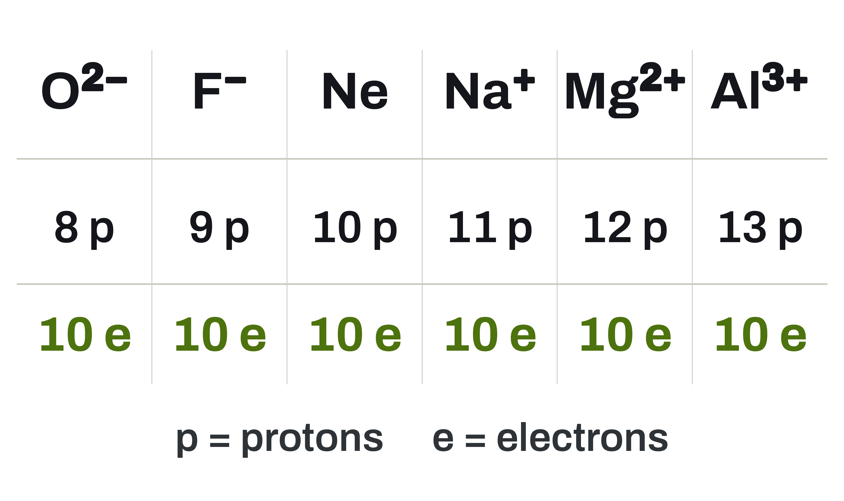
Same Electrons, Different Atoms
UNIT 02 • CHEMISTRY
Isoelectronic means the same number of electrons and the same configuration.
ALL TEN
Each of these has 10 electrons: 1s² 2s² 2p⁶.
DIFFERENT NUCLEI
The proton counts differ, so these are different particles. Their sizes differ too. Unit 3 explains why.
COUNT IT
Electrons = protons − charge. Check any column.
U02 • S02.4
Notes:
Isoelectronic = same electron count and configuration. Sizes differ; the reason is Unit 3, only pointed to here (one-line pointer, not taught).

Slide 13
Transition Metal Ions: 4s Leaves First
UNIT 02 • CHEMISTRY
This is the rule that surprises people. Watch the order.
THE RULE
THE REASON
Remove electrons from the outermost s first: 4s.
Then take from 3d if more must go.
Once 3d has electrons, it sits lower in energy than 4s.
So 4s electrons leave first, even though 4s filled first.
Transition-metal ions lose their ns electrons before their (n−1)d electrons.
U02 • S02.4
Notes:
PROVISIONAL (simplified): 'why 4s leaves first' is a student-language account (once 3d has electrons it sits lower than 4s). It is not a full energetics explanation; do not extend it. Matches S2.3 wording. Image slot empty. Prompt subject: a polished iron nail and a copper coin on dark slate.

Slide 14
Iron: Fe, Fe²⁺, and Fe³⁺
UNIT 02 • CHEMISTRY
Both 4s electrons go first. The third comes out of 3d.
Fe
Fe³⁺ Z = 26 [Ar] CORE
[Ar] 4s² 3d⁶
26 electrons
Fe²⁺
4s⁰
3d⁵
[Ar] 3d⁶
24 electrons. Both 4s electrons left.
Highest n is 4: 4s leaves first
Fe: charge 0, 26 electrons
Fe³⁺: charge 3+, 23 electrons
Fe³⁺
[Ar] 3d⁵
23 electrons. One 3d electron leaves too.
U02 • S02.4
Notes:
Fe 26, Fe2+ 24 [Ar]3d6, Fe3+ 23 [Ar]3d5. Present 3d5 as an observed electron count, not proof of a cause. Click build replaces the static figure: one slide carries Fe, Fe2+ and Fe3+ (the 4s arrows leave first, then one 3d). Click 3 passes through Fe+ (25 electrons), named on the slide so no species goes unlabelled. The static PNG chem_u02_s2.4_fe_ions_orbitals.png stays on disk for print.
STATIC FINAL STATE: print and handout copy, no animation. This slide shows the final state of the click build (Fe); the animated deck shows it one click at a time.

Slide 15
Example: Zn²⁺, Cu⁺, and Cu²⁺
UNIT 02 • CHEMISTRY
Same rule as iron. Copy the setup, not just the answer.
Write the [Ar] shorthand for Zn²⁺, Cu⁺, and Cu²⁺.
GIVEN
NEED
Zn: [Ar] 4s² 3d¹⁰
Cu: [Ar] 4s¹ 3d¹⁰
Electrons to remove
Which sublevel they leave
Each ion's shorthand
Take the 4s electrons first. Only then take from 3d.
U02 • S02.4
Notes:
Same rule as iron. Cu is the taught exception: [Ar] 4s1 3d10. Image slot empty. Prompt subject: a galvanized zinc sheet beside a length of copper wire.

Slide 16
Zn²⁺, Cu⁺, and Cu²⁺, Worked
UNIT 02 • CHEMISTRY
None of these ends at a noble gas configuration.
SETUP
Take 4s first, then 3d.
Zn 30 → 28. Cu 29 → 28 or 27.
Zn²⁺: [Ar] 3d¹⁰
Cu⁺: [Ar] 3d¹⁰
Cu²⁺: 4s, then one 3d
→ [Ar] 3d⁹
Zn²⁺ and Cu⁺ are both [Ar] 3d¹⁰. Cu²⁺ is [Ar] 3d⁹.
U02 • S02.4
Notes:
Zn2+ = Cu+ = [Ar] 3d10 (28 e). Cu2+ = [Ar] 3d9 (27 e). Not noble-gas configurations; these are stable anyway. Image slot empty. Prompt subject: a pencil resting on a page of handwritten calculations.

Slide 17
Why Calcium Forms Ca²⁺
UNIT 02 • CHEMISTRY
Count valence electrons first. The count tells you the move.
Ca²⁺ Z = 20 [Ne] CORE
THE ATOM
THE ION
Ca: [Ar] 4s²
2 valence electrons.
Lose 2, not gain 6: the fewest wins.
Lose both 4s electrons: [Ar].
18 electrons, 20 protons.
Charge: 20 − 18 = 2+
3s²
3p⁶
4s⁰
Valence electrons leave first: this is the outermost level
Ca: charge 0, 20 electrons
Ca²⁺ = [Ar]: charge 2+
Ca has 2 valence electrons. Losing both leaves [Ar], so Ca forms Ca²⁺.
U02 • S02.4
Notes:
NEW. Closing synthesis, step 1: Ca walk-through in four moves: count (2 valence), move (lose 2; gaining 6 is more), result ([Ar], 18 electrons), charge (20 protons minus 18 electrons = 2+). Valence-electron reasoning only. Do not teach ionization energy; Unit 3 (U3.4, U3.7) explains the energy side. Scope boundary set by Matt 2026-10-04; DECISIONS.md not changed. Avoid 'wants' or 'needs' language for atoms. The picture slot holds the Ca click build (valence arrows highlighted, then removed one per click).
STATIC FINAL STATE: print and handout copy, no animation. This slide shows the final state of the click build (Ca); the animated deck shows it one click at a time.

Slide 18
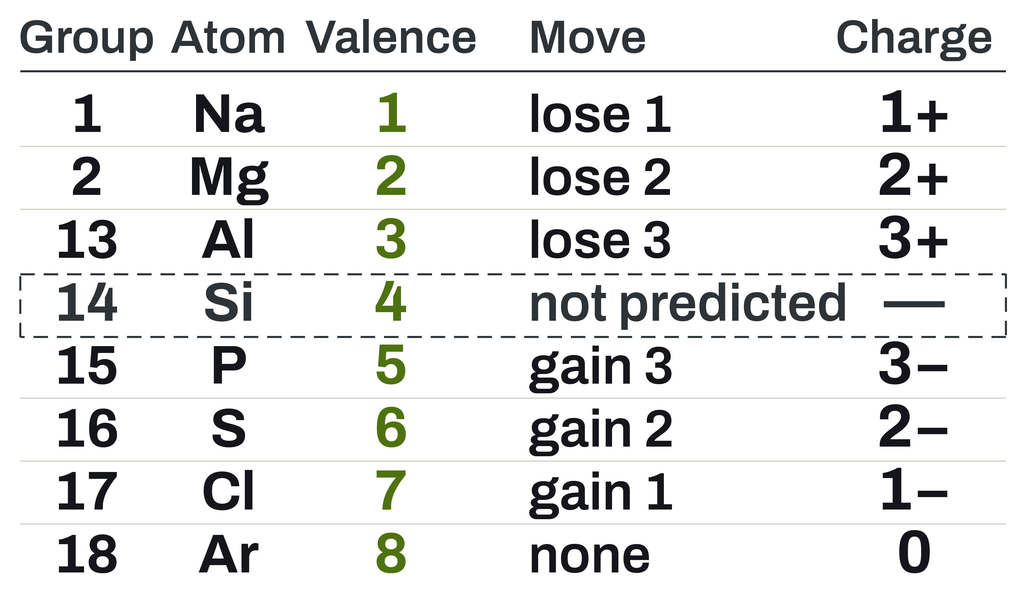
Valence Electrons Predict the Charge
UNIT 02 • CHEMISTRY
Lose or gain the fewest electrons to reach 8. Unit 3 will explain the energy side.
LOSE
Groups 1, 2, 13 lose all their valence electrons.
Charges 1+, 2+, 3+.
GAIN
Groups 15, 16, 17 gain 3, 2, 1 to reach 8.
Charges 3−, 2−, 1−.
NOT PREDICTED HERE
Group 14 and the transition metals. Group 18 is already full.
U02 • S02.4
Notes:
NEW. Rule by group (period 3 examples; hand-built, every count asserted in the figure script). Main group: lose or gain the fewest electrons to reach 8 (2 in period 1). PROVISIONAL: group 14 (4 lost or 4 gained, no 'fewest') and the transition metals are not predicted by this rule here; transition-metal ions were covered on the iron and Zn/Cu slides. Pointer only: the energy side (why that charge is favoured) is Unit 3, U3.4 and U3.7; do not teach ionization energy. Charges are written plain and large (3−, 2−, 1−) because the superscript minus is faint.

Slide 19
Example: Predict the Ions of Mg, Al, S, Br
UNIT 02 • CHEMISTRY
We do this one together. Copy the setup, not just the answer.
Use valence electrons to predict each ion. Give the move, the result, and the charge.
GIVEN
NEED
Mg: group 2
Al: group 13
S: group 16
Br: group 17
Valence electrons
Lose or gain how many
Noble gas and charge
Lose or gain the fewest electrons to reach 8 valence electrons.
U02 • S02.4
Notes:
NEW worked example (replaces the earlier Mg2+/S2- configuration example, which this one subsumes). Do together; work area empty on purpose. Answers on next slide. Image slot empty. Prompt subject: four sample vials of magnesium, aluminum, sulfur, and bromine on a dark bench.

Slide 20
Mg, Al, S, and Br Ions, Worked
UNIT 02 • CHEMISTRY
Count, move, result, charge. Check the electron count at the end.
SULFUR ION Z = 16 [Ne] CORE
SETUP
Each line reads: valence,
move, noble gas, charge.
Mg: 2, lose 2, [Ne], 2+
Al: 3, lose 3, [Ne], 3+
S: 6, gain 2, [Ar], 2−
Br: 7, gain 1, [Kr], 1−
3s²
3p⁶
6 valence + 2 gained = 8
S ion: charge 2−
Mg²⁺, Al³⁺, S²⁻, Br⁻. Each move ends at a noble gas configuration.
U02 • S02.4
Notes:
Mg: 12 e to 10, Mg2+, [Ne]. Al: 13 to 10, Al3+, [Ne]. S: 16 to 18, S2-, [Ar]. Br: 35 to 36, Br-, [Kr] (3d10 already full). All numbers re-added in the figure script assertions. Anion charges are written plain (2−, 1−) on the slide for legibility. Same pattern, same rule: Mg2+ and S2- were the old example's ions. The picture slot holds a click build for S only (two down arrows added); Mg, Al and Br stay in the text.
STATIC FINAL STATE: print and handout copy, no animation. This slide shows the final state of the click build (S); the animated deck shows it one click at a time.

Slide 21
Check Yourself
UNIT 02 • CHEMISTRY
Work these in your notes. We compare in a minute.
Valence
Ca²⁺
Predict
Three ions
Valence electrons in Al, Se, and Xe?
Write it. Name the matching noble gas.
Predict O's ion. Write its full configuration.
[Ar] shorthand for Fe³⁺, Cu²⁺, and Zn²⁺.
U02 • S02.4
Notes:
Answers. 1) Al 3, Se 6, Xe 8. 2) Ca2+: 20 to 18 electrons, 1s2 2s2 2p6 3s2 3p6 = [Ar], argon. 3) O: group 16, 6 valence, gain 2, O2- (charge 2−), 10 electrons, 1s2 2s2 2p6 = [Ne]. 4) Fe3+: [Ar] 3d5; the two 4s electrons leave first, then one 3d. (The 'which leave first' part is not printed on the tile.) 5) Cu2+ [Ar] 3d9 (27 e); Zn2+ [Ar] 3d10 (28 e). The slide tile 4 carries Fe3+, Cu2+, Zn2+ together, so items 4 and 5 share one tile. If time, oral extras using the rule: K 1 valence, lose 1, K+, [Ar]; Se 6 valence, gain 2, Se2-, [Kr]; Al 3 valence, lose 3, Al3+, [Ne]. Group 14 (Si, C) and transition metals: not predicted by the rule here (PROVISIONAL). Tile 3 was changed from 'write the O2- configuration' to a predict-then-write prompt so the new rule is checked. Image slot empty. Prompt subject: a periodic table wall chart photographed at a shallow angle.

Slide 22
Unit 3 Picks Up
From Here
LOOKING AHEAD
You can predict the charge of a main-group ion from its valence electrons. Unit 3 explains the energy side.
U02 • S02.4
Notes:
Boundary (Matt, 2026-10-04): S2.4 owns valence-electron-based charge prediction (main group). Why that charge is favoured and the energy it takes: U3.4 and U3.7. Group 14 and transition metals not predicted by the rule here (PROVISIONAL). DECISIONS.md not changed. Image slot empty. Prompt subject: a long laboratory bench receding into shadow.

