Slide 1
2.2
Energy Levels, Sublevels & Orbitals
02
Name the levels, sublevels, and orbitals, and say how many electrons each can hold.
U02 • S02.2
Notes:
Section opener. Pacing: 22 slides is the top of range for a 50-minute period. Cuttable if short: slides 14, 15 and 19 (energy order, 4s before 3d, period lengths). Image slot (empty): section: a long-exposure photograph of fireflies over a dark field.

Slide 2
What You Will Be Able to Do
UNIT 02 • CHEMISTRY
By the end of 2.2 you can do these three things.
THE MODEL
NAMES AND COUNTS
THE TABLE
Describe an orbital as a region where an electron is probably found.
Name the sublevels in each level. State the orbitals and electrons each holds.
Link sublevels and orbitals to the block layout of the periodic table.
I can name any sublevel and say how many electrons it holds.
U02 • S02.2
Notes:
Learning targets, condensed from the four in the brief to three cards: targets 2 and 3 (names, orbitals, capacities) are merged. Matt to confirm the merge. Read aloud, do not linger. Image slot (empty): aside: a hand ticking a checklist on a clipboard.

Slide 3
Bohr Failed for Helium
UNIT 02 • CHEMISTRY
The Bohr model worked for hydrogen. For helium and every atom after it, the energies came out wrong.
Bohr failed for helium. What replaced it?
U02 • S02.2
Notes:
Hook. Ask first, then reveal: Bohr failed for helium. Answer to take: the quantum-mechanical (electron cloud) model. Image slot (empty): concept: a chalkboard with a half-erased circular orbit diagram.

Slide 4
Three Words You Need First
UNIT 02 • CHEMISTRY
Write these before we go further. Each one sits inside the one before.
ENERGY LEVEL
SUBLEVEL
ORBITAL
The main shell. Numbered n = 1, 2, 3, 4, and up.
A group of orbitals inside a level. Named s, p, d, f.
A region where an electron is probably found. Holds up to 2 electrons.
Energy levels contain sublevels. Sublevels contain orbitals.
U02 • S02.2
Notes:
Three nested words. Students write the bar. Check that they say 'inside', not 'equal to'. Image slot (empty): aside: a set of nested wooden boxes, open, on a bench.

Slide 5
How the Model Changed
UNIT 02 • CHEMISTRY
Two ideas replaced Bohr's circular paths.
SCHRÖDINGER, 1926
HEISENBERG
THE RESULT
Described electrons with wave equations.
The math gives probabilities, not paths.
The uncertainty principle: you cannot know an electron's exact position and exact momentum at once.
The quantum-mechanical model, also called the electron cloud model.
Electrons are described by probability, not by paths.
U02 • S02.2
Notes:
Name Heisenberg only; do not derive. Probability replaces paths. Image slot (empty): aside: a vintage chalkboard covered in wave equations.

Slide 6
Orbit vs. Orbital
UNIT 02 • CHEMISTRY
The two words sound alike. They mean different things.
BOHR ORBIT
ORBITAL
A fixed circular path.
The electron is on the line.
A region of space.
The electron is probably
inside it.
An orbital is a region of high probability for finding an electron, not a path.
U02 • S02.2
Notes:
Misconception to hit: electrons do not travel along the orbital outline. Image slot (empty): concept: a long-exposure photograph of a swarm of fireflies forming a glowing cloud.

Slide 7
Energy Levels: the Number n
UNIT 02 • CHEMISTRY
n is the principal quantum number: 1, 2, 3, 4, and up.
LOW n
HIGH n
n = 1
Closest to the nucleus on average.
Lowest energy.
n = 4
Farther from the nucleus on average.
Higher energy.
Higher n means higher energy and a larger average distance from the nucleus.
U02 • S02.2
Notes:
Higher n: higher energy, larger average distance. Image slot (empty): concept: a stone staircase seen from the bottom step, lit from above.

Slide 8
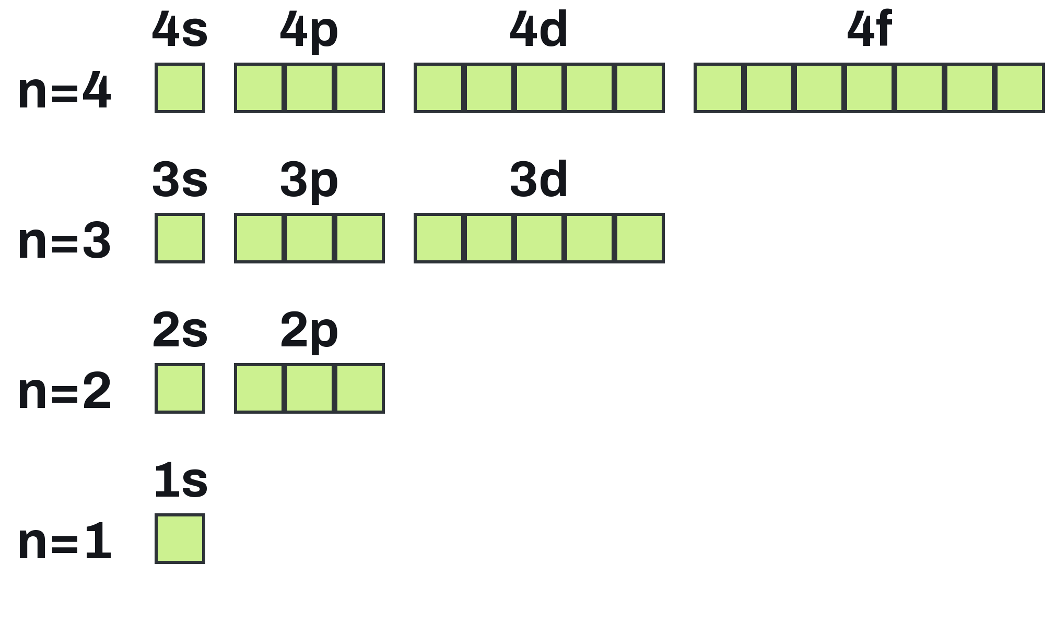
Levels, Sublevels, Orbitals
UNIT 02 • CHEMISTRY
Each box is one orbital. Read the map from the bottom up.
SUBLEVELS PER LEVEL
Level n has n sublevels.
ORBITALS PER SUBLEVEL
s = 1, p = 3, d = 5, f = 7.
WHERE THEY START
d starts at n = 3. f starts at n = 4.
U02 • S02.2
Notes:
Read the map bottom up. d starts at n = 3, f at n = 4; n = 1 has only s, n = 2 only s and p.

Slide 9
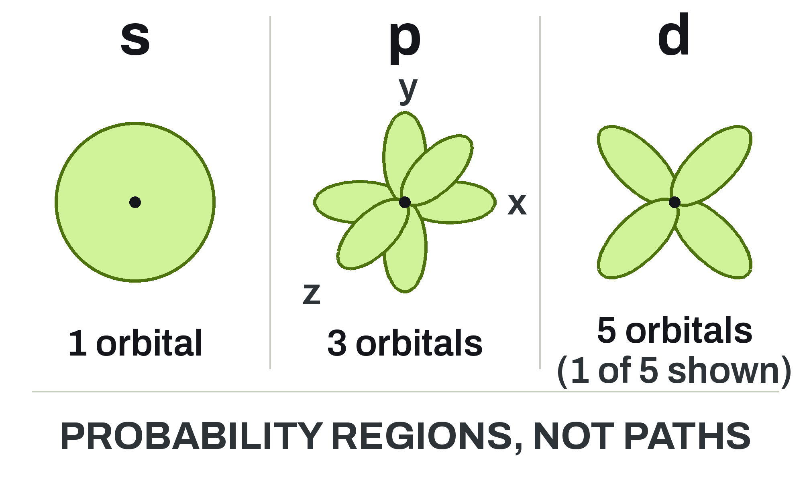
Orbital Shapes
UNIT 02 • CHEMISTRY
These are probability regions. The electron does not travel along the outline.
s: SPHERE
One orbital, centered on the nucleus.
p: DUMBBELL
Three orbitals: along x, y, and z.
d AND f
d: five orbitals, mostly four lobes. f: more complex.
U02 • S02.2
Notes:
Shapes are probability regions, not paths. Slide shows one of the five d orbitals; the fifth d shape differs slightly (named, not drawn). f is names only.

Slide 10
How Many Electrons Fit
UNIT 02 • CHEMISTRY
Orbitals are the unit. Count orbitals, then double.
ONE ORBITAL
ONE SUBLEVEL
OPPOSITE SPINS
Holds at most 2 electrons.
s: 1 × 2 = 2
p: 3 × 2 = 6
d: 5 × 2 = 10
f: 7 × 2 = 14
The 2 electrons in one orbital have opposite spins. Section 2.3 puts this to work.
One orbital holds 2 electrons. s holds 2, p holds 6, d holds 10, f holds 14.
U02 • S02.2
Notes:
Misconception: an orbital holds 2 electrons, not as many as its sublevel. Spin pairing is formalised in S2.3. Image slot (empty): aside: an open egg carton on a lab bench.

Slide 11
Example: The n = 3 Level
UNIT 02 • CHEMISTRY
We do this one together. List first, then count.
List the sublevels in n = 3. Give the orbitals and maximum electrons in each.
GIVEN
NEED
n = 3
Level n has n sublevels
Sublevels
Orbitals in each
Max electrons
Level n has n sublevels. List them, then count the orbitals.
U02 • S02.2
Notes:
Do together. Students list sublevels first (3s, 3p, 3d), then count. Work area stays empty for the board. Image slot (empty): aside: a three-tier wooden shelf with small boxes.

Slide 12
The n = 3 Level, Worked
UNIT 02 • CHEMISTRY
Check your list against this.
SETUP
n = 3 gives 3 sublevels:
3s, 3p, 3d
3s: 1 orbital, 2 e⁻
3p: 3 orbitals, 6 e⁻
3d: 5 orbitals, 10 e⁻
Total: 9 orbitals, 18 e⁻
n = 3 holds 9 orbitals (n²) and 18 electrons (2n²).
U02 • S02.2
Notes:
Key: 3s 1 orbital 2 e-; 3p 3 orbitals 6 e-; 3d 5 orbitals 10 e-. Total 9 orbitals = n^2, 18 e- = 2n^2. Image slot (empty): data: pencil and graph paper with tally marks.

Slide 13
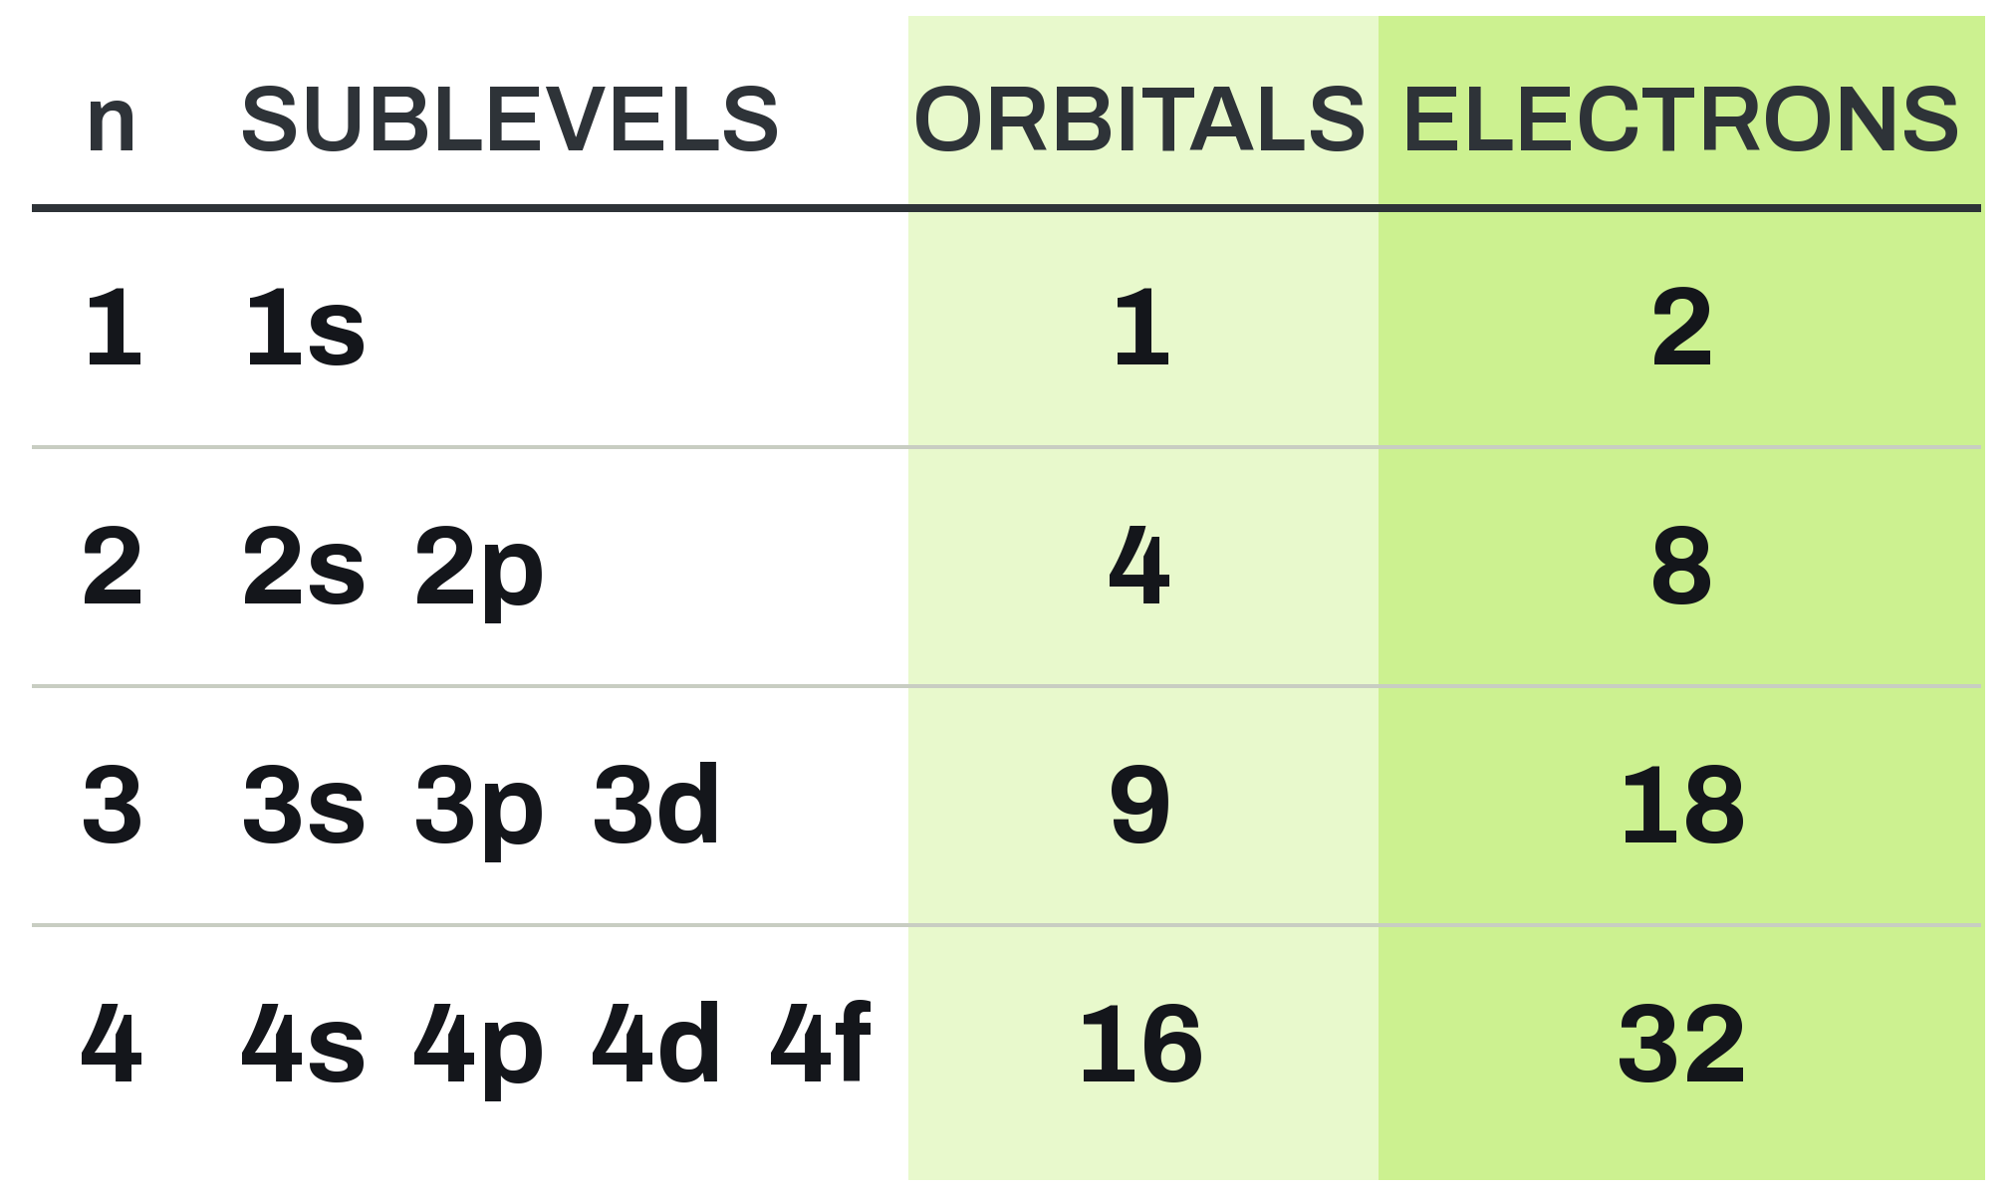
Capacity of Each Level
UNIT 02 • CHEMISTRY
Add up the sublevels and the pattern shows.
ORBITALS IN LEVEL n
n² : 1, 4, 9, 16
ELECTRONS IN LEVEL n
2n² : 2, 8, 18, 32
SUBLEVELS IN LEVEL n
n of them, one new letter per level.
U02 • S02.2
Notes:
Pattern: orbitals n^2 (1, 4, 9, 16); electrons 2n^2 (2, 8, 18, 32).

Slide 14
Energy Order Inside a Level
UNIT 02 • CHEMISTRY
The answer depends on how many electrons the atom has.
MORE THAN ONE ELECTRON
HYDROGEN ONLY
Within one level, energy rises s, then p, then d, then f.
One electron, so every sublevel of the same n has the same energy.
Do not carry this to other atoms.
With more than one electron, energy rises s < p < d < f within a level.
U02 • S02.2
Notes:
Within one level, energy rises s < p < d < f for atoms with more than one electron. Hydrogen is the exception: same-n sublevels are equal. Image slot (empty): concept: four wooden shelves of increasing height in a workshop.

Slide 15
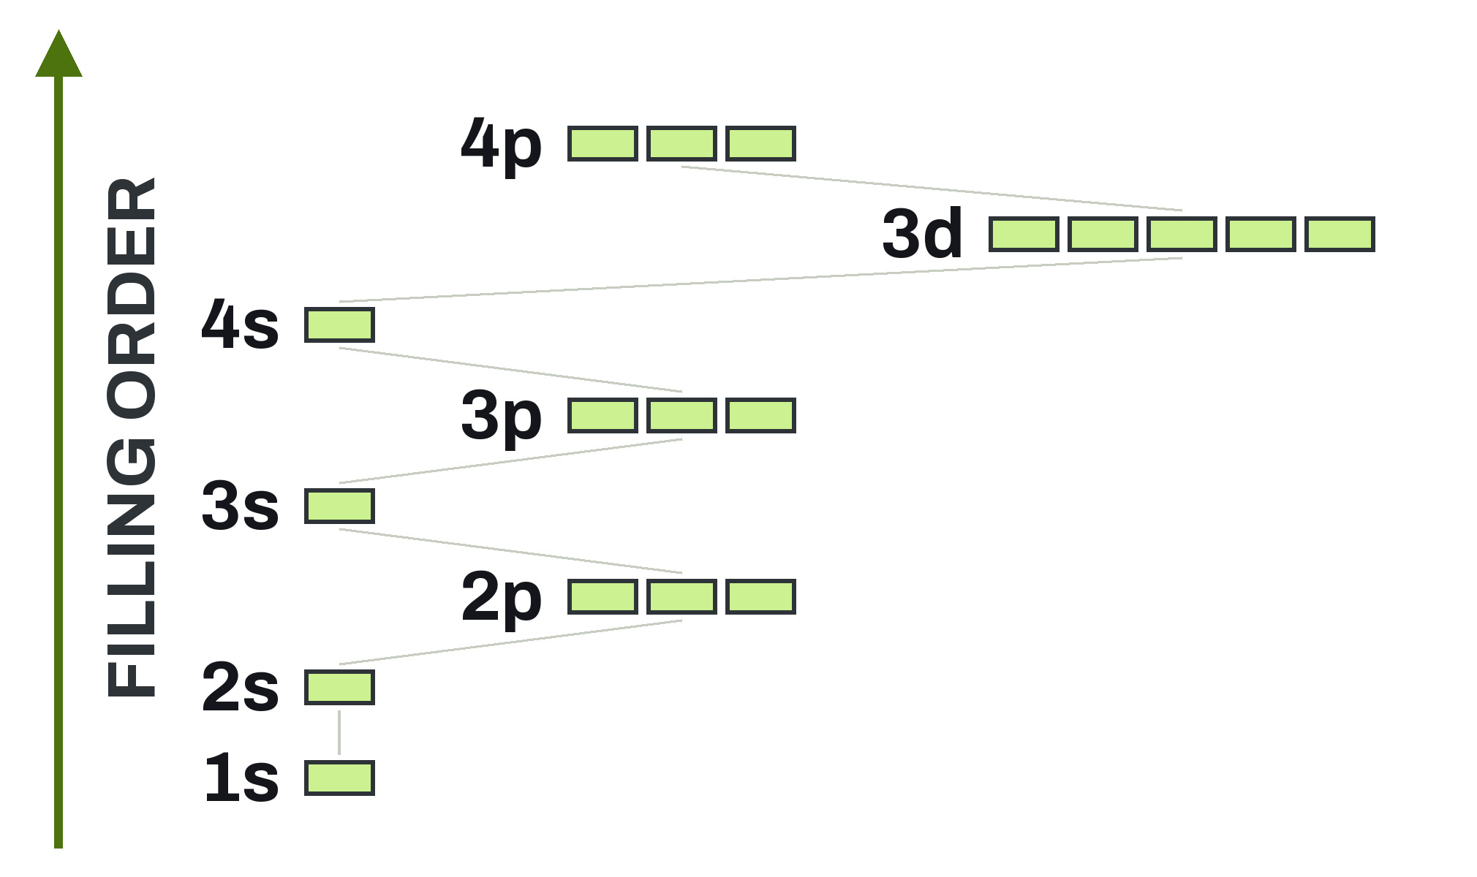
4s Fills Before 3d
UNIT 02 • CHEMISTRY
Filling order for a neutral atom. Levels overlap.
FILLING ORDER
1s 2s 2p 3s 3p 4s 3d 4p
ORDER RULE
In a neutral atom, 4s fills before 3d.
WHAT IS NEXT
Section 2.3 uses this order.
U02 • S02.2
Notes:
PROVISIONAL wording: '4s fills before 3d' is stated as a neutral-atom filling order, not as a claim that 4s is lower in energy in every situation. Matt to confirm the wording. Previews S2.3. Cuttable. Label reads 'Order rule'.

Slide 16
Example: Capacity
UNIT 02 • CHEMISTRY
Your turn first. Then we compare.
What is the maximum number of electrons in the 4f sublevel? In the n = 2 level?
GIVEN
NEED
4f sublevel
n = 2 level
Electrons in 4f
Electrons in n = 2
Electrons in a sublevel = orbitals × 2.
U02 • S02.2
Notes:
Students try first. Work area stays empty. Image slot (empty): aside: a rack of seven small test tubes.

Slide 17
Capacity, Worked
UNIT 02 • CHEMISTRY
Check yours against this.
SETUP
f has 7 orbitals.
n = 2 has 2s and 2p.
4f: 7 × 2 = 14
2s: 1 × 2 = 2
2p: 3 × 2 = 6
n = 2: 2 + 6 = 8
4f holds 14 electrons. The n = 2 level holds 8, which is 2n².
U02 • S02.2
Notes:
Key: 4f = 7 x 2 = 14 e-. n = 2: 2s 2 + 2p 6 = 8 e- = 2(2)^2. Image slot (empty): data: a handwritten tally on a lab notebook page.

Slide 18
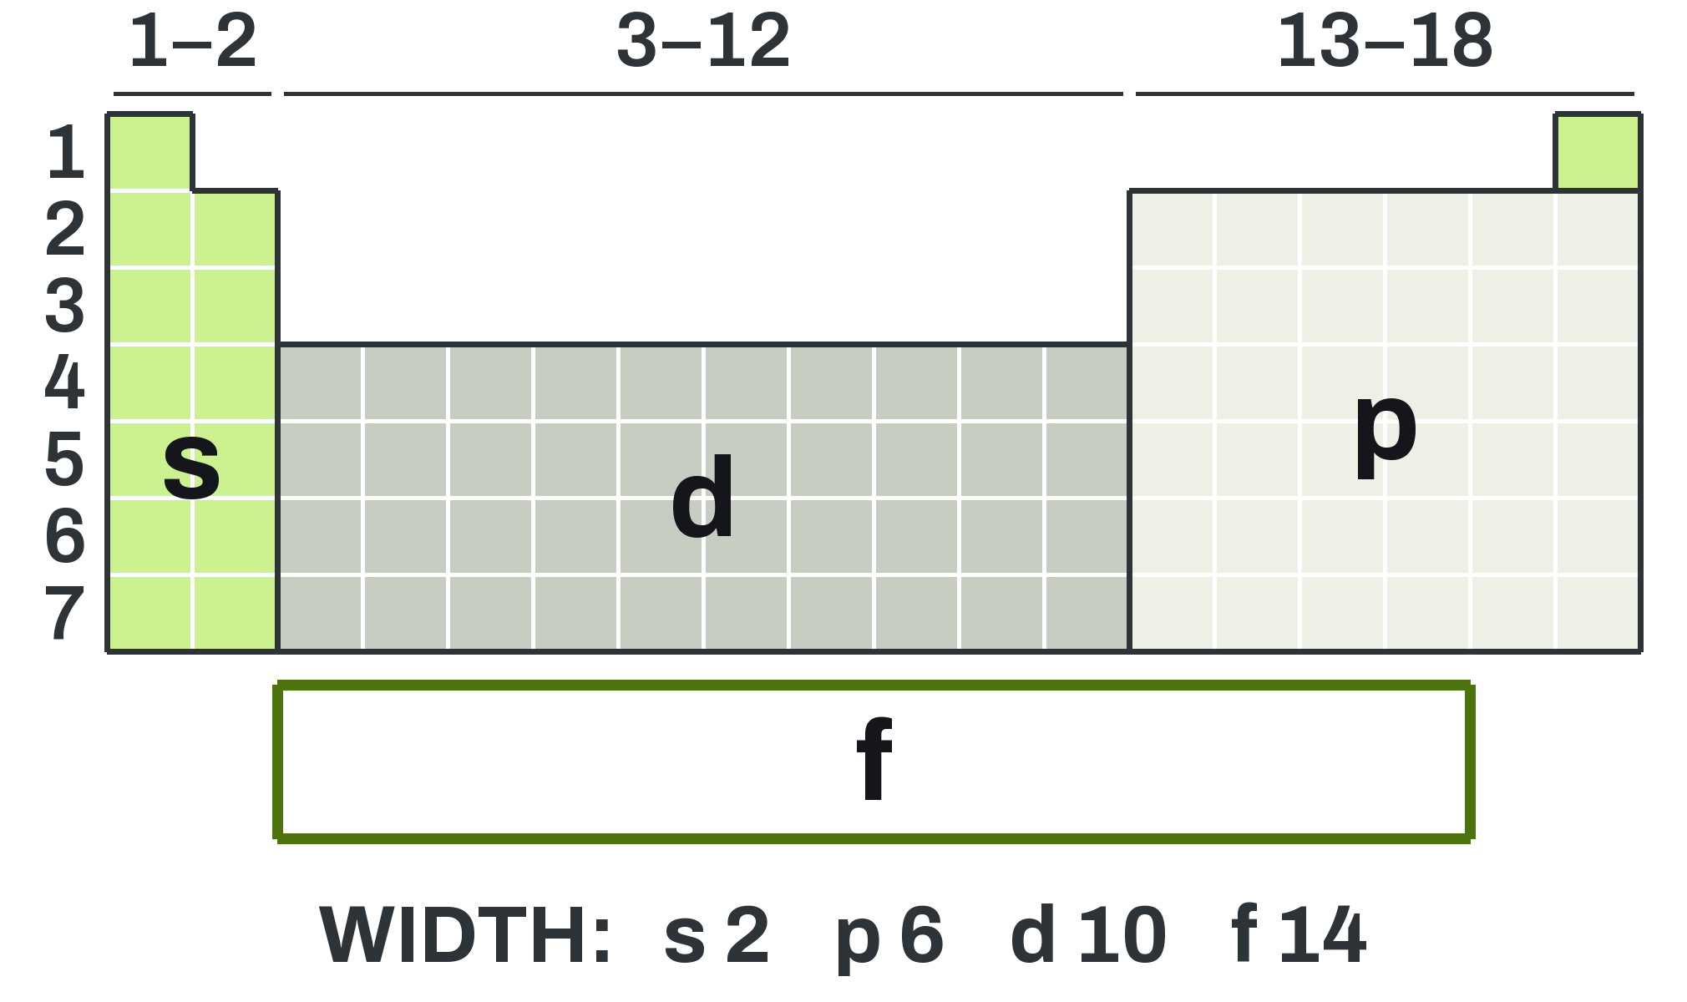
The Table Maps the Sublevels
UNIT 02 • CHEMISTRY
Block width equals sublevel capacity. Helium (1s²) sits in group 18.
s BLOCK
Groups 1 and 2: 2 columns wide.
p BLOCK
Groups 13 to 18: 6 columns wide.
d AND f BLOCKS
d: groups 3 to 12. f: drawn below, 14 wide.
U02 • S02.2
Notes:
PROVISIONAL: group 3 and f block drawing convention. The f block is drawn 14 wide below the table, detached, with a border; which elements sit in group 3 (La/Ac vs Lu/Lr) is not stated. Matt to confirm. Helium: 1s^2, sits in group 18, s-coloured.

Slide 19
Why Periods Have These Lengths
UNIT 02 • CHEMISTRY
The number after = is how many elements are in that period.
PERIODS 1 TO 3
PERIODS 4 AND 5
PERIODS 6 AND 7
Period 1: 1s = 2
Period 2: 2s 2p = 8
Period 3: 3s 3p = 8
Period 4: 4s 3d 4p = 18
Period 5: 5s 4d 5p = 18
Period 6: 6s 4f 5d 6p = 32
Period 7: 7s 5f 6d 7p = 32
Period lengths 2, 8, 8, 18, 18, 32, 32 come from the sublevels that fill in each.
U02 • S02.2
Notes:
Periods: 2, 8, 8, 18, 18, 32, 32 from the sublevels that fill in each. Cuttable. Image slot (empty): aside: a periodic table wall chart photographed at a shallow angle.

Slide 20
Check: Level, Sublevel, Orbital
UNIT 02 • CHEMISTRY
Questions 1 to 3. Answer in your notes.
QUESTION 1
QUESTION 2
QUESTION 3
How is an orbital different from a Bohr orbit?
List all the sublevels in n = 2.
How many orbitals are in a d sublevel? How many electrons can it hold?
Level n has n sublevels. Orbitals per sublevel: s 1, p 3, d 5, f 7.
U02 • S02.2
Notes:
Formative 1 to 3. Answers: (1) An orbit is a fixed path; an orbital is a region where the electron is probably found. (2) 2s and 2p. (3) 5 orbitals; 10 electrons. Image slot (empty): aside: a pencil resting on a blank notebook page.

Slide 21
Check: Capacity
UNIT 02 • CHEMISTRY
Questions 4 and 5. Show the count.
QUESTION 4
QUESTION 5
What is the maximum number of electrons in the third energy level?
How many orbitals are in the n = 4 level?
Orbitals in level n = n². Electrons in a sublevel = orbitals × 2.
U02 • S02.2
Notes:
Formative 4 and 5. Answers: (4) n = 3: 3s 2 + 3p 6 + 3d 10 = 18 electrons (2n^2 = 18). (5) n = 4: 1 + 3 + 5 + 7 = 16 orbitals (n^2 = 16). Collect or compare. Image slot (empty): concept: an empty desk with a calculator and a pencil.

Slide 22
S2.3
Electron Configurations
NEXT
Fill the orbitals in order.
U02 • S02.2
Notes:
Close. Next section S2.3 uses the filling order from slide 15. Image slot (empty): divider: a long laboratory bench receding into shadow.

