Slide 1
2.1
The Bohr Model
01
Find hydrogen's energy levels, and explain emission and absorption as an electron changing level.
U02 • S02.1

Slide 2
Why Only a Few Colors?
UNIT 02 • CHEMISTRY
Heat hydrogen gas and it glows. A prism spreads that glow into a few thin lines of color, not a rainbow.
Why does hydrogen give only a few colors of light?
U02 • S02.1

Slide 3
Three Words You Need First
UNIT 02 • CHEMISTRY
Write the first one down. The other two come back on later slides.
ENERGY LEVEL
QUANTIZED
PHOTON
One allowed energy for the electron.
Labeled n = 1, 2, 3, and up.
Only certain values are allowed.
Nothing in between.
A packet of light.
Its energy sets its color.
Energy level: one allowed energy for the electron, labeled n.
U02 • S02.1

Slide 4
Why Bohr Needed a New Model
UNIT 02 • CHEMISTRY
Rutherford put the electrons outside a dense nucleus. That left a problem.
WHAT WAS KNOWN
THE PROBLEM
Thomson: electrons inside positive material.
Rutherford, 1911: a dense nucleus, electrons outside it.
A charge moving in a circle should give off energy and spiral into the nucleus.
Atoms do not collapse.
Bohr proposed a new model of the hydrogen atom in 1913.
U02 • S02.1

Slide 5
Bohr's Three Ideas
UNIT 02 • CHEMISTRY
He kept the nucleus and put rules on the electron.
FIXED ORBITS
NO RADIATION
PHOTON JUMPS
The electron moves in a circular orbit.
Each orbit has one fixed energy.
In an allowed orbit, the electron does not give off energy.
It changes orbit only by absorbing or emitting a photon.
The photon's energy equals the energy difference between the two orbits.
U02 • S02.1

Slide 6
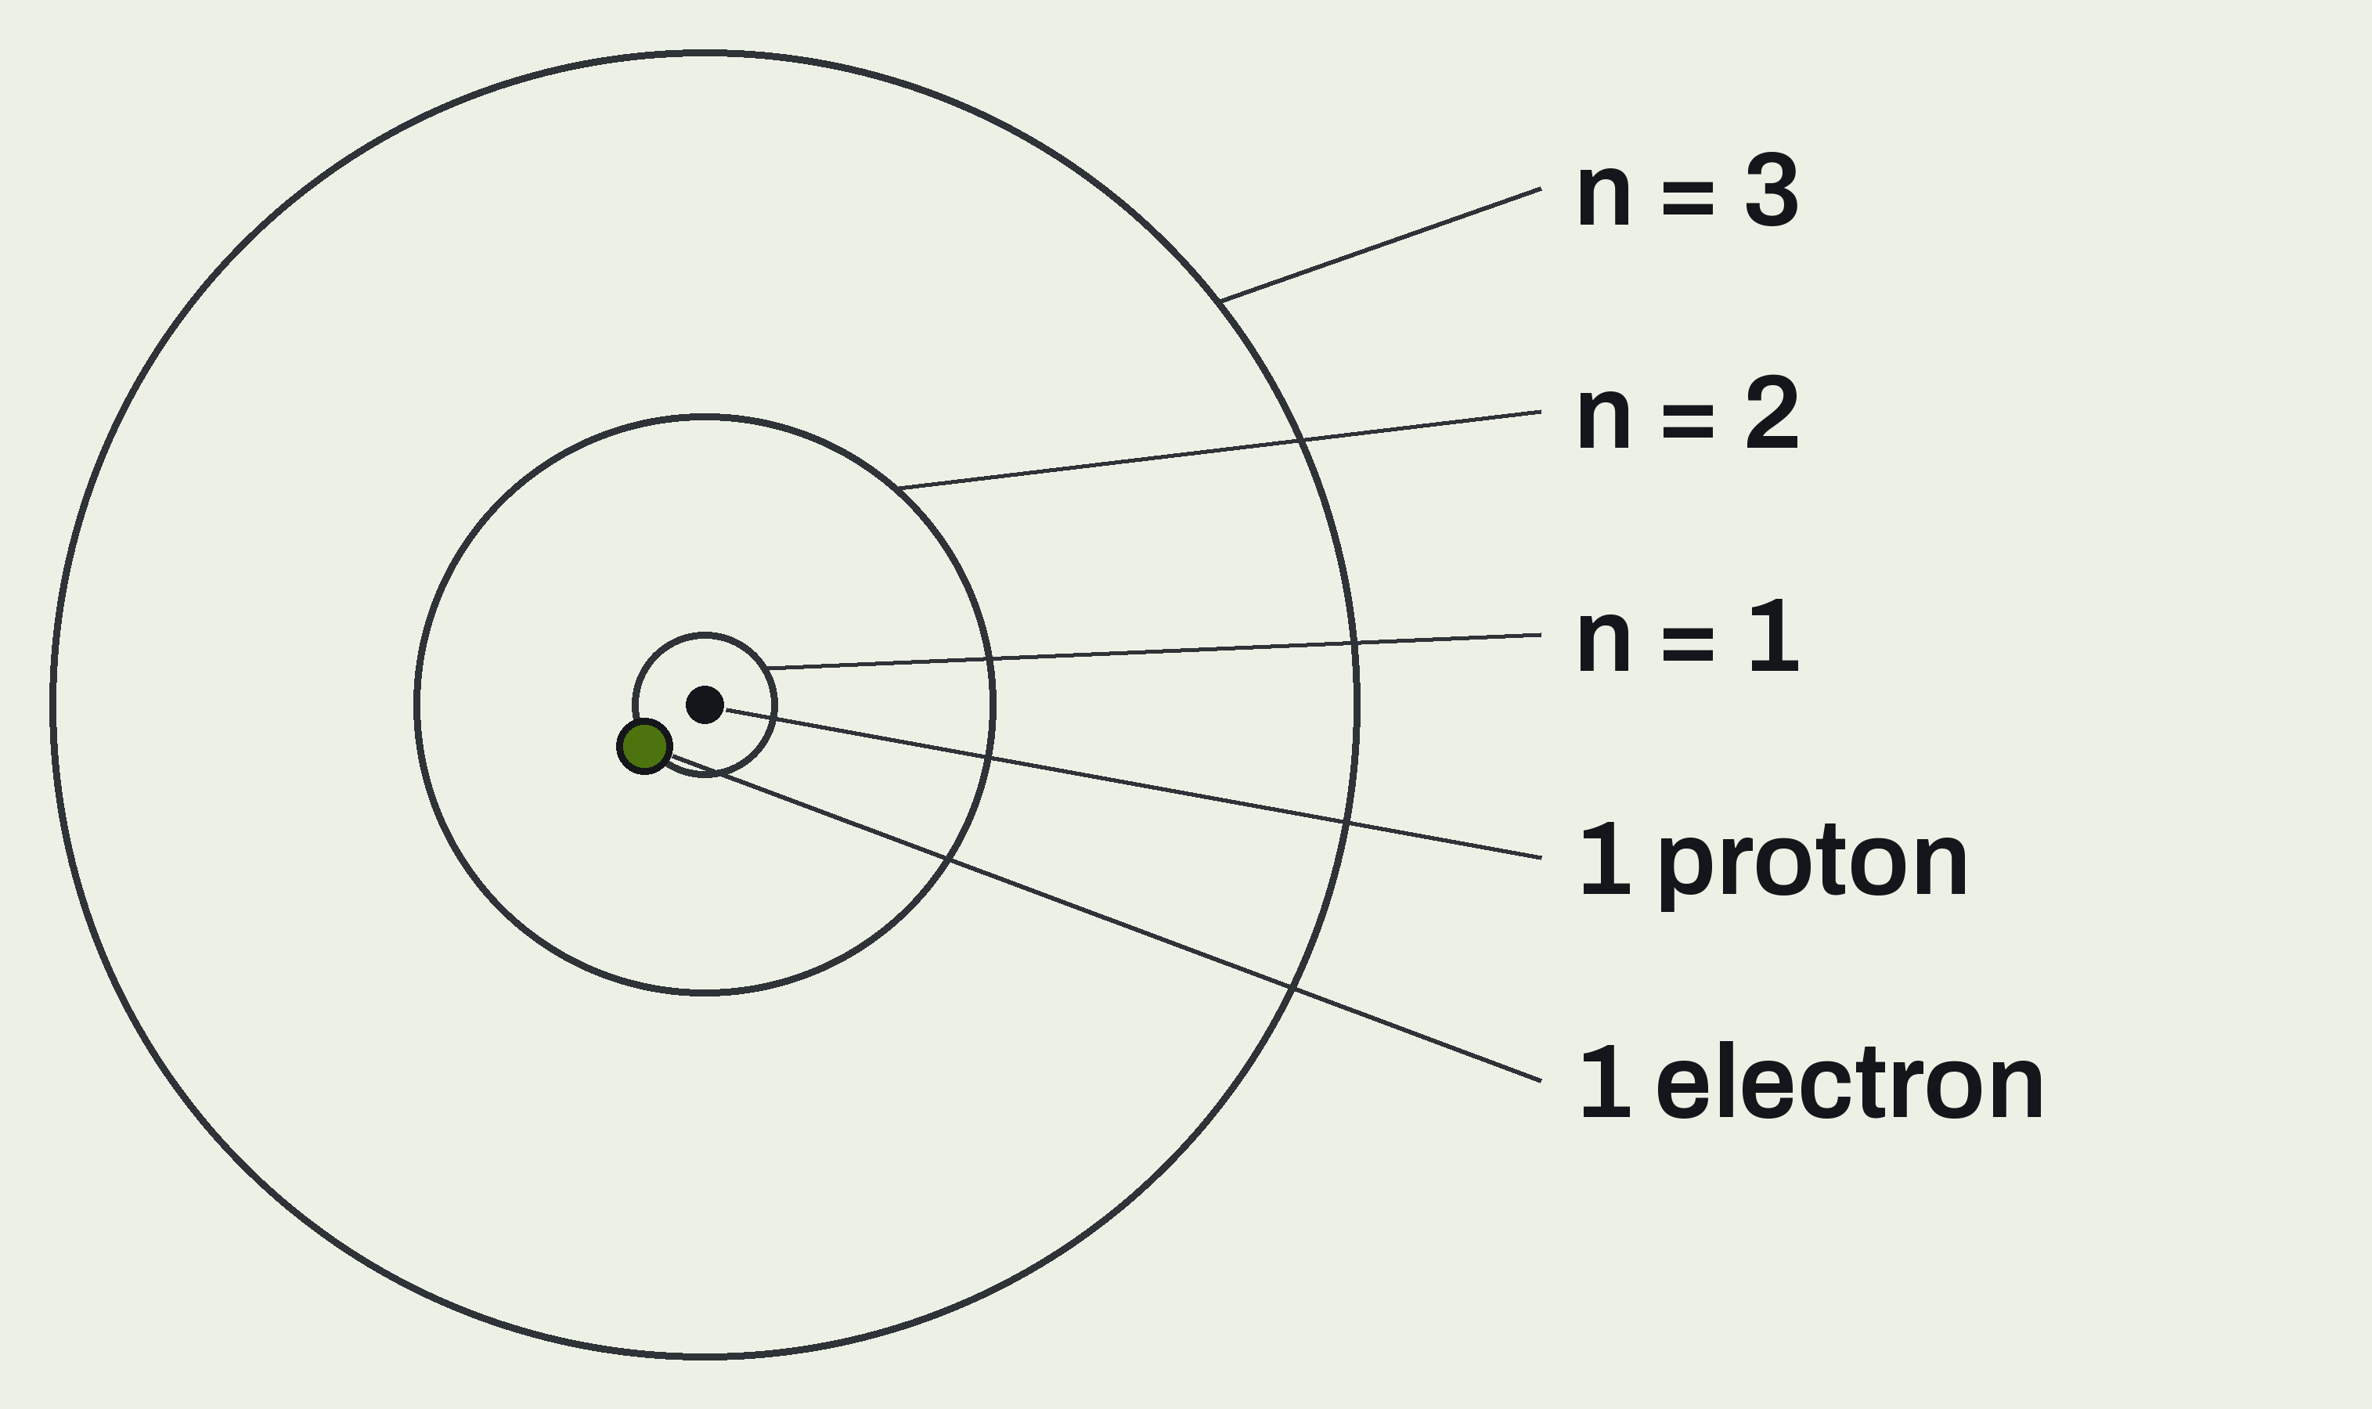
Bohr's Hydrogen Atom
UNIT 02 • CHEMISTRY
One proton, one electron, orbits at fixed distances.
THE NUCLEUS
One proton, drawn as the dot in the center.
THE ORBITS
n = 1, 2, 3 and up. Farther out is higher energy.
THE ELECTRON
One electron, in one orbit at a time. Here: n = 1.
U02 • S02.1

Slide 7
Quantized Means Steps, Not a Ramp
UNIT 02 • CHEMISTRY
You can stand on a stair. You cannot stand between two stairs.
STAIRS
A RAMP
Only certain heights.
An electron's energy works like this.
Any height at all.
Electrons do not behave this way.
Quantized: only certain energy values are allowed. Nothing in between.
U02 • S02.1

Slide 8
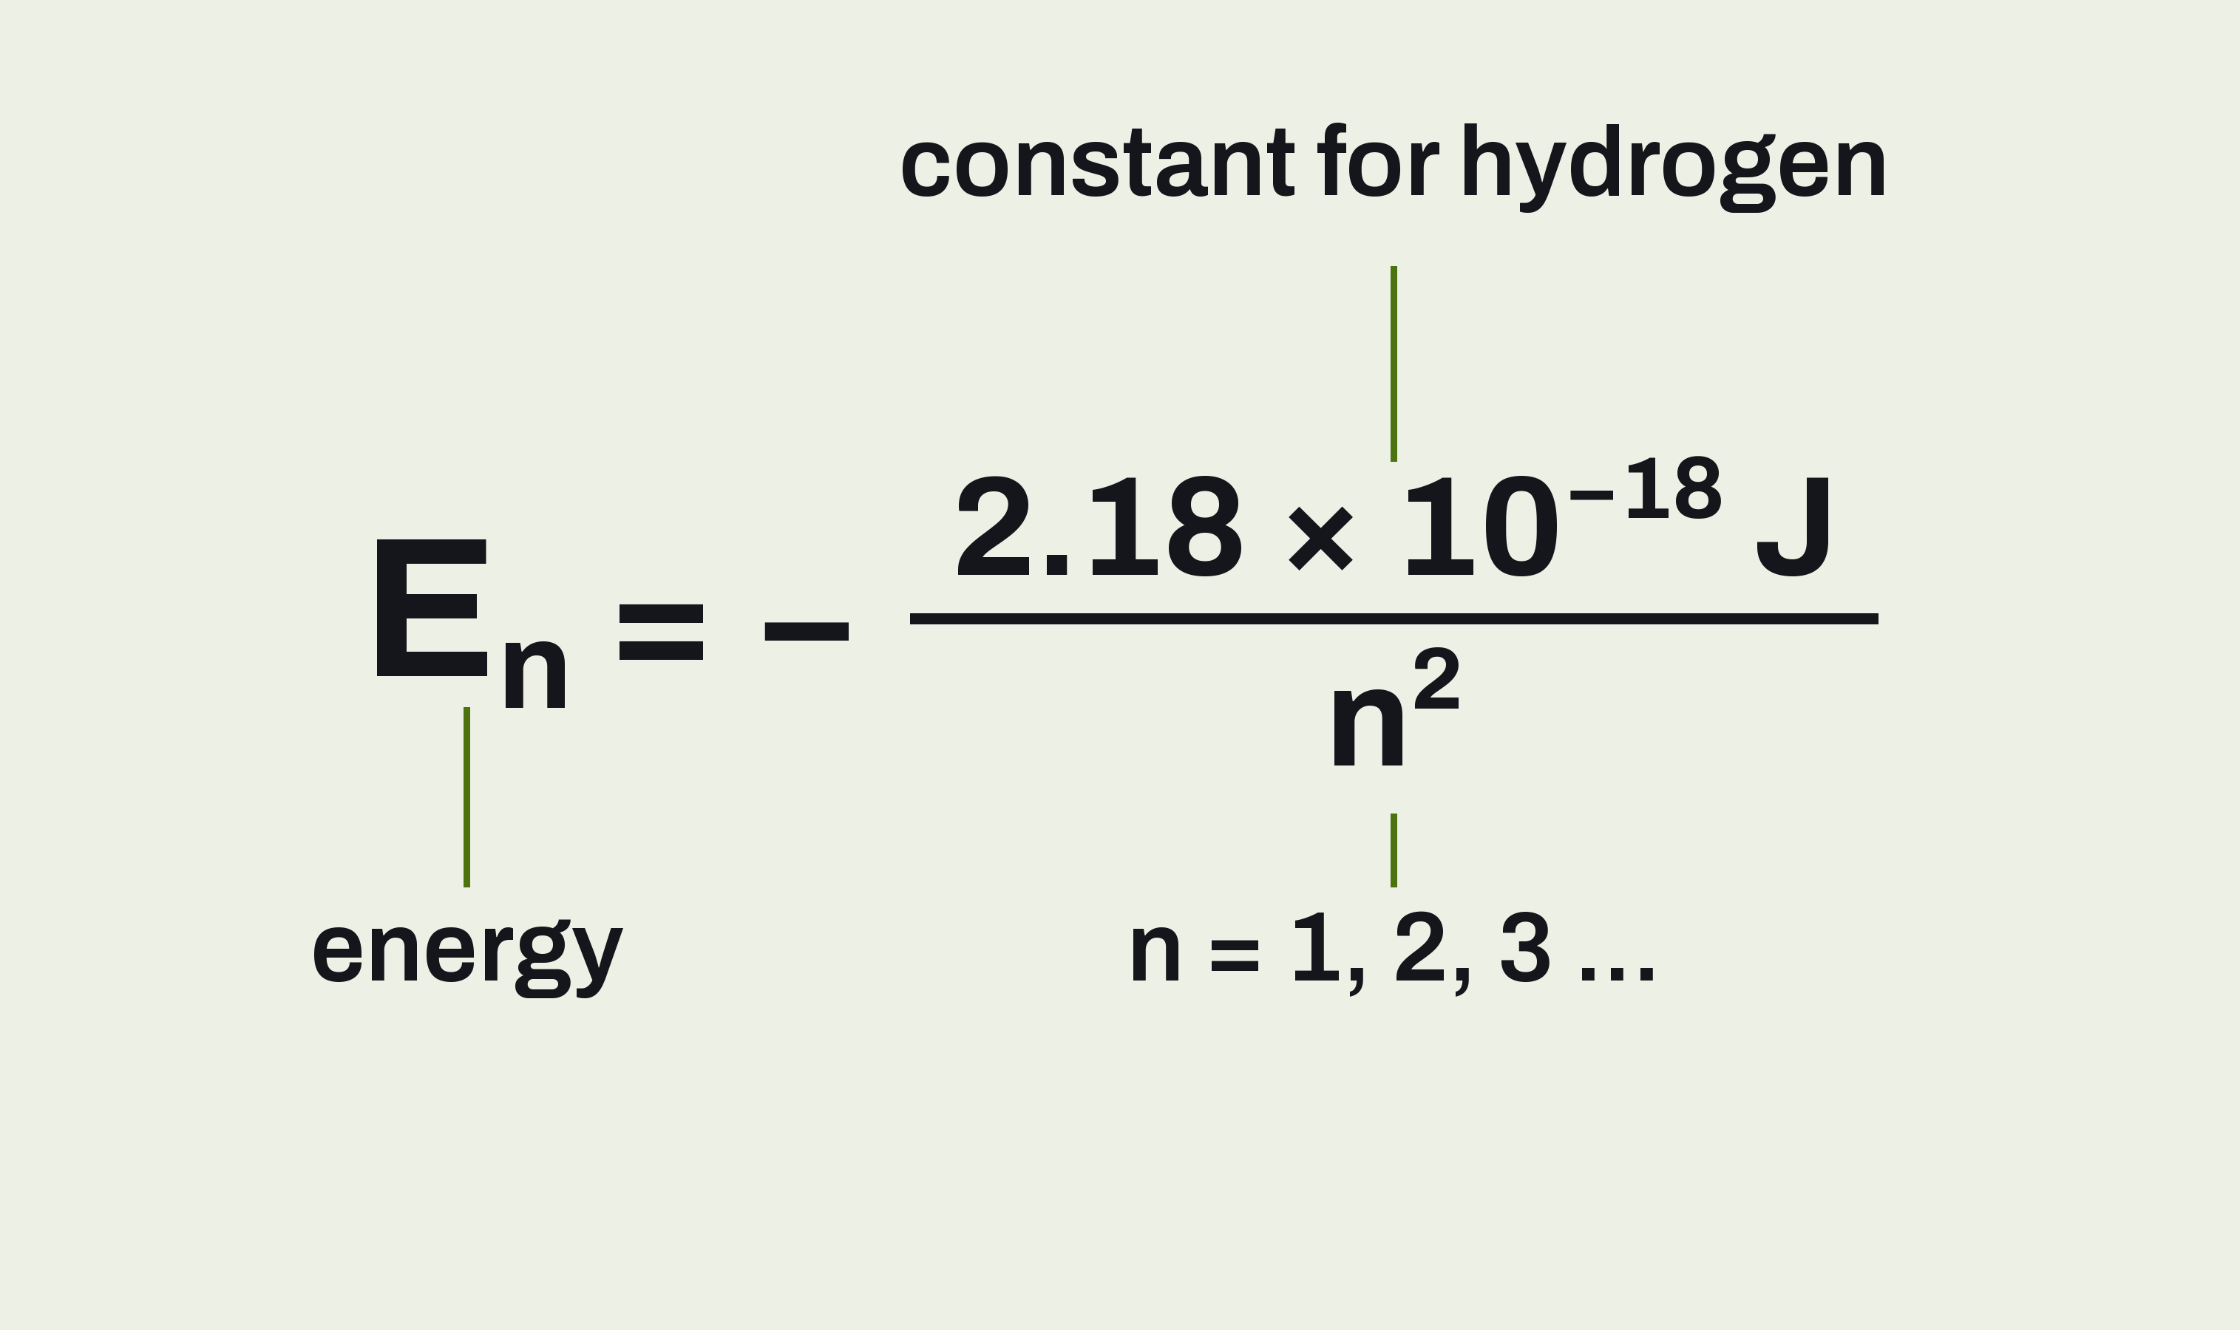
The Energy of Each Level
UNIT 02 • CHEMISTRY
Put in n and you get that level's energy, in joules.
n
Whole numbers only: 1, 2, 3 ... Never 1.5.
THE NEGATIVE SIGN
The electron is bound to the nucleus. E = 0 is a free electron.
HYDROGEN ONLY
This formula fails for atoms with 2 or more electrons.
U02 • S02.1

Slide 9
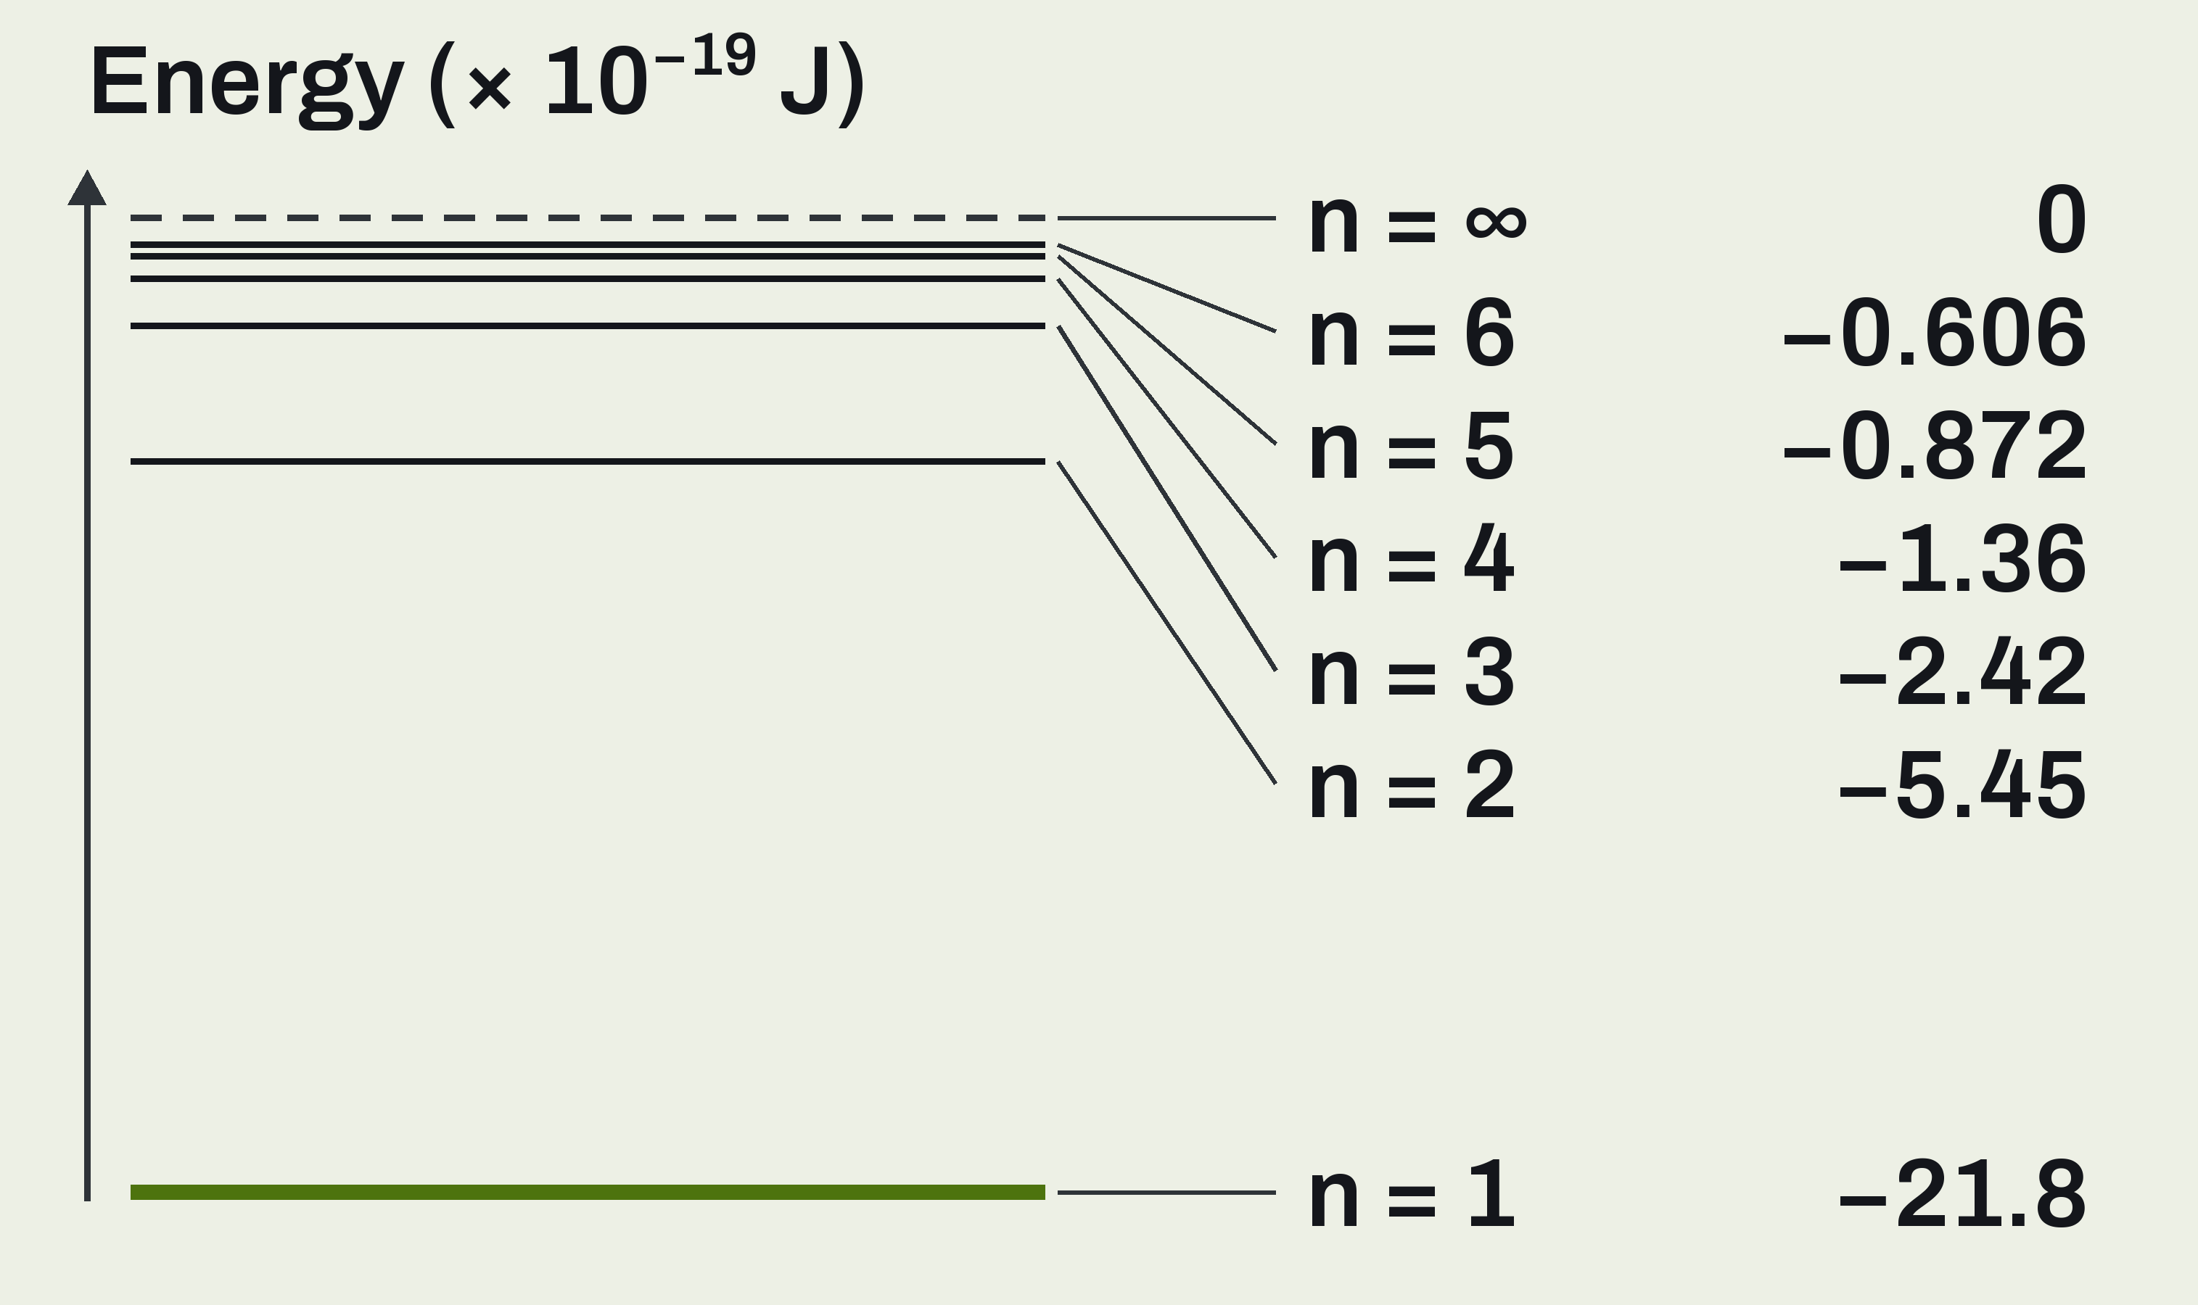
Hydrogen's Energy Levels
UNIT 02 • CHEMISTRY
Drawn to scale. Watch what happens to the spacing.
LOWEST ENERGY
More negative means lower. n = 1 is the lowest.
THE SPACING SHRINKS
The levels crowd together as n gets larger.
ZERO
n = ∞ is E = 0. The electron has left the atom.
U02 • S02.1

Slide 10
Example: Energy at n = 3
UNIT 02 • CHEMISTRY
We do this one together. Write the setup, not just the number.
What is the energy of the hydrogen electron when n = 3?
GIVEN
NEED
Hydrogen
n = 3
E₃, in joules
Eₙ = −2.18 × 10^−18 J ÷ n²
U02 • S02.1

Slide 11
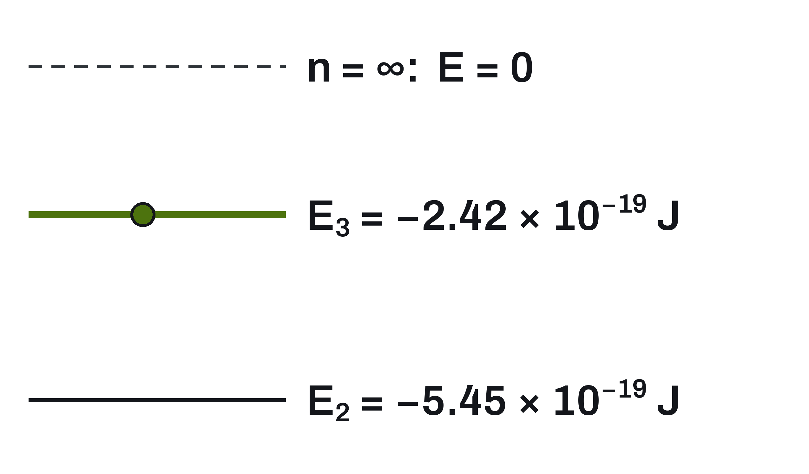
n = 3, Worked
UNIT 02 • CHEMISTRY
Square n first, then divide.
FORMULA
Eₙ = −2.18 × 10^−18 J ÷ n²
3² = 9
−2.18 × 10^−18 ÷ 9
= −2.42 × 10^−19 J
Less negative means higher energy. E₃ is above E₂.
U02 • S02.1

Slide 12
Ground State and Excited States
UNIT 02 • CHEMISTRY
Hydrogen's electron has one lowest level and many higher ones.
GROUND STATE
EXCITED STATE
n = 1.
The lowest energy level.
Where the electron normally sits.
Any level above n = 1.
Short-lived. The electron falls back down.
Ground state: n = 1. Excited state: any higher n.
U02 • S02.1

Slide 13
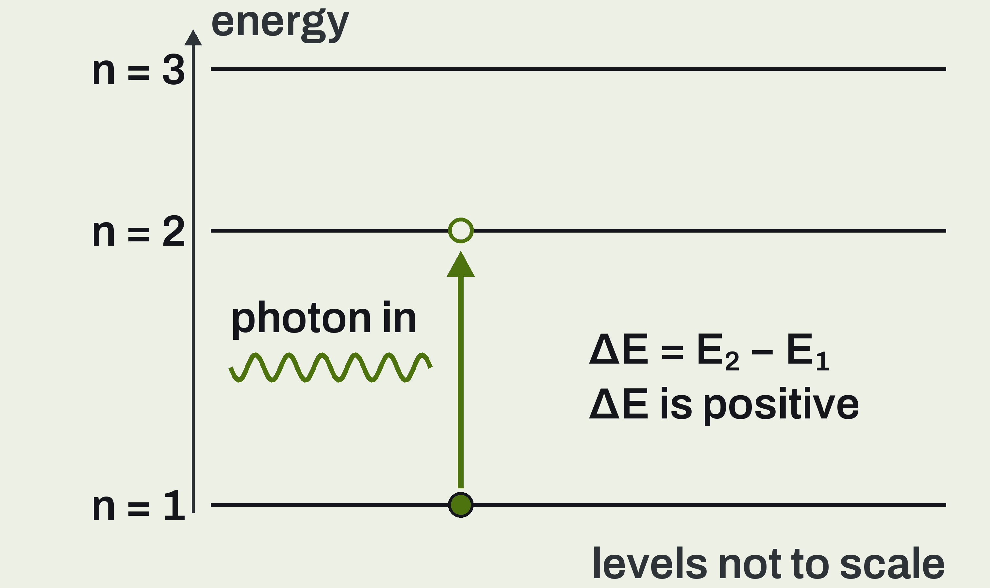
Absorption: The Electron Goes Up
UNIT 02 • CHEMISTRY
The atom takes in energy from a photon.
AN EXACT MATCH
Photon energy must equal E final minus E initial.
THE WRONG ENERGY
The photon passes through. Nothing happens.
THE RESULT
The electron moves up. The atom gains energy.
U02 • S02.1

Slide 14
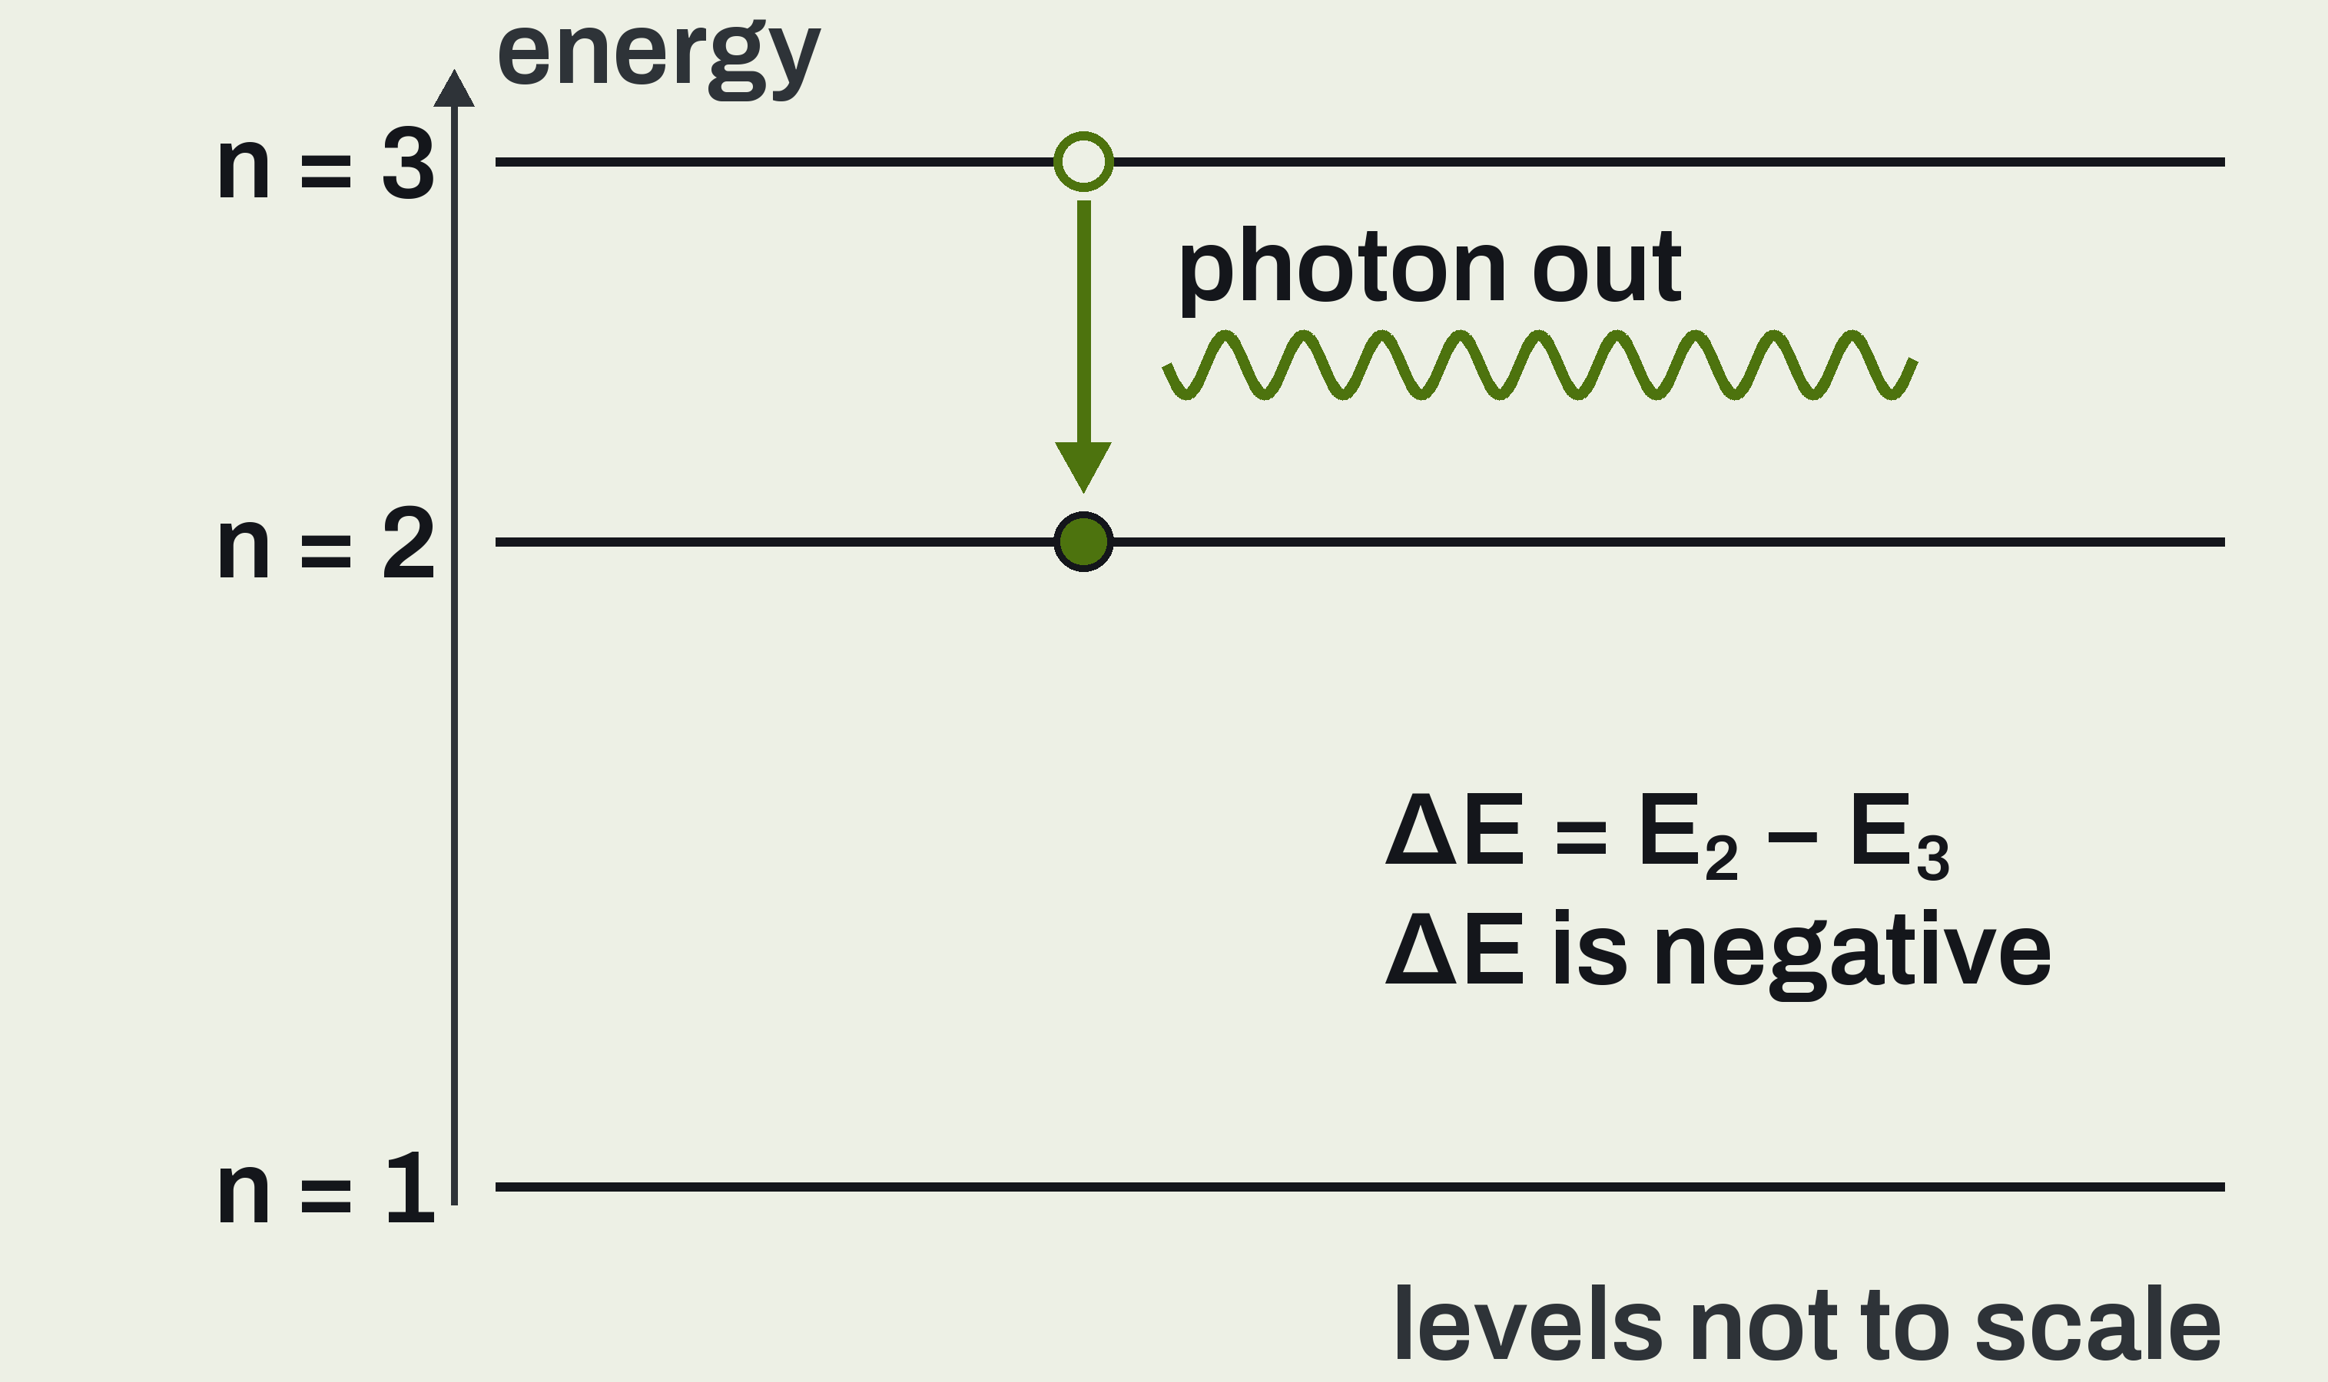
Emission: The Electron Drops
UNIT 02 • CHEMISTRY
The atom gives energy out as a photon.
THE DROP
The electron falls from a higher level to a lower one.
THE PHOTON
Its energy is the absolute value of ΔE.
A BIGGER DROP
A bigger drop gives a higher-energy photon.
U02 • S02.1

Slide 15
Example: Drop from n = 3 to n = 2
UNIT 02 • CHEMISTRY
Find the energy change, then say where the energy went.
A hydrogen electron drops from n = 3 to n = 2. Find ΔE. Is energy absorbed or released?
GIVEN
NEED
n = 3 to n = 2
E₃ = −2.42 × 10^−19 J
E₂ = −5.45 × 10^−19 J
ΔE
Absorbed or released?
ΔE = final energy minus initial energy. A negative ΔE means energy leaves the atom.
U02 • S02.1

Slide 16
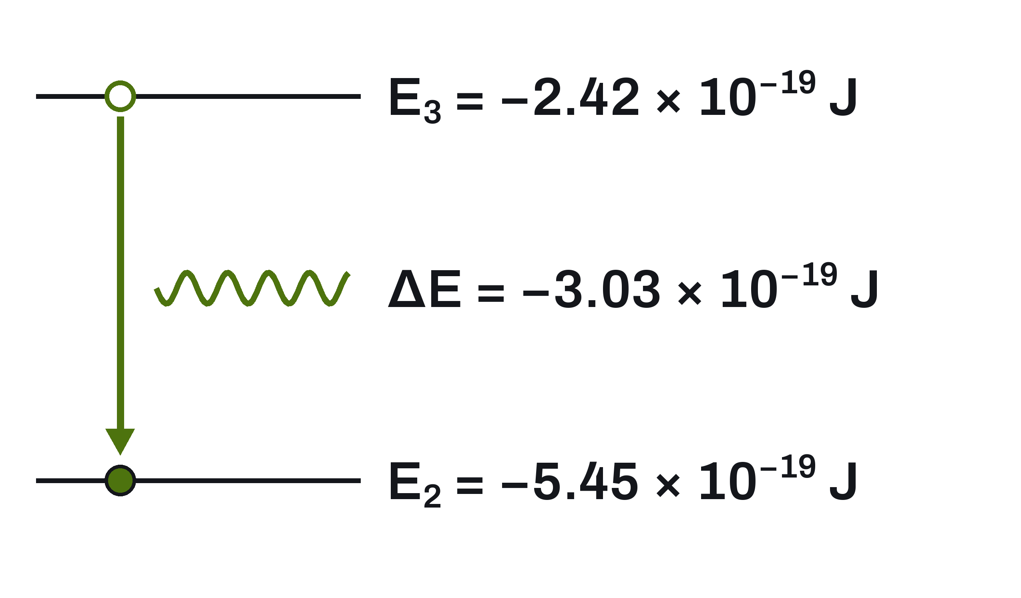
n = 3 to n = 2, Worked
UNIT 02 • CHEMISTRY
Final minus initial. Keep the negative signs.
SETUP
ΔE = E₂ − E₃
Final level: n = 2
Initial level: n = 3
−5.45 × 10^−19
− (−2.42 × 10^−19)
= −3.03 × 10^−19 J
Released.
Energy released: a photon of 3.03 × 10^−19 J leaves the atom.
U02 • S02.1

Slide 17
Example: Removing the Electron
UNIT 02 • CHEMISTRY
Ionization means n goes all the way to infinity.
How much energy removes the electron from a hydrogen atom in its ground state?
GIVEN
NEED
Hydrogen, ground state
n = 1 to n = ∞
E at n = ∞ is 0
ΔE
Absorbed or released?
Ionization: the electron goes from its level to n = ∞, where E = 0.
U02 • S02.1

Slide 18
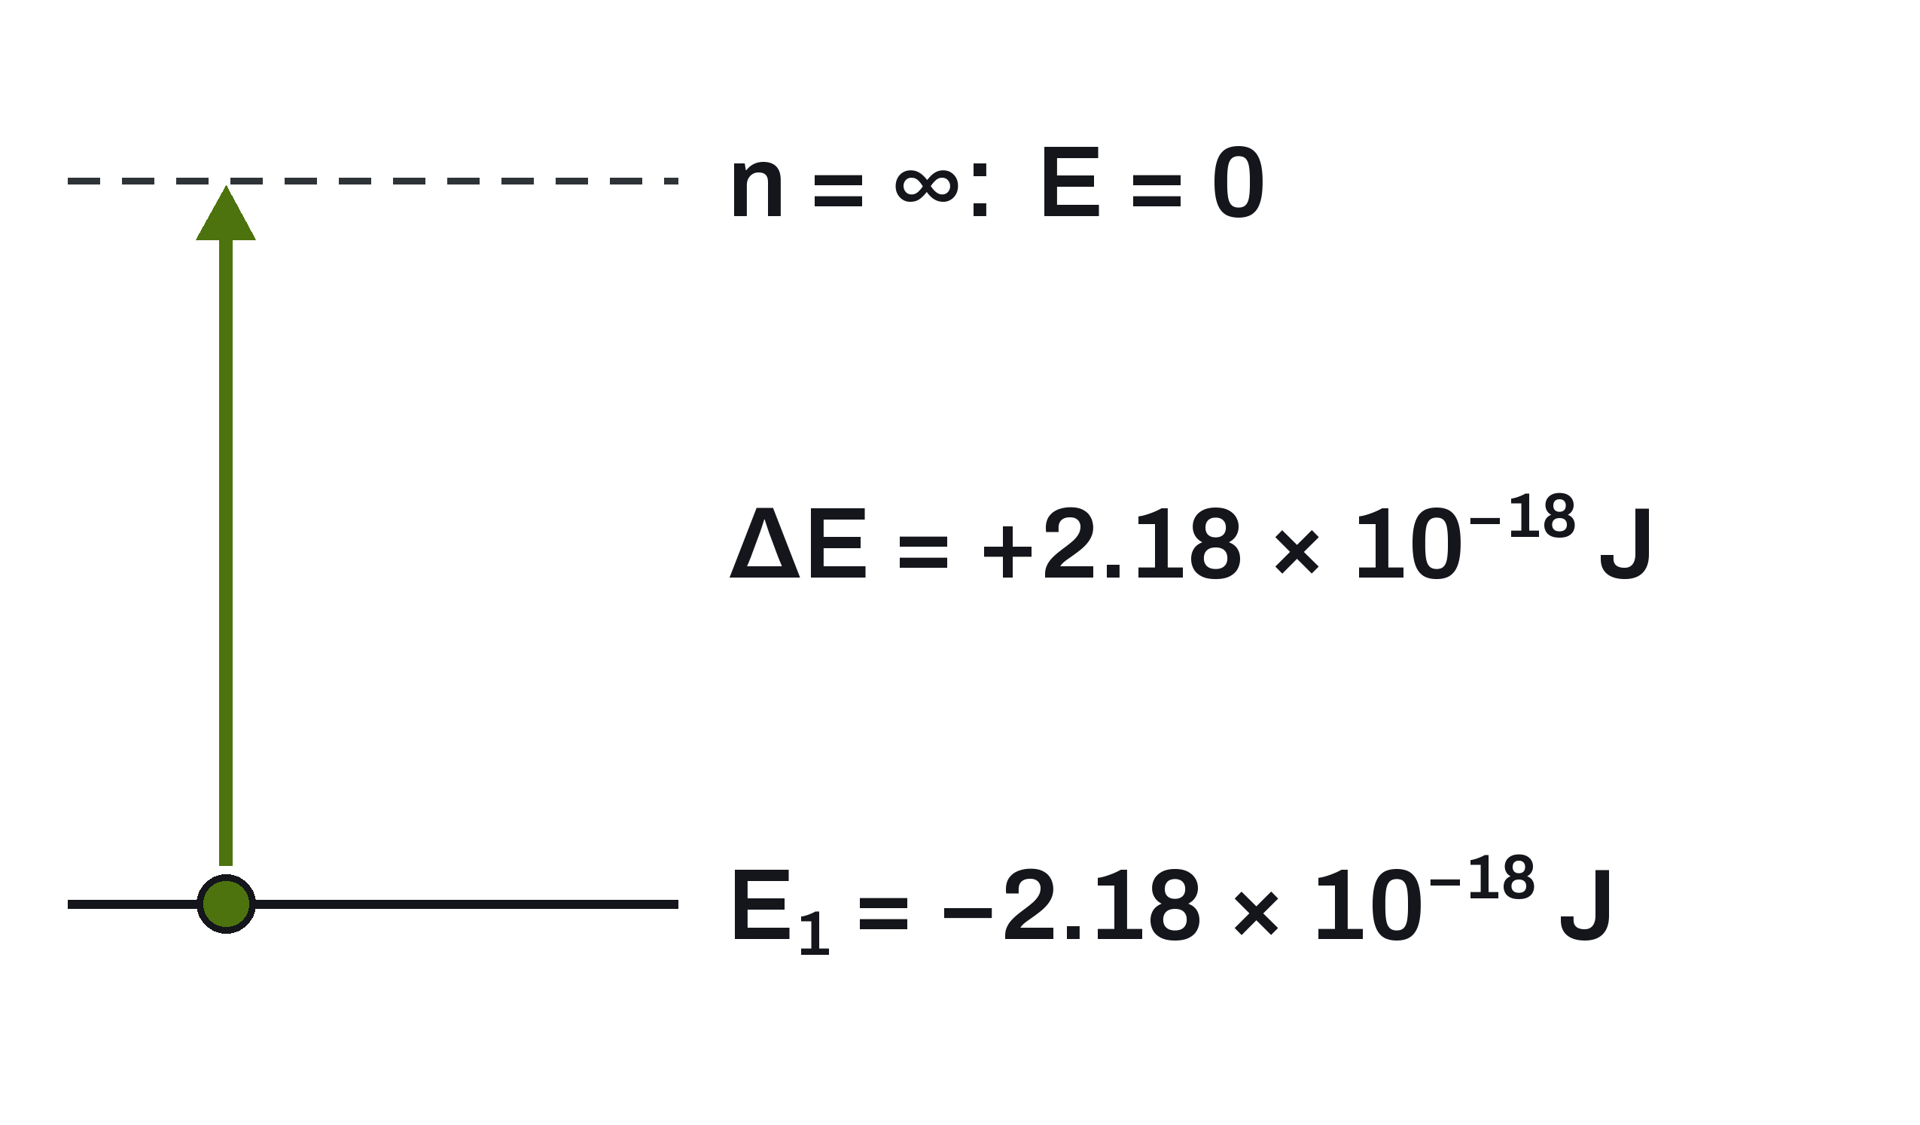
Ionization, Worked
UNIT 02 • CHEMISTRY
Final minus initial again. The sign tells you the direction.
SETUP
ΔE = final − initial
Final (n = ∞): 0
Initial (n = 1): E₁
E₁ = −2.18 × 10^−18 J
ΔE = 0 − E₁
= +2.18 × 10^−18 J
Absorbed.
A positive ΔE means energy absorbed. Ionizing hydrogen takes 2.18 × 10^−18 J.
U02 • S02.1

Slide 19
Where the Bohr Model Stops Working
UNIT 02 • CHEMISTRY
It was a real step forward. It is no longer the accepted model.
HYDROGEN ONLY
THE PICTURE
WHAT SURVIVES
Correct energies for hydrogen. Wrong for He, Li, and every atom with 2 or more electrons.
Electrons are not particles on circular tracks. The electron-cloud model replaces the orbits.
Quantized energy levels.
A level change means a photon in or out.
Keep this: energy is quantized, and a change of level means a photon in or out.
U02 • S02.1

Slide 20
Quick Check: Items 1 to 3
UNIT 02 • CHEMISTRY
Work these on your own paper, then we compare.
CHECK 1
CHECK 2
CHECK 3
Explain why hydrogen emits light at only certain colors. Use the word quantized.
Calculate the energy of the hydrogen electron at n = 2.
A hydrogen electron drops from n = 4 to n = 2. Is energy absorbed or released? How much?
For every calculation, write the equation first, then the numbers, then the units.
U02 • S02.1

Slide 21
Quick Check: Items 4 and 5
UNIT 02 • CHEMISTRY
Same as before. Your own paper first.
CHECK 4
CHECK 5
Which drop releases more energy, n = 3 to n = 2 or n = 2 to n = 1? Find both ΔE values.
Give one reason the Bohr model is no longer the accepted model of the atom.
Check 4: put a number on both drops before you compare them.
U02 • S02.1

Slide 22
Where This Goes
Next
LOOKING AHEAD
Bohr's model works for hydrogen and nothing bigger. Next: what replaced it, and what an orbital is.
U02 • S02.1

