Slide 1
2.5
Atomic &
Electron
Spectra
05
Explain how atoms make colored light, and use it to identify elements.
U02 • S02.5

Slide 2
Where Does Color
Come From?
UNIT 02 • CHEMISTRY
Fireworks, neon signs, a flame on a lab burner. Different colors, one question.
What inside an atom decides the color of the light it gives off?
U02 • S02.5

Slide 3
Three Words to Start
UNIT 02 • CHEMISTRY
Write these first. The rest of the section uses them.
PHOTON
WAVELENGTH
SPECTRUM
A single packet of light energy.
The distance between two wave crests, measured in nm.
Light spread out by wavelength.
A photon is one packet of light. Its energy is set by its wavelength.
U02 • S02.5

Slide 4
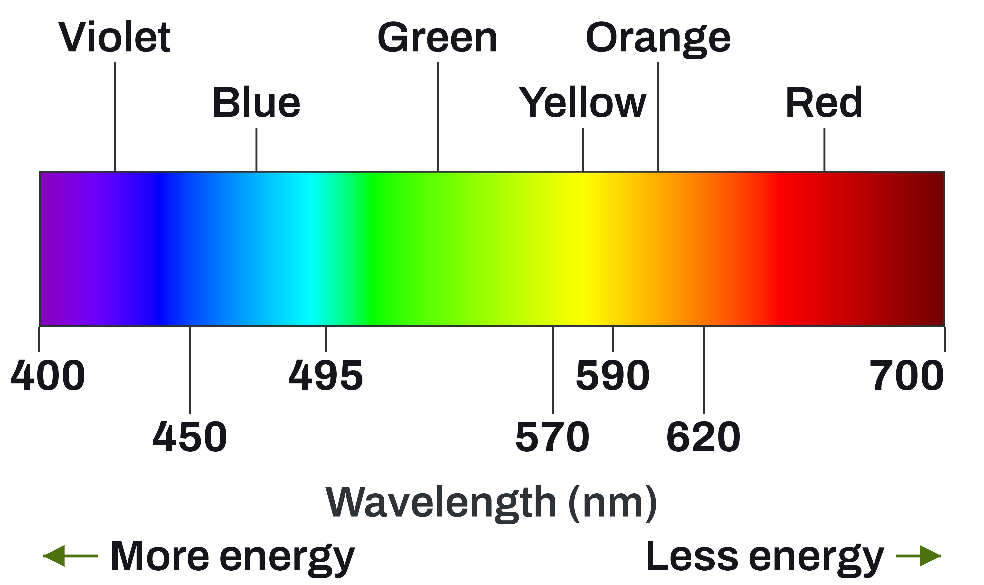
The Visible Spectrum
UNIT 02 • CHEMISTRY
Light we can see runs from about 400 nm to 700 nm.
UNITS
One nm is one billionth of a meter: 1e-9 m.
VIOLET END
Shortest wavelength, most energy.
RED END
Longest wavelength, least energy.
U02 • S02.5

Slide 5
Wavelength Sets the Energy
UNIT 02 • CHEMISTRY
Shorter wavelength means higher frequency and more energy per photon.
LONG WAVELENGTH
SHORT WAVELENGTH
Red light.
Low frequency.
Low energy per photon.
Violet light.
High frequency.
High energy per photon.
Shorter wavelength means more energy. A violet photon beats a red one.
U02 • S02.5

Slide 6
The Photon Energy Equation
UNIT 02 • CHEMISTRY
Energy goes up as wavelength goes down. Calculator provided.
How much energy does one photon of a given wavelength carry?
GIVEN
EQUATION
h = 6.626e-34 J·s
c = 3.00e8 m/s
1 nm = 1e-9 m
E = hc ÷ wavelength
E = h × frequency
c = wavelength × frequency
E in joules (J)
U02 • S02.5

Slide 7
Hot Solid or Hot Gas
UNIT 02 • CHEMISTRY
What is glowing decides what the spectrum looks like.
HOT SOLID
HOT GAS
A glowing filament.
Gives every color, no gaps.
Excited atoms in a tube.
Give a few separate lines.
A hot solid gives a continuous spectrum. A hot gas gives a line spectrum.
U02 • S02.5

Slide 8
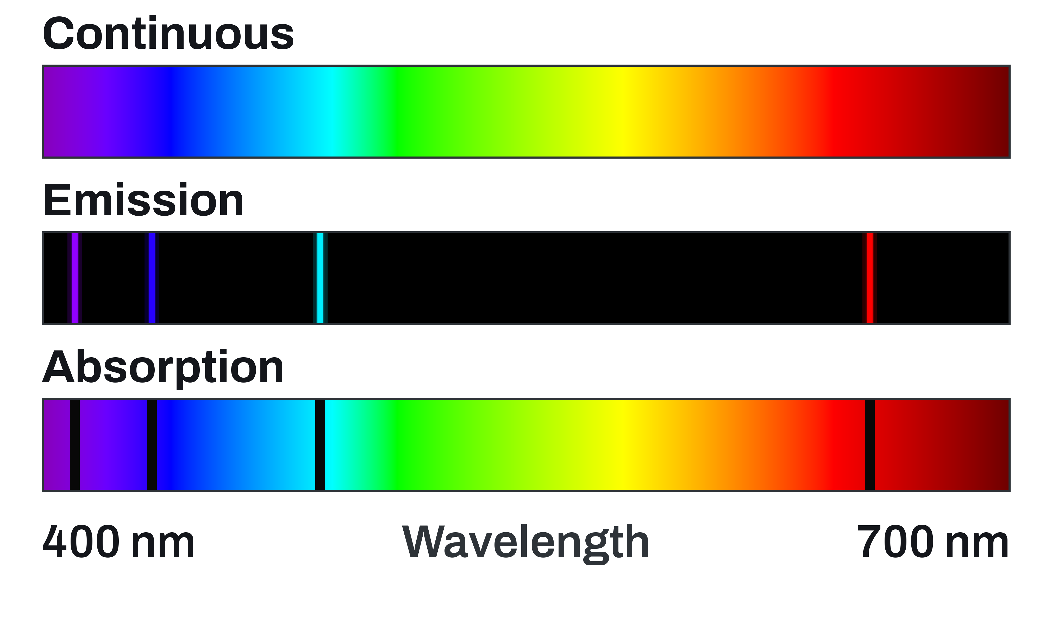
Three Kinds of Spectra
UNIT 02 • CHEMISTRY
Same range of colors, three different patterns.
CONTINUOUS
Every color, no gaps. Made by a hot solid.
EMISSION
Bright lines on black. Made by a hot gas.
ABSORPTION
Dark lines at the same places as emission lines.
U02 • S02.5

Slide 9
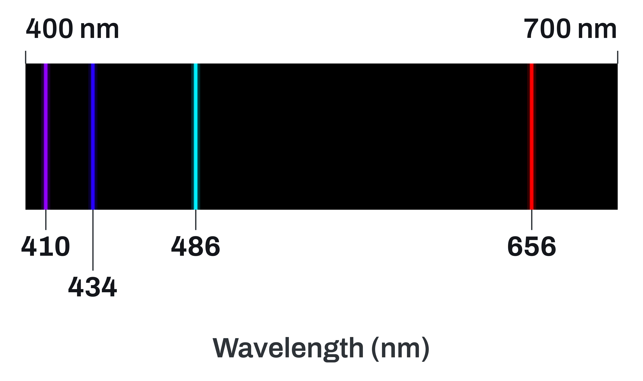
Hydrogen's Visible Emission Spectrum
UNIT 02 • CHEMISTRY
Four lines, computed from the energy levels.
THE FOUR LINES
656, 486, 434, and 410 nm. Red to violet.
WHERE THEY END
Every one is a drop that ends at n = 2.
MORE LINES
More sit in the UV and IR. Your eyes miss them.
U02 • S02.5

Slide 10
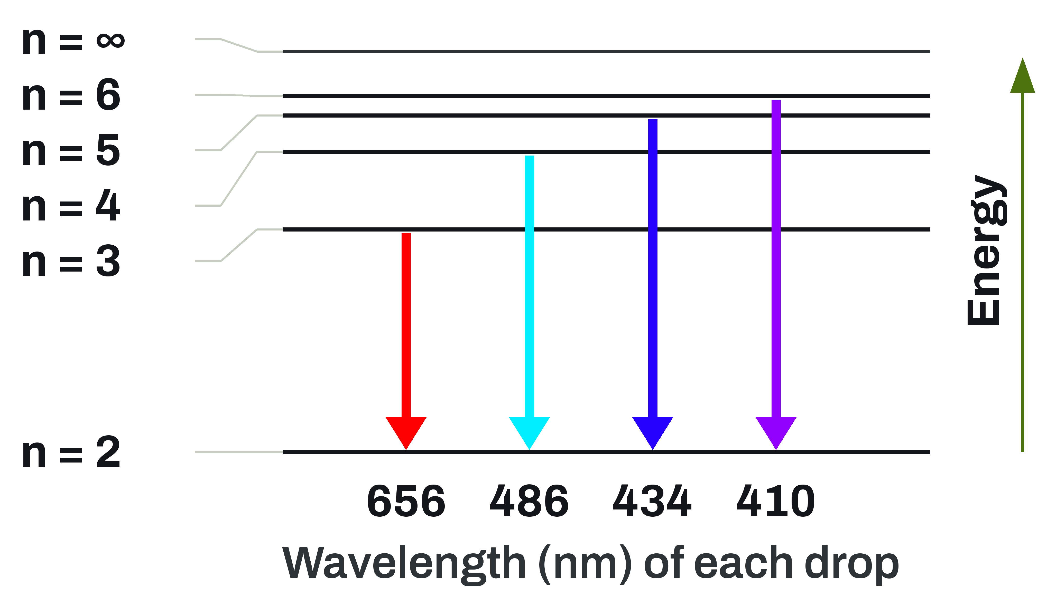
Which Drop Makes Which Line
UNIT 02 • CHEMISTRY
Each line is one electron dropping to n = 2.
EXCITED STATE
Heat or electricity lifts an electron up a level.
EMISSION
The drop releases one photon with energy ΔE.
BIGGER DROP
More energy, shorter wavelength, bluer light.
U02 • S02.5

Slide 11
Example: Color of the 3 to 2 Drop
UNIT 02 • CHEMISTRY
Calculator provided. Copy the setup, not just the answer.
Hydrogen's 3 to 2 drop emits a 3.03e-19 J photon. Find its wavelength and color.
GIVEN
NEED
E = 3.03e-19 J
h = 6.626e-34 J·s
c = 3.00e8 m/s
Wavelength in nm
Color
Rearrange first: wavelength = hc ÷ E.
U02 • S02.5

Slide 12
The 3 to 2 Drop, Worked
UNIT 02 • CHEMISTRY
Accept 656 or 657 nm, depending on rounding.
SETUP
wavelength = hc ÷ E
h × c = 6.626e-34 × 3.00e8
h × c = 1.988e-25 J·m
1.988e-25 ÷ 3.03e-19
= 6.56e-7 m
= 656 nm
Red light
656 nm is red: the 3 to 2 drop makes hydrogen's red line.
U02 • S02.5

Slide 13
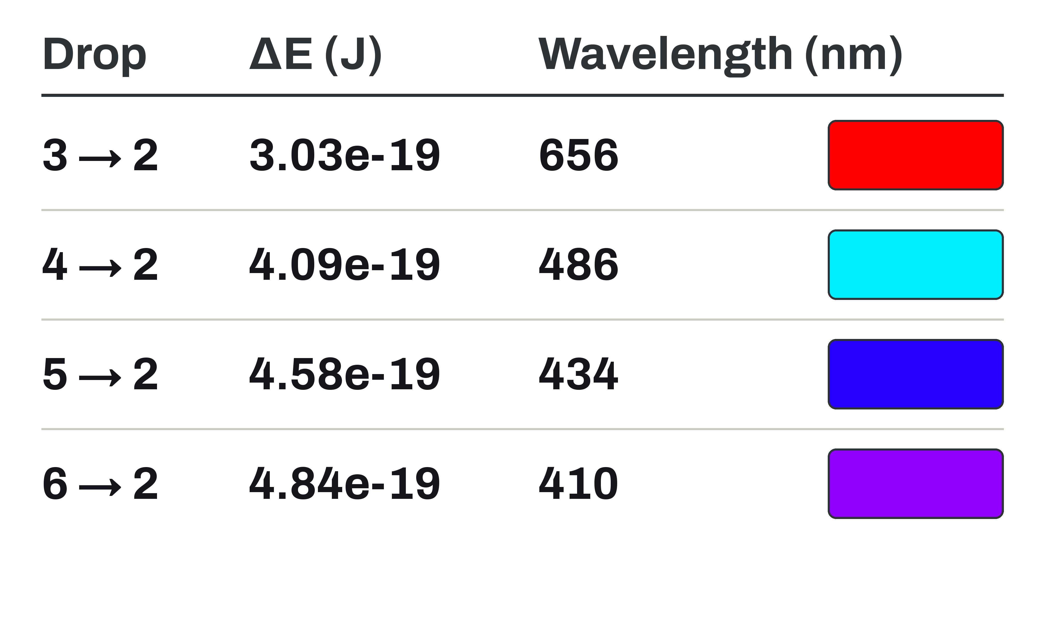
Four Drops to n = 2
UNIT 02 • CHEMISTRY
A pre-built table. Read it, do not recalculate it.
READ DOWN
Bigger drop: more energy, shorter wavelength.
CHECK
The first row is the example you just solved.
ΔE UNITS
Joules, for one photon from one atom.
U02 • S02.5

Slide 14
Every Element Has Its Own Lines
UNIT 02 • CHEMISTRY
Only certain energy drops exist, so only certain lines appear.
UNIQUE LEVELS
A FINGERPRINT
Each element has its own energy levels.
So its drops, and its lines, are its own.
Line positions identify an element.
Helium was first found in sunlight, 1868.
Each element has a unique line spectrum because its energy levels are unique.
U02 • S02.5

Slide 15
Same Idea,
In a Flame
FLAME TESTS
Metal ions in a flame emit light too. The color tells you which metal.
U02 • S02.5

Slide 16
How a Flame Test Makes Color
UNIT 02 • CHEMISTRY
The color is not the metal burning. It is electrons dropping levels.
IN THE FLAME
AS THEY DROP
Heat lifts electrons in the metal ion to higher levels.
They release photons of visible light. The color names the metal.
The color of the emitted light identifies the metal ion.
U02 • S02.5

Slide 17
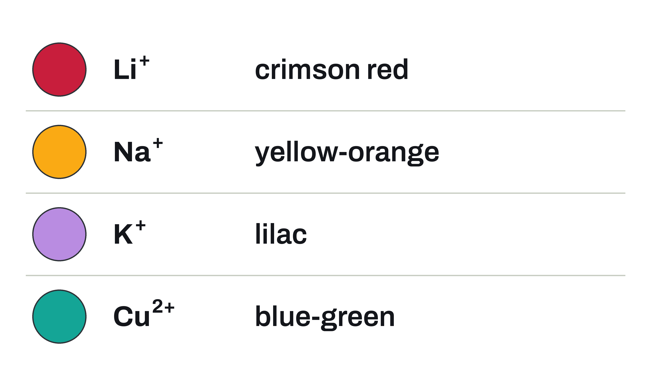
Flame Test Colors, Part 1
UNIT 02 • CHEMISTRY
Match the color you see to the metal ion.
READ THE TABLE
Each metal ion gives its own flame color.
SODIUM IS EVERYWHERE
A little Na+ turns many flames yellow.
NOT ONE WAVELENGTH
A flame color is a mix, not one exact line.
U02 • S02.5

Slide 18
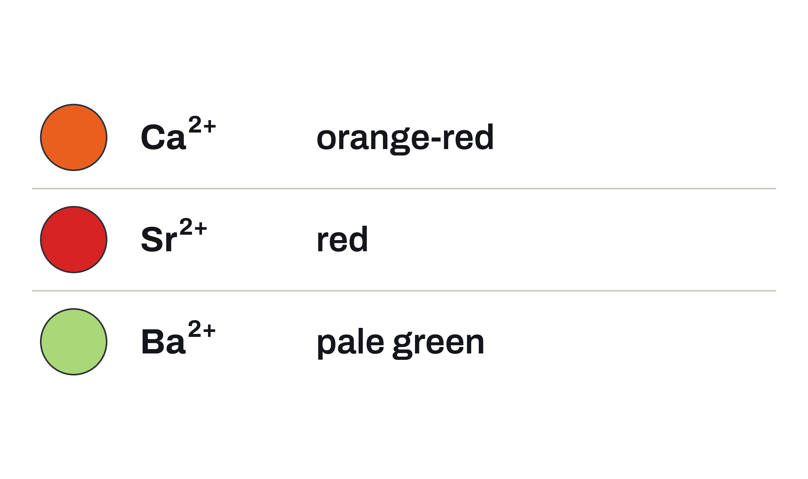
Flame Test Colors, Part 2
UNIT 02 • CHEMISTRY
Some of these colors look a lot alike.
LOOK-ALIKES
Sr2+ red and Ca2+ orange-red are easy to confuse.
NO COLOR
Many elements give no flame color we can see.
ONE TEST IS NOT ENOUGH
It narrows the options. It does not prove the ion.
U02 • S02.5

Slide 19
Example: Identify the Metals
UNIT 02 • CHEMISTRY
Use the flame color tables. Copy the reasoning.
One salt burns lilac with a trace of yellow. Another burns orange-red. Which metals?
GIVEN
NEED
Salt A: lilac, with some yellow
Salt B: orange-red
The metal ion behind each color
Write the metal ion for each color, not just the color.
U02 • S02.5

Slide 20
Two Unknowns, Identified
UNIT 02 • CHEMISTRY
Sodium contaminates almost every flame.
SETUP
Match each color
to the table.
Na+ gives yellow.
Salt A: K+ (lilac)
Yellow trace: Na+
Salt B: Ca2+
(orange-red)
Flame colors can look alike, so a flame test alone does not prove the ion.
U02 • S02.5

Slide 21
Check Yourself
UNIT 02 • CHEMISTRY
Answer in your notes. Use the words photon and energy level.
ENERGY
WHY DIFFERENT
FLAME TEST
Which has more energy, a red photon or a blue photon? Why?
Why does each element have its own line spectrum?
A flame is lilac. Which ion? Explain the color with electrons.
Answer in full sentences. Name the photon and the energy level.
U02 • S02.5

