Slide 1
2.3
Electron
Configurations
03
Write configurations and orbital diagrams through krypton, and catch mistakes in them.
U02 • S02.3
Notes:
PROVISIONAL scope: required through Kr (Z = 36), per the content brief; Matt to confirm. Period 5 and beyond (Mo, Ag, Au) are not taught on these slides and are not checked in the build script. PROVISIONAL notation: configurations are written in filling order, e.g. [Ar] 4s^2 3d^6, not energy order. Image prompt (section slot): a long row of numbered wooden mail slots in a dim hallway, a few holding envelopes.

Slide 2
Where Are Oxygen's Electrons?
UNIT 02 • CHEMISTRY
The periodic table gives you the count: 8. Today you write where each one sits.
Oxygen has 8 electrons. Do all 8 have the same energy?
U02 • S02.3
Notes:
Hook. Ask: do all 8 electrons have the same energy? Let them guess; the slides answer it (no). Z = 8 comes from the periodic table. Image prompt (concept slot): an apartment building at dusk with a few lit windows on different floors.

Slide 3
Reading an Electron Configuration
UNIT 02 • CHEMISTRY
Take 2p⁴ apart one piece at a time.
ENERGY LEVEL
SUBLEVEL
ELECTRONS
2p⁴
The big number in front is the level: 2.
2p⁴
The letter is the sublevel: p.
2p⁴
The raised number is the electron count: 4.
A configuration lists where the electrons sit. Ground state means the lowest-energy arrangement.
U02 • S02.3
Notes:
Say it aloud: two-p-four. Level 2, p sublevel, 4 electrons. Ground state = lowest-energy arrangement; every configuration today is a ground state unless the slide says otherwise. Image prompt (aside slot): a printed periodic table with oxygen's cell circled in pencil.

Slide 4
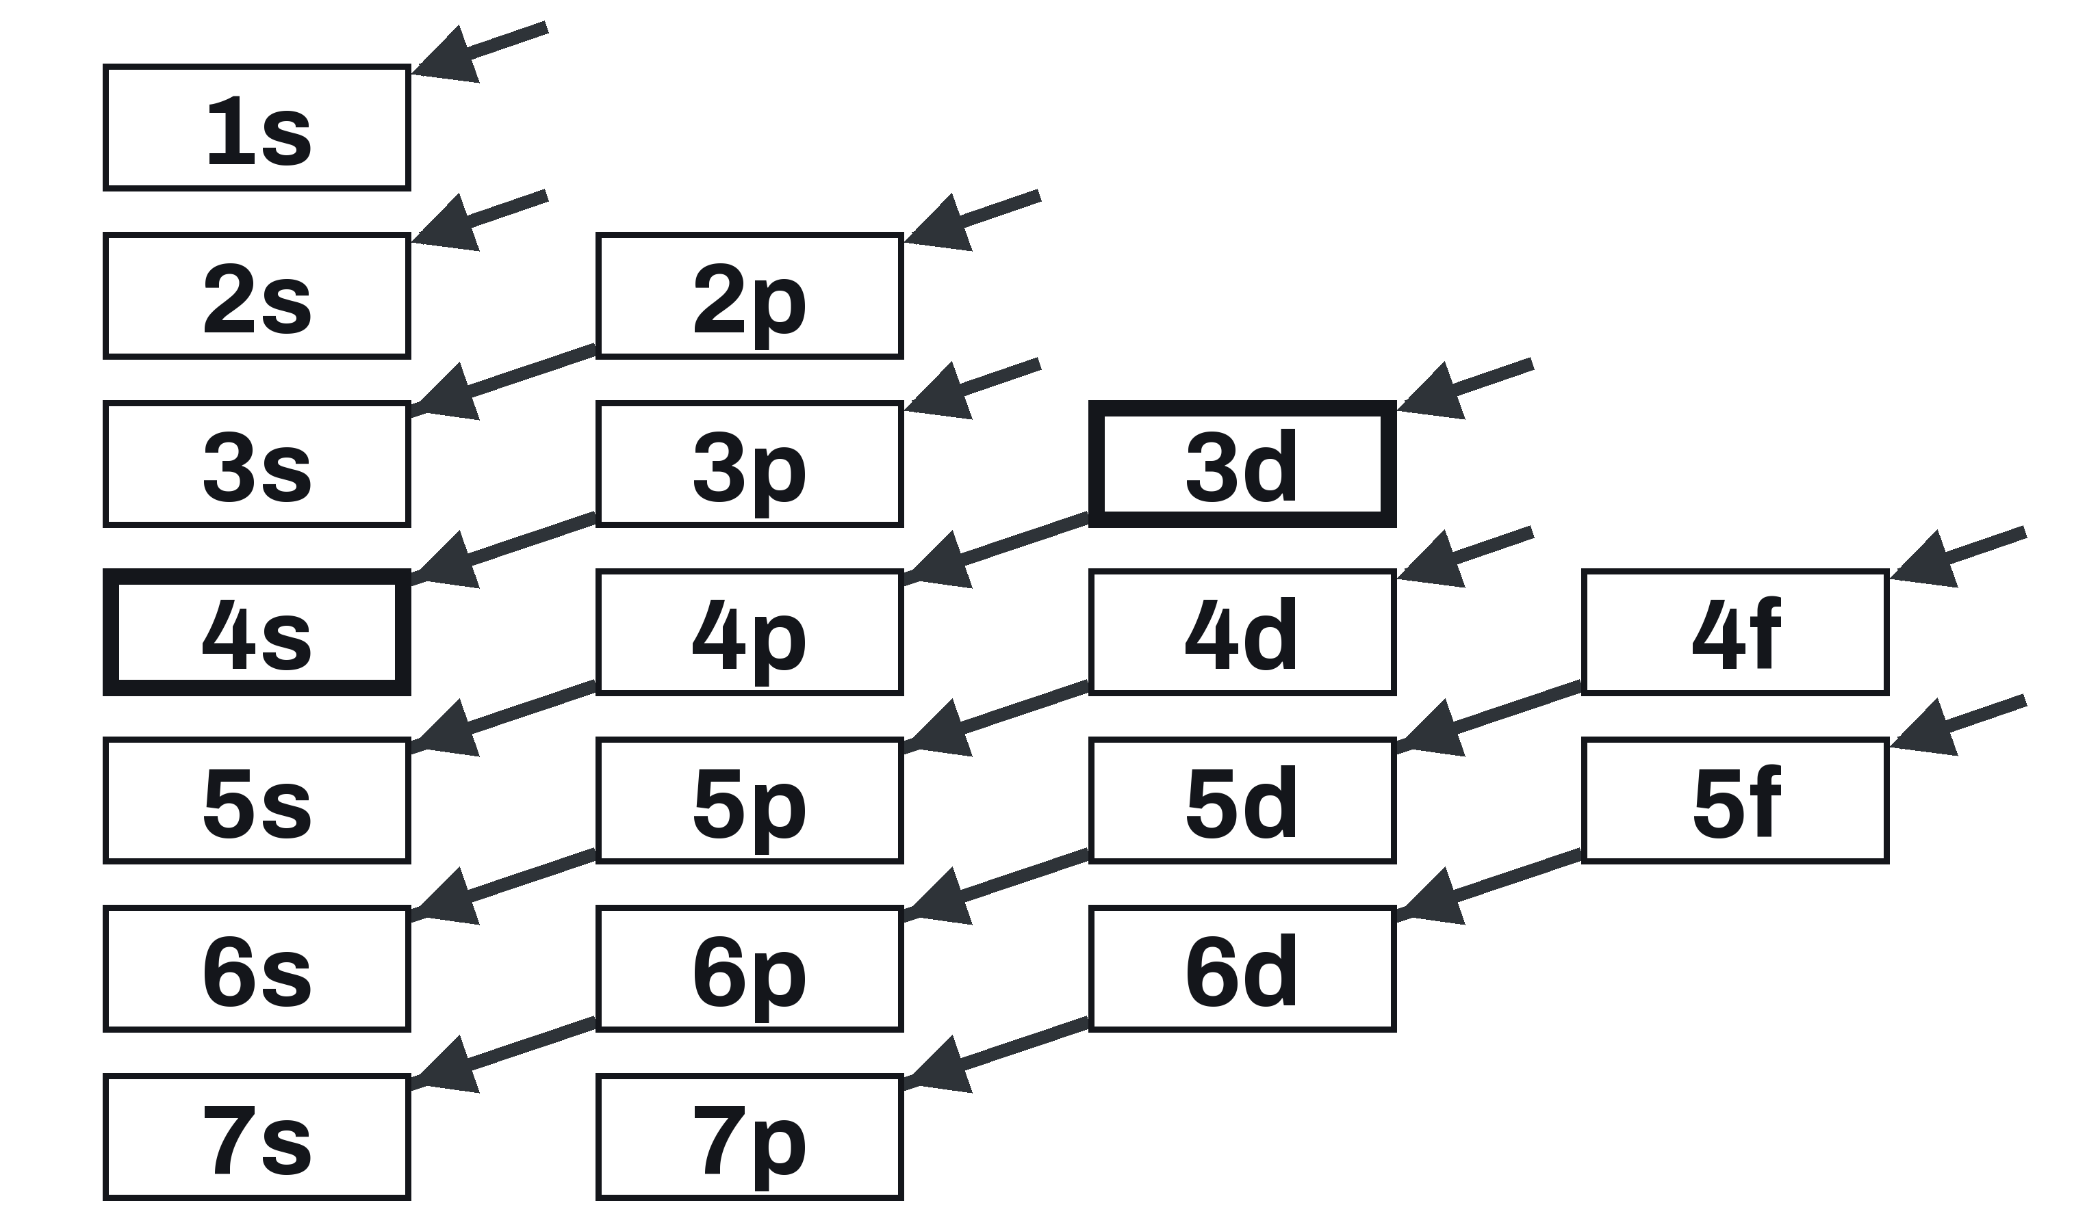
The Order Electrons Fill In
UNIT 02 • CHEMISTRY
Read each arrow from top right to bottom left, then start the next arrow.
AUFBAU PRINCIPLE
The lowest-energy open orbital fills first.
THE ORDER
1s 2s 2p 3s 3p 4s 3d 4p 5s 4d 5p
HEAVY BOXES
4s fills before 3d, in K and Ca.
U02 • S02.3
Notes:
Walk each arrow top right to bottom left. We need the order through 5p: 1s 2s 2p 3s 3p 4s 3d 4p 5s 4d 5p. Say it as: 4s fills before 3d in neutral K and Ca. Do not say 4s is always lower than 3d (once 3d holds electrons it sits lower; that is S2.4, ions).

Slide 5
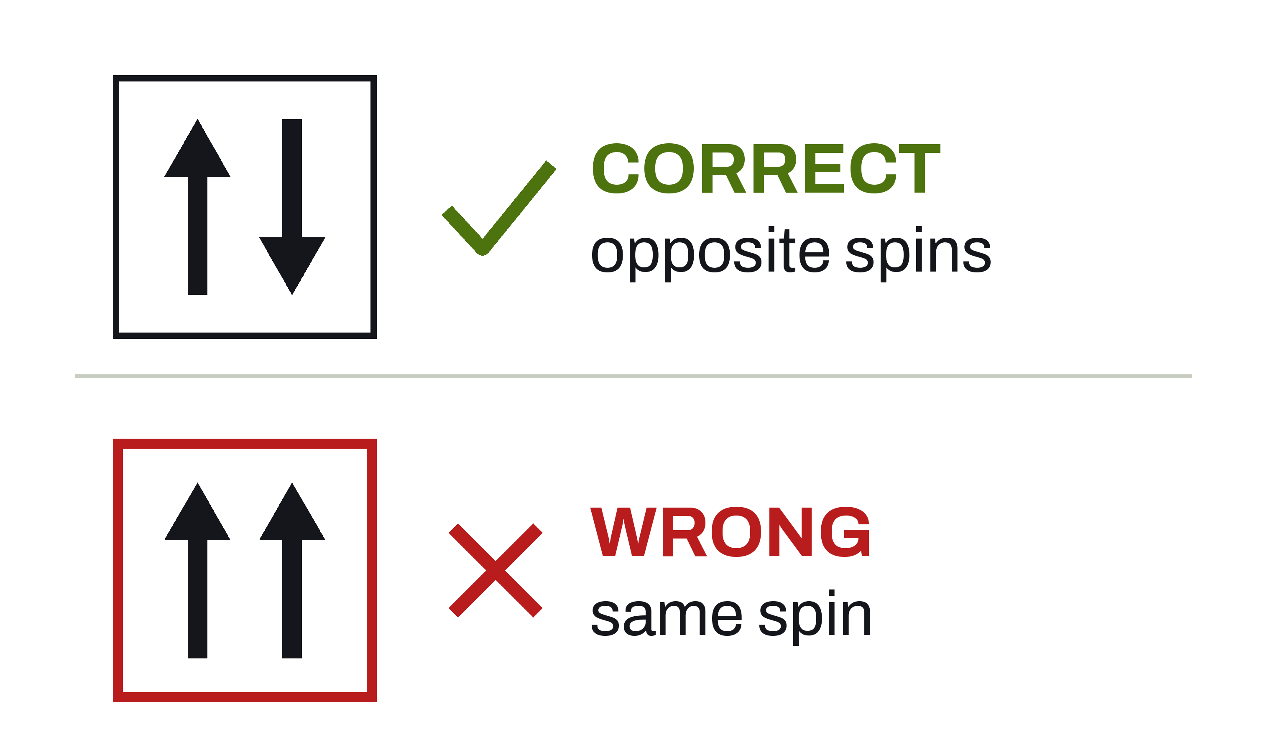
Pauli: Two per Orbital, Opposite Spins
UNIT 02 • CHEMISTRY
Up and down arrows are spin labels, not electrons orbiting opposite ways.
PAULI EXCLUSION PRINCIPLE
One orbital holds at most 2 electrons.
THE SPINS
If there are two, their spins are opposite.
COMMON MIX-UP
Two per orbital, not two per sublevel.
U02 • S02.3
Notes:
Spin up and down are labels, not literal rotation. Common mix-up: two per orbital, not two per sublevel (a p sublevel has 3 orbitals and holds 6).

Slide 6
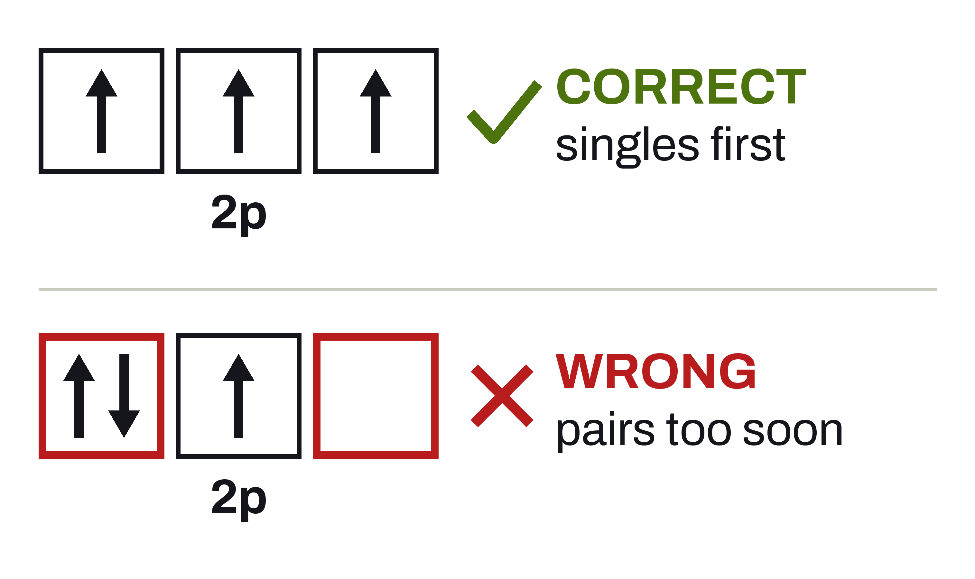
Hund's Rule: Singles Before Pairs
UNIT 02 • CHEMISTRY
Equal-energy orbitals, like the three 2p boxes, each get one electron first.
HUND'S RULE
Singles first, all pointing the same way.
NITROGEN
Its 2p³ is three single electrons: 3 unpaired.
THE TERM
Equal-energy orbitals are called degenerate.
U02 • S02.3
Notes:
Figure: N in 2p. Correct = three singles, spins parallel. Wrong = one pair, one single, one empty box. Equal-energy orbitals are called degenerate. Electrons spread out first because sharing an orbital costs repulsion.

Slide 7
Reading an Orbital Diagram
UNIT 02 • CHEMISTRY
One box per orbital. Nitrogen has 7 electrons, so 7 arrows.
BOXES
NITROGEN Z = 7
1s and 2s have 1 box each. 2p has 3.
ARROWS
1s
²
2s
²
2p
³
Draw the up arrow first in every box.
Pauli: pair with opposite spin
Hund: one up arrow in each box first
2 + 2 + 3 = 7
THE LABEL UNDER EACH GROUP
The raised number counts the arrows.
U02 • S02.3
Notes:
N has 7 electrons so 7 arrows: 2 + 2 + 3. Convention: draw the up arrow first in every box, and the label's raised number counts the arrows.
STATIC FINAL STATE: print and handout copy, no animation. This slide shows the final state of the build.
Animated version: SHULL_CHEM_Slides_U02_S02.3.pptx has the click-by-click build.

Slide 8
Filling Oxygen's 2p Boxes
UNIT 02 • CHEMISTRY
Four electrons, three boxes. Watch the order of the arrows.
THE BOXES
OXYGEN 2p SUBLEVEL
The 2p sublevel has 3 boxes. Oxygen puts 4 electrons in them.
HUND'S RULE
2p
⁴
One up arrow in each box first.
Hund: one up arrow in each box first
Pauli: pair with opposite spin
4 arrows = 4 electrons in 2p
PAULI EXCLUSION PRINCIPLE
The fourth arrow pairs up, pointing the opposite way.
U02 • S02.3
Notes:
The three 2p boxes hold the oxygen filling: one up arrow in each box first (Hund: singles first), then a down arrow in box 1 (Pauli: a pair has opposite spins). Result: 2p^4 with one pair and two singles, so 2 unpaired electrons. Have students draw the arrows in their notes in that order. Same filling as the oxygen example later in this deck.
STATIC FINAL STATE: print and handout copy, no animation. This slide shows the final state of the build.
Animated version: SHULL_CHEM_Slides_U02_S02.3.pptx has the click-by-click build.

Slide 9
Writing a Configuration
UNIT 02 • CHEMISTRY
The same four steps, for every element.
Find Z
Fill in order
Respect the caps
Add it up
Atomic number is the electron count.
Follow the chart, lowest first.
s holds 2, p 6, d 10, f 14.
The raised numbers must total Z.
U02 • S02.3
Notes:
Four steps, every element. Caps: s 2, p 6, d 10, f 14. Always check that the sum equals Z. Image prompt (band slot): a periodic table wall chart photographed at a shallow angle.

Slide 10
Example: Oxygen
UNIT 02 • CHEMISTRY
Copy the setup, not just the answer.
Write the longhand configuration and the orbital diagram for oxygen.
GIVEN
NEED
Oxygen, Z = 8
Neutral atom
Longhand configuration
Orbital diagram
Unpaired electrons
Always check that the raised numbers add up to Z.
U02 • S02.3
Notes:
Students copy the setup; the work area stays empty on purpose and is filled live on the board. Answer on the next slide: 1s^2 2s^2 2p^4, 2 unpaired. Image prompt (aside slot): a small cylinder of oxygen gas with a regulator, on a lab cart.

Slide 11
Oxygen, Worked
UNIT 02 • CHEMISTRY
Order first. Then singles before pairs in the 2p boxes.
OXYGEN Z = 8
SETUP
Z = 8 electrons
Fill 1s, then 2s, then 2p
1s² 2s² 2p⁴
2 + 2 + 4 = 8
Unpaired: 2
1s
²
2s
²
2p
⁴
Pauli: opposite spins
Hund: singles first
2 + 2 + 4 = 8
Oxygen is 1s² 2s² 2p⁴, with 2 unpaired electrons.
U02 • S02.3
Notes:
Oxygen: 1s^2 2s^2 2p^4, 2 + 2 + 4 = 8. The 2p boxes hold one pair and two singles, so 2 unpaired.
STATIC FINAL STATE: print and handout copy, no animation. This slide shows the final state of the build.
Animated version: SHULL_CHEM_Slides_U02_S02.3.pptx has the click-by-click build.

Slide 12
Longhand: N, Cl, and Ca
UNIT 02 • CHEMISTRY
Calcium stops at 4s². The 3d sublevel stays empty until scandium.
NITROGEN, Z = 7
CHLORINE, Z = 17
CALCIUM, Z = 20
1s² 2s² 2p³
Sum: 2+2+3 = 7
Unpaired: 3
1s² 2s² 2p⁶ 3s² 3p⁵
Sum: 2+2+6+2+5 = 17
Unpaired: 1
1s² 2s² 2p⁶ 3s² 3p⁶ 4s²
Sum: 2+2+6+2+6+2 = 20
Unpaired: 0
The raised numbers add up to the atomic number, every time.
U02 • S02.3
Notes:
N: 1s^2 2s^2 2p^3, 3 unpaired. Cl: 1s^2 2s^2 2p^6 3s^2 3p^5, 1 unpaired. Ca: 1s^2 2s^2 2p^6 3s^2 3p^6 4s^2, 0 unpaired. 3d stays empty until scandium. Image prompt (aside slot): period 3 of a periodic table wall chart, lit from the side.

Slide 13
Noble-Gas Shorthand
UNIT 02 • CHEMISTRY
Replace the filled inner core with a noble gas in brackets.
LONGHAND: Cl
SHORTHAND: Cl
1s² 2s² 2p⁶ 3s² 3p⁵
All 17 electrons written out.
[Ne] 3s² 3p⁵
[Ne] stands for the first 10: 1s² 2s² 2p⁶.
Use the previous period's noble gas. Cl is in period 3, so its core is [Ne], not [Ar].
U02 • S02.3
Notes:
COMMON ERROR (brief): using the noble gas of the same period, or the element's own. Cl is period 3, so the core is [Ne], not [Ar]; the core is the previous period's noble gas. Shorthand: [Ne] 3s^2 3p^5, which equals the longhand 1s^2 2s^2 2p^6 3s^2 3p^5. Next slide: the same idea for germanium, built one click at a time (the longhand first, then the noble gas before it in brackets). Image prompt (concept slot): a neon sign tube glowing orange-red in a dark window.

Slide 14
Shorthand: Germanium
UNIT 02 • CHEMISTRY
Write it long first. Then swap the argon part for [Ar].
STEP 1: LONGHAND
GERMANIUM Z = 32
All 32 electrons, in filling order.
Longhand
1s² 2s² 2p⁶ 3s² 3p⁶ 4s² 3d¹⁰ 4p²
Shorthand
STEP 2: THE SUBSTITUTE
[Ar]
4s²
3d¹⁰
4p²
[Ar] is a placeholder for argon's 18 electrons.
[Ar] stands for the first 18 electrons: the noble gas before germanium
STEP 3: FINISH
18 + 2 + 10 + 2 = 32 electrons
Then write what is left, the usual way.
U02 • S02.3
Notes:
Shorthand for germanium (Z = 32). Teach it in this order: write the longhand first; find the noble gas that comes BEFORE germanium and mark those electrons; put that noble gas in brackets; finish the line. Longhand: 1s^2 2s^2 2p^6 3s^2 3p^6 4s^2 3d^10 4p^2, 2+2+6+2+6+2+10+2 = 32. The first five segments total 18 and are exactly argon's configuration, so [Ar] is a placeholder, a substitution like writing one symbol for a long repeated expression in math. Shorthand: [Ar] 4s^2 3d^10 4p^2, 18 + 2 + 10 + 2 = 32, with 2 unpaired electrons (the two 4p singles). Common error (brief): using the noble gas of the element's own period. Krypton ends germanium's period and comes AFTER it (Z = 36 > 32), so [Kr] would claim 36 electrons; the next slide shows the table strip. This slide shows the longhand line, the shorthand line under it, and the check sum. Cl stays on the previous slide as the static example.
STATIC FINAL STATE: print and handout copy, no animation. This slide shows the final state of the build (Ge).
Animated version: SHULL_CHEM_Slides_U02_S02.3.pptx has the click-by-click build.

Slide 15
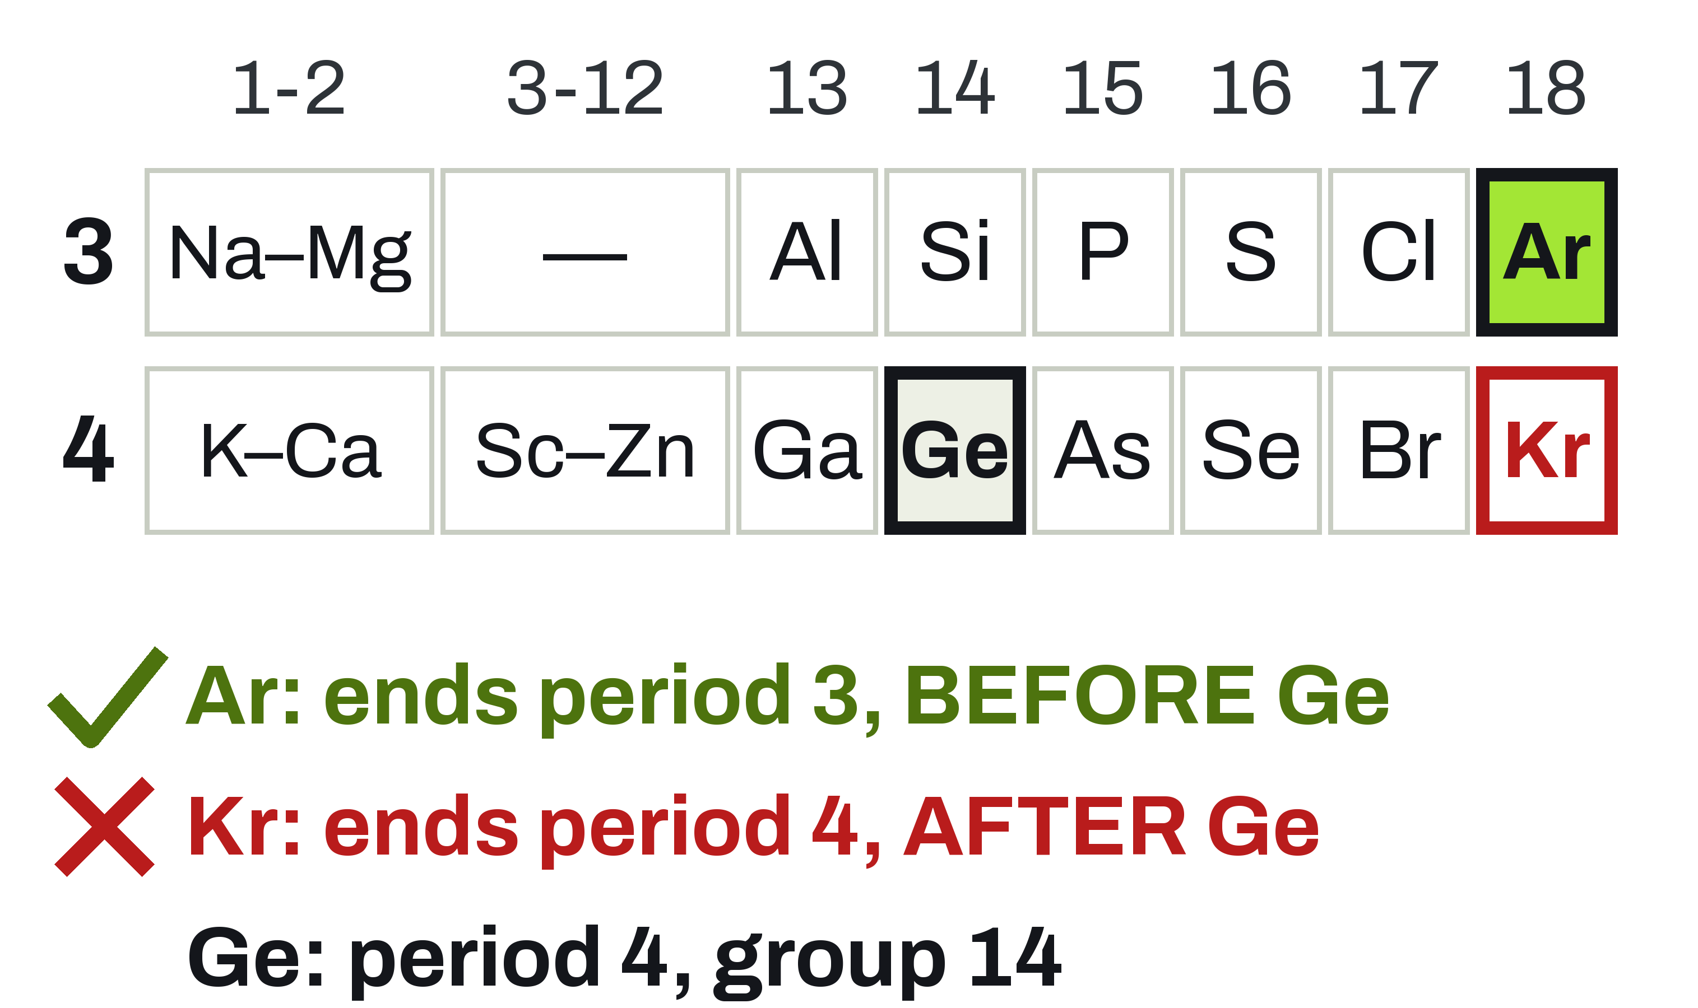
Why [Ar] and Not [Kr]?
UNIT 02 • CHEMISTRY
Germanium is in period 4. Its core is the noble gas that ends period 3.
ARGON, Z = 18
Ends period 3. It comes BEFORE germanium.
GERMANIUM, Z = 32
Period 4, group 14. Use the previous period's noble gas.
KRYPTON, Z = 36
Ends period 4. It comes AFTER germanium, so it is the wrong core.
U02 • S02.3
Notes:
Table strip, periods 3 and 4 (groups 1-2, 3-12 as spans, then 13-18). Argon (Z = 18) is the last element of period 3: the noble gas BEFORE germanium. Germanium (Z = 32) is period 4, group 14. Krypton (Z = 36) ends period 4: it comes AFTER germanium, so it cannot be a core for a 32-electron atom. Rule restated: the core is the previous period's noble gas. Positions are asserted from the atomic numbers in scripts/build_diagram_u02_s02.3_configurations.py. The marks use a tick, a cross and words as well as colour. Alt text on the picture describes the strip.

Slide 16
Example: Iron
UNIT 02 • CHEMISTRY
Longhand, shorthand, and the unpaired count.
Write longhand and shorthand for iron. How many unpaired electrons?
GIVEN
NEED
Iron, Z = 26
Neutral atom
Longhand
Shorthand
Unpaired electrons
Fill 4s before 3d. We write 4s ahead of 3d.
U02 • S02.3
Notes:
Students copy the setup, then work it. Answer on the next slide. Fe, Z = 26. Fill 4s before 3d, and we write 4s ahead of 3d (filling-order notation, PROVISIONAL convention). Image prompt (aside slot): a rusted iron nail on a white bench.

Slide 17
Iron, Worked
UNIT 02 • CHEMISTRY
Argon is the core. Then 4s, then 3d.
IRON Z = 26
LONGHAND
1s² 2s² 2p⁶ 3s² 3p⁶
4s² 3d⁶
[Ar] 4s² 3d⁶
18 + 2 + 6 = 26
Unpaired: 4
4s
²
3d
⁶
Pauli: opposite spins
Hund: singles first
[Ar] 18 + 2 + 6 = 26
Fe is [Ar] 4s² 3d⁶. One pair and 4 singles in the 3d boxes.
U02 • S02.3
Notes:
Fe: [Ar] 4s^2 3d^6, 18 + 2 + 6 = 26. The 3d boxes hold one pair and four singles, so 4 unpaired. Longhand: 1s^2 2s^2 2p^6 3s^2 3p^6 4s^2 3d^6.
STATIC FINAL STATE: print and handout copy, no animation. This slide shows the final state of the build.
Animated version: SHULL_CHEM_Slides_U02_S02.3.pptx has the click-by-click build.

Slide 18
Exception: Copper
UNIT 02 • CHEMISTRY
The rules predict 4s² 3d⁹. Watch what the real atom does.
WATCH
COPPER Z = 29 [Ar] CORE
Which sublevel loses an electron, and which gains one?
4s¹
3d¹⁰
ONE OF TWO
What the rules predict
Copper and chromium are the only exceptions we learn.
[Ar] 4s² 3d⁹
One 4s electron moves into 3d
Actual: [Ar] 4s¹ 3d¹⁰
LOOKING AHEAD (S2.4)
4s empties first in ions: Cu⁺ is [Ar] 3d¹⁰, Cu²⁺ is [Ar] 3d⁹.
U02 • S02.3
Notes:
Copper. Boxes for 4s and 3d only; the [Ar] core (18 electrons) is not drawn. The atom as the rules predict: [Ar] 4s^2 3d^9 (4s before 3d; 18 + 2 + 9 = 29). The measured ground state: [Ar] 4s^1 3d^10, 18 + 1 + 10 = 29, one unpaired electron (the 4s). Same electron count before and after: an electron MOVES from 4s to 3d, none is gained. Say 'measured ground state', not 'textbook error'. The arrows are bookkeeping for the end state; the diagram does not track one electron's journey. Forward pointer to S2.4: the 4s^1 electron leaves first, so Cu^+ = [Ar] 3d^10 and Cu^2+ = [Ar] 3d^9 (both checked by the figure script). The reason follows on the Why slide. Do not extend this to Ag or Au: not taught, not checked (look it up).
STATIC FINAL STATE: print and handout copy, no animation. This slide shows the final state of the build (Cu).
Animated version: SHULL_CHEM_Slides_U02_S02.3.pptx has the click-by-click build.

Slide 19
Exception: Chromium
UNIT 02 • CHEMISTRY
Same move. The rules predict 4s² 3d⁴.
WATCH
CHROMIUM Z = 24 [Ar] CORE
Count the arrows in 3d before and after.
4s¹
3d⁵
THE TOTAL
What the rules predict
Cr still has 24 electrons. [Ar] is 18, so 6 are drawn.
[Ar] 4s² 3d⁴
One 4s electron moves into 3d
Actual: [Ar] 4s¹ 3d⁵
UNPAIRED ELECTRONS
Count them at the end. Is it more than iron's 4?
U02 • S02.3
Notes:
Chromium. The atom as the rules predict: [Ar] 4s^2 3d^4 (18 + 2 + 4 = 24): four up arrows in 3d and one empty box. The measured ground state: [Ar] 4s^1 3d^5, 18 + 1 + 5 = 24; every box in 4s and 3d holds exactly one up arrow, all spins parallel (Hund), so 6 unpaired electrons, more than iron's 4. The arrows are bookkeeping for the end state: the arrow that leaves 4s is the down one and the arrow that arrives in 3d is an up one, so do not present it as one electron keeping its spin; the point is the final arrangement. Answer to the unpaired question: 6. Same teaching label as Cu: measured ground state. Mo (same group, one period down) is an exception too, and W is not; not taught, not checked here.
STATIC FINAL STATE: print and handout copy, no animation. This slide shows the final state of the build (Cr).
Animated version: SHULL_CHEM_Slides_U02_S02.3.pptx has the click-by-click build.

Slide 20
Why Cr and Cu Break the Pattern
UNIT 02 • CHEMISTRY
A simplified reason, and where it stops working.
THE ENERGIES ARE CLOSE
THE PAYOFF
THE RESULT
4s and 3d are almost the same energy, so a small change can tip the balance.
One 4s electron moves. 3d becomes completely full (Cu) or half full with parallel spins (Cr).
That lowers the atom's total energy slightly, so the real atom does it.
A simplification, not a rule: it misses other exceptions. Learn Cr and Cu; look the rest up.
U02 • S02.3
Notes:
STUDENT LEVEL (simplified; say so out loud): 4s and 3d are very close in energy here. Moving one 4s electron gives a completely filled 3d (Cu) or a half-filled 3d with all five spins parallel (Cr). That lowers the atom's total energy slightly, so the real atom does that. This explains Cr and Cu; it does not predict every exception, and in this course students learn Cr and Cu and look the rest up. Do NOT say that half-full and full are always more stable. TEACHER LEVEL: the near-degeneracy of 4s and 3d is what lets a small energy change decide the arrangement. Textbook accounts cite exchange stabilization (same-spin electrons in different orbitals lower the energy; Cr has six parallel spins) and reduced electron-electron repulsion. PROVISIONAL: the textbook story is simpler than the real energy accounting, which needs electron-correlation calculations; that is why the heuristic fails. COUNTEREXAMPLES (checked against a secondary dataset, the mendeleev PyPI package, for Cr, Cu, Nb, Mo, W, Ag and Au; NIST was not reachable from here; still PROVISIONAL until Matt or a source confirms. The script itself checks only that the electron totals are 41 and 74): Nb is [Kr] 5s^1 4d^4, an exception that is not half-full or full; W is the regular [Xe] 6s^2 4f^14 5d^4 although Cr and Mo, in the same group, are exceptions. So the heuristic is not a predictor. Mo, Ag and Au (one period down) are not taught and not checked here. Forward pointer to S2.4: the 4s^1 electron leaves first, so Cu^+ = [Ar] 3d^10 and Cu^2+ = [Ar] 3d^9. Image prompt (aside slot): a coil of copper wire beside a chromium-plated tap on a lab bench.

Slide 21
Checking a Configuration
UNIT 02 • CHEMISTRY
Run these four checks in order.
Count
Caps and order
Hund and Pauli
Core, Cr, Cu
Do the raised numbers add up to Z?
Max 2, 6, 10, 14. Aufbau order.
Singles first. Pairs have opposite spins.
Previous noble gas? Is it Cr or Cu?
U02 • S02.3
Notes:
Run the four checks in order: count, caps and order, Hund and Pauli, then core / Cr / Cu. Stop at the first failure. Image prompt (band slot): a teacher's red pen resting on a page of student work.

Slide 22
Example: Spot the Mistake
UNIT 02 • CHEMISTRY
Each was written as a ground state.
Each of these is wrong. Name the rule or fact it breaks.
GIVEN (a), (b)
GIVEN (c), (d)
(a) O: 1s² 2s² 2p⁶
(b) K: [Ar] 3d¹
(c) Ca: [Ne] 4s²
(d) Cr: [Ar] 4s² 3d⁴
Add the electrons first. If the total is not Z, stop there.
U02 • S02.3
Notes:
Answers on the next slide. Each was written as a ground state. (a) O: 1s^2 2s^2 2p^6 is 10 electrons, O has 8. (b) K: [Ar] 3d^1 puts 3d before 4s. (c) Ca: [Ne] 4s^2 is 12 electrons, wrong core. (d) Cr: [Ar] 4s^2 3d^4 obeys the rules but is not the real ground state. Replay the Chromium click build if students are unsure. Image prompt (aside slot): a page of student work with a few lines circled in red pen.

Slide 23
Spot the Mistake, Worked
UNIT 02 • CHEMISTRY
Four problems, four different checks. Each fix is on the right.
WHAT IS WRONG
(a) Count: 10, not 8
(b) Aufbau: 4s first
(c) Core: needs [Ar]
(d) Real Cr differs
Corrected:
(a) 1s² 2s² 2p⁴
(b) [Ar] 4s¹
(c) [Ar] 4s²
(d) [Ar] 4s¹ 3d⁵
Cr follows the rules on paper, but the measured ground state is [Ar] 4s¹ 3d⁵.
U02 • S02.3
Notes:
Corrected: (a) O 1s^2 2s^2 2p^4. (b) K [Ar] 4s^1. (c) Ca [Ar] 4s^2. (d) Cr [Ar] 4s^1 3d^5. (d) is the Chromium click build: predicted [Ar] 4s^2 3d^4, actual [Ar] 4s^1 3d^5. Teach 'rules-consistent' versus 'observed': (d) passes every rule on paper and is still not the real atom. Image prompt (data slot): a pencil resting on a page of crossed-out electron counts.

Slide 24
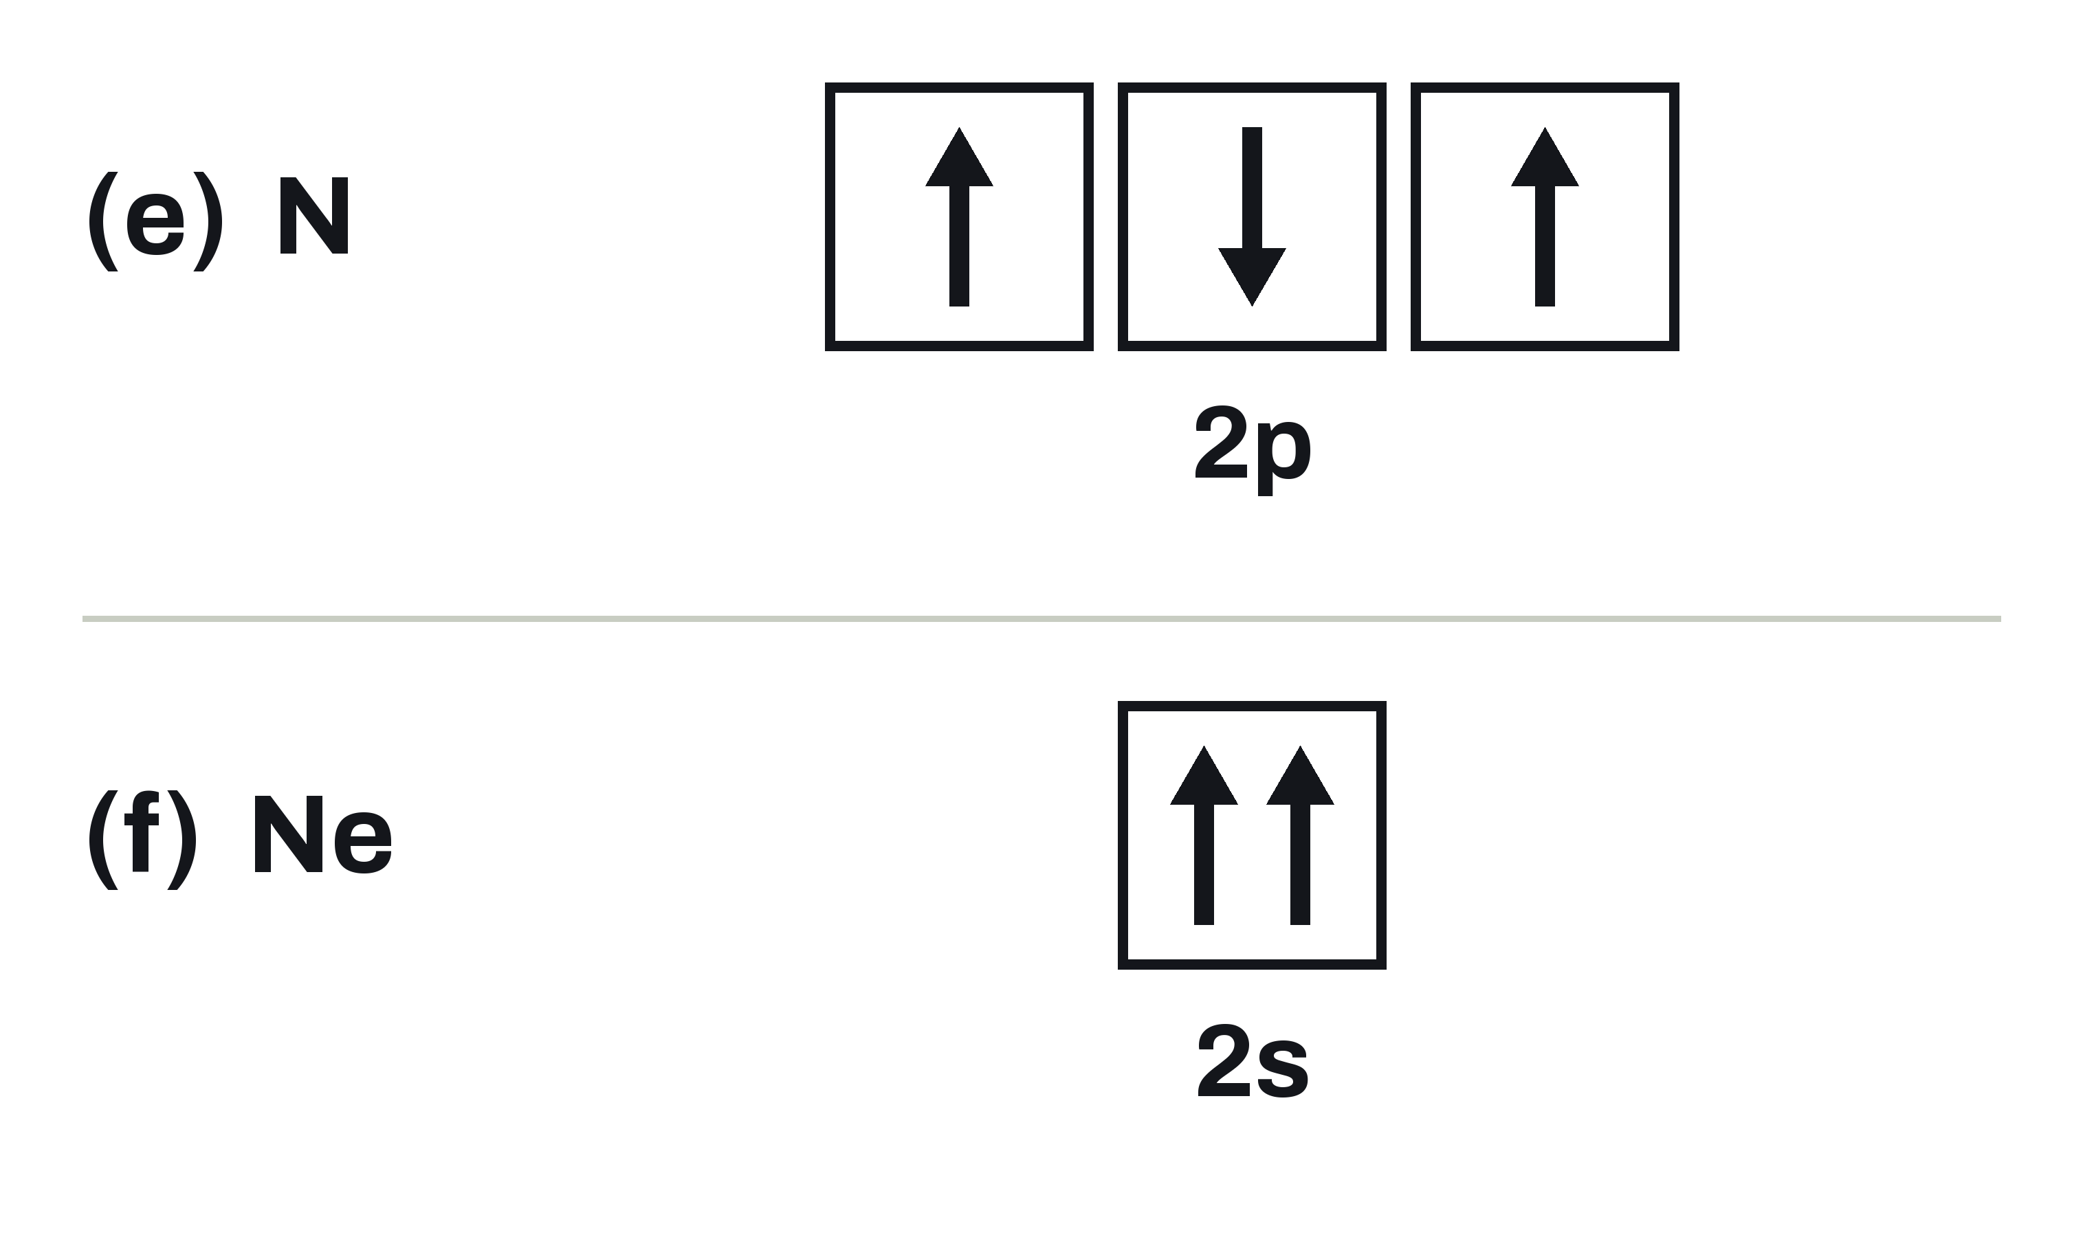
Example: Spot the Mistake, Diagrams
UNIT 02 • CHEMISTRY
Two orbital diagrams. Each breaks a different rule.
(E) NITROGEN, Z = 7
Only the three 2p boxes are drawn.
(F) NEON, Z = 10
Only the 2s box is drawn.
YOUR JOB
Name the broken rule. Redraw it correctly.
U02 • S02.3
Notes:
Orbital-diagram errors (brief items c, d), labelled (e) and (f) here. (e) N 2p drawn up, down, up: three singles but not parallel. (f) Ne 2s drawn up, up in one box: Pauli. Ask which rule each breaks and what the fix looks like.

Slide 25
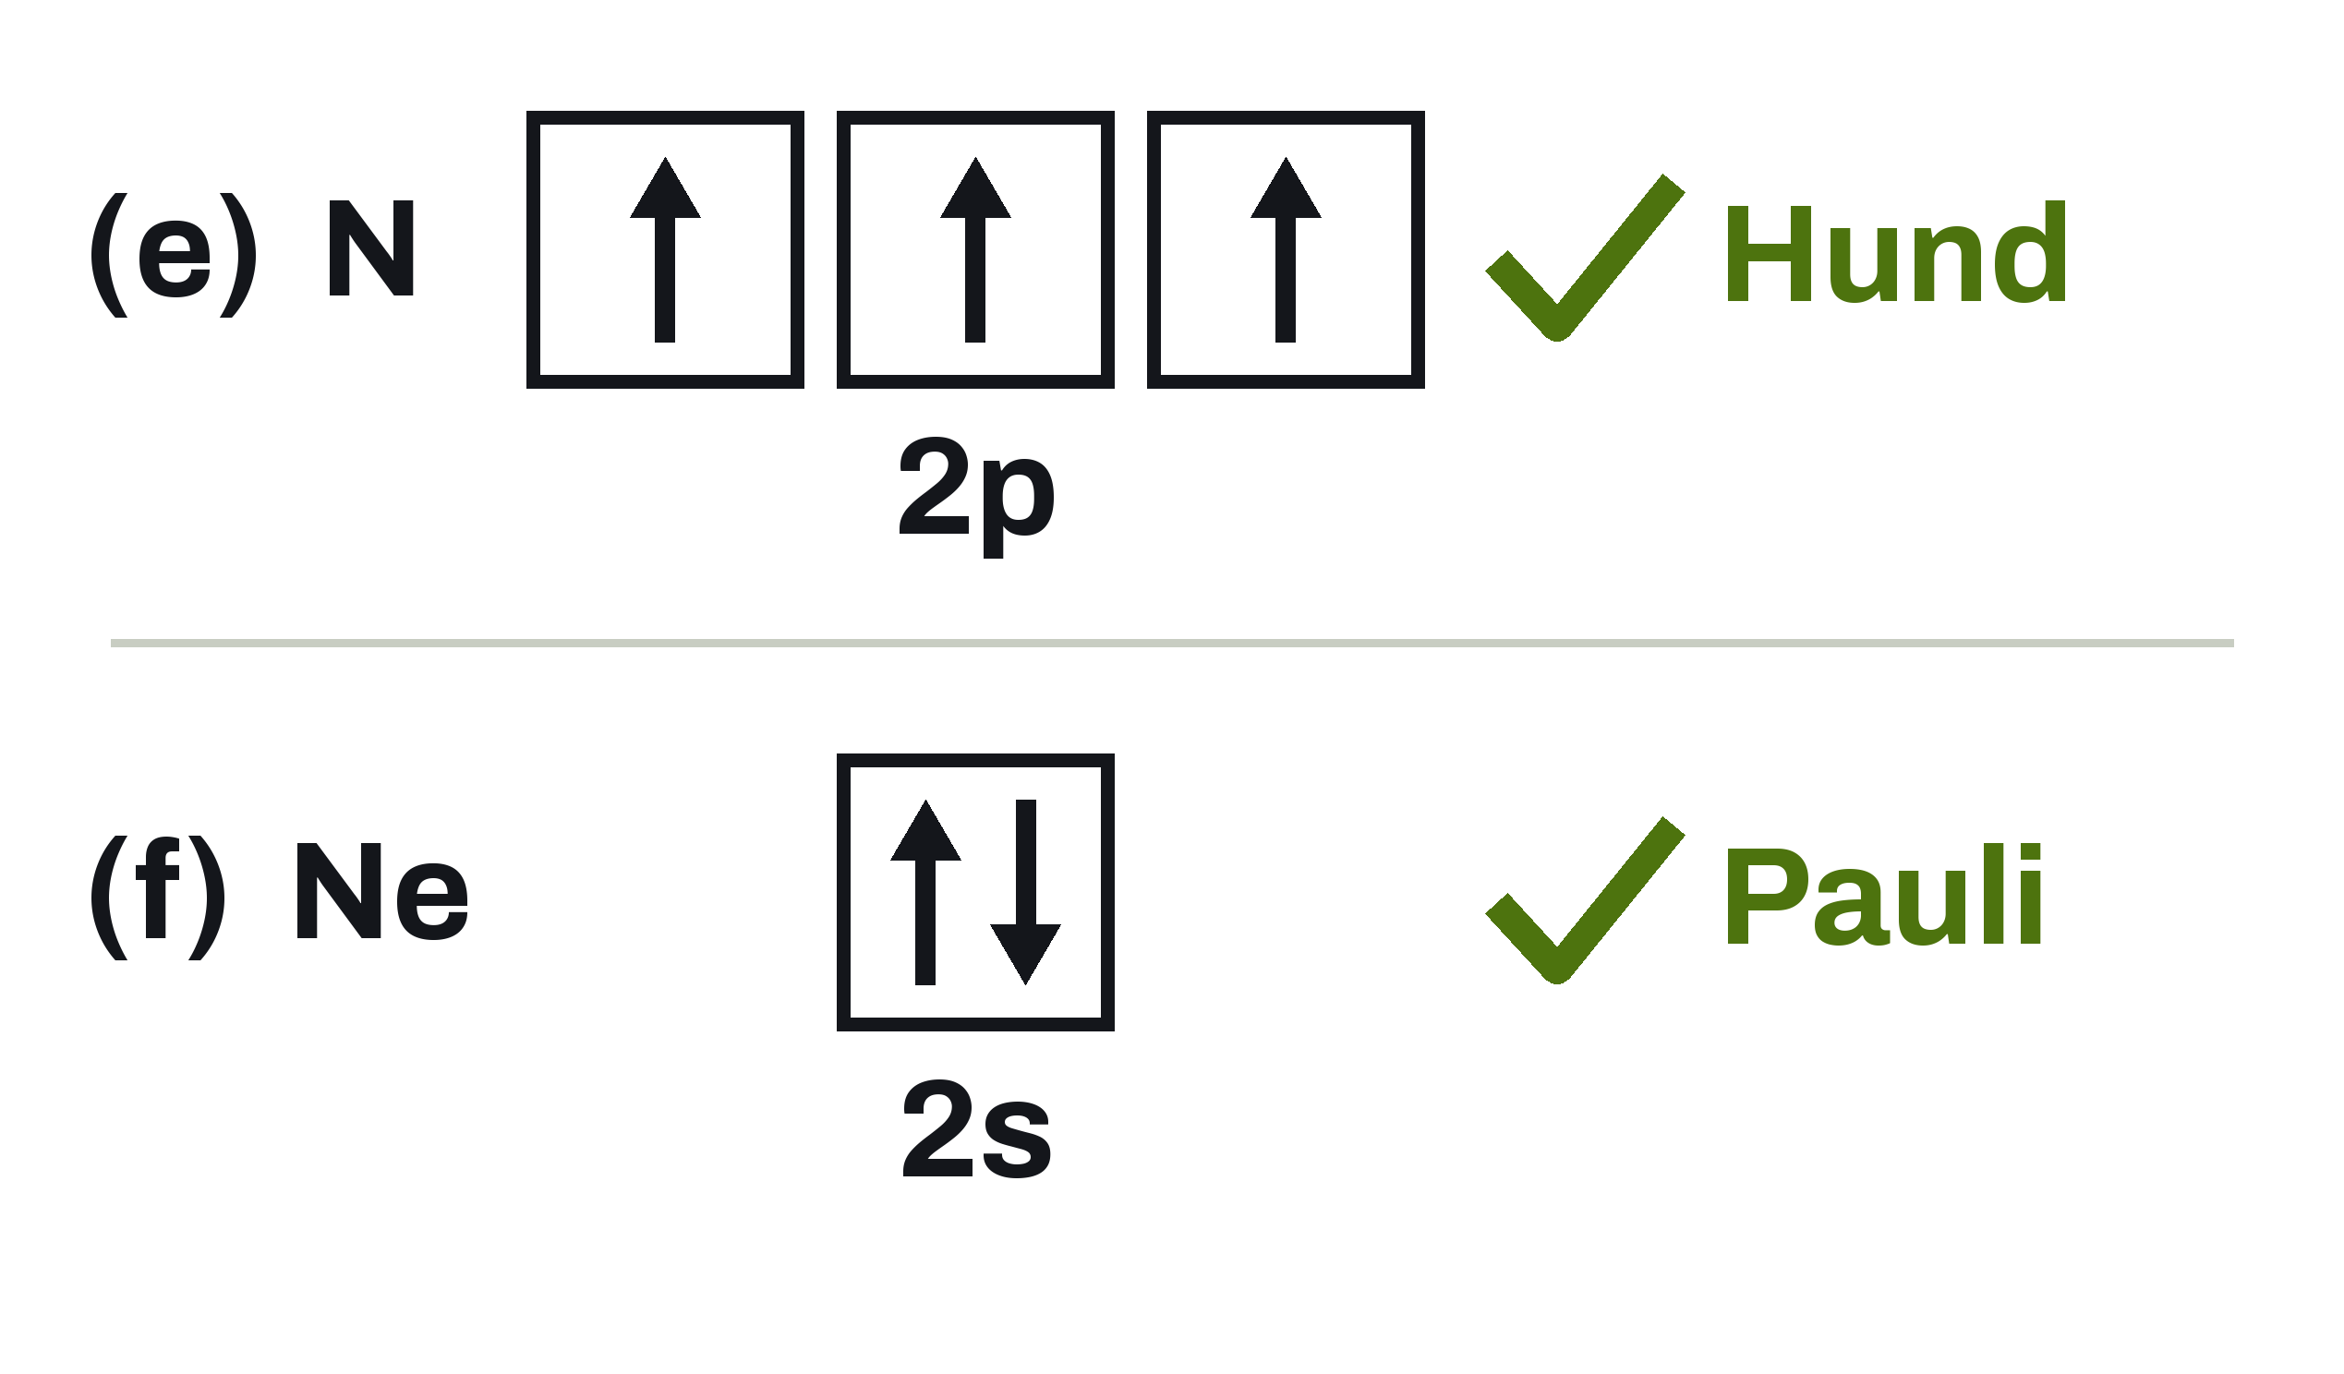
Spot the Mistake, Diagrams, Worked
UNIT 02 • CHEMISTRY
One Hund error and one Pauli error. The fixes are drawn at left.
WHAT IS WRONG
(e) Hund: spins differ
(f) Pauli: same spin
Fixed:
(e) 2p: up, up, up
(f) 2s: up, down
Hund: singles first, all spins the same. Pauli: two in one orbital must be opposite.
U02 • S02.3
Notes:
(e) Hund: unpaired electrons need parallel spins. Correct N 2p: up, up, up. (f) Pauli: two electrons in one orbital must have opposite spins. Correct Ne 2s: up, down. The brief's other Hund error (pair, single, empty) is the WRONG row on the Hund slide earlier in this deck.

Slide 26
Check Yourself
UNIT 02 • CHEMISTRY
Work all three in your notes before we compare.
PHOSPHORUS, Z = 15
SULFUR, Z = 16
COPPER, Z = 29
Write the longhand configuration.
Write the shorthand and sketch the 3p boxes.
Write the actual shorthand. Say why it is an exception.
Show the electron sum for each one. If it is not Z, find the error.
U02 • S02.3
Notes:
Answers (re-derived). P, Z = 15: 1s^2 2s^2 2p^6 3s^2 3p^3, 2+2+6+2+3 = 15, 3 unpaired. S, Z = 16: [Ne] 3s^2 3p^4, 10+2+4 = 16; 3p boxes: one pair and two singles, 2 unpaired. Cu, Z = 29: [Ar] 4s^1 3d^10, 18+1+10 = 29. Exception: replay the Copper click build (slide 'Exception: Copper'): the rules predict [Ar] 4s^2 3d^9, one 4s electron moves into 3d, and the filled 3d lowers the atom's total energy slightly. That is the simplified reason from the Why slide (4s and 3d are close in energy); it does not predict every exception, so do not accept 'full is always more stable'. Image prompt (aside slot): a pencil and a blank sheet of lined paper on a lab bench.

Slide 27
Where This
Goes Next
LOOKING AHEAD
Next: valence electrons, and the configurations of ions.
U02 • S02.3
Notes:
Looking ahead: next is valence electrons and ion configurations (S2.4). Image prompt (divider slot): an empty lab stool at a long bench, window light across the floor.

