Slide 1

ECE595: Power Converters for AC Systems
Lecture 20
(… Other multilevel Configurations
and Optimized PWM)
Prof. Euzeli Dos Santos

Slide 2
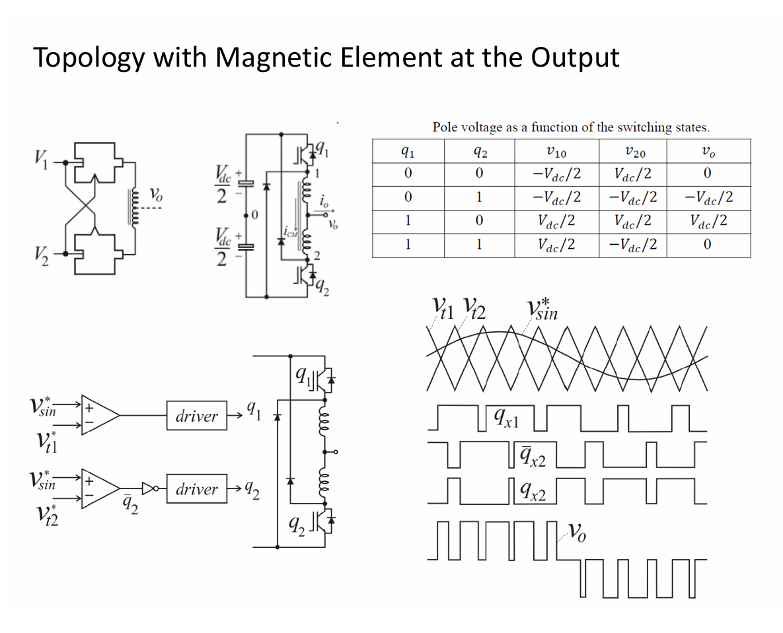
Peak: 50 V
Period: 1 ms

Slide 3
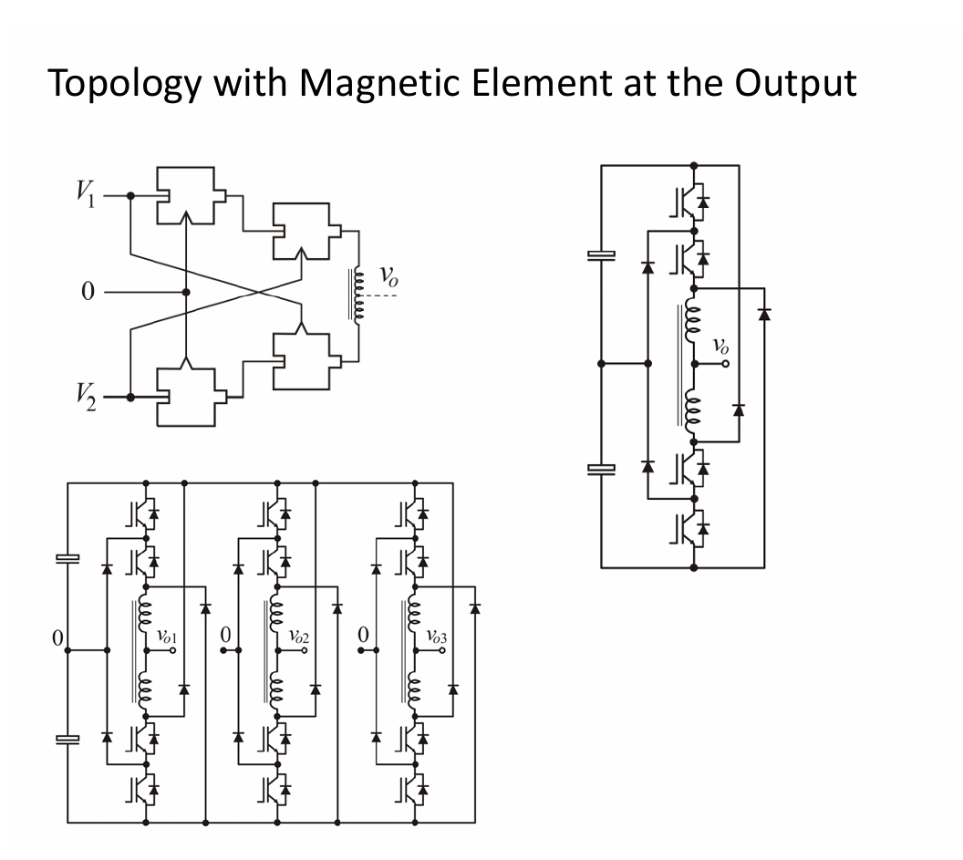
Peak: 50 V
Period: 1 ms

Slide 4
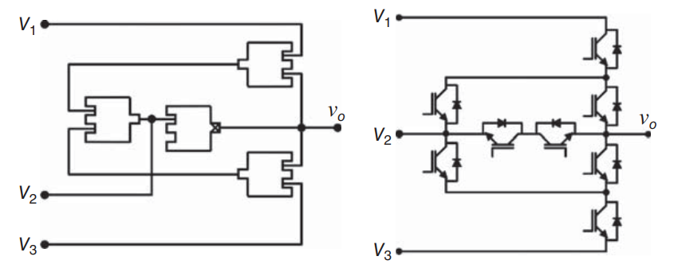
More Multilevel Converters

Slide 5
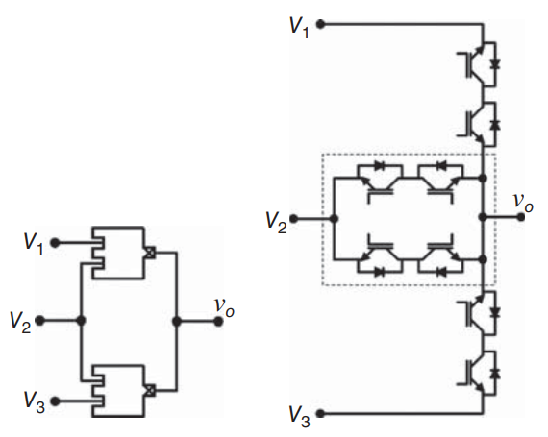
More Multilevel Converters
Peak: 50 V
Period: 1 ms

Slide 6
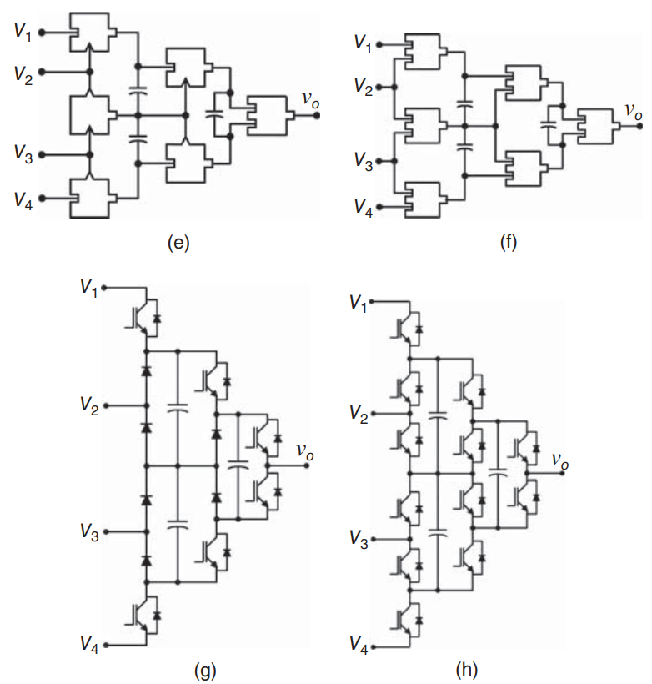
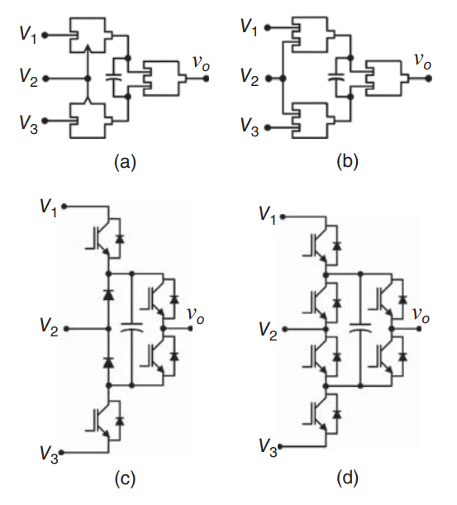
More Multilevel Converters
Peak: 50 V
Period: 1 ms

Slide 7
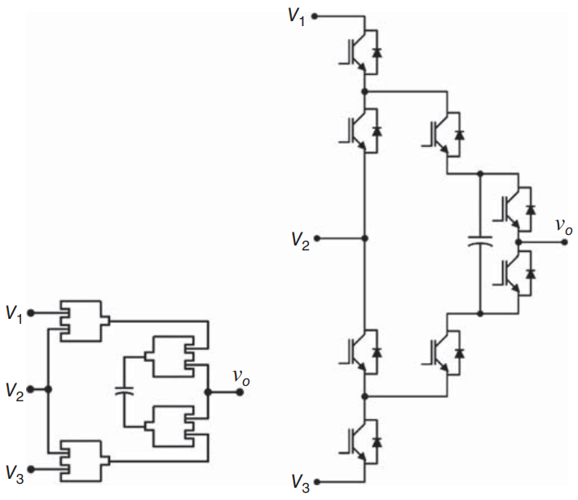
More Multilevel Converters

Slide 8
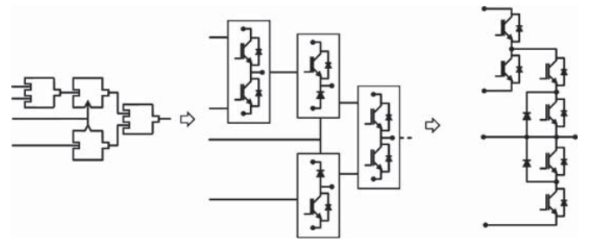
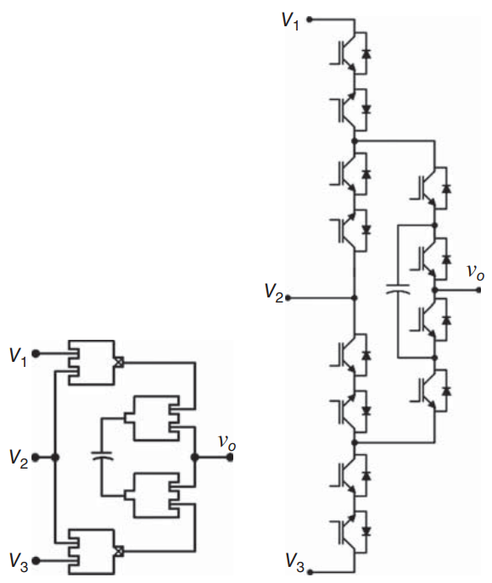
More Multilevel Converters

Slide 9
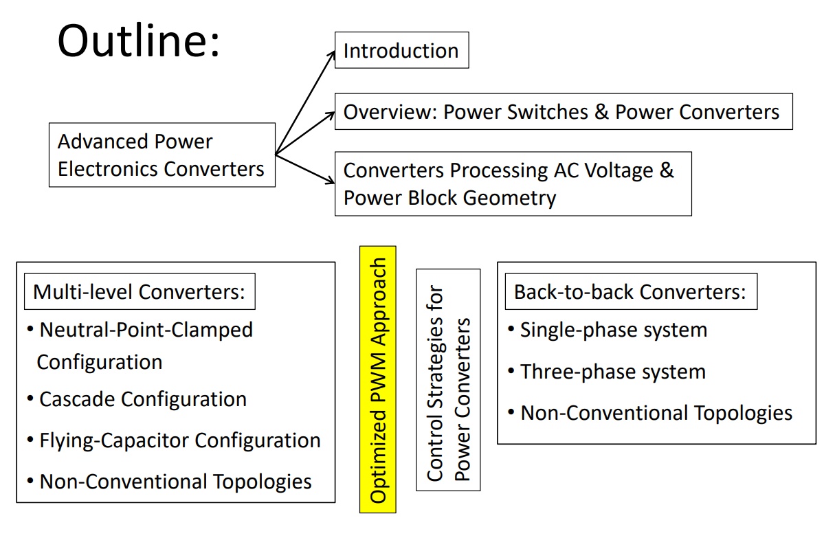

Slide 10
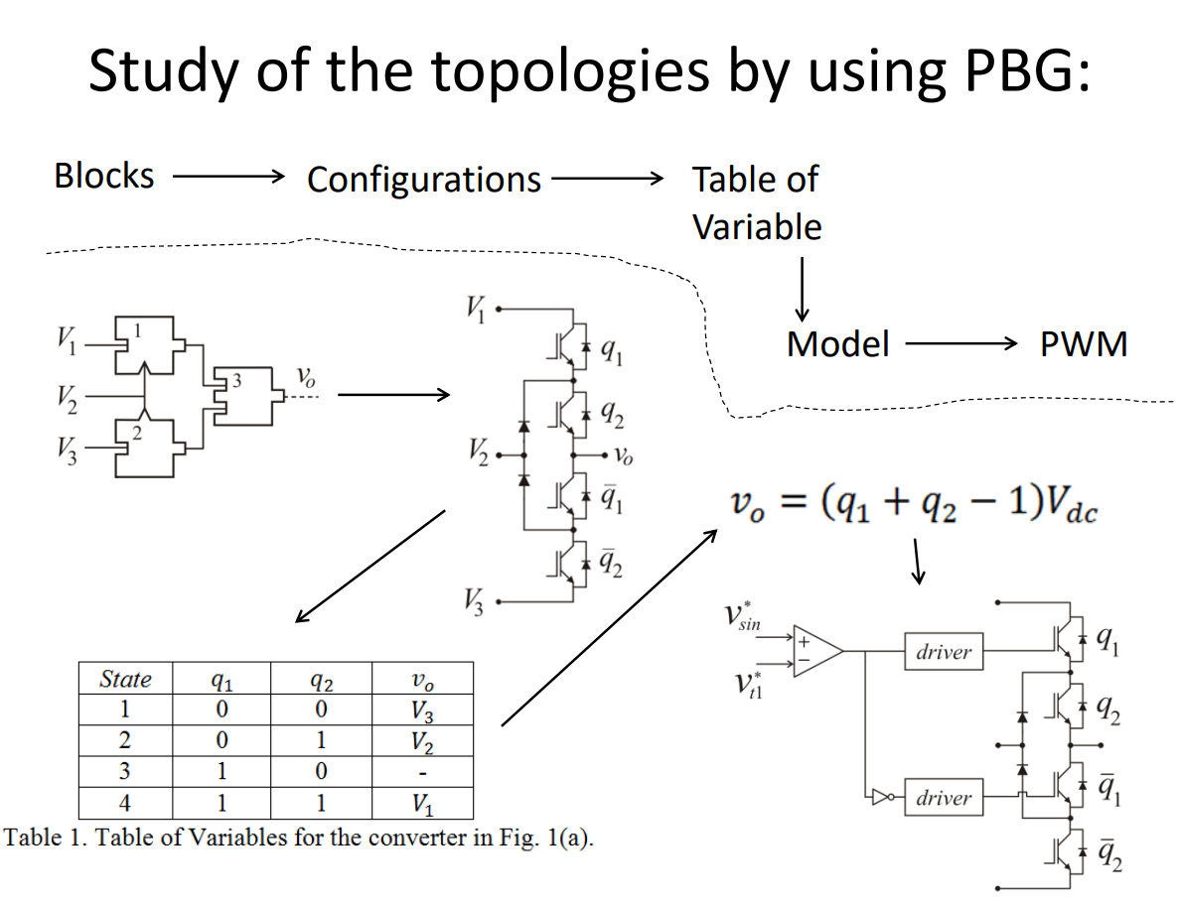

Slide 12
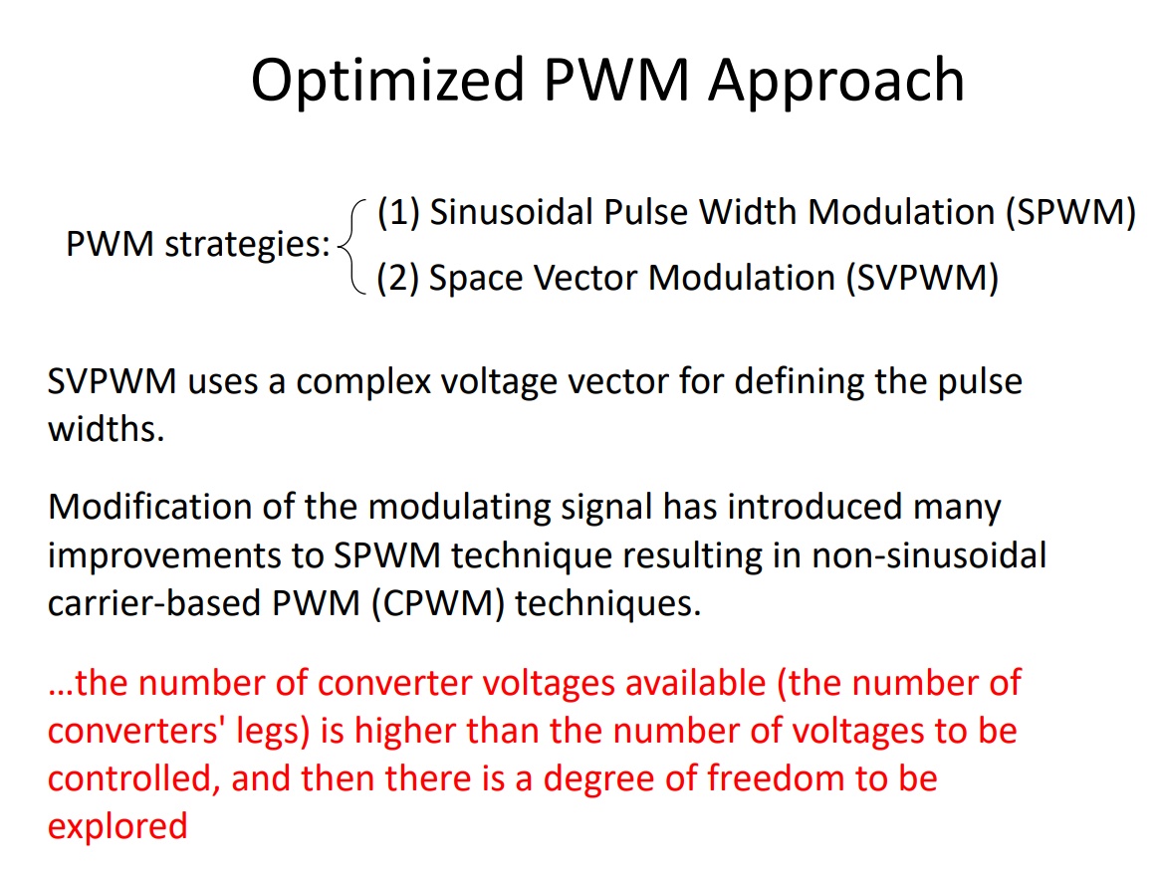

Slide 13
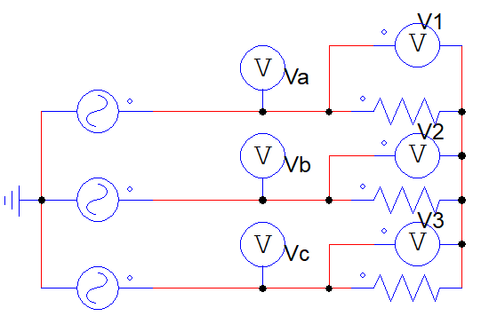
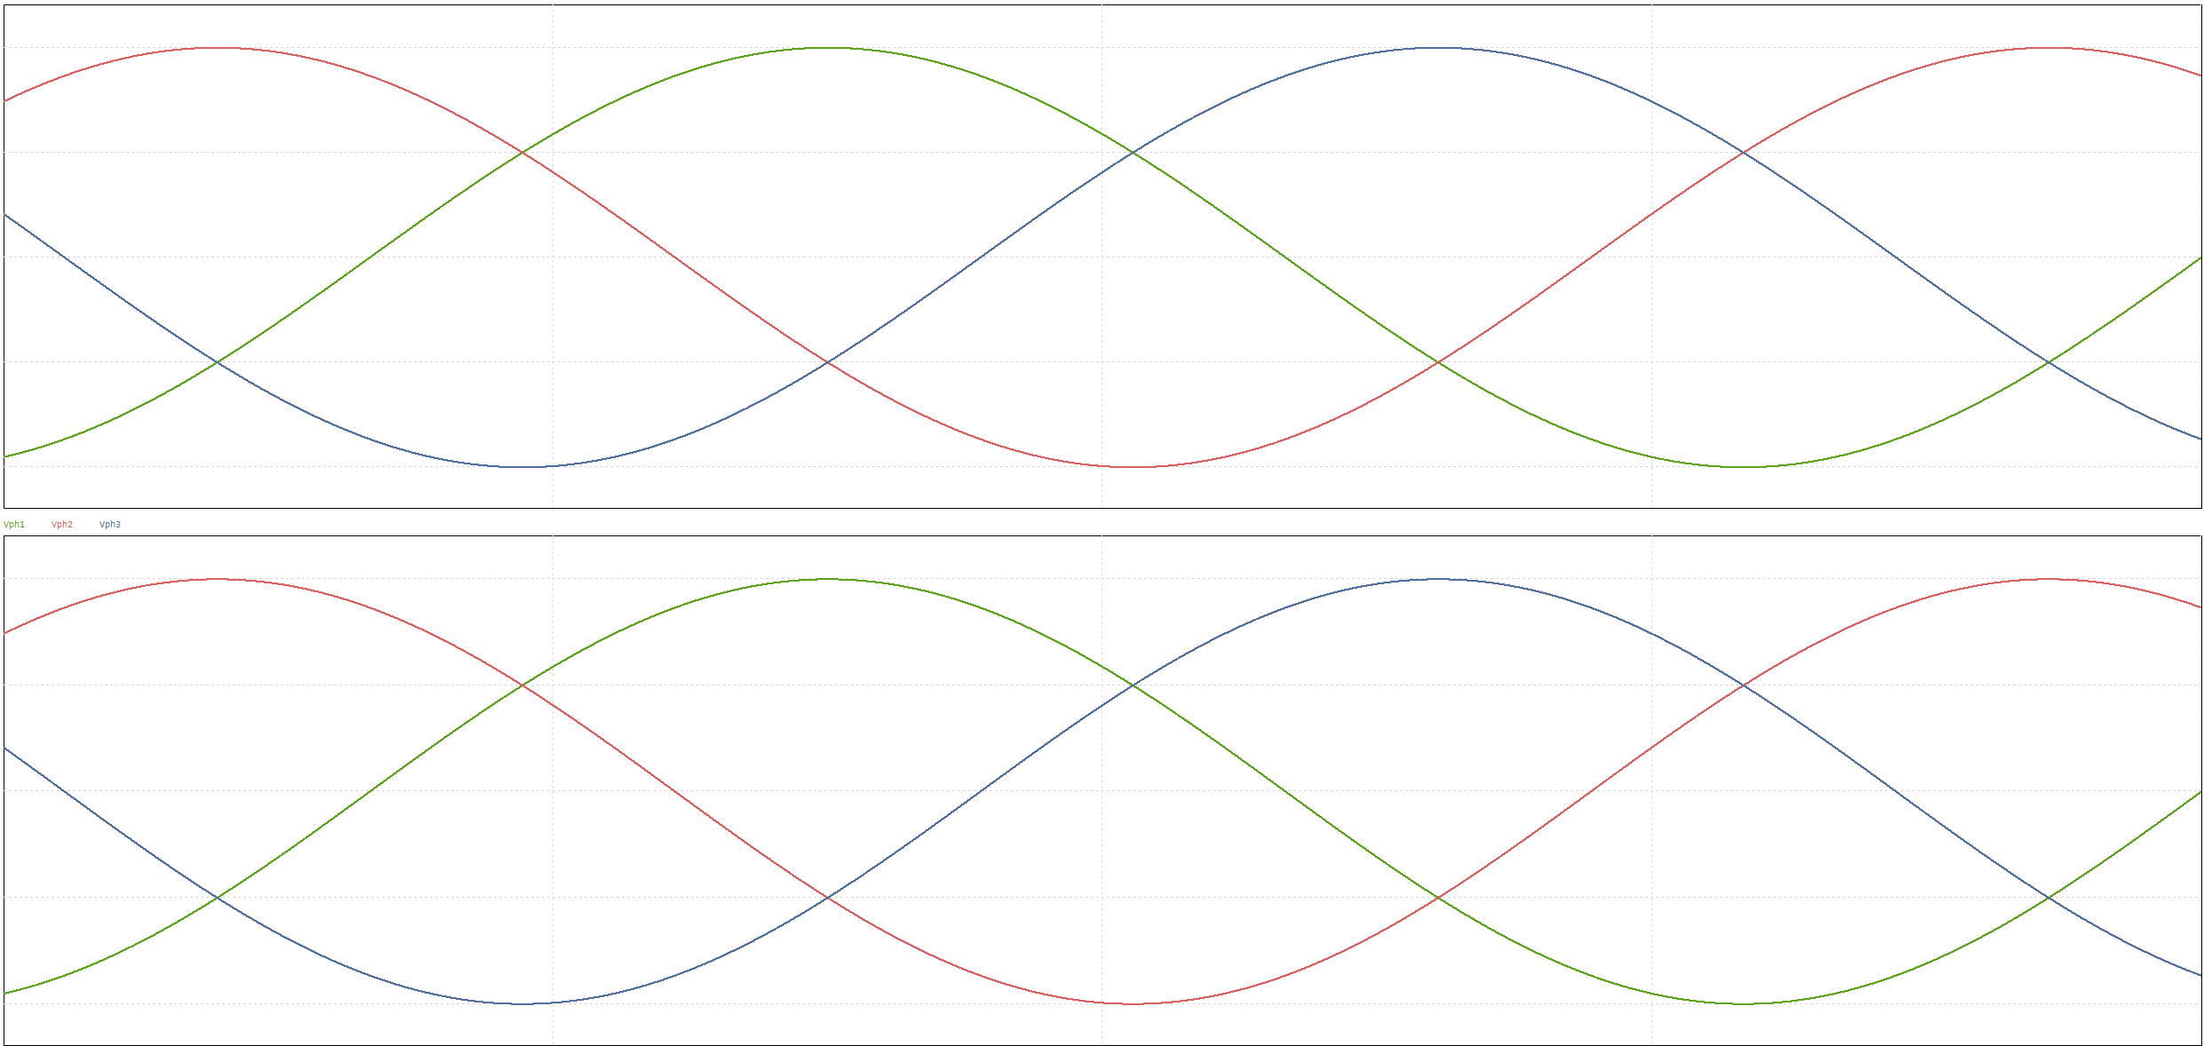
Peak: 50 V
Period: 1 ms

Slide 14
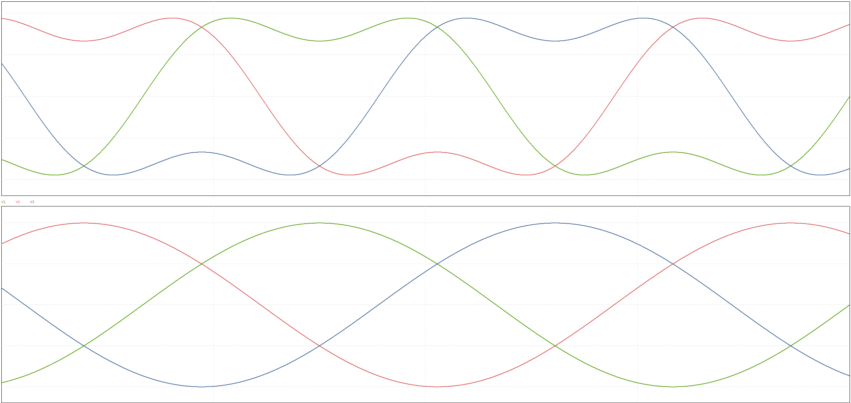
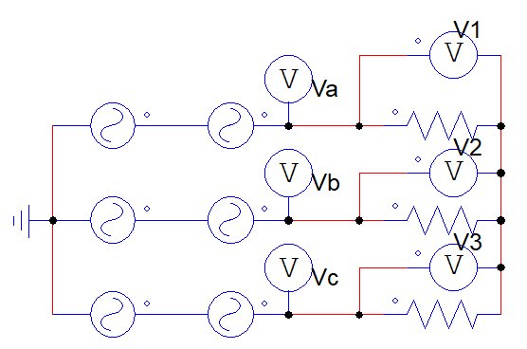
Peak: 50 V
Period: 1 ms

Slide 15
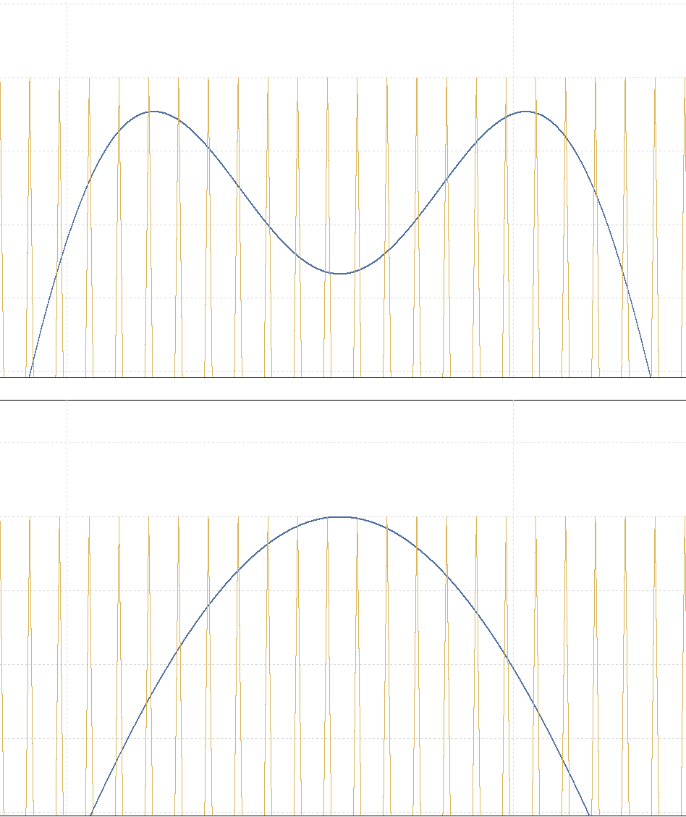
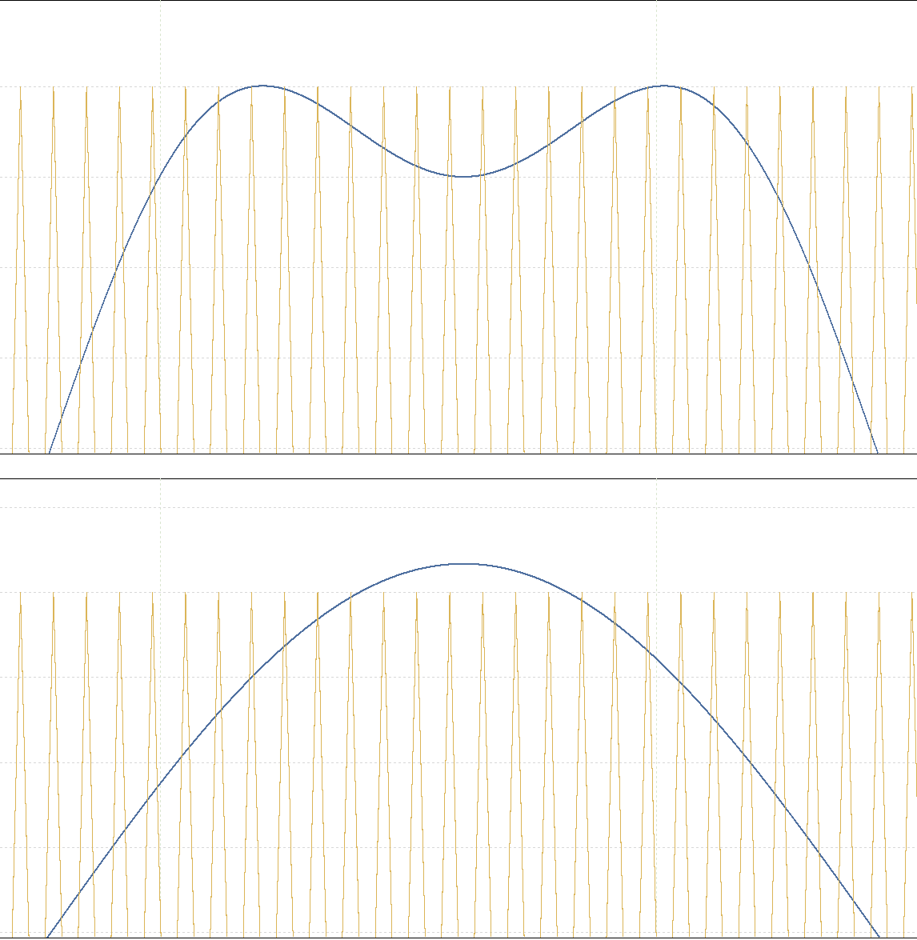
Peak: 50 V
Period: 1 ms

Slide 16
Peak: 50 V
Period: 1 ms

Slide 17
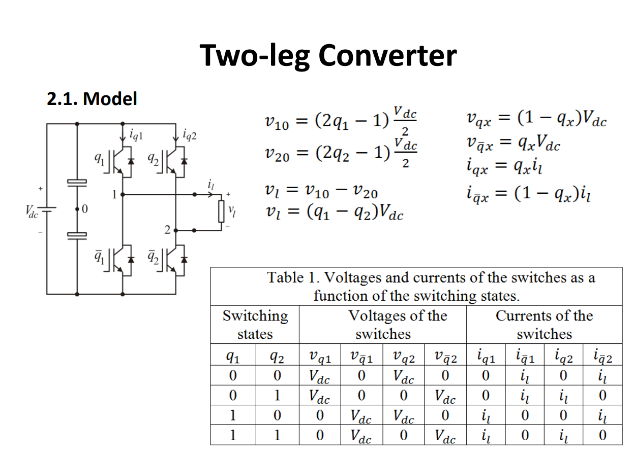
Peak: 50 V
Period: 1 ms

Slide 18
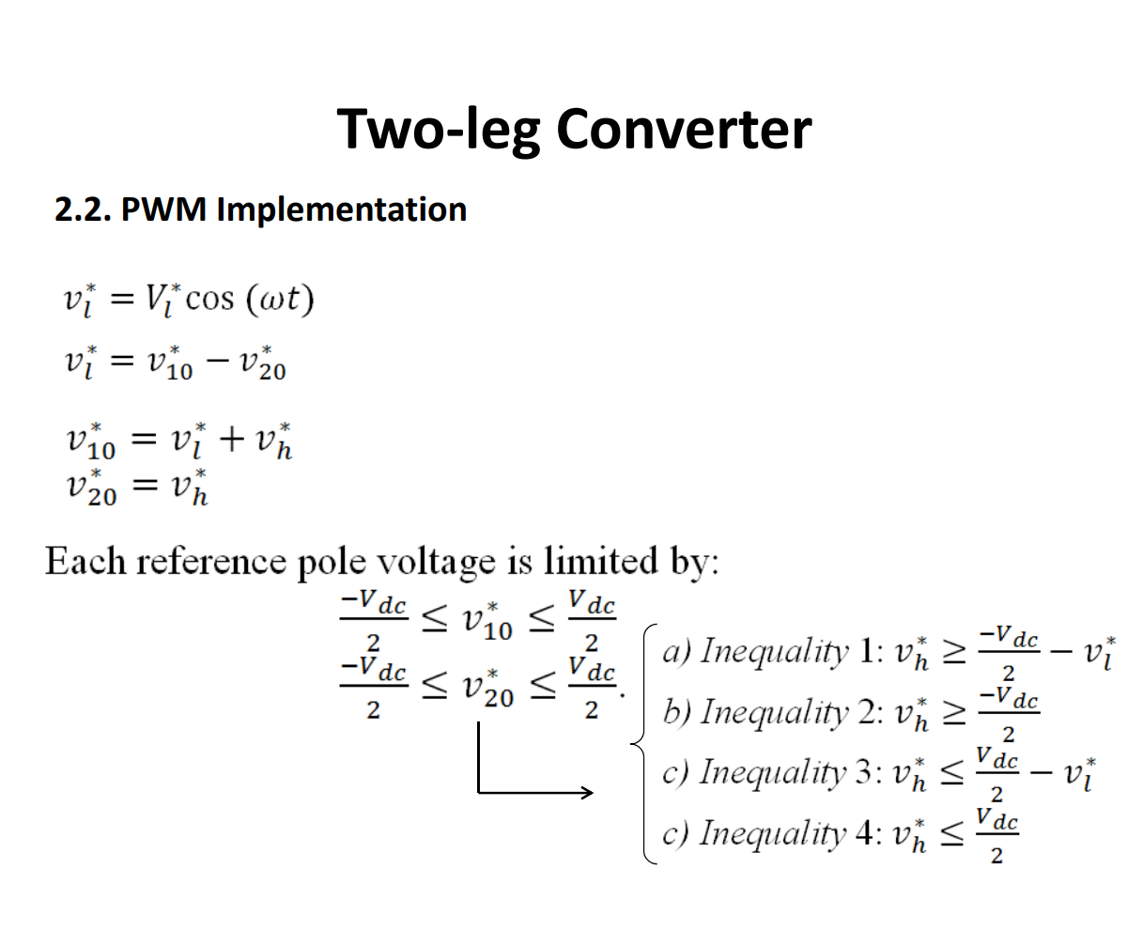
Peak: 50 V
Period: 1 ms

Slide 19
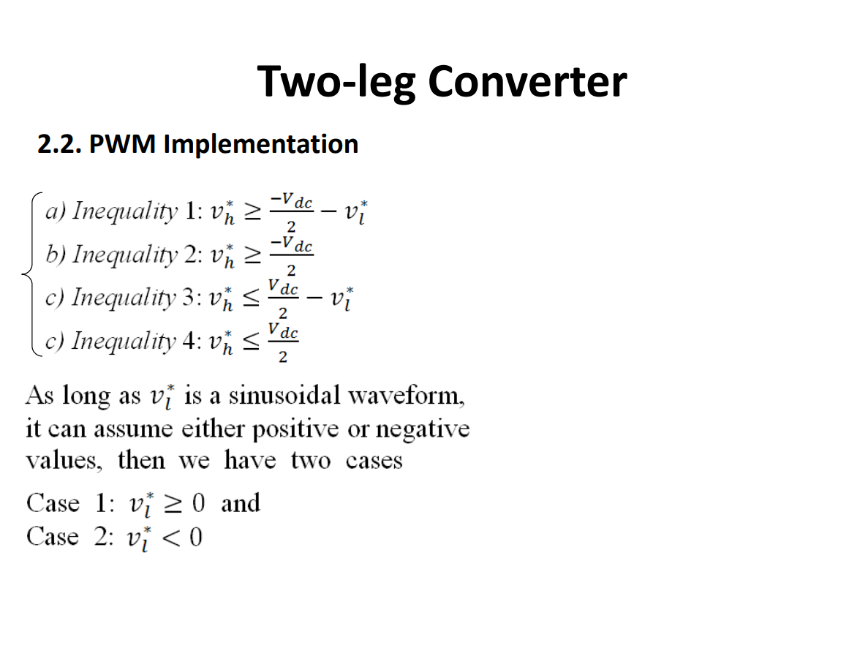
Peak: 50 V
Period: 1 ms

Slide 20
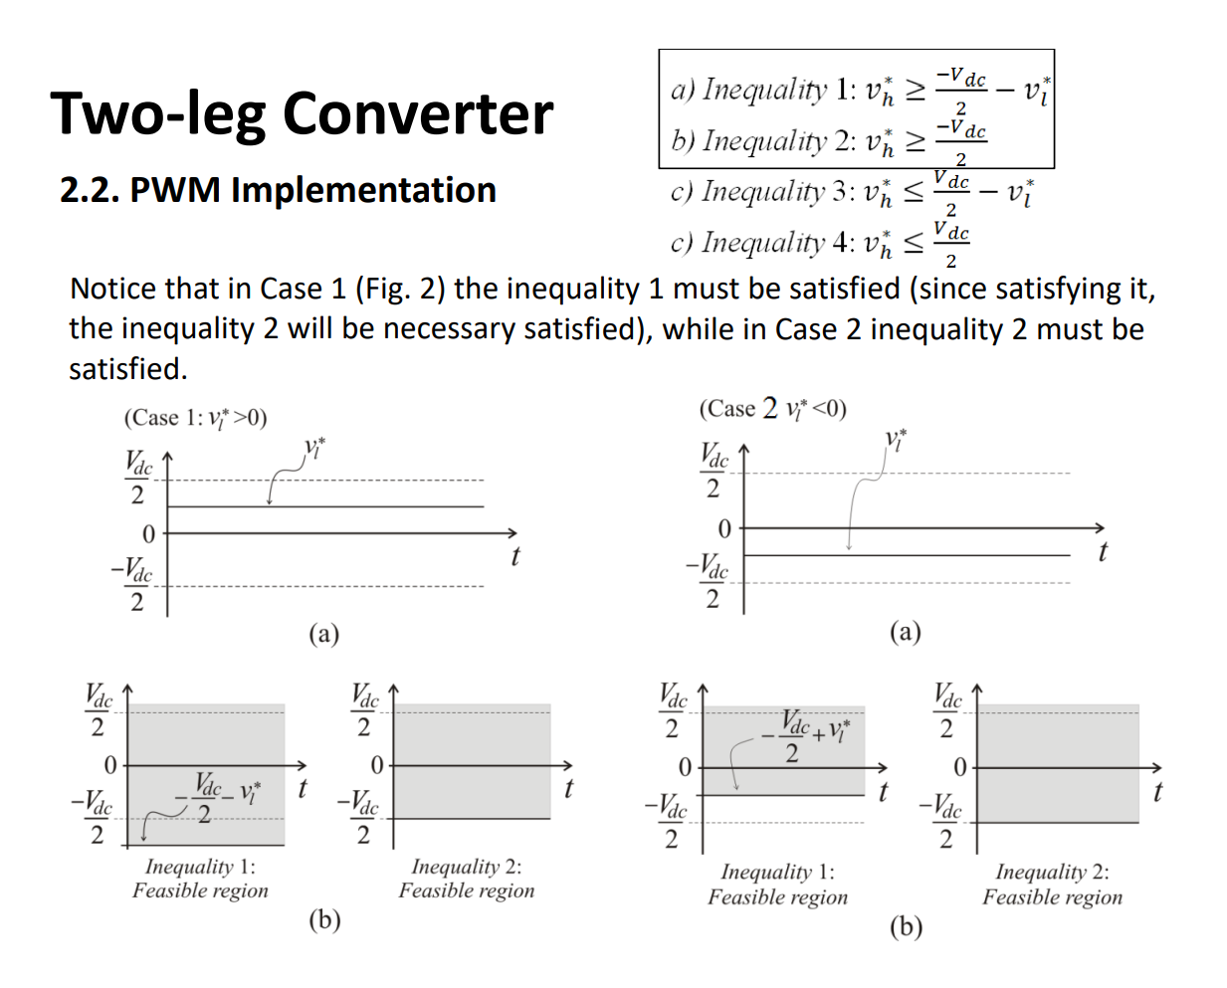
2
1
1
Peak: 50 V
Period: 1 ms

Slide 21
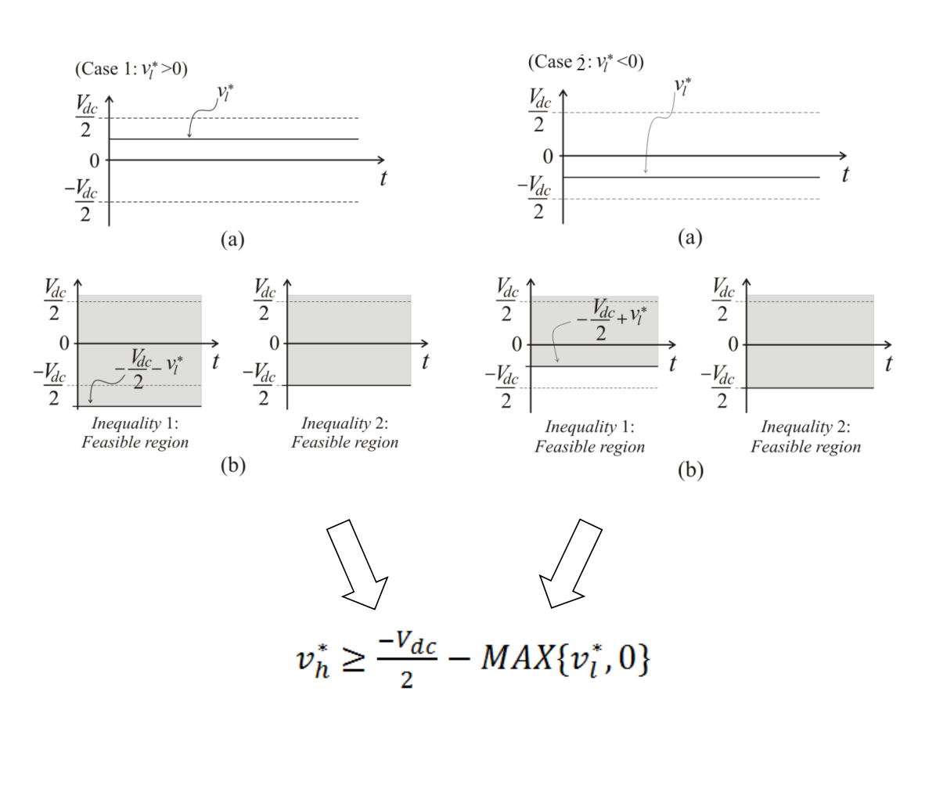
Peak: 50 V
Period: 1 ms
MIN

Slide 22
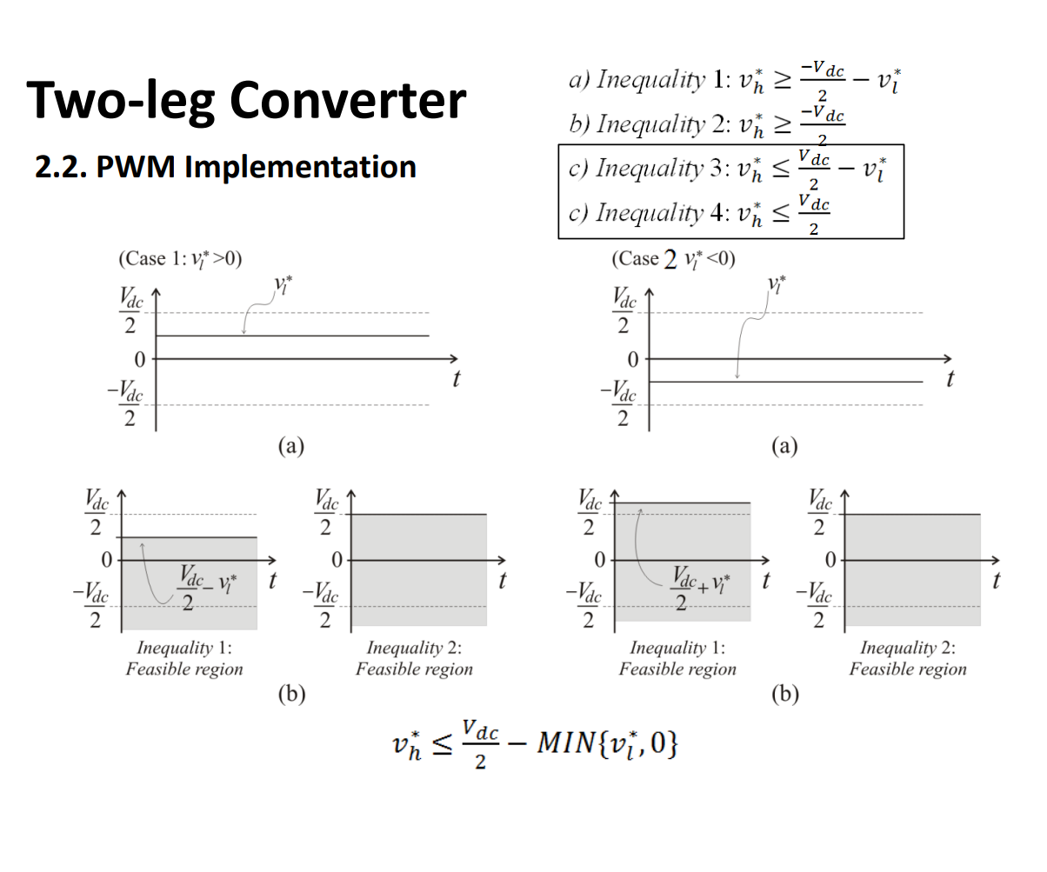
Peak: 50 V
Period: 1 ms
-MAX{

Slide 23
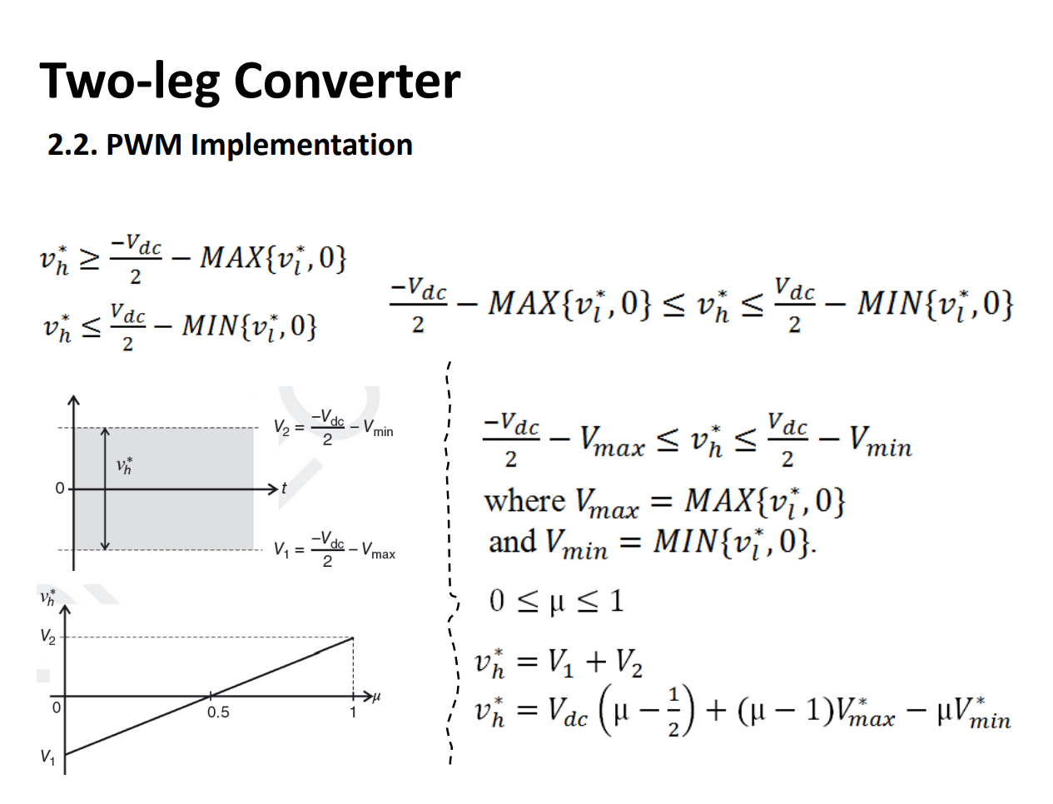
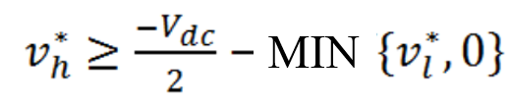





The Concept of Distribution Ratio and Its Use
Peak: 50 V
Period: 1 ms
$$V_{min}$$
$$V_{max}$$

Slide 24
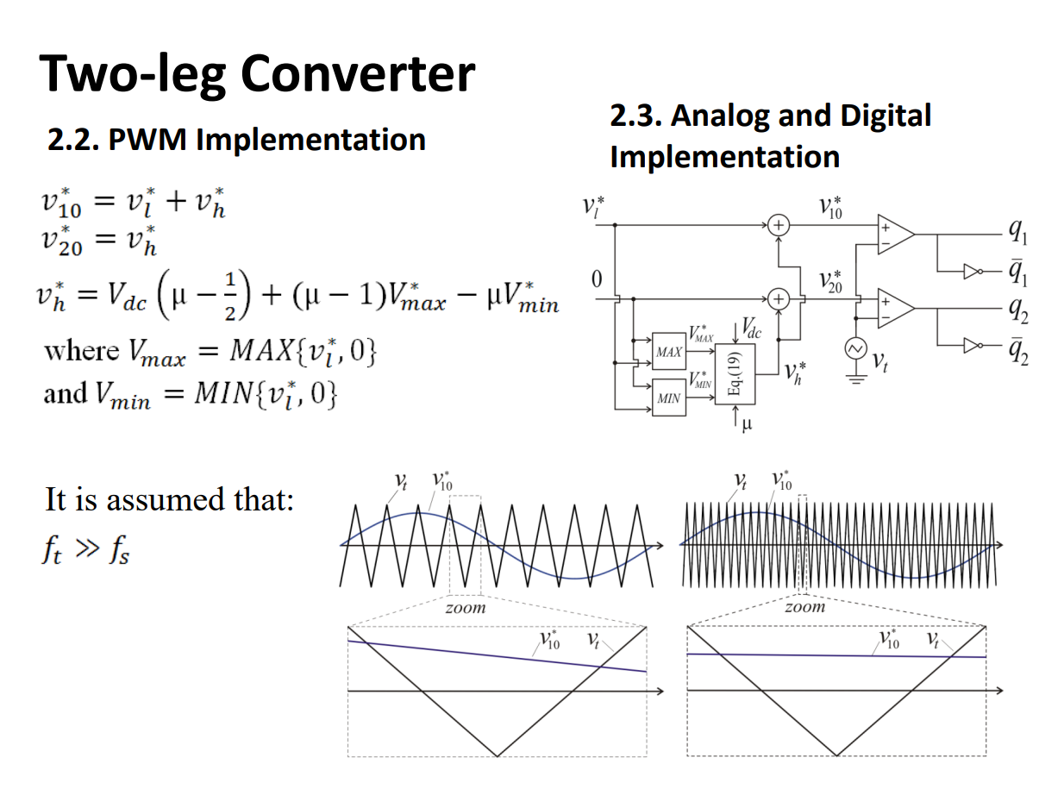

Peak: 50 V
Period: 1 ms

Slide 25
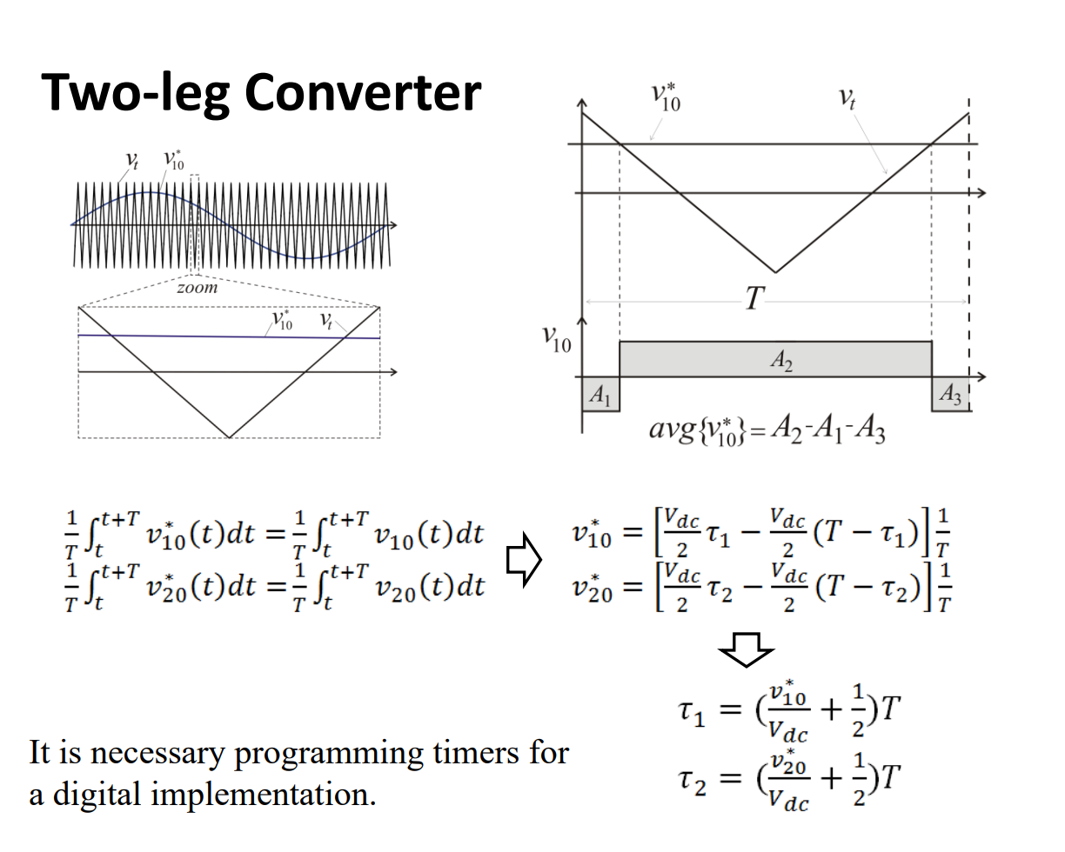
Peak: 50 V
Period: 1 ms

Slide 26
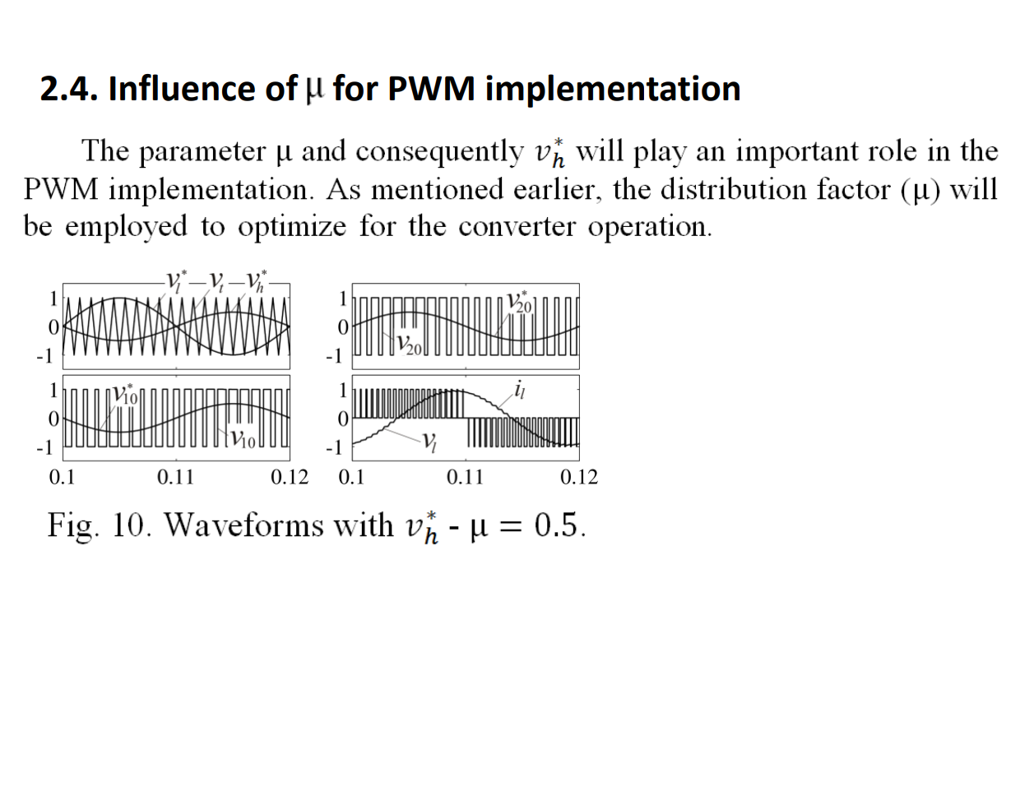
Peak: 50 V
Period: 1 ms

Slide 27
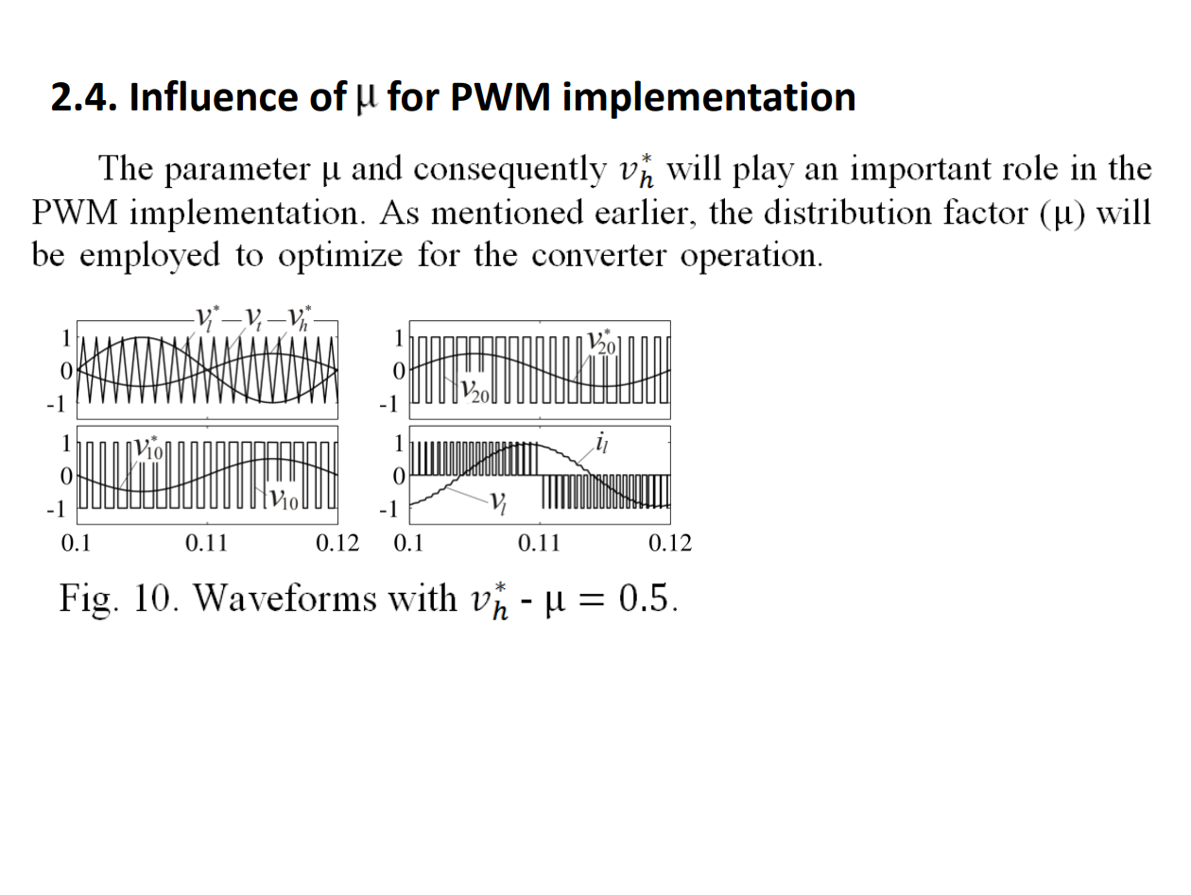
Peak: 50 V
Period: 1 ms

Slide 28
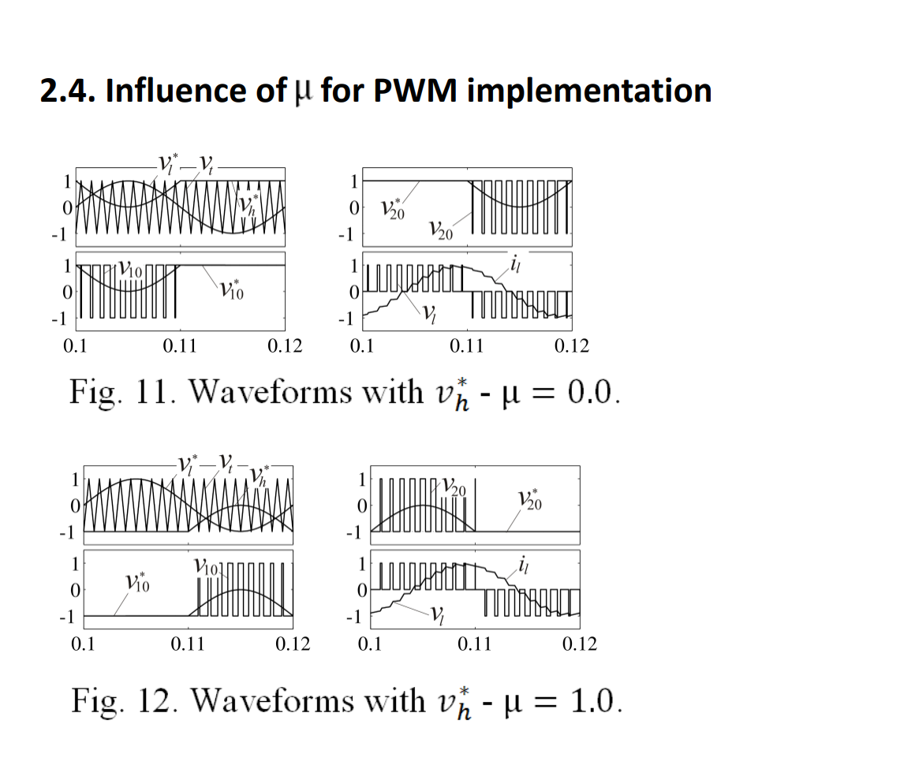
Peak: 50 V
Period: 1 ms

Slide 29
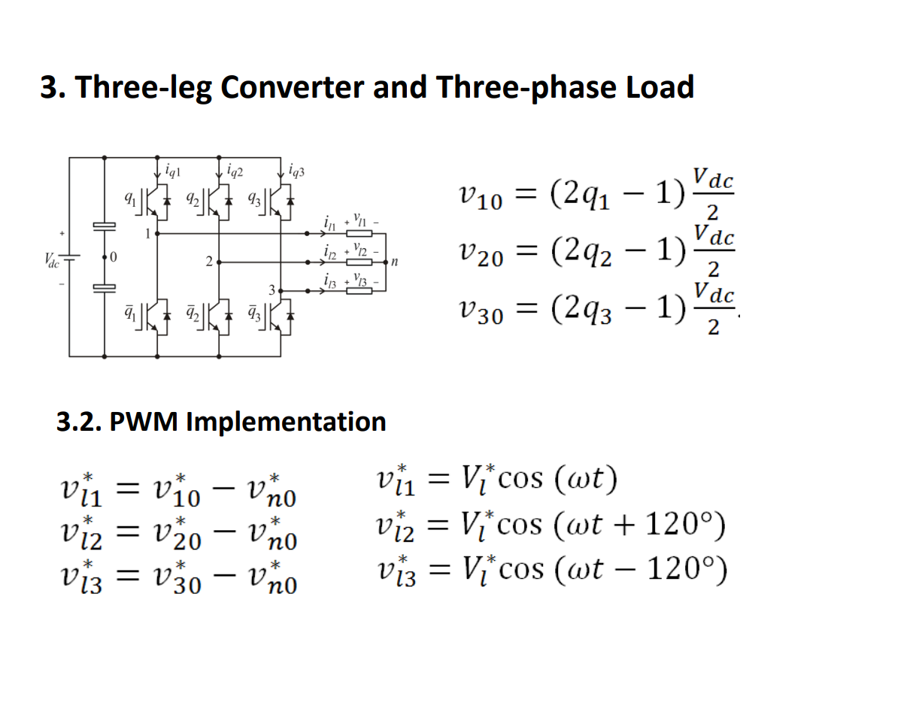
Peak: 50 V
Period: 1 ms

Slide 30
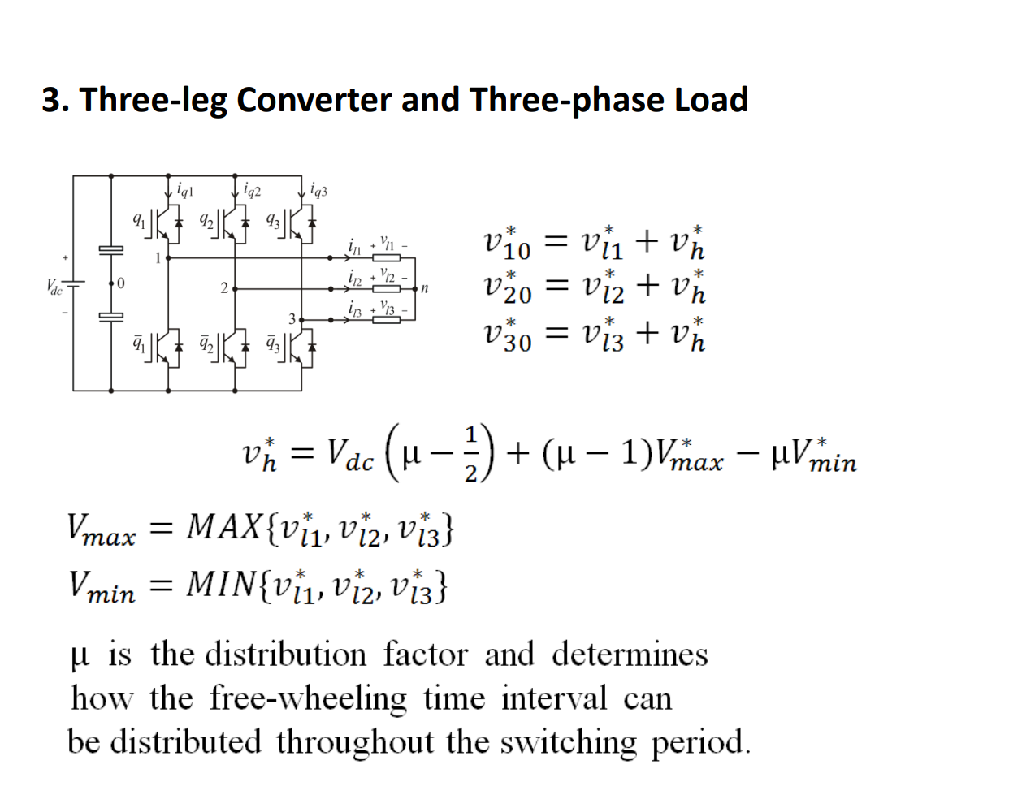
Peak: 50 V
Period: 1 ms

Slide 31
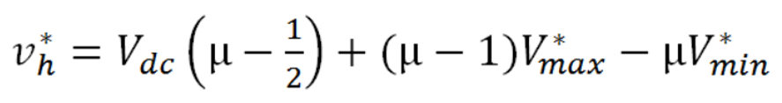
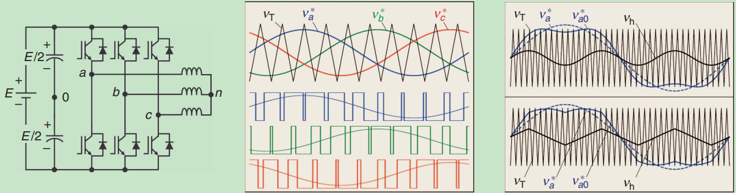
Peak: 50 V
Period: 1 ms

Slide 32

The Concept of Distribution Ratio
When a zero-sequence component is added to each sinusoidal reference, new references are generated. Note that the time of active vectors remain unchanged

Slide 33
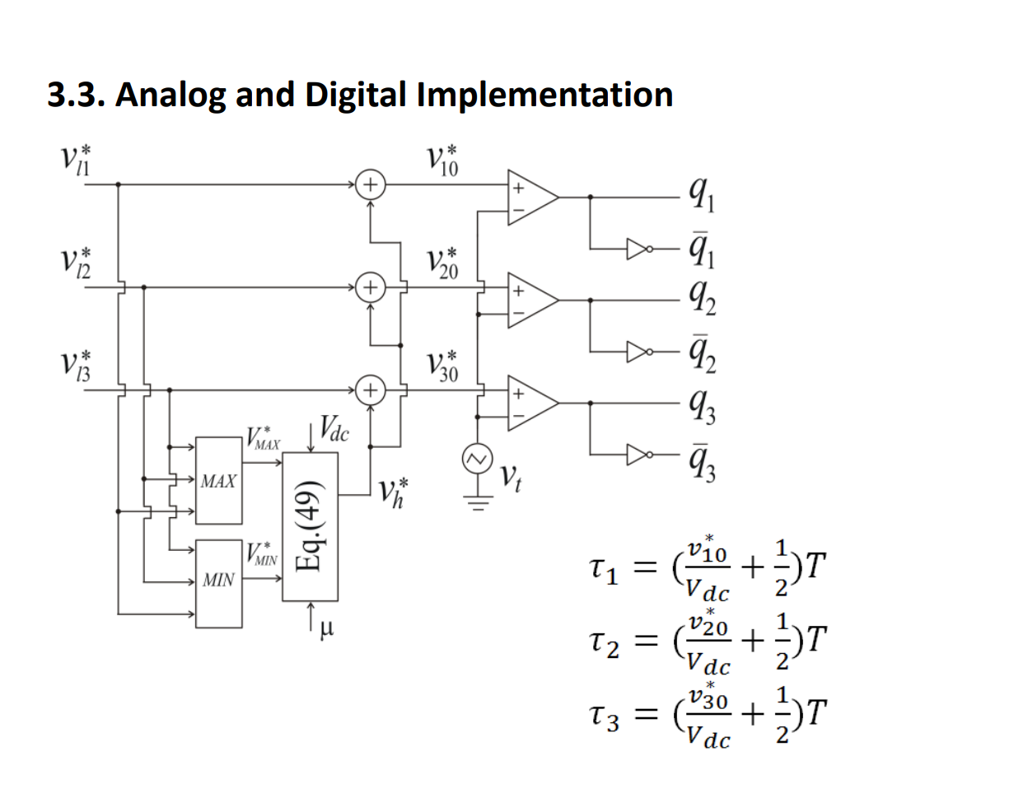
Peak: 50 V
Period: 1 ms

Slide 34
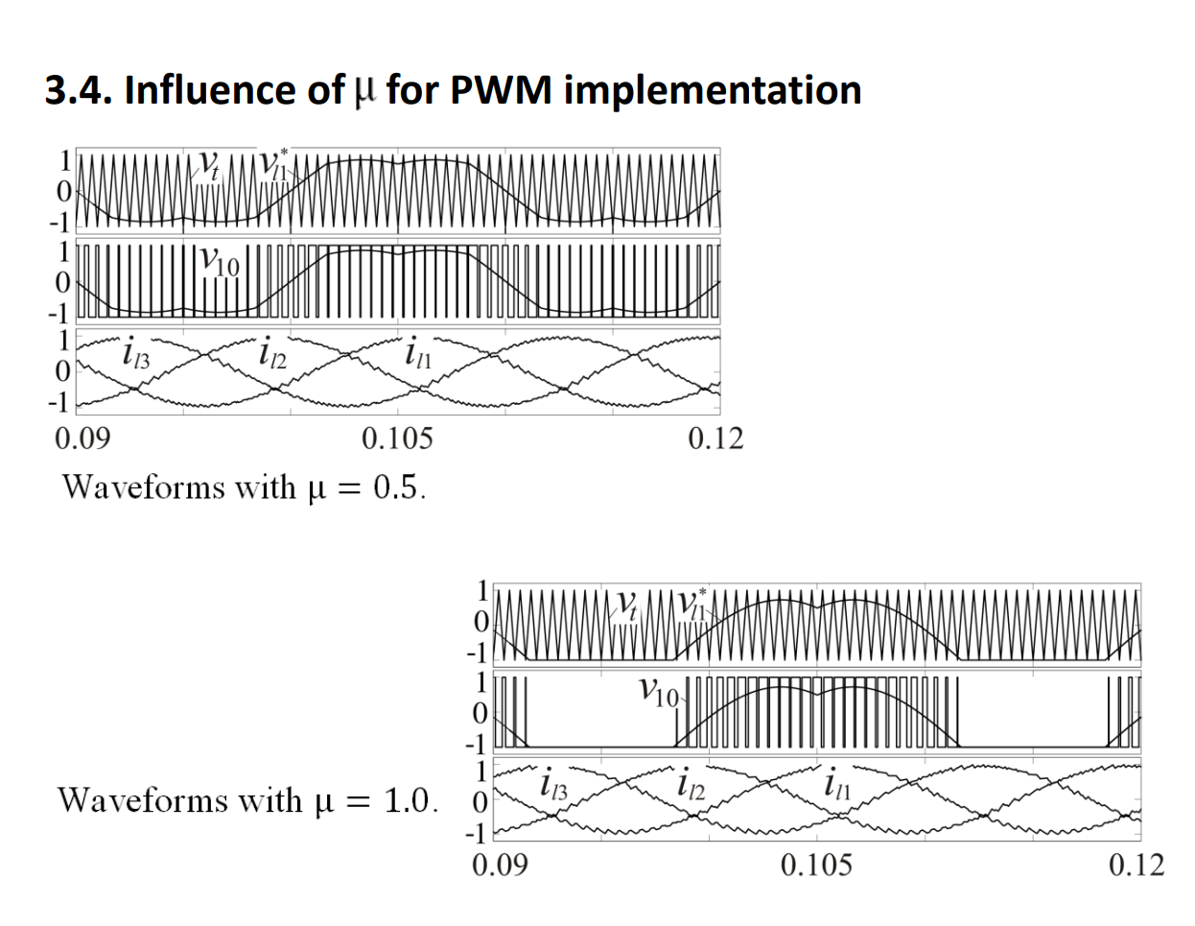
Peak: 50 V
Period: 1 ms

Slide 35
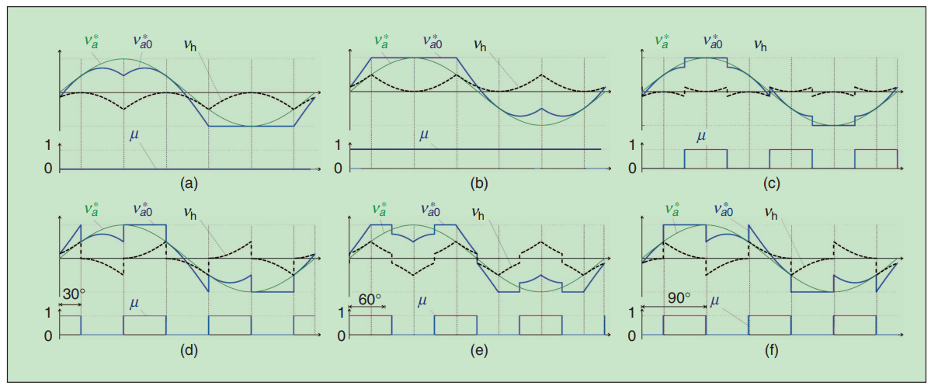
Peak: 50 V
Period: 1 ms

Slide 36
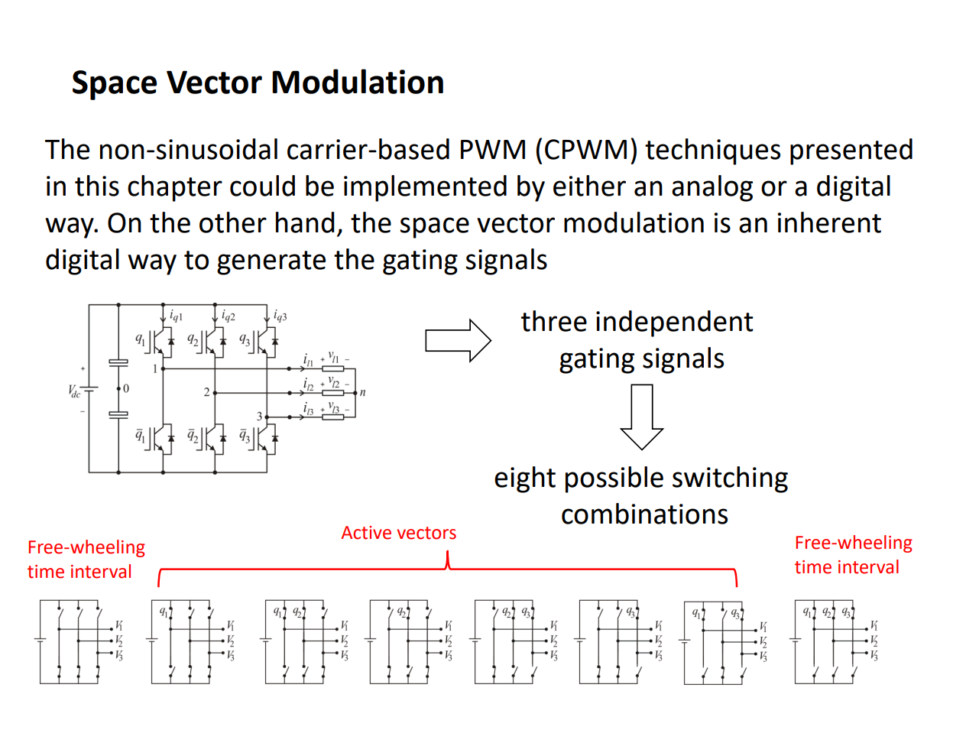
Peak: 50 V
Period: 1 ms

Slide 37
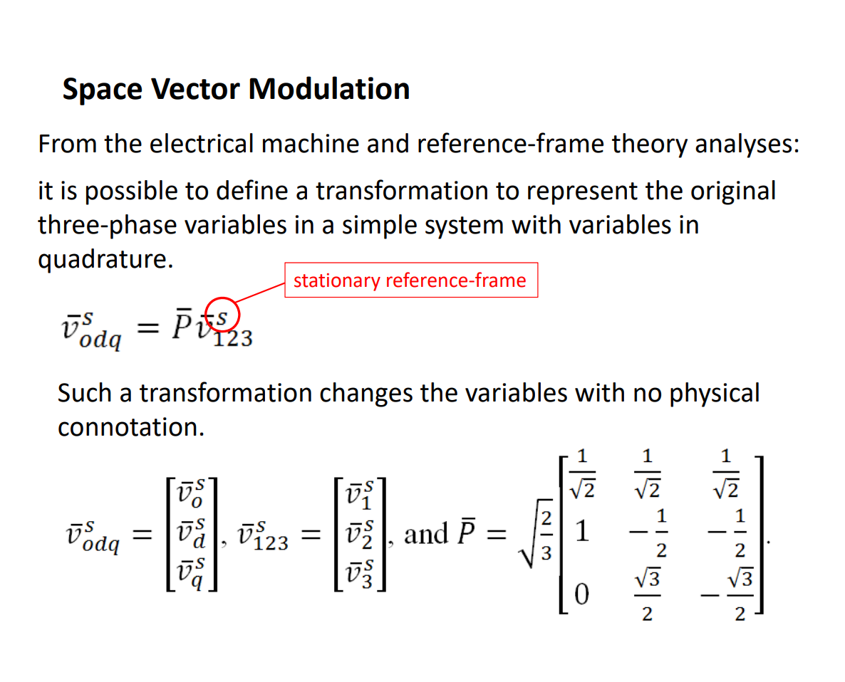
Peak: 50 V
Period: 1 ms

Slide 38
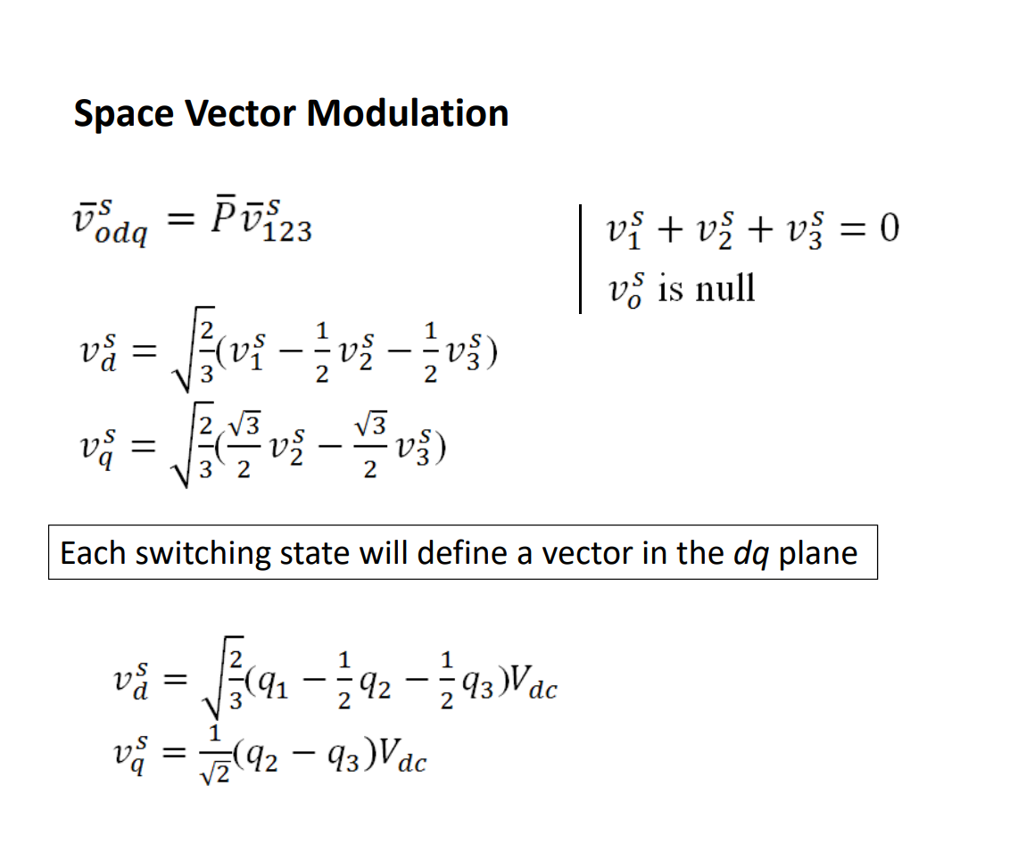
Peak: 50 V
Period: 1 ms

Slide 39
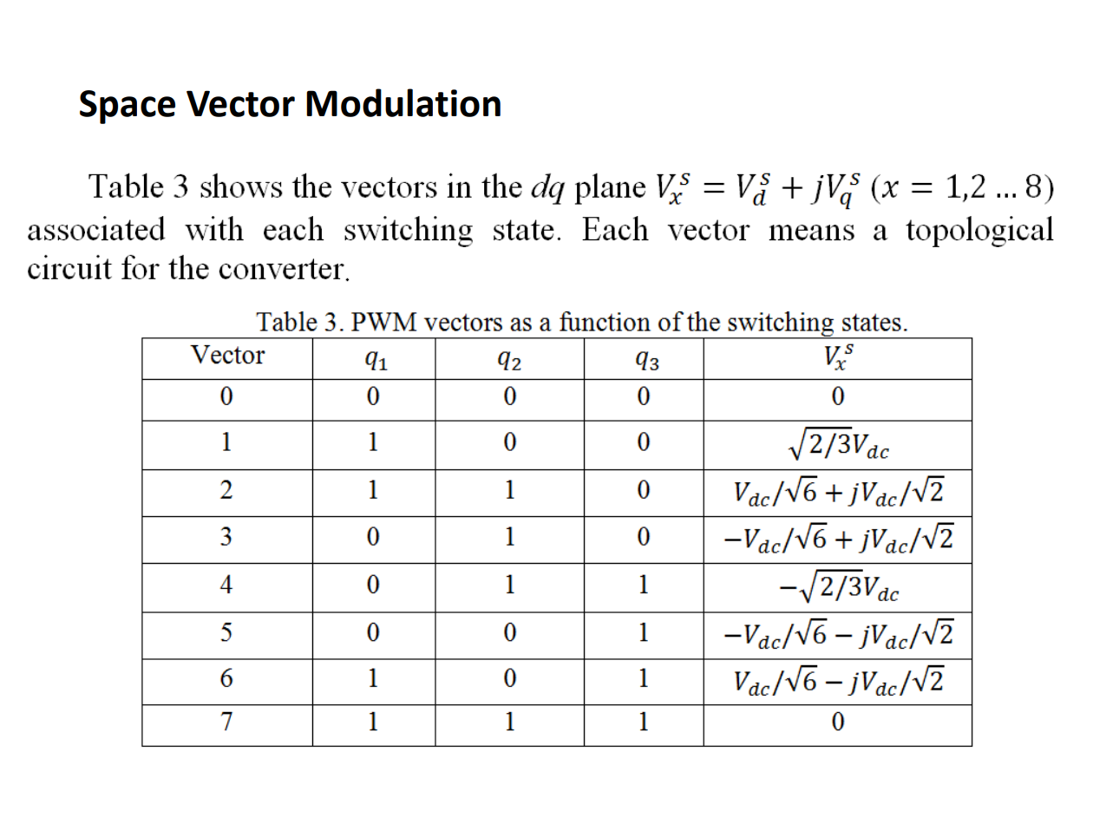
Peak: 50 V
Period: 1 ms

Slide 40
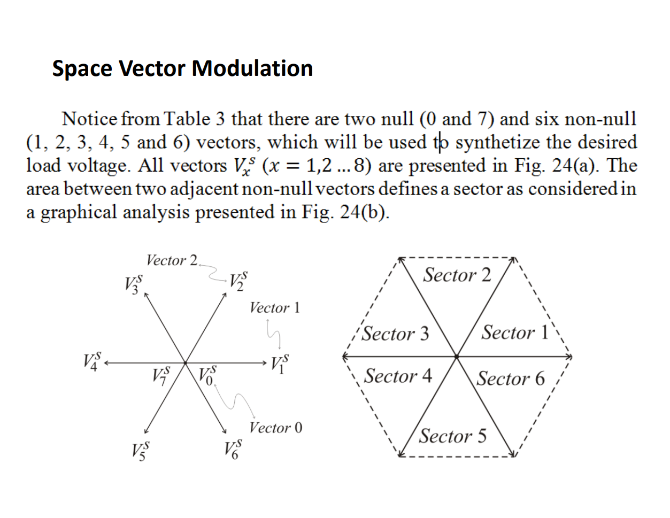
Peak: 50 V
Period: 1 ms

Slide 41
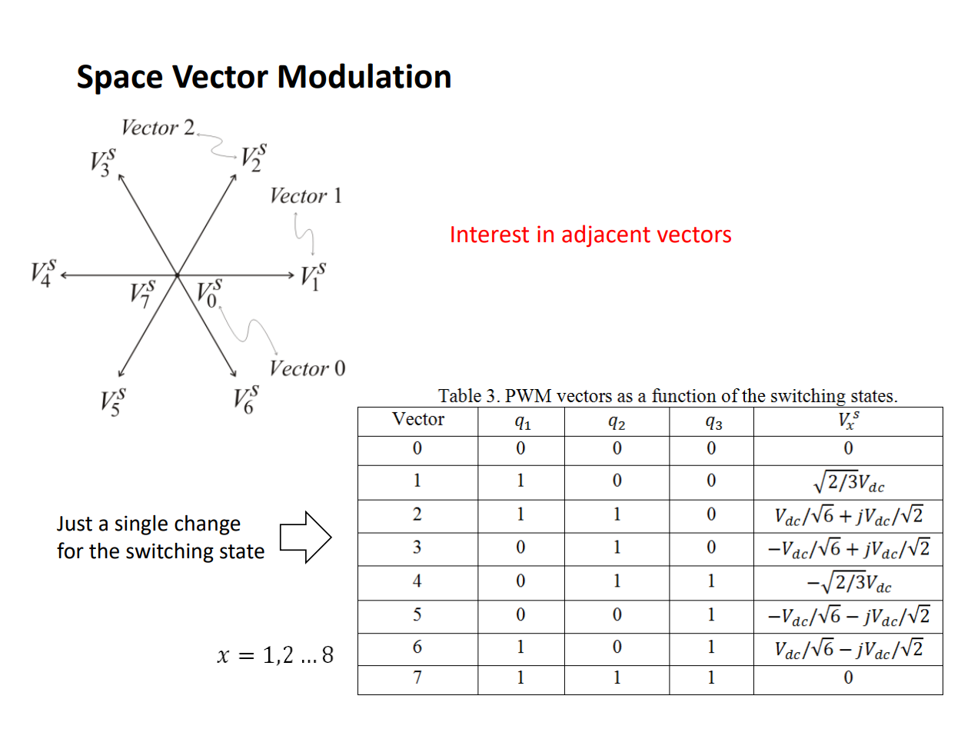
Peak: 50 V
Period: 1 ms

Slide 42
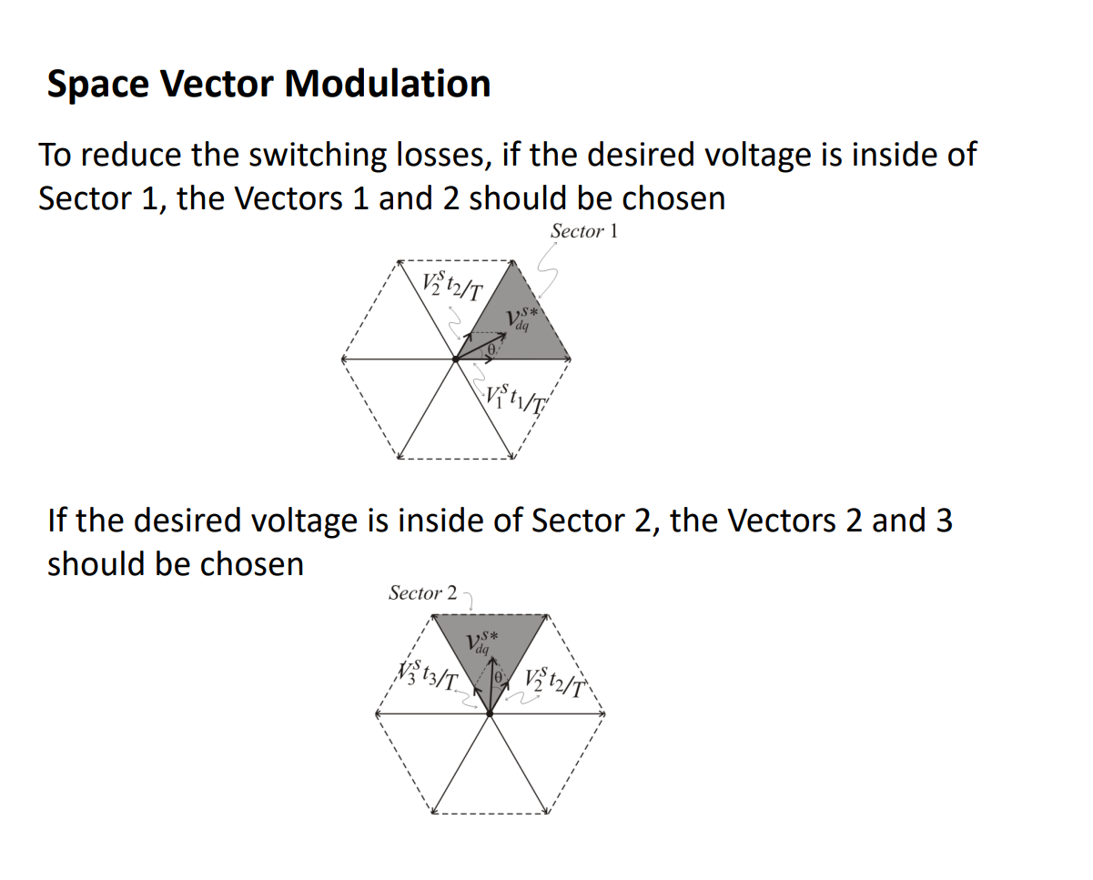
Peak: 50 V
Period: 1 ms

Slide 43
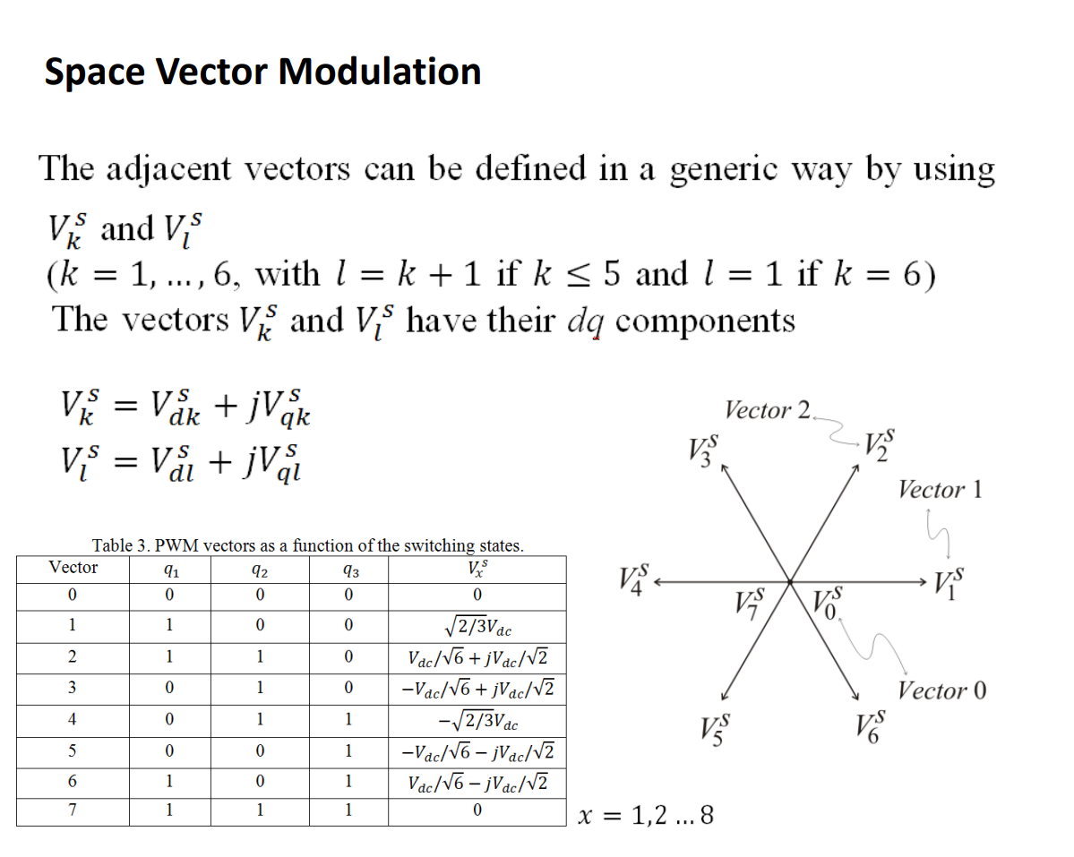
Peak: 50 V
Period: 1 ms

Slide 44
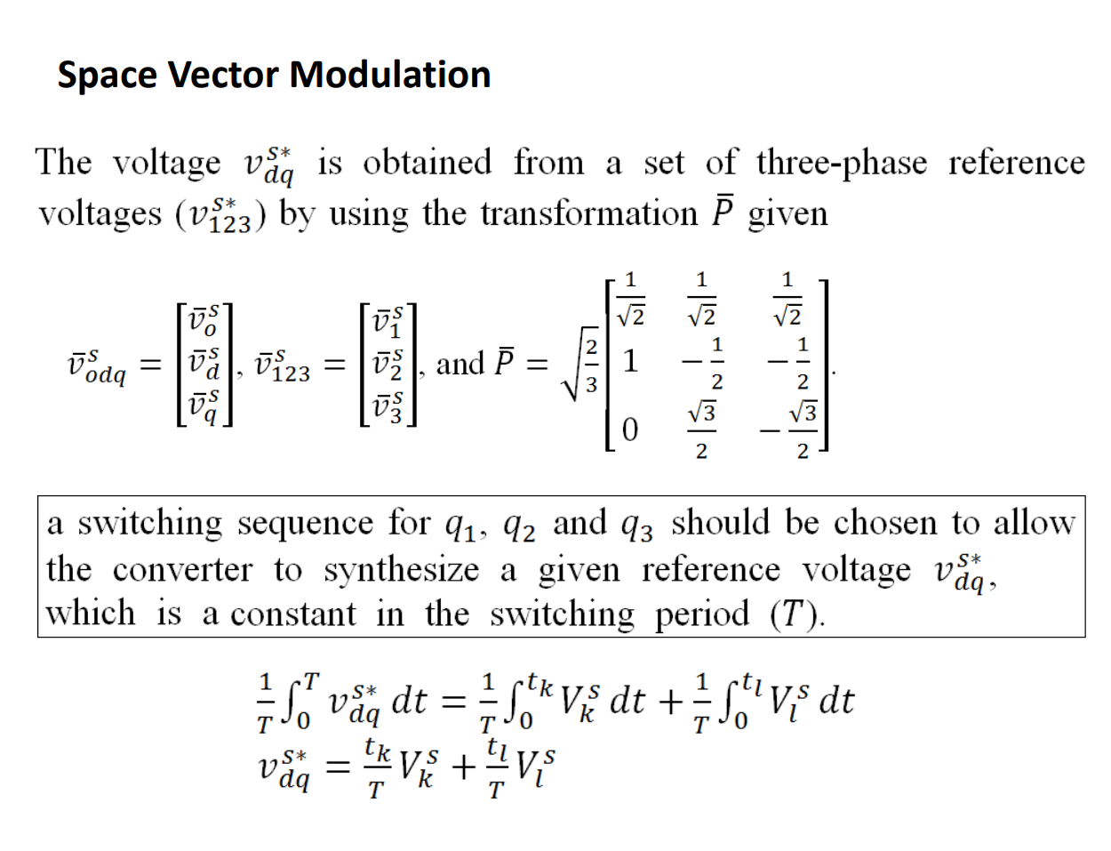
Peak: 50 V
Period: 1 ms

Slide 45
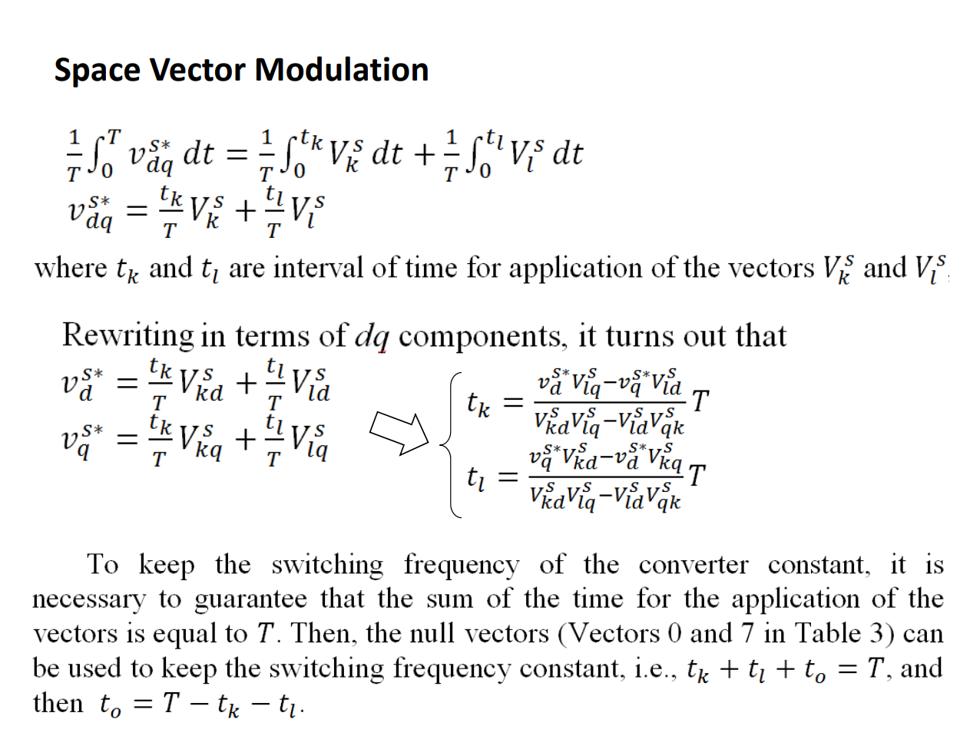
Peak: 50 V
Period: 1 ms

Slide 46
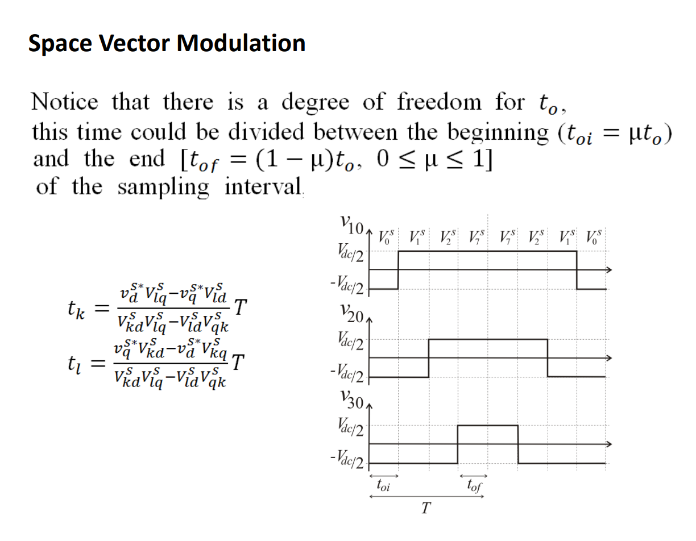
Peak: 50 V
Period: 1 ms

Slide 47
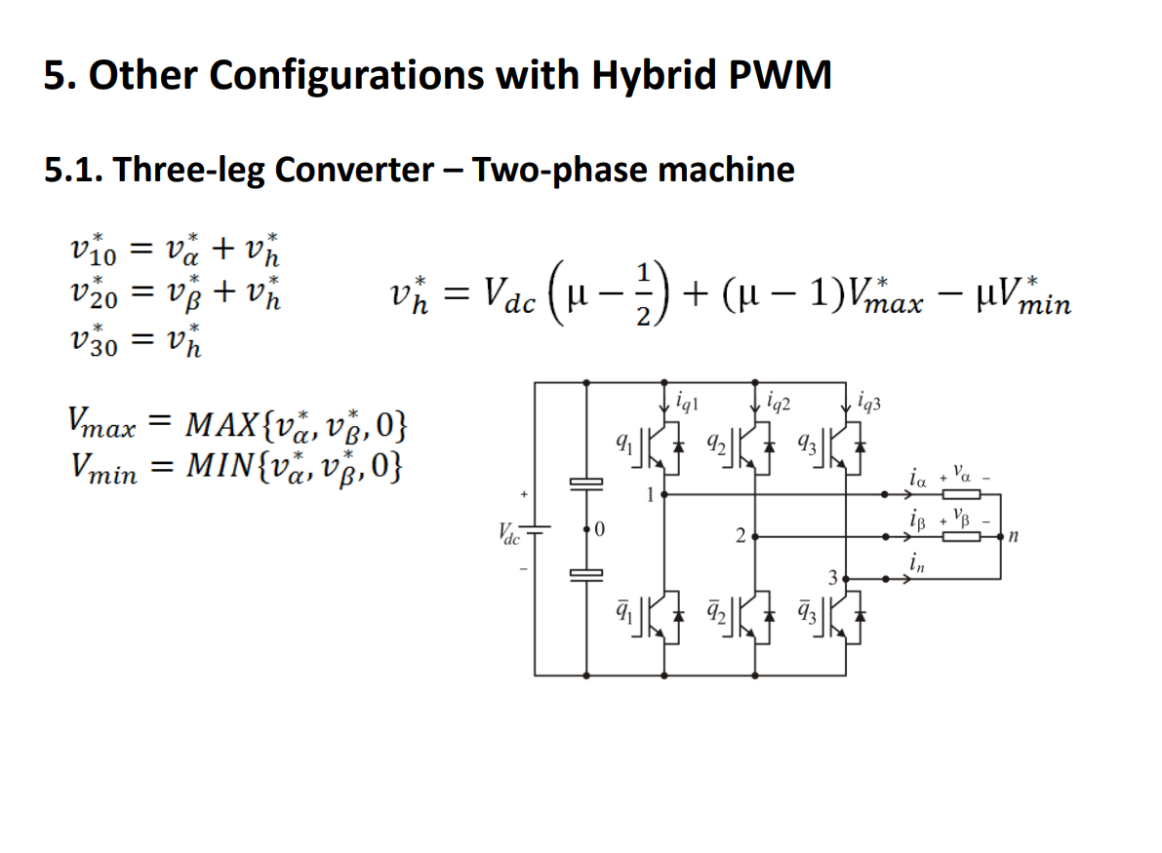
Peak: 50 V
Period: 1 ms

Slide 48
Peak: 50 V
Period: 1 ms

Slide 49
Peak: 50 V
Period: 1 ms

Slide 50
Peak: 50 V
Period: 1 ms

Slide 51
Peak: 50 V
Period: 1 ms

Slide 52
Peak: 50 V
Period: 1 ms

Slide 53
Peak: 50 V
Period: 1 ms

