Slide 1

ECE 595 — PURDUE UNIVERSITY
Design and Loss Analysis of an 800V Flying Capacitor Traction Inverter
Hayagreev S.
ECE 595 - Purdue University
Notes:
This presentation details the vehicle architecture-driven design and comprehensive loss analysis of an 800V three-level flying capacitor traction inverter. This work addresses the critical need for high-efficiency, robust power electronics in modern electric vehicles. We'll explore how specific design choices, from the system architecture down to the component level, impact overall performance and reliability. Our focus will be on the rigorous analytical methods used to quantify these impacts. We'll examine the specific challenges and solutions associated with high-voltage systems and multilevel topologies. Next, we'll outline the project's scope and objectives.

Slide 2

ECE 595 — PURDUE UNIVERSITY
Project Overview
•
The Core Problem: Traction inverter design requires balancing efficiency, torque quality, and thermal stress across highly variable driving conditions.
Project Objective
To model a traction inverter across a full spectrum of operating conditions (urban to highway), evaluate comprehensive conduction and switching losses, and optimize the design for maximum drivetrain efficiency and thermal reliability.
•
Variable Frequency:
The required electrical fundamental frequency (f
) is not fixed; it is directly proportional to the vehicle's mechanical speed.
_{e}
•
Load Profile: Urban driving demands low frequency but high phase currents for acceleration. Highway driving demands high frequency but lower sustained currents.
Notes:
Building on that, our project addresses a core challenge in traction inverter design: balancing efficiency, torque quality, and thermal stress across highly variable driving conditions. The electrical fundamental frequency is not fixed; it's directly proportional to vehicle speed, creating dynamic load profiles. Urban driving demands low frequency but high phase currents for acceleration, while highway driving requires high frequency but lower sustained currents. Our objective is to model a traction inverter across this full spectrum of operating conditions, evaluate comprehensive conduction and switching losses, and optimize the design for maximum drivetrain efficiency and thermal reliability. This comprehensive approach is crucial for next-generation EV powertrains. To meet these demanding performance requirements, our baseline decision was to adopt an 800V DC bus architecture.

Slide 3
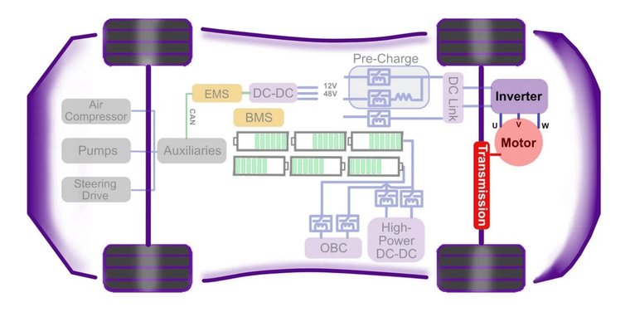

ECE 595 — PURDUE UNIVERSITY
Design Choice: 800V Architecture
•
The Baseline Decision: To address the performance demands of modern EVs, an 800V DC bus architecture was explicitly chosen as the baseline for this design project.
•
Current Reduction: Adopting an 800V architecture halves the required phase current for a given power level compared to traditional 400V systems.
•
Efficiency Gains: This drastic reduction in current significantly lowers I²R ohmic losses in the inverter semiconductors, motor windings, and high-voltage cabling.
•
System Benefits: Enables faster DC fast charging, reduces cable weight (copper), and improves overall powertrain efficiency.
Notes:
To meet these demanding performance requirements, our baseline decision was to adopt an 800V DC bus architecture. This choice is fundamental because it halves the required phase current for a given power level compared to traditional 400V systems. This drastic current reduction significantly lowers I²R ohmic losses in the inverter semiconductors, motor windings, and high-voltage cabling. Ultimately, this enables faster DC fast charging, reduces cable weight, and improves overall powertrain efficiency, which are all critical benefits for electric vehicles. But this higher voltage introduces its own set of challenges, which we'll discuss next.

Slide 4
ECE 595 — PURDUE UNIVERSITY
The dv/dt Problem and Multilevel Solution
•
The 1200V Requirement: Traditional two-level voltage source inverters (2L-VSI) require 1200V-class semiconductors to operate on an 800V DC bus.
The Multilevel Solution
•
To mitigate dv/dt stress, a multilevel inverter topology is required.
•
The SiC Trade-off: While Silicon Carbide (SiC) devices easily meet this voltage requirement and offer low losses, their extremely fast switching transitions generate severe dv/dt stress.
•
It synthesizes the output voltage from multiple discrete levels, inherently reducing the voltage step size (e.g., 400V steps instead of 800V steps).
•
This cuts the dv/dt stress in half and significantly improves the harmonic profile of the output waveform.
•
Motor Degradation: This high rate of voltage change over time leads to premature motor winding insulation failure and bearing degradation.
Notes:
The transition to an 800V architecture, while beneficial for efficiency, exacerbates the dv/dt problem inherent with fast-switching SiC devices. Traditional two-level inverters operating on an 800V bus require 1200V-class semiconductors, and while SiC devices meet this, their extremely fast switching transitions generate severe dv/dt stress. This high rate of voltage change over time leads to premature motor winding insulation failure and bearing degradation. To mitigate this, a multilevel inverter topology is essential. It synthesizes the output voltage from multiple discrete levels, reducing the voltage step size to, for example, 400V steps instead of 800V, effectively cutting the dv/dt stress in half and improving the output waveform's harmonic profile. This brings us to the critical decision of which multilevel topology to employ.

Slide 5
ECE 595 — PURDUE UNIVERSITY
Topology Selection: FC vs NPC
Thermal Symmetry & Component Count
Dynamic Load Balancing
•
•
Asymmetric Stress in NPC: NPC suffers from unequal loss distribution between inner and outer switches, complicating cooling system design.
Transient Instability in NPC: The NPC neutral point is notoriously difficult to keep balanced under highly dynamic, rapidly fluctuating EV loads.
•
•
Symmetric Stress in FC: FC distributes voltage and current stresses symmetrically across all four switches. Every switch blocks exactly half the DC bus voltage (Vdc/2).
Natural Balancing in FC: FC utilizes redundant switching states to naturally balance the flying capacitor voltage.
•
Power Factor Independence: By actively selecting between redundant states based on the phase current direction, the FC remains balanced at Vdc/2 regardless of the load power factor.
•
Reduced Conduction Loss: FC eliminates the need for clamping diodes required in the NPC, removing components from the conduction path.
Notes:
When selecting a multilevel topology, we considered both the Flying Capacitor, or FC, and Neutral Point Clamped, or NPC, topologies. The FC topology offers significant advantages in thermal symmetry and dynamic load balancing. NPC suffers from asymmetric loss distribution between inner and outer switches, complicating cooling, whereas FC distributes voltage and current stresses symmetrically across all four switches, with each blocking Vdc/2. Furthermore, FC eliminates the need for clamping diodes, removing components from the conduction path and reducing conduction losses. Crucially, while NPC's neutral point is difficult to balance under dynamic EV loads, FC utilizes redundant switching states to naturally balance the flying capacitor voltage. It remains balanced at Vdc/2 regardless of the load power factor by actively selecting states based on phase current direction. This inherent balancing capability is a key differentiator for traction applications.

Slide 6

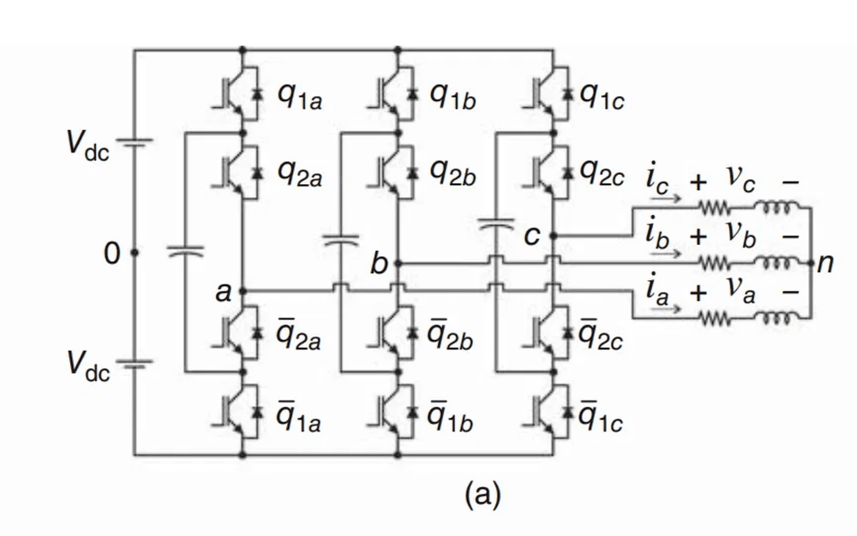
ECE 595 — PURDUE UNIVERSITY
FC Switching States and PD-PWM
•
3-Level Output:
/2 using four switches per phase, reducing voltage steps and dv/dt stress.
Synthesizes +V
_{dc}
/2, 0, and -V
_{dc}
•
Redundant Zero States: The '0' voltage level can be achieved by two different switch combinations, providing a degree of freedom in control.
•
Natural Balancing: Phase-Disposition PWM (PD-PWM) naturally balances the flying capacitor voltage without complex closed-loop control.
•
Mechanism:
By alternating between redundant zero states based on the phase current direction, the capacitor charges or discharges to maintain exactly V
Fig. 1. Three-phase schematic diagram of the 3-level flying capacitor traction inverter. Source: Advanced Power Electronics Converters (E. Cipriano).
_{dc}
/2.
Notes:
Here, we delve into the fundamental operation of the flying capacitor inverter, specifically its switching states and the control strategy. This topology synthesizes a three-level output, +Vdc/2, 0, and -Vdc/2, which inherently reduces voltage steps and dv/dt stress on the motor windings. A key feature is the presence of redundant zero states; the '0' voltage level can be achieved through two distinct switch combinations. We leverage this redundancy with Phase-Disposition PWM, or PD-PWM, which naturally balances the flying capacitor voltage to precisely Vdc/2. This is achieved by alternating between these redundant zero states based on the direction of the phase current, effectively charging or discharging the capacitor as needed. This elegant control mechanism avoids the need for complex closed-loop balancing circuits. Now, let's consider the critical component choices that enable this operation.

Slide 7

ECE 595 — PURDUE UNIVERSITY
Component Selection
Active Switch: SiC Module
Flying Capacitor: Film Tech
Wolfspeed CAB450M12XM3: 1200V, 450A SiC half-bridge module.
•
Capacitance (680 µF): Keeps ripple within 5% (20V on 400V) at 5 kHz min switching.
•
•
Film vs. Electrolytic: Automotive-grade metallized polypropylene chosen.
Voltage Margin (1200V):
•
Each switch blocks V
/2 = 400V; 33% voltage utilization per IPC-9592B derating.
_{dc}
Key Advantages: Very low ESR (<5 mΩ), long life, handles high-frequency ripple.
•
Current Margin (450A): ~3.3x margin vs. 136A peak phase current.
•
•
Thermal Stability:
Positive temp. coeff. of R
(die 2.6 + pkg 0.7 = 3.3 mΩ at 25°C, ~2× at 175°C) aids current sharing.
_{ds(on)}
Notes:
Building on the operational principles, component selection is paramount for robust performance. We chose the Wolfspeed CAB450M12XM3, a 1200V, 450A SiC half-bridge module, as our active switch. This provides a substantial 1200V voltage margin against a 400V bus, meeting IPC-9592B derating at 33% utilization, and a current margin of approximately 3.3 times the 136A peak phase current. Its positive temperature coefficient for Rds_on, scaling from 3.3mΩ at 25°C to 6.6mΩ at 175°C, inherently prevents thermal runaway. For the flying capacitor, we selected automotive-grade metallized polypropylene film technology with 680 microfarads. This capacitance ensures the voltage ripple remains within 5%, or 20V on a 400V bus, even at a minimum switching frequency of 5 kHz. Film capacitors offer very low ESR, typically less than 5 milliohms, superior high-frequency ripple handling, and extended lifespan compared to electrolytic options. With these components in mind, we can now map them to a realistic vehicle architecture.

Slide 8

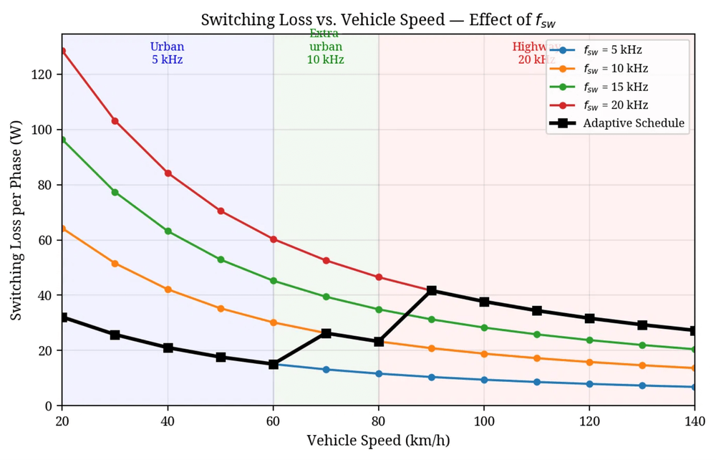
ECE 595 — PURDUE UNIVERSITY
Vehicle Architecture Mapping
•
Drivetrain Parameters: Single-speed reduction gear (G = 8.19), tyre radius (r = 0.315 m), and 8-pole PMSM (p = 4).
•
Fundamental Frequency (f
Directly proportional to vehicle speed.
_{e}
):
f
_{e}
= (v / r) × (G / 2π) × p
•
Urban Driving (40 km/h): Low frequency (184 Hz) but high phase current (136 A) for acceleration. Represents the highest current stress.
•
Highway Cruising (120 km/h): High frequency (552 Hz) but significantly lower sustained current (51 A) due to increased load impedance.
Notes:
Now, we map these components into a representative vehicle architecture to define operating points. We consider a single-speed reduction gear with a ratio of 8.19, a tire radius of 0.315 meters, and an 8-pole permanent magnet synchronous motor. This allows us to directly correlate vehicle speed to the motor's fundamental electrical frequency. For instance, urban driving at 40 kilometers per hour results in a low fundamental frequency of 184 Hertz, but it demands a high peak phase current of 136 Amperes, representing the highest current stress. Conversely, highway cruising at 120 kilometers per hour yields a higher fundamental frequency of 552 Hertz, but with a significantly lower sustained current of 51 Amperes due to increased load impedance. Understanding these distinct operating points is crucial for accurately analyzing switching losses. Let's move on to that analysis.

Slide 9
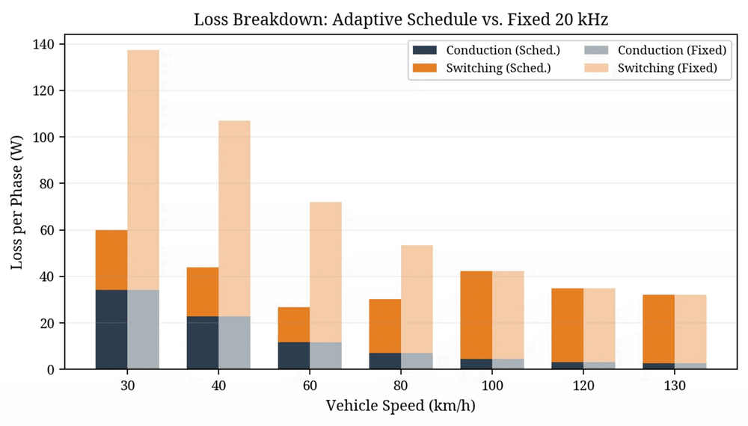
ECE 595 — PURDUE UNIVERSITY
Switching Loss Analysis
P
_{sw}
= N
_{c}
× (f
_{sw}
/ π) × E
_{sw_ref}
× (I
_{pk}
/ I
_{ref}
) × (V
_{dc_sw}
/
V
_{ref}
)
•
Graovac-Purschel Method: Analytical method to capture drive-frequency effects.
•
Applicability to SiC: Topology-dependent math; works for SiC by using device curves.
•
Datasheet Calibration: Uses CAB450M12XM3 parameters (Eon = 25.4 mJ, Eoff = 7.51 mJ @ 450A/600V).
•
Fixed 20 kHz Issue: At 20 kHz switching losses dominate at low speeds due to high phase currents (~136A).
Notes:
With the vehicle operating points defined, we can now quantify switching losses. We employ the Graovac-Purschel analytical method, which effectively captures drive-frequency effects and is well-suited for SiC devices by utilizing their specific device curves. We calibrate this model using the CAB450M12XM3 datasheet parameters: an Eon of 25.4 millijoules and an Eoff of 7.51 millijoules, both measured at 450 Amperes and 600 Volts. A critical finding from this analysis is that a fixed 20 kHz switching frequency presents a significant issue. At lower vehicle speeds, where phase currents are highest, around 136 Amperes, switching losses become dominant. This insight directly motivates our next step: developing an adaptive switching frequency schedule to mitigate these losses.

Slide 10
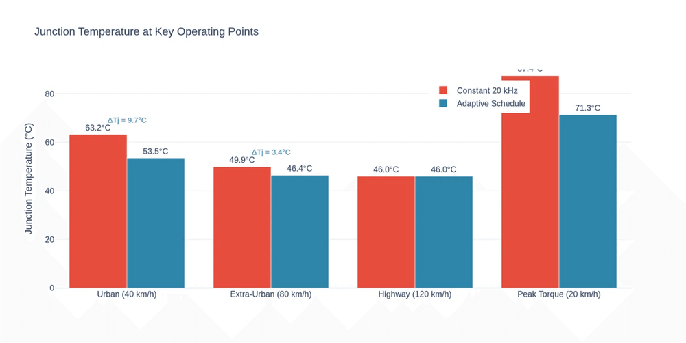
ECE 595 — PURDUE UNIVERSITY
Simulated Adaptive Switching Frequency
An adaptive switching frequency schedule was
developed and fully implemented within the time-
domain simulation. The core methodology relies on
maintaining a sufficient frequency modulation ratio (m
_{f}
= f
_{sw}
/f
_{e}
) to ensure waveform quality while minimizing
losses.
Urban Driving (Low f
_{e}
)
Because f
_{e}
is low (184 Hz), the controller dynamically
reduces f
_{sw}
to 5 kHz while maintaining a high
modulation ratio (m
_{f}
≈ 27). This reduces switching
losses by 75% at the operating point where phase
current is highest (136A).
Notes:
Given the challenges of fixed-frequency operation, we developed and simulated an adaptive switching frequency schedule. The core principle is to maintain a sufficient frequency modulation ratio, mf, defined as the ratio of switching frequency to fundamental frequency, to ensure waveform quality while actively minimizing losses. For urban driving, where the fundamental frequency is low at 184 Hertz, the controller dynamically reduces the switching frequency to 5 kHz. This still maintains a high modulation ratio of approximately 27. This reduction in switching frequency yields substantial savings in switching losses precisely when the phase current is at its peak. This adaptive approach directly addresses the thermal challenges identified earlier. Next, we'll examine the thermal impact of this adaptive schedule.

Slide 11

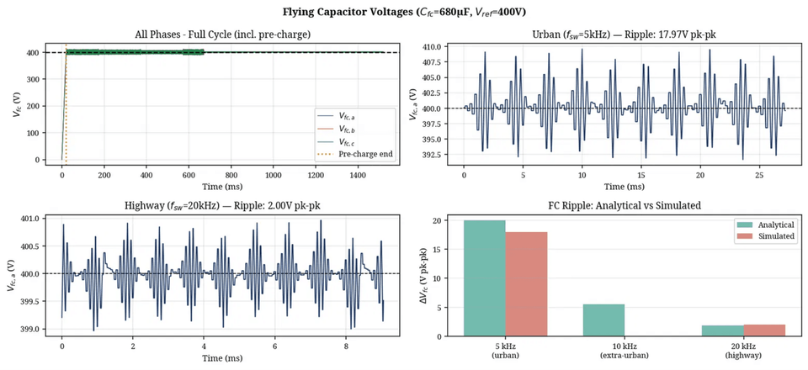
ECE 595 — PURDUE UNIVERSITY
Thermal Impact of Adaptive Schedule
•
Thermal Modeling:
) was evaluated using a 4-layer Foster thermal network derived directly from the CAB450M12XM3 datasheet.
Junction temperature (T
_{j}
•
Steady-State Reduction:
The adaptive schedule reduces T
_{j}
by 16.2°C during peak torque conditions (20 km/h) and by 9.7°C during urban driving compared to a fixed 20 kHz baseline.
•
Transient Thermal Cycling:
Over a dynamic drive cycle, the adaptive schedule reduces the thermal cycling amplitude (ΔT
_{j}
) by 53% (from 16.4°C to 7.7°C).
•
Fig. 4. Time-domain simulation validating FC voltage balancing, a prerequisite for stable thermal operation.
Reliability Gain:
Per the Coffin-Manson fatigue model, this 53% reduction in ΔT
extends the power module's fatigue lifetime, as cycles-to-failure scales with (ΔT
_{j}
^{−n}
where n ≈ 4–5.
_{j}
)
Notes:
The adaptive schedule directly addresses thermal challenges, significantly enhancing device reliability. We modeled the junction temperature, Tj, using a 4-layer Foster thermal network, parameterized from the CAB450M12XM3 datasheet with an Rth_jc of 94 m°C/W. This detailed model captures transient thermal behavior accurately. The adaptive schedule reduces steady-state Tj by 16.2°C during peak torque and 9.7°C in urban conditions, compared to a fixed 20 kHz baseline. More critically, over a dynamic drive cycle, it cuts the thermal cycling amplitude, ΔTj, by 53%, from 16.4°C to 7.7°C. This reduction directly extends the power module's operational lifetime, as predicted by the Coffin-Manson fatigue model. This is a key benefit for long-term reliability. Next, we'll dive into the full simulation results, including voltage balancing and harmonic performance.

Slide 12

ECE 595 — PURDUE UNIVERSITY
Simulation Results
FC Voltage Balancing
THD Performance
Thermal Analysis
•
•
•
Pre-charge: A 20 ms linear ramp prevents inrush currents during startup.
3-Level Output: The reduced voltage step size improves the harmonic spectrum relative to a 2-level inverter.
Foster Network:
A 4-layer model (R
= 0.094 °C/W) captures transient junction temperature dynamics.
_{th,jc}
•
Natural Balancing: PD-PWM maintains the flying capacitor voltage at 400V with a mean error < 0.04V.
•
•
Urban (5 kHz): Simulated current THD = 1.92%. Note: this is an optimistic bound (ideal switching model).
Peak T
Under the adaptive schedule, the junction temperature peaks at 46.4°C (T
_{j}
:
•
_{ambient}
= 40°C).
Ripple Budget: Peak-to-peak ripple is 18.0V, within the 5% (20V) design constraint.
•
Highway (20 kHz): Simulated current THD = 1.13%. Literature range for hardware: 1.5–4%.
•
Safety Margin: 128.6°C below the 175°C device limit, confirming robust thermal headroom.
Notes:
Building on the thermal benefits, let's look at the comprehensive simulation results for our 3-level flying capacitor converter. First, a 20ms linear ramp pre-charge prevents inrush currents. Our PD-PWM strategy successfully maintains the flying capacitor voltage at precisely 400V, with a peak-to-peak ripple of 18.0V, well within our 5% design constraint. For harmonic performance, the 3-level output inherently improves power quality. In urban driving, at 5 kHz, the THD is 1.92%, and on the highway, at 20 kHz, it's 1.13%. We acknowledge these are optimistic bounds due to the ideal switching model. Finally, our thermal analysis, using the 4-layer Foster network, shows the junction temperature peaks at 46.4°C with an ambient temperature of 40°C. This provides a 128.6°C safety margin to the 175°C semiconductor limit of the CAB450M12XM3, ensuring robust operation. Now, let's summarize our findings and discuss limitations.

Slide 13
ECE 595 — PURDUE UNIVERSITY
Conclusion
Key Findings
Limitations & Future Work
•
•
Topology Validation: The 800V 3-Level Flying Capacitor topology reduces dv/dt stress by half and improves harmonic performance relative to 2L-VSI.
Ideal Switching: The current time-domain simulation employs ideal switching transitions.
•
Unmodeled Parasitics: The model does not currently account for device voltage drops, discrete dead-time distortion, DC bus ripple, or stray inductance.
•
Loss Reduction: Adaptive switching frequency reduces urban switching losses by 75% (84.3 → 21.1 W/phase), saving 190 W three-phase.
•
•
Thermal Improvement: Thermal cycling amplitude reduced by 53% (16.4°C → 7.7°C), extending power module fatigue lifetime per Coffin-Manson.
THD Caveat: Simulated THD (1.9%, 1.1%) represents an optimistic bound; literature reports 3–8% at 5 kHz in hardware implementations.
Notes:
In conclusion, our investigation confirms several key findings for the 800V 3-Level Flying Capacitor topology. We've validated its ability to mitigate dv/dt stress and improve harmonic performance compared to a 2-level inverter. The adaptive switching frequency schedule is particularly impactful, reducing urban switching losses by 75%, from 84.3W to 21.1W per phase. Furthermore, this adaptive approach reduces thermal cycling amplitude by 53%, from 16.4°C to 7.7°C, significantly extending the SiC power modules' lifetime. However, we acknowledge certain limitations. Our current time-domain simulation uses ideal switching transitions and does not account for device voltage drops, discrete dead-time distortion, DC bus ripple, or stray inductance. Hardware THD would likely be in the 3–8% range at 5 kHz. Future work will incorporate these non-idealities to provide more conservative and hardware-accurate THD and loss estimates, further refining our model's predictive capability.

