Slide 1



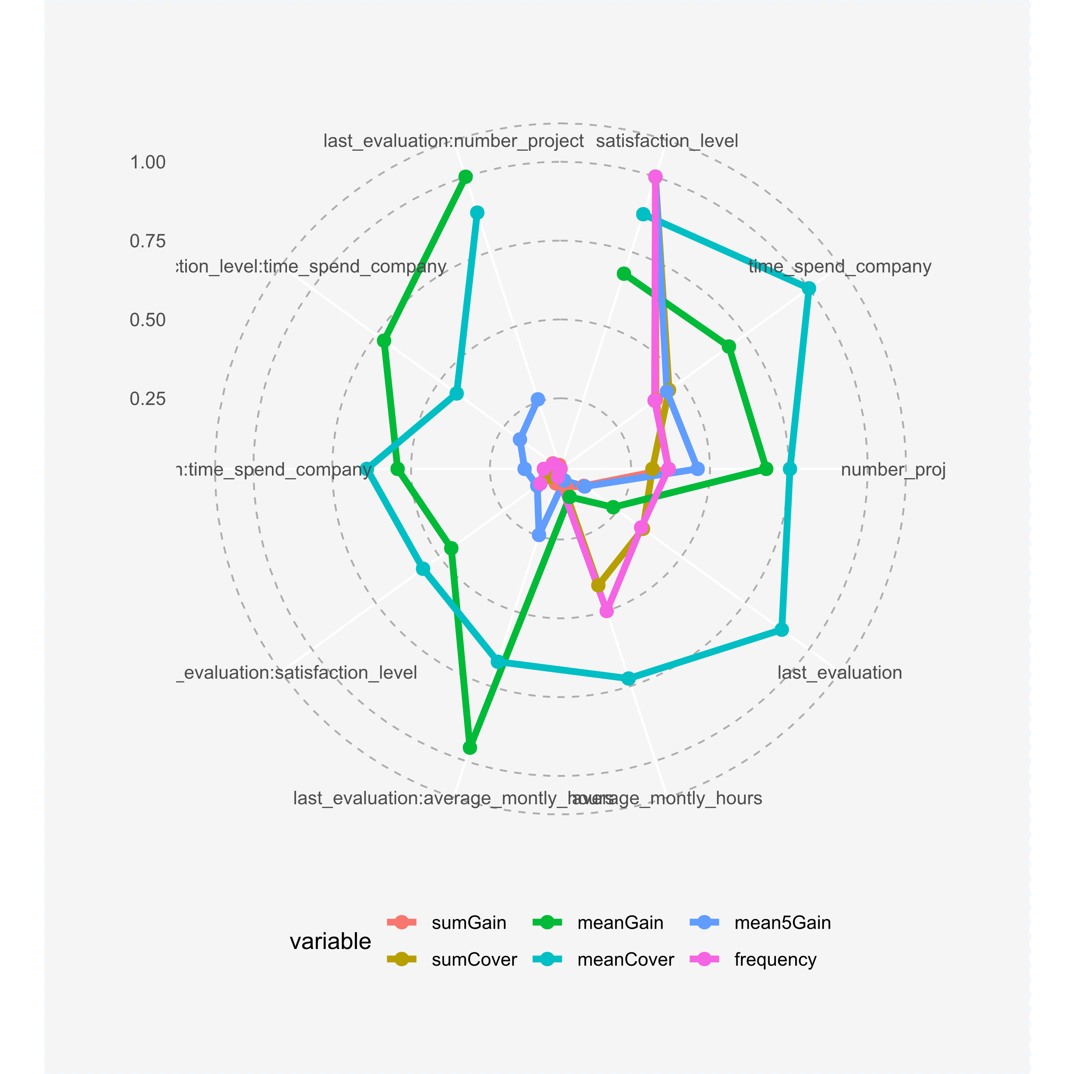
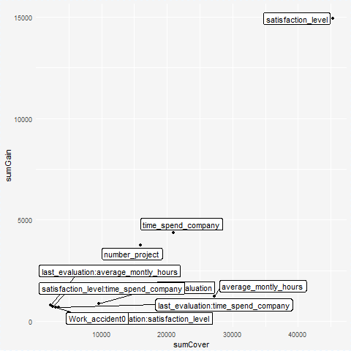
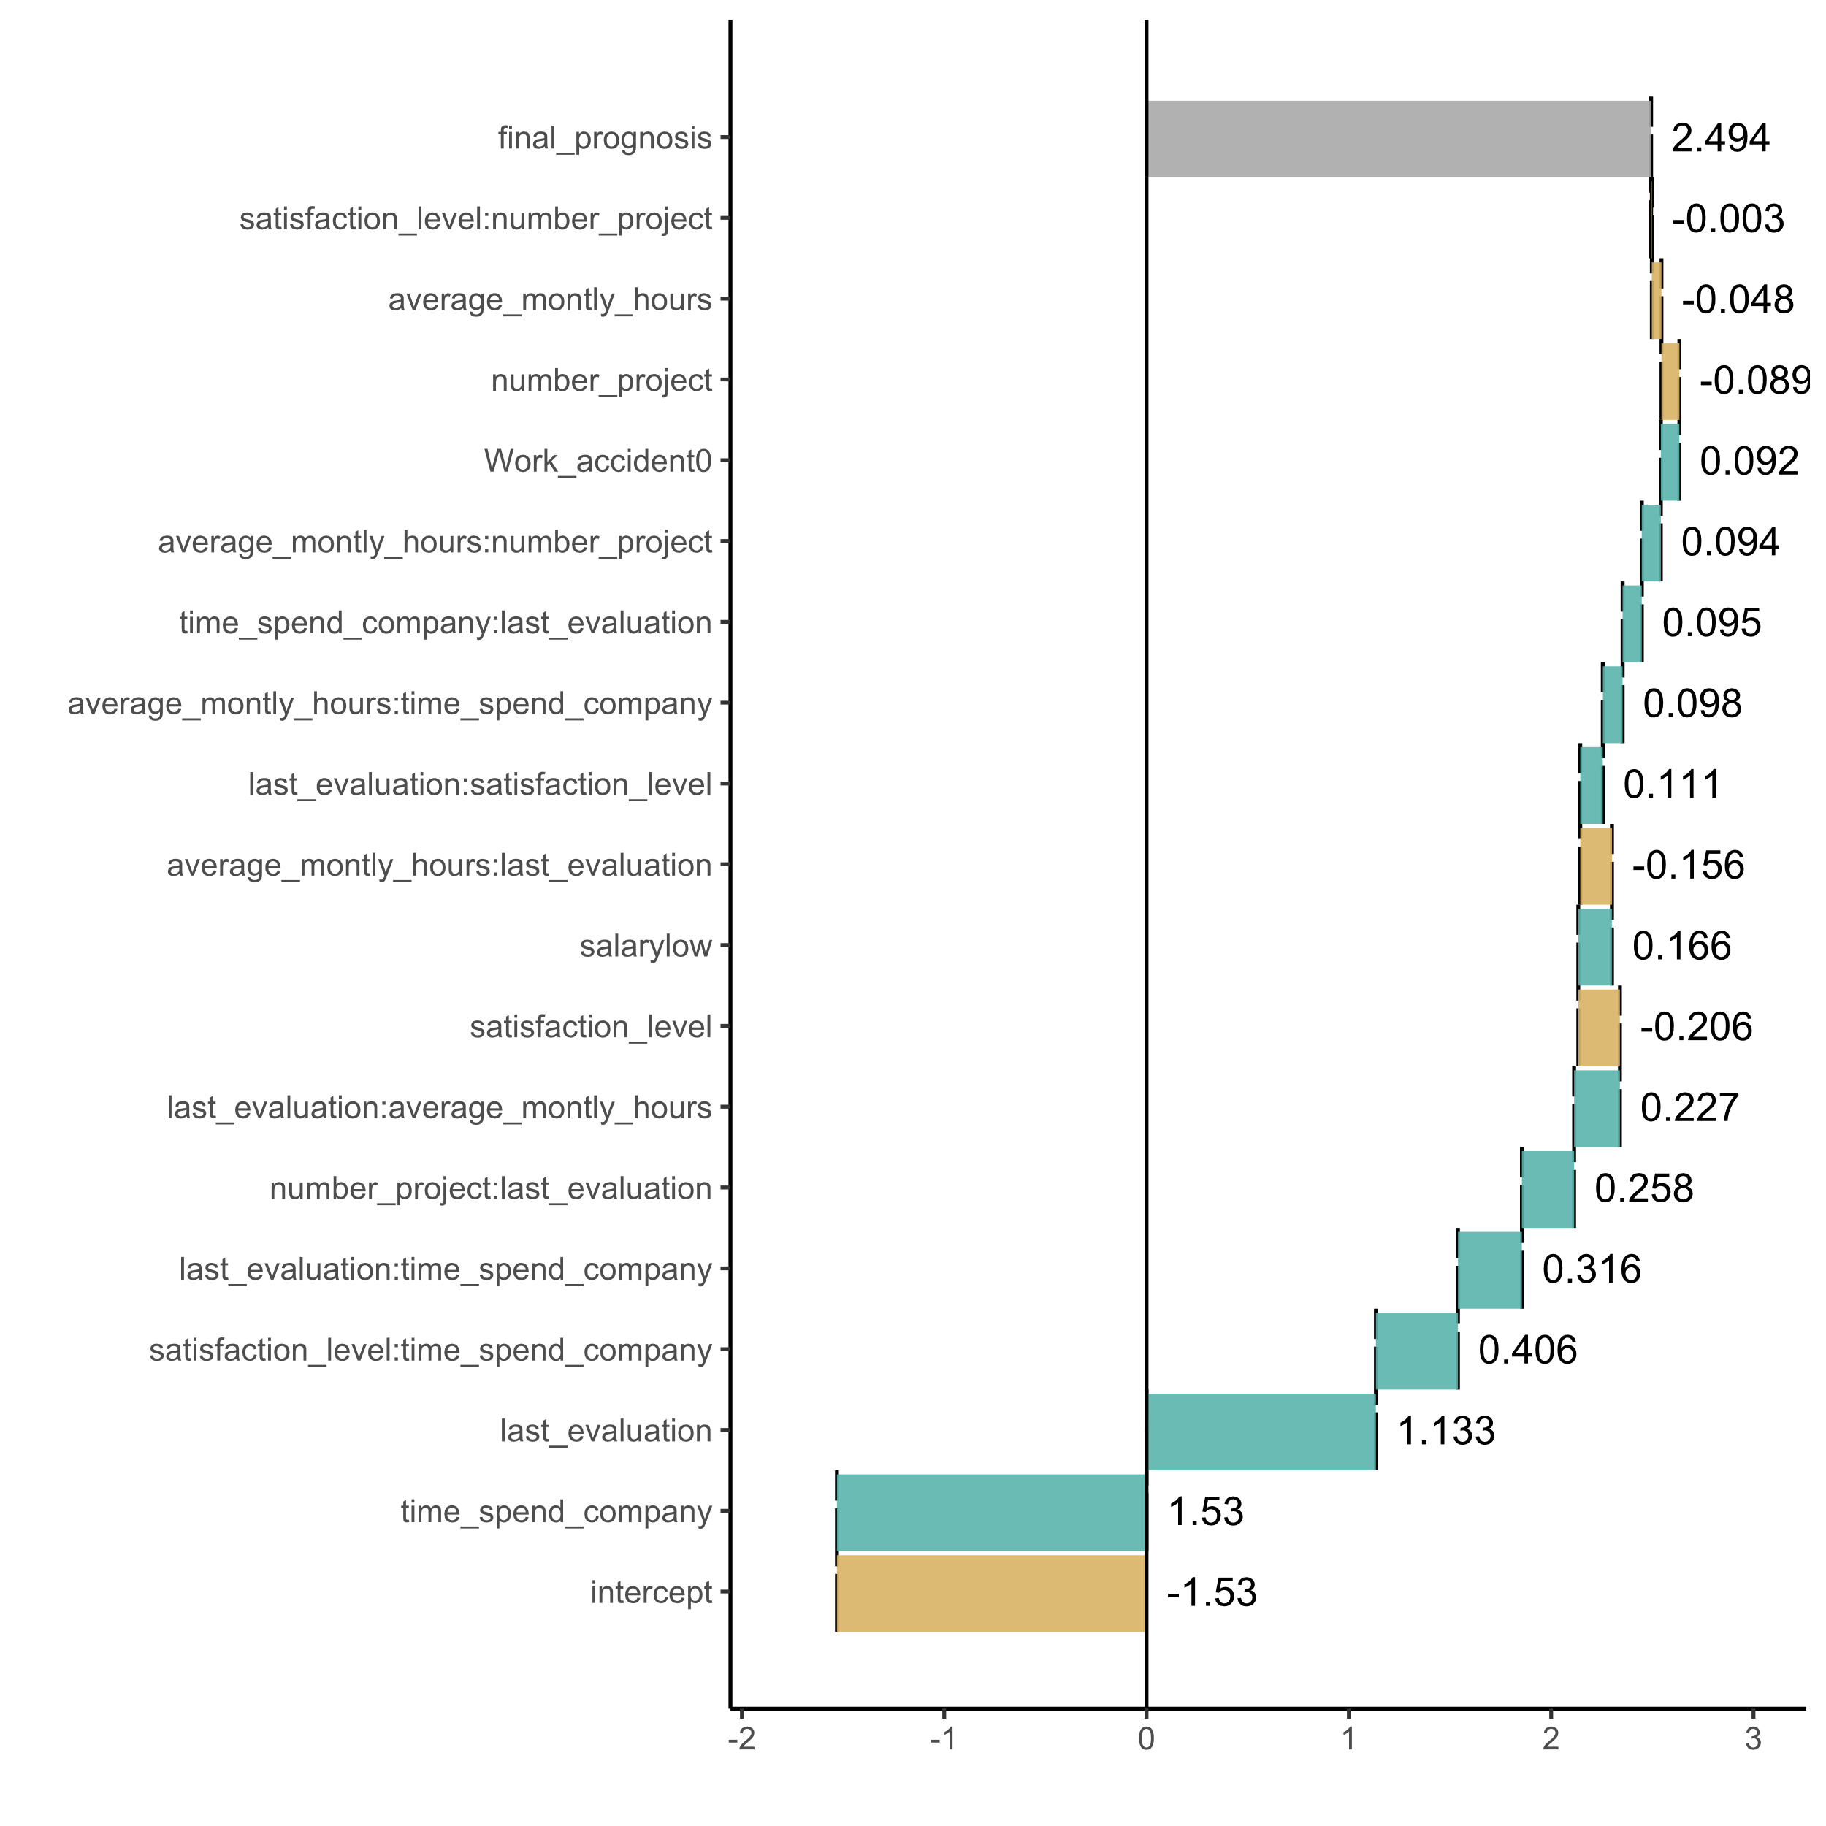
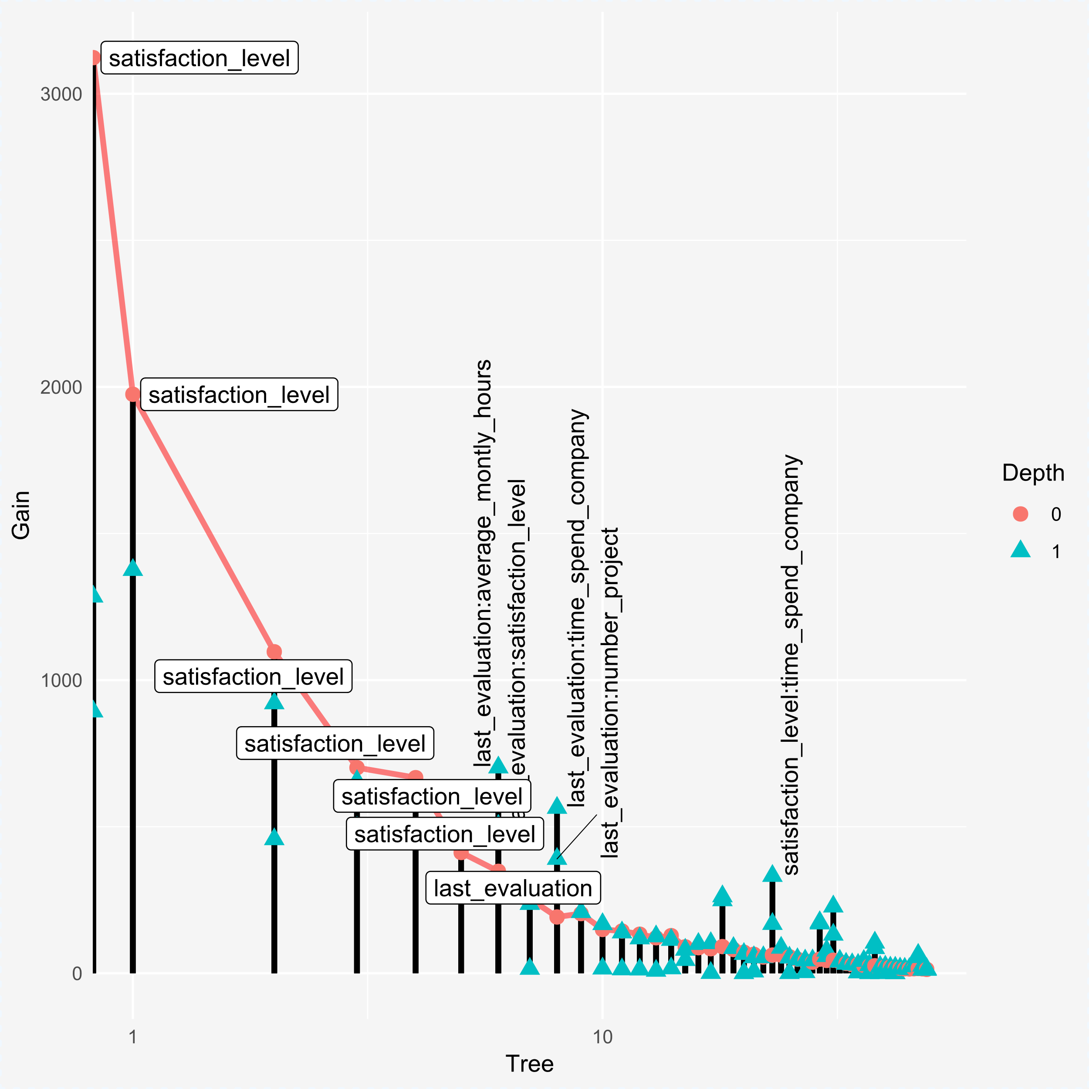
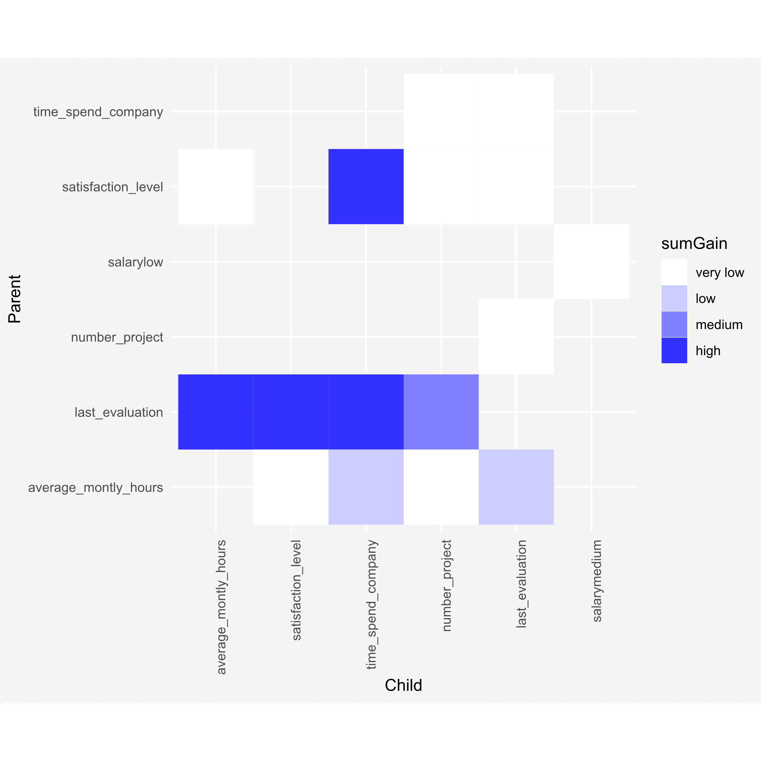
EIX : : Explain Interactions in XGBoost
The EIX (Explain Interactions in XGBoost) package supports structure mining from XGBoost and LightGBM models.
Key functionalities of this package cover: visualisation of tree-based ensembles models, identification of interactions, measuring of variable importance, measuring of interaction importance, explanation of single prediction with break down plots (based on xgboostExplainer and breakDown packages).
Importance of variables and interactions
The importance table includes different measures of importance for variables and interactions. It is possible to visualise it in two ways using plot() function.
imp <- importanceTable(xgb.model, sm, option = "both") plot(imp, top = 10)
plot(imp, radar = FALSE, xmeasure = "sumCover", ymeasure = "sumGain", top = 10)
option = " variables" - object consists only single variables
option = "interactions" – only interactions
option = "both" - object shows importance both single variables and interactions. Default option.
devtools :: install_github("ekarbowiak/EIX")
library("EIX")
library("Matrix")
library("data.table")
library("xgboost")
dt_HR <- data.table(HR_data)
sm <- sparse.model.matrix(left ~ . - 1, data = dt_HR)
param <- list(objective = "binary:logistic", base_score = 0.5, max_depth = 2)
xgb.model <- xgboost( param = param, data = sm,
label = dt_HR[, left] == 1, nrounds = 50, verbose = FALSE)
Available measures: sumGain, sumCover, mean5Gain (mean gain from 5 occurrences of given variable with the highest gain), meanGain, meanCover, frequency
For single variables additionally: numberOfRoots, meanDepth, weightedRoot (last two weighted by Gain of variable)
Interactions
Explanation of a single prediction
The interactions table makes the ranking of interactions in the model. Importance of interactions it can also be visualised with plot() function.
The waterfall plot shows, which variables have influence on the prediction of a single observation.
Visualisation of model
The lollipop plot shows the model with labels of the most important variables and interactions.
inter <- interactionsTable(xgb.model, sm, option = "interactions")
plot(inter)
new_observation <- sm[9,]
wf <- EIX_waterfallPlot(xgb.model, new_observation, option = "interactions ")
plot(wf)
lolli <- EIX_lollipop(xgb.model, sm)
plot(lolli, labels = "topAll", log_scale = TRUE)
option = "interactions" - these pairs of variables in which variable on the bottom (child) has higher gain than variable on the top (parent) . Default option.
option = "pairs" - all pairs of variables, which occur in the model one above the other.
CC BY Ewelina Karbowiak • ewelina.karbowiak@student.uw.edu.pl • https://github.com/ekarbowiak/EIX • https://ekarbowiak.github.io/EIX • package version 0.0.0.9000 • Updated: 2019-01

