Slide 1
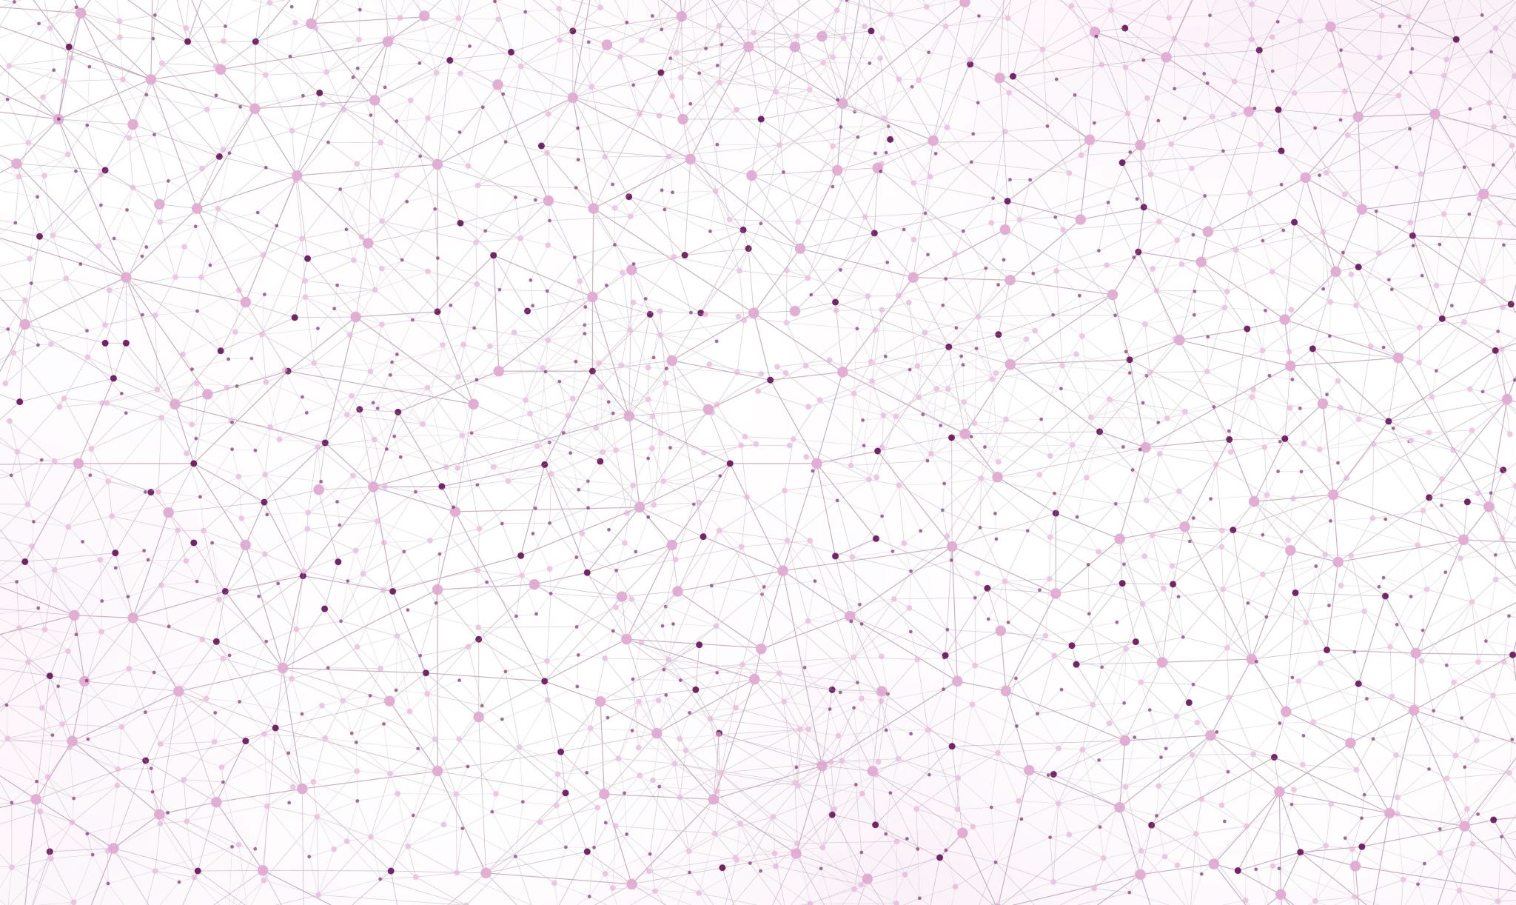
Self-Injury and Usage of Social Media Analysis
By
Hayal DARGIN

Slide 2
The Problem
High use of social media has a negative impact on young people which leads them to self harm.

Slide 3
The Solution
To reduce injury rates and suicide attempts there should be strict restrictions on the number of social media apps that teenagers aged between 10 to 19 have access to on their phones and on any other devices.

Slide 4
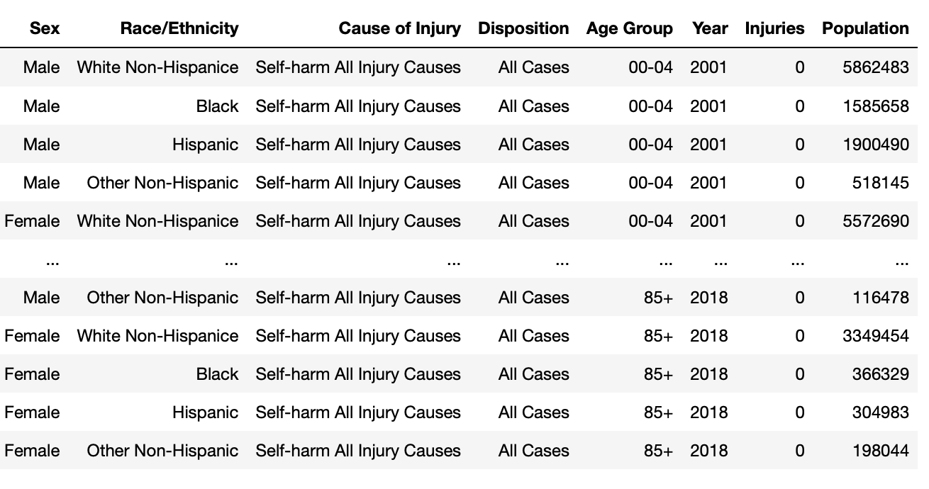
1. Data Set

Slide 5
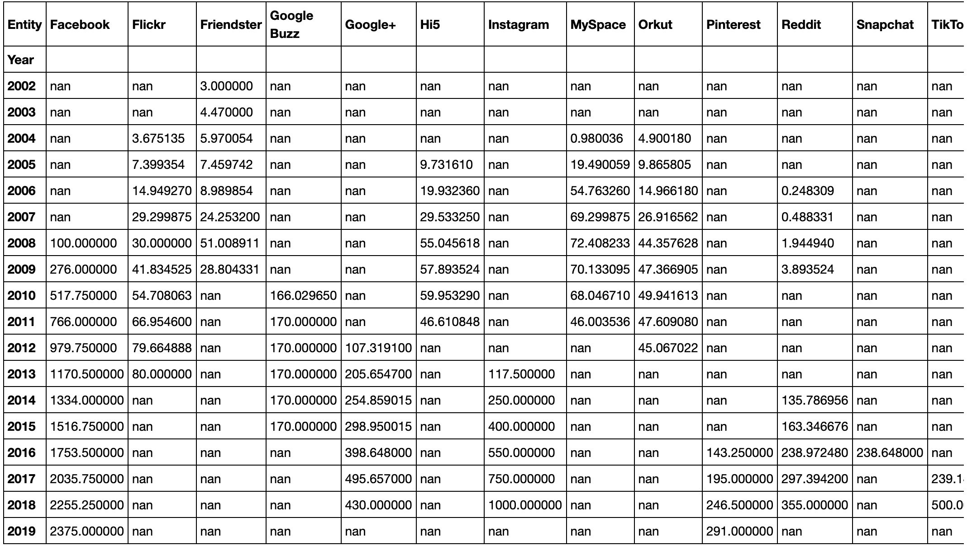
2. Data Set

Slide 6
Data Wrangling Self Harm
The row data set from CDC (Centers for Disease Control and Prevention) Self Harm contained 5889 rows with 21 columns.
Target Variable: Injury
Drop redundant columns
Drop/Fulfill missing values
Correct data types
Define unclear values

Slide 7
Data Wrangling Social Media
The row data set from Statista Monthly Active Users by My Space contained 142 rows with 3 columns.
Target Variable: Users
Reshape the data set

Slide 8
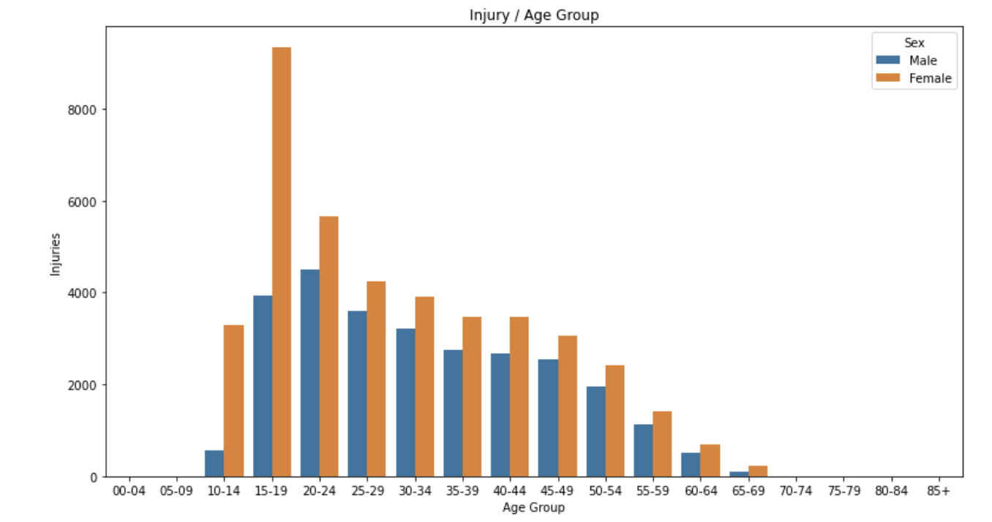
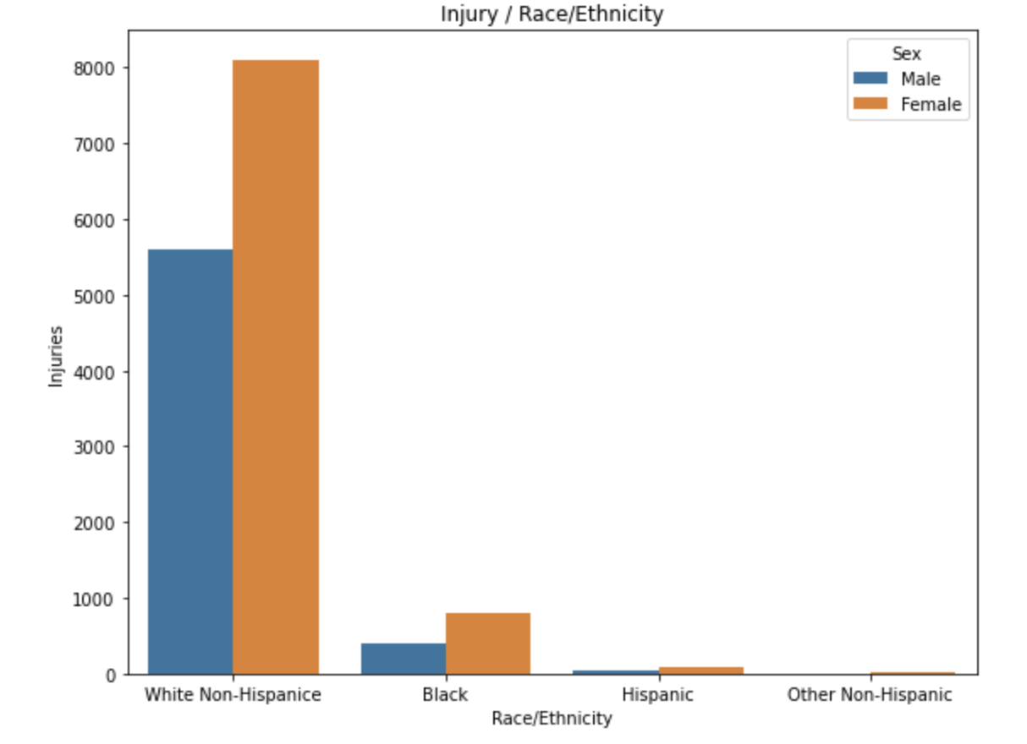
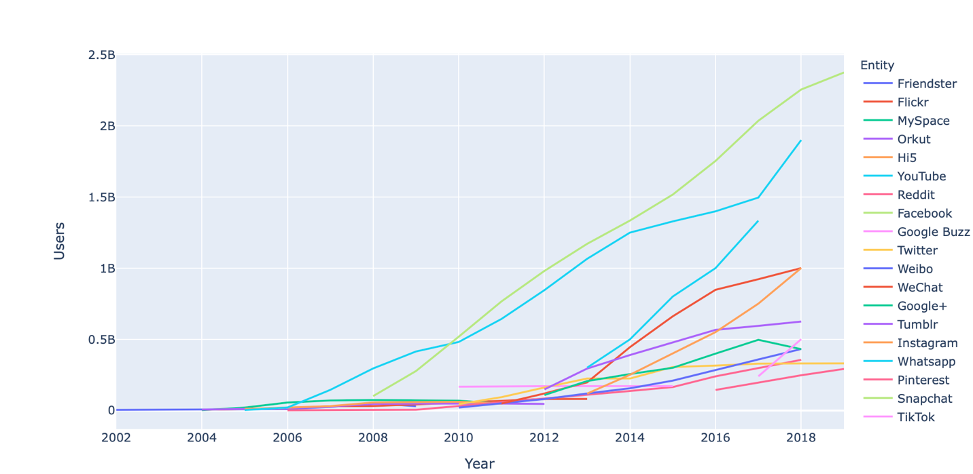
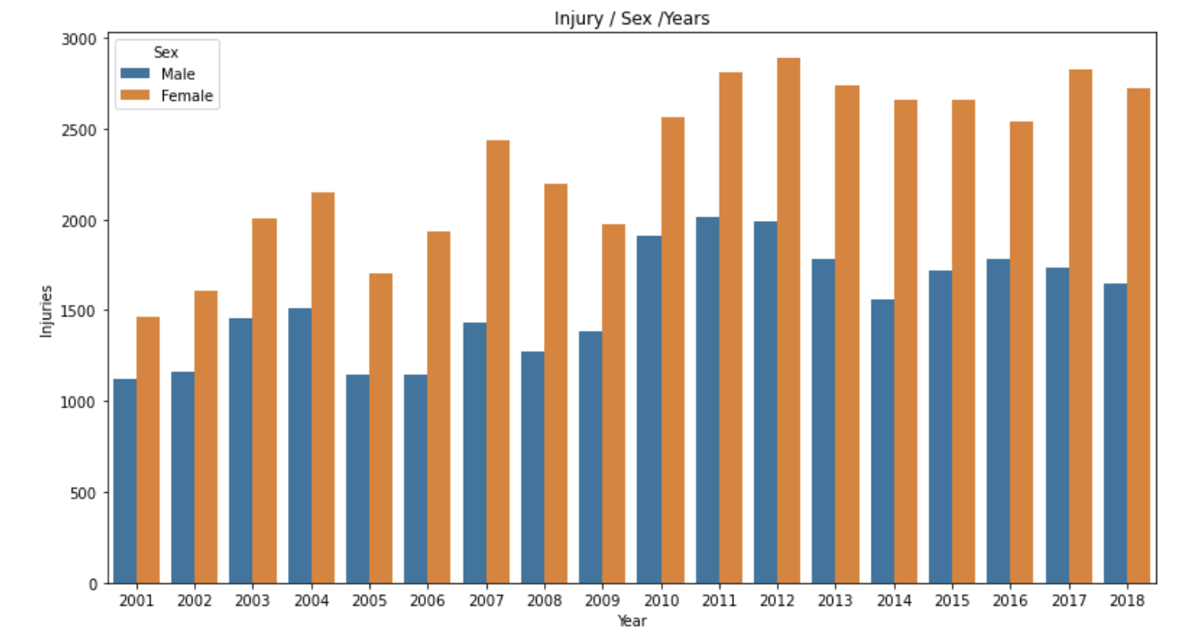
Exploratory
Data Analysis

Slide 9
Model Selection
Linear Regression
Random Forest Regressor

Slide 10
Takeaways
In Self Harm data set self-injuries of White Non-Hispanic females between the age group 15-19 are more likely to commit self-harm.
Random forest regressor was the best model

Slide 11
Future Research
Expand the data set
Expand modeling
Expand to more features in social media data set

Slide 12
Thank You!

