Slide 1
Misunderstandings of OSS licenses
This document summarizes misunderstandings which are often appeared in articles on the internet and questions in seminars etc. Please note that this document includes some topics related only to Japan. You can make additions or modifications on this document, for this document can be used under the CC0-1.0(Public Domain). In no event shall the author be liable with regard to the contents of this document.
[Provided by Fujitsu Ltd.]

Slide 2
If not prohibited, can I use it?
Question
An program can be downloaded at an web site on the internet. Because there is no license condition and commercial use is not prohibited, can I include the program into our product?
Answer
No
Even if downloadable for free, it may not be an OSS.
According to copyright laws, the rights to copy, modify, and distribute are solely belong to the copyright holder.
Without permission of the right from the copyright holder, you cannot use the program for your product.

Slide 3
If another section have used it, can I use it?
Question
When investigating OSSs which I can use, I found out that an OSS used by another section in my company has required function for our product. Can I regard that I can follow license condition because the another section have used that OSS?
Answer
No
Whether you can follow the license condition or not depends on the object and methods for using the OSS. You need to refer to the license condition and confirm that your use of the OSS follows the condition.
For example, when the OSS is used only in your company, the condition for distribute does not matter. But if you include the OSS into your product, you need to follow the condition of the distribution.

Slide 4
Doesn’t OSS relate to patent infringement?
Question
Because free use of OSS is permitted, can I think that OSS does not relate to patent infringement?
Answer
No
Although the OSS developer licensed his patent to the OSS user, another person may have related patent.
Therefore, if the OSS infringes the another person’s patent, the patentee may request compensation for damage or injunction of your product.

Slide 5
If I contribute to OSS community, do I need to abandon my patent?
Question
When contributing a program to OSS community, does the contributor need to abandon his patent?
Answer
No
Contributor has no duty to abandon his registered patents.
Contributor cannot request injunction or compensate for damage against the OSS which were contributed on the premise that the contributor permits free use.
But the contributor can exercise the patent against another product which is not related the OSS.

Slide 6
If not modified, don’t I need to provide source code?
Question
Some licenses such as GPL, MPL, and EPL stipulate a duty to provide source code. As long as I don’t modify the OSS, don’t I need to provide source code, even though I include the OSS into a product?
Answer
Yes
The license condition of GPL, MPL, and EPL requires to provide source code when binary OSS is provided, regardless of whether the OSS is modified of not.
Therefore, if you sell your product including binary OSS, you need to provide the source code too.
By the way, we often think that a customer who obtained a product can obtain the same source code from an OSS download site, but once the site is updated, the OSS may not be downloaded any more. So, it is recommended for you to keep the originally downloaded source code and provide customer with it.

Slide 7
If modified, do I need to provide the modified source?
Question
If I modify an OSS, do I need to provide the modified source code to OSS community?
Answer
No
Although it depends on license, under many licenses(GPL, MPL, EPL etc.) provision of the modified source code to the community is voluntary and not a duty.
However, you need to confirm the license condition of the OSS because the OSS developer can define the license condition.
But, in case you fixed a bug, it is recommended to provide the fixed program to the OSS community in order for the community to be able to fix the original OSS. Because, if original OSS is fixed by the community, you would not need to fix the same bug in a revised version of the OSS again.

Slide 8
Can I provide source cord by indicating the developer’s URL?
Question
Some licenses such as GPL, MPL, and EPL stipulate a duty to provide source code. When I include an OSS into a product, is it sufficient to indicate the URL of a download site of the OSS developer?
Answer
No
The company using the OSS has the duty to provide source code. Therefore, The company selling a product which includes OSS binary needs to provide the source code too.
The source code would be impossible to be download at a download site of the OSS developer, when the OSS version is renewed. And the URL of such a site would be a dead link.
If you want to make your customer to download the source code, you need to provide it from a site that your company can control.

Slide 9
Is it kind to provide translated license document?
Question
An OSS license condition requires that the license document to be included when the OSS is distributed. If the license is in English and the customer is Japanese, is it sufficient to provide the customer with a Japanese translation of the license?
Answer
No
You need to include the original English license provided by OSS developer. If you provide a the Japanese translation as a reference, you need to clarify that the English license is the official version.

Slide 10
If I install on behalf of the customer, don’t I need to follow the license condition?
Question
When I download an OSS and install it on behalf of a customer on the customer’s request, do I need to care about the license condition because I provide the OSS to the customer?
Answer
Yes
It depends on the license condition, but, just a few licenses are care about business relation between OSS distributor and the customer.
If you download the OSS in an office of your company and provide it with your customer, please confirm the condition of distribution because it is regarded as the “OSS distribution.”

Slide 11
Is it OK to copy a license from OSI site?
Question
The OSS download site indicates MIT LICENSE is applied, but there are no license document on the site. Is it OK to copy MIT License from OSI’s site and distribute the OSS with the copy?
Answer
No
The OSI’s site introduces samples of MIT license and BSD license, and copyright notice is also just a sample(See next page).
Firstly, please confirm whether a license document is contained in the downloaded OSS files.
Because OSS developer may add license condition, you need to confirm the license document contained in the downloaded OSS, regarding not only the above licenses but also other licenses.

Slide 12
（Supplement) Sample in the OSI site
It’s NG to copy the sample of OSI site and distribute it(MIT, BSD etc.）
⇒ The formal license is included in the OSS by the developer
No copyright notice
The MIT License (MIT)
Copyright (c) <year> <copyright holders>
Permission is hereby granted, free of charge, to any person obtaining a copyof this software and associated documentation files (the "Software"), to deal in the Software without restriction, including without limitation the rights to use, copy, modify, merge, publish, distribute, sublicense, and/or sell copies of the Software, and to permit persons to whom the Software is furnished to do so, subject to the following conditions:
The above copyright notice and this permission notice shall be included in all copies or substantial portions of the Software.
THE SOFTWARE IS PROVIDED "AS IS", WITHOUT WARRANTY OF ANY KIND, EXPRESS OR IMPLIED, INCLUDING BUT NOT LIMITED TO THE WARRANTIES OF MERCHANTABILITY, FITNESS FOR A PARTICULAR PURPOSE AND NONINFRINGEMENT. IN NO EVENT SHALL THE AUTHORS OR COPYRIGHT HOLDERS BE LIABLE FOR ANY CLAIM, DAMAGES OR OTHER LIABILITY, WHETHER IN AN ACTION OF CONTRACT, TORT OR OTHERWISE, ARISING FROM,OUT OF OR IN CONNECTION WITH THE SOFTWARE OR THE USE OR OTHER DEALINGS IN THE SOFTWARE.

Slide 13
Can I modify the license?
Question
The OSS license contains a condition that the customer cannot follow. Can I delete the condition when I distribute the OSS?
Answer
No
Only the copyright holder can decide the OSS license conditions.
OSS distributor cannot modify the OSS’s license condition.

Slide 14
How to deal with a blank for copyright notice?
Question
In the bottom portion of the APACHE LICENSE V2.0, there is a blank for copyright notice. Is it OK to fill in the blank with distributor’s name when distribute the OSS? （See the next slide）
Answer
No
The blank etc. in the APPENDIX of the APACHE LICENSE V2.0, is a sample of copyright notice when adopting Apache License V2.0 for originally developed program.(GPL is the same)
Only copyright holder can write copyright notice.

Slide 15
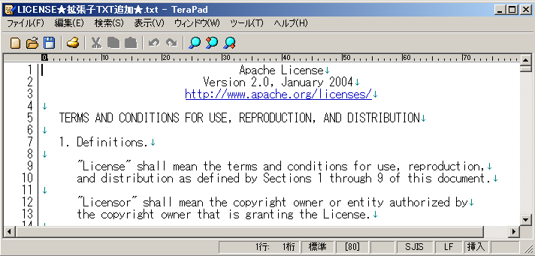
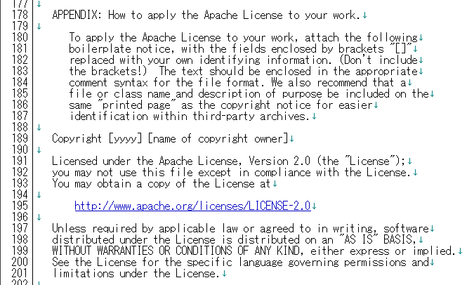
（Example） APPENDIX of APACHE LICENSE V2.0
APPENDIX introduces how to adopt
Apache License V2.0 for an original
program. Distributer cannot write
copyright notice for non-developed
program.

Slide 16
Does the BSD license require only copyright notice?
Question
A book says “an OSS under BSD license can freely used only by indicating copyright notice.” When I use the OSS in our product, is it OK for me to just retain the copyright notice?
Answer
No
BSD license requires to retain the copyright notice, the list of conditions and the disclaimer, that is, the whole license document needs to be retained.
Because some books mistakenly says that only the copyright notice is required, it is important to confirm the license condition by yourself.

Slide 17
Does GPL prohibit sale?
Question
When OSS under GPL is used in a product, can I sell the product for a fee?
Answer
Yes
GPL does not prohibit sales for a fee. Therefore, you can sell the product including the OSS.
However, when the customer who bought the product copies the OSS under GPL, you cannot charge royalty based on the number of the copy.
This is because GPL allows to copy and modify freely and prohibits additional conditions.

Slide 18
Does GPL affect to dynamic linked program?
Question
When an OSS under GPL and an original program is linked statically, the original program needs to adopt GPL. In case of dynamic link, GPL affects to the original program?
Answer
Yes
GPL requires that the work as a whole is licensed under GPL and it does not clearly distinguish dynamic link and static link.
Free Software Foundation(who has made the GPL) indicates in its FAQ that GPL affects to linked program regardless of the link is dynamic or static.
(FYI) Does the GPL have different requirements for statically vs dynamically
linked modules with a covered work?
https://www.gnu.org/licenses/gpl-faq.html.en#GPLStaticVsDynamic

Slide 19
Does LGPL affect to statically linked program?
Question
Do I need to adopt LGPL for my original program which is statically linked to an OSS under LGPL?
Answer
No
LGPL need not to be adopted to the original program.
(FYI)
LGPL stipulates a duty to allow reverse engineering etc.,
regardless whether the link is dynamic or static.
In addition to the above, if the link is static, object code or source
code of the original program have to be provided. This is
because: if the recipient modifies the OSS, he needs the codes to
be linked and executed with the modified OSS.

Slide 20
Is GPL replaceable with compatible license?
Question
I heard that MIT license is compatible with GPL. Does this mean that when OSSs under GPL and MIT are linked, MIT license is replaceable with GPL?
Answer
No
When GPL OSS and other program are linked and distributed, the whole work needs to be distributed under GPL. Because the GPL prohibits to add conditions, licenses which are covered by GPL (such as MIT license) is called “compatible”, and licenses which include a condition that GPL does not have is called “incompatible”. OSS under the incompatible license cannot be linked to the GPL OSS.
This does not mean that GPL and MIT is replaceable. Only the OSS copyright holder can decide license conditions.
Because when the word “compatible” is translated to “gokan-sei” in Japanese, the meaning could be misunderstood. It is recommended to use the word ”ryouritsu-sei” alternatively.

