Slide 1
Dates | Rooms | Time
9/29 Thursday | HELD 100 - 200 | 7:30 PM–9:30 PM

Slide 2
Before the Exam
1) Students should obtain a Texas A&M University Scantron. It is a full page, 1 sided, and has
places for 150 answers. Students are strongly recommended to “pre-code” the following items:
a. Name
b. UIN
c. Section Number
d. Date and SEAT NUMBER in date section.

Slide 3
Before the Exam
2) In Canvas under grades, a “Seat for Exam _” will be posted a few days before each exam. It will be a 5 digit number. The ten thousands digit will give you the room number. 1X,XXX will be
HELD 100, 2X,XXX will be HELD 200, 3X,XXX will be HELD 107, and 4X,XXX will be HELD 105.
The thousands and hundreds digit will give you the row number (row 01 is closest to the computer at the front of the room). The tens and ones digit will give you the seat number (seat 01 is to your right as you enter the room).

Slide 4
Before the Exam
3) Students will be allowed to “check-in” starting 30 minutes before your exam. I strongly suggest
that you arrive close to this time. At “check-in”, tell the TA your SEAT NUMBER as you are
walking up to them. You will need to show them your Student ID and scantron after they find
you on the check-in list so have them both out as you are approaching the front of the line.

Slide 5
You will be allowed to bring the following items into the room:
a. At your workspace:
i. Pencils (Bring extras and #2 pencils are required for scantrons)
ii. Texas A&M University Scantron (Which should be “pre-coded”)
1. Bringing “extra” pencils and/or scantron for a friend who forgot would
be a nice gesture...
iii. Student ID

Slide 6
You will be allowed to bring the following items into the room:
b. At the front of the room:
i. Bag (Which will be placed at the front of the room and contain everything else
that you bring to the exam.)
ii. If possible, I would not bring your bag to the exam. The room can fill up with
bags quickly...

Slide 7
You will be allowed to bring the following items into the room:
c. Things to be wary of:
Cell phones/smart devices should not be brought to the exam or turned off and placed in your bag at the front of the room.
No food or drink will be allowed into the testing room.
No hats/hoods should be worn during the exam.
No outside assistance should be received during the exam. Impermissible assistance would include (but is not limited to): calculators, online solvers, cheat sheets, or any unapproved aid. Student exam responses should represent their original thought.

Slide 8
During the Exam
If a student is found to have a cell phone or other smart device during the exam, the student
will receive a 0 on the exam.
Bathroom use: 1 person out of test room at a time

Slide 9
After the Exam
Students are REQUIRED to work on their exam for at least 30 minutes.
After 30 minutes, students will be allowed to “check-out” with the TA in charge of checking out. Students should double check to make sure that their scantron has been filled out properly (particularly that your UIN, section number, and test version are all bubbled correctly).
Exams will be turned in by section with separate piles for scantrons and exams. Please show your Student ID to your TA and place your scantron and exam (FACING THE CORRECT DIRECTION) in the appropriate piles (by your section number). DO NOT TAKE YOUR SCANTRON OR EXAM OUTSIDE OF THE TESTING ROOM!

Slide 10
Review
Lecture notes 1.5 hrs
Complete at least 1 past midterm ≥ 2 hrs
Grade it yourself 0.5 hr
Redo the wronged problems 1 hr
≥ 5 hrs

Slide 11

Tricks
Work out as many multiple choices as possible
Tentatively, 20 multiple choices and 4 or 5 work out questions.
Write some “English” on your work
Not just “A=B, x=y…...”, explain what you write: What’s “x”? How do you define “y” ? How do you get the equation ? What’s the assumption ? Tell me what you’re trying to do?......
Take your time, relax
Most students turn in half hour early.
Double check multiple choices(scantron).
Scantron will not be returned.
Calculus

Slide 12
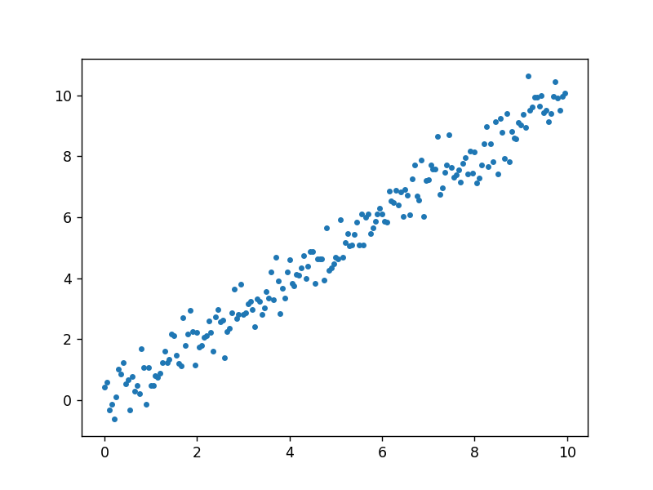
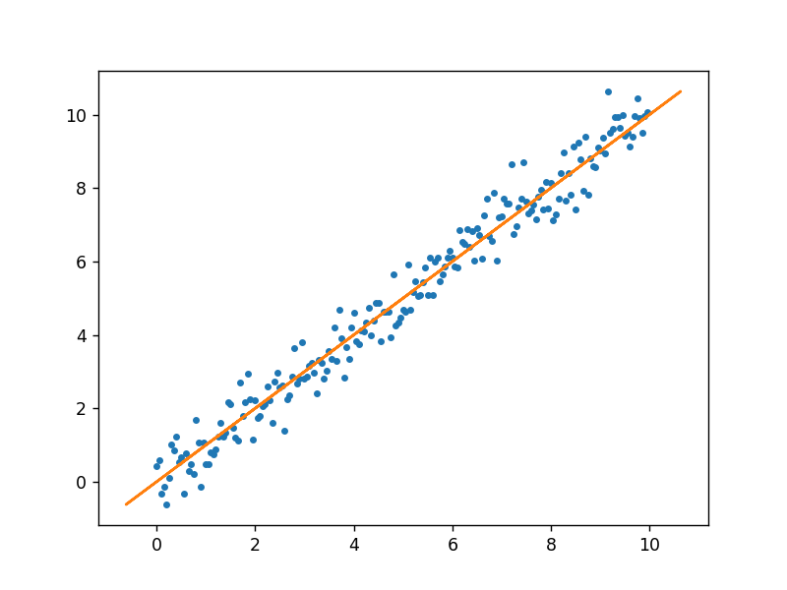
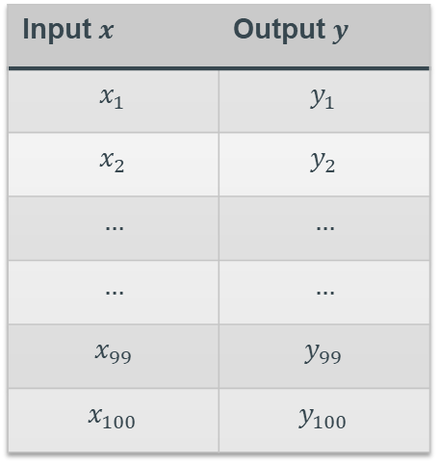
Why Vectors? Application of vectors
100 Experimental Data
How to find the orange line?
Input $x$ | Output $y$
$$x_{1}$$ | $$y_{1}$$
$$x_{2}$$ | $$y_{2}$$
$$…$$ | $$…$$
$$…$$ | $$…$$
$$x_{99}$$ | $$y_{99}$$
$$x_{100}$$ | $$y_{100}$$

Slide 13

Application of vectors
100 Experimental Data
Input
$$x = <x_{1},x_{2},……,x_{99},x_{100}>$$
Output
$$y = <y_{1},y_{2},……,y_{99},y_{100}>$$
Input $x$ | Output $y$
$$x_{1}$$ | $$y_{1}$$
$$x_{2}$$ | $$y_{2}$$
$$…$$ | $$…$$
$$…$$ | $$…$$
$$x_{99}$$ | $$y_{99}$$
$$x_{100}$$ | $$y_{100}$$

Slide 14


Application of vectors
Input
$$x = <x_{1},x_{2},……,x_{99},x_{100}>$$
Output
$$y = <y_{1},y_{2},……,y_{99},y_{100}>$$
Assume: The line is through the origin
Target: Find a line $y=kx$ which fits the data most
Fact: You can not adjust the line to fit in all data. There must be some error in the model!
New Target:
Find a value $k$ such that $y=kx$ has the least
error

Slide 15


Application of vectors
Input
$$\overline{x} = <x_{1},x_{2},……,x_{99},x_{100}>$$
Output
$$\overline{y}= <y_{1},y_{2},……,y_{99},y_{100}>$$
Fact: The error is measured by
$\left\|\left.\overline{y}−k∙\overline{x}\right\|\right.$
$k∙\overline{x}$ is a line; $\overline{y}$ is a point;
Oh, it’s just the distance between line and point
Question:
How to find the distance ?
Projection!

Slide 16

Application of vectors
Input
$$\overline{x} = <x_{1},x_{2},……,x_{99},x_{100}>$$
Output
$$\overline{y}= <y_{1},y_{2},……,y_{99},y_{100}>$$
$k∙|\left|\overline{x}\right||=|\left|{\text{Proj}}_{\overline{x}}\overline{ y}\right||$
$k=\frac{{\text{||}\text{Proj}}_{\overline{x}}\overline{ y}||}{||\overline{x}||}$
$k=\frac{\frac{\overline{x}∙\overline{y}}{||\overline{x}||}}{||\overline{x}||}=\frac{\overline{x}∙\overline{y}}{\left|\left|\overline{x}\right|\right|∙||\overline{x}||}$
$$k=\frac{x_{1}y_{1}+…+x_{100}y_{100}}{x_{1}^{2}+…+x_{100}^{2}}$$
In the end
$$y=\frac{x_{1}y_{1}+…+x_{100}y_{100}}{x_{1}^{2}+…+x_{100}^{2}}∙x$$

